Slide 1
Lecture 2 Statistical Tests
09/20/23

Slide 2
Learning Outcomes
Understand basic statistical methods and tests and scenarios where they can be applied
Understand the basics of these methods, implement these methods in R and interpret output

Slide 3
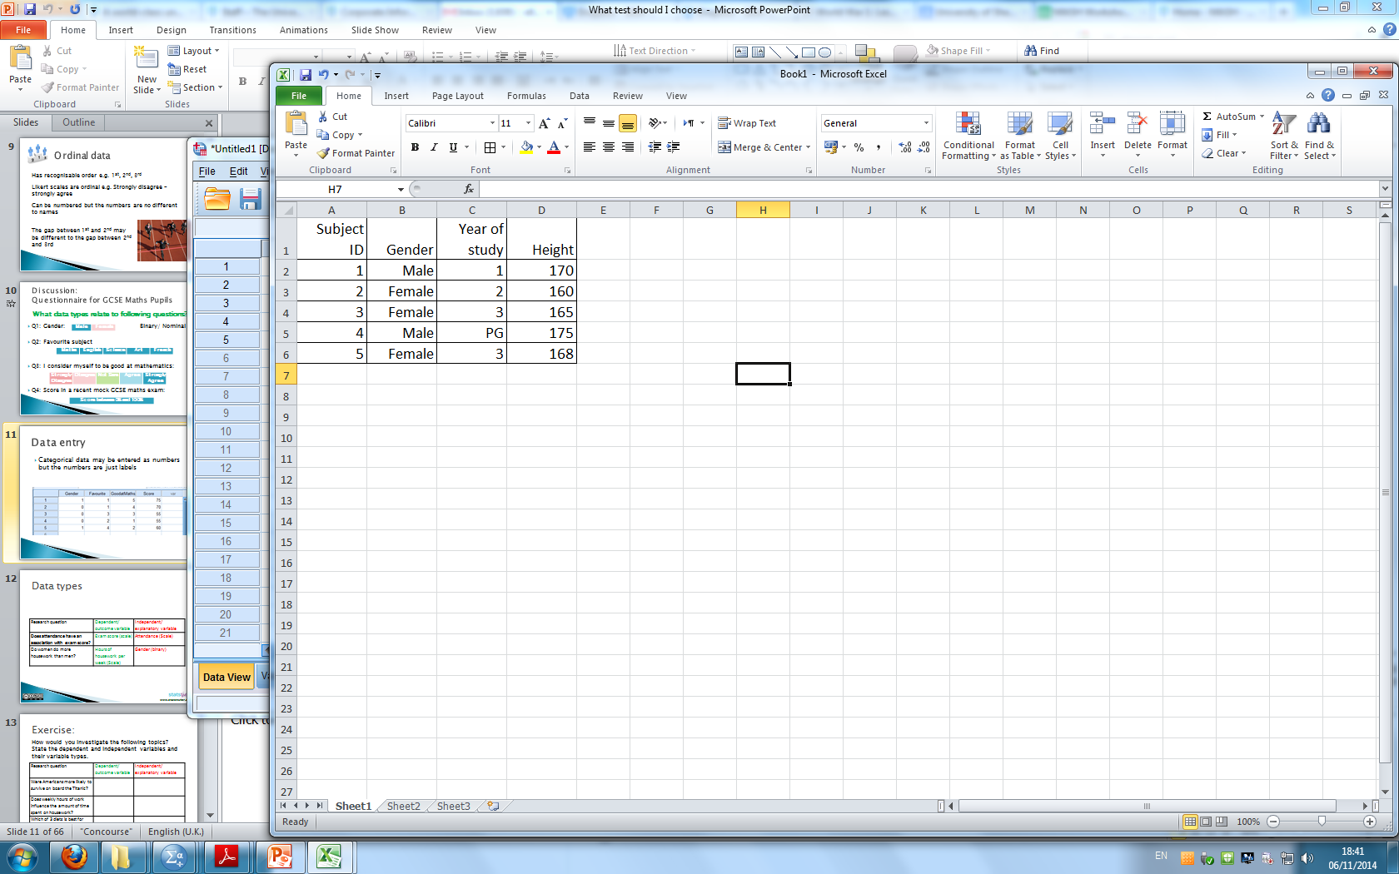
Data and variables
DATA: the answers to questions or measurements from the experiment
VARIABLE = measurement which varies between subjects e.g. height or gender
One variable per column
One row per subject

Slide 4


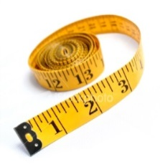

Data types
Variables
Scale
Categorical
Continuous
Measurements
takes any value
Discrete:
Counts/ integers
Ordinal:
obvious order
Nominal:
no meaningful order

Slide 5
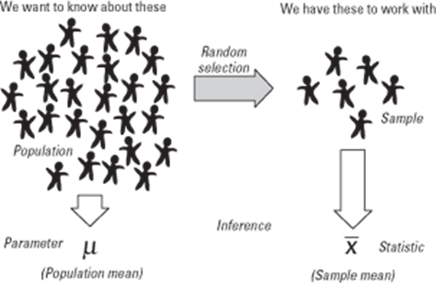
Populations and samples
Taking a sample from a population
Sample data ‘represents’ the whole population

Slide 6


Point estimation
Sample data is used to estimate parameters of a population
Statistics are calculated using sample data.
Parameters are the characteristics of population data
sample mean
Sample SD
Population mean
Population SD
$$\overline{x}$$
estimates
$$S$$
Notes:
We use x bar and s to represent the sample mean and standard deviation but we are really interested in the parameters of the population. The population parameters are represented by mu and sigma.

Slide 7
Descriptive statistics
Why they are useful:
Help us summarize the characteristics of our data/observations
They form the initial step in a statistical analysis
We get information about the centrality (e.g., mean, median)
We get information about the variability (e.g., variance, standard deviation)

Slide 8
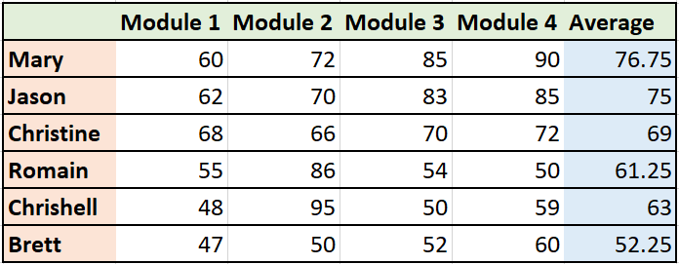
Descriptive statistics
The Mean:
Mean is another word for average.
Most commonly used statistic that tells us about the centre of a data set.
It is the average of the numbers in your dataset.
The sum of all values divided by the number of observations.
n = 4
+
+
+
= 307
307 ÷ 4

Slide 9
Descriptive statistics
The Median :
Is the middle point of your ordered data.
Example: 1,3,10,5,8
Step1: Order the observations
1,3,5,8,10
The median is the number in the middle
median=5

Slide 10
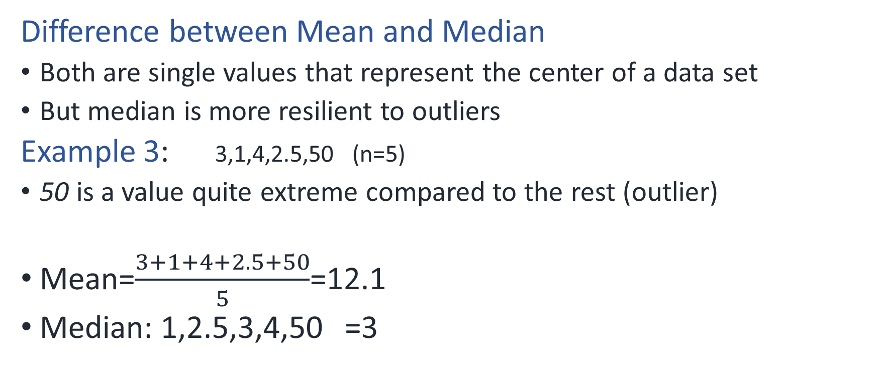
Descriptive statistics
Difference between Mean and Median
Both are single values that represent the center of a data set
But median is more resilient to outliers
Example 3: 3,1,4,2.5,50 (n=5)
50 is a value quite extreme compared to the rest (outlier)
Mean=$\frac{3+1+4+2.5+50}{5}$=12.1
Median: 1,2.5,3,4,50 =3

Slide 11
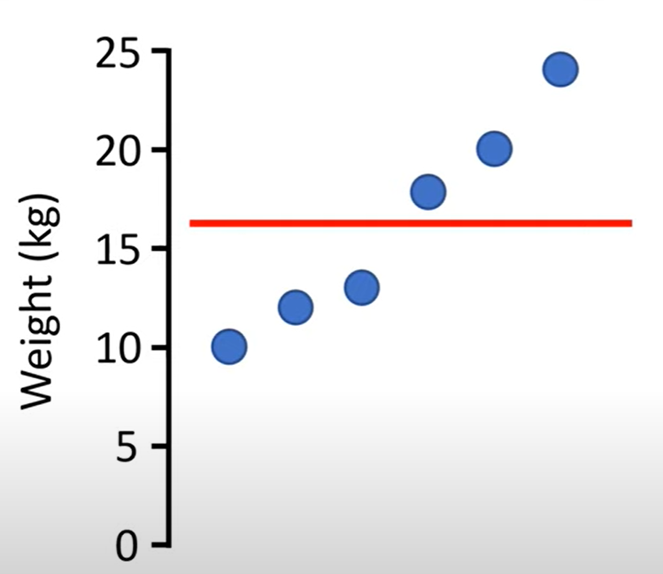
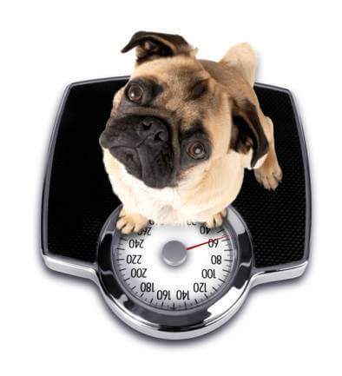

Descriptive statistics
The Variance ($s^{2}$ )
A measure to show how spread out our observations are
Based on the distance of each observation from the mean

Slide 12

Descriptive statistics
The Variance ($s^{2}$ )
Squared (multiplied by itself)
The average of the squared differences from the mean.
Dog 1: 10kg
Dog 2: 12kg
Dog 3: 13kg
Dog 4: 17kg
Dog 5: 20kg
Dog 6: 24kg
Mean = 16kg
Notes:
Example & graphs from: https://www.youtube.com/watch?v=x0rmUXWtSS8

Slide 13

Descriptive statistics
The Variance ($s^{2}$ )
Work out the difference from the mean and square each value (i.e., multiply it by itself).
Add all the squared values together.
Dog 1: -6
Dog 2: -4
Dog 3: -3
Dog 4: 1
Dog 5: 4
Dog 6: 8
36
16
9
1
16
64
142
Mean = 16kg

Slide 14

Descriptive statistics
The Variance ($s^{2}$ )
3. Divide the squared value by the number of observations (n).
n = 6
142
651
Variance value: 28.4kg²

Slide 15
Descriptive statistics
Mean =
The Standard deviation (s) :
Standard deviation (s) is a measure of how much the individuals differ from the mean
It is the square root of variance
The result is in the same measurement units as our data (e.g., kg).
This makes it easier to interpret and understand the spread of the data than variance alone.
Large SD = spread out data Small SD = there is little variation from the mean

Slide 16
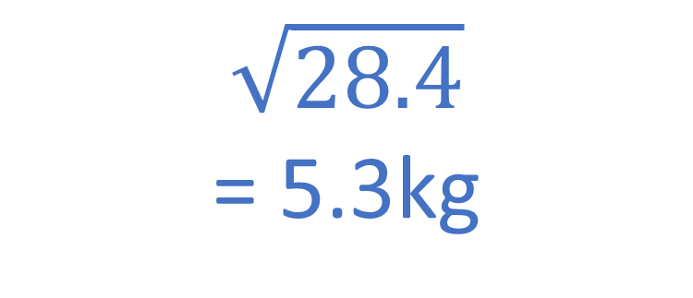
Descriptive statistics
The Standard deviation (s) :
$$\sqrt{28.4}$$
= 5.3kg

Slide 17
Descriptive statistics
The Standard deviation (s) :
Often plotted as error bars above and below the mean (5.3kg in our example).
Small value indicates data are gathered close to the mean
Large value indicates data are gathered far from the mean

Slide 18
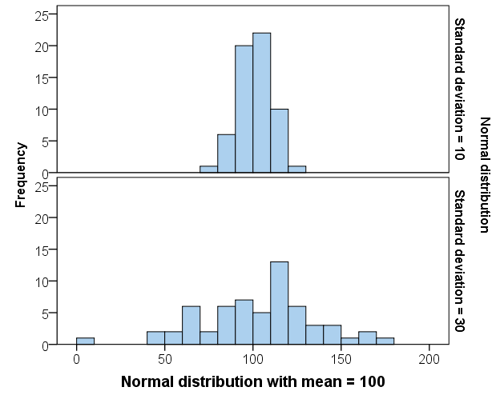
Interpretation of standard deviation
The larger the standard deviation, the more spread out the data is.
Notes:
For most students, the standard deviation is calculated using the computer so it is the interpretation that is most important. Showing them how standard deviation is a measure of spread using histograms is helpful.

Slide 19
Group Frequency Table
 |  | Frequency | Percent
 | 0 but less than 10 | 4 | 6.7
 | 10 but less than 20 | 9 | 15.0
 | 20 but less than 30 | 17 | 28.3
 | 30 but less than 40 | 15 | 25.0
 | 40 but less than 50 | 9 | 15.0
 | 50 but less than 60 | 5 | 8.3
 | 60 or over | 1 | 1.7
 | Total | 60 | 100.0
Notes:
You could explain what the normal distribution is by building a histogram from data. Here the exam score data is used.
First build a frequency distribution by counting the number of students within each category.

Slide 20
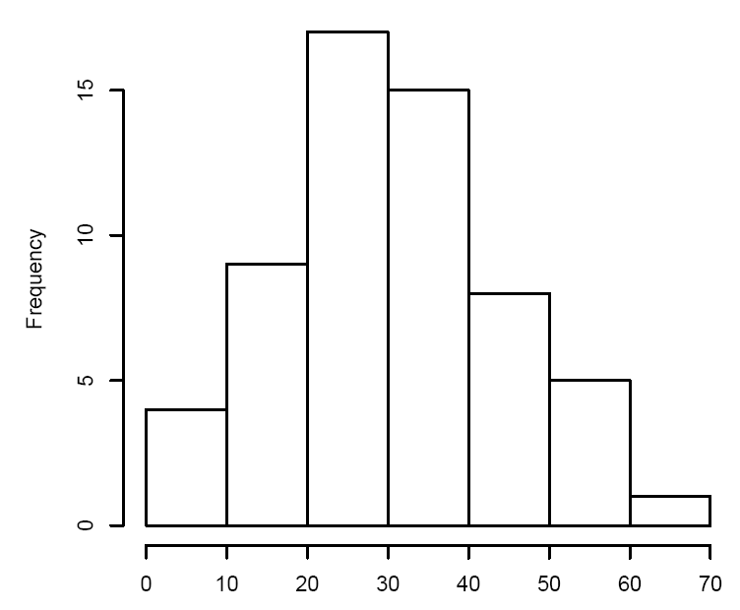
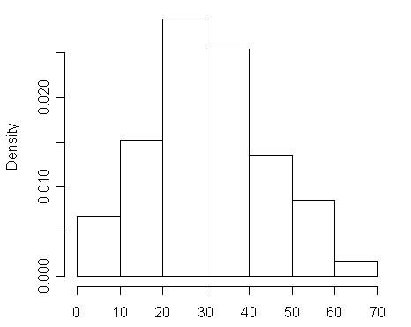
Histogram and Probability Distribution for Exam Marks Data

Slide 21
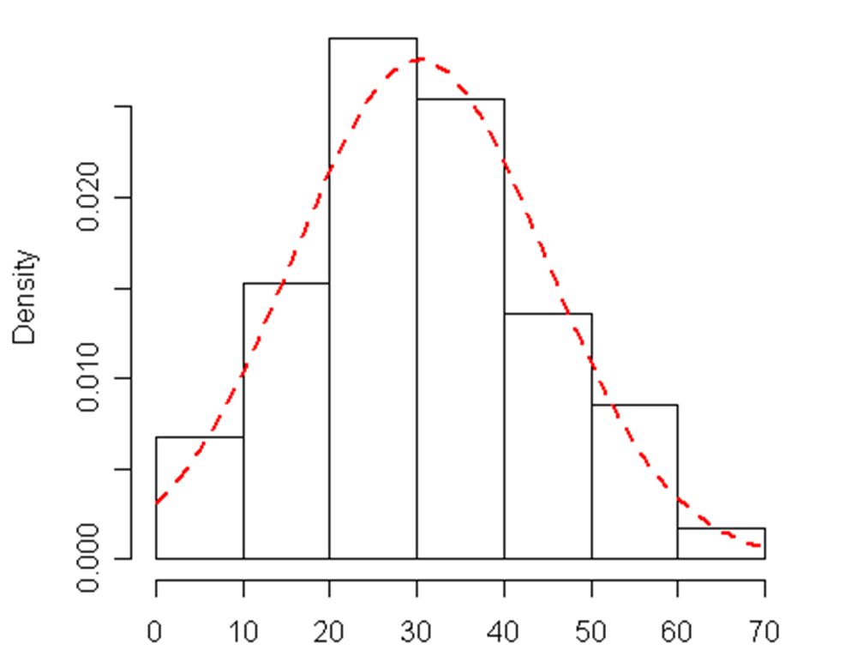
Histogram and Probability Distribution for Exam Marks Data
Notes:
A normal curve can be added which smoothes out the histogram. This can be used to estimate probabilities given the mean and standard deviation.

Slide 22
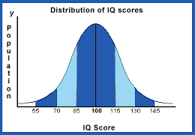
IQ is normally distributed
Above average
Average
Mensa
Mean = 100, SD = 15.3

Slide 23
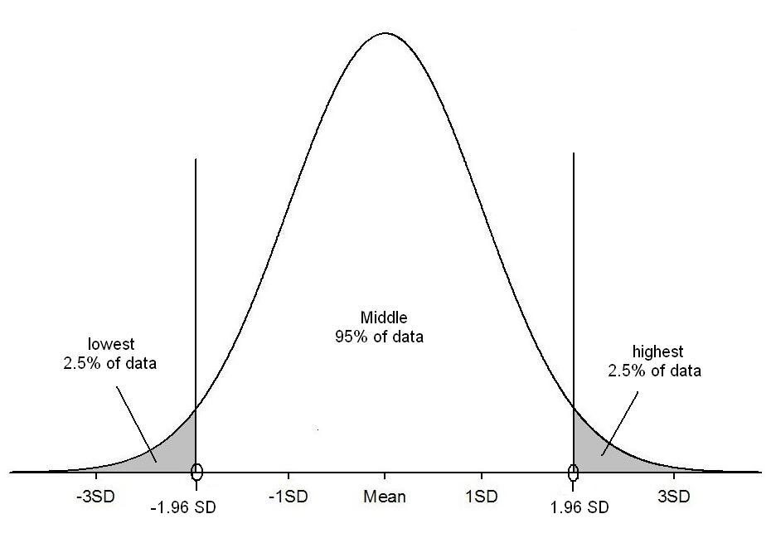
95% 1.96 x SD’s from the mean
95% of values
P(score > 130) = 0.025
100
130
70
95% of people have an IQ between 70 and 130
Notes:
Another important fact about normally distributed data is that 95% of the population lie between plus and minus 1.96*SD’s of the mean. For the IQ data this means that 95% of people have an IQ between 70 and 130 with only 2.5% above 130. This is important when understanding confidence intervals.

Slide 24
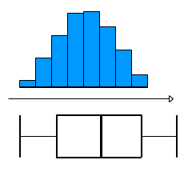
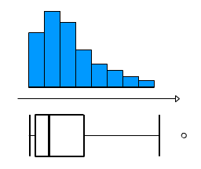
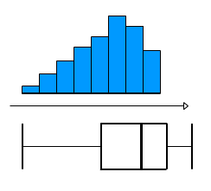
Assessing Normality
Charts can be used to informally assess whether data is:
Normally
distributed
Or….Skewed
The mean and median are very different for skewed data.

Slide 25
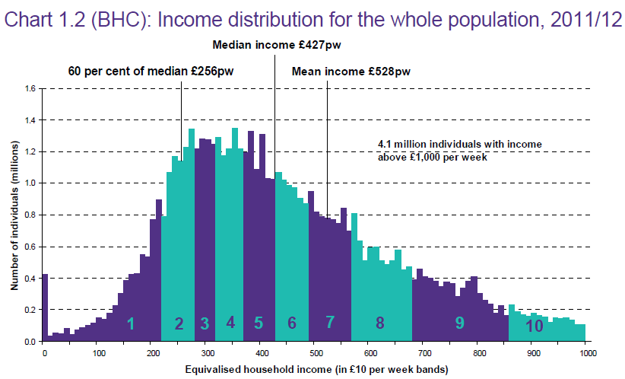
Sometimes the median makes more sense!
2/3rd people
50% people
Source: Households Below Average Income: An analysis of the income distribution1994/95 – 2011/12, Department for Work and Pensions

Slide 26
Choosing summary statistics
Which average and measure of spread?
Scale
Categorical
Normally distributed
Mean (Standard deviation)
Skewed data
Median (Interquartile range)
Ordinal:
Median
(Interquartile range)
Nominal:
Mode (None)

Slide 27
Hypothesis Testing

Slide 28
Hypothesis testing
An objective method of making decisions or inferences from sample data (evidence)
Sample data used to choose between two choices i.e. hypotheses or statements about a population
We typically do this by comparing what we have observed to what we expected if one of the statements (Null Hypothesis) was true
In statistical parlance:
H_{A}: Research (Alternative) Hypothesis
What we aim to gather evidence of
Typically that there is a difference/effect/relationship etc.
H₀: Null Hypothesis
What we assume is true to begin with
Typically that there is no difference/effect/relationship etc.

Slide 29
“Jury Trial”
Members of a jury have to decide whether a person is guilty or innocent based on evidence
Null: The person is innocent (legal requirement)
Alternative: The person is not innocent (i.e. guilty)
The null can only be rejected if there is enough evidence to doubt it
The jury can only convict if there is beyond reasonable doubt for the null of innocence
They may make a mistake

Slide 30
Types of Errors
Controlled via sample size (=1-Power of test)
Typically restrict to a 5% Risk
= level of significance
 | Study reports NO difference (Do not reject H₀) | Study reports IS a difference (Reject H₀)
H₀ is true Difference Does NOT exist in population
H_{A} is true Difference DOES exist in population
X
Type I Error
X
Type II Error
Prob of this = Power of test

Slide 31
Steps to undertaking a Hypothesis test
Define study question
Choose a suitable test
Set null and alternative hypothesis
Calculate a test statistic
Calculate a p-value
Make a decision and interpret your conclusions
Notes:
Point is to highlight the steps involved in undertaking a hypothesis test, but that the initial steps are often iterative when determining the research question(s) and the appropriate hypotheses and statistical tests to answer those questions.

Slide 32
Categorical Data Analysis- Example
The ship Titanic sank in 1912 with the loss of most of its passengers
809 of the 1,309 passengers and crew died
= 61.8%
Research question: Did class (of travel) affect survival?

Slide 33
Chi squared Test?
Null: There is NO association between
class and survival
Alternative: There IS an association between
class and survival
3 x 2
contingency table
Notes:
Since we have two categorical variables and want to know if they are associated we can use a chi-squared test. Class could be considered as an ordinal variable but there are only 3 levels here and so a chi-squared test therefore be quite appropriate. Point out there are 3 rows and 2 columns in our table and hence this is called a 3x2 contingency table. Discuss whether the table suggests class and survival are connected and try to tease out that we might be better looking at the % of 1st class passengers that died/survived and compare this with the % for 2nd class and 3rd class.

Slide 34
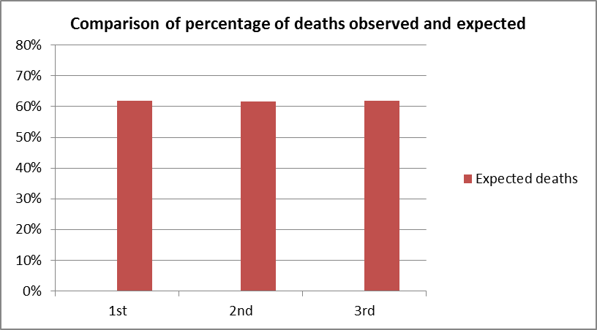
What would be expected if the null is true?
Same proportion of people would have died in each class!
Overall, 809 people died out of 1309 = 61.8%
Notes:
Discuss that this is what the % would be if there was no difference between the classes with respect to the chances of survival.

Slide 35
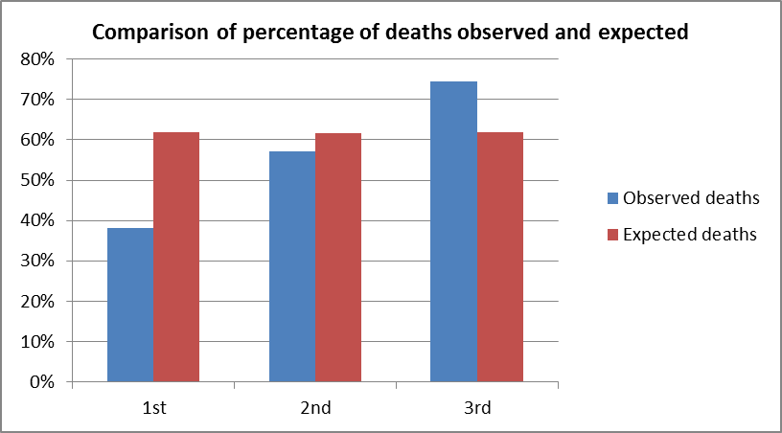
What would be expected if the null is true?
Same proportion of people would have died in each class!
Overall, 809 people died out of 1309 = 61.8%
Notes:
These show the % that were OBSERVED deaths in each class and are compared with the EXPECTED % shown in the previous slide. Discuss how the observed % for 1st class is the lowest whilst 3rd class is the highest.

Slide 36
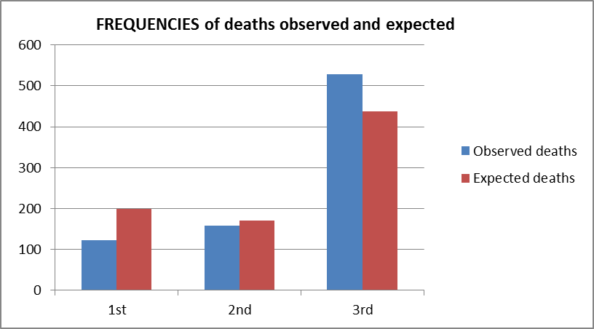
Chi-Squared Test Actually Compares Observed and Expected Frequencies
Expected number dying in each class = 0.618 * no. in class
Notes:
This slide is shown since the chi-squared test formally compares the observed FREQUENCIES with the expected frequencies.

Slide 37
Chi-squared test statistic
The chi-squared test is used when we want to see if two categorical variables are related
The test statistic for the Chi-squared test uses the sum of the squared differences between each pair of observed (O) and expected values (E)
Notes:
This is an optional slide if your session allowed time for this to be included and shows how the chi-squared test statistic compares the observed and expected.

Slide 38
Chi-Square Test in R
Pearson's Chi-squared test
data: titanic
X-squared = 127.86, df = 2, p-value < 2.2e-16
Test Statistic = 127.859
p-value < 2.2e-16
If P < 0.05 reject H₀ => Evidence of H_{A} being true (i.e. IS association)
If P > 0.05 do not reject H₀ (i.e. NO association)

Slide 39
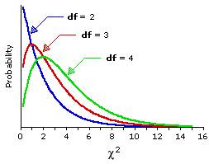
Chi squared distribution
The p-value is calculated using the Chi-squared distribution for this test
Chi-squared is a skewed distribution which varies depending on the degrees of freedom
Testing relationships between 2:
v = degrees of freedom
(no. of rows – 1) x (no. of columns – 1)
Note: One sample test:
v = df = outcomes – 1

Slide 40
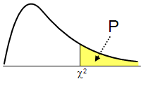
What’s a p-value?
Probability of getting a test statistic at least as extreme as the one calculated if the null is true
In Titanic example, the probability of getting a test statistic of 127.859 or above (if the null is true) is < 0.001
P-value p < 0.001
Distribution of test statistics
Our test Statistic = 127.859
Notes:
This is to discuss what the p-value actually is.

Slide 41
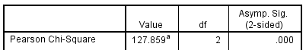
Interpretation
P-value
p < 0.001
Since p < 0.05 we reject the null
There is evidence (χ²₂=127.86, p < 0.001) to suggest that there is an association between class and survival
But… what is the nature of this association/relationship?
Test Statistic = 127.859
Notes:
As we square the differences in the test statistic, the chi squared test is always one tailed.

Slide 42
Continuous Data Analysis: Comparing means

Slide 43
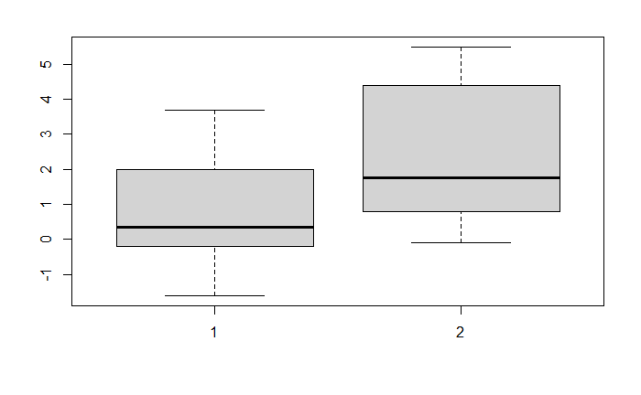
Summarising means
Sleep data example- The Sleep data show the effect of two soporific drugs on 10 patients, where the observed values are differences in hours of sleep compared to the control group (the “extra” column)
Calculate summary statistics by group
Look for outliers/ errors
Use a box-plot or confidence interval plot

Slide 44
T-tests Paired or Independent (Unpaired) Data?
T-tests are used to compare two population means
Paired data: same individuals studied at two different times or under two conditions PAIRED T-TEST
Independent: data collected from two separate groups INDEPENDENT SAMPLES T-TEST

Slide 45

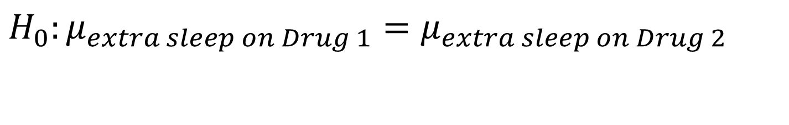
Comparison of the effects of the two soporific drug in 10 patients
Paired or unpaired?
If the same people had taken the two drugs (at different time points)- PAIRED measurements of the same variable (extra hours of sleep)
Paired Null hypothesis: The mean of the paired differences = 0
If different people administered the two drugs, they have independent measurements
Independent Null hypothesis: The mean extra hours of sleep experienced by participants on Drug 1 are the same as the mean extra hours of sleep from taking Drug 2
$$H_{0}:μ_{extra sleep on Drug 1}=μ_{extra sleep on Drug 2}$$
Notes:
Two examples of a paired and independent situation when comparing means

Slide 46
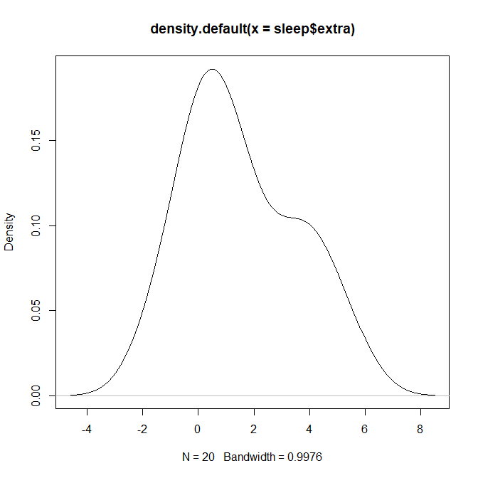
What is the t-distribution?
The t-distribution is similar to the standard normal distribution but has an additional parameter called degrees of freedom (df or v)
For a paired t-test, v = number of pairs – 1
For an independent t-test,
Used for small samples and when the population standard deviation is not known
Small sample sizes have heavier tails
Notes:
The t-distribution is similar to the standard normal distribution but has an additional parameter called degrees of freedom (df)
The degrees of freedom is calculated as the number of observations – 1 and is often referred to as v in many t-tables.
When we have small sample sizes (n < 30), we replace the normal distribution with Student’s t distribution, which has slightly less probability of being close to the mean and a somewhat larger probability of being in the tails. As the sample size increases, the critical values tend towards those of the normal distribution e.g. for a two tailed test with 5% significance, the critical value gets closer to 1.96, as the sample size increases.

Slide 47
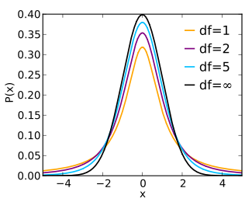
Relationship to normal
As the sample size gets big, the t-distribution matches the normal distribution
Normal curve
Notes:
As the sample size increase the df increases and the t-dist becomes more like the standard normal distribution.

Slide 48
T-Test in R
 |  |  |  |  |  | t | df | Sig. (2-tailed)
 | Mean | Std. Deviation | Std. Error Mean | 95% Confidence Interval of the Difference
 |  |  |  | Lower | Upper
Extra hours of sleep on Drug1- Extra hours of sleep on drug 2 | -1.58 | 1.229995 | 0.3889587 | -2.4598858 | -0.7001142 | -4.0621 | 9 | 0.002833
Null Hypothesis is: there is no difference between the extra hours of sleep due to drugs 1 and 2
P-value =0.002833
Decision Reject Null
Conclusion: Drug 2 induces more hours of sleep than Drug 1

Slide 49
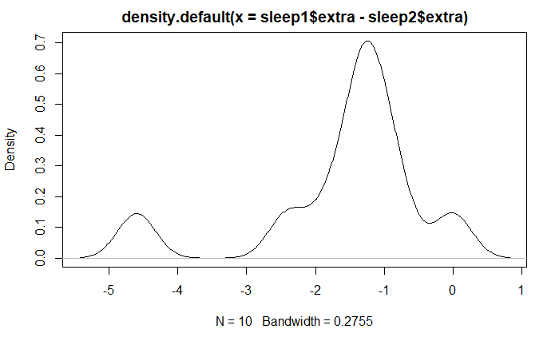
Assumptions in t-Tests
Normality: Plot histograms
One plot of the paired differences for any paired data
Two (One for each group) for independent samples
Don’t have to be perfect, just roughly symmetric
Equal Population variances: Compare sample standard deviations
As a rough estimate, one should be no more than twice the other
However the t-test is very robust to violations of the assumptions of Normality and equal variances, particularly for moderate (i.e. >30) and larger sample sizes
For paired data it is the differences that are assumed to be normal.

Slide 50
Correlation and Regression
Notes:
This section covers correlation and regression.

Slide 51
Relationship between two continuous variables
Is there a relationship between x and y?
What is the strength of this relationship
Correlation (Pearson’s r)
Can we describe this relationship and use this to predict y from x?
Regression
Is the relationship we have described statistically significant?
t test
CORRELATION ≠ CAUSATION
In order to infer causality: manipulate independent variable and observe effect on dependent variable

Slide 52
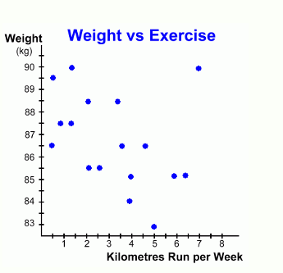
Scatterplot
Relationship between two continuous variables:
Explores the way the two co-vary: (correlate)
Positive / negative
Linear / non-linear
Strong / weak
Presence of outliers
Statistic used:
r = correlation coefficient
Outlier
Linear

Slide 53
Variance vs Covariance
Do two variables change together?
Variance:
Gives information on variability of a single variable.
Covariance:
Gives information on the degree to which two variables vary together.
Note how similar the covariance is to variance: the equation simply multiplies x’s error scores by y’s error scores as opposed to squaring x’s error scores.

Slide 54
Covariance
When X and Y : cov (x,y) = pos.
When X and Y : cov (x,y) = neg.
When no constant relationship: cov (x,y) = 0

Slide 55
Example Covariance
x
y
x
−
x
y
−
y
(
x
−
x
)(
y
−
y
)
i
i
i
i
0
3
-
3
0
0
2
2
-
1
-
1
1
3
4
0
1
0
4
0
1
-
3
-
3
6
6
3
3
9
x
=
3
y
=
3
∑
=
7
What does this number tell us?

Slide 56
Problem with Covariance:
The value obtained by covariance is dependent on the size of the data’s standard deviations: if large, the value will be greater than if small… even if the relationship between x and y is exactly the same in the large versus small standard deviation datasets.

Slide 57
Example of how covariance value relies on variance
 | High variance data |  |  |  | Low variance data
Subject | x | y | x error * y error |  | x | y | X error * y error
1 | 101 | 100 | 2500 |  | 54 | 53 | 9
2 | 81 | 80 | 900 |  | 53 | 52 | 4
3 | 61 | 60 | 100 |  | 52 | 51 | 1
4 | 51 | 50 | 0 |  | 51 | 50 | 0
5 | 41 | 40 | 100 |  | 50 | 49 | 1
6 | 21 | 20 | 900 |  | 49 | 48 | 4
7 | 1 | 0 | 2500 |  | 48 | 47 | 9
Mean | 51 | 50 |  |  | 51 | 50
Sum of x error * y error : |  |  | 7000 |  | Sum of x error * y error : |  | 28
Covariance: |  |  | 1166.67 |  | Covariance: |  | 4.67

Slide 58
Solution: Pearson’s r
Covariance does not really tell us anything
Solution: standardise this measure
Pearson’s R: standardises the covariance value.
Divides the covariance by the multiplied standard deviations of X and Y:

Slide 59
Limitations of r
When r = 1 or r = -1:
We can predict y from x with certainty
all data points are on a straight line: y = ax + b
r is actually
r = true r of whole population
= estimate of r based on data
r is very sensitive to extreme values:

Slide 60
Correlation Interpretation
An interpretation of the size of the coefficient has been described by Cohen (1992) as:
Cohen, L. (1992). Power Primer. Psychological Bulletin, 112(1) 155-159
Correlation coefficient value | Relationship
-0.3 to +0.3 | Weak
-0.5 to -0.3 or 0.3 to 0.5 | Moderate
-0.9 to -0.5 or 0.5 to 0.9 | Strong
-1.0 to -0.9 or 0.9 to 1.0 | Very strong

Slide 61
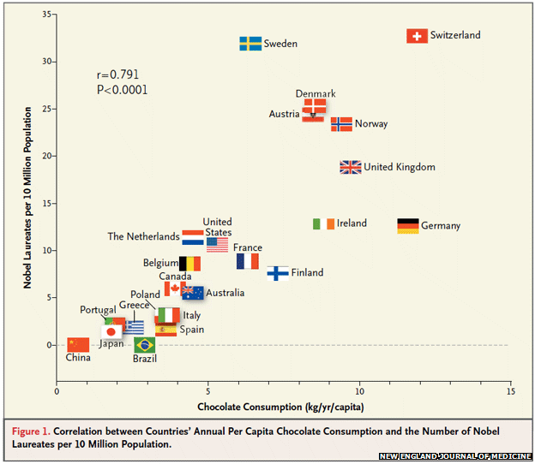
Does chocolate make you clever or crazy?
A paper in the New England Journal of Medicine claimed a relationship between chocolate and Nobel Prize winners
http://www.nejm.org/doi/full/10.1056/NEJMon1211064
r = 0.791
Notes:
A paper was published stating that there was a relationship between eating the chocolate consumption of a country and Nobel prize winners. What else is related to chocolate??

Slide 62
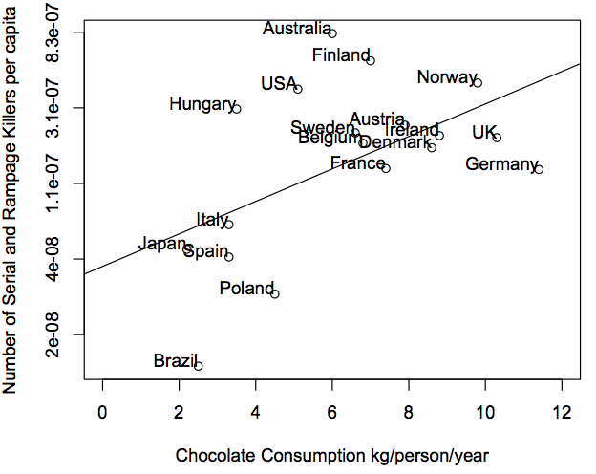
Chocolate and serial killers
What else is related to chocolate consumption?
http://www.replicatedtypo.com/chocolate-consumption-traffic-accidents-and-serial-killers/5718.html
r = 0.52
Notes:
Apparently, the number of serial killers! This was a reply to the paper making the first claim.

Slide 63
Hypothesis tests for r
Tests the null hypothesis that the population correlation r = 0 NOT that there is a strong relationship!
It is highly influenced by the number of observations e.g. sample size of 150 will classify a correlation of 0.16 as significant!
Use Cohen’s interpretation

Slide 64
Confounding
Is there something else affecting both chocolate consumption and Nobel prize winners?
Chocolate consumption
Number of Nobel winners
GDP (wealth)
Temperature
Notes:
When looking into correlations, it’s possible that a relationship between two variables may actually be caused by something else related to both. These are called confounding variables. In the case of chocolate consumption and nobel prize winners, the GDP and average temperature of a country are related to both chocolate consumption and nobel prize winners and it’s this relationship that is being measured with the correlation.

Slide 65
Regression
Correlation tells you if there is an association between x and y but it doesn’t describe the relationship or allow you to predict one variable from the other (or factor in confounding effects).
To do this we need REGRESSION!

Slide 66
Best-fit Line
Aim of linear regression is to fit a straight line, ŷ = ax + b, to data that gives best prediction of y for any value of x
This will be the line that minimises distance between data and fitted line, i.e. the residuals
ŷ = ax + b
slope
intercept
ε
= ŷ, predicted value
= y _{i} , true value
ε = residual error

Slide 67
Least Squares Regression
To find the best line we must minimise the sum of the squares of the residuals (the vertical distances from the data points to our line)
Model line: ŷ = ax + b
a = slope, b = intercept
Residual (ε) = y - ŷ
Sum of squares of residuals = Σ (y – ŷ)²
we must find values of a and b that minimise
Σ (y – ŷ)²

Slide 68
Finding b
First we find the value of b that gives the min sum of squares
ε
b
ε
b
b
Trying different values of b is equivalent to shifting the line up and down the scatter plot

Slide 69
Finding a
Now we find the value of a that gives the min sum of squares
b
b
b
Trying out different values of a is equivalent to changing the slope of the line, while b stays constant

Slide 70
Minimising sums of squares
Need to minimise Σ(y–ŷ)²
ŷ = ax + b
so need to minimise:
Σ(y - ax - b)²
If we plot the sums of squares for all different values of a and b we get a parabola, because it is a squared term
So the min sum of squares is at the bottom of the curve, where the gradient is zero.
sums of squares (S)
Gradient = 0
min S
Values of a and b

Slide 71
The maths bit
The min sum of squares is at the bottom of the curve where the gradient = 0
So we can find a and b that give min sum of squares by taking partial derivatives of Σ(y - ax - b)² with respect to a and b separately
Then we solve these for 0 to give us the values of a and b that give the min sum of squares

Slide 72
The solution
Doing this gives the following equations for a and b:
r s_{y}
r = correlation coefficient of x and y
s_{y} = standard deviation of y
s_{x} = standard deviation of x
a =
s_{x}
From you can see that:
A low correlation coefficient gives a flatter slope (small value of a)
Large spread of y, i.e. high standard deviation, results in a steeper slope (high value of a)
Large spread of x, i.e. high standard deviation, results in a flatter slope (small value of a)

Slide 73
Dataset for analysis
fage
Father's age in years.
mage
Mother's age in years.
mature
Maturity status of mother.
weeks
Length of pregnancy in weeks.
premie
Whether the birth was classified as premature (premie) or full-term.
visits
Number of hospital visits during pregnancy.
gained
Weight gained by mother during pregnancy in pounds.
weight
Weight of the baby at birth in pounds.
lowbirthweight
Whether baby was classified as low birthweight (low) or not (not low).
gender
Gender of the baby, female or male.
habit
Status of the mother as a nonsmoker or a smoker.
marital
Whether mother is married or not married at birth.
whitemom
Whether mom is white or not white.
North Carolina births, 1000 cases
Description
“In 2004, the state of North Carolina released to the public a large data set containing information on births recorded in this state. This data set has been of interest to medical researchers who are studying the relation between habits and practices of expectant mothers and the birth of their children. This is a random sample of 1,000 cases from this data set.”
https://www.openintro.org/data/index.php?data=ncbirths

Slide 74
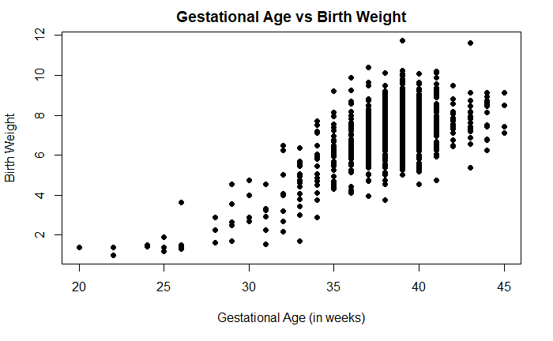
Gestational age and birth weight
Describe the relationship between the gestational age of a baby and their weight at birth.
Correlation between gestational age and birth weight= 0.6701013

Slide 75
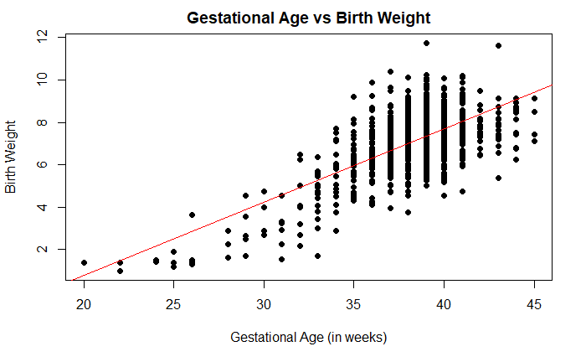
Describe the relationship between the gestational age of a baby and their weight at birth.
There is a strong positive relationship which is linear

Slide 76
Regression: Association between two variables
Regression is useful when we want to
look for significant relationships between two variables
predict a value of one variable for a given value of the other
It involves estimating the line of best fit through the data which minimises the sum of the squared residuals
What are the residuals?
Notes:
Regression produces an equation for the line of best fit. The equation can be used to predict values for the dependent variable given the independent variable. More commonly students use regression to look for significant relationships. The computer classifies the line of best fit which minimises the sum of the squared residuals but what are the residuals?

Slide 77
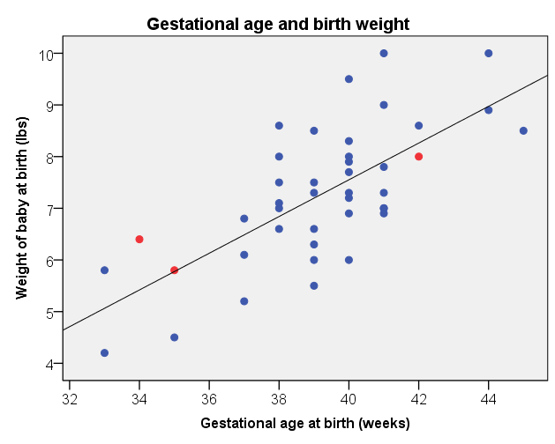
Residuals
Residuals are the differences between the observed and predicted weights
Residuals
Baby heavier than predicted
Baby lighter than expected
Regression line
Baby the same as predicted
X Predictor / explanatory variable (independent variable)
Notes:
Residuals are the differences between the observed dependent variables and the predicted value from the regression equation. These residuals are squared and added together.

Slide 78
Running regression in R
Regression output summary
Call:
lm(formula = ncbirths$weight ~ ncbirths$weeks)
Residuals:
Min 1Q Median 3Q Max
-3.5775 -0.7048 -0.0235 0.7022 4.4165
Coefficients:
Estimate Std. Error t value Pr(>|t|)
(Intercept) -6.09529 0.46464 -13.12 <2e-16 ***
ncbirths$weeks 0.34433 0.01209 28.49 <2e-16 ***
Residual standard error: 1.119 on 996 degrees of freedom
(2 observations deleted due to missingness)
Multiple R-squared: 0.449, Adjusted R-squared: 0.4485
F-statistic: 811.7 on 1 and 996 DF, p-value: < 2.2e-16
Y= -6.09 + 0.35*X
p<0.001
Gestational age is a significant predictor of birth weight. Weight increases by 0.35 lbs for each week of gestation.

Slide 79
How reliable are predictions? – R²
How much of the variation in birth weight is explained by the model including Gestational age?
Residual standard error: 1.119 on 996 degrees of freedom
(2 observations deleted due to missingness)
Multiple R-squared: 0.449, Adjusted R-squared: 0.4485
F-statistic: 811.7 on 1 and 996 DF, p-value: < 2.2e-16
Proportion of the variation in birth weight explained by the model R² = 0.499 = 50%
Predictions using the model are fairly reliable.
Which variables may help improve the fit of the model?
Compare models using Adjusted R²
Notes:
Another important value contained in the output is R squared. This is a measure of how well the model fits the data and therefore how reliable predictions are. For simple linear regression, R squared is just the correlation coefficient squared. It therefore takes values between 0 and 1. Turning it into a percentage makes it easier to explain. Here 50% of the variation in birthweight is explained by the model including gestational age. This is quite good for a model containing only one independent variable. What constitutes ‘good’ varies by discipline.

Slide 80
Assumptions for regression
Assumption | Plot to check
The relationship between the independent and dependent variables is linear. | Original scatter plot of the independent and dependent variables
Homoscedasticity: The variance of the residuals about predicted responses should be the same for all predicted responses. | Scatterplot of standardised predicted values and residuals
The residuals are independently normally distributed | Plot the residuals in a histogram
Look for patterns.

Slide 81
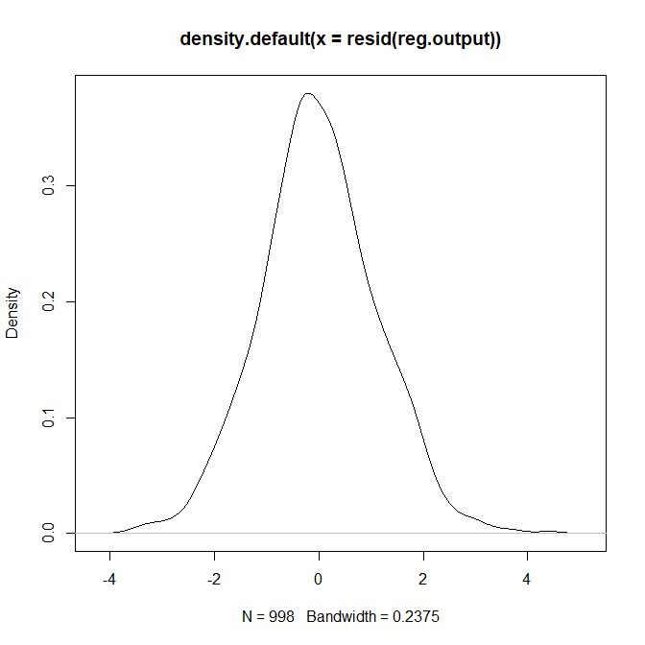
Checking normality
Histogram of the residuals looks approximately normally distributed
When writing up, just say ‘normality checks were carried out on the residuals and the assumption of normality was met’

Slide 82
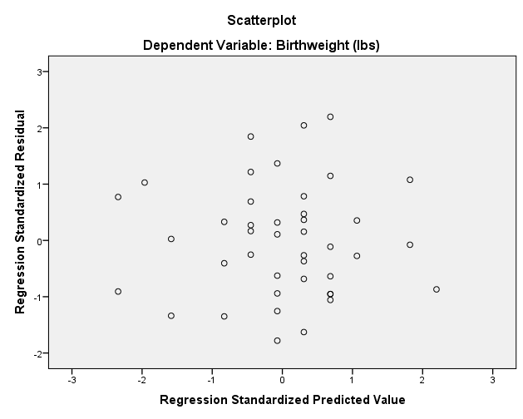
Predicted values against residuals
Are there any patterns as the predicted values increases?
There is a problem with Homoscedasticity if the scatter is not random. A “funnelling” shape such as this suggests problems.
Notes:
This plot shows predicted values on the x axis and residuals on the y axis. What we want is random scatter with no patterns. One problem to look for is an increase in the width of the scatter as predicted values increase.

Slide 83
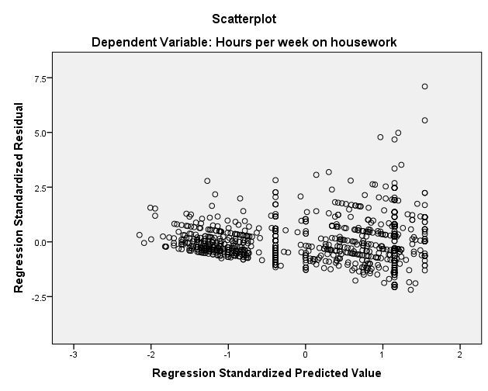
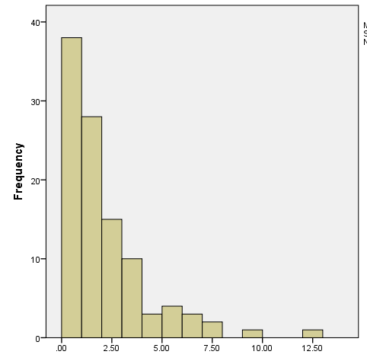
What if assumptions are not met?
If the residuals are heavily skewed or the residuals show different variances as predicted values increase, the data needs to be transformed
Try taking the natural log (ln) of the dependent variable. Then repeat the analysis and check the assumptions
Notes:
Here are some examples of problem data. The histogram on the left shows residuals that are very positively skewed and the plot on the right shows an increase in variability of the residuals as predicted values increase. The dependent variable needs to be transformed and the most common transformation is to take the log of the dependent variable. The analysis is re-run using the transformed variable and the assumptions checked again. The downside to this is the interpretation of the output changes and some students will struggle with the interpretation.

Slide 84
Additional Slides

Slide 85
Pearson’s R

Slide 86
Regression-The solution cont.
Our model equation is ŷ = ax + b
This line must pass through the mean so:
y = ax + b
b = y – ax
b = y – ax
We can put our equation for a into this giving:
r s_{y}
r = correlation coefficient of x and y
s_{y} = standard deviation of y
s_{x} = standard deviation of x
b = y -
x
s_{x}
The smaller the correlation, the closer the intercept is to the mean of y

Slide 87
Back to the model
a
b
r s_{y}
r s_{y}
ŷ = ax + b =
x + y -
x
s_{x}
s_{x}
a
a
r s_{y}
Rearranges to:
ŷ =
(x – x) + y
s_{x}
If the correlation is zero, we will simply predict the mean of y for every value of x, and our regression line is just a flat straight line crossing the x-axis at y
But this isn’t very useful.
We can calculate the regression line for any data, but the important question is how well does this line fit the data, or how good is it at predicting y from x

Slide 88
How good is our model?
∑(y – y)²
SS_{y}
Total variance of y:
s_{y}² =
=
n - 1
df_{y}
Variance of predicted y values (ŷ):
∑(ŷ – y)²
SS_{pred}
This is the variance explained by our regression model
s_{ŷ}² =
=
n - 1
df_{ŷ}
Error variance:
This is the variance of the error between our predicted y values and the actual y values, and thus is the variance in y that is NOT explained by the regression model
∑(y – ŷ)²
SS_{er}
s_{error}² =
=
n - 2
df_{er}

Slide 89
How good is our model cont.
Total variance = predicted variance + error variance
s_{y}² = s_{ŷ}² + s_{er}²
Conveniently, via some complicated rearranging
s_{ŷ}² = r² s_{y}²
r² = s_{ŷ}² / s_{y}²
so r² is the proportion of the variance in y that is explained by our regression model

Slide 90
How good is our model cont.
Insert r² s_{y}² into s_{y}² = s_{ŷ}² + s_{er}² and rearrange to get:
s_{er}² = s_{y}² – r²s_{y}²
= s_{y}² (1 – r²)
From this we can see that the greater the correlation the smaller the error variance, so the better our prediction

Slide 91
Is the model significant?
i.e. do we get a significantly better prediction of y from our regression equation than by just predicting the mean?
F-statistic:
complicated
rearranging
s_{ŷ}²
r² (n - 2)²
F
=
=......=
(df_{ŷ},df_{er})
s_{er}²
1 – r²
And it follows that:
r (n - 2)
So all we need to
know are r and n
t_{(n-2)} =
(because F = t²⁾
√1 – r²

Slide 92
General Linear Model
Linear regression is actually a form of the General Linear Model where the parameters are a, the slope of the line, and b, the intercept.
y = ax + b +ε
A General Linear Model is just any model that describes the data in terms of a straight line

Slide 93
Multiple regression
Multiple regression is used to determine the effect of a number of independent variables, x₁, x₂, x₃ etc, on a single dependent variable, y
The different x variables are combined in a linear way and each has its own regression coefficient:
y = a₁x₁+ a₂x₂ +…..+ a_{n}x_{n} + b + ε
The a parameters reflect the independent contribution of each independent variable, x, to the value of the dependent variable, y.
i.e. the amount of variance in y that is accounted for by each x variable after all the other x variables have been accounted for

Slide 94
ANOVA

Slide 95
ANOVA
Compares the means of several groups
Which diet is best?
Dependent: Weight lost (Scale)
Independent: Diet 1, 2 or 3 (Nominal)
Null hypothesis: The mean weight lost on diets 1, 2 and 3 is the same
Alternative hypothesis: The mean weight lost on diets 1, 2 and 3 are not all the same
Notes:
Previously we’ve discussed how ANOVA is used to compare 3 or more means. Now we’re going to look at how an ANOVA is carried out. We’ll use an example of comparing the effectiveness of 3 diets. People were allocated to one of three diets randomly. Their weights before and after the diets were measurements and the weight lost calculated. The null hypothesis is that the mean weight lost is the same for all 3 diets.

Slide 96
Summary statistics
Which diet was best?
Are the standard deviations similar?
 | Overall | Diet 1 | Diet 2 | Diet 3
Mean | 3.85 | 3.3 | 3.03 | 5.15
Standard deviation | 2.55 | 2.24 | 2.52 | 2.4
Number in group | 78 | 24 | 27 | 27
Notes:
First, calculate the mean weight lost for each diet and the standard deviation. Ask the participants to decide which diet was best for losing weight and whether the standard deviations are similar.
The answers are Diet 3 and that the SD’s are similar.

Slide 97
How Does ANOVA Work?
ANOVA = Analysis of variance
We compare variation between groups relative to variation within groups
Population variance estimated in two ways:
One based on variation between groups we call the Mean Square due to Treatments/ MST/ MS_{between}
Other based on variation within groups we call the Mean Square due to Error/ MSE/ MS_{within}
Notes:
Although ANOVA compares means, ANOVA stands for analysis of variance. This is because it compares between group variation to within group variation to decide if there is a difference. The variance in the population can be split into two parts. Variation due to the group/ treatment which we call mean square due to treatments and the natural variation we expect between people which we called within group variation or mean square due to error. Let’s look at these different variations graphically.
97

Slide 98
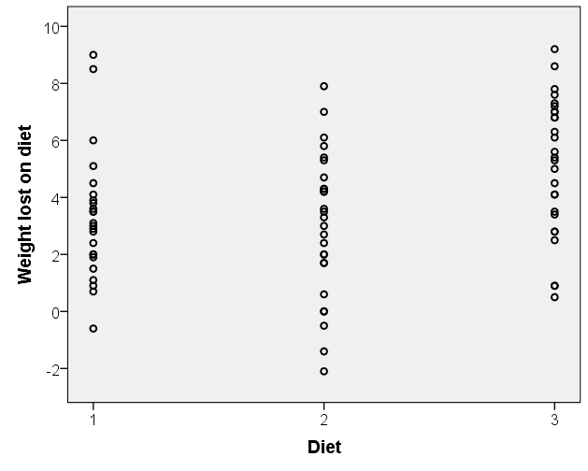
Within group variation
Residual =difference between an individual and their group mean
SS_{within}=sum of squared residuals
Person lost 9.2kg kg so residual =9.2 – 5.15 = 4.05
Mean weight lost on diet 3 = 5.15kg
Notes:
Remember from earlier that a residual is the difference between individuals and expected values. Each of the three groups has a mean weight lost but people deviate from this mean. Each dot represents an individual and the bars are the group means. The closer the individuals are about the mean, the smaller the variation. As some have negative residuals, the residuals are squared before being added. We call this the sum of the squared residuals or SS within.

Slide 99
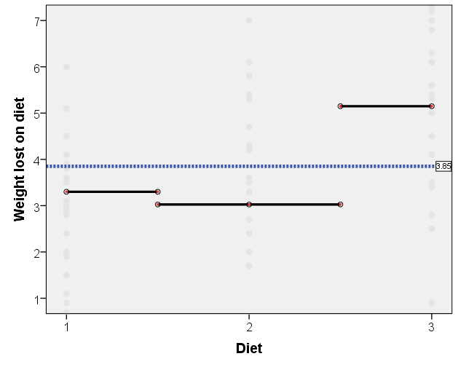
Between group variation
Differences between each group mean and the overall mean
Diet 3 difference =5.15 – 3.85 = 1.3
Overall mean = 3.85
Notes:
Next we look at between group variation which is measured by how much each group mean varies from the overall mean for everyone in the study. This is called the between groups variation or SS between. Lets see that mathematically.

Slide 100
Sum of squares calculations
K = number of groups
Notes:
Most students are not interested in the maths and some will be put off by it. We’ve included it here as you are all mathematicians. K is the number of groups, j = 1 to 3 and I = 1 to 78

Slide 101
ANOVA test statistic
Test Statistic (usually reported in papers)
N = total observations in all groups,
K = number of groups
Notes:
The common output of ANOVA test is the ANOVA table, as you can see on this slide. The first column contains the sum of squares between groups, within groups and the total sum of squares; the second column are the degrees of freedom for the corresponding sum of squares. The third column is normally called ‘mean square’; it is calculated by dividing the values of second column by their degrees of freedom (3rd column). The last column includes only one value which is the F statistic, i.e. The ratio of Mean Square between groups to the Mean Square within group. This is also the key value of ANOVA test on which the decision will be based.

Slide 102
Test Statistic (by hand)
Filling in the boxes
 | Sum of squares | Degrees of freedom | Mean square | F-ratio (test statistic)
SS_{between} | 71.045 | 2 | 35.522 | 6.193
SS_{within} | 430.180 | 75 | 5.736
SS_{total} | 501.275 | 77
F = Mean between group sum of squared differences
Mean within group sum of squared differences
If F > 1, there is a bigger difference between groups than within groups
Notes:
Here’s the table for our example with the numbers filled in. If the test statistic F is greater than one it suggests that there is more between group than within group variation but it will need to quite a bit bigger than 1 to classify as a statistically significant difference.

Slide 103
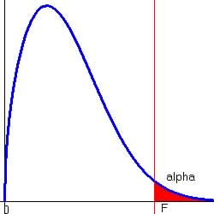
P-value
The p-value for ANOVA is calculated using the F-distribution
If you repeated the experiment numerous times, you would get a variety of test statistics
p-value = probability of getting a test statistic at least as extreme as ours if the null is true
Test Statistic
Notes:
The p-value for ANOVA is calculated using the F distribution. This is the distribution of test statistics if the null is true and we wish to see how likely our test statistic or one more extreme is if the null is true.

Slide 104
One way ANOVA
MS_{between}
MS_{within}
There was a significant difference in weight lost between the diets (p=0.003)
Notes:
This is the output from SPSS for the diet example. There is a bit more than the table used if you calculating the test statistic by hand. The between groups variation is labelled ‘Diet’ and the within group variation is labelled Error. The p-value is in the ‘sig’ column. For assessing the effect of diet, use the p-value in the diet row. The p-value is 0.003 which is much less than 0.05 so the null is rejected. The conclusion is that there is a difference between at least two of the diets but which ones?

Slide 105
Post hoc tests
If there is a significant ANOVA result, pairwise comparisons are made
They are t-tests with adjustments to keep the type 1 error to a minimum
Tukey’s and Scheffe’s tests are the most commonly used post hoc tests.
Hochberg’s GT2 is better where the sample sizes for the groups are very different.
Notes:
If there is a significant ANOVA result, pairwise comparisons are made
They are t-tests with adjustments to keep the type 1 error to a minimum
Tukey’s and Scheffe’s tests are the most commonly used post hoc tests but get the student to check with their discipline in case they have a preferred method.
Hochberg’s GT2 is better where the sample sizes for the groups are very different.

Slide 106
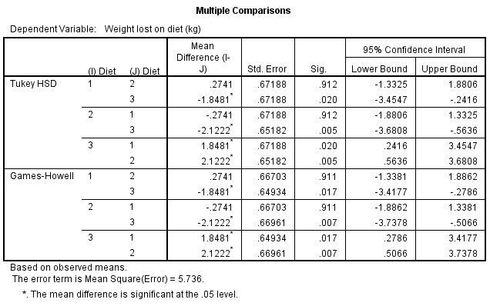
Post hoc tests
Which diets are significantly different?
Write up the results and conclude with which diet is the best.
Notes:
Here is the output for the Tukey tests. There are 3 pairwise comparisons diet 1 vs 2, diet 1 vs 3 and diet 2 vs 3. Get the students to interpret the output and write their conclusions about which diet was best on the following slides.

Slide 107
Pairwise comparisons
Test | p-value
Diet 1 vs Diet 2
Diet 1 vs Diet 3
Diet 2 vs Diet 3
Results
Report:
Notes:
Student working

Slide 108
Pairwise comparisons
Test | p-value
Diet 1 vs Diet 2 | P = 0.912
Diet 1 vs Diet 3 | P = 0.02
Diet 2 vs Diet 3 | P = 0.005
Results
There is no significant difference between Diets 1 and 2 but there is between diet 3 and diet 1 (p = 0.02) and diet 2 and diet 3 (p = 0.005).
The mean weight lost on Diets 1 (3.3kg) and 2 (3kg) are less than the mean weight lost on diet 3 (5.15kg).
Notes:
Solutions for the ANOVA

Slide 109
Assumptions for ANOVA
Assumption | How to check | What to do if assumption not met
Normality: The residuals (difference between observed and expected values) should be normally distributed | Histograms/ QQ plots/ normality tests of residuals | Do a Kruskall-Wallis test which is non-parametric (does not assume normality)
Homogeneity of variance (each group should have a similar standard deviation) | Levene’s test | Welch test instead of ANOVA and Games-Howell for post hoc or Kruskall-Wallis
Notes:
There are two main assumptions for ANOVA. As previously discussed it is the residuals that need to normally distributed. The residuals are the differences between individual scores and their group mean. As with the t-test, the variances of the groups need to be similar. The Levene’s test has to be requested in the options section of SPSS. If either assumption is not met, the kruskall-wallis test can be carried out or the Welch test can be used instead of ANOVA and the Games Howell post hoc test instead of Tukey.

Slide 110
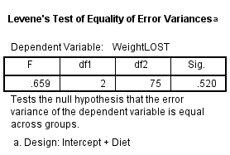
Ex: Can equal variances be assumed?
Null:
Conclusion:
p =
Reject/ do not reject
Notes:
This is a student exercise with room for them to write the solutions on two slides

Slide 111
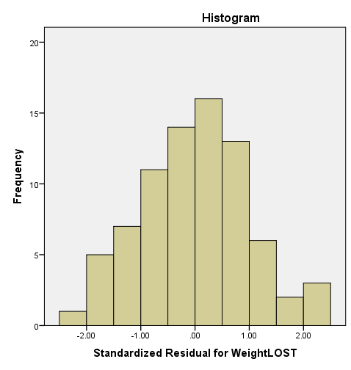
Exercise: Can normality be assumed?
Histogram of standardised residuals
Conclusion:
Can normality be assumed?
Should you:
Use ANOVA
Use Kruskall-Wallis
Notes:
Student exercise

Slide 112
Ex: Can equal variances be assumed?
Null:
Conclusion: Equality of variances can be assumed
p = 0.52
Do not reject
Notes:
Solution

Slide 113
Ex: Can normality be assumed?
Histogram of standardised residuals
Conclusion:
Can normality be assumed?
Yes
Use ANOVA
Notes:
Solution

Slide 114
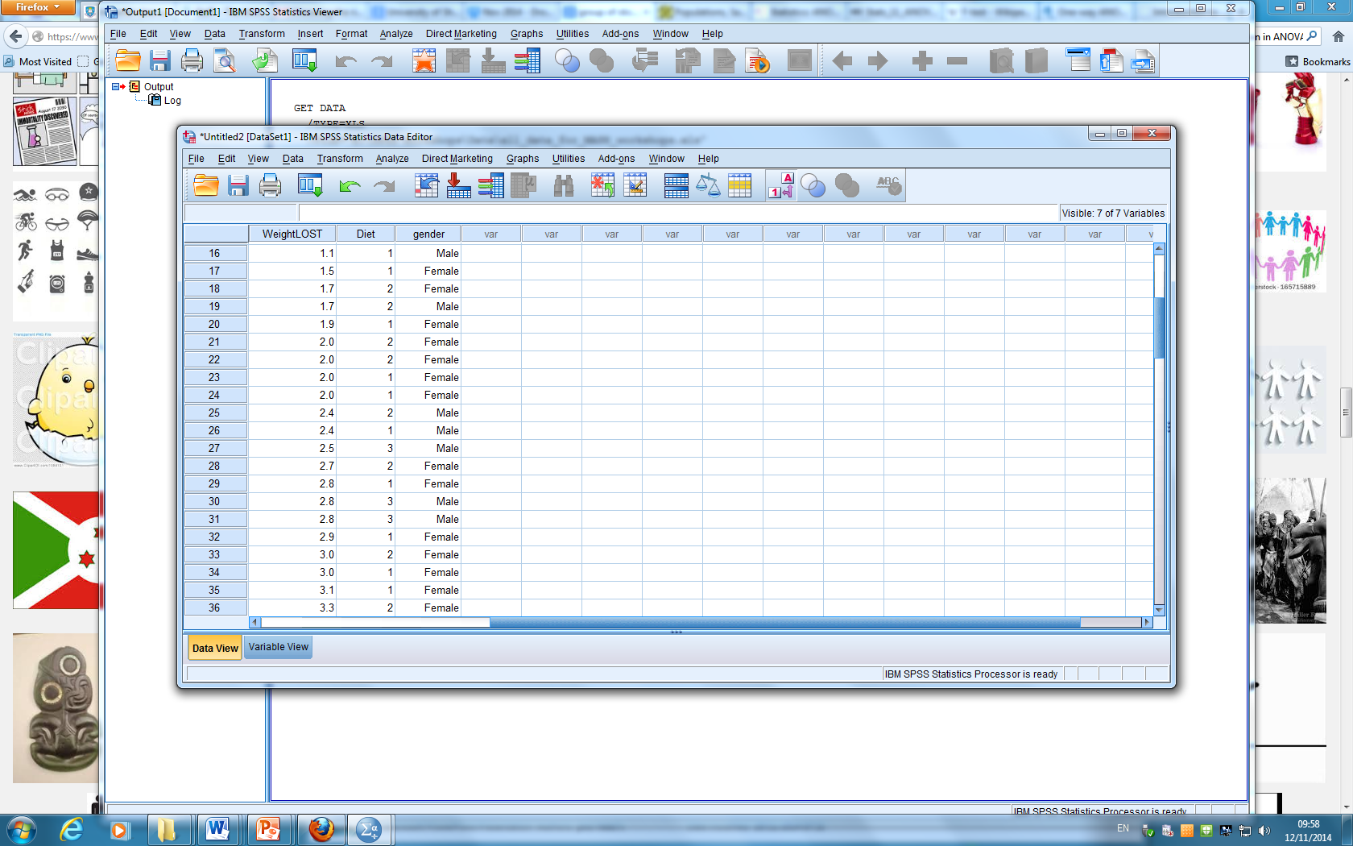
ANOVA
Between groups factor
Between groups factor
Two-way ANOVA has 2 categorical independent between groups variables
e.g. Look at the effect of gender on weight lost as well as which diet they were on
Notes:
We have just been through an example of a one way ANOVA but there are other ANOVA’s for several independent variables. A one-way ANOVA has 1 categorical independent variable, a two way has two etc. For example, if we wanted to see if there was a gender effect regarding weight lost as well as a diet effect, they are both between groups factors so a standard 2 way ANOVA would be suitable.

Slide 115
Two-way ANOVA
Dependent = Weight Lost
Independents: Diet and Gender
Tests 3 hypotheses:
Mean weight loss does not differ by diet
Mean weight loss does not differ by gender
There is no interaction between diet and gender
What’s an interaction?
Notes:
A two way ANOVA tests 3 hypotheses. The first two are called tests of main effects as they look at gender and diet separately. The third looks at the interaction between diet and gender but what is an interaction?

Slide 116
Means plot
Mean reaction times after consuming coffee, water or beer were taken and the results by drink or gender were compared.
Mean Reaction times | male | female
alcohol | 30 | 20
water | 15 | 9
coffee | 10 | 6
Notes:
We can explain an interaction using a means plot. This is a line chart which joins the means of each combination of independent variables. Here we have an experiment looking at reaction times after consuming one of 3 drinks. We are also interested in whether there is a gender effect. The table contains the mean reaction times for each of the 6 combinations. For example, the mean reaction time for men who had alcohol was 30 seconds. These means are plotted on the following slide.

Slide 117

Means/ line/ interaction plot
No interaction between gender and drink
Mean reaction time for men after water
Mean reaction time for women after coffee
Notes:
These are the 6 means in a plot. Can you see that women were consistently faster after all three drinks and that for both groups, those having alcohol were the slowest? The two lines are approximately parallel so we say that there is no interaction.

Slide 118

Means plot
Interaction between gender and drink
Notes:
However, if the plot looked something like this, the lines are not parallel suggesting the drink effect is not consistent for men and women. There’s a smaller difference between the drinks for women. For men both alcohol and coffee cause them to slow down. Here there is a clear interaction effect as the lines are overlapping considerably. I would expect the test for the interaction to be significant. If that happens, the tests for the main effects can not be interpreted. Instead either refer to the plot to describe what is going on or run one way ANOVA’s separately by gender.

Slide 119

ANOVA
Mixed between-within ANOVA includes some repeated measures and some between group variables
e.g. give some people margarine B instead of A and look at the change in cholesterol over time
Between groups factor
Repeated measures
Notes:
Finally, if the student has a mixture of repeated measures and between groups factors, a mixed between-within ANOVA can be carried out. Here each person has their cholesterol measured at 3 time points to see if one of two margarines has reduced cholesterol. They have either margarine A or B but not both so the margarine is an independent/ between group factor. Be careful with deciding whether the student has repeated measures or between groups factors.

