Slide 1
Intro to R
Bioinformatics workshop
May 4 2k22
Archana Yadav

Slide 2
Aims of the R-intro session
Meant for beginners
Get familiar with R language and comfortable working and writing basic scripts on R studio notebooks.
Install and load R packages
Read and interrogate tabular data files.(aka data frames)
What we are not covering, today:
Plotting with R
Statistical concepts such as performing t-tests etc.

Slide 3
Format
Introductory slides
R- intro : Demonstration in the R notebook (Session-1a)
Exercise 1: Time limit 15 min.
R-data frames: Demonstration in the R notebook (Session-1b)
Exercise 2: Time limit 15 min.
Time left: Feedback and what we want to learn in future R workshops

Slide 4
What is R?
A statistical programming environment suited to high-level data analysis.
Very popular among data scientists.
Freely available and can be used on most operating systems
Extensive graphics capabilities
Diverse range of well documented add-on packages for advanced data analysis
Active community of developers

Slide 5

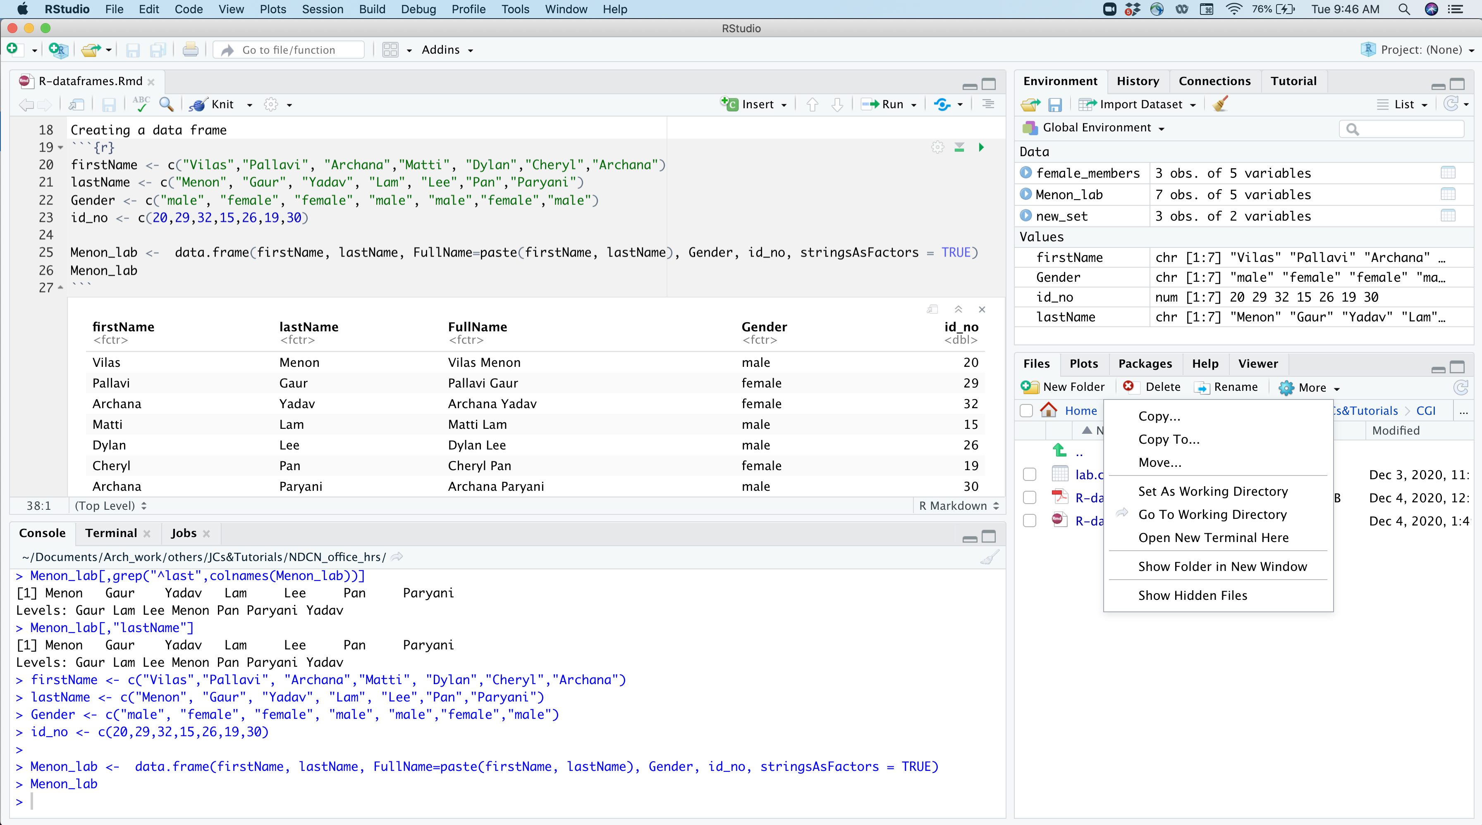

Slide 6
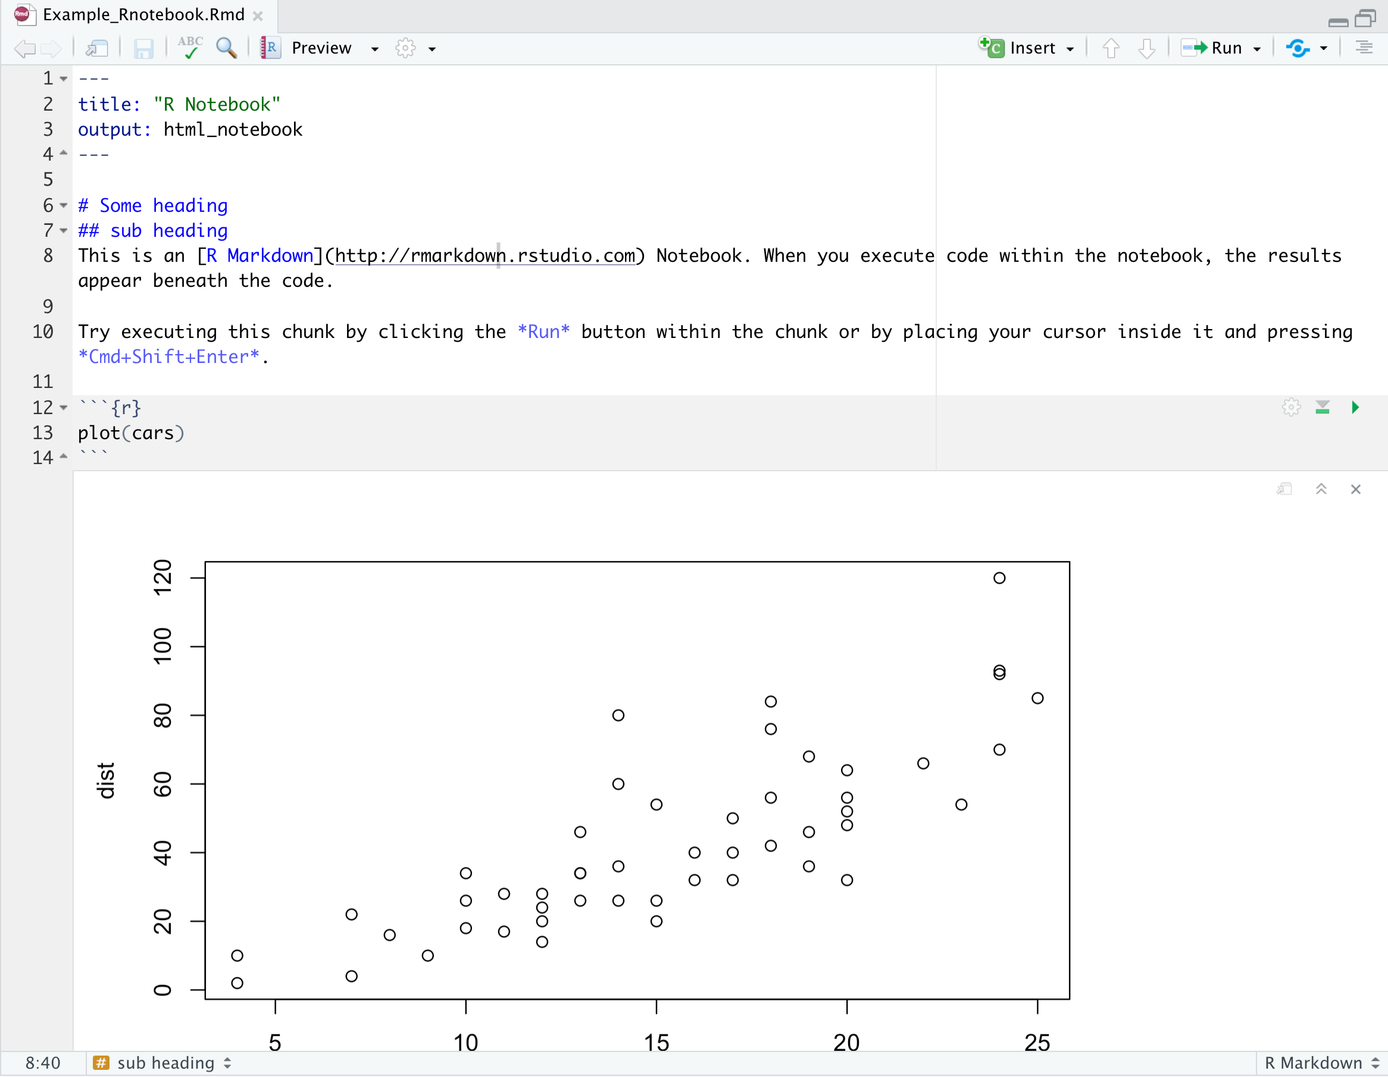
R notebooks
Filename
Insert code
R notebooks allows for direct interaction with R.
The notebooks files use the extension ‘.Rmd’. E.g R-intro.Rmd
When you execute code within the notebook, the results appear beneath the code.
When you save the notebook, an HTML file containing the code and output will be saved alongside it
You can also prepare a pdf file of your entire notebook.
Good practice for reproducible research.
Execute code
CODE
OUTPUT

Slide 7
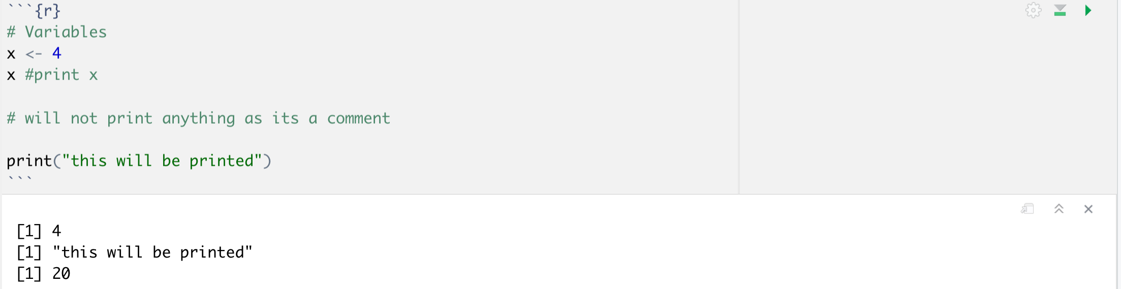
R code
code
output
Anything written after ‘#’ is a comment and is not executed as a code.
Comments are written in the code to make it more informative and easy to understand.
It’s a good practice to use comments in the code. (Helps in future!)

Slide 8
Installing and loading R Packages
Packages in R can be installed using the function install.packages()
E.g. Install.packages(“ggplot2”) will install the package named ‘gglpot2’ from CRAN (Comprehensive R archive Network), which is the primary location for obtaining R packages.
Packages can also be installed using R studio GUI mode.
After the package is successfully installed, it has to be loaded in order to start working with it.
Packages are loaded using function “library()”
E.g. library(ggplot2)

Slide 9
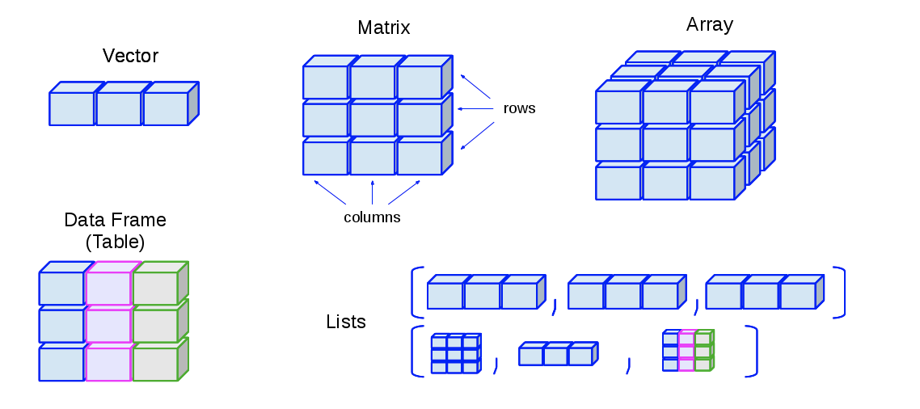
Basic concepts- Data structures
Vectors - one dimensional
Matrix- 2D, rows X columns
Arrays can be 3D
Data Frames: similar to matrix but each column can be diff data type
List: Ordered collection of diff data structures.

Slide 10
Basic Concepts in R- variables
A variable is a letter or word which takes (or contains) a value. We use the assignment operator: <- to assign values to variables.
E.g. x <- 10 , myNumber <- 25
We can perform arithmetic on variables: e.g. sqrt(myNumber)
Add variables : x + myNumber
We can modify the contents of a variable: myNumber <- myNumber + sqrt(16).

Slide 11
Basic concepts in R - vectors
The basic data structure in R is a vector – an ordered collection of values.
The function c combines its arguments into a vector.
x <- c(3,4,5,6)
The square brackets [] indicate the position within the vector (the index).
We can extract individual elements by using the [] notation:
E.g. : x <- c(3,4,5,6)
x[1] is 3, x[2] is 4, x[3] is 5, x[4] is 6
Incase, you want to output multiple values
x[c(2,4)] : will output 4,6
There are a number of shortcuts to create a vector.
x <- 3:12
Or use seq function: x <- seq(2, 20, 4)

Slide 12
Basic concepts in R - functions
Functions in R perform operations on arguments (the inputs(s) to the function).
Arguments are always contained in parentheses – curved brackets, () – separated by commas.
E.g. sin(x) : This returns the sine of x
Many other functions :
head(data) : displays top 6 lines
dim(data) : displays the size of your data e.g. n rows, m cols
read.csv(“filename.csv”)
You can use functions from the installed packages in the same manner. For e.g. when using Seurat package, the functions from Seurat can be called as follows:
library(Seurat) # load the installed package in working environment
CreateSeuratObject()
AddMetaData()
RunPCA()
Most imp tip: to know how to use a function type: ?functionname, e.g. ?RunPCA()

Slide 13
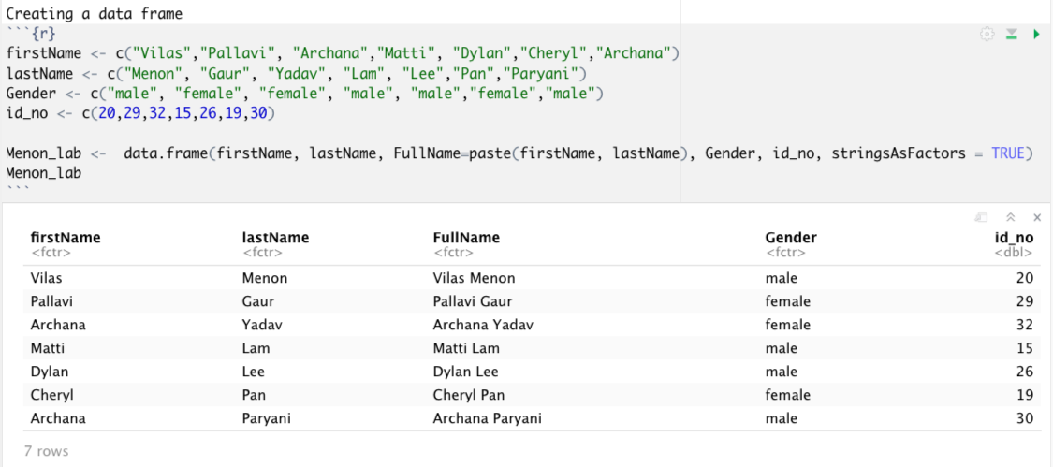
Data frames
A data frame is a table or a two-dimensional array-like structure divided as rows (n) and columns(m). Dimension is (n,m).
rows : Observations. Each row is a mini-dataframe (1,m).
columns are vectors of particular data types (such as character, integer, logical).
Different columns can be diff datatype.
Elements of same column should be same type
You can load these data frames through ‘csv’ files as well.

