Slide 1
Introduction to Clustering
11 May 2022
Vilas Menon
Introduction to Bioinformatics Mini-Course

Slide 2
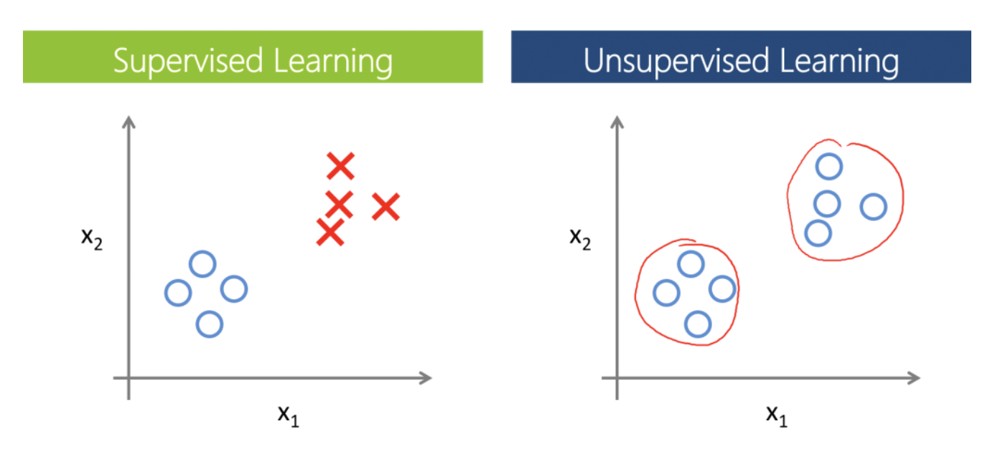
Supervised vs. unsupervised learning
Data points are labeled
No direct labels
Differential feature analysis
Classification
Clustering
Pattern/feature recognition

Slide 3
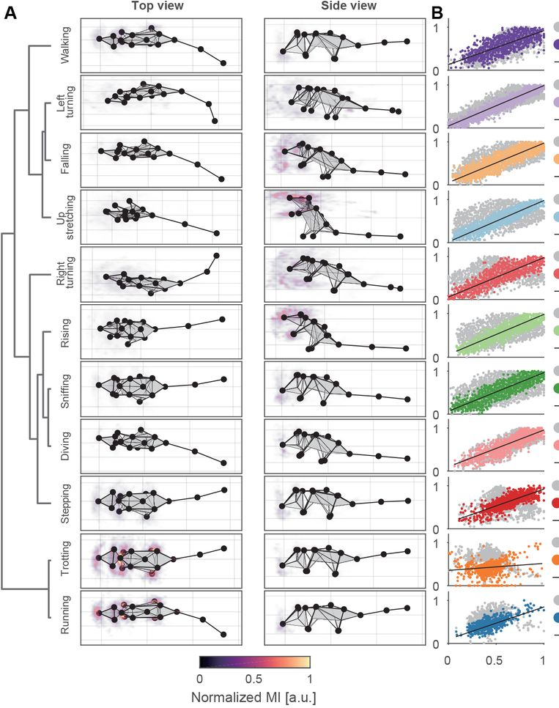
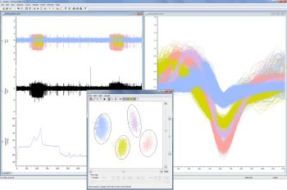
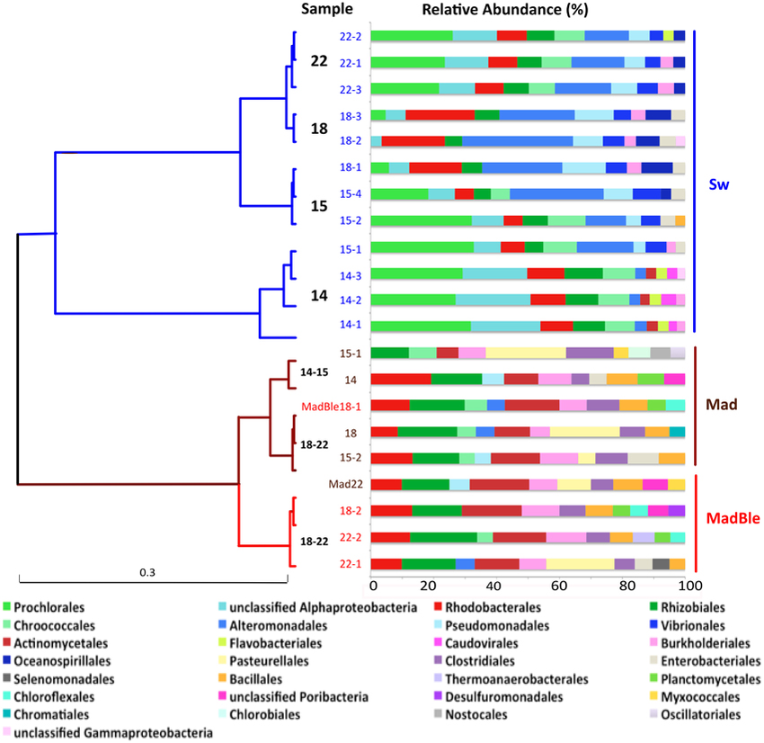
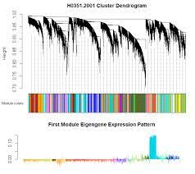
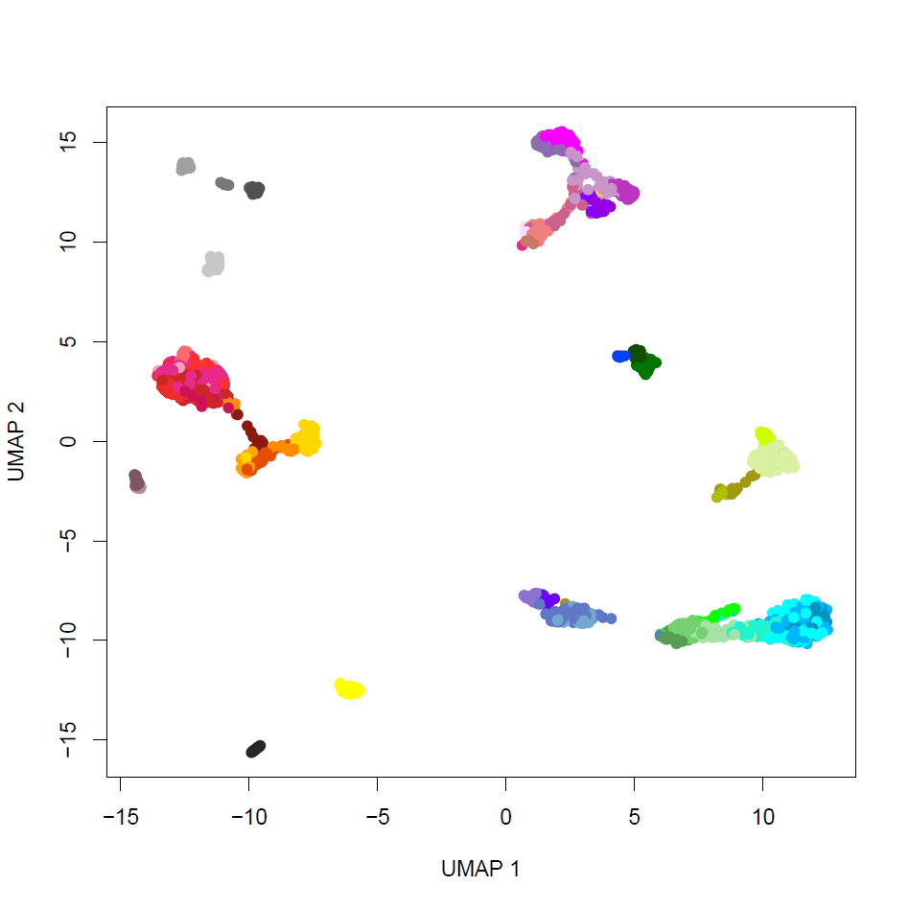
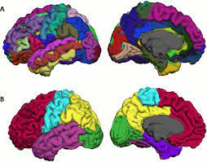
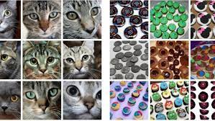
Clustering in biology
Behavioral analysis
Spike sorting
Metagenomics
Bulk RNA-seq & proteomics
Functional/structural imaging
Single-cell RNA-seq
Image clustering

Slide 4
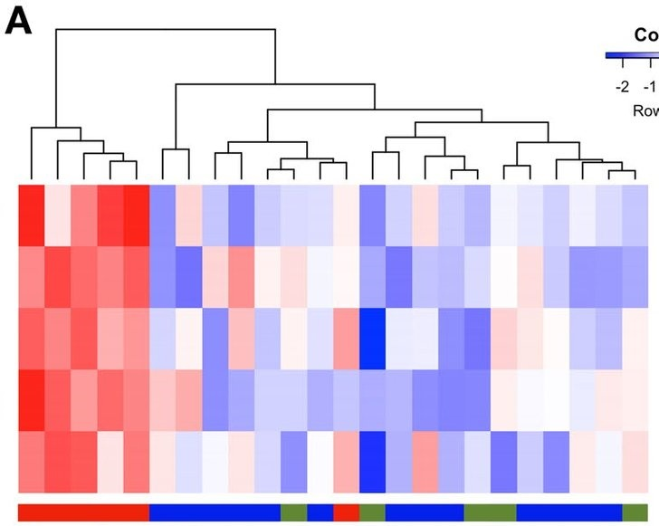
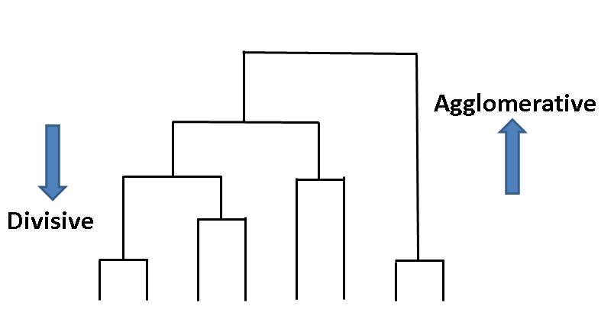
Unsupervised analysis - clustering
Clustering requires:
A distance metric
An algorithm to assign elements to groups
2 major classes: 1) Agglomerative clustering (“building up” of clusters from elements)
2) Divisive clustering (“splitting” data into clusters)

Slide 5
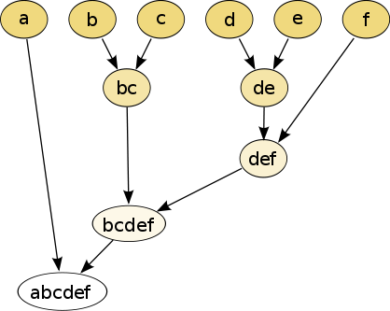
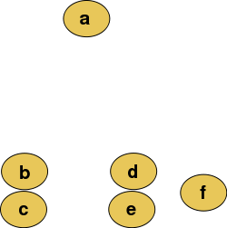
Hierarchical clustering
Using a distance metric, successively group pairs of elements into a tree
After each grouping, recalculate distance metric for new group
Cut the final tree at a specific height to get individual clusters
Wikipedia.org

Slide 6
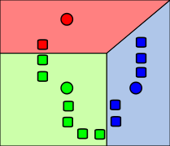
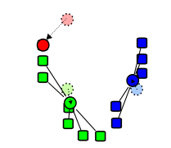
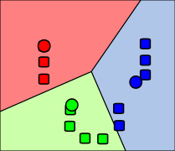
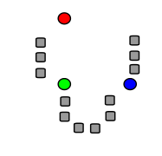
K-means clustering
Select n (pre-specified parameter) random centroids
Associate every data point to its closest mean using the distance metric
Recalculate centroids
Repeat until no changes are made
Initial selection of centroids is random
Number of clusters is pre-specified
Wikipedia.org

Slide 7
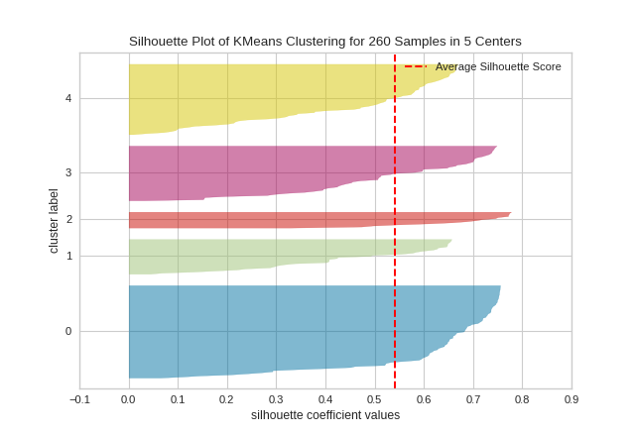
How many clusters are there?
Select a given number of clusters and assess separation
Within-cluster distance versus between-cluster distance
Silhouette plots (within-cluster distance compared to “closest” cluster for each point)
Post-hoc classification (supervised learning)
Visualize the data! (Heuristic)

Slide 8
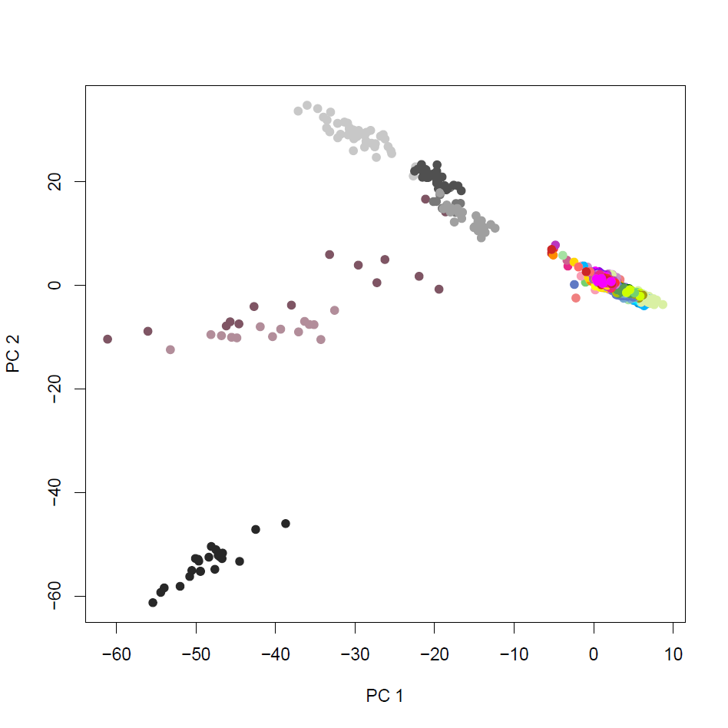
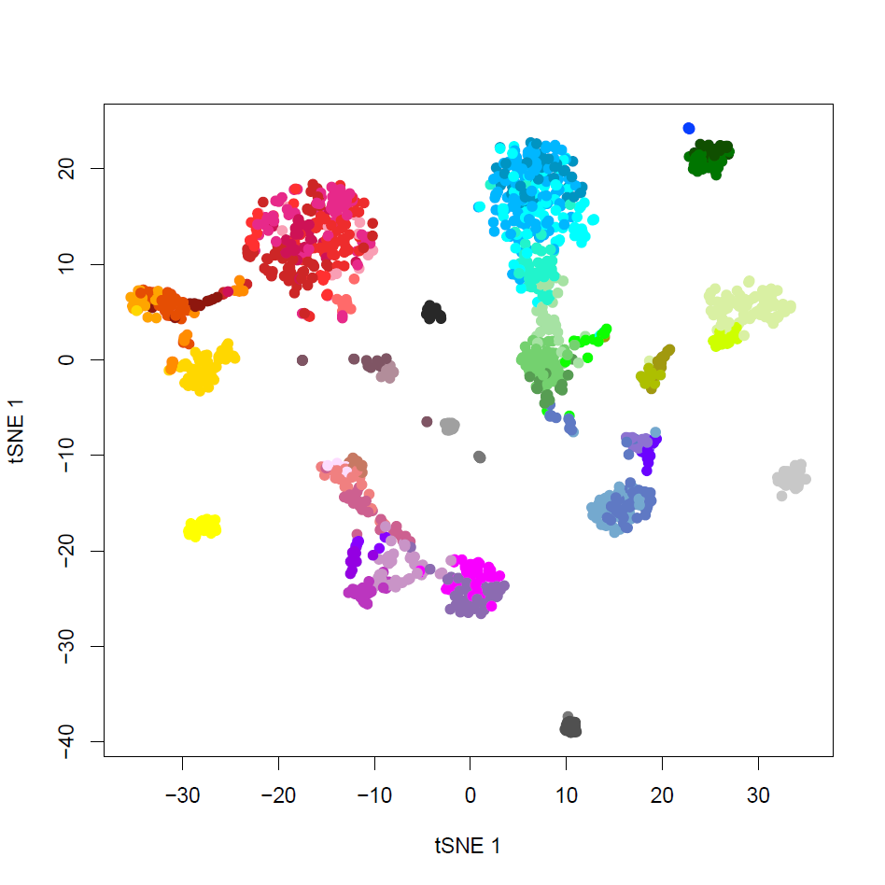
Visualizing high dimensional data: Dimensionality reduction
PCA (linear)
t-SNE (nonlinear)
UMAP (nonlinear)
All measurements (rows) are not independent – there exists some lower-dimensional space (manifold) on which data can be organized

Slide 9
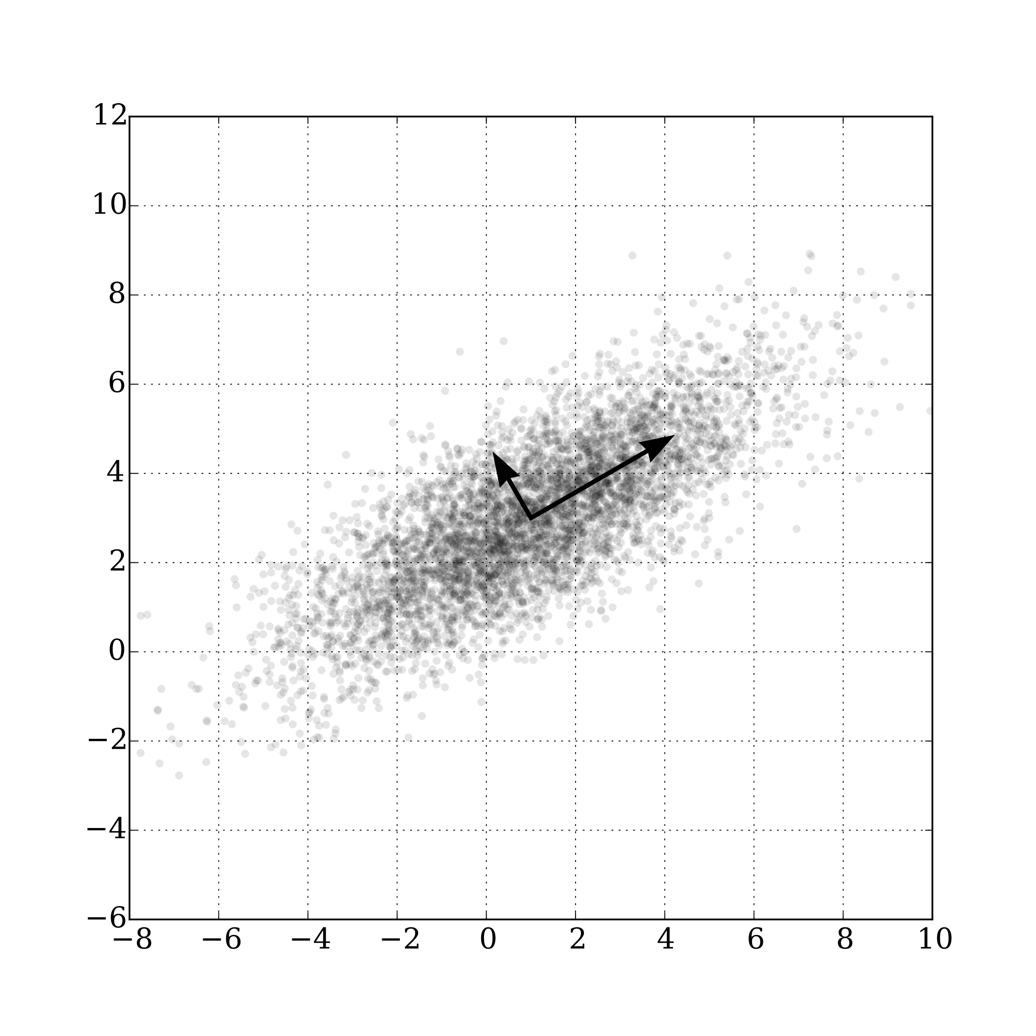
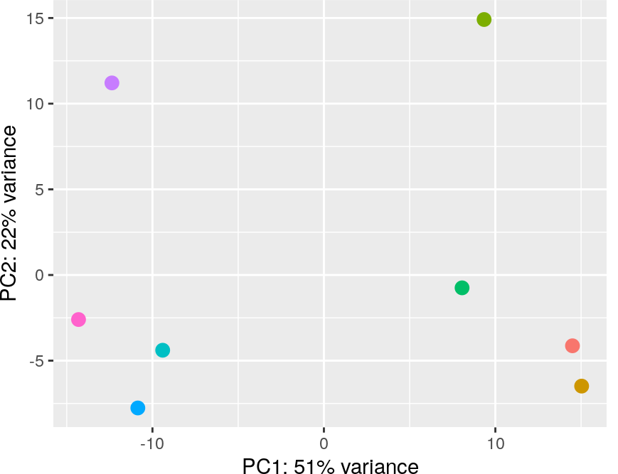
Dimensionality reduction: Principal Component Analysis
Principal components explain significant portions of the variance

Slide 10
Dimensionality reduction for visualization versus clustering
Dimensionality reduction for clustering
Often require >>2 dimensions
Distance metric needs to preserve local and global similarity/differences
PCA, Module analysis, Factor analysis
Dimensionality reduction for visualization
Need to work in 2 (or 3) dimensions
Distance metrics are often highly nonlinear, and non-interpretable over large differences
PCA, t-SNE, UMAP
If the approaches agree, great news!

