Slide 1
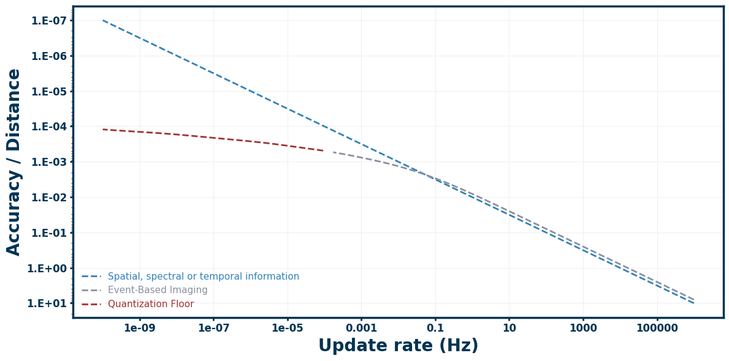
Theoretical localization bounds for intensity-based z-estimation. The photon-limited Cramér-Rao Lower Bound (blue dashed line) establishes that spatial uncertainty scales with the square root of the update rate (∝ √f), with the absolute vertical offset determined primarily by the numerical aperture (NA). At lower update rates, the event-based imaging model (grey dashed line) diverges from the photon limit and is restricted by a quantization floor (red dashed line). This floor imposes a fundamental limit on maximum achievable accuracy due to the loss of information between event thresholds (τ). Minor deviations at extreme high update rates are attributed to numerical instability during the Fisher Information matrix inversion.

