Slide 1
Signed-Polarity Spectral Correlation
Verifying our results against Shah et al., CodedEvents (CVPR 2024) — and what the fine-grid sweep changed
Hypercam spectral correlation · verification report · September 2026
Notes:
Executive summary: all four shared claims verify against Shah et al. The new instrumented sweep shows the strong negative short-time correlation was a polarity-folding artifact, not physics. Switching to the paper's ON−OFF binning strengthens the converged signal from 0.61 to 0.78 and pushes green-red to 0.90 — 80% similarity is now reached, contradicting our earlier conclusion #3. 16 ms is measured as the lower edge of detectability at 1 ms accumulation. Two diagnostics need a fix before the next deck refresh.

Slide 2
Scope: what was verified, and with what instrument
• Paper evidence: paper + supplement extracted and read (S1–S4, Tables 1/3/4, Figs. 2/11–13); all quoted numbers taken from the text
• Results audited: all folders — spectral / gaussian / no_filter laser scans, LCD circle RGB (raw + filtered), and the three duration-sweep variants (min1 / min5 / unmasked)
• New instrument: duration × accumulation sweep upgraded — fine 12/14/16/18/20/22 ms grid, ± polarity split, split-half noise ceiling with Student-t discernibility per pair
• Signed polarity: each window accumulates ON − OFF per pixel with sign-preserving log1p — exactly the paper's binned event frame ≈ Δlog I / T (Supplement S4, |error| < 1)
• Data: 5 s circle_blue / green / red recordings, 720 × 1280 EVT3, crop + 64 px high-pass + support-masked Pearson
Hypercam spectral correlation · polarity verification report · September 2026 · 2
Notes:
The signed mode is not a new metric — it is the paper's own measurement model. The earlier sweeps folded both polarities into one count, which the paper never does.

Slide 3
Verification verdicts on the four shared claims
Claim | Shah et al. (CVPR 2024) | Our results
Binned frames recreate the log-intensity change | Proven (Supp. S4; Fig. 2): binned frame = Δlog I / T ± 1 | Signed binning raises converged r 0.61 → 0.78 — verified, now demonstrated
Success at 16 refresh cycles (16 × 1 ms?) | 16 cycles stated; 10 kHz refresh ⇒ 1.6 ms/bin, so 16 ms is our interpretation | First positive reproducible r at 14–16 ms (1 ms acc.) — supported as a detectability edge
CRLB-loss inverse design behaves ideally | NPM: CRB 33.1 nm (best of 5), tracking RMSE 51.2 nm | DoE artifacts are not in this workspace — not checkable here
Multiple accumulated frames strictly required | Without accumulation: RMSE +45% (NPM), +54% (NAM) | ≥5-frame floor (deviation ≤0.075); 1–2 frames break down (up to ~0.74)
Hypercam spectral correlation · polarity verification report · September 2026 · 3
Notes:
Caveat on row 2: the paper never states 1 ms per refresh cycle. Its own numbers (1000 accumulated frames/s; 10 kHz → 625 FPS with 16-frame bins) imply 1–1.6 ms per bin. Our real-world prototype demo in S1 uses 1 ms bins without 16-frame accumulation. Treat '16 ms' as our reading, and the claim as verified only in the detectability-edge sense.

Slide 4
Finding 1 — the −0.99 short-time regime was polarity folding
Total averaged time | ON+OFF (old) | ON−OFF (paper)
1–2 ms | −0.996 | −0.112
25 ms | −0.708 | −0.013
50 ms | −0.253 | +0.011
100 ms | −0.163 | −0.004
• Artifact confirmed: the strong negative cross-color r below 25 ms exists only when ON and OFF are folded into one count
• Not spectral physics: under the paper's pos−neg binning the same cells sit at ~0 — the September deck's 'disjoint event spikes' hypothesis was right
• Consequence: any conclusion drawn from the negative branch (e.g. 'disjoint event patterns') described the transform, not the scene
Mean cross-color Pearson r, ON+OFF vs ON−OFF (signed), matched durations.
Hypercam spectral correlation · polarity verification report · September 2026 · 4
Notes:
The signed cells are not exactly zero because the union-support mask biases two sparse frames toward slight anti-correlation. Magnitude ≤ 0.11 and non-monotonic — noise-level wobble, not structure.

Slide 5
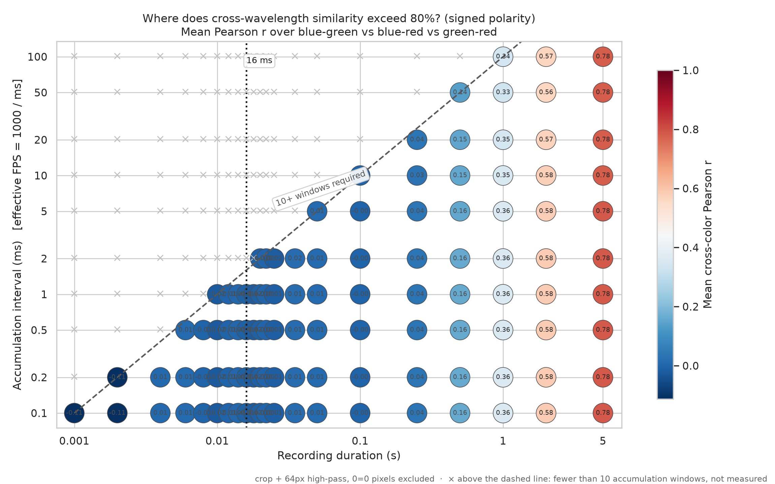
Finding 2 — signed polarity strengthens the signal at every duration
• Converged signal up: mean cross-color r 0.612 → 0.784 at 5 s (1 ms acc.); every duration ≥ 0.5 s improves
• Green–red hits 0.897: pair ordering now tracks wavelength separation (green–red > blue–red > blue–green)
• 80% threshold reached: green–red crosses 0.8 between 2 s and 5 s — the September deck's conclusion #3 ('max 0.62, 80% never reached') is falsified
• 16 ms grid line: the dotted line marks 16 × 1 ms — the paper's bin structure, now a measured column
Hypercam spectral correlation · polarity verification report · September 2026 · 5
Notes:
The improvement is expected from the paper's model: signed frames approximate the log-intensity change itself, while folded counts mix the pattern with a polarity-independent activity map. This upgrades the log-intensity claim from 'consistent with the paper' to demonstrated.

Slide 6
Finding 3 — 16 ms is the lower edge of detectability (1 ms acc.)
Duration | blue–green | blue–red | green–red
10 ms | −0.006 (ns) | −0.005 (ns) | −0.059 (ns)
12 ms | +0.003 (ns) | +0.010 (ns) | −0.033 (ns)
14 ms | +0.010 (t=+7.5) | +0.024 (ns) | −0.029 (ns)
16 ms | +0.006 (t=+4.8) | +0.017 (t=+3.3) | −0.048 (t=−11.2)
18 ms | +0.000 (ns) | +0.005 (ns) | −0.056 (t=−6.3)
25 ms | +0.004 (ns) | +0.010 (ns) | −0.054 (t=−5.6)
50 ms | +0.008 (ns) | −0.008 (ns) | +0.034 (t=+14.8)
• Holds as an edge: 16 frames × 1 ms is the first duration with reproducible positive cross-color structure (14–16 ms); 10–12 ms shows nothing
• Honest caveats: effect size r ≈ 0.006–0.024 — a hint, not usable signal; flags flicker again by 18–25 ms; the green–red flag at 16 ms is negative anti-structure
• Usable signal: needs 0.5–1 s of total averaged time (r ≥ 0.16 → 0.36)
Signed sweep, 1 ms accumulation column. ns = not significant at 95% (Student-t across replicates).
Hypercam spectral correlation · polarity verification report · September 2026 · 6
Notes:
This is the direct measurement of the claim that 16 × 1 ms is 'the very limit of discernibility'. Supported as a lower edge; state it with the effect-size caveat. The flagged rows below 50 ms reproducibly wobble around zero with both signs.

Slide 7
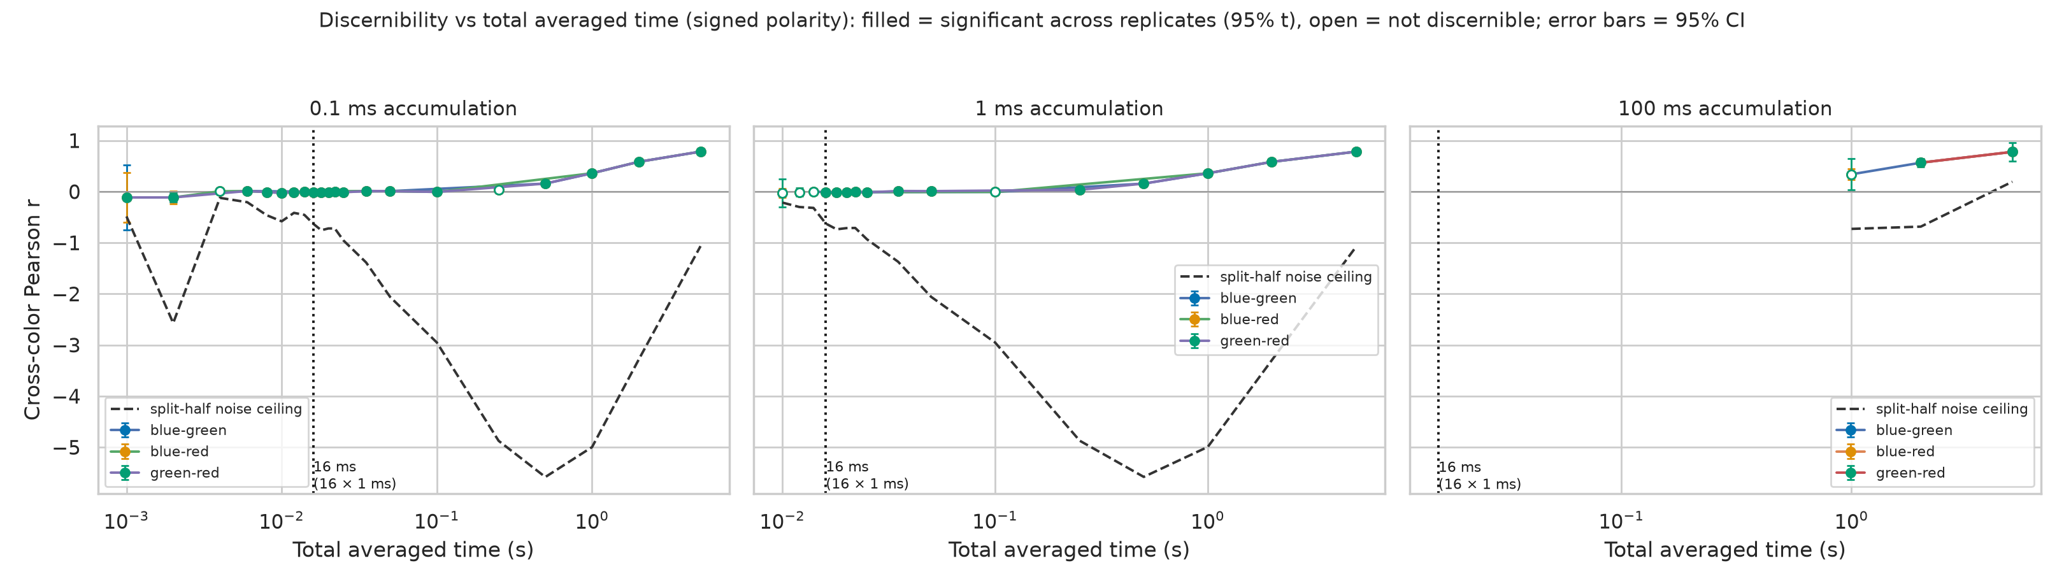
Discernibility vs total averaged time
• Panel rule: filled = significant across interleaved replicates (95% t); error bars = 95% CI; dashed = split-half noise ceiling (see open issue)
• Read: positive reproducible structure appears at the 16 ms line and grows monotonically with total averaged time, independent of accumulation interval
Hypercam spectral correlation · polarity verification report · September 2026 · 7
Notes:
The three panels are 0.1 ms, 1 ms and 100 ms accumulation — the independence of the curves' shape from accumulation interval is the visual form of 'total averaged time is what matters'.

Slide 8
Finding 4 — the accumulation-time story is reframed
5 s total, 0.1 → 100 ms acc. | ON+OFF (old) | ON−OFF (paper)
r at 0.1 ms / 100 ms | 0.614 / 0.543 | 0.785 / 0.780
Spread (relative) | 0.072 (11.6%) | 0.005 (0.65%)
Verdict | strong degradation | near-independent
• Claim 1 — strengthened: per-frame accumulation time is close to a free choice; total averaged time is the operative variable (needs ~0.5–1 s)
• Claim 2 — deflated: the strong 'signal degrades with longer accumulation' result was mostly a folding artifact; under signed polarity it is monotonic but ~20× weaker
• What the paper has not shown: still true for both — the paper never varies per-frame bin time at fixed total time
Hypercam spectral correlation · polarity verification report · September 2026 · 8
Notes:
The earlier degradation result is real under the old transform but should be attributed to the transform, not to wavelength physics. Keep the monotonicity claim, drop the magnitude.

Slide 9
Open issue — the split-half ceiling breaks under signed data
• Symptom: within-recording reliability is negative almost everywhere (blue/green/red −0.27/−0.36/−1.24 at 16 ms; worst ceiling −5.6 at 1 s), so Spearman-Brown correction is undefined and fraction-of-ceiling is meaningless (the one defined value, 3.99, is nonsense)
• Cause: interleaved odd/even windows of signed frames systematically anti-correlate (raw part-r down to ≈ −0.7) — opposite-phase windows, consistent with ON-burst/OFF-burst alternation or a display PWM/blink period commensurate with the window grid
• What still works: the replicate Student-t discernibility test and the SEM error bars — the ceiling line in the curves figure is the only casualty
Planned fix
• Contiguous split mode: first half vs second half of the windows — each half spans whole blink cycles, restoring positive part-reliability
• Sign-aware flags: report discernible-positive and discernible-negative separately, so 'first structure' and 'first shared structure' stop being conflated
Hypercam spectral correlation · polarity verification report · September 2026 · 9
Notes:
The 16 ms claim does not depend on the ceiling — it uses the t-test only. The ceiling matters for the 'are we noise-limited or signal-limited' question and for the next deck refresh.

Slide 10
Recommendations and next steps
1. Implement the ceiling fix: contiguous split mode + sign-aware discernibility flags, then re-run the signed fine sweep
2. Complete the polarity split: fine-grid runs for ON+OFF (both), ON-only, OFF-only — the comparison table above uses the old coarse grid for the old transform
3. Regenerate the main matrices signed: 500-frame results move from 0.54–0.67 to ~0.71–0.90; the stakeholder deck's conclusions #3–#5 need updating
4. Characterize the anti-phase source: A/B interleaved vs contiguous splits isolates the display PWM/blink periodicity behind the negative reliability
5. Push past the mean threshold: green–red is already ≥ 0.8; recordings ≥ 6 s should carry the mean past 0.8 too
6. Keep the operating envelope: ≥5 accumulated frames, ≥0.5–1 s total averaged time, any frame rate 10–10,000 FPS; 16 ms remains the detectability edge, not an operating point
Hypercam spectral correlation · polarity verification report · September 2026 · 10
Notes:
Order matters: the ceiling fix (1) should land before the re-runs (2) so the new sweeps carry a usable ceiling. Items 3–5 can then reuse the fixed instrument.

