Slide 1
Wavelength Pattern Correlation in EVT3 Event Streams
Separating measurement artifact from spectral signal on the LCD calibration scene
Hypercam spectral correlation · summary for stakeholders · September 2026
Notes:
Executive summary: the initial 87% green-red similarity was an artifact of shared scene geometry on the LCD target. After spatial filtering the correlation drops to 0.67. A sweep across frame rates (10 to 10,000 FPS) and recording lengths reveals that frame rate does not buy differentiation — scene time does (requiring ~1 to 2 seconds). The measurement floor is established at >=5 accumulated frames.

Slide 2
Experimental setup and data
• Sensor: Prophesee EVT3 neuromorphic event sensor (720 × 1280 resolution)
• Calibration target: Blinking circle displayed on an LCD monitor, captured one color at a time (green, red, blue)
• Data volume: 5 seconds per color; 5.3 to 7.6 million events per recording
• Activity frames: 10 ms accumulation windows, log-transformed, averaged across 500 frames per color
• Metric: Pairwise Pearson correlation coefficient (r) between spatial activity patterns
• Objective: Determine whether differing display wavelengths produce measurably distinct spatial patterns
Hypercam spectral correlation · September 2026 · 2
Notes:
The target is an LCD monitor displaying a blinking circle in pure primary colors. Event cameras respond to temporal contrast (the blink transitions). Recordings capture 5 seconds of active blinking per color.

Slide 3


Diagnosis: the 87% similarity was scene geometry
green — raw averaged activity frame
red — raw averaged activity frame
• Shared geometry: Bright circle in the same pixel location + diffuse sensor background → coarse pattern r ≈ 0.99 for all pairs
• Unshared fine detail: Interior texture correlates near r ≈ 0.0 across all color pairs
• Why blue scored lower (0.60): Silicon sensitivity is lower at blue wavelengths (~3.7× dimmer disc), softening its coarse agreement
• Takeaway: The raw 0.87 measured 'same circle in the same spot,' not optical or spectral similarity
Hypercam spectral correlation · September 2026 · 3
Notes:
Because Pearson correlation is variance-weighted, the large shared circle dominates the raw calculation. Breaking the images into spatial-frequency bands proves that the coarse envelope correlates at 0.99 while the fine interior texture correlates at zero.

Slide 4
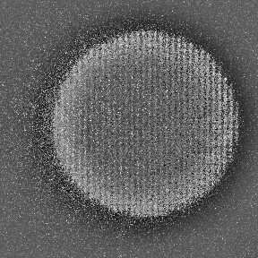
Refined analysis methodology
1. Signal cropping: Isolates the 288 × 288 px active region, removing ~91% of inactive sensor background
2. Spatial high-pass filter: Removes broad illumination envelope (>64 px), retaining mid-band spatial texture
3. Support-masked correlation: Evaluates only pixels active in either recording, preventing shared empty pixels from inflating agreement
4. Meaningful labeling: Recordings tracked by color name (green / red / blue) rather than arbitrary numeric identifiers
green after crop + high-pass filter
Hypercam spectral correlation · September 2026 · 4
Notes:
The refined methodology strips away the shared background and coarse circle envelope, leaving only the mid-band and fine texture where optical or display-specific patterns can be evaluated honestly.

Slide 5
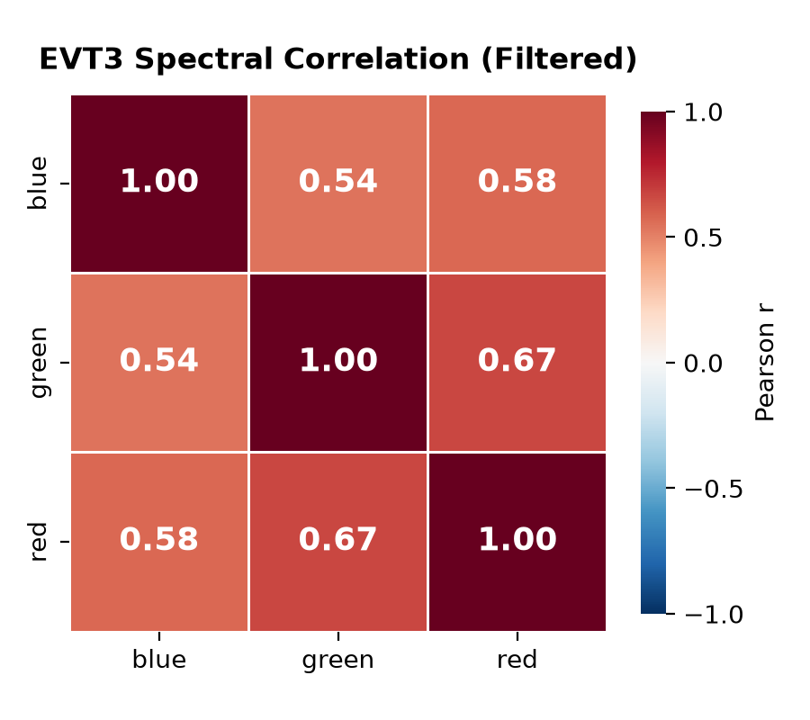
Results: before and after spatial filtering
Color pair | Raw | Filtered
green ↔ red | 0.869 | 0.669
blue ↔ green | 0.596 | 0.539
blue ↔ red | 0.620 | 0.576
Raw: full-frame. Filtered: cropped, 64 px high-pass, support-masked.
• Geometry inflation eliminated: The spurious 0.87 correlation drops to 0.67
• Blue pairs stabilize: Blue pairs show modest change (0.60 → 0.54, 0.62 → 0.58) because the high-pass removes the photometric brightness gap
• Narrower spread: All pairs now fall within 0.54 to 0.67, representing shared mid-band structure rather than scene geometry
Hypercam spectral correlation · September 2026 · 5
Notes:
Filtering flattens the correlation matrix substantially. Green-red remains the most similar pair at 0.67, which prompts the investigation into what shared structure remains.

Slide 6
Interpreting the remaining 0.67 correlation
• LCD subpixel grid: Monitors use fixed vertical subpixel stripes (R-G-B) at fixed screen coordinates. Camera blur couples this grid into a shared spatial pattern regardless of active color
• Common backlight modulation: LCD backlights use global pulse-width modulation (PWM), imposing identical temporal modulation across all displayed colors
• Broadband primary spectra: LCD color filters have broad, overlapping spectral profiles (~50–80 nm FWHM), unlike narrowband lasers or LEDs
• Setup alignment: Small centroid offsets (20–60 px) between captures reflect physical camera/monitor positioning, not wavelength dispersion
• Validated reference: Narrowband laser scans on this sensor demonstrate genuine spectral separation (e.g., 525 vs 625 nm correlates at 0.41)
Hypercam spectral correlation · September 2026 · 6
Notes:
Knowing the target is an LCD monitor clarifies the residual correlation: the physical subpixel geometry and shared backlight impose spatial and temporal structure common to all recordings. The LCD target is a functional test scene, not a narrowband calibration source.

Slide 7
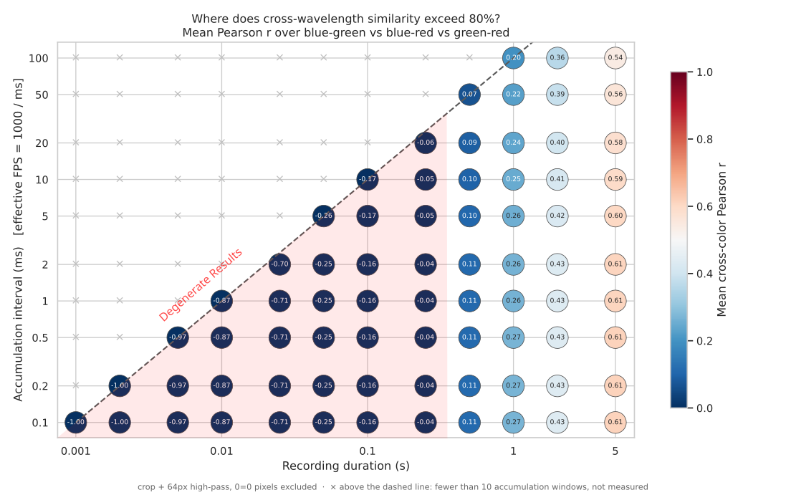
Frame rate vs recording length: what drives differentiation?
• 80% threshold is never reached: Across 120 tested combinations (10 to 10,000 FPS, 1 ms to 5 s duration), maximum correlation is 0.62
• Frame rate does not buy differentiation: At any given duration, columns from 10 FPS (100 ms) to 10,000 FPS (0.1 ms) yield nearly identical correlation values
• Scene time is what matters: Cross-color correlation requires ~1 to 2 seconds of exposure to stabilize and differentiate pairs
• Ultra-short durations (<25 ms): Frames are sparse, uncorrelated event spikes — Pearson correlation reads negative (~ −0.99) due to disjoint event patterns, not physical anticorrelation
Hypercam spectral correlation · September 2026 · 7
Notes:
Key takeaway for system design: increasing effective frame rate does not improve spectral differentiation. The event statistics require ~1 to 2 seconds of scene time to accumulate sufficient signal. High frame rates are viable without penalty, but exposure duration cannot be compressed below ~1 second for this metric.

Slide 8
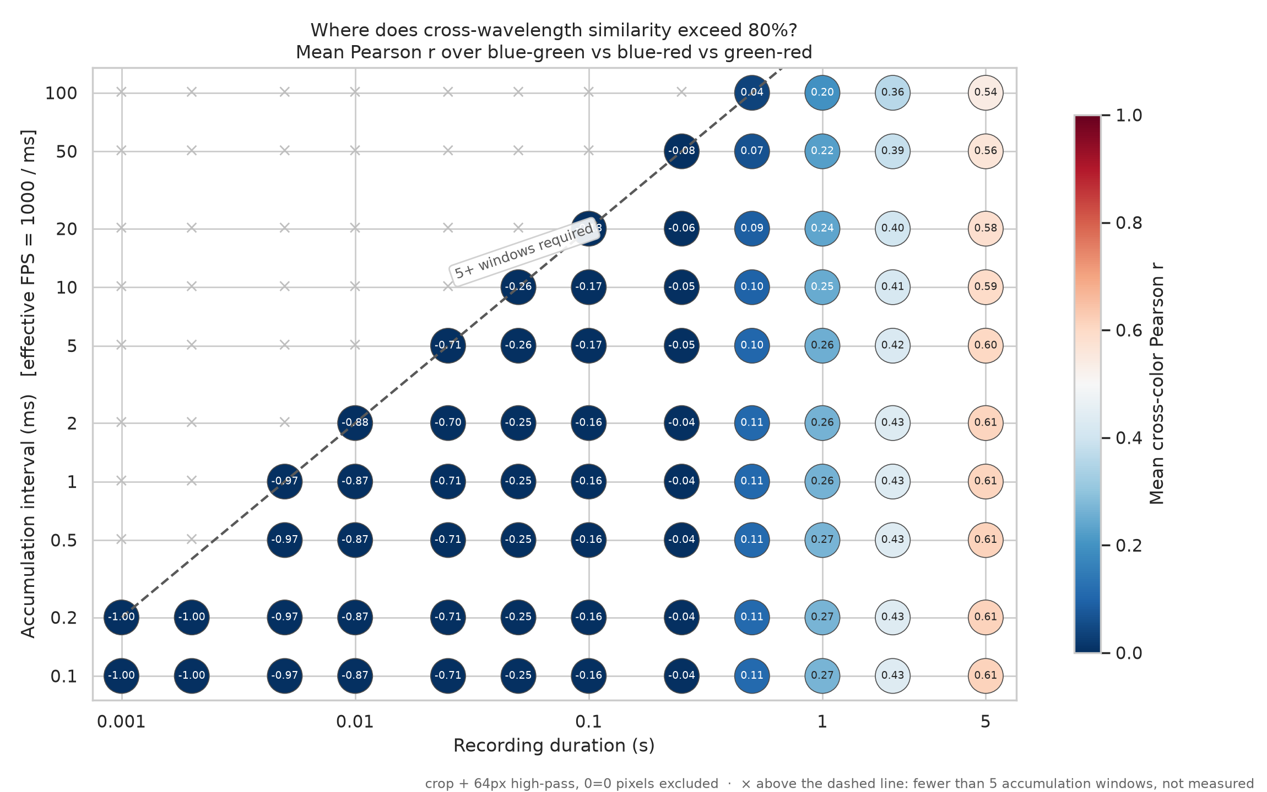
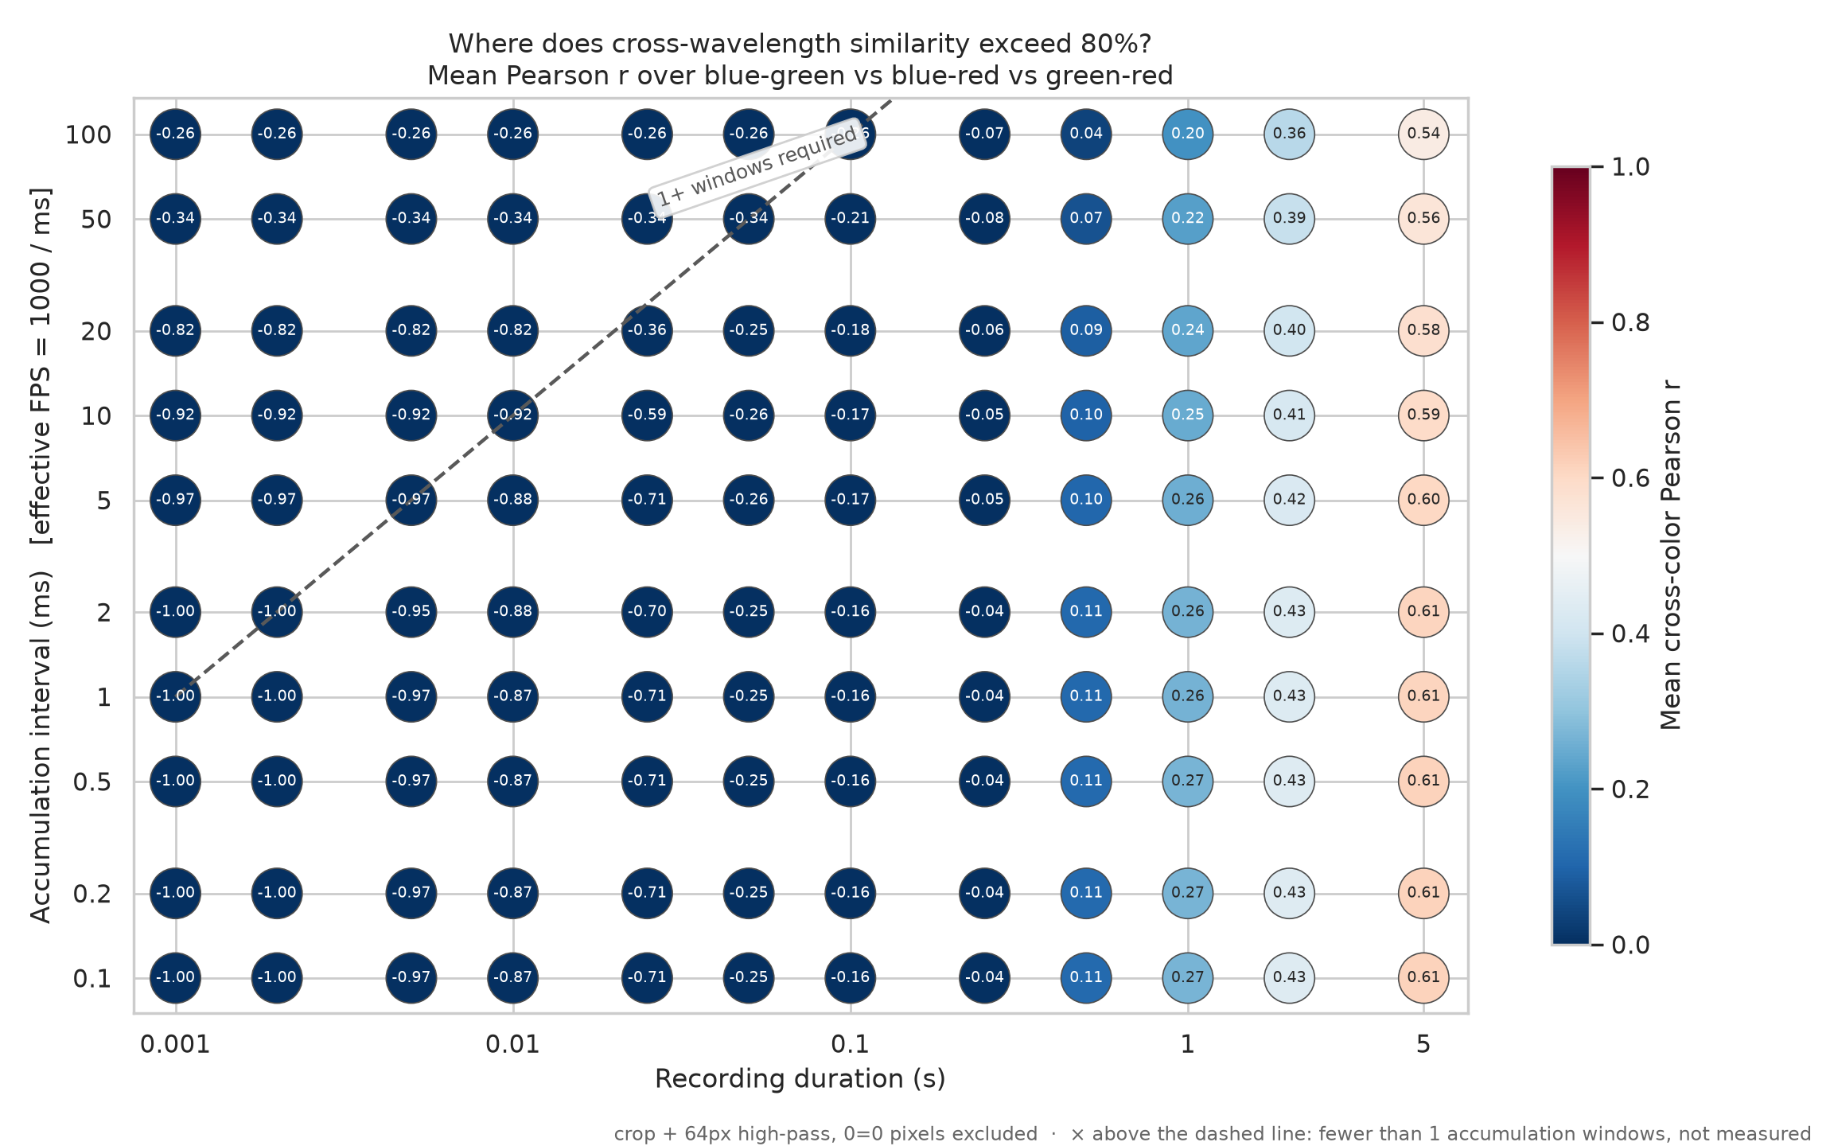
Measurement floor: how few frames can we average?
10-frame cutoff (conservative)
5-frame cutoff (operational floor)
1-frame cutoff (breakdown regime)
• 5 frames is the true empirical floor: Every 5-frame cell reproduces the converged multi-frame value within 0.08 — no loss of measurement fidelity
• 1 to 2 frames breakdown: Values deviate by up to ±0.35 from converged readings; single-frame rows become flat (correlation is set solely by accumulation interval, duration axis is meaningless)
• Operating rule: Require ≥5 accumulated frames for any measurement. Higher counts (10+) add safety margin but do not change the result
Hypercam spectral correlation · September 2026 · 8
Notes:
Quantifying the frame cutoff: 10 frames was our initial conservative setting. Testing down to 5 frames shows identical trend reproduction (within 0.08 across all cells). Testing down to 1 frame reveals severe breakdown: deviations up to 0.35 and flat rows where the duration axis loses physical meaning. 5 frames is the solid operational floor.

Slide 9
Executive Conclusions
• 1. The 87% similarity was an artifact: Full-frame correlation was dominated by scene geometry (shared circle + sensor fog), not wavelength-dependent optics
• 2. Filtered correlation is 0.67, driven by LCD hardware: Spatial filtering removes geometry; residual 0.67 is explained by the display's physical subpixel grid and shared backlight PWM
• 3. 80% cross-color similarity is never reached: Across 120 tested parameter combinations, correlation tops out at 0.62 — '80% similarity' does not occur in this optical configuration
• 4. Frame rate does not buy differentiation: 10 FPS to 10,000 FPS yield nearly identical correlation values; spectral differentiation requires ~1 to 2 seconds of scene exposure
• 5. Clear operational envelope: Valid measurements require ≥5 accumulated frames and ≥1–2 s scene time. Effective frame rate (10 to 1,000+ FPS) is an unconstrained engineering choice
Hypercam spectral correlation · September 2026 · 9
Notes:
Five definitive conclusions for project leadership: 1) Artifact diagnosed and resolved. 2) Residual correlation understood through LCD physics. 3) 80% threshold does not bind. 4) System trade-off identified: scene time matters, frame rate is flexible. 5) Concrete operational parameters established.

Slide 10
Recommendations and next steps
1. Split-half reliability control: Correlate the first and second halves of each recording against itself to establish the experimental noise ceiling
2. Exploit temporal dynamics: Use LCD pixel transition profiles (rise/fall response curves differ by color primary) rather than purely spatial pattern correlation
3. Characterize subpixel contribution: Shift target position on screen to decouple display subpixel grid from sensor pixel grid
4. Transition to narrowband targets: Use calibrated spectral sources (lasers / filtered LEDs) where optical dispersion is the primary physical mechanism
5. Adopt operating envelope: Standardize capture duration at ≥2 seconds; select frame rate based on downstream processing needs (10 to 1,000+ FPS)
Hypercam spectral correlation · September 2026 · 10
Notes:
Recommendations: 1) Measure the noise ceiling directly with split-half validation. 2) The temporal domain (transition dynamics) offers stronger color discrimination than static spatial correlation for LCD targets. 3) Narrowband sources remain the path to true spectral calibration.

