Slide 1
SAGE IV DRISM Meta-Filter
Diffractive optic: delivered design, validation, and expected camera output
Inversely designed pillar relief · 266 × 266 cells · ma-P 1275 photoresist
Validated against the proposed-work operating table (HySpec2: 200 µrad / 9.4 nm)
Richard G. Baird · Hypercam project · 27 October 2026

Slide 2
Executive Summary
• Delivered optic: an aperiodic array of 70,756 polymer pillars (266 × 266 cells, 10.35 µm pitch, 2.75 mm square), heights 0.4 – 49.5 µm, etched in ma-P 1275 photoresist. Each pillar height is an independent design parameter; the array is neither periodic nor blazed.
• Optical prescription: the DOE sits in the collimated beam; a Fourier lens (f = 55 mm, F/20, NA 0.025) turns every scene point into a wavelength-specific diffraction code on the 3296 × 2472 @ 5.5 µm reference detector.
• Validated performance: angular resolution 116 µrad and spectral resolution 5.7 nm (decorrelation half-widths) — both inside the HySpec2 requirement of 200 µrad / 9.4 nm.
• Spectral channels: all four design channels (386, 525, 600, 1020 nm at 15 nm FWHM) produce mutually uncorrelated codes (pairwise overlap ≤ 0.04), so each exposure carries independent spectral information.
• Demonstrated end-to-end: we synthesized the expected video from a real hyperspectral cube (400–700 nm, 151 bands) with the full physical model: measured material dispersion, Fraunhofer propagation, noiseless detector.
SAGE IV DRISM meta-filter · design validation report · October 2026 · 2

Slide 3
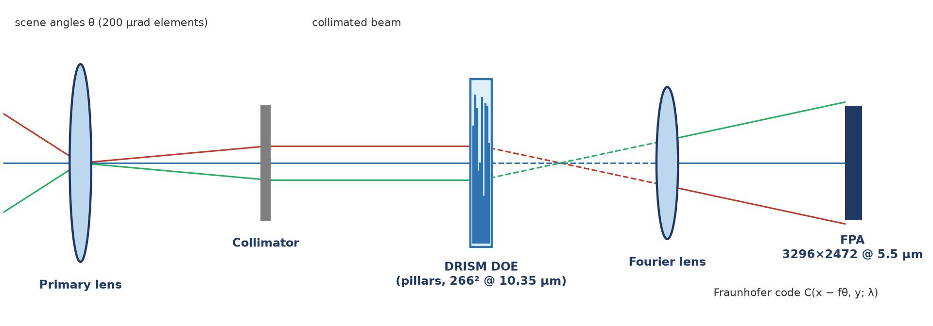
Instrument and Optical Prescription
Parameter | Value
Detector | 3296 × 2472
Pixel pitch | 5.5 µm
Field of view | 1° circular
Fourier lens f | 55 mm
Coherent width D | 2.75 mm (F/20)
Angular scale | 100 µrad / px
Speckle grain | 11 µm = 2 px
Scene footprint | 175 px
Collimated Fourier-plane layout: scene angle → plane-wave tilt at the DOE → lateral code shift f·θ on the FPA.
SAGE IV DRISM meta-filter · design validation report · October 2026 · 3

Slide 4
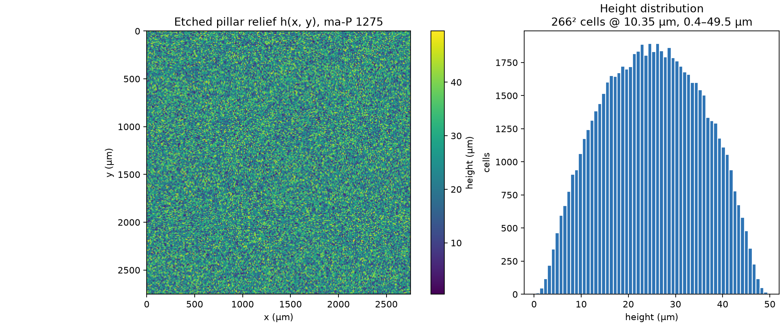
The Delivered Diffractive Optic
• 266² pillars, 10.35 µm pitch
• heights 0.4–49.5 µm (≈ 60 waves at 400 nm)
• aperiodic: one free height per cell
• ma-P 1275 relief in air; substrate transmission 1
Fabrication note: peak aspect ratio ≈ 4.8. Confirm processability (HAR resist or etch transfer) before mask release.
SAGE IV DRISM meta-filter · design validation report · October 2026 · 4

Slide 5
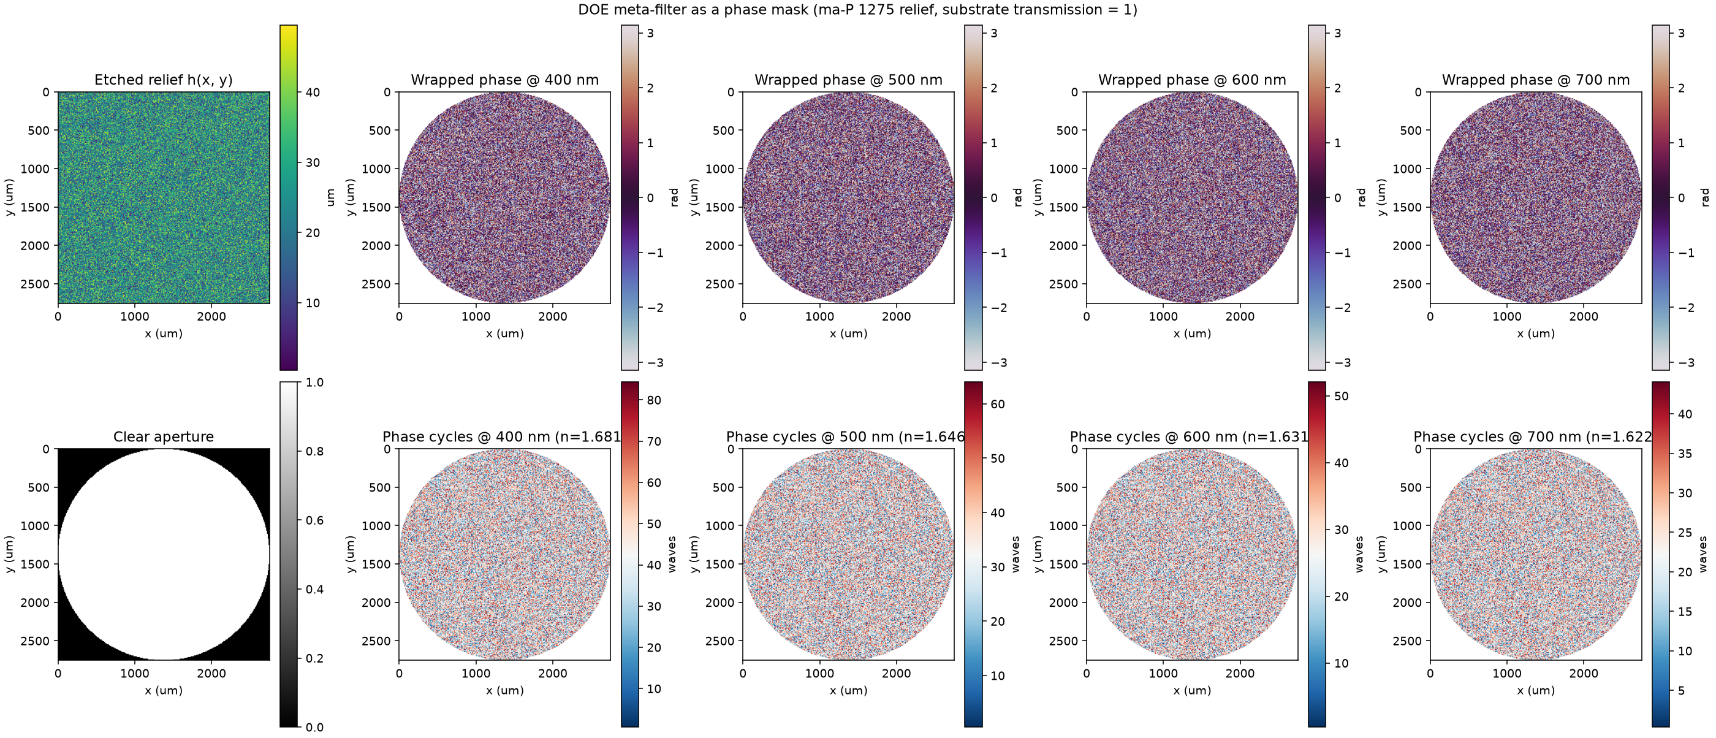
The Optic as a Phase Mask
Top: wrapped transmission phase at 400–700 nm — the fabrication-relevant view. Bottom: phase in waves. The relief reaches 80 waves at 400 nm and 40 at 700 nm; this 1/λ scaling, plus material dispersion, encodes the spectrum.
SAGE IV DRISM meta-filter · design validation report · October 2026 · 5

Slide 6
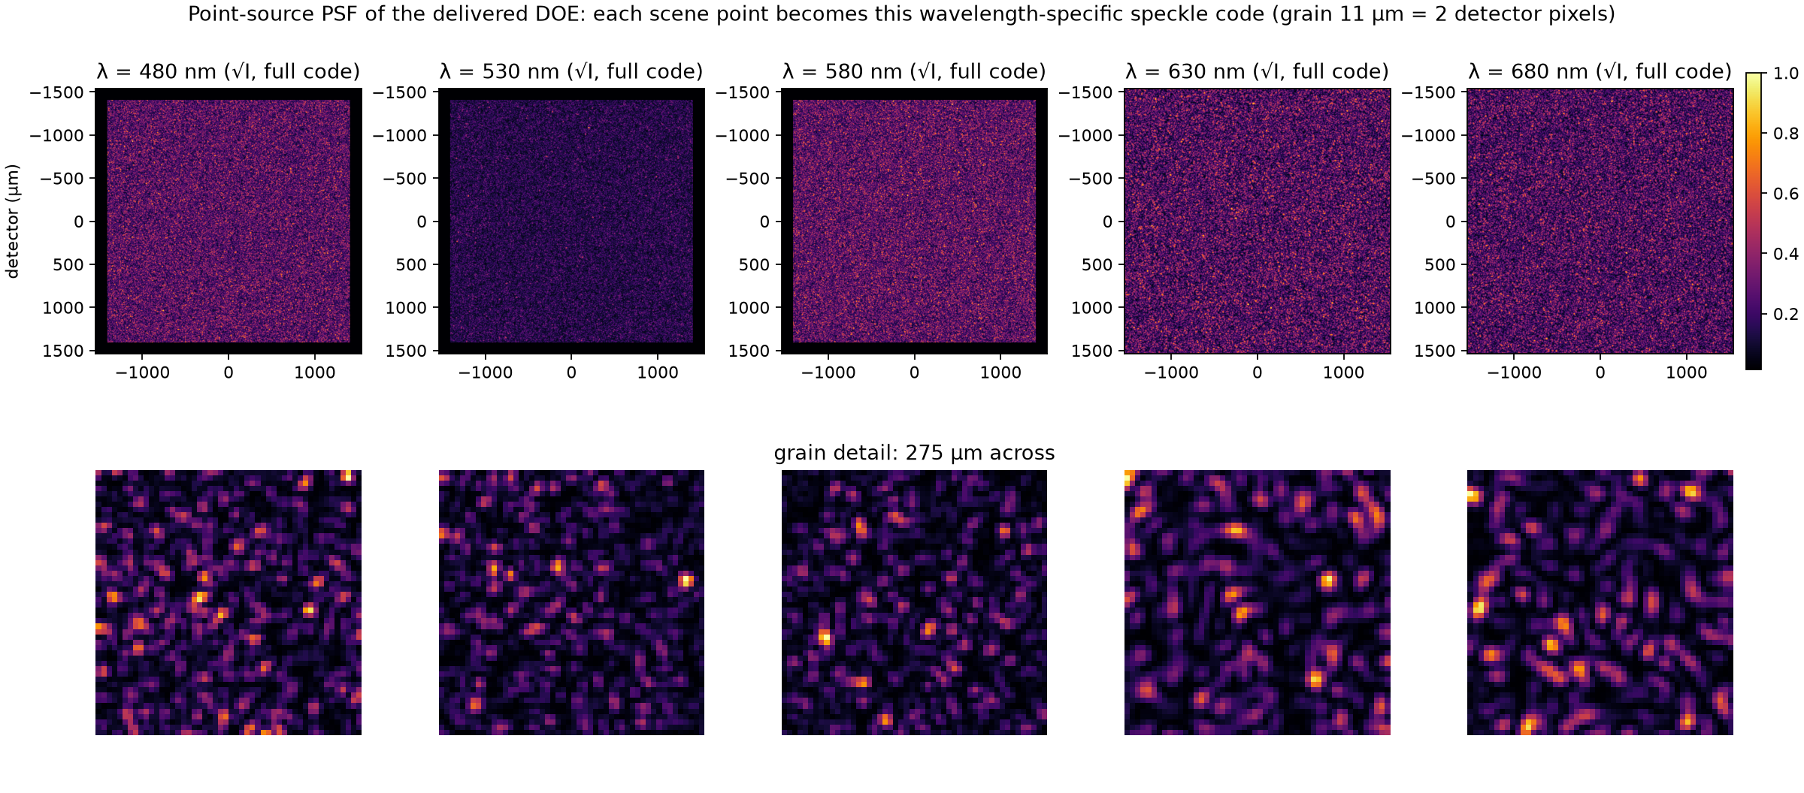
What Every Scene Point Becomes on the Sensor
Top: the point-spread code across the detector (square-root intensity — the code grows with wavelength because diffraction angles scale with λ). Bottom: 275 µm detail showing the 11 µm speckle grain. Each scene point becomes this pattern, shifted by f·θ; the layout changes completely between bands — the meta-filter's joint angular/spectral encoding.
SAGE IV DRISM meta-filter · design validation report · October 2026 · 6

Slide 7
Validation Method — What a Reconstruction Can Distinguish
• Operational criteria, not photon-limited bounds: two points are resolvable when their codes decorrelate; the same test applies to two wavelengths. These thresholds hold for any exposure and any decoder.
• Angular resolution: half-width at half-maximum of the code autocorrelation, converted through f·θ.
• Spectral resolution: code overlap versus Δλ at 400 / 550 / 700 nm.
• Pearson (mean-subtracted) overlap. Independent speckle patterns share raw intensity overlap 0.5 exactly, because speckle intensity follows negative-exponential statistics. Subtracting each mean makes identical codes score 1 and independent codes score 0, so the 0.5 threshold means what it should.
• Envelope normalization. Every code carries the same smooth aperture envelope, which is deterministic and carries no information. We measure overlap on the speckle that remains after subtracting each code's blurred envelope.
• Channel check: band-integrated codes for the four design channels (Gaussian FWHM 15 nm) must all decorrelate.
SAGE IV DRISM meta-filter · design validation report · October 2026 · 7

Slide 8
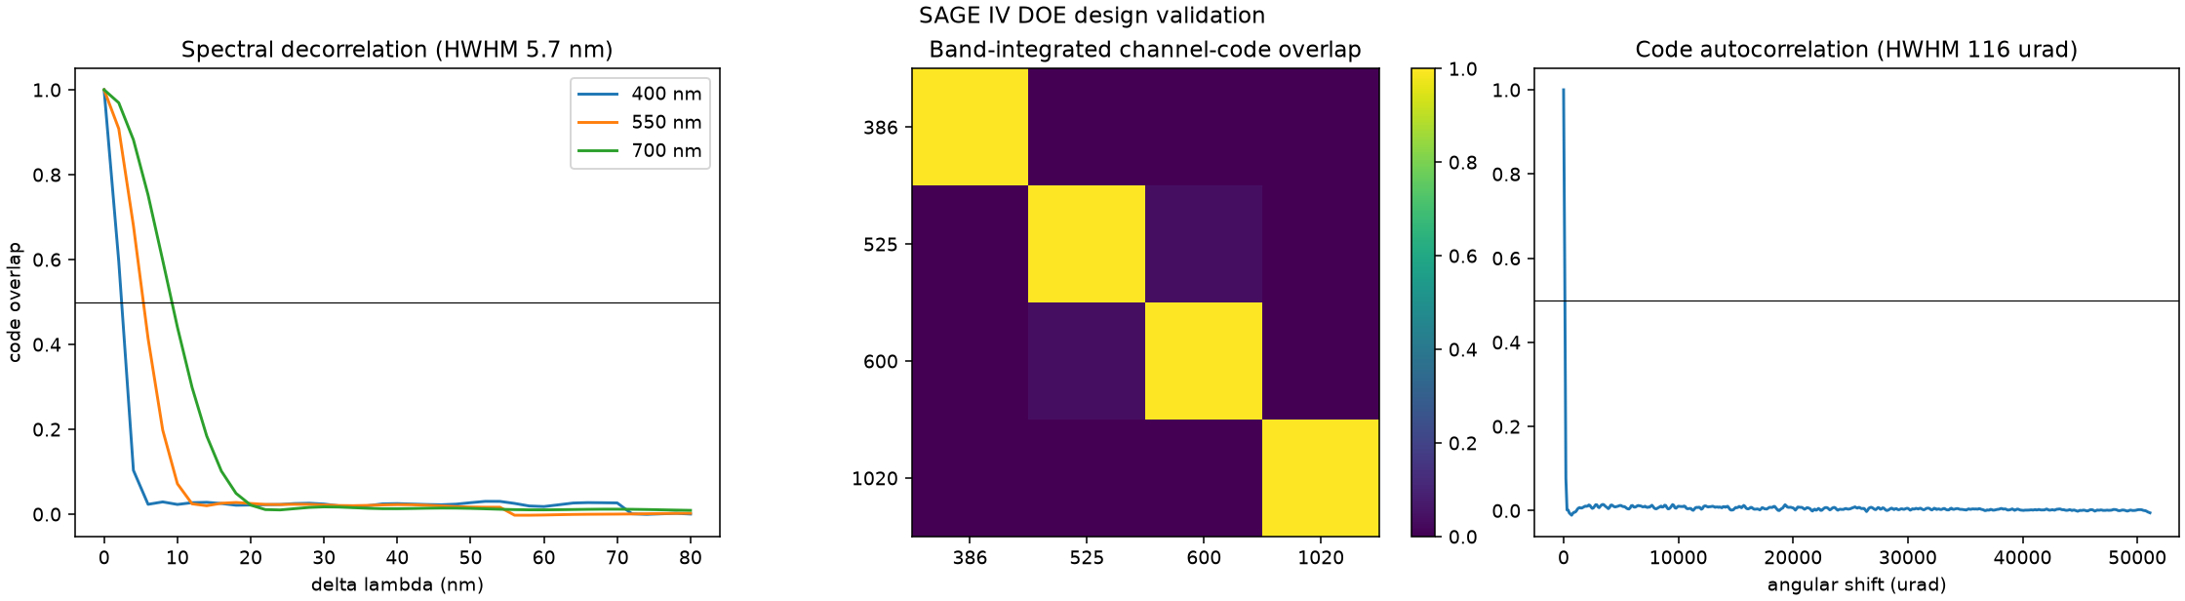
Validation Results — HySpec2 Requirement Met
Metric | Measured | HySpec2 spec | Verdict
Angular resolution (HWHM) | 116 µrad | ≤ 200 µrad | PASS
Spectral resolution (half-width) | 5.7 nm | ≤ 9.4 nm | PASS
Closest channel pair (525/600 nm) | 0.037 | < 0.5 | PASS
SAGE IV DRISM meta-filter · design validation report · October 2026 · 8

Slide 9
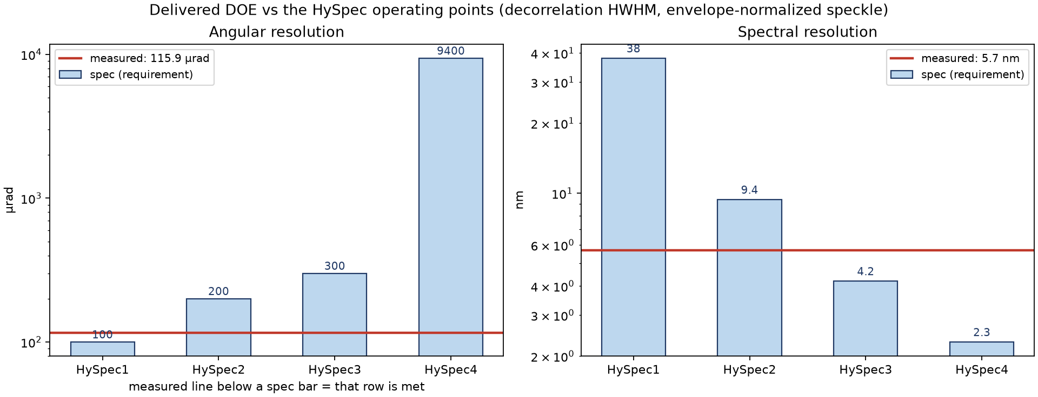
Scorecard Against the Proposed Operating Table
• HySpec2 (200 µrad / 9.4 nm): MET on both axes.
• HySpec3 (300 µrad / 4.2 nm): angular met with 2.6× margin; spectral 5.7 vs 4.2 nm — reachable with a ~70 µm height budget.
• HySpec1 (100 µrad / 38 nm): spectral met with margin; angular needs a 5.5 mm coherent window (larger optic).
• HySpec4 (9400 µrad / 2.3 nm): spectral-limited; requires the taller relief as well.
SAGE IV DRISM meta-filter · design validation report · October 2026 · 9

Slide 10
Deliverables and Reproduction
• Optic definition: data/nasa/profile_v2.mat — 266² heights (m), cell pitch, 2.753 mm aperture, f = 55 mm, F/20 metadata.
• Validation report: results/doe_synthetic_v2/validation/ (validation.png, validation.json) — reproduce with: synthesize_doe_video.py --validate --profile data/nasa/profile_v2.mat
• Expected video: results/doe_synthetic_v2/running-frog/running-frog_doe.mp4 (151 bands, 400–700 nm, 11 frames) — reproduce with: synthesize_doe_video.py --clip running-frog --profile data/nasa/profile_v2.mat
• Forward model & renderer: src/scripts/synthesize_doe_video.py — Fraunhofer code stack, band-integrated exposure, design tables built in.
• Design pipeline: src/notebooks/coded_mask_drism.py — pillar parameterization, CRLB + channel-overlap objective (TOML-configurable for CHPC batches).
• Material data: data/nasa/mat_maP1275.xlsx — measured n(λ), k(λ); k < 0.002 across 400–700 nm justifies the lossless-substrate assumption.
SAGE IV DRISM meta-filter · design validation report · October 2026 · 11

Slide 11
Summary and Next Steps
• Delivered and validated: the pillar-relief DRISM meta-filter meets the HySpec2 operating point (116 µrad / 5.7 nm measured vs 200 µrad / 9.4 nm required) with all four spectral channels decorrelated (≤ 0.04).
• Fabrication: confirm the 4.8 aspect-ratio pillar array in ma-P 1275 (or transfer to a harder resist / fused-silica etch) before mask release.
• Reconstruction: a decoder demultiplexes the coded exposures; the validated overlap metrics bound the achievable (x, y, λ) precision and set the decoder's design target.
• Upgrade path: a ~70 µm height budget (same optics, retrain) reaches the HySpec3 column (300 µrad / 4.2 nm); a 5.5 mm coherent window reaches HySpec1.
SAGE IV DRISM meta-filter · design validation report · October 2026 · 12

