Slide 1
Spatio-Temporal Databases

Slide 2
Outline
Spatial Databases
Temporal Databases
Spatio-temporal Databases
Multimedia Databases
…..

Slide 3
Introduction
Spatio-temporal Databases: manage spatial data whose geometry changes over time
Geometry: position and/or extent
Global change data: climate or land cover changes
Transportation: cars, airplanes
Animated movies/video DBs

Slide 4
ST DBs
A special Temporal Database
  All the features of temporal database
  Attributes can be spatial also
Extension of Spatial Databases
  Objects change instead of being static
  At any timestamp it is a conventional Spatial Database
New Database type

Slide 5
Requirements
Efficient Representation of Space and Time
Data Models
Query Languages
Query processing and Indexing
GUI for spatio-temporal datasets

Slide 6
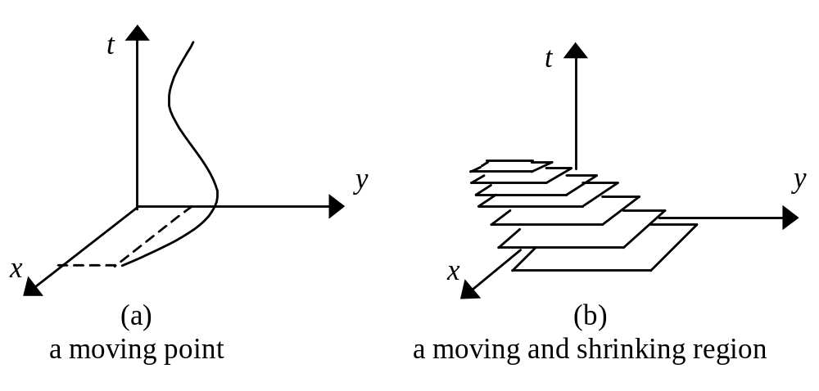
Spatio-temporal Objects

Slide 7
ST Queries
Selection Queries: “find all objects contained in a given area Q at a given time t”
NN queries: “find which object became the closest to a given point s during time interval T,”
Aggregate queries: “find how many objects passed through area Q during time interval T,” or, “find the fastest object that will pass through area Q in the next 5 minutes from now”

Slide 8
ST Queries
join queries: “given two spatiotemporal relations R1 and R2, find pairs of objects whose extents intersected during the time interval T,” or “find pairs of planes that will come closer than 1 mile in the next 5 minutes”
similarity queries: “find objects that moved similarly to the movement of a given object o over an interval T”

Slide 9
SP Data Types
Moving Points
  Extent does not matter
  Each object is modeled as a point (moving vehicles in a GIS based transportation system)
Moving regions
  Extent matters!
  Each object is represented by an MBR, the MBR can change as the object move (airplanes, storm,…)

Slide 10
SP Data Types
Different Type of changes:
  Changes are applied discretely
    Urban planning: appearance or dis-appearance of buildings
  Changes are applied continuously
    Moving objects (eg. Vehicles)

Slide 11
Trajectories
Moving objects create trajectories
Usually we can sample the positions of the objects at periodic time intervals Δt
Linear Interpolation:easy and usually accurate enough
Trajectory: a sequence of 2 or 3-dim locations

Slide 12
Temporal Environment
Transaction or Valid time: (usually we assume transaction time)
Two types of environments:
  Predicting the future positions: Each object has a velocity vector. The DB can predict the location at any time t>t_{now} assuming linear movement. Queries refer to the future
  Storing the history. Queries refer to the past states of the spatial database

Slide 13
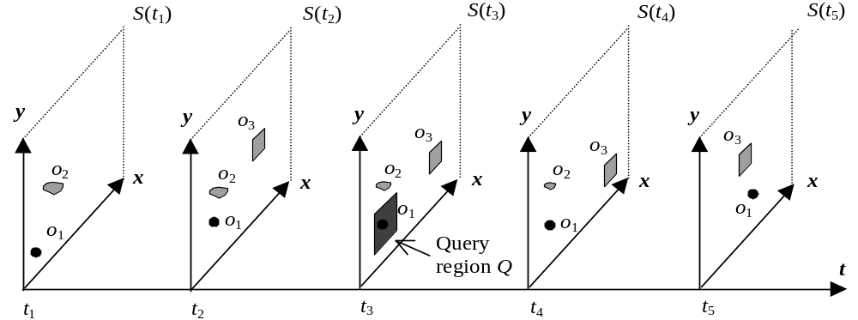
The Historical Environment
Spatio-temporal Evolution

Slide 14
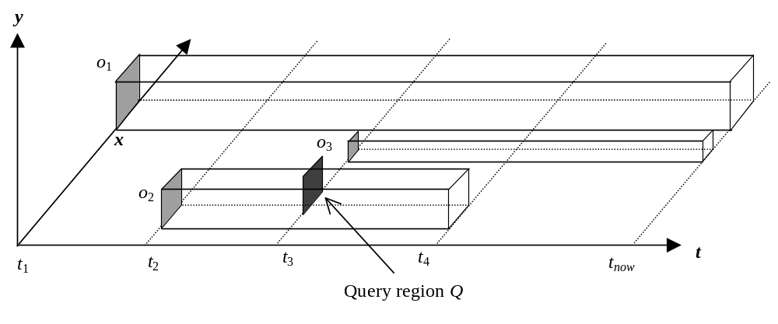
Indexing using R-trees
Assume that time is another dimension, use a 3D R-tree
Store the objects as their 3D MBR. How to compute that?

Slide 15
Problems of 3D R-tree
How to store “now”? Use a large value…
Common ending problem
Long lived objects will have very long MBRs, difficult to cluster
Extensive overlap and empty space → bad query performance for specific queries
Also, works only for discrete changes

Slide 16
PPR-tree
Better idea, partially persistent R-tree
Two approaches: Multiversion and overlapping
Multi-version: use the idea of the MVBT applied to R-tree.

Slide 17
Indexing Moving Objects
The problem of indexing any type of moving objects can be reduced to indexing discrete rectangles.
Discrete rectangles
Continuous points
Continuous rectangles
time
t
y
x

Slide 18
Historical R-trees (HR-trees)
An R-tree is maintained for each timestamp in history.
Trees at consecutive timestamps may share branches to save space.
o₃
o₄
timestamp 1
o₁
o₆
p₂
o₅
p₁
o₂
p₃
o₇
timestamp 1
p₁
p₂
p₃
o₁
o₂
o₃
o₄
o₅
o₆
o₇

Slide 19
Historical R-trees
An R-tree is maintained for each timestamp in history.
Trees at consecutive timestamps may share branches to save space.
o₃
o₄
timestamp 2
o₁
o₆
p₂’
o₅’
p₁
o₂
p₃’
o₇
timestamp 1
p₁
p₂
p₃
timestamp 2
p₁
p₂’
p₃’
o₁
o₂
o₃
o₄
o₅
o₆
o₇
o₃
o₄
o₃
o₄
o₅’

Slide 20
HR-trees: Pros and Cons
HR-trees answer timestamp queries very efficiently.
  A timestamp query degenerates into a spatial window query handled by the corresponding R-tree at the query timestamp.
Not quite efficient:
  Expensive space consumption.
  A node needs to be duplicated even when only one object moves.
  Interval query processing is inefficient.
  Although redundancy (from duplication) is necessary to maintain good timestamp query performance, it is excessive in HR-trees.

Slide 21
MVR-tree or PPR-Tree
Consider a 2D R-tree that evolves over time
Use the Multiversion B-tree approach to store the evolution of the tree…
Need to consider some “spatial” issues:
  No unique siblings, split methods, copies due to time split
To insert a new object, compute a bounding box that encloses the object at all time instants, insert this bb as MBR

Slide 22
PPR-Tree
An update or a query at some time instant t searches only among the spatial objects that are alive at t
Space is linear to the number of updates, the problem of “now” is avoided
Very efficient for snapshot or small interval queries

Slide 23
An improvement: The MV3R-tree
[Tao & Papadias 01]
The MV3R-tree consists of a multi-version R-tree (MVR-tree) and an auxiliary 3D R-tree built on the leaves of the MVR-tree.
The MVR-tree is optimized from the original multi-version framework, taking into account spatial properties.

Slide 24
The Multi-Version Framework: Version Copy
One important feature of multi-version framework is the utilization of version copies to handle node overflows.
R₁
p₁, [1,*), A
p₂, [1,*), B
insert o₈, [3,*), and node B overflows
p₃’, [1,*), C
A
B
C
o₁, [1,*)
o₃, [1,*)
o₆, [1,*)
o₂, [1,*)
o₄, [1,*)
o₇, [1,*)
o₅, [1,2)
o₅’, [2,*)

Slide 25
3D Visualization of Version Copy
Bounding boxes of the two nodes involved in version copy.
o₆
These two objects have copies in two nodes respectively.
Long bounding boxes are truncated naturally by introducing redundancy.
o₄
o₅
o₃

Slide 26
Redundancy in MVR-trees
As with HR-trees, multi-version structures also aim at optimizing timestamp queries.
  To achieve this goal, the original multi-version framework still leads to considerable redundancy, though much less than HR-trees.
Excessive redundancy is harmful.
  Space consumption is increased.
  Compromise interval query performance, as multiple copies of the same object need to be retrieved.

Slide 27
Optimizing MVR-trees: Reducing Redundancy
There are some heuristics to reduce data redundancy in MVR-trees in order to lower the space consumption and improve interval query performance.
  Insertion
    General Key Split
    Insert in node after reinserting one of the entries
    Insert in another node
    Version split
The resulting trees contain much less redundancy
  Lower tree sizes and accelerate interval queries.
  Timestamp queries are only slightly compromised.

Slide 28
Interval Query with Multi-Version Structures
Need to search several logical trees responsible for the queried timestamps.
Since multiple parent entries may point to the same child node, it is imperative to avoid duplicate accesses to the child.
  If a node is re-visited, the entire subtree rooted at the node needs to be re-visited.
Solution? Keep a hash table, other solutions exist also.

Slide 29
Building a 3D R-tree on the Leaves of the MVR-tree
Build a 3D R-tree on the leaf nodes of the MVR-tree
The size of the 3D R-tree is much smaller than a complete 3D R-tree as the number of leaf nodes is significantly lower than the number of actual objects.
Since the 3D R-tree is not an acylic graph but a tree, we do not have duplicate visit problem.
Long interval queries are processed with the auxiliary 3D R-trees.

Slide 30
What about moving objects?
Problem: the MBR representation creates large empty space
Use artificial deletes, approximate the object using many small MBRs
But then, the space is increased
Use an algorithm to distribute a small number of splits to the objects that need them most

Slide 31
What about moving objects?
If objects move with linear functions of time:
Minimize total volume by splitting in equidistant points
Given K splits you can decide the best splits in O(KlogN) time.
Reference:
[Tao & Papadias 01]:MV3R-Tree: A Spatio-Temporal Access Method for Timestamp and Interval Queries. VLDB 2001: 431-440

