Slide 1
DEEP
REINFORCEMENT
LEARNING
A Survey on
Zero-Sum Games

Slide 2
OUTLINE
01
02
03
INTRODUCTION
ALGORITHMS
TESTS
Problem formulation and Deep Reinforcement Learning Taxonomy
Dueling Double Deep Q-Network,
Soft Actor-Critic and AlphaGo Zero
TicTacToe,
Connect Four and Santorini

Slide 3
REINFORCEMENT LEARNING
AGENT
STATE
REWARD
ACTION
ENVIRONMENT

Slide 4
TAXONOMY
RL Algorithms
Model Free RL
Model Based RL
Policy Optimization
Value Optimization
Model Learnt
Model Given
PPO
SAC
DQN
I2A
AlphaGo

Slide 5



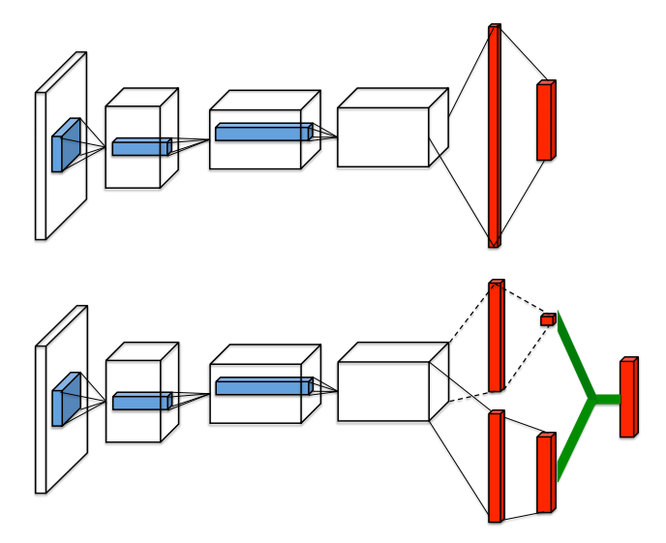



DDDQN
Prioritized Experience Replay Buffer
Main features:
Bellman Optimality Equation
Model Free
Value Based
Off-Policy
Q-Learning
2 Q-Networks
Loss
Loss Double
Dueling Architecture
Double Q-Learning
Prioritized Experience
Replay Buffer
Dueling Architecture

Slide 6






SAC
Objective Function
Main features:
Critic Loss
Model Free
Policy Based
Off-Policy
Actor-Critic
1 Actor Network
4 Critic Networks
Entropy Maximization
Actor Loss
ENTROPY
ACTOR-CRITIC
REPARAM-TRICK
DISCRETE

Slide 7


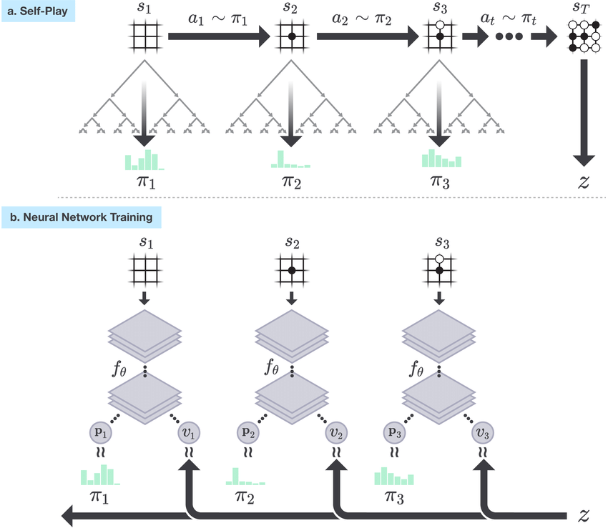
ALPHAGO ZERO
Exponentiated Visit Count
PUCT Algorithm
Main features:
Loss
Model Based
Model Given
Self-Play
Asynchronous Algorithm
Parallel Execution
MCTS
1 Network (Policy and Value)
Simil-Attention Mechanism
Algorithm
Residual Block
X
f(X)+X
Convolution Block
Convolution Block
X
f(X)
SINGLE NETWORK (+ LOSS)
ALGORITHM
-SELFPLAY
-TRAINING
-EVALUATION
COMPUTATION REQUIRED

Slide 8

ENVIRONMENTS
Zero-Sum Games
Game Metrics
Game | Branching Factor | Game Average Length | State-Space Complexity (log10) | Game-Tree Complexity (log10)
TicTacToe | 4 | 9 | 3 | 5
Connect Four | 4 | 36 | 13 | 21
Santorini | 60 | 25 | 21 | 44
ZERO SUM GAMES (DEFINIZIONE + METRICHE)
GYM API
INTRODUZIONE ENVS COMPLEXITY

Slide 9
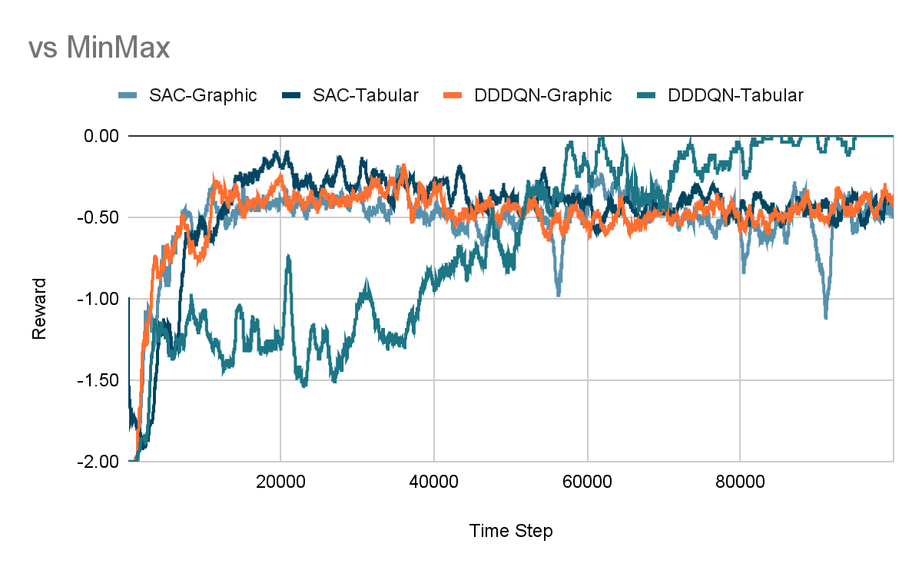
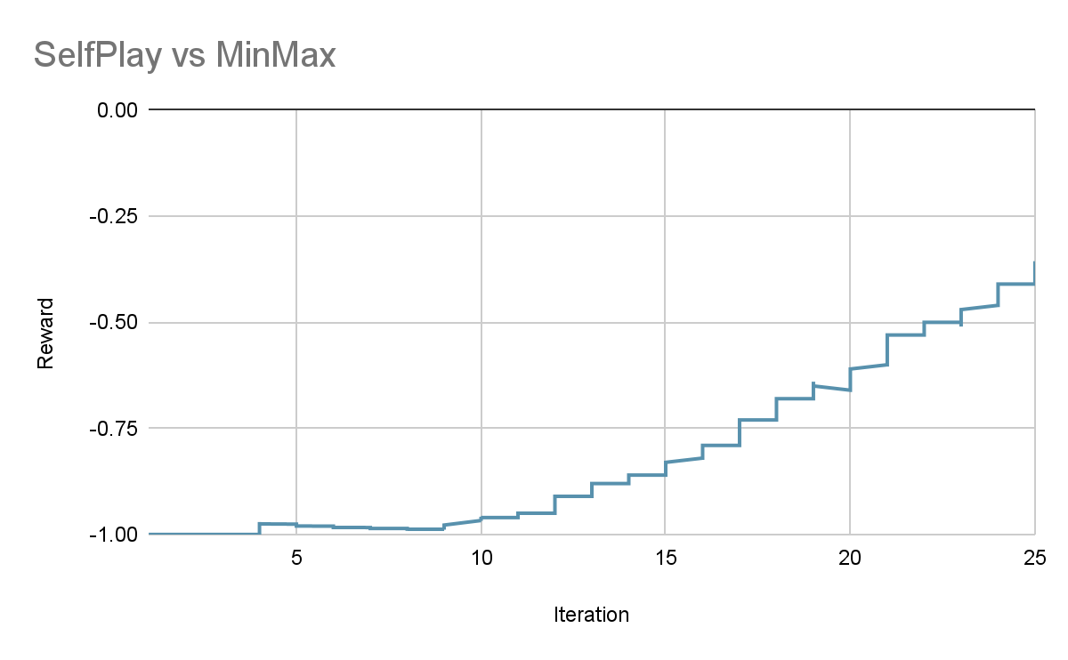
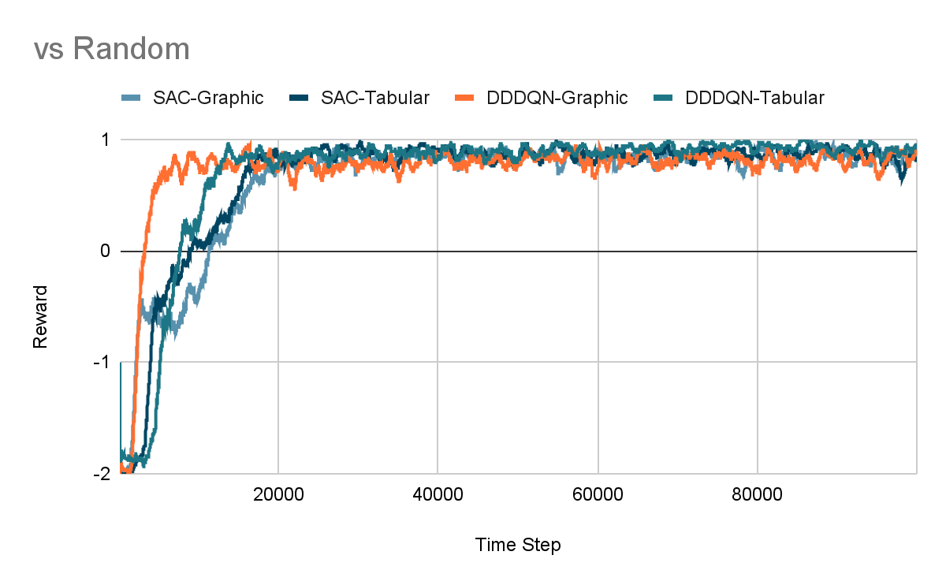
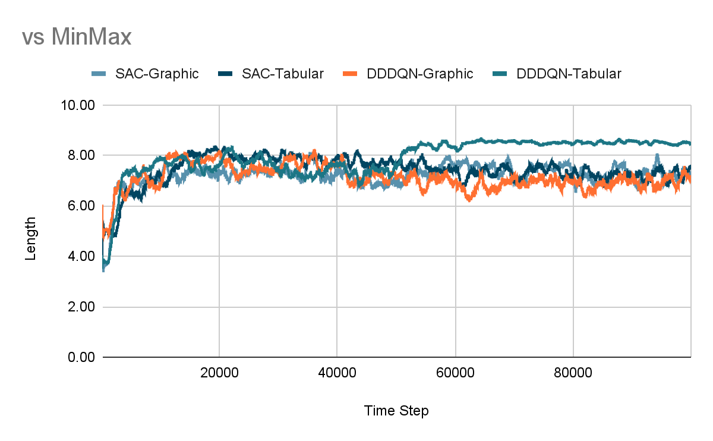
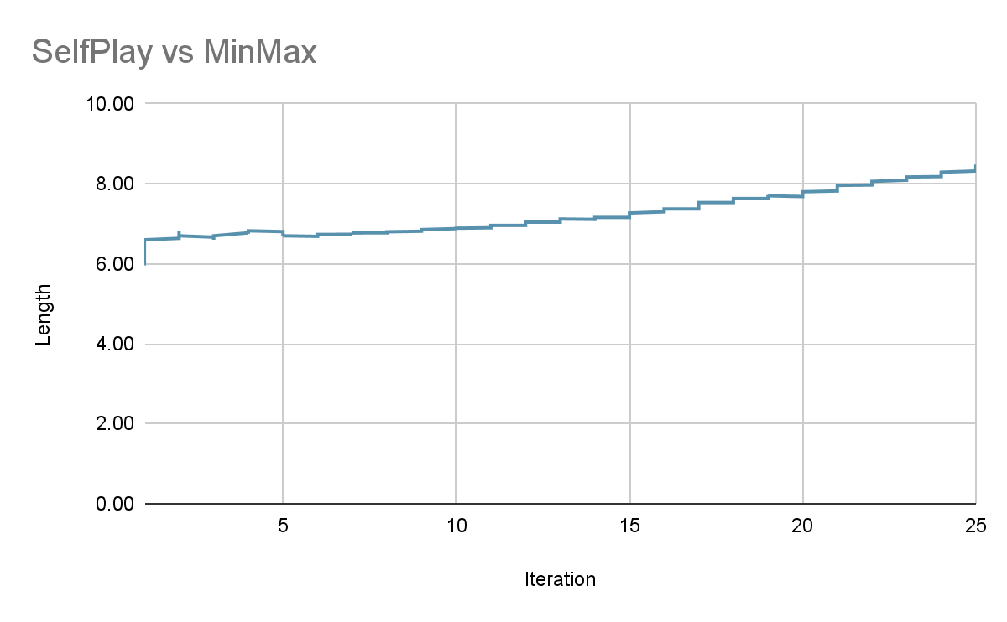

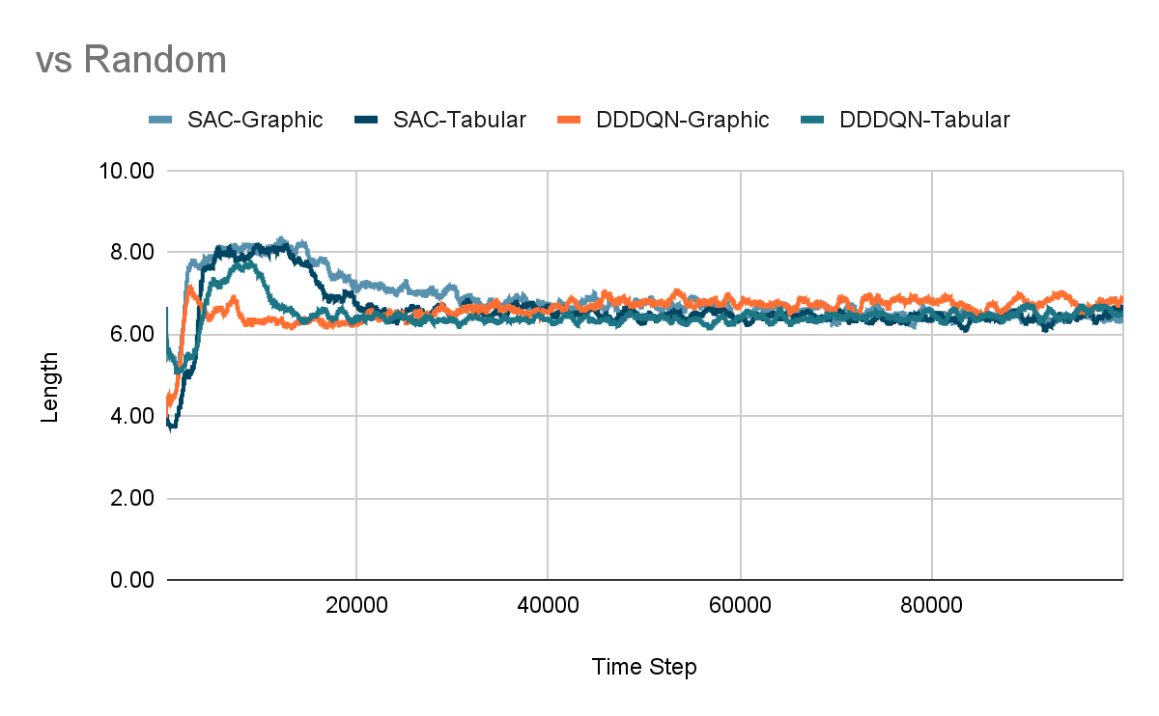

TICTACTOE
Game Step
Results
Action (6)
Reward (0)
Initial State
(3x3x1
or
96x96)
Final State
(3x3x1
or
96x96)
DESCRIZIONE
STATE SPACE (2 RAPPRESENTAZIONI)
ACTION SPACE (MAPPING)
REWARD FUNCTION
COMMENTO DEI RISULTATI

Slide 10
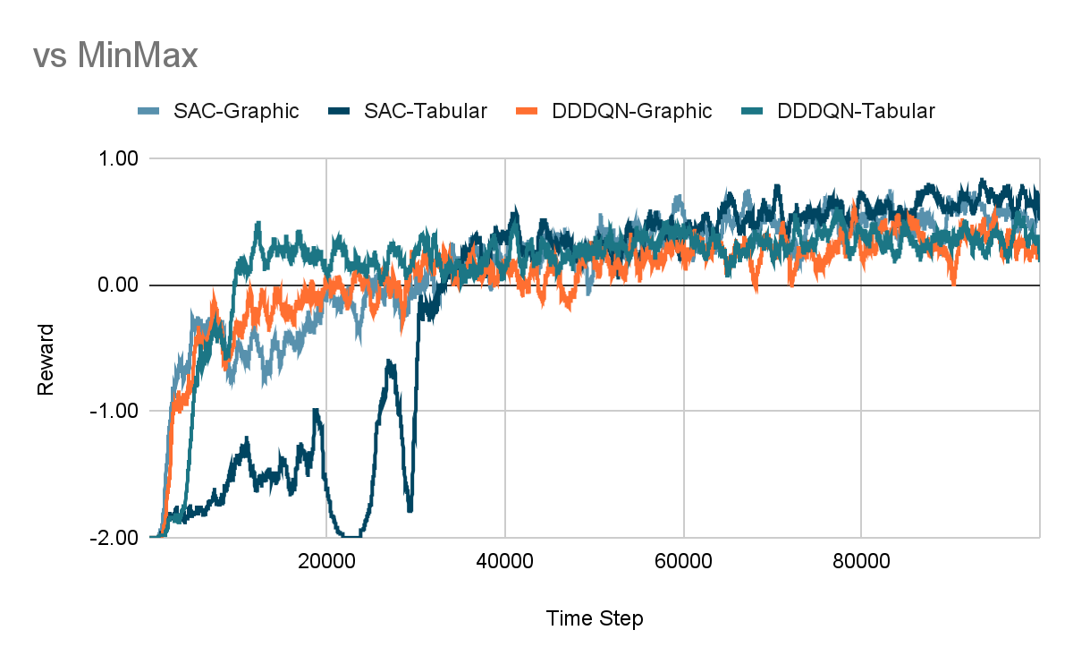
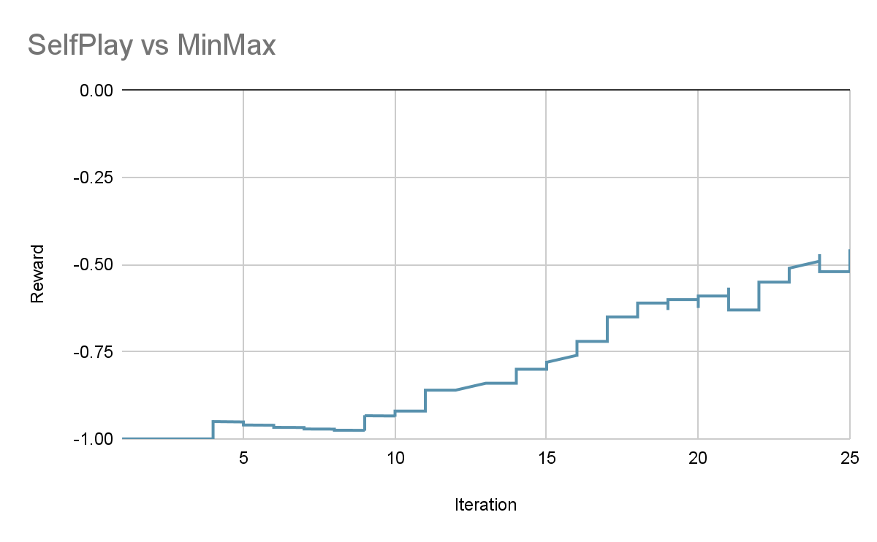
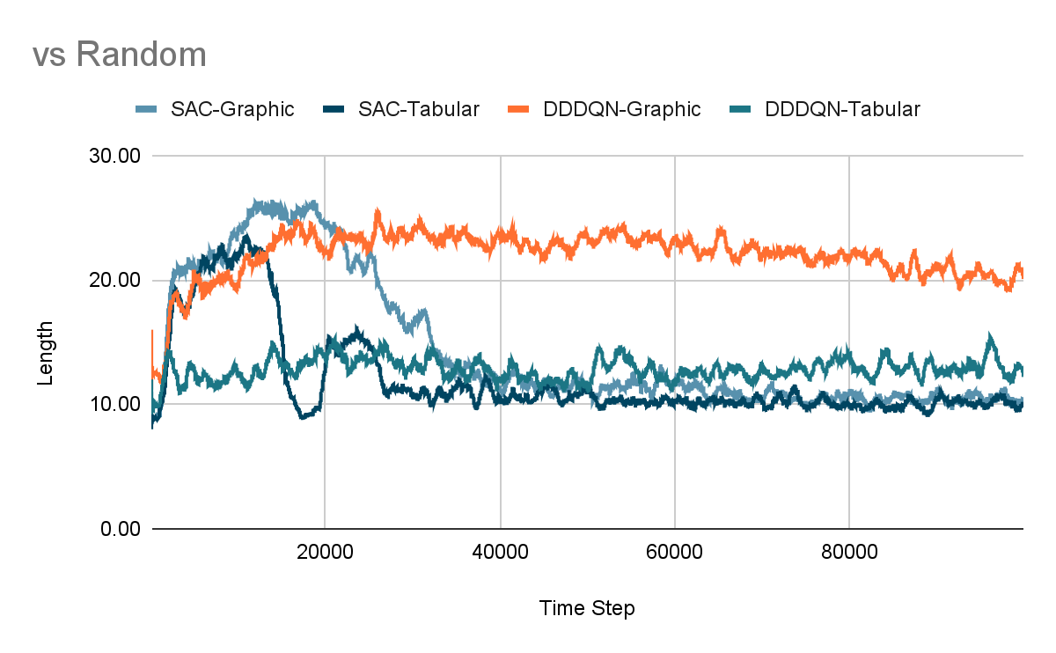
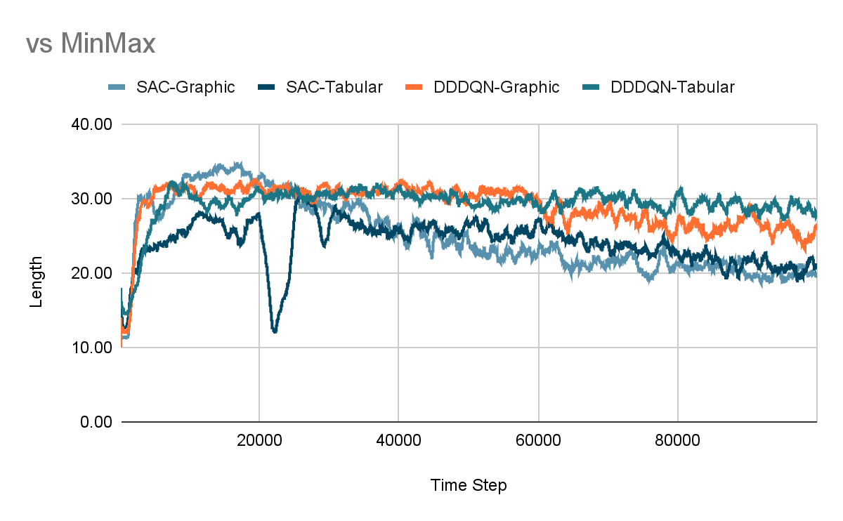
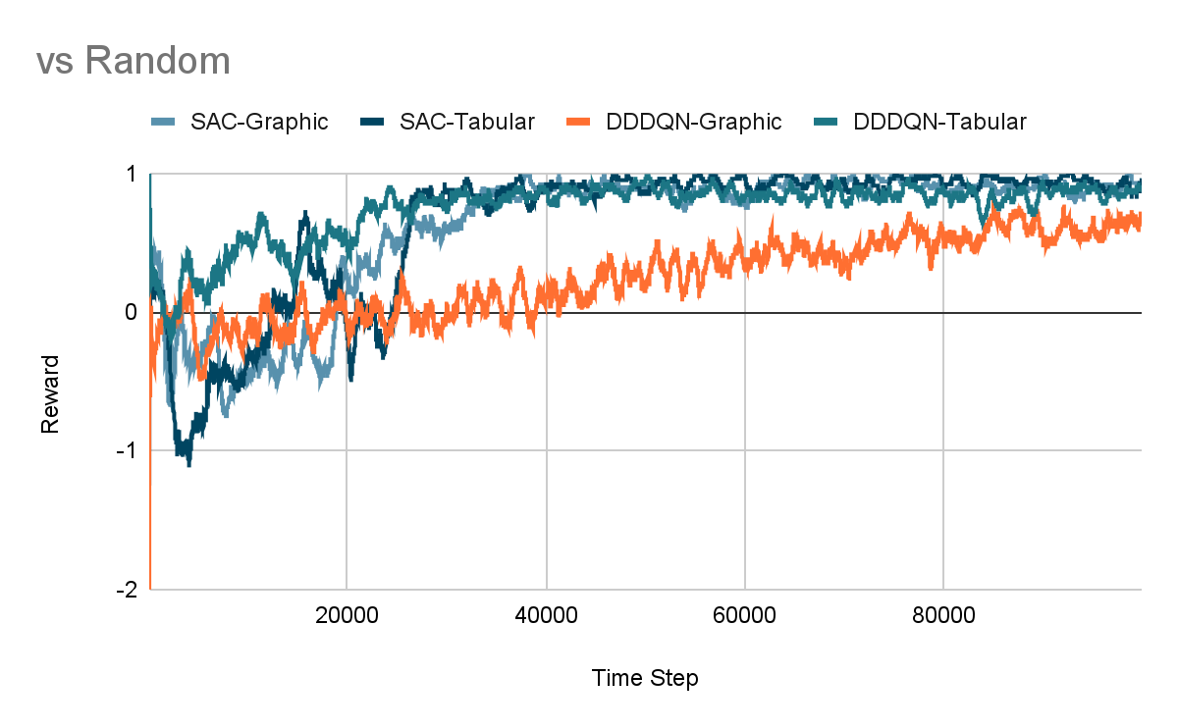
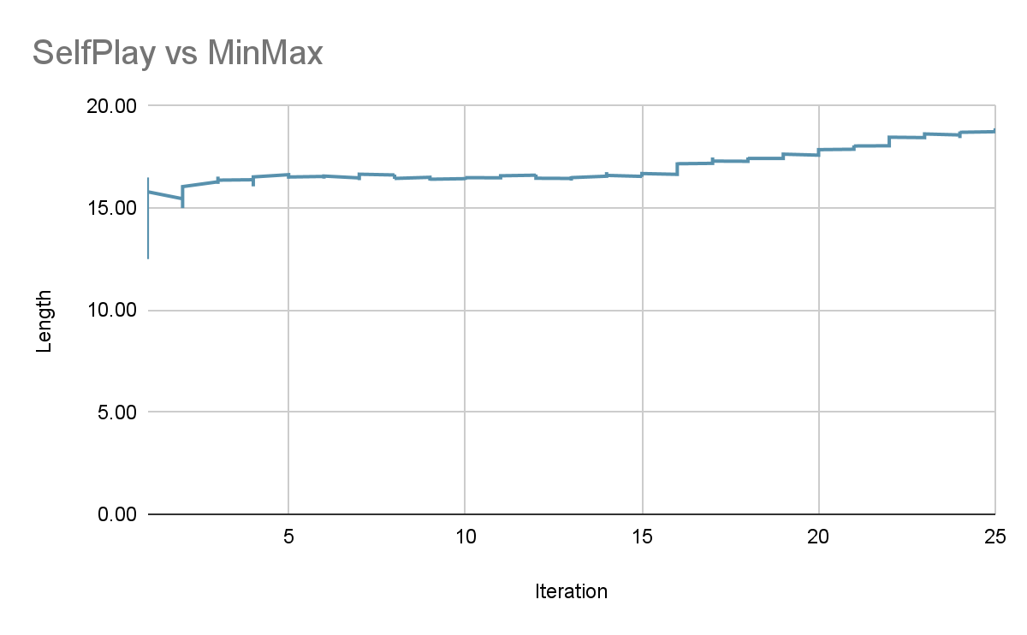


CONNECT FOUR
Game Step
Results
Action (6)
Reward (1)
Initial State
(6x7x1
or
192x224)
Final State
(6x7x1
or
192x224)
DESCRIZIONE
STATE SPACE (2 RAPPRESENTAZIONI)
ACTION SPACE (MAPPING)
REWARD FUNCTION
COMMENTO DEI RISULTATI

Slide 11
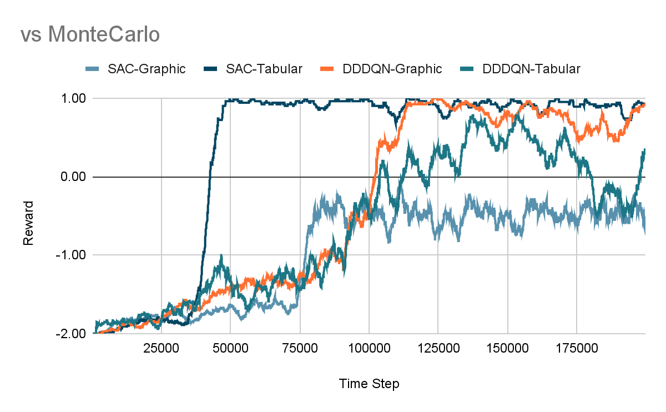
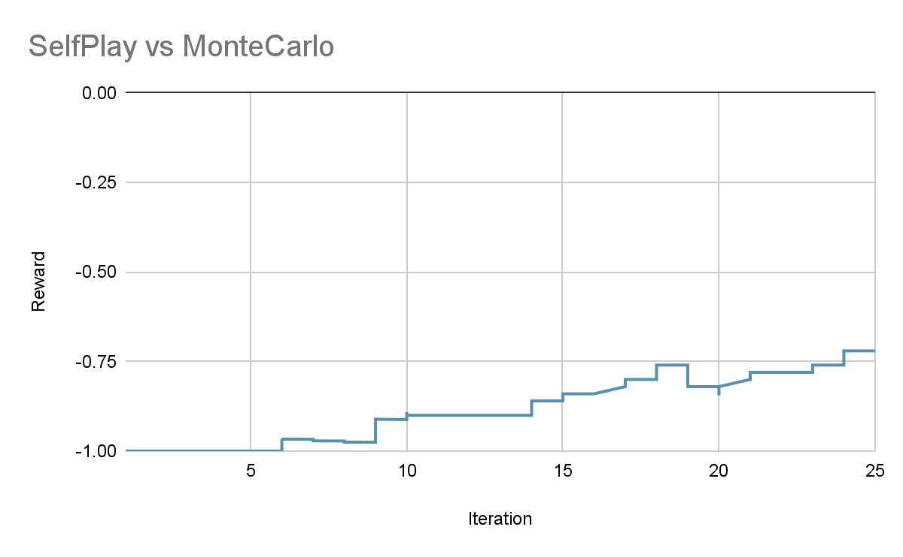
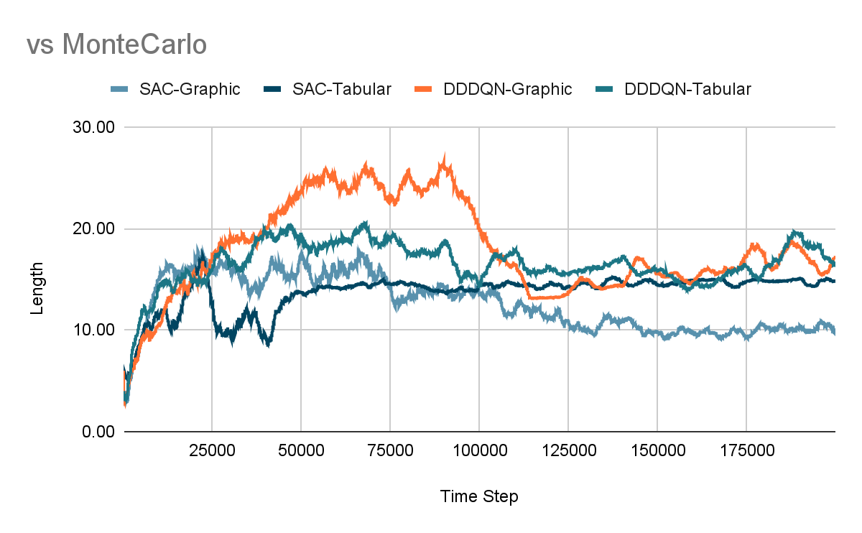
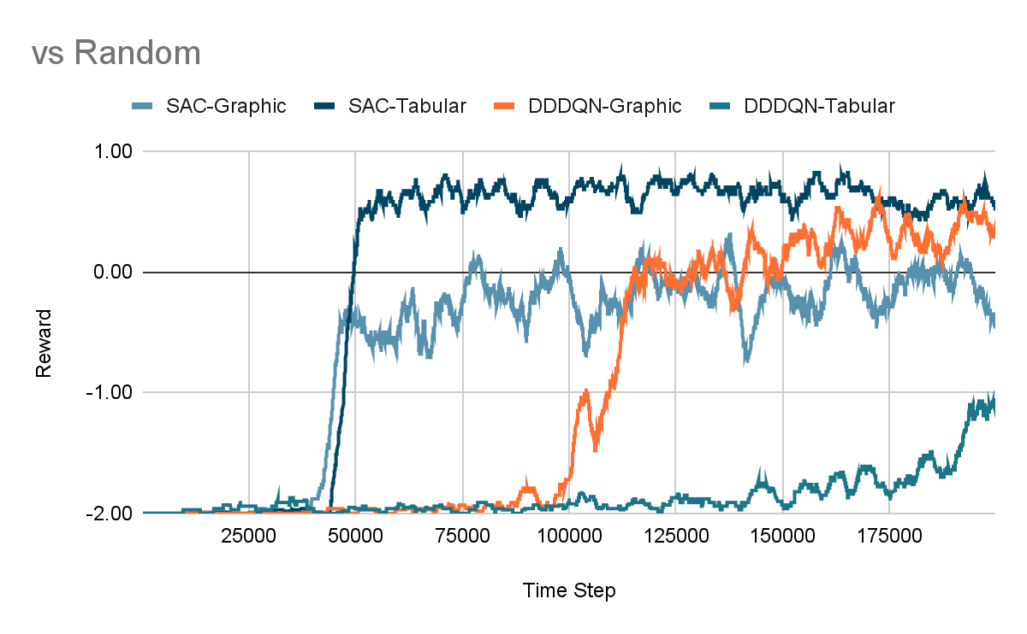
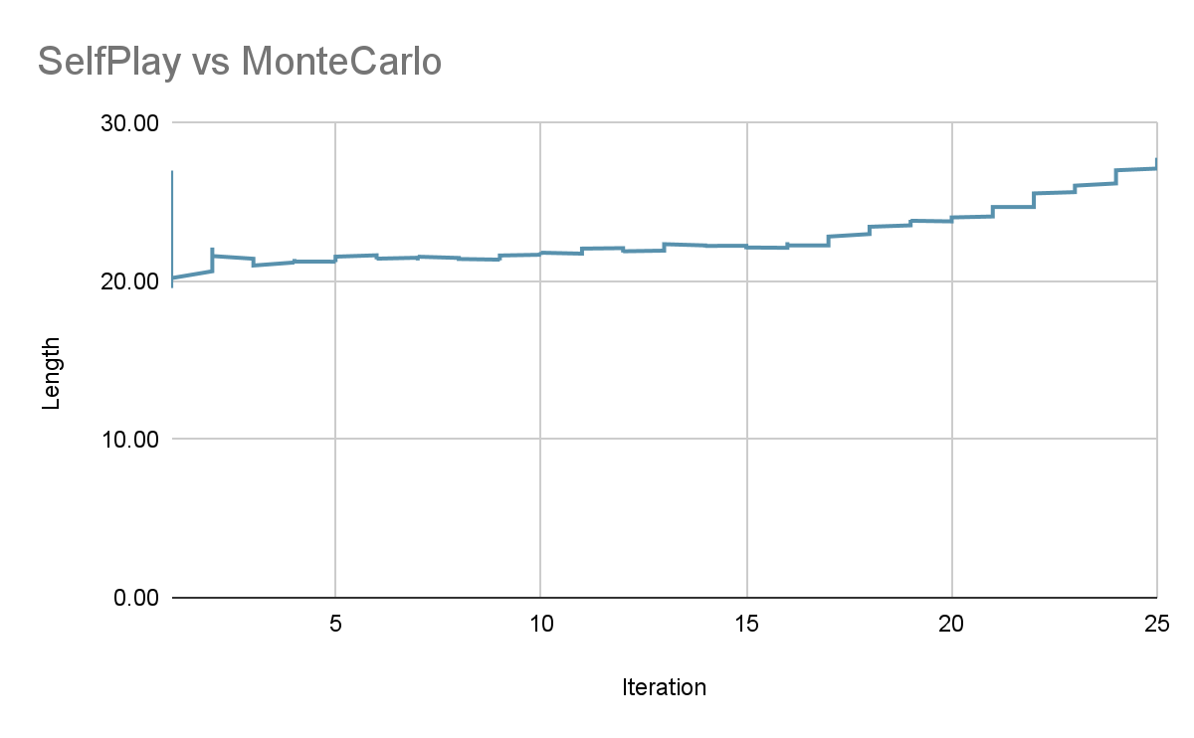
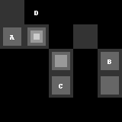
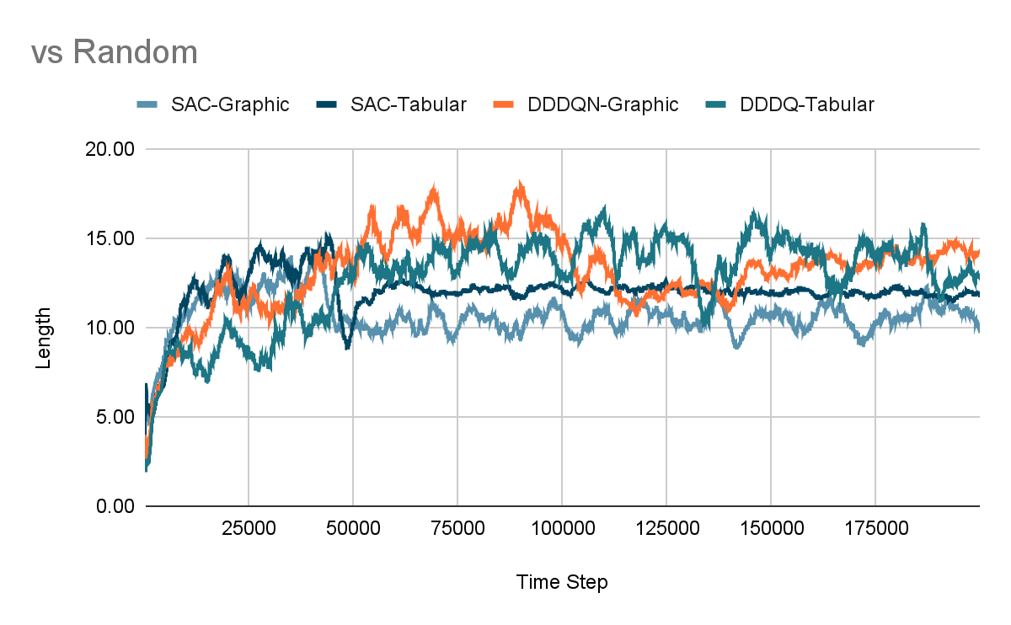
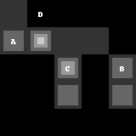
SANTORINI
Game Step
Results
Action ([0,0,1,0,1]
or
27)
Reward (-1)
Initial State
(5x5x6
or
160x160)
Final State
(5x5x6
or
160x160)
DESCRIZIONE
STATE SPACE (2 RAPPRESENTAZIONI)
ACTION SPACE (MAPPING)
REWARD FUNCTION
COMMENTO DEI RISULTATI

Slide 12
CONCLUSION
Main Takeaways from Tests:
Model Free approaches are sufficiently powerful to learn even complex games
Training is usually noisy, Catastrophic-Forget can happen
Prioritized Experience Replay Buffer ensures faster convergence
SAC generally reaches better optima than DDDQN
DDDQN is usually 3 times faster than SAC
Self-Play is promising but very computational-intense
AGENT COMPARISON (TOURNAMENT)
MODEL FREE => THEOR. RES
SELF PLAY => BLOCK COMPUT

Slide 13
THANKS
Do you have any questions?
andrea.menta@mail.polimi.it
giovanni.nisti@mail.polimi.it
Code available on GitHub

