Slide 1

Uunsupervised Anomaly
Infosys Internship Program
Detection

Slide 2
Uunsupervised Anomaly Detection

Slide 3
Anomaly Detection
Objective :
Problem Statement
Dataset Details
Pre-processing steps
Clustering results
ML Algorithm results
DL results

Slide 4
Healthcare Providers in US
Problem Statement
The dataset link : Healthcare Providers.xlsx
The problem statement of the dataset that which I have selected for the project is to analyse and improve the quality of healthcare services provided by various healthcare providers in US. This involves identifying any anomalies in the dataset that might indicate issues such as errors in data entry, unusual patterns in healthcare provision, or other irregularities that could affect the quality of service in US Government.
Objective
The objective of this project is to identify anomalies or outliers in a healthcare dataset using unsupervised machine learning techniques. Anomalies in this context could indicate unusual patterns or fraudulent activities related to healthcare services and payments.

Slide 5
Dataset Details
• Total Entries: 100,000
• Total Columns: 26
Categorical Columns
Credentials of the Provider: Professional credentials
Gender of the Provider : Gender (Female, Male)
Entity Type of the Provider: Type of entity
City of the Provider : City
State Code of the Provider : State code
Country Code of the Provider: Country code
Provider Type: Type of provider (e.g., physician, hospital)

Slide 6
Numerical columns
Number of services : Number of services which are provided by the provider
• Number of Distinct Medicare Beneficiary/Per Day Services: Number of distinct beneficiary
services per day
• Average Medicare Allowed Amount : Average allowed amount by Medicare
• Average Submitted Charge Amount: Average amount charged
• Average Medicare Payment Amount: Average payment amount by Medicare
Remaining columns
Index
National provider identifier
Last name/organization name of the provider
First of the provider
Middle initial of the provider
Street address 1 of the provider
Street address 2 of the provider
Zip code of the provider
HPCSC code
HPCSC code description

Slide 7
Exploratory Data Analysis (Univariate & Bivariate)
Exploratory Data Analysis (EDA) is an analysis approach that identifies general patterns in the data. These patterns include outliers and features of the data that might be unexpected. Exploratory Data Analysis (EDA) is a crucial initial step in data science projects. It involves analysing and visualizing data to understand its key characteristics, uncover patterns, and identify relationships between variables refers to the method of studying and exploring record sets to apprehend their predominant traits, discover patterns, locate outliers, and identify relationships between variables.
In which I’ve plotted graphs like bar plots for the categorical columns and some normal columns.
And I have plotted Correlation matrix heatmap for the numerical columns

Slide 8
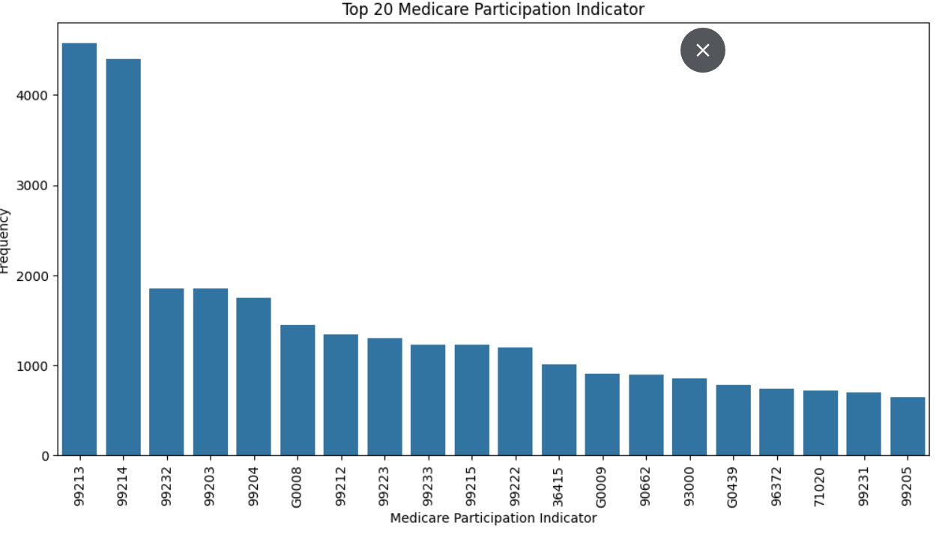
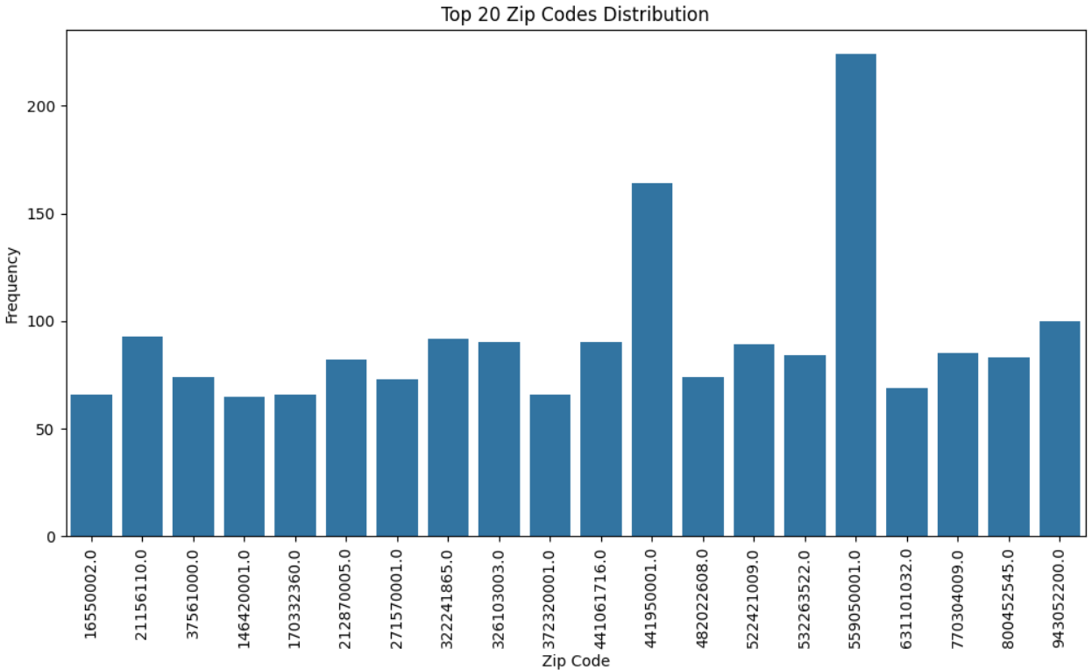
Univariate Analysis:
In this graph the zip code has been considered as a categorical value and then its only distributed as top 20 rows because there are so many unique values
This codes are essential for facilitating communication between healthcare providers and insures for the types of care provided, so that this graph represents the top 20 distribution code.

Slide 9
Univariate Analysis:
In this graph the zip code has been considered as a categorical value and then its only distributed as top 20 rows because there are so many unique values
This codes are essential for facilitating communication between healthcare providers and insures for the types of care provided, so that this graph represents the top 20 distribution code.
I’ve plot a bar graphs for the Zip code distribution which indicates the univariate of Exploratory data analysis
I’ve plot a bar graphs for the top 20 HCPCS code distribution which indicates the univariate of Exploratory data analysis

Slide 10
Univariate Analysis:
I’ve plot a bar graphs for the Zip code distribution which indicates the univariate of Exploratory data analysis
I’ve plot a bar graphs for the top 20 HCPCS code distribution which indicates the univariate of Exploratory data analysis

Slide 11
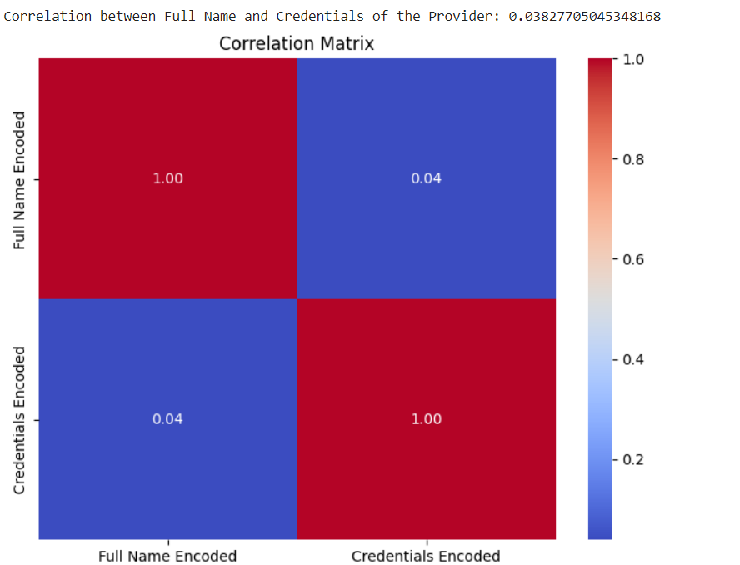
Correlation matrix heatmap (Bivariate analysis):
Correlation matrix heatmap for the provider and the credentials of the provider and the correlation is : 0.038277050453.
It is a Correlation matrix heatmap (Bivariate) graph for the Exploratory data analysis
It shows how much these columns full name and the credentials of the providers were co-related which is 0.038277050453

Slide 12
Correlation matrix heatmap (Bivariate)
It is a Correlation matrix heatmap (Bivariate) graph for the Exploratory data analysis
It shows how much these columns full name and the credentials of the providers were co-related which is 0.038277050453

Slide 13
Pre-processing steps
Preprocessing steps :
For some columns I have used mean Imputation and for other Forward/Backward Fill in my dataset. This is how I have handled missing values.
In some columns there are some special character like (,),(.), That I’ve removed from the dataset and cleaned the dataset.
And I have removed some unwanted columns like street address, index, zip code, HPSCS code description for the dataset.
I’ve used some encoded techniques to convert the categorial columns to numerical columns
Those are :
For the columns which are having less than 2 unique values I used One-Hot encoding
For the columns which are having more than 2 unique values I have used Frequency encoding

Slide 14
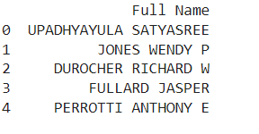
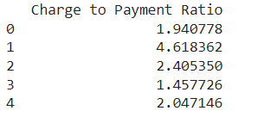
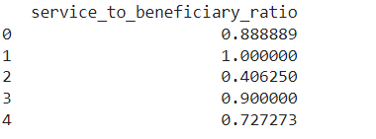
Feature engineering :
Full name (combining last, first, middle names)
Added some new columns service utilisation rate (ratio of Number of Medicare Beneficiaries and Number of Services.) which is Service to beneficiary ratio
Average cost per service
Charge to Payment Ratio(the ratio between Average Submitted Charge Amount by the Average Medicare Payment Amount.)
Transformation Techniques :
In the dataset I have used Standardization for the numerical and encoded columns, To adjusting data to have a mean of zero and a standard deviation of one.

Slide 15
Feature engineering :
Full name (combining last, first, middle names)
Added some new columns service utilisation rate (ratio of Number of Medicare Beneficiaries and Number of Services.) which is Service to beneficiary ratio
Charge to Payment Ratio(the ratio between Average Submitted Charge Amount by the Average Medicare Payment Amount.)

Slide 16
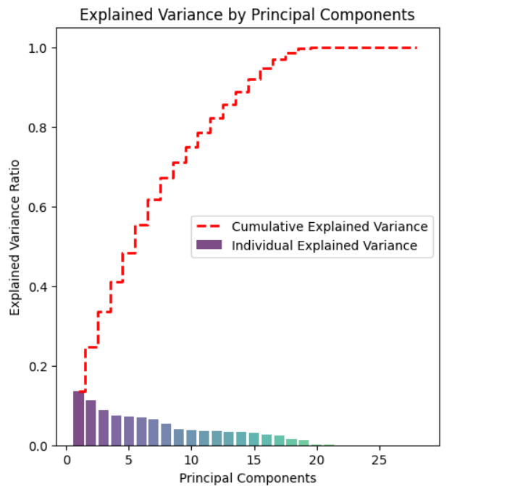
The red dashed line shows the cumulative explained variance. It increases as more principal components are added, indicating the total variance captured by the selected components.
Principal Component Analysis (PCA):
Dimensionality Reduction Principal Component Analysis is a technique used to reduce the number of variables in a dataset while retaining most of the original information. It transforms the original variables into a new set of uncorrelated variables called principal components.
PCA will be performed on standardization data on understand how the variable related to each other then principal components selection that the eigenvectors are sorted by their corresponding eigenvalues in descending order and Finally, the original data is transformed into the new feature space defined by the principal components

Slide 17
Principal Component Analysis (PCA):
The red dashed line shows the cumulative explained variance. It increases as more principal components are added, indicating the total variance captured by the selected components.
The red dashed line shows the cumulative explained variance. It increases as more principal components are added, indicating the total variance captured by the selected components.

Slide 18
Principal Component Analysis (PCA):
The red dashed line shows the cumulative explained variance. It increases as more principal components are added, indicating the total variance captured by the selected components.
The red dashed line shows the cumulative explained variance. It increases as more principal components are added, indicating the total variance captured by the selected components.

Slide 19
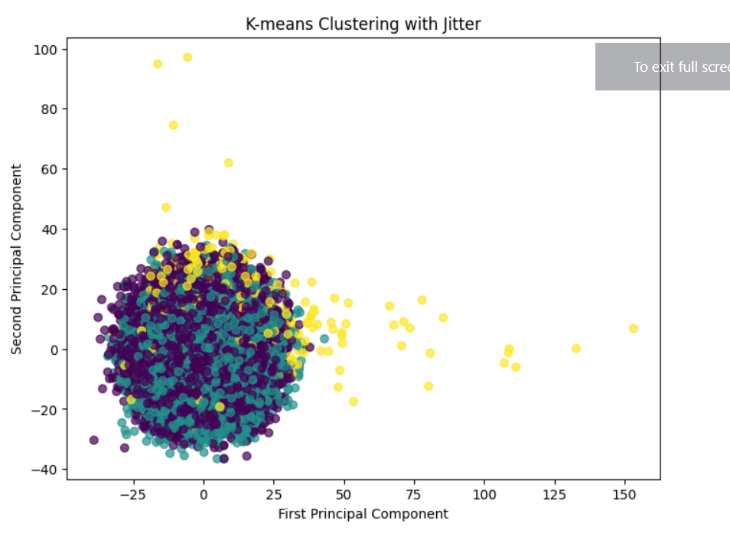
Clustering Results
K-means Clustering
K-means clustering partitions data into k clusters where each data point belongs to the cluster with the nearest mean, minimizing within-cluster variances.
It is an iterative algorithm that updates cluster centroids and reassigns data points

Slide 20
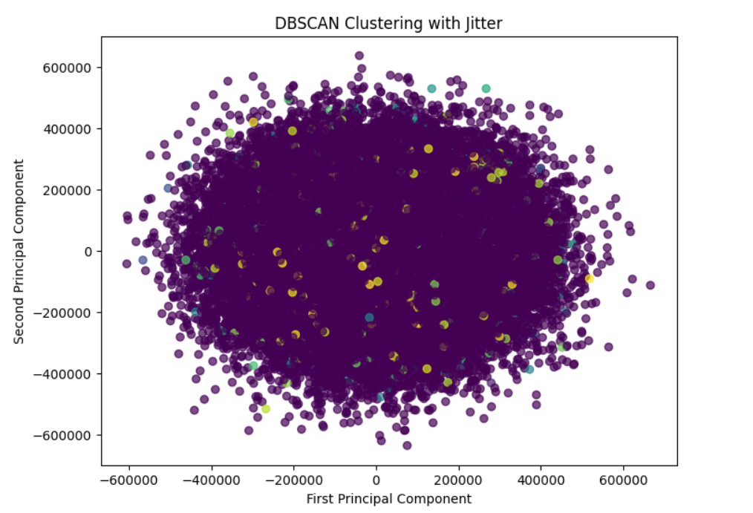
Clustering Results
DBSCAN Clustering
DBSCAN identifies clusters based on the density of data points. It group together points that are closely packed, marking points in sparse regions as outliers or noise.

Slide 21
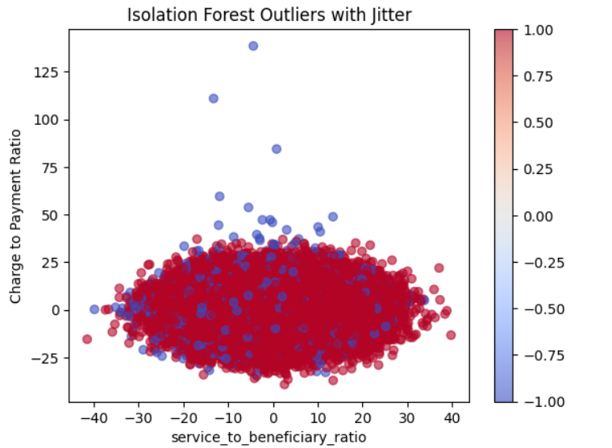
ML Algorithms
Isolation Forest
Isolation Forest is an unsupervised learning algorithm used for anomaly detection. It is particularly effective for high-dimensional data.
The algorithm isolates anomalies by recursively partitioning the data using random splits. This process creates isolation trees, and the anomaly score is based on the path length required to isolate a data point. Shorter paths indicate anomalies.

Slide 22
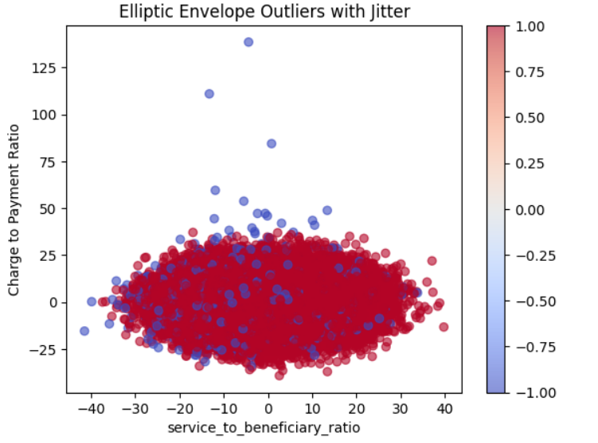
ML Algorithms
Elliptical Envelope
Isolation Forest is an unsupervised learning algorithm used for anomaly detection. It is particularly effective for high-dimensional data.
The algorithm isolates anomalies by recursively partitioning the data using random splits. This process creates isolation trees, and the anomaly score is based on the path length required to isolate a data point. Shorter paths indicate anomalies.

Slide 23
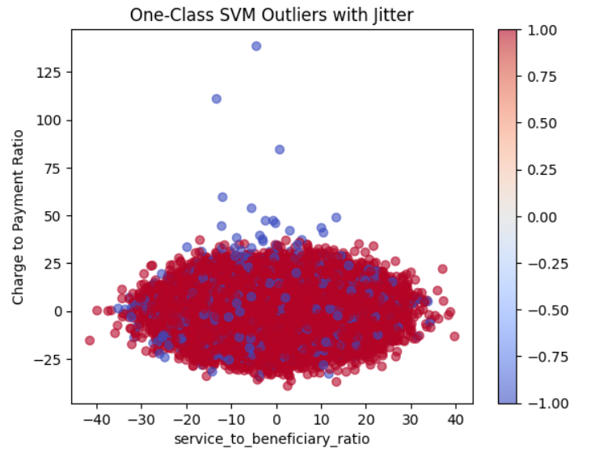
ML Algorithms
Support Vector Machine (SVM)
Isolation Forest is an unsupervised learning algorithm used for anomaly detection. It is particularly effective for high-dimensional data.
The algorithm isolates anomalies by recursively partitioning the data using random splits. This process creates isolation trees, and the anomaly score is based on the path length required to isolate a data point. Shorter paths indicate anomalies.

Slide 24
Number of anomalies detected by Elliptic Envelope: 10000
Number of anomalies detected by One-Class SVM: 10001
Number of anomalies detected by Isolation Forest: 9980

Slide 25
Number of anomalies detected by Isolation Forest: 9980
Number of anomalies detected by One-Class SVM: 10001
Number of anomalies detected by Elliptic Envelope: 10000

Slide 26
Number of anomalies detected by Elliptic Envelope: 10000
Number of anomalies detected by Isolation Forest: 9980
Number of anomalies detected by One-Class SVM: 10001

Slide 27
DL MODELS(AUTOENCODERS)
Autoencoders are a type of neural network used for unsupervised learning, primarily for dimensionality reduction and anomaly detection. They consist of an encoder that compresses input data into a lower-dimensional latent space and a decoder that reconstructs the original data from this compressed representation
The network is trained to minimize the difference between the input and the reconstructed output. In anomaly detection, autoencoders learn to reconstruct normal data patterns accurately, while anomalies, which deviate from these patterns, result in higher reconstruction errors, making them identifiable. This ability makes autoencoders valuable for tasks such as noise reduction, feature extraction, and detecting unusual patterns in data.

Slide 28
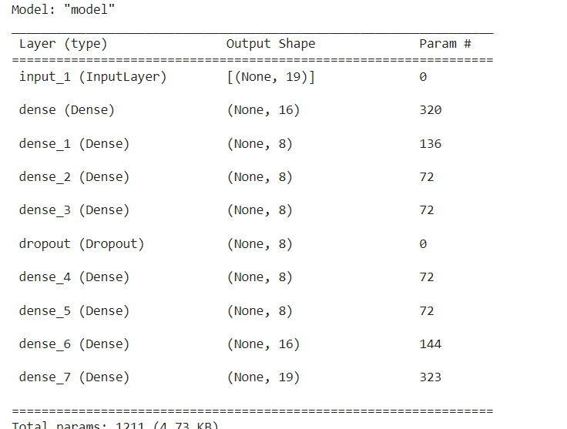
The architecture of an autoencoder model
Interpretation:
The encoder compresses the input data into a lower- dimensional representation
Initial dimensionality:
Initial dimensionality is represented by the input layer with the shape (None, 19).
Final dimensionality:
Final dimensionality matches the initial input
size(None, 19)
Reduced dimensionality is (None,8)

Slide 29
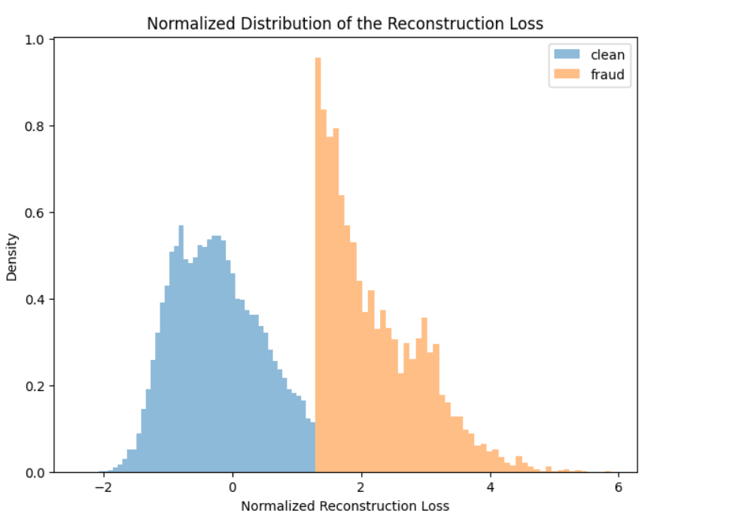
Distribution of Reconstruction Loss:
Interpretation :
The blue distribution represents clean data points Most of these have lower reconstruction loss(around -1 to 0 on the normalized scale) The orange data points indicates the fraud data points having higher reconstruction loss(around 2 to 3 on the normalized scale) Hence, if a data point has higher reconstruction loss than the clean distribution it might be considered as anomaly

Slide 30
Thank you

