Slide 1
Healthcare Fraud Detection System

Slide 2
Problem Statement
The healthcare industry is plagued by fraudulent activities that lead to significant financial losses, estimated in billions of dollars annually. Fraudulent claims, billing inaccuracies, and unauthorized transactions undermine the integrity of healthcare systems, inflate costs, and divert resources away from patient care. Traditional manual methods of fraud detection are time-consuming, inefficient, and often fail to keep up with the sophisticated and evolving nature of fraud schemes. There is a critical need for an advanced, automated solution that can analyze vast amounts of healthcare data in real-time to identify and prevent fraudulent activities, ensuring the integrity of financial transactions and compliance with regulatory standards. This solution must maintain patient data privacy, adapt to emerging fraud patterns, and provide actionable insights to healthcare professionals for effective intervention and investigation.

Slide 3
Dataset
The dataset contains detailed information about physicians and suppliers, including their NPI (National Provider Identifier), name (last/organization, first, middle initial), credentials, gender, and whether they are an individual or organization. It includes address details (street, city, state, zip, country), provider type, Medicare participation status, and place of service (facility or non-facility). The dataset also covers HCPCS codes and descriptions for services provided, an indicator for Medicare Part B Drug(ASP)File, counts of services provided, distinct Medicare beneficiaries, and distinct beneficiary per day services. Financial metrics include averages and standard deviations for Medicare allowed amounts, submitted charges, and Medicare payments. This information aids in analyzing healthcare services, provider details, service utilization, and Medicare-related financial transactions.

Slide 4
Exploratory Data Analysis(EDA)
The steps taken during the EDA of the dataset is as follows-
The dataset is first observed to check all the fields and the fields are observed on what kind of information they provide.
We also check the distribution of the values of each field.
We then add a new column called “Money difference” in the dataset which is basically the difference between the Average Submitted Charge Amount and the Average Medicare Payment Amount columns for each row. We will use this difference to check which rows has an anomalously high value for this field.
The next step was to check the percentage of null or missing values in each field.
A library called sweetviz was then used to analyse the different fields and check the correlations between all the fields.

Slide 5
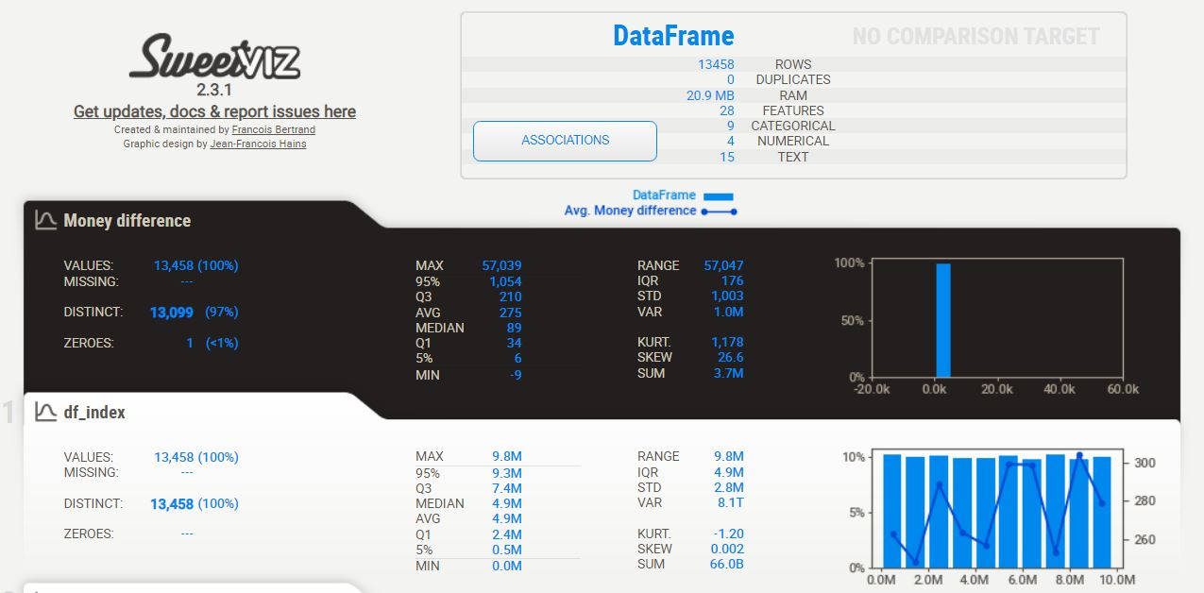
The sweetviz library checks the correlation between the different fields and give us a report like the following -

Slide 6
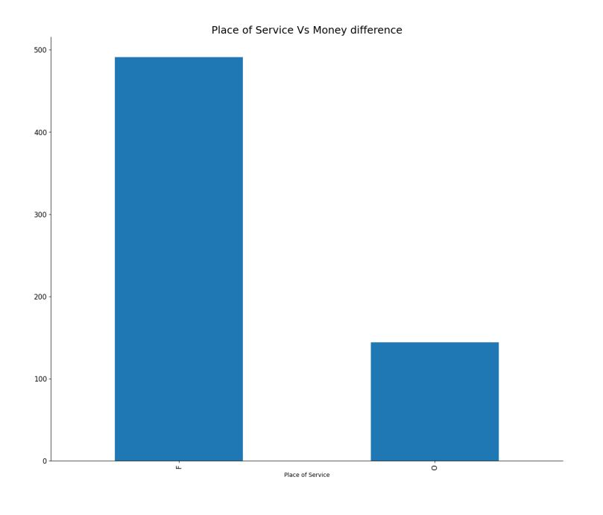
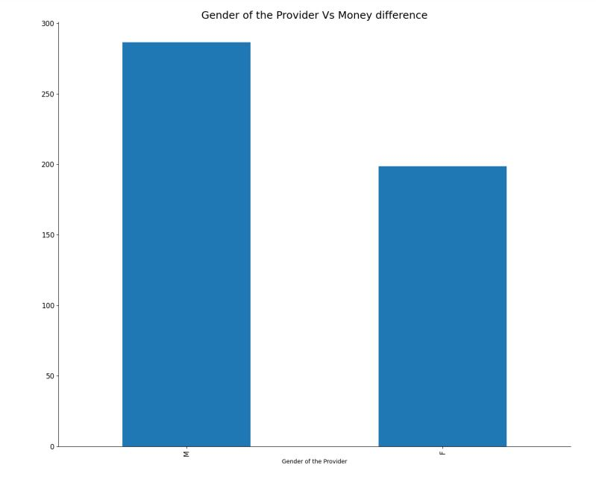
From the report we get to know that the Provider Type , Place of Service and the Gender of the Provider fields has the highest correlation with the Money difference column
Lastly we plot graphs to check the relation between the above columns and the money difference column to check their distribution.

Slide 7
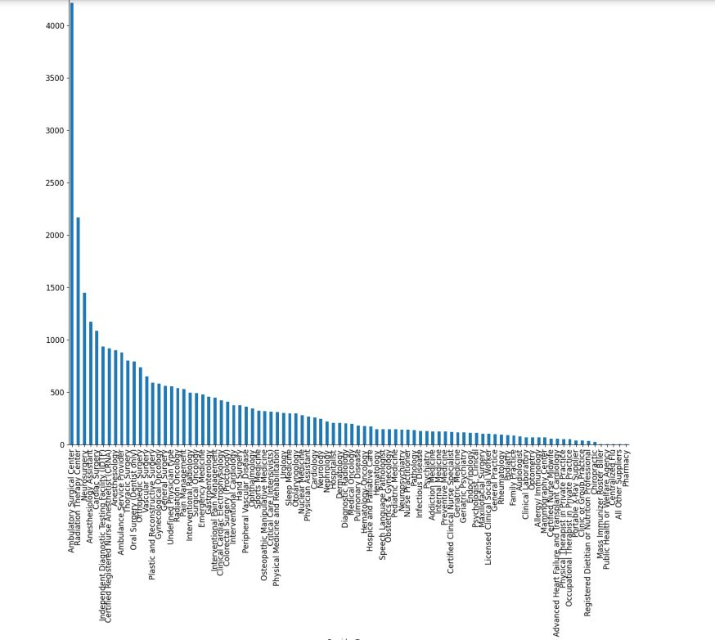
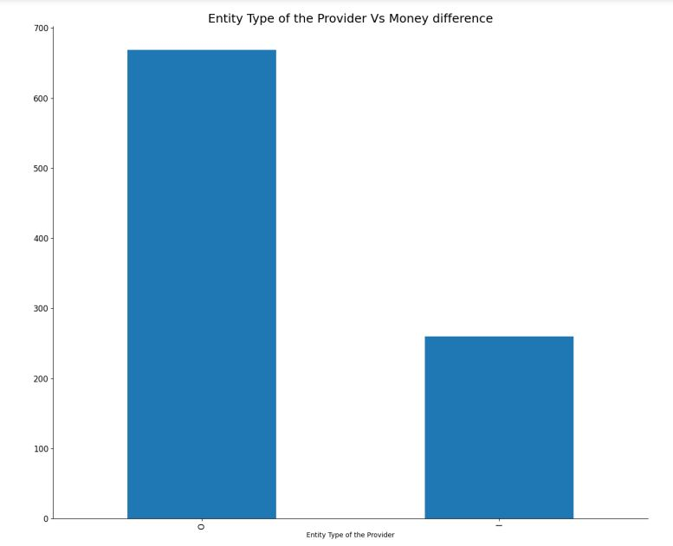

Slide 8
Pre-Processing
The steps taken during the preprocessing of the dataset are given below-
All the fields are first checked and evaluated for there usefulness in the anomaly detection process.
The fields deemed to not add any value to the anomaly detection process are dropped.
We then scale the numerical the fields using standard scaler and encode the categorical columns using one hot encoding.
We also use frequency encoding for the categorical columns with high number of categories.
The next step was to get the mean and standard deviation of every field and calculate the Z-score for each row.
The Z-score is then used to flag the rows that surpass the threshold as fraud since there is a chance it can be a fraudulent row and store it in a new column called “Fraud”.

Slide 9
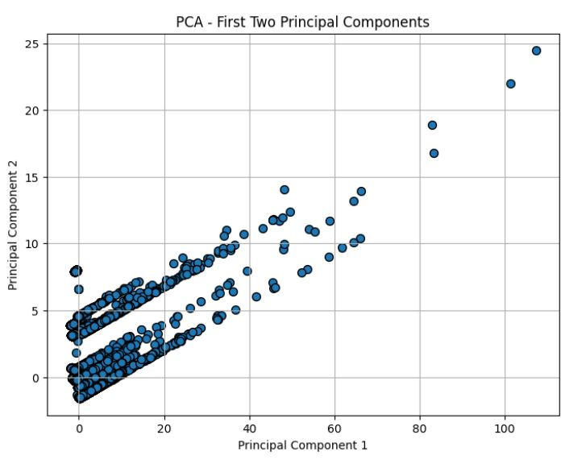
The next step was to do PCA on the dataset and plot a graph of the two principal components.

Slide 10
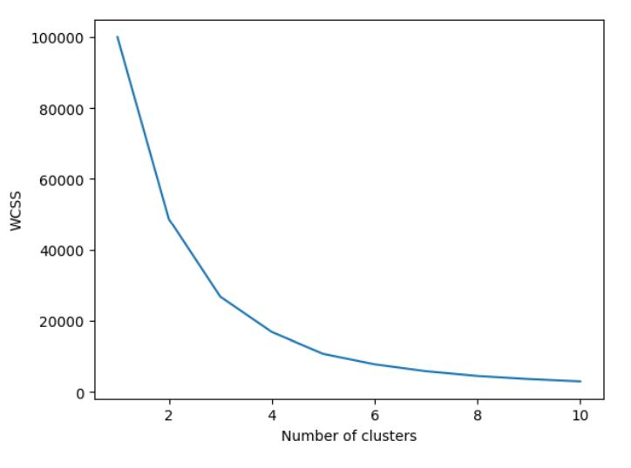
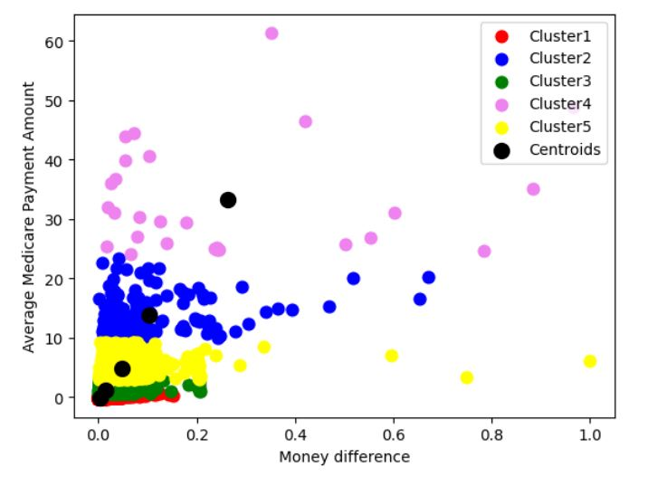
CLUSTERING MODELS
The clustering models which are used for the anomaly detection are K-means clustering and DBScan.
The elbow method is used to get the optimal number of clusters for the K-means model and then the K-means model is fitted to the dataset.
A graph of the dataset after fitting is also generated.

Slide 11
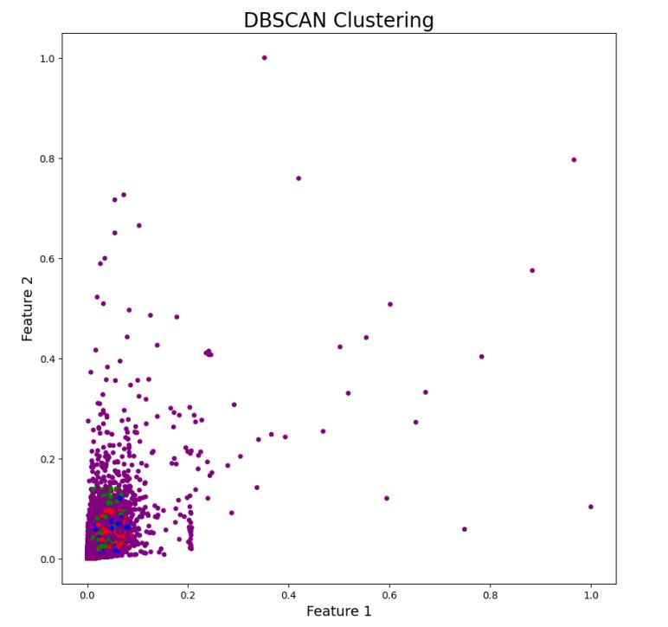
The DBScan model is also fitted to the dataset and a graph is generated to visualize the clusters.

Slide 12
Machine Learning Models
For the Machine learning models we use Isolation Forest, Elliptic Envelope, and One-Class SVM for anomaly detection in the dataset.
Isolation Forest isolates observations by randomly selecting a feature and then randomly selecting a split value, making it efficient for identifying anomalies, which are isolated quickly due to their unique characteristics.
The Elliptic Envelope method fits an ellipse to the data, assuming it follows a Gaussian distribution, and detects outliers based on the Mahalanobis distance from the center of the ellipse.
One-Class SVM, a variant of the Support Vector Machine, learns a decision boundary around the normal data points and classifies points outside this boundary as anomalies, making it effective for high-dimensional data.

Slide 13
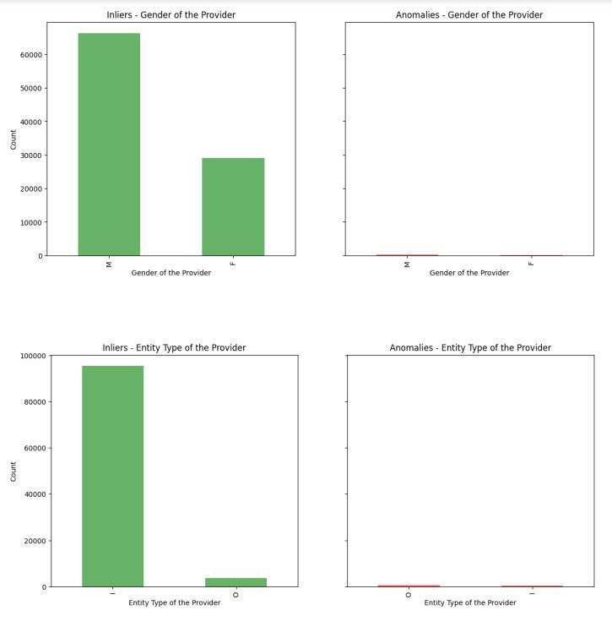
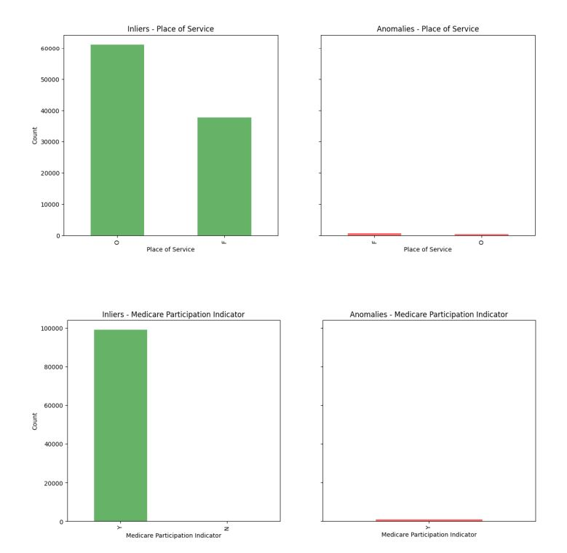
Isolation Forest
We fit the Isolation Forest model on the dataset and make graphs of the predictions by the model. The model gives us roughly about 1000 anomalies

Slide 14
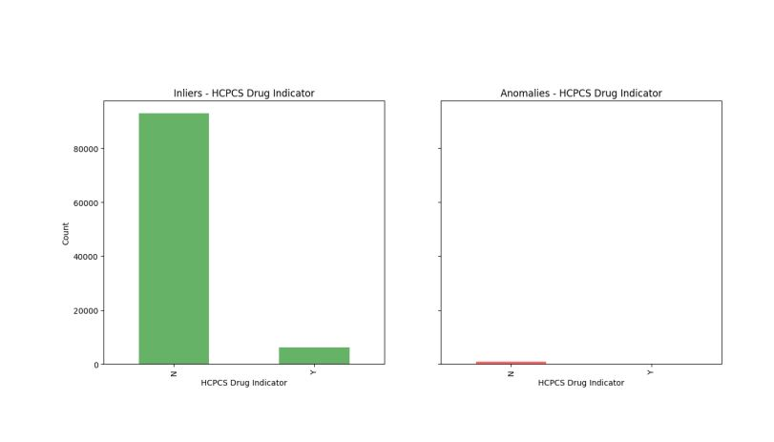
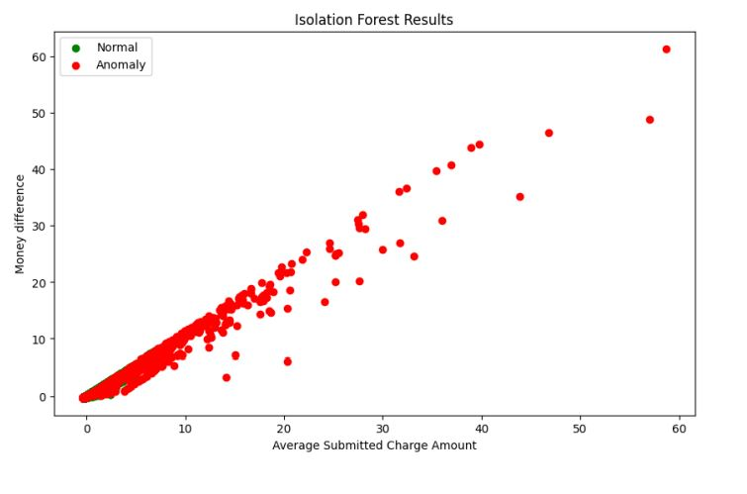
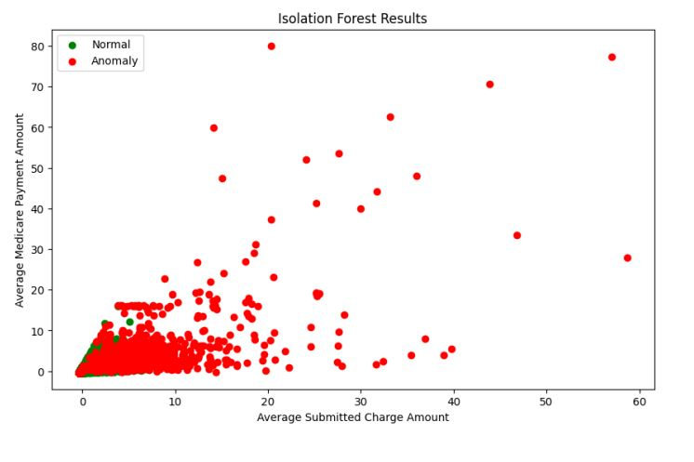
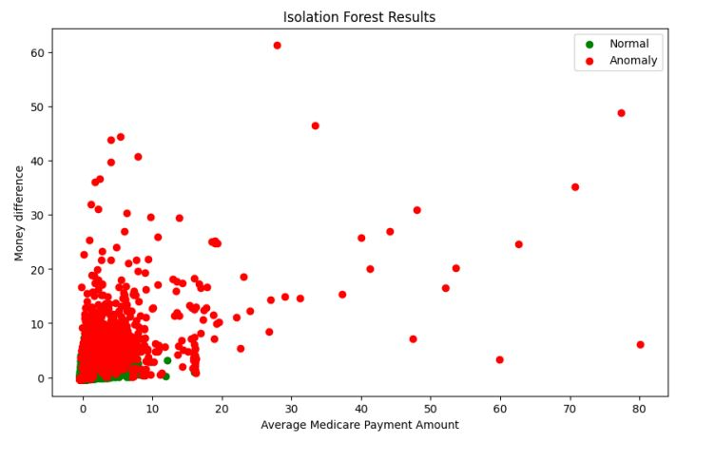

Slide 15
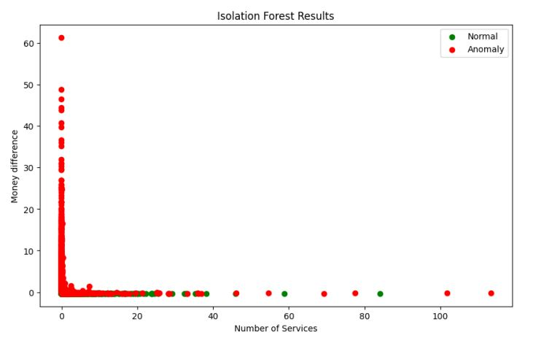
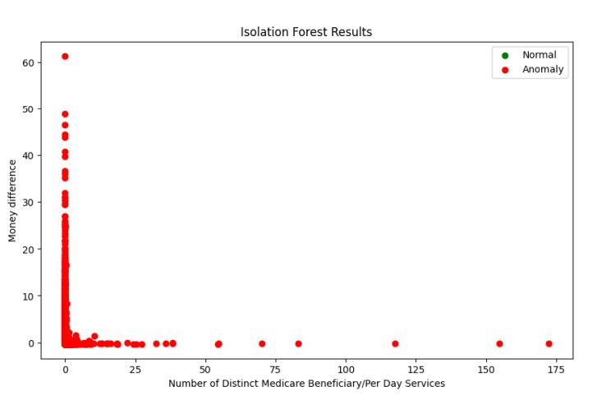
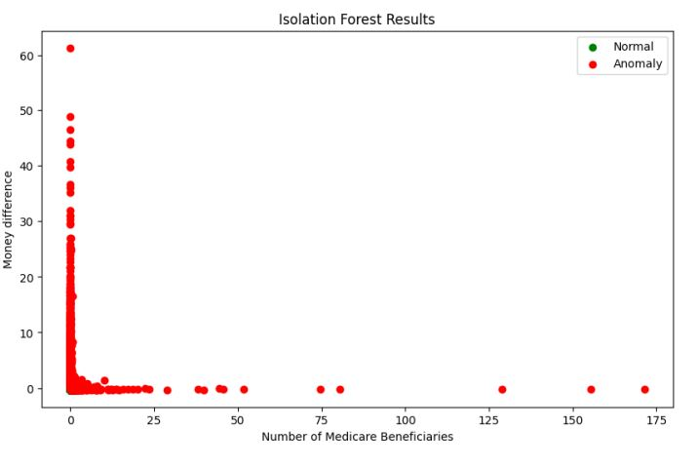

Slide 16
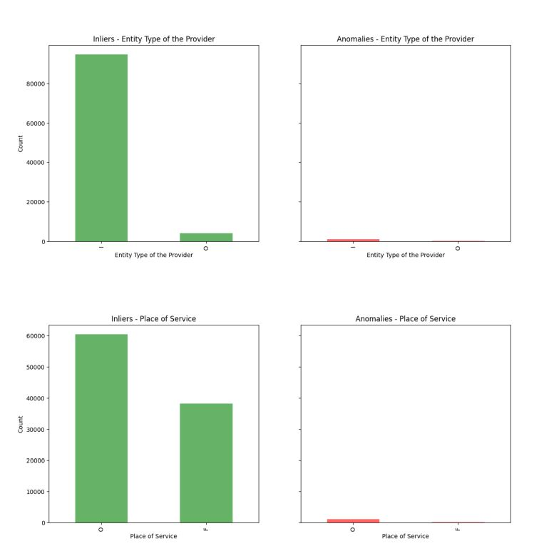
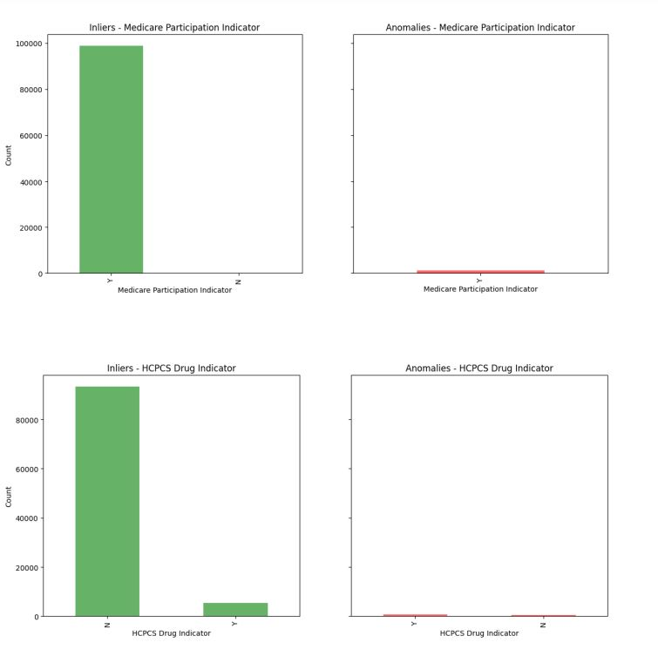
Elliptic Envelope
We fit the Elliptic Envelope model on the dataset and make graphs of the predictions by the model. The model gives us roughly about 1027 anomalies

Slide 17
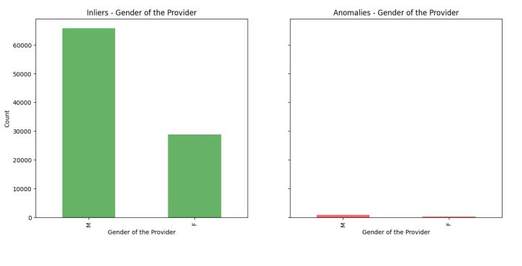
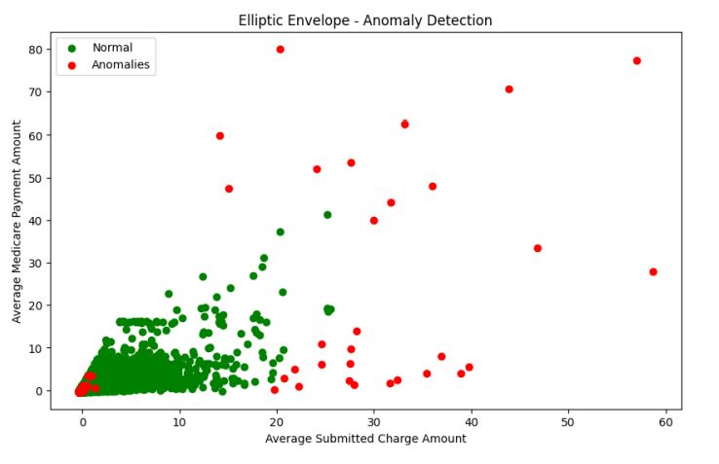
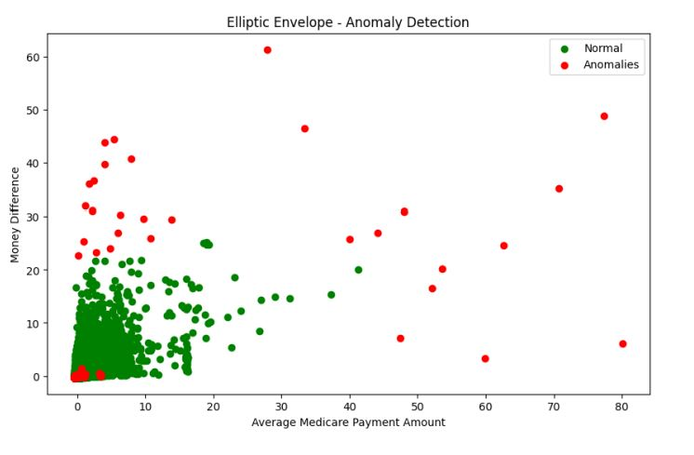
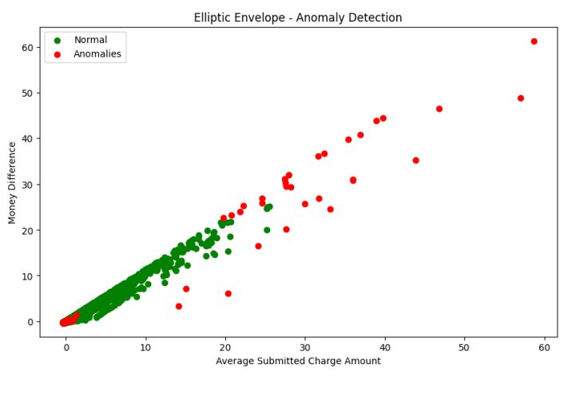

Slide 18
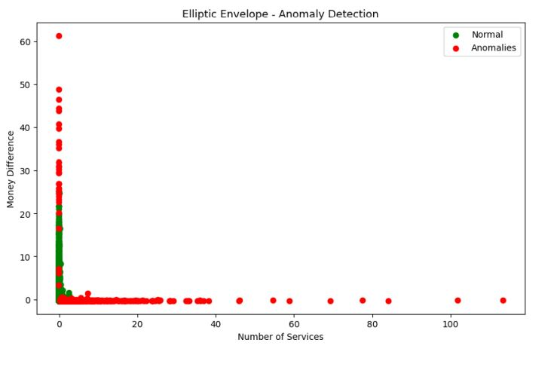
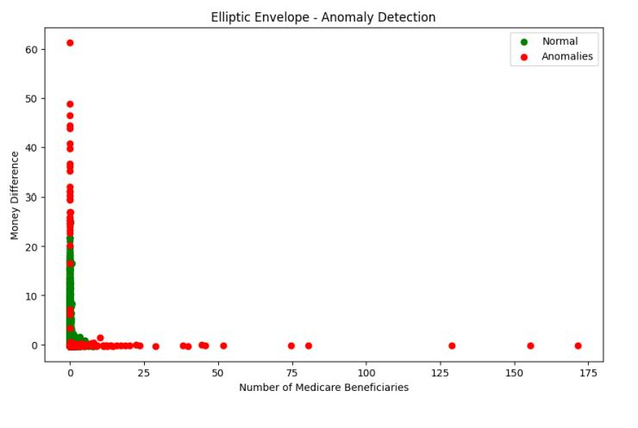
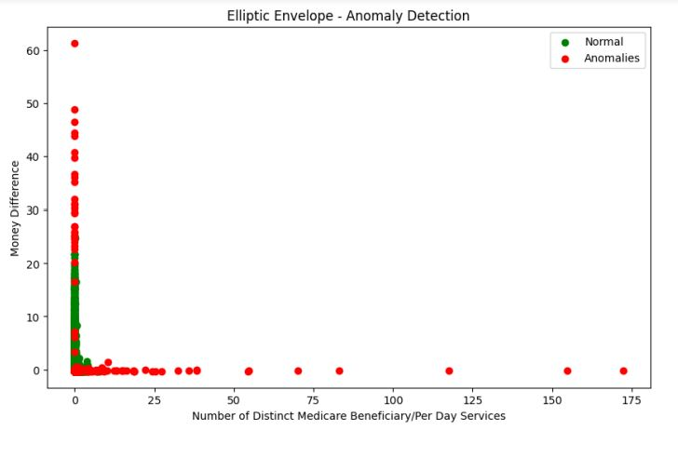

Slide 19
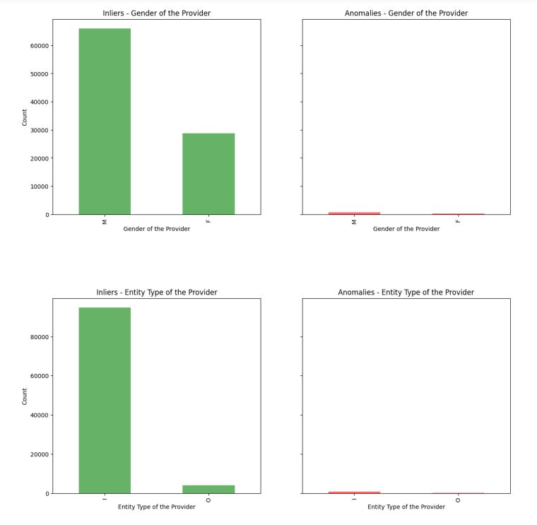
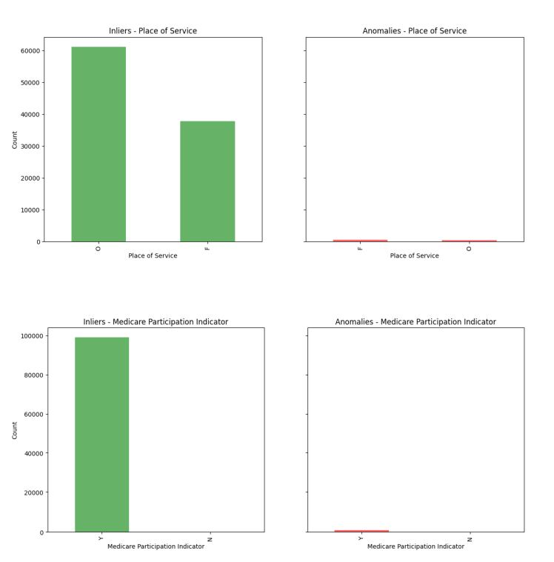
One Class SVM
We fit the One Class SVM model on the dataset and make graphs of the predictions by the model. The model gives us roughly about 1000 anomalies

Slide 20
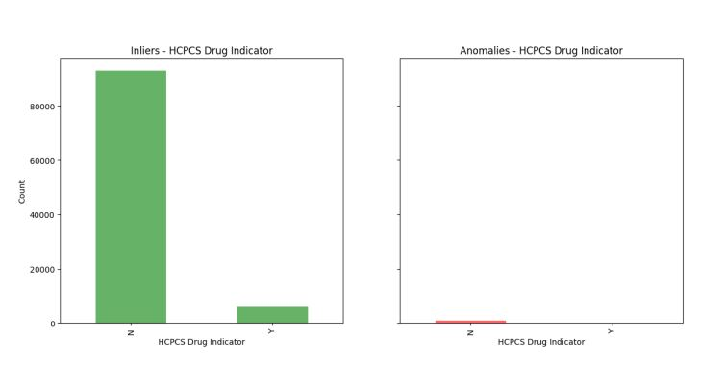
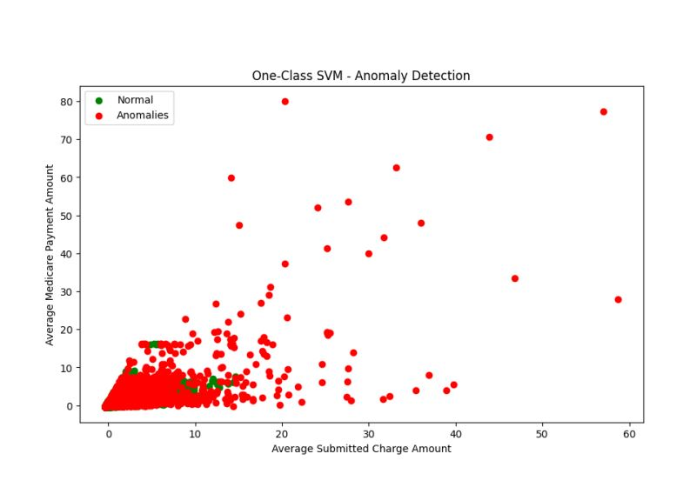
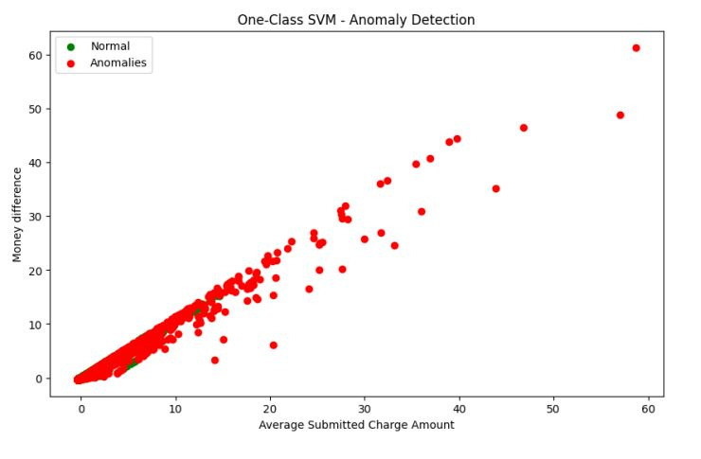
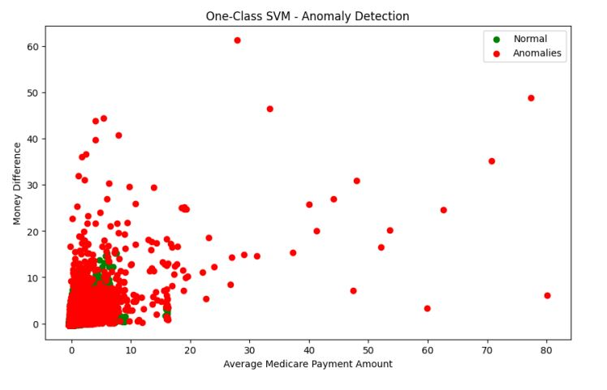

Slide 21
DL MODELS(AUTOENCODERS)
Autoencoders are a type of neural network used for unsupervised learning, primarily for dimensionality reduction and anomaly detection. They consist of an encoder that compresses input data into a lower-dimensional latent space and a decoder that reconstructs the original data from this compressed representation.
The network is trained to minimize the difference between the input and the reconstructed output. In anomaly detection, autoencoders learn to reconstruct normal data patterns accurately, while anomalies, which deviate from these patterns, result in higher reconstruction errors, making them identifiable. This ability makes autoencoders valuable for tasks such as noise reduction, feature extraction, and detecting unusual patterns in data.

Slide 22
AUTOENCODER MODEL
The model consists of an autoencoder neural network with Keras for unsupervised learning tasks like dimensionality reduction and anomaly detection. The input layer is designed to match the number of features (input_dim) in the input data X.
The encoder compresses the input data using dense layers: the first layer has 32 neurons with ReLU activation and L1 activity regularization to encourage sparsity, followed by layers with 16 and 2 neurons respectively, each using ReLU activation to reduce the data into a lower-dimensional latent space representation.
The decoder then reverses this process, expanding from the 2-dimensional latent space back to the original input dimension through layers of 16 and 32 neurons with ReLU activation.
The model is compiled with the Adam optimizer and uses mean squared error as the loss function to minimize reconstruction error, crucial for accurately reconstructing the input data and detecting anomalies based on deviations from normal patterns.
The model again gives us roughly about 1000 anomalies

Slide 23
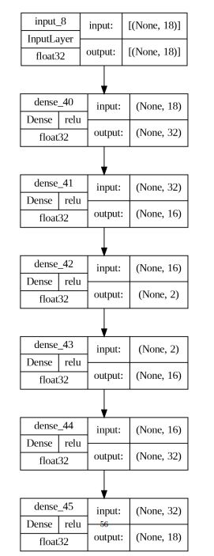

Slide 24
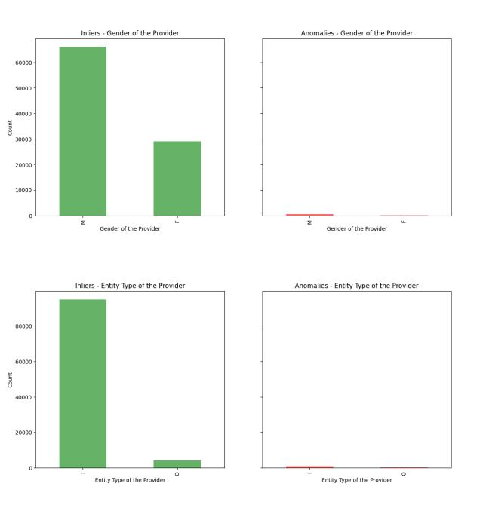
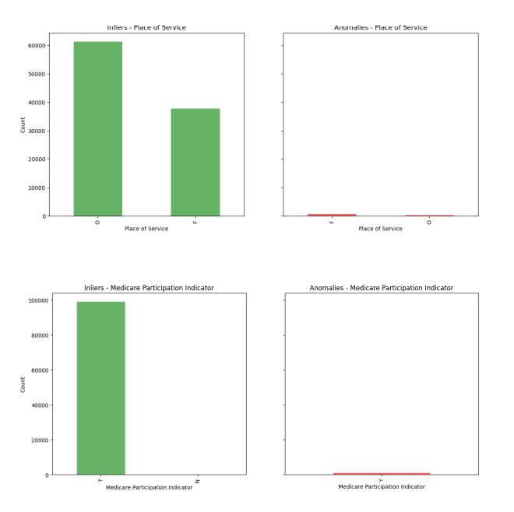
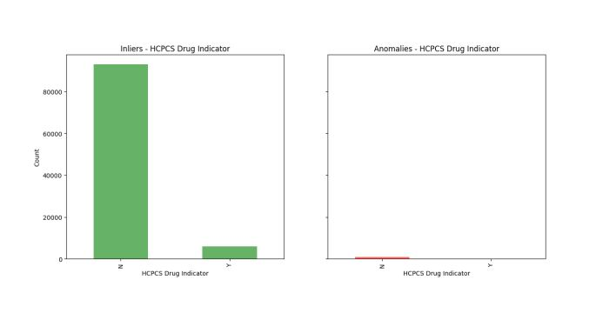

Slide 25
