Slide 1
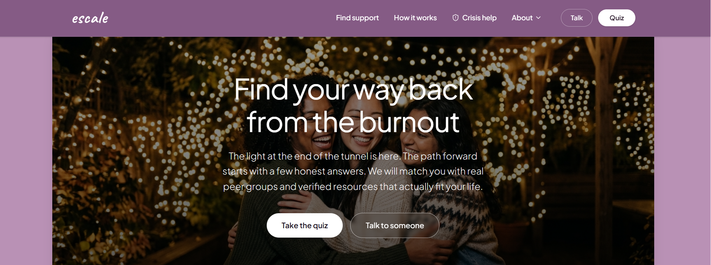
PARTNER OVERVIEW
escale
The fastest, safest way from burnout to real support
escale is a two-minute, anonymous routing tool that matches burned-out employees, caregivers, and healthcare staff with verified peer groups and affordable resources — no clinical assessment, no dead links, no guesswork.
escale.app — landing experience
“The light at the end of the tunnel is here. The path forward starts with a few honest answers.”
WHAT IT IS
A burnout-to-support routing platform
WHO IT'S FOR
Employers, health plans & community partners
THE PITCH
One partnership, thousands of people routed to real help
01

Slide 2
THE PROBLEM
Burnout is costing you people — quietly.
Your people already know they're burning out. What stops them is the next step — finding help that fits their role, their budget, and the ten minutes they have to look.
76%
53%
$438B
of employees experience burnout at least sometimes — a retention and productivity risk hiding in plain sight (Gallup).
of employees know how to access the mental-health benefits you already pay for. Almost half never use what's on offer (NAMI).
lost globally each year to reduced productivity from poor employee well-being (Gallup).
WHAT'S ALREADY OUT THERE FALLS SHORT
Generic EAP directories
Stale, unverified listings
Low utilization
Long lists with no filtering by role, budget, or how someone actually feels — people give up before they find a fit.
Broken links and defunct programs erode trust the moment someone finally reaches out.
Benefits go unused not because people don't need them, but because finding the right one feels like a second job.
02

Slide 3
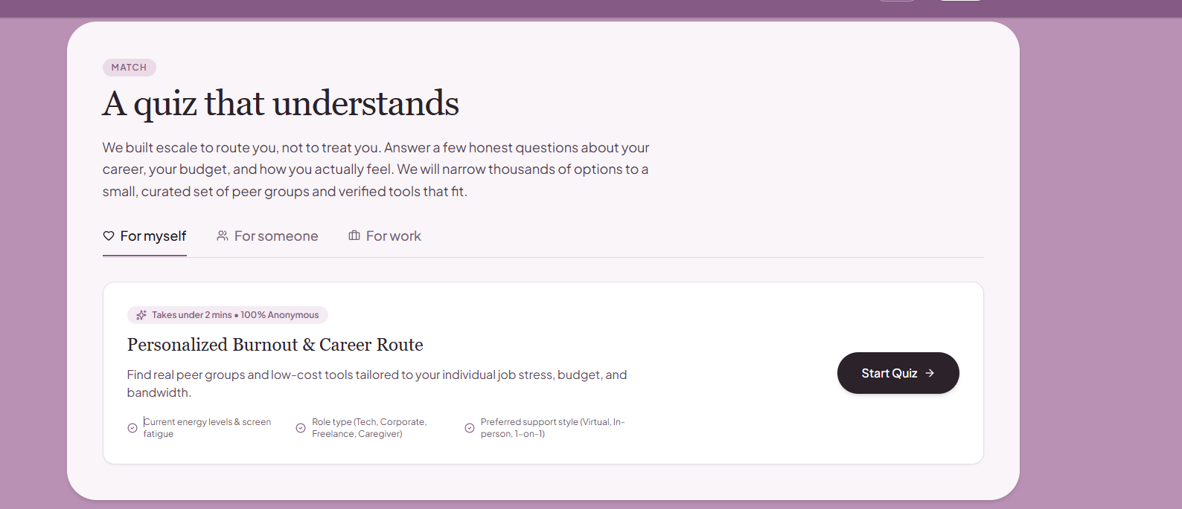
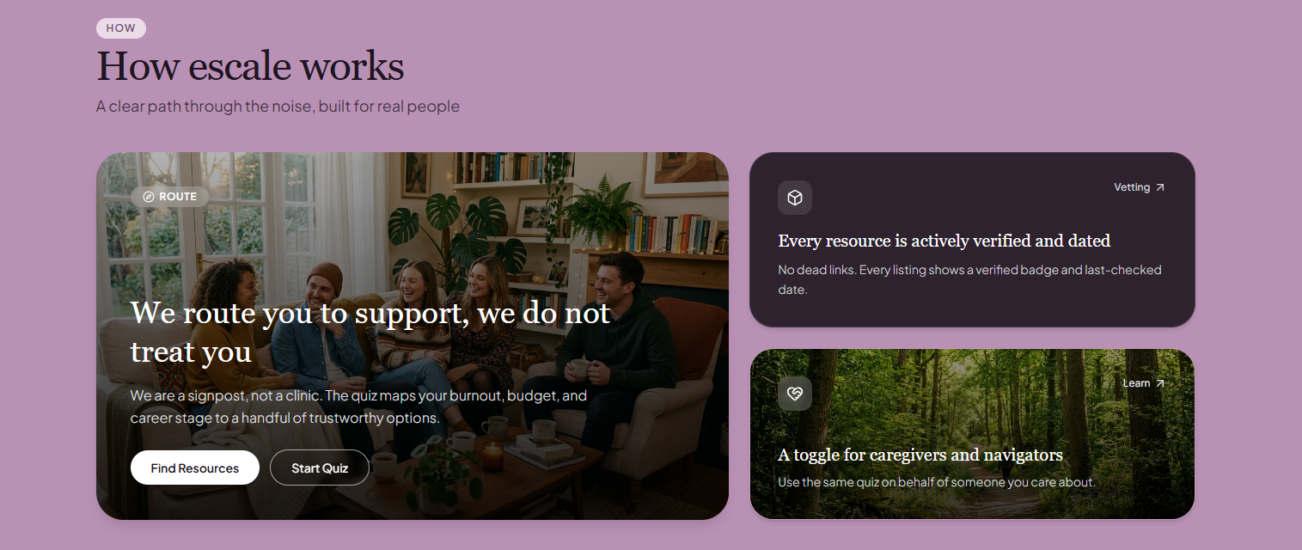
THE SOLUTION
A signpost, not another clinic
escale doesn't try to be a therapist, an app subscription, or a benefits portal. It's the missing layer that gets people from “I need help” to a real, verified option in under two minutes.
1
Answer a few honest questions
Energy level, role, budget, and preferred support style — no lengthy clinical intake.
2
Get matched, not overwhelmed
The routing quiz — the entire ask, in one screen.
Thousands of possible resources narrowed to a small, relevant shortlist.
3
Reach real, verified help
Peer groups, tools, and professionals — every listing actively checked and dated.
03

Slide 4
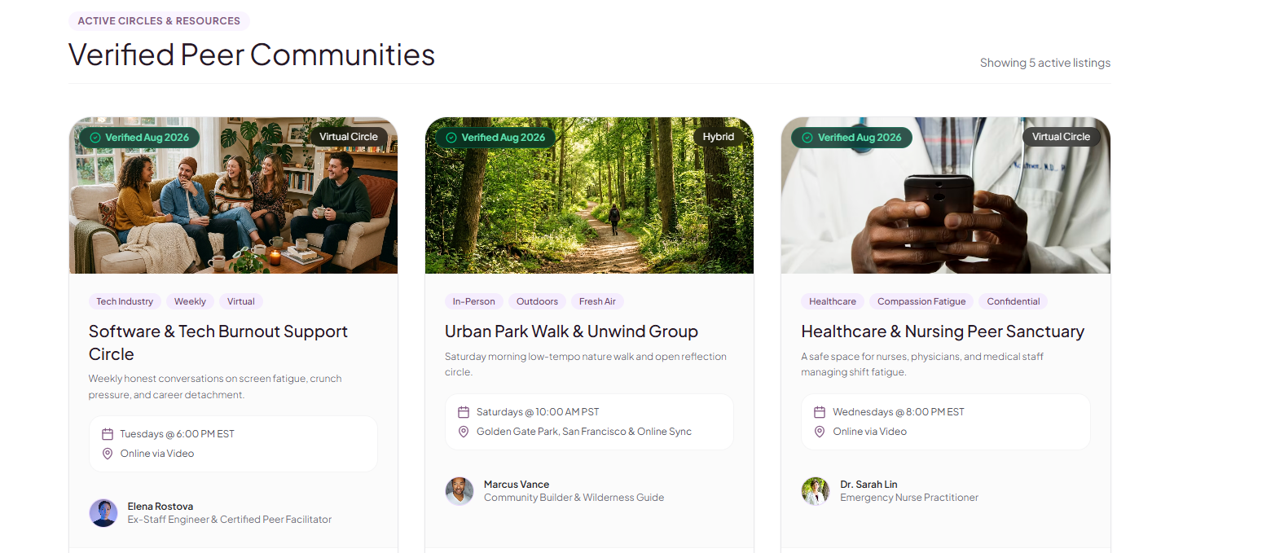
WHY PARTNERS TRUST ESCALE
Every listing, verified down to the date
You can't put your name behind a broken link. Every peer group, tool, and professional resource in escale is actively re-checked — so what you recommend to your people stays credible.
Live product view: verified peer communities, each showing a facilitator, schedule, and “Verified” badge.
Recurring verification
48 active peer groups
Privacy-first, always
Listings are re-checked on a set cadence and display their last-verified date.
Spanning tech burnout, caregiving, healthcare, neurodivergent spaces, and general burnout — with room to add your population.
100% free for seekers; no data shared with employers or third-party ad networks.
04

Slide 5
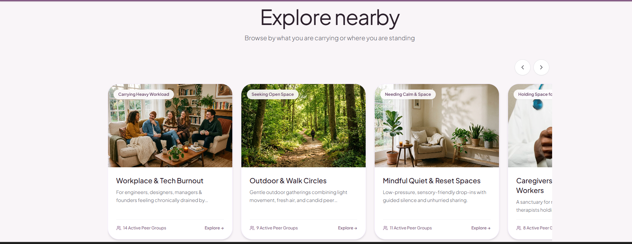
WHO IT SERVES
Built for every kind of burnout in your population
A software engineer, a night-shift nurse, and an unpaid family caregiver don't need the same resource. escale segments by what someone is carrying, not a one-size-fits-all hotline.
Segmented browsing: workplace burnout, outdoor circles, mindful reset spaces, caregiver sanctuaries, and more.
For myself
For someone
For work
Self-directed employees find their own match, fully anonymous.
Managers and family members route on behalf of someone they're worried about.
HR and benefits teams point an entire team to escale as a first-line resource.
05

Slide 6
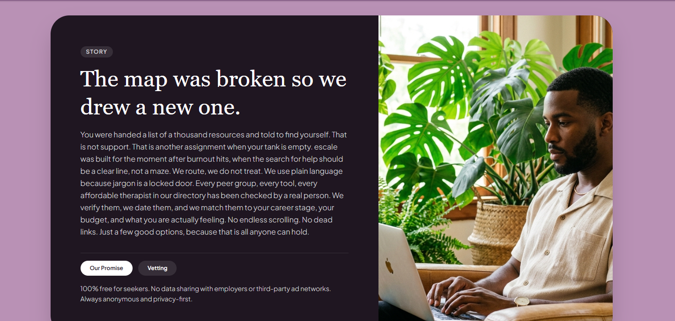
LET'S WORK TOGETHER
Give your people a clear next step.
We're looking for employer, health-plan, and community partners who want a fast, trustworthy on-ramp to support for the people they're responsible for — without building or maintaining it themselves.
Co-branded access
A dedicated escale entry point for your employees, members, or community, ready to launch.
Your resources included
Your own EAP, benefits, or in-house programs added to the verified shortlist alongside ours.
Simple engagement reporting
Aggregate, anonymized usage trends — never individual identities — shared back with your team.
Let's talk about piloting escale with your people.
06

