Slide 1
Competitor Strategy Tracker for E-commerce - VIDZAI
By Team 3,
Rohan
Jahnavi
Kavya
Jayanth

Slide 2
Introduction
Competitor Strategy Tracker for E-commerce - VIDZAI is a Python-based system leveraging LLMs and ML models to track competitor pricing, discounts, and insights for pricing optimization in e-commerce.

Slide 3
Problem Statement
E-commerce businesses struggle with real-time competitive pricing insights.
Lack of automation in tracking competitor discounts and pricing strategies.
Manual analysis is inefficient and time-consuming.
No AI-powered recommendations for pricing optimization.

Slide 4
Objectives
Automatic price tracking.
⁠Provides actionable insights.
Predicts future prices.
⁠Analyzed customer sentiment.
Optimized discount strategies.

Slide 5
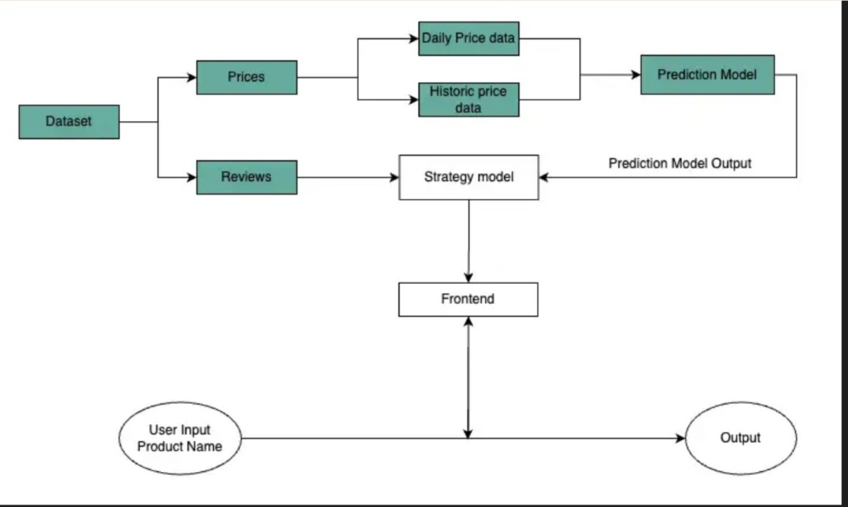
Flowchart

Slide 6
Technology Stack
Python & Machine Learning (ARIMA, Sentiment Analysis, Discount Optimization)
LLMs(OpenAI GPT, Meta LLaMA for insights)
Price API (Real-time price tracking)
Streamlit (Frontend and dashboard)
GitHub (Project management & issue tracking)

Slide 7
Features
Real-time Price Tracking across multiple e-commerce platforms.
Machine Learning Predictions for future pricing trends.
Competitor Discount Analysis using AI-powered insights.
Automated Reports & Dashboards for decision-making.

Slide 8
Competitor insights chatbot
The chatbot provides instant insights on competitor pricing trends.
Built using LLMs (GPT, LLaMA) for natural conversations.
Users can ask questions and receive real-time pricing insights.
Integrated with the backend to fetch data from CSV files and ML models.
Enhances usability by offering a conversational way to access competitor analysis.

Slide 9
Future Improvements
Improve AI models for better sentiment and price predictions.
Expand support for more e-commerce platforms.
Integrate more data sources for comprehensive insights.
Enhance UI/UX for better usability and experience.

Slide 10
Conclusion
E-commerce pricing strategies by leveraging AI to track competitor prices, analyze discount trends, and provide data-driven insights. By automating these processes, businesses can stay competitive, make informed decisions, and maximize profitability.

Slide 11



