Slide 1

MentorMuni
Placement Platform for Engineering Colleges
We make every student drive-ready — and give your placement office one live number to run the season on.
PREPARED FOR
CAMPUSES
CITY
SESSION
Training & Placement Office
Medi-Caps · IIST · Shri Vaishnav
Indore, Madhya Pradesh
Live product walkthrough
Notes:
Open by naming the room: "I am not here to sell you a training package. I am here to show you the operating system underneath placement season." Say the three college names out loud. Two lines is all this slide owes them.

Slide 2

WHY MENTORMUNI
MentorMuni
Placement Platform for Engineering Colleges
Two years ago this product
was not buildable.
1
2
3
What changed
What recruiters changed
What that means for you
Real-time voice AI matured. A scored, spoken mock interview for every student, every day, was economically impossible eighteen months ago. It is possible now.
Aptitude, coding and communication are filtered before a human ever sees your student. The elimination happens in rounds you cannot currently see or measure.
Every serious campus will run a placement OS within three years. The question is whether yours starts this season or after two more batches graduate.
Built with industry practitioners — the assessments and mock rounds are designed around what actually eliminates students in Indian campus drives, not around a syllabus.
Notes:
This slide replaces a customer-logo slide. Do not apologise for being early — sell being early. If asked "who else uses this?", answer straight: we are signing our founding campuses this season, which is exactly why the terms on the costing slide are what they are. Never invent a customer. Be ready to name the practitioners if challenged. If you cannot, cut the bottom bar.

Slide 3
MentorMuni
THE PROBLEM IN COLLEGES TODAY
Placement Platform for Engineering Colleges
The drive is in 21 days.
Who on this campus is actually ready?
“We will know after the first round.”
“The HODs said their students are fine.”
“We ran the aptitude test in August.”
That is three weeks too late to fix anything.
Said from memory, not from data.
One score, one day, six months stale.
None of these are people problems. Your TPO works harder than anyone on campus. The problem is that the campus has no shared, live picture of readiness.
Notes:
Do NOT rush. Read the three quotes and pause. Ask: "Which of these have you said out loud this year?" The moment a TPO admits one, you have earned the next twenty minutes. Land the last line hard — you are explicitly not blaming their team.

Slide 4
THE PROBLEM
MentorMuni
The six problems every placement cell fights
Placement Platform for Engineering Colleges
Ranked by how much placement percentage they quietly cost you each year.
1
No single source of truth
2
Readiness is discovered too late
3
The TPO is the bottleneck
Readiness lives in five spreadsheets, three WhatsApp groups, and one person's head. Nobody can answer "how many are drive-ready?" in under a week.
The first honest signal arrives in the company's first round. By then there is no time left to intervene.
Collecting resumes, chasing branches, building shortlists, sending reminders — all manual, all on two or three people.
4
HODs are blind to their own branch
5
Students prepare randomly
6
Management has no leading indicator
Departments own the students but see none of the readiness data, so intervention never starts where it should.
Free YouTube, random PDFs, last-night cramming. No plan, no feedback, no idea what a real interview feels like.
The board sees placement % once a year — after it is already final. Nothing to steer with mid-season.
Notes:
Never read all six. Ask "which two of these are true on your campus?" and let their answer steer the rest of the demo. Number six is the slide that gets you a meeting with the Director.

Slide 5
MentorMuni
HOW MENTORMUNI SOLVES IT
Placement Platform for Engineering Colleges
Stop running placement as an event.
Run it as an operating system.
TODAY
WITH MENTORMUNI
Readiness measured once a year
Readiness recalculated every single day
Data lives in spreadsheets and memory
One live number per student, branch, and campus
TPO chases every update manually
Roles, invites, and approvals run themselves
HODs find out when the TPO tells them
HODs see their own branch in real time
Students prepare on guesswork
Every student gets a plan sized to today
Management sees a result
Management sees a trend they can still change
Notes:
The pivot slide. Say the headline verbatim — it is the line you want them repeating to their Director after you leave. Go left-to-right down the six rows quickly. Everything after this is proof of the right-hand column.

Slide 6
HOW MENTORMUNI SOLVES IT
MentorMuni
Measure. Plan. Practice. See.
Placement Platform for Engineering Colleges
Not a course. Not a portal. A running system with a live readiness score at the centre of it.
1
2
3
4
Measure
Plan
Practice
See
Eight baseline assessments — aptitude, skills, coding, resume, and AI mock interviews — produce one honest readiness score per student.
That score becomes a 90-day plan, broken into a daily mission sized to the time the student actually has.
A scored AI voice mock interview every day, coding rounds, and company-specific drive sprints — no panel to schedule.
Every score rolls up live to the HOD, the TPO, and management, with the intervention already suggested.
The loop closes: what the student does today changes what the TPO sees tomorrow. That is the whole product.
Notes:
Four words: Measure, Plan, Practice, See. If they remember nothing else, they remember four words. The closing line is the differentiator — every competitor does one or two of these; nobody closes the loop back to the TPO.

Slide 7
HOW MANY PORTALS, AND WHO EACH ONE SERVES
MentorMuni
Three portals. Four roles. One number.
Placement Platform for Engineering Colleges
Each level sees exactly what it should — and nothing it should not.
Platform
Organization — TPO
Organization — HOD
Student
MentorMuni ops
Placement office
Department head
The batch
Provisions your college as an isolated tenant
Attaches your plan, seats, and validity
Enables features · hands you the Org Admin key
Departments, HOD invites, and access control
Enrollment approvals and campus roster
Campus-wide performance, AI brief, CSV shortlist
Own branch roster and readiness only
Assign programs and mocks to weak students
Notify the branch — no TPO round trip
Daily mission, 90-day plan, streak
AI mocks, coding rounds, company prep
Private Fear → Fearless track
Student answers stay with the student. HODs see only their branch. The TPO sees the campus. We do not access any of it.
Notes:
Draw the arrow with your hand, left to right. Then stop on the last line — it pre-empts the most common objection in a campus sale. Say "we do not access it", never "we cannot see it". We operate the platform; the honest claim is a policy commitment, not a technical impossibility.

Slide 8
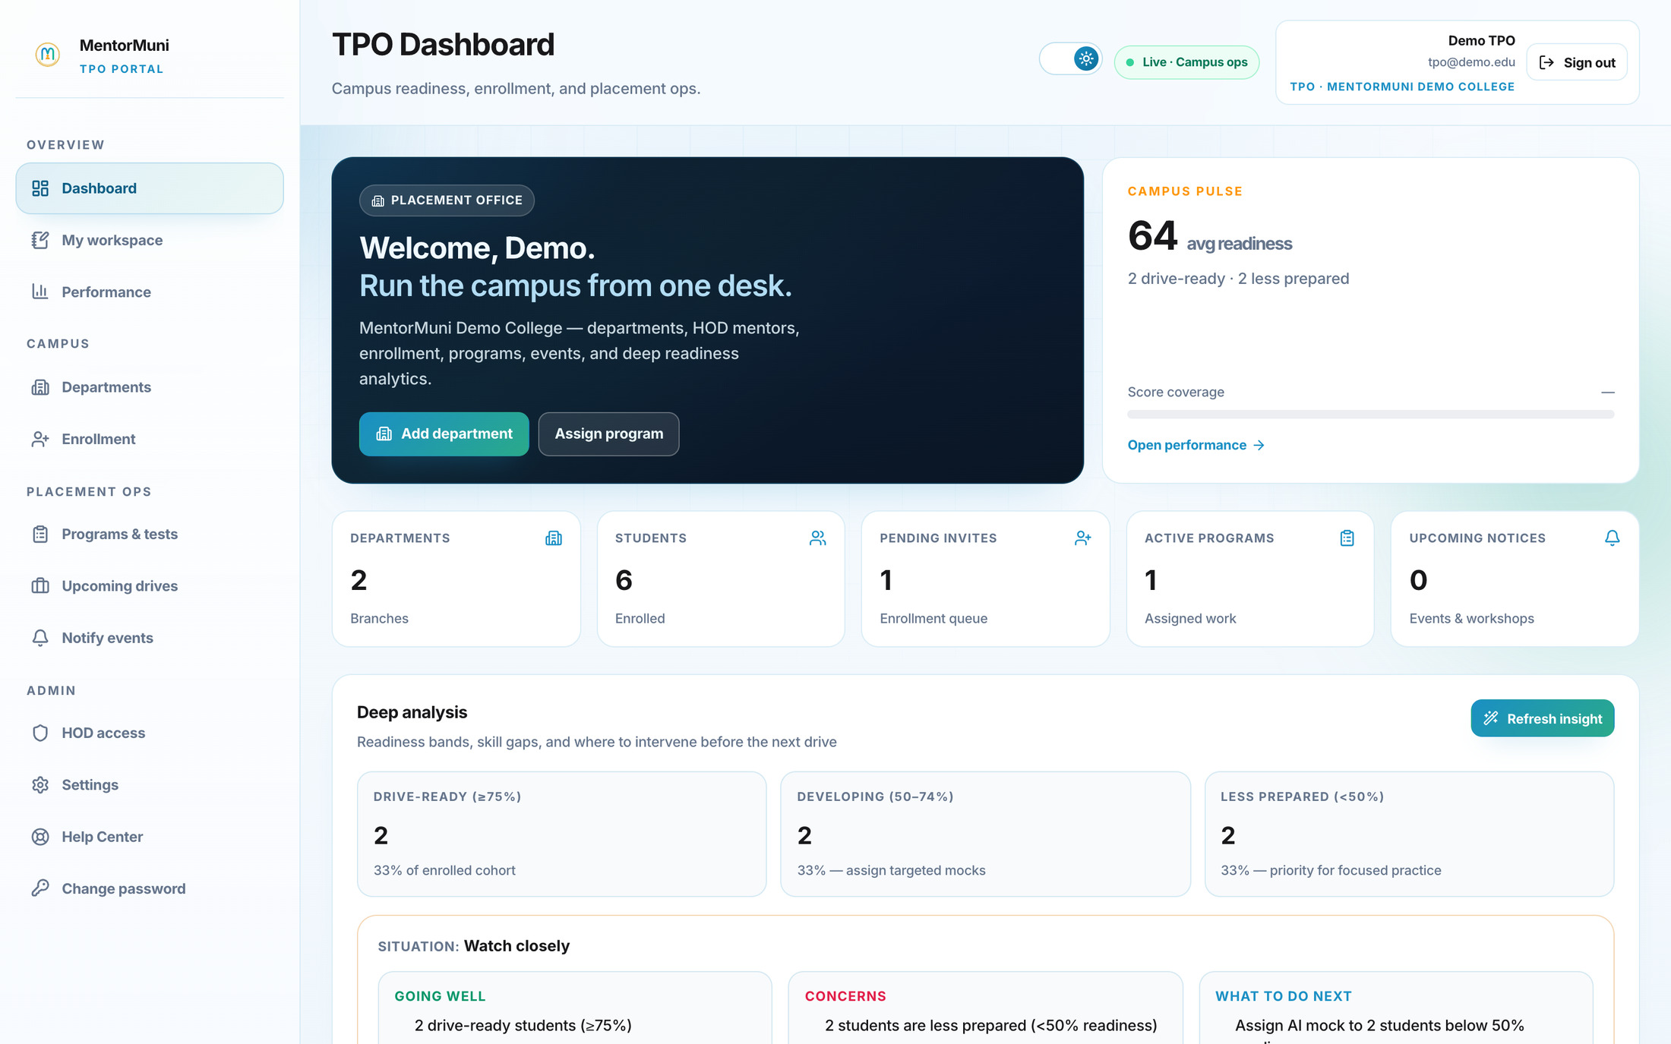
TPO PORTAL · DASHBOARD
MentorMuni
Placement Platform for Engineering Colleges
Open one screen and know where the campus stands
1
Campus pulse, live
Average readiness, drive-ready count, and score coverage — recalculated as students practise, not once a term.
2
Readiness banded automatically
Drive-ready, developing, and less prepared. You instantly know the size of the problem, not just that one exists.
3
It tells you what to do next
Deep analysis surfaces what is going well, what is a concern, and the specific action — assign mocks, escalate a branch, chase an invite.
Screens are the live product, captured against a demo cohort.
Notes:
The killer line: "You have not opened a spreadsheet, called a single HOD, or asked anyone for an update — and you already know your campus is at 64 with two students in trouble." Then ask: "How long does it take you to get to this screen today?" Write their answer down in front of them. That is your business case.

Slide 9
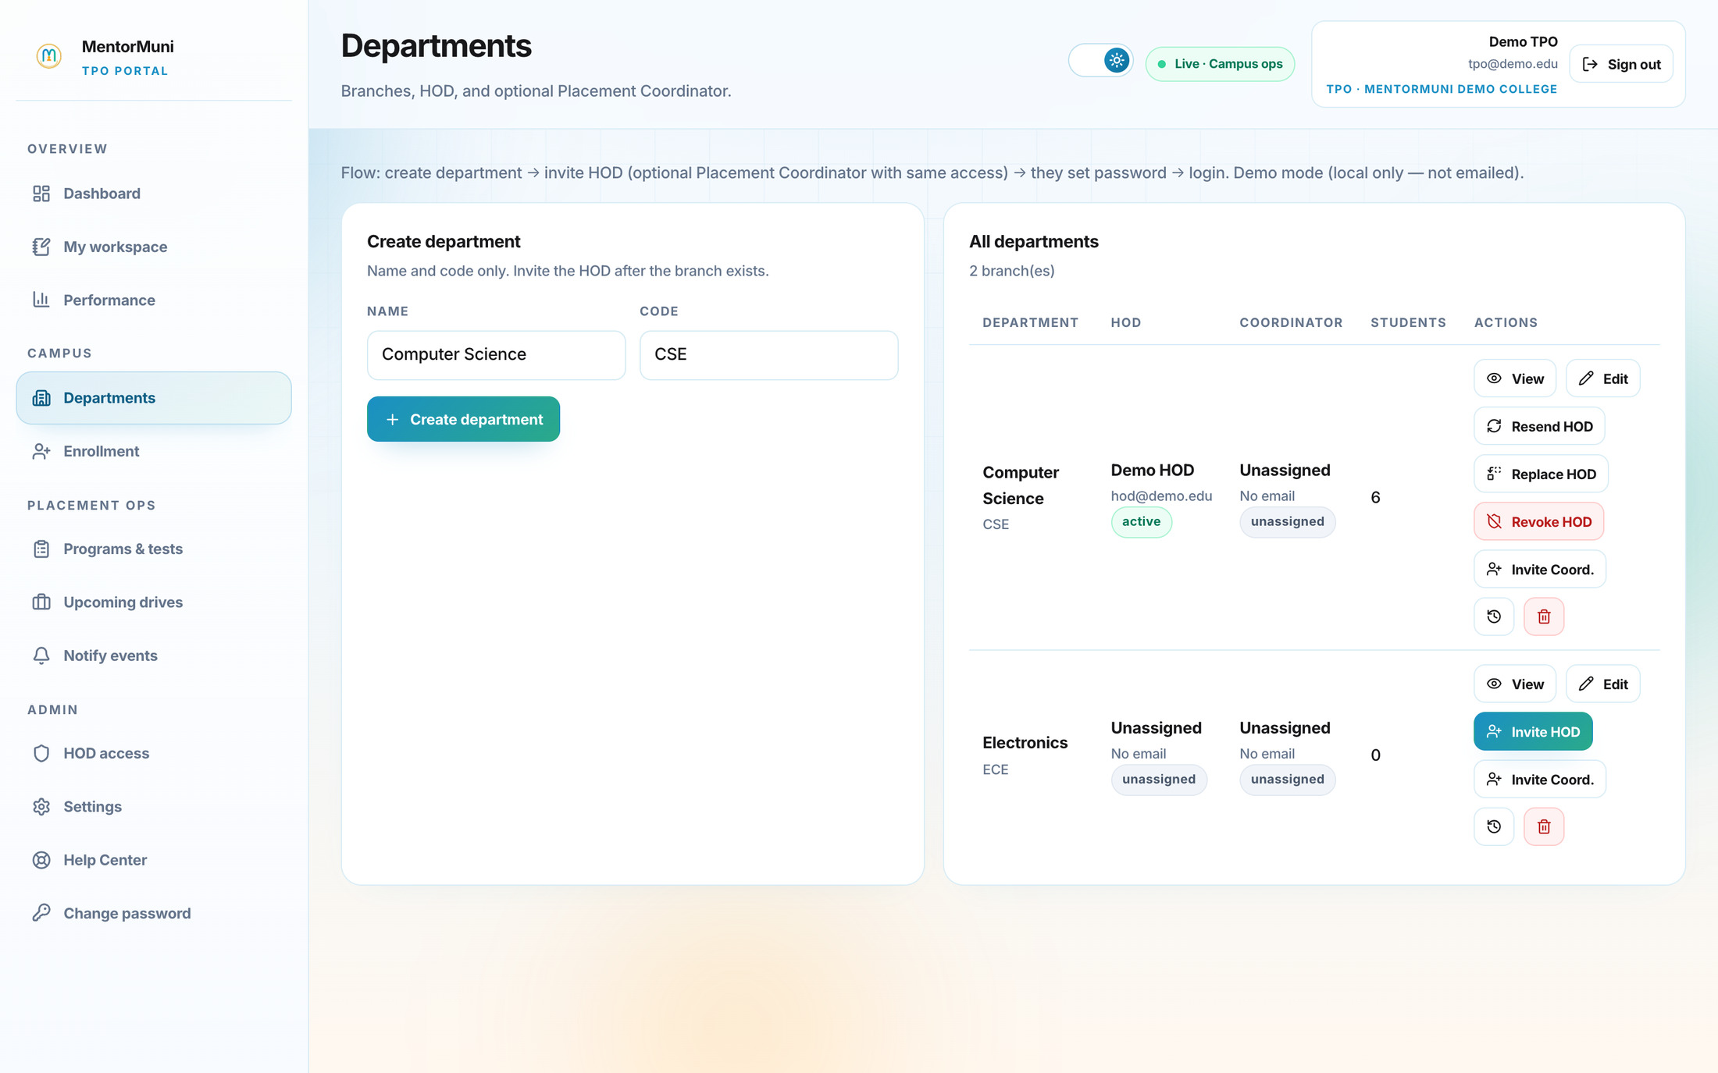
TPO PORTAL · DEPARTMENTS
MentorMuni
Placement Platform for Engineering Colleges
Stand the whole campus up in an afternoon
1
Create the branch structure
CSE, ECE, Mechanical, IT — name and code, and the branch exists with its own roster and readiness.
2
Invite the HOD, they self-activate
One invite, they set their own password. No credential sheets, no password resets landing on your desk.
3
Add a Placement Coordinator
Departments that need extra hands get a coordinator with the same branch-level access. Delegation without losing control.
Notes:
Kills the "we bought it and never rolled it out" fear. Nobody has to be trained to receive an email and set a password. This slide sets up the three-day onboarding promise later — flag it now so it lands then.

Slide 10
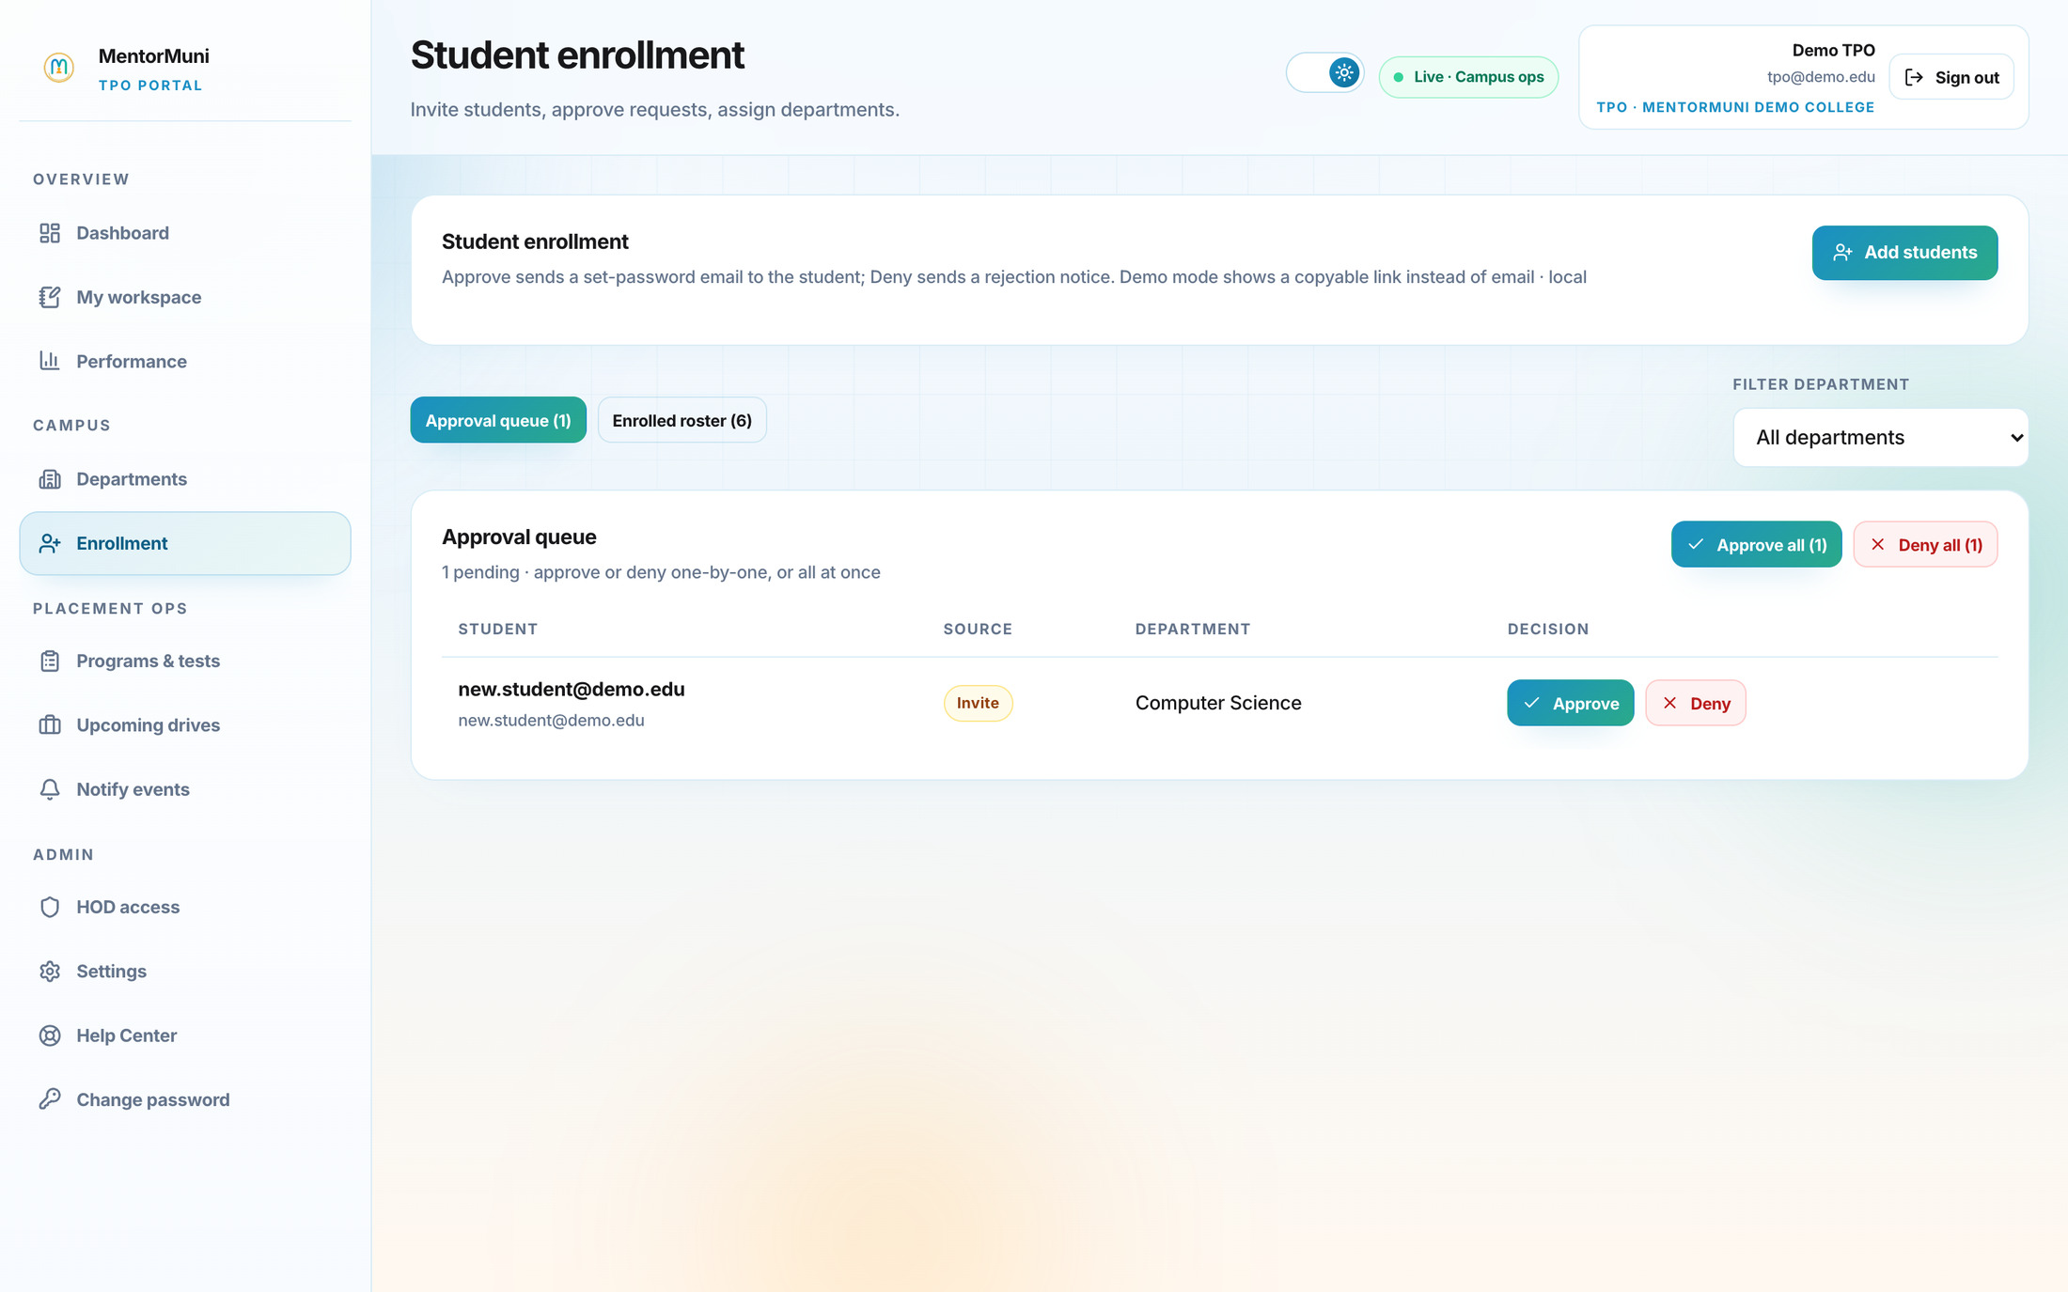
TPO PORTAL · ENROLLMENT
MentorMuni
Placement Platform for Engineering Colleges
Onboard the batch without collecting a single form
1
Invite or let them request
Add students directly, or let them request access — either way they land in one approval queue.
2
Approve one, or approve all
Bulk approve the batch. Each approval sends a set-password email and assigns the department automatically.
3
One roster, always current
The enrolled roster is the single list every other screen in the system reads from. No reconciliation, ever.
Notes:
This is where the "our students will never use it" objection dies. No form, no app-store download, no training session — an email, a password, and they are in. The whole batch can be onboarded before their next drive.

Slide 11
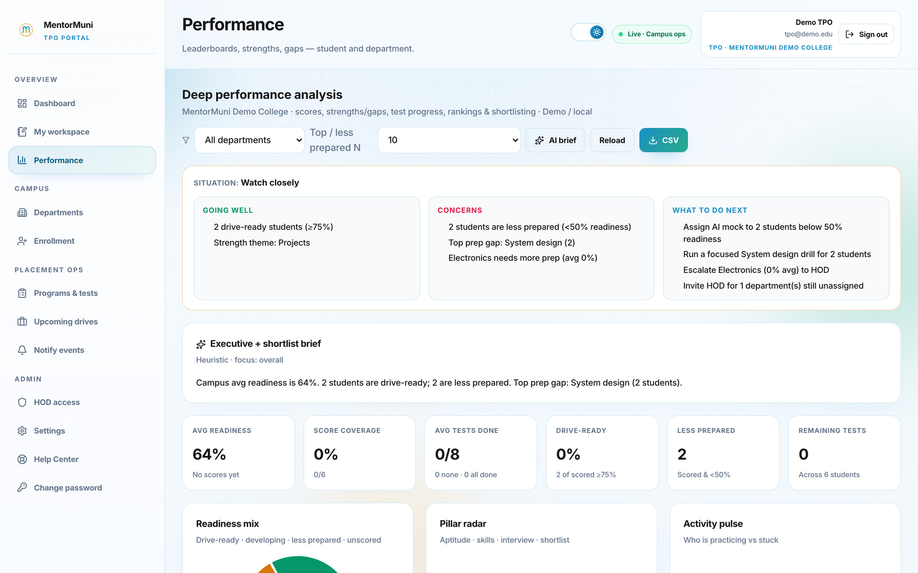
TPO PORTAL · PERFORMANCE
MentorMuni
Placement Platform for Engineering Colleges
The recruiter asks for a list. You send it today.
1
Rank and filter instantly
Sort the campus by readiness, filter by department, set your top-N cut. The shortlist assembles itself.
2
An AI brief you can forward
A written executive summary — average readiness, drive-ready count, top prep gap — ready to paste into a mail to your Director.
3
Export to CSV for the recruiter
One click. No collation, no chasing branches, no reconciling three versions of the same sheet.
Notes:
Highest-ROI screen for the TPO personally. Do not assert how long shortlisting takes them — ASK: "When Infosys asks for eighty eligible names, what does that take you today?" Then point at the CSV button and stay quiet.

Slide 12
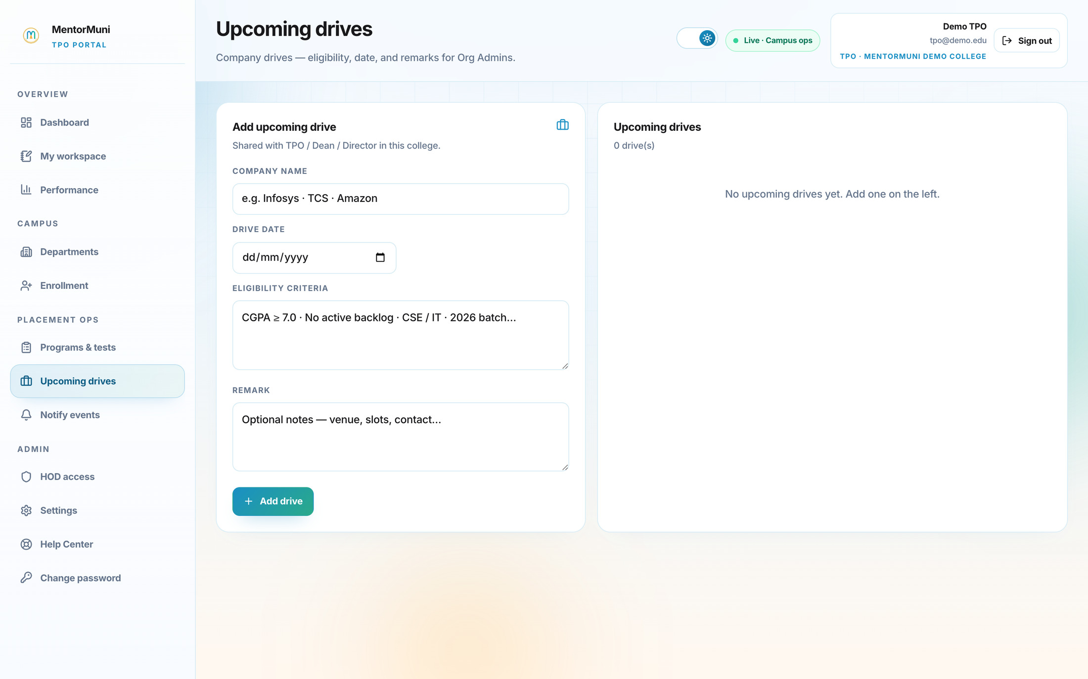
TPO PORTAL · UPCOMING DRIVES
MentorMuni
Placement Platform for Engineering Colleges
Publish a drive once — the whole campus starts preparing
1
Company, date, eligibility
Enter the drive once. CGPA cut, backlog rules, eligible branches and batch — captured in one place.
2
Every eligible student is notified
No WhatsApp forwards, no notice board, no "sir I did not know about it" on the morning of the drive.
3
Preparation reprioritises itself
The drive date flows straight into each eligible student's daily plan as a countdown sprint.
Notes:
Bridge slide into the student portal. "You publish once, and the system does the notifying AND the preparing." Then say "let me show you what happens on the student's phone the moment you press that button."

Slide 13
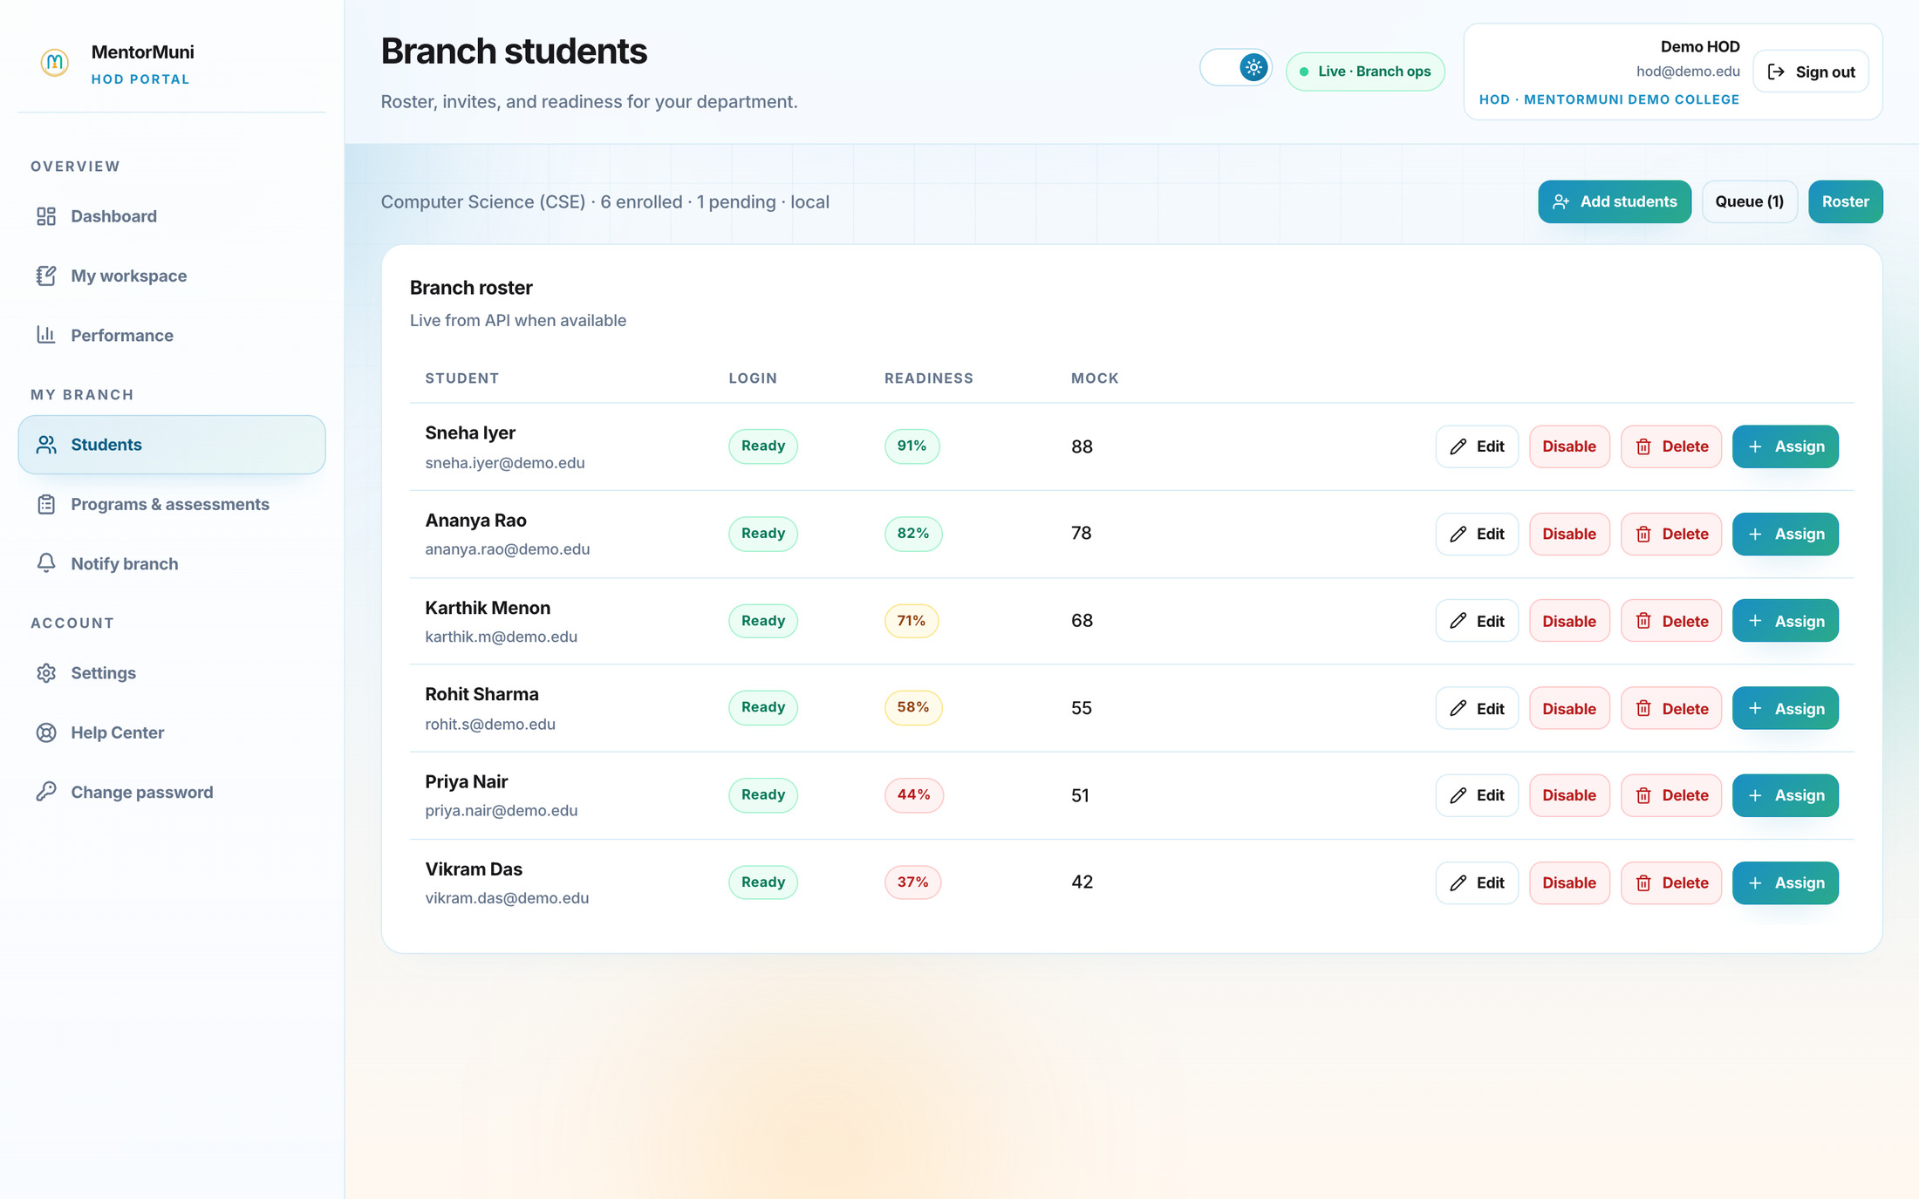
HOD PORTAL · BRANCH STUDENTS
MentorMuni
Placement Platform for Engineering Colleges
Your HODs stop guessing and start intervening
1
Their branch, and only their branch
CSE sees CSE. ECE sees ECE. Access is scoped in the system, so there is no politics about who saw whose numbers.
2
Weak students surface themselves
Readiness sorted top to bottom. The 37% and the 44% are visible in September, while there is still time.
3
Assign help in one click
Assign a mock interview or a program to a struggling student directly from the roster — no request routed through the TPO.
Notes:
HOD buy-in is what makes a rollout survive past month two. Frame it as "we are giving your HODs something, not watching them." Point at the 44% and the 37%: "These two will fail round one of your next drive. Today you meet them in December. Here you meet them in September."

Slide 14
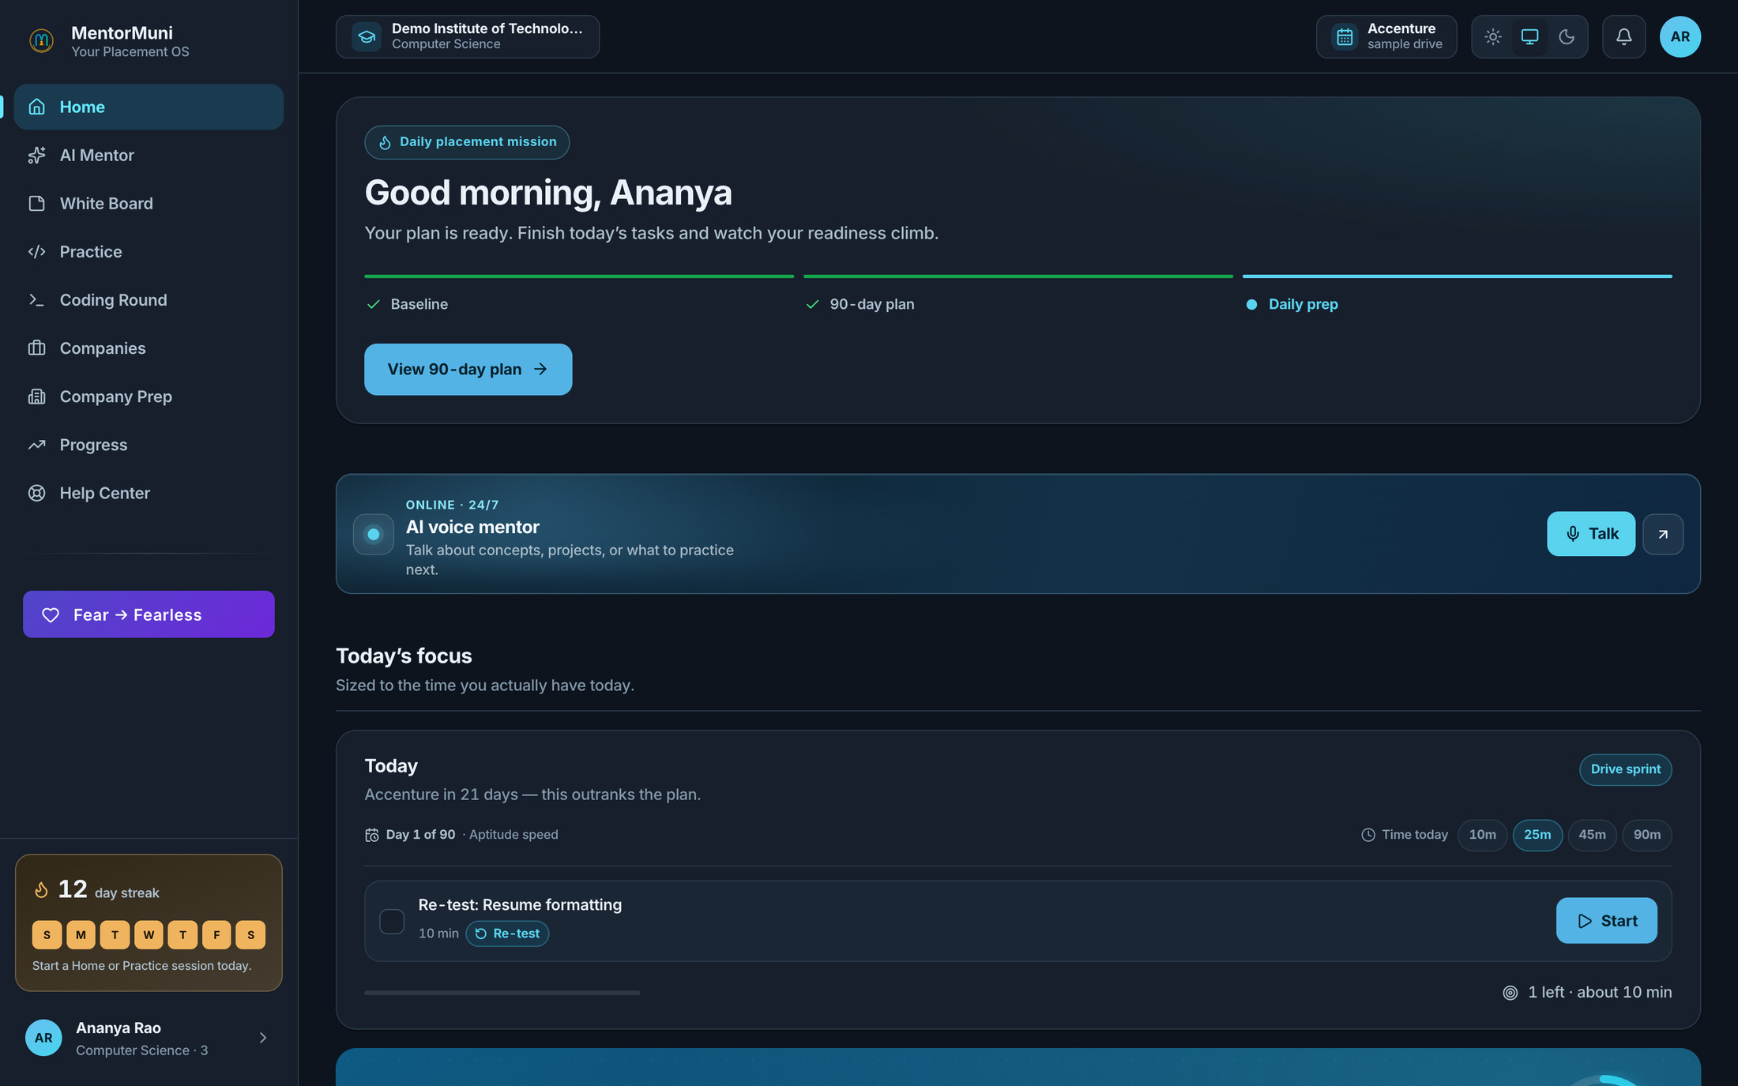
STUDENT PORTAL · HOME
MentorMuni
Placement Platform for Engineering Colleges
Every student wakes up knowing what to do today
1
A daily mission, not a syllabus
Baseline done, 90-day plan generated, today's tasks queued. No decision fatigue, no blank page.
2
Sized to the time they have
10, 25, 45 or 90 minutes. A student with a lab practical still keeps the streak alive.
3
The drive outranks the plan
When a company is 21 days out, the system reprioritises automatically — drive prep beats the generic plan.
Notes:
Point at the 12-day streak and the "Accenture in 21 days" line. "This is why they come back tomorrow." Expect the adoption objection. Answer honestly: that is the real risk in every campus rollout, which is why the pilot is scoped to one branch and why we report weekly active students to you from week one. Do not claim a retention number we have not measured.

Slide 15
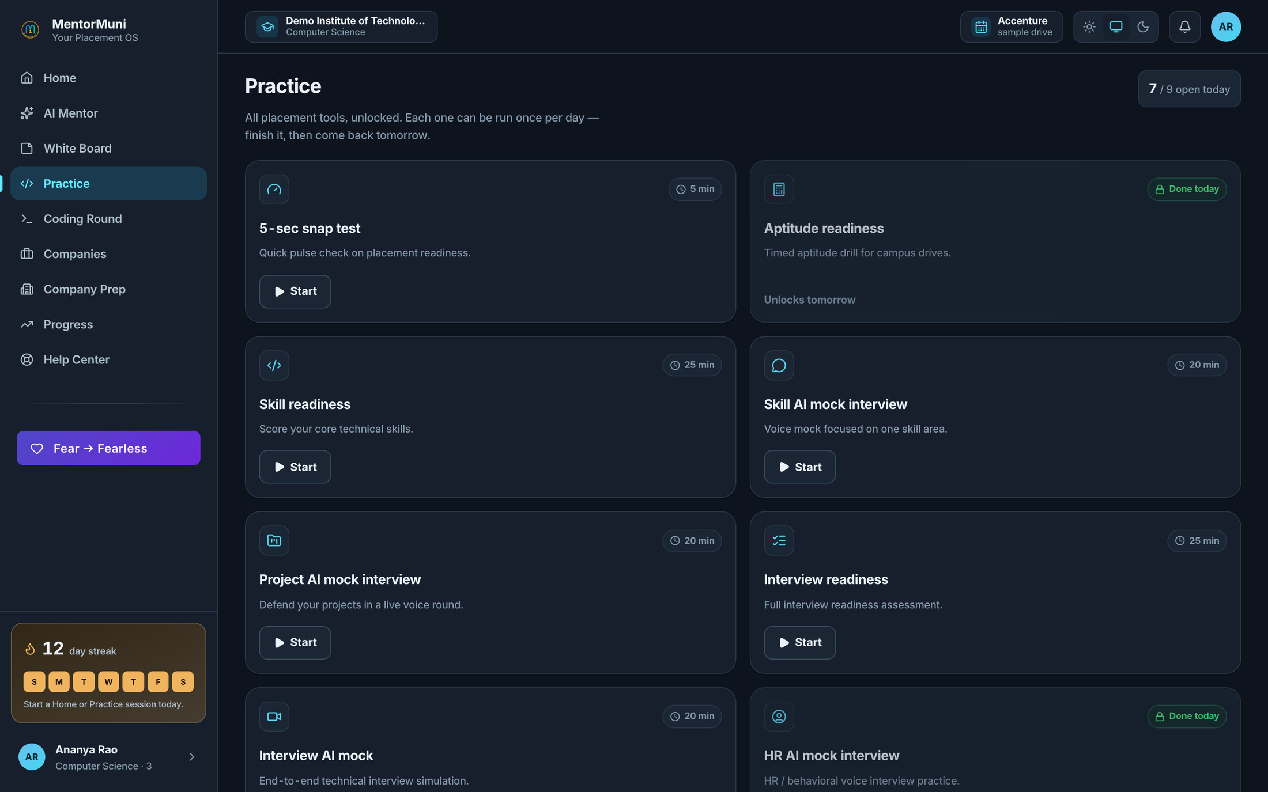
STUDENT PORTAL · PRACTICE
MentorMuni
Placement Platform for Engineering Colleges
Nine tools. Eight of them score the baseline.
1
AI mock interviews, on demand
Skill, project, HR, and full technical rounds — voice-based, available at 2am, no panel to schedule.
2
Aptitude, coding, and resume ATS
The three rounds that actually eliminate your students, drilled daily instead of crammed once.
3
One focused run per day, by design
A student can take a scored mock every single day of the season — but only one, so it builds a habit, not a weekend binge.
Notes:
The economics line: "How many mock interview panels can you realistically run for six hundred students? Two rounds each? This gives every student a scored round every day, and scores every one of them."

Slide 16
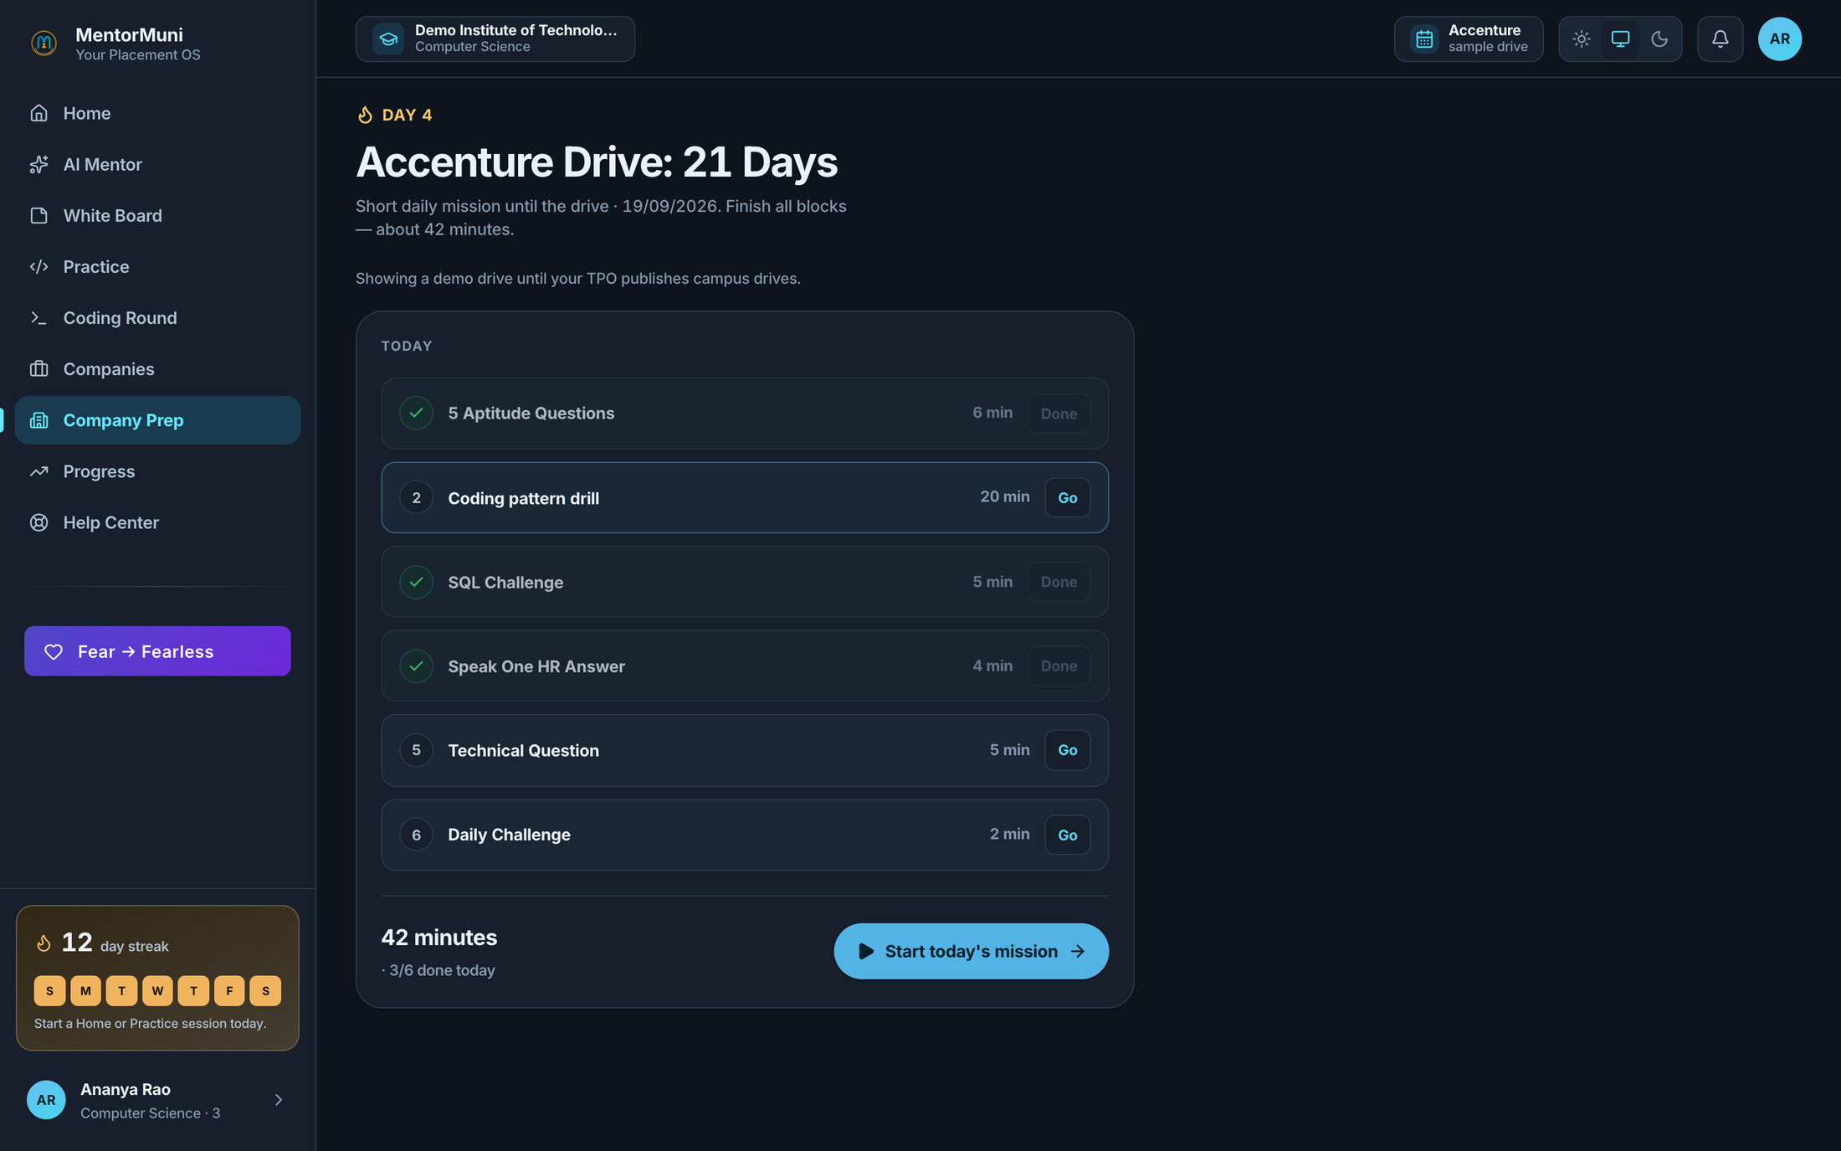
STUDENT PORTAL · COMPANY PREP
MentorMuni
Placement Platform for Engineering Colleges
A 21-day countdown for the company that is actually coming
1
Prep matched to the recruiter
Aptitude, coding pattern, SQL, HR answer, technical question — shaped for that company's process.
2
Roughly 40 focused minutes a day
Six short blocks. Achievable after class, which is the only reason it gets done at all.
3
Fed by the drive you published
The moment the TPO publishes a drive, this countdown appears for every eligible student. No coordination needed.
Notes:
Close the loop out loud: "Remember the drive you published four screens ago? This is what appeared on three hundred phones that evening. You did one thing; the system did three hundred."

Slide 17
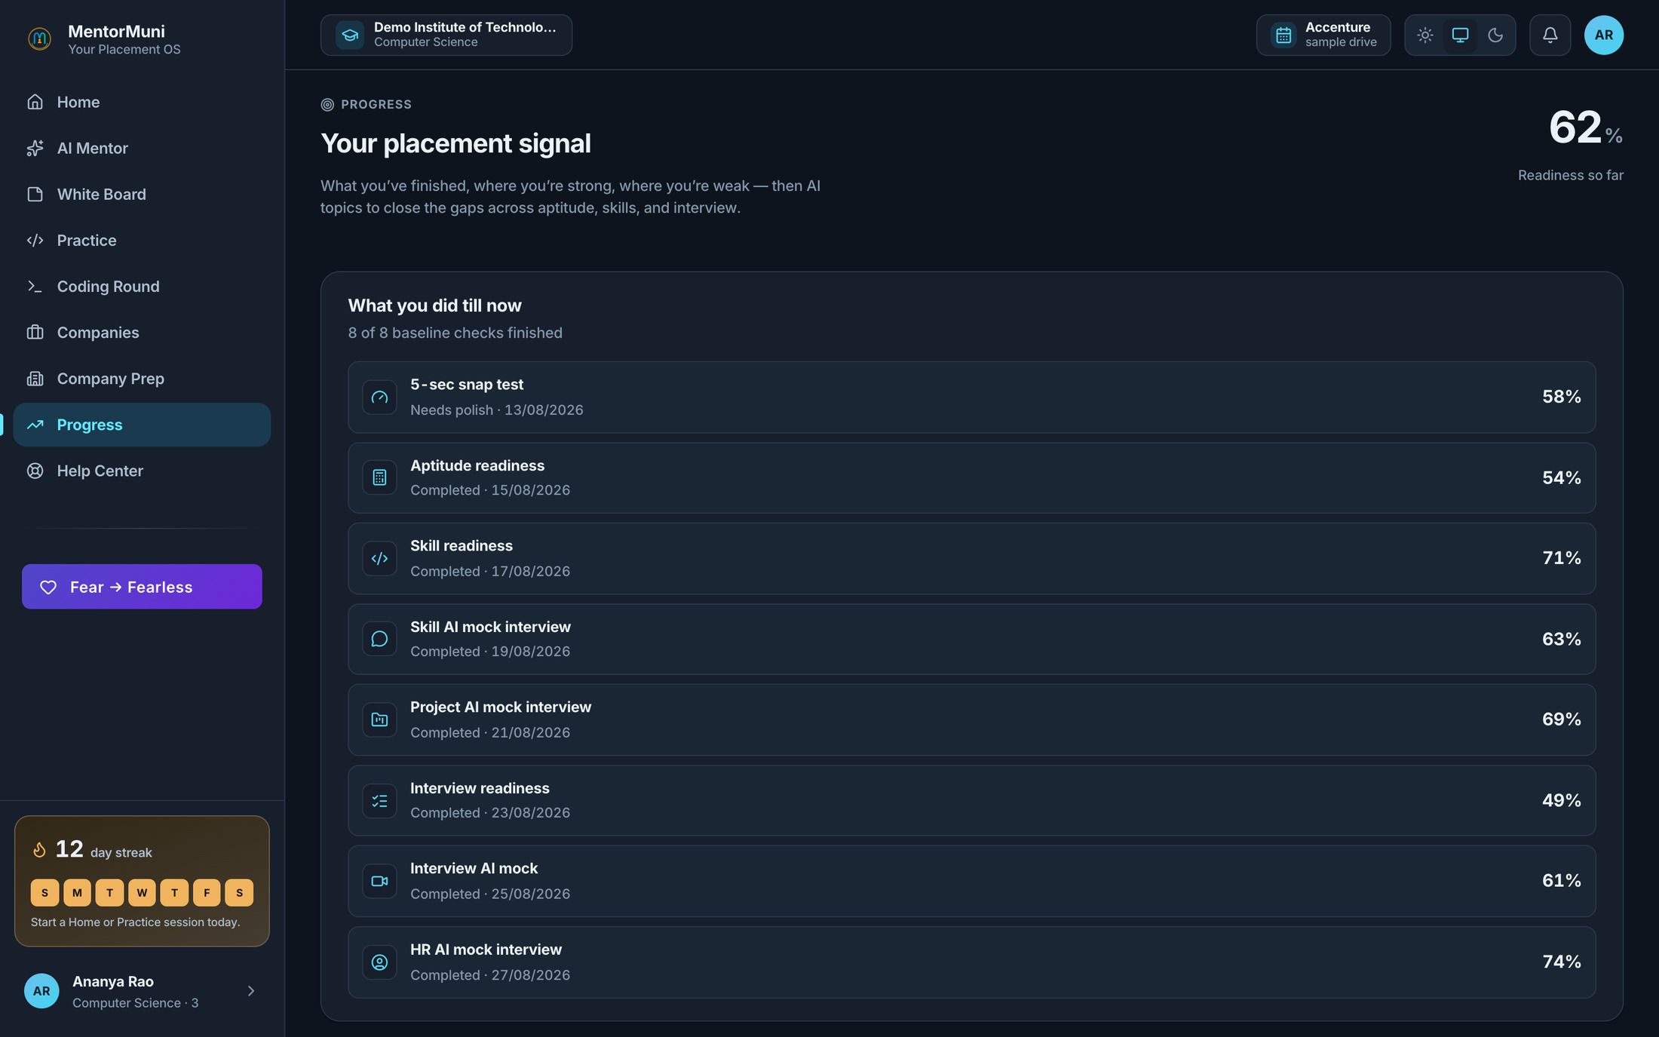
STUDENT PORTAL · PROGRESS
MentorMuni
Placement Platform for Engineering Colleges
The student sees the same number the TPO sees
1
One honest score
Eight baseline checks roll into a single readiness figure. No vanity metrics, no participation certificates.
2
Strengths and gaps, named
The student knows their aptitude is 54 and their HR is 74 — so the next hour goes to the right place.
3
Shared truth, no arguments
When a student asks "why was I not shortlisted?", the answer is on screen. Nobody has to defend a decision.
Notes:
This quietly solves a political problem every TPO has: shortlist disputes. The criterion becomes visible and objective before the drive, not argued after it.

Slide 18
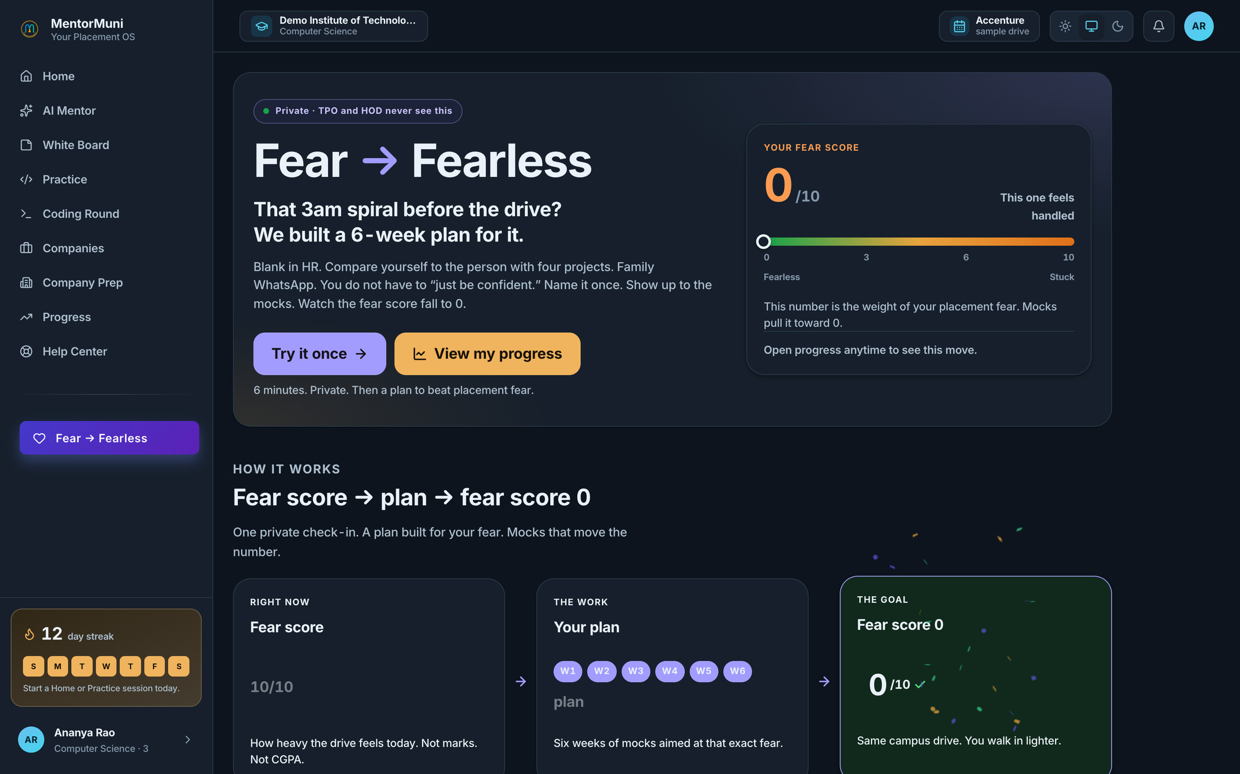
STUDENT PORTAL · FEAR → FEARLESS
MentorMuni
Placement Platform for Engineering Colleges
The part nobody else is building
1
Placement anxiety, measured
A private 6-minute check-in produces a fear score — the weight of the drive, separate from marks or CGPA.
2
A six-week plan for that fear
Targeted mock exposure designed to bring the number down, week by week, before the drive arrives.
3
Private by design
TPO and HOD never see it. That guarantee is why students answer honestly — and why it works at all.
Notes:
Every TPO in India has lost a capable student to nerves in an HR round. Ask: "Have you had a student who was technically strong and still froze?" They always have, and they usually remember the name. This is the emotional close — do not rush past it into features. If a Director asks about duty of care on a high fear score: it is a preparation tool, not a clinical assessment, the student always sees their own result, and we will align escalation wording with their student-welfare policy at onboarding.

Slide 19
COSTING
MentorMuni
Start with Computer Science. Grow on results.
Placement Platform for Engineering Colleges
You do not have to bet the campus on the first meeting. You have to give one branch one season.
START HERE
THEN
FULL CAMPUS
Computer Science
Multi-branch
Every branch
Up to 100 students
Up to 500 students
Whole college, all batches
₹2,00,000
₹5,00,000
₹8,00,000
per academic year
per academic year
per academic year
₹2,000 per student
₹1,000 per student
Best per-student rate
One licence replaces the stack: aptitude vendor · external mock panels · soft-skills trainer · coding assessment platform · resume and ATS review.
Mutual success: you only move to the next tier if the branch moves the metric you chose. If it does not, you stop at tier one and we have both learned something real.
Notes:
Never open with the ₹8 lakh number. Put your finger on ₹2,00,000 and leave it there — that is a number a Director can approve without a tender, and it is the only number you are asking for today. The ladder sells for you: they can see what "it worked" costs next year, and the per-student rate halves as they grow. CRITICAL — agree the success metric here, in the room, and write it down. It must be something THE COLLEGE already tracks (round-one clearance, shortlist turnaround, students eligible on drive day), never our own readiness score. If the test is our number, a sharp Director will read it as rigged, and they will be right. All figures are per academic year. Confirm GST treatment before you send the proposal.

Slide 20
ONBOARDING
MentorMuni
Placement Platform for Engineering Colleges
College onboarded and students preparing
in three days.
1
DAY 1
2
DAY 2
3
DAY 3
College onboarded
Students onboarded
Preparation starts
We provision your college as its own tenant
You create the branch and invite the HOD
HOD activates their own account
Bulk-invite the batch by branch
Approve the enrollment queue in one click
Students set their own passwords and sign in
Students begin the baseline assessments
Readiness starts appearing on your dashboard
Daily missions begin the same evening
No IT project. No integration. No server. One nominated coordinator on your side, and roughly two hours of their time.
Notes:
The number that matters is three. Every campus has been burned by software that needed a committee and a semester. Say it plainly: "If we start Monday, your students are preparing by Wednesday evening." Be straight about the one dependency: day three delivers readiness only as fast as students actually sit the baseline. We send the invites and the reminders; a word from the TPO or HOD moves it far faster. Promise the setup in three days — not that all six hundred will have finished testing by then.

Slide 21
Thank you.
One question before you decide: what is your campus readiness number right now? If the honest answer is "we do not have one", that is the whole reason for this meeting.
THE ASK
One branch. One season. ₹2,00,000.
WEBSITE
EMAIL
PLATFORM
mentormuni.com
mentormuniteam@gmail.com
Placement Platform for
Engineering Colleges
Notes:
Do not read this slide. Ask the question, then stay silent — the pause is the close. Leave with three things written down or you did not close: the name of the branch, the success metric they chose, and a date for the provisioning call. If they say "we will discuss internally", counter with: "Of course. What would you need from me to make that discussion a yes?" — then build the follow-up around exactly that. SWAP THE GMAIL for a dedicated sales alias before this deck leaves the room.

Slide 22
EVERYTHING BELOW IS ON DEMAND
Appendix
The competitor comparison, the admissions argument, the vendor-stack audit, the security answers, and the platform layer. Open a slide only when the room asks for it.
Notes:
Do not present the appendix. It exists so that when someone asks "what about security?", you jump to one slide, answer it, and come back. A deck you never finish presenting reads as depth.

Slide 23
APPENDIX · YOU HAVE TRIED THESE
MentorMuni
Why the four usual fixes never hold
Placement Platform for Engineering Colleges
Each one solves a slice. None of them gives the campus a live readiness picture.
Training vendor
LMS / course library
Assessment platform
In-house Excel
3-day workshop
Content, not readiness
A snapshot, not a system
Heroic, unscalable
Energy on day one, nothing on day thirty. No per-student data, no follow-through, and the same cheque again next year.
Videos measure watch time. Watch time is not interview readiness. Completion rates collapse after week two.
One test, one day, one score. It tells you who is weak; it does nothing to make them stronger.
Works until the person maintaining it is busy, leaves, or the batch doubles. It is a person, not a system.
All four are point solutions bolted onto a season that has no backbone. MentorMuni is the backbone.
Notes:
Never rubbish a vendor the TPO personally hired. If they name an incumbent (Superset, AMCAT, CoCubes, eLitmus, Unstop, TCS iON), ask what it does well, agree, then ask what it tells them about a student who is NOT ready yet. That gap is where we live.

Slide 24
APPENDIX · THE BILL YOU ARE ALREADY PAYING
MentorMuni
A placement leak, not a software gap
Placement Platform for Engineering Colleges
The cost of "we will find out later" shows up in four places — none of them on an invoice.
Weeks
Late
0
Next year
lost per season rebuilding the same shortlist data by hand
is when most at-risk students are identified — after round one
leading indicators available to management mid-season
is what a weak placement number really costs — admissions
The number that actually matters
Your placement percentage is your admissions brochure. A batch that under-performs does not just lose offers — it softens next year's intake, your NIRF graduation-outcome score, and your negotiating position with recruiters. That is the real cost centre, and it compounds.
Notes:
This is the Director slide, not the TPO slide. If a Dean or Director walks in, jump here immediately — admissions is their language, readiness is not.

Slide 25
APPENDIX · WHAT CHANGES FOR WHOM
MentorMuni
What actually gets easier, level by level
Placement Platform for Engineering Colleges
A rollout only survives if every level gets something. Here is what each one gets.
LEVEL
TODAY
WITH MENTORMUNI
Management
Placement % known only after the season ends
A live readiness trend and a mid-season lever to pull
TPO
Manual collation before every drive
A shortlist in one click and a brief you can forward
HOD
Blind to their own branch until results arrive
Branch readiness live, with one-click intervention
Faculty / Coordinator
Chasing students for updates over WhatsApp
A roster that updates itself and flags who is stuck
Student
Random prep, no feedback, no idea where they stand
A daily plan, a scored mock every day, one honest score
Notes:
Read only the row belonging to whoever is in the room. Reading all five is how you lose them.

Slide 26
APPENDIX · THE AUDIT
MentorMuni
One licence replaces a stack you already buy
Placement Platform for Engineering Colleges
Run this as an exercise, not a slide. Fill the middle column in with them, line by line.
WHAT YOU BUY TODAY
YOUR ANNUAL SPEND
COVERED BY MENTORMUNI
Aptitude / assessment vendor
₹ ______________
Included — run daily, not annually
External mock interview panels
₹ ______________
Included — a scored AI round every day, per student
Soft-skills & communication trainer
₹ ______________
Included — HR and behavioural mocks
Coding assessment platform
₹ ______________
Included — coding round built in
Resume / ATS review service
₹ ______________
Included — scored and re-testable
Placement-cell staff hours
₹ ______________
Reduced to minutes per drive
Total their column, then put it next to ₹2,00,000 for the Computer Science pilot. The comparison does the arguing.
Notes:
Put a pen on the table and fill the middle column WITH them. A TPO who has just written six numbers in your column owns the business case; you no longer have to argue it. For reference: an individual student pays ₹9,999 for our six-week program. The CS pilot is ₹2,000 per student. Use that anchor only after they have totalled their own column.

Slide 27
MentorMuni
APPENDIX · THE RETURN
Placement Platform for Engineering Colleges
The licence does not have to save money.
It has to move the number.
Placement %
Admissions
Take your batch size and move it two points. Do that arithmetic in the room with their number — those are offers from students they already have.
Placement percentage is the first thing a parent in Indore checks. It is an admissions asset, not a placement metric.
Recruiter trust
Accreditation
Send a pre-qualified, readiness-ranked shortlist and companies come back next year with more roles.
Graduation outcomes and placement data carry weight in NIRF and NBA submissions — and it is already exportable.
One additional placed student justifies more of this licence than any feature in this deck.
Notes:
Never state a placement-uplift figure as a claim. Ask for their batch size, do the two-point arithmetic on paper in front of them, and let it be THEIR number.

Slide 28
APPENDIX · OBJECTION HANDLING
MentorMuni
Your data, your tenant, your control
Placement Platform for Engineering Colleges
The questions your IT head and your Director will ask — answered before they ask them.
Who can see our student data?
Do you own our students afterwards?
Your college is a separate tenant. HODs are scoped to their own branch, the TPO to your campus. No other college can see anything of yours.
No. The roster, scores, and history belong to the institution. Exportable to CSV at any time, by you, without asking us.
What about the Fear → Fearless data?
How do accounts get created?
It is private to the student and never surfaces to TPO or HOD. It is a preparation tool, not a clinical assessment, and we will align the escalation wording with your student-welfare policy at onboarding.
Invite and self-activation. Every user sets their own password from their own email — no shared credential sheets anywhere on campus.
Raise these yourself before the room does. Volunteering the boundary is what makes people believe it.
Notes:
The person who blocks a campus deal is usually not in the room — it is the IT head or the registrar who reads the proposal later. Leave this slide with them specifically. Say "we do not access it", never "we cannot see it", and offer to write it into the agreement before they ask.

Slide 29
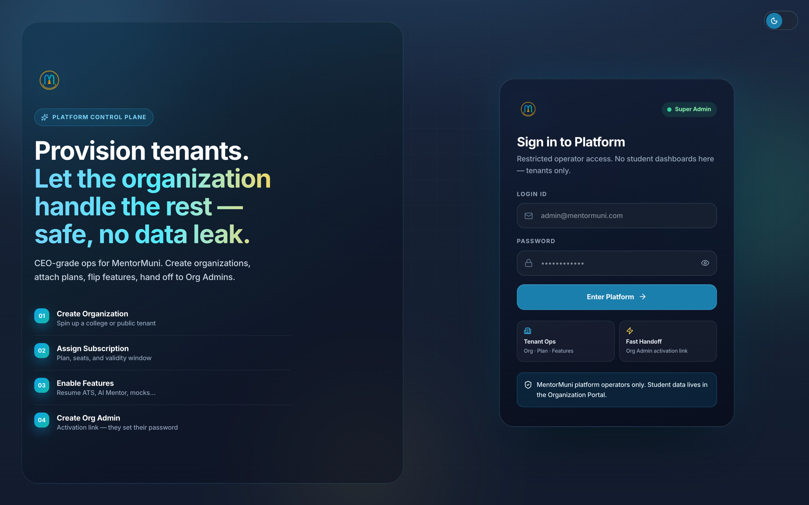
APPENDIX · PLATFORM · MENTORMUNI OPERATIONS
MentorMuni
Placement Platform for Engineering Colleges
Your college is provisioned as its own tenant
1
Isolated by design
Your college is created as a separate organization with its own students, departments, and data boundary.
2
Plan, seats, validity
Subscription and seat count are attached at provisioning — you never share a pool with another campus.
3
Then we hand over the keys
An activation link creates your Org Admin. From that moment the placement office runs the portal, not us.
Notes:
"This screen is ours, not yours — you will never log in here. I am showing it so you know exactly where the wall is."

Slide 30
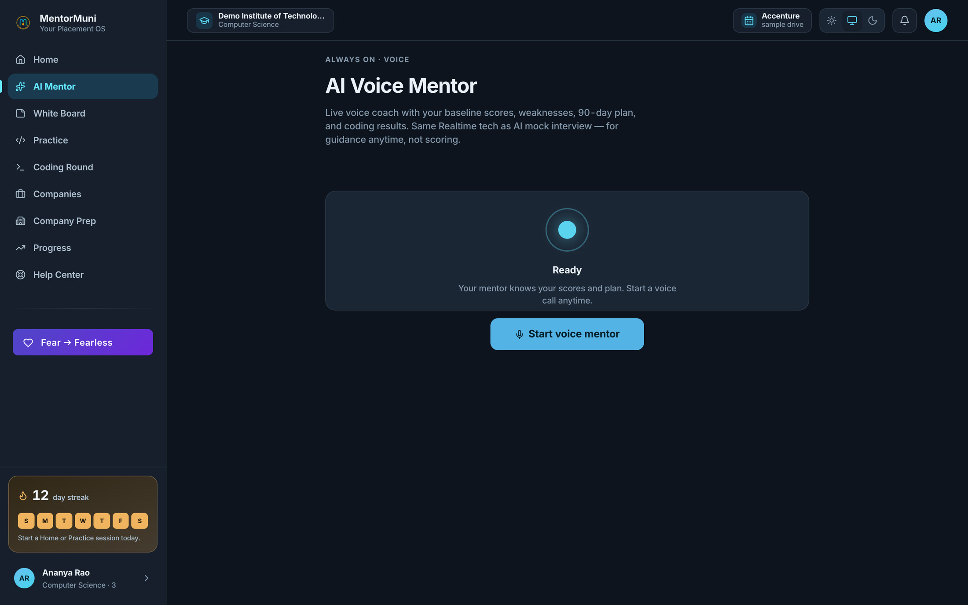
APPENDIX · STUDENT PORTAL · AI VOICE MENTOR
MentorMuni
Placement Platform for Engineering Colleges
A mentor that knows the student, available at 2am
1
Context-aware, not a chatbot
It already knows their baseline scores, weak areas, 90-day plan, and coding results before they speak.
2
Live voice, not a text box
The same realtime voice engine as the mock interviews — so speaking under pressure becomes normal.
3
Mentor capacity without hiring
First-line guidance for six hundred students without recruiting a single additional trainer.
Notes:
Position as first-line support that frees your real mentors for the students who need people. Never sell it as a human replacement.

