Slide 1
Object-Oriented using Java Course Introduction

Slide 2
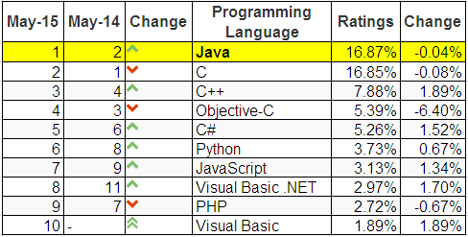
Why should you study Java?
Top ten common programming languages:
From http://www.tiobe.com/index.php/content/paperinfo/tpci/index.html

Slide 3
Why Java?
Java Is Architecture Neutral.
Java Provides “One-Stop Shopping”.
Java Is Object-Oriented from the Ground Up.
Practice Makes Perfect.
Java Is an Open Standard.
Java Is Free!
Notes:
DEFINITION of 'One-Stop Shop'
A company or a location that offers a multitude of services to a client or a customer. The idea is to provide convenient and efficient service and also to create the opportunity for the company to sell more products to clients and customers.
BREAKING DOWN 'One-Stop Shop'
For example, a bank may be able to offer you not only personal banking services and loans, but also investment advice, investment vehicles and insurance policies. Compared to visiting a separate institution for each area of need, the "one-stop shop" saves the consumer a lot of time and effort.
Read more: One-Stop Shop Definition | Investopedia http://www.investopedia.com/terms/o/onestopshop.asp#ixzz3krJSIeO3 Follow us: Investopedia on Facebook

Slide 4
Course Overview
Prerequisite:
Programming Fundamentals Using C

Slide 5
Course objectives
Make you comfortable with fundamental object-oriented (OO) terminology and concepts.
Getting to know the “World of Java”.
Understand the implementation of a Java Application.
Understand the roles of java built-in packages.

Slide 6
Contents
Learning the Java Language
Classes and Objects
More on Classes
Nested Classes
Numbers and strings
Exceptions
Collections
Algorithms
Generics
Basic I/O

Slide 7
Resources
Tool
NetBean IDE 8.x
JDK8
Text book
http://docs.oracle.com/javase/tutorial/
http://www.oracle.com/technetwork/java/javase/documentation/jdk8-doc-downloads-2133158.html

Slide 8
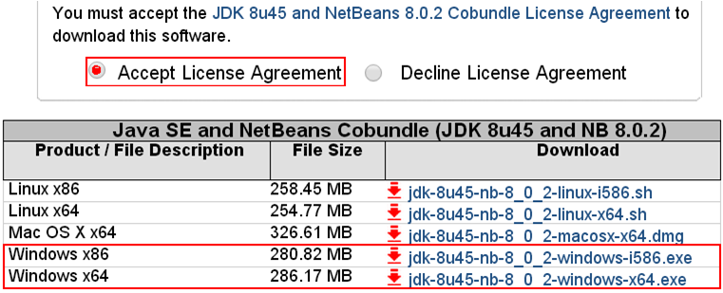
Download & Install JDK & NetBeans 8
http://www.oracle.com/technetwork/java/javase/downloads/jdk-netbeans-jsp-142931.html

Slide 9
Course Plan
See course plan on CMS

Slide 10
Course Requirements
Following lessons in classroom
Reading textbook and documents at home
Completing chapter assessment in time
Discussing actively in your teams and in classroom

Slide 11
Assessment Scheme
10 Labs (10%) + some reports (notebook is used)
01 Assignment (20%)
02 Progress test (10%)
01 Practical Exam (30%)
Final Exam (30%)

Slide 12
Academic policy
Cheating, plagiarism and breach of copyright are serious
offenses under this Policy.
Cheating
Cheating during a test or exam is construed as talking, peeking at another student’s paper or any other clandestine method of transmitting information.
Plagiarism
Plagiarism is using the work of others without citing it; that is, holding the work of others out as your own work.
Breach of Copyright
If you photocopy a textbook without the copyright holder's permission, you violate copyright law.

Slide 13
Enjoy the course
Be enthusiastic about the material because it is interesting, useful and an important part of your training as a software engineer. Our job is to help you learn and enjoy the experience. We will do our best but we need your help. So let’s all have fun together with Object-Oriented Paradigm using Java.

Slide 14
Q&A

