Slide 1
Session 08 Collections (http://docs.oracle.com/javase/tutorial/collections/ index.html)
Notes:
Lists are common data in almost all of programs. In this lesson, the framework for managing group of elements in the java.util package are introduced . If you use them, you will save noticeable efforts.

Slide 2
Objectives
Collections Framework (package java.util):
List: ArrayList, Vector → Duplicates are agreed
Set: HashSet, TreeSet → Duplicates are not agreed
Map: HashMap, TreeMap
Queue: LinkedList, PriorityQueue
Deque: LinkedList, ArrayDeque
Notes:
Cung cấp các interface như List, Set, Map định nghĩa các hành vi chuẩn cho các loại collection
VD: nhóm các sinh viên -> Set ; danh sách các SV của câu lạc bộ -> List …

Slide 3
The Collections Framework
The Java 2 platform includes a new collections framework.
A collection is an object that represents a group of objects.
The Collections Framework is a unified architecture for representing and manipulating collections.
The collections framework as a whole is not threadsafe.
Notes:
Cung cấp các interface như List, Set, Map định nghĩa các hành vi chuẩn cho các loại collection
VD: nhóm các sinh viên -> Set ; danh sách các SV của câu lạc bộ -> List …
=> Hình thành nên các collection/bộ sưu tập, nghĩa là mỗi collection là một đối tượng biểu diễn cho một nhóm các đối tượng nào đó
=> Cung cấp kiến trúc thuần nhất tương tự nhau để biểu diễn và thao tác trên collection
Thread: unit of running code (methods) of a process ( program in running).
Nowaday, operating systems support the time-sharing mechanism which allows many process running concurrently. CPU will run instructions of each process in a duration (about 50 milsecond) the the process will pause to yield CPU to others.
Also, a computer can have a multicore-CPU with 2, 4, 8,… cores. Some processes/ threads execute really concurrently.
A common data can be accessed by some threads concurrently → It’s value is not reliable → not threadsafe.
To make a common data being reliable, a mechanism in which at a time, only one thread is granted to access this data → Synchronization → threadsafe

Slide 4
The Collections Framework…
Reduces programming effort by providing useful data structures and algorithms so you don't have to write them yourself.
Increases performance by providing high-performance implementations of useful data structures and algorithms.
Provides interoperability between unrelated APIs by establishing a common language to pass collections back and forth.
Reduces the effort required to learn APIs by eliminating the need to learn multiple ad hoc collection APIs.
Reduces the effort required to design and implement APIs by eliminating the need to produce ad hoc collections APIs.
Fosters software reuse by providing a standard interface for collections and algorithms to manipulate them.
Notes:
Giảm nỗ lực, công sức phải tốn khi lập trình (có cấu trúc tương tự, và kèm theo các thuật toán cài đặt sẵn)
Nâng cao năng suất lập trình -> lập trình nhanh, dễ dàng hơn
Cung cấp kả năng tươngtác, trao đổi giữa các nhóm thư viện API khác nhau
Giảm thời gian tìm hiểu nhóm hàm API mới

Slide 5
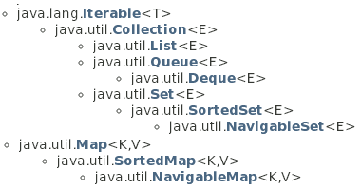
Collection Interfaces
Methods declared in these interfaces can work on a list containing elements which belong to arbitrary type. T: type, E: Element, K: Key, V: Value
Details of this will be introduced in the topic Generic
3 types of group:
List can contain duplicate elements; sortable
Set can contain distinct elements only; un- sortable
Map can contain pairs <key, value>. Key of element is data for fast searching
Queue, Deque contains methods of restricted list.
Common methods on group are: Add, Remove, Search, Clear,…
Notes:
Có 3 nhóm Interface chính : List, Set và Map => sau đó có các class được implement cho các interface này

Slide 6
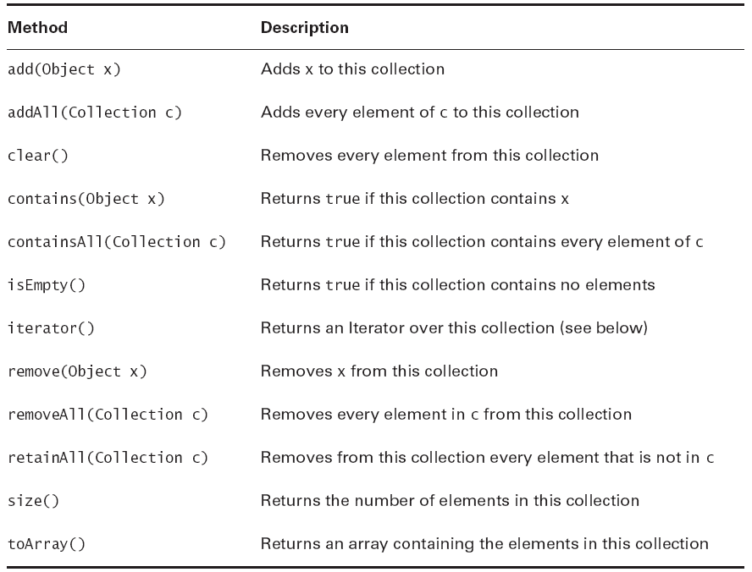
Common Methods of the interface Collection
Elements can be stored using some ways such as an array, a tree, a hash table.
Sometimes, we want to traverse elements as a list → We need a list of references → Iterator
Notes:
Các interface như Set, List , Map có chung các hành vi/method như liệt kê ở trê
Trong đó có hành vi đặc biệt là iterator (mang ý nghĩa lặp, duyệt -> đếm ; hay tham chiếu tới đối tượng ). Iterator là interface có các hành vi: hasNext()/kiểm tra xem còn không, và next()/tham chiếu tới đối tượng trong collection

Slide 7
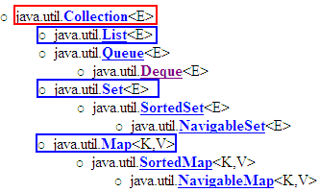



The Collection Framework…
Central Interfaces
Common Used Classes
Store: Dynamic array
Use index to access an element.
Store: Specific structure/tree
Use iterator to access elements
java.lang.Comparable interface
keySet()
values()
Use iterator
A TreeSet will stored elements using ascending order. Natural ordering is applied to numbers and lexicographic (dictionary) ordering is applied to strings.
If you want a TreeSet containing your own objects, you must implement the method compareTo(Object), declared in the Comparable interface.
Notes:
Có 3 nhóm Interface chính : List, Set và Map => sau đó có các class được implement cho các interface này
Nhóm implement cho List, vì có thể sắp xếp sortable: vd như ArrayList, Vector => dùng index để truy cập
Nhóm implement cho Set, vì không thể sắp xếp un-sortable: vd như HashSet, TreeSet => không dùng index để truy cập, mà dùng bộ duyệt iterator để truy xuất
(với TreeSet, tuy không cho phép sắp xếp, vì khi đưa một element vào collection thì đã sắp theo trật tự tự nhiên => cần phải implement phương thức compareTo)
Nhóm implement cho Map => dùng giá trị key để truy xuất

Slide 8
Lists
A List keeps it elements in the order in which they were added.
Each element of a List has an index, starting from 0.
Common methods:
void add(int index, Object x)
Object get(int index)
int indexOf(Object x)
Object remove(int index)

Slide 9
Classes Implementing the interface List
AbstractList
ArrayList
Vector (like ArrayList but it is synchronized)
LinkedList: linked lists can be used as a stack, queue, or double-ended queue (deque)
Notes:
Vector dùng synchronized nên thread-safe

Slide 10
List Implementing Classes
Vector vec = new Vector();
for (int i = 101; i <= 110; i++) {
vec.add(i);
}
for (int i = 0; i < vec.size(); i++) {
System.out.println(vec.get(i));
}
//or using Iterator
/*
Iterator iter = vec.iterator();
while (iter.hasNext()) {
System.out.println(iter.next());
}
*/

Slide 11
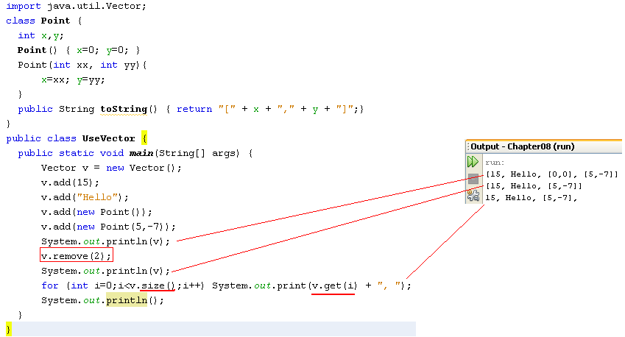
Using the Vector class
java.util.Vector<E> (implements java.lang.Cloneable,
java.util.List<E>, java.util.RandomAccess, java.io.Serializable)
The Vector class is obsolete from Java 1.6 but it is still introduced because it is a parameter in the constructor of the javax.swing.JTable class, a class will be introduced in GUI programming.

Slide 12
Sets
Lists are based on an ordering of their members. Sets have no concept of order.
A Set is just a cluster of references to objects.
Sets may not contain duplicate elements.
Sets use the equals() method, not the == operator, to check for duplication of elements.
void addTwice(Set set) {
set.clear();
Point p1 = new Point(10, 20);
Point p2 = new Point(10, 20);
set.add(p1);
set.add(p2);
System.out.println(set.size());
}
will print out 1, not 2.

Slide 13
Sets…
Set extends Collection but does not add any additional methods.
The two most commonly used implementing classes are:
TreeSet
Guarantees that the sorted set will be in ascending element order.
log(n) time cost for the basic operations (add, remove and contains).
HashSet
Constant time performance for the basic operations (add, remove, contains and size).

Slide 14
TreeSet and Iterator
Ordered Tree – Introduced in the subject Discrete Mathematics
Set: Group of different elements
TreeSet: Set + ordered tree, each element is called as node
Iterator: An operation in which references of all node are grouped to make a linked list. Iterator is a way to access every node of a tree.
Linked list: a group of elements, each element contains a reference to the next

Slide 15
TreeSet = Set + Tree
The result may be:
Random r = new Random();
TreeSet myset = new TreeSet();
for (int i = 0; i < 10; i++) {
int number = r.nextInt(100);
myset.add(number);
}
//using Iterator
Iterator iter = myset.iterator();
while (iter.hasNext()) {
System.out.println(iter.next());
}
7
27
36
41
43
46
49
57
75
83

Slide 16
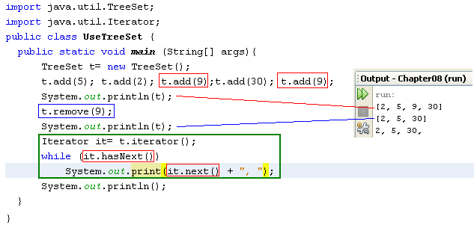
Using the TreeSet class & Iterator
A TreeSet will stored elements using ascending order. Natural ordering is applied to numbers and lexicographic (dictionary) ordering is applied to strings.
If you want a TreeSet containing your own objects, you must implement the method compareTo(Object), declared in the Comparable interface.

Slide 17
Hash Table
49
In array, elements are stored in a contiguous memory blocks → Linear search is applied → slow, binary search is an improvement.
Hash table: elements can be stored in a different memory blocks. The index of an element is determined by a function (hash function) → Add/Search operation is very fast (O(1)).
14
Brown
9
Hoa
5
Smith
“Smith”
f
5
The hash function f may be: ‘S’*10000+’m’*1000+’i’*100+’t’*10+’h’ % 50
0
Linel
Notes:
This slide is intended to introduce the most basic concept about a hash table. More details about hash table will be studied in the subject Data Structure and Algorithms.
Độ phức tạp O(1) : độ phức tạp hằng số, không phụ thuộc vào độ lớn của dữ liệu đầu vào

Slide 18
HashSet = Set + Hash Table
The result may be:
Random r = new Random();
HashSet myset = new HashSet();
for (int i = 0; i < 10; i++) {
int number = r.nextInt(100);
myset.add(number);
}
//using Iterator
Iterator iter = myset.iterator();
while (iter.hasNext()) {
System.out.println(iter.next());
}
84
55
7
76
77
95
94
12
91
44

Slide 19
HashSet or TreeSet?
If you care about iteration order, use a Tree Set and pay the time penalty.
If iteration order doesn’t matter, use the higher-performance Hash Set.
Notes:
Cần thứ tự: dùng TreeSet, nhưng performance thấp

Slide 20
How to TreeSet ordering elements?
Tree Sets rely on all their elements implementing the interface java.lang.Comparable.
public int compareTo(Object x)
Returns a positive number if the current object is “greater than” x, by whatever definition of “greater than” the class itself wants to use.

Slide 21
How to TreeSet ordering elements?
class Student implements Comparable{
int no;
...
public int compareTo(Object o) {
Student st = (Student) o;
if(no > st.getNo())
return 1;
else if(no == st.getNo())
return 0;
else
return -1;
}
. . .
}
Comparing 2 students based on their IDs ( field no)

Slide 22
How to TreeSet ordering elements?
public static void main(String[] args) {
Random r = new Random();
TreeSet myset = new TreeSet();
for (int i = 0; i < 10; i++) {
int no = r.nextInt(100);
Student st = new Student(no, "abc");
myset.add(st);
}
//using Iterator
Iterator iter = myset.iterator();
while (iter.hasNext()) {
Student st = (Student)iter.next();
System.out.println("No: " + st.getNo());
}
}
No: 2
No: 8
No: 11
No: 19
No: 33
No: 52
No: 78
No: 83
No: 92
No: 96

Slide 23
Maps
Map doesn’t implement the java.util.Collection interface.
A Map combines two collections, called keys and values.
The Map’s job is to associate exactly one value with each key.
A Map like a dictionary.
Maps check for key uniqueness based on the equals() method, not the == operator.
IDs, Item code, roll numbers are keys.
The normal data type for keys is String.
K
V
key
value
Each element: <key,value>

Slide 24
Maps..
Java’s two most important Map classes:
HashMap (mapping keys are unpredictable order – hash table is used, hash function is pre-defined in the Java Library).
TreeMap (mapping keys are natural order)-> all keys must implement Comparable (a tree is used to store elements).

Slide 25
HashMap
public static void main(String[] args) {
HashMap mymap = new HashMap();
mymap.put(1, “One");
mymap.put(2, “Two");
mymap.put(3, “Three");
mymap.put(4, “Four");
//using Iterator
Iterator iter = mymap.keySet().iterator();
while (iter.hasNext()) {
Object key = iter.next();
System.out.println(key + ": " + mymap.get(key));
}
}
//output
1: One
2: Two
3: Three
4: Four
Key: integer, value: String

Slide 26
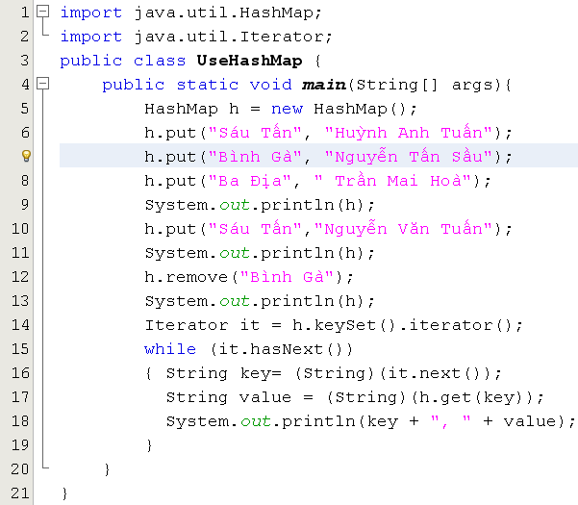
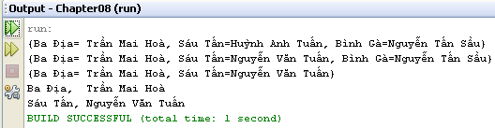
Using HashMap class & Iterator
Key: String, value: String

Slide 27
Interface Queue and Deque
Queue
Deque
Interfaces for restricted list (limited manipulation), programmers can not access an arbitrary element but elements at the beginning or the end of the list only.
Deque: A linear collection that supports element insertion and removal at both ends. The name deque is short for "double ended queue" and is usually pronounced "deck". Most Deque implementations place no fixed limits on the number of elements they may contain, but this interface supports capacity-restricted deques as well as those with no fixed size limit.

Slide 28
Interface Queue
Queue
public interface Queue<E> extends Collection<E>
boolean | add(E e) Inserts the specified element into this queue if it is possible to do so immediately without violating capacity restrictions, returning true upon success and throwing an IllegalStateException if no space is currently available.
E | element() Retrieves, but does not remove, the head of this queue.
boolean | offer(E e) Inserts the specified element into this queue if it is possible to do so immediately without violating capacity restrictions.
E | peek() Retrieves, but does not remove, the head of this queue, or returns null if this queue is empty.
E | poll() Retrieves and removes the head of this queue, or returns null if this queue is empty.
E | remove() Retrieves and removes the head of this queue.
Classes:

Slide 29
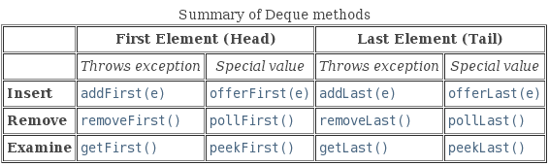
Interface Deque…
Deque
Head
Tail
public interface Deque<E> extends Queue<E>
IN addition to methods inherited from the interface Queue, some methods are declared:
Classes
java.util.LinkedList<E> (implements java.lang.Cloneable, java.util.Deque<E>,
java.util.List<E>, java.io.Serializable)
java.util.ArrayDeque<E> (implements java.lang.Cloneable,
java.util.Deque<E>, java.io.Serializable)

Slide 30
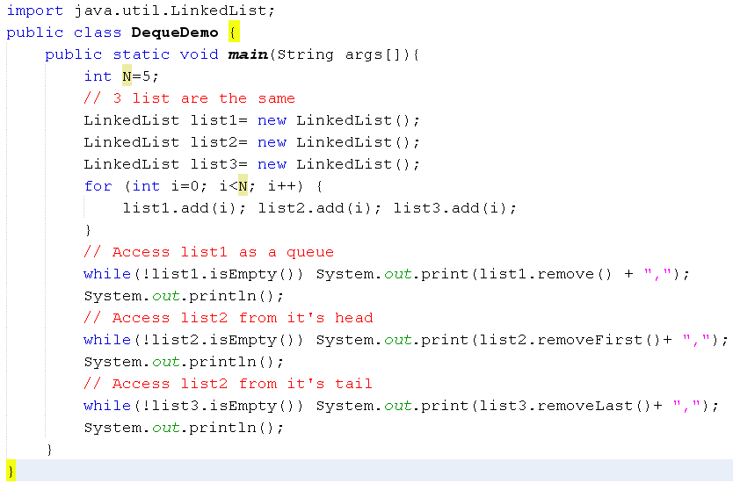

Queue/Deque Demo.
4
3
2
1
0
0
tail
head

Slide 31
Summary
The Collections Framework
The Collection Super interface and Iteration
Lists
Sets
Maps
Support Classes
Collections and Code Maintenance

