Slide 1
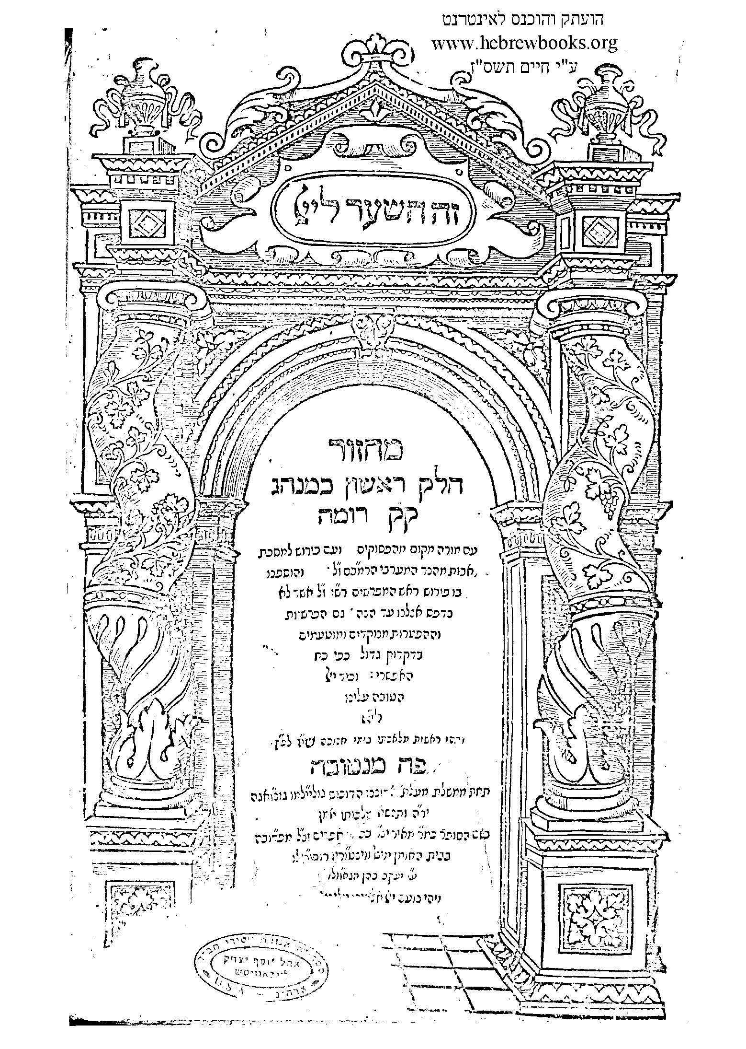
Highlights From The Machzor Roma Published 1560
copyright 2012. The Beurei Hatefila Institute www.beureihatefila.com

Slide 2
Table Of Contents
Slide 3-Introduction To Birchos Ha’Shachar;
Slide 4-Birchos Ha’Shachar;
Slide 5-L’Olam Yihei Odom;
Slide 6-Yishtabach;
Silde 7-Semichas Geula L’Tefila;
Slide 8-Adding Personal Requests To Shemona Esrei;
Slide 9-Defining The Word: Modim;
Slide 10-La’Minatzeach Mizmor L’Dovid;
Slide 11-An Example Of Censorship Of Jewish Books;
Slide 12-The Fifth Bracha Of Kriyas Shema In Tefilas Arvis;
Slide 13-Seder Arvis Shel Shabbos;
Slide 14-The Third Bracha Of Kriyas Shema On Friday Night;
Slide 15-The Middle Bracha Of Shemona Esrei On Friday Night;
Slide 16-The Second Bracha After The Reading Of The Haftorah ;
Slide 17-Mi Sh’Beirach And Yizkor During Mussaf On Shabbos ;
Slide 18-Havdalah
Slide 19-The Bracha Of Boneh Yerushalayim On Tisha B’Av;
Slide 20-Kinos As An Extension Of The Keruva For Boneh Yerushalayim;
Slide 21-Why The Recital Of The Kinos Where Moved To After Shemona Esrei;
Slide 22-The Unique Features Of Ha’Kalir’s Tisha B’Av Keruvos;
Slide 23-Ha’Kalir’s Messianic Kinah-Ba’Yamim Ha’Heim Ba’Yom Ha’Hu.
copyright 2012. The Beurei Hatefila Institute www.beureihatefila.com

Slide 3
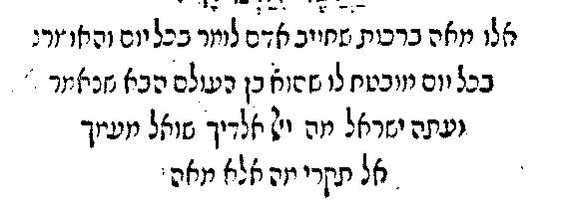
Instructions Before Reciting Birchos Ha’Shacahar
Translation: These are the 100 Brachos that a person is required to recite each day. He who recites 100 Brachos each day is guaranteed a place in the next world, as it is written: Attention-Jewish People-what does G-d ask of you each day? Read the word not as “mah” meaning “what”-instead read the word as “Me’Ah meaning “100”. What does G-d ask of you? To recite 100 Brachos each day.
The Machzor Roma begins with the same rule that opens Seder Rav Amrom Gaon and other early Siddurim. The instruction is significant because it confirms that the original purpose of the Siddur was to be a guide as to how a Jew can fulfill his obligation to recite 100 Brachos each day.

Slide 4
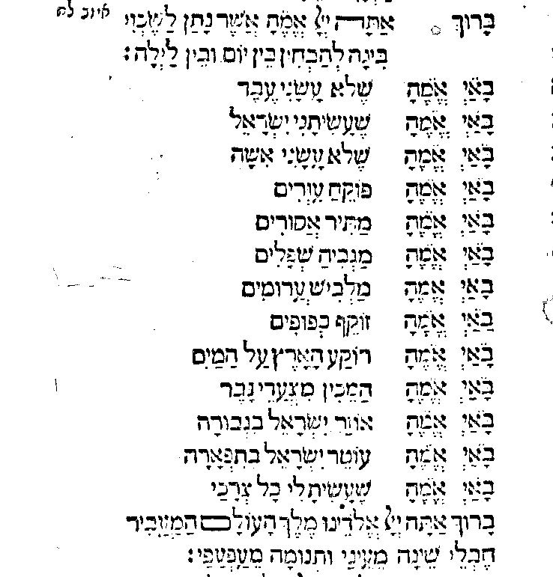
Birchos Ha’Shachar
Three points to note:
The Bracha of Sh’Asasani Yisroel –it is written in the positive voice because the Christian censor objected to Jews saying the standard Bracha of Sh’Lo Asani Goy.
2. It includes the Bracha of Mag’Bi’Hah Shefalim-that Bracha is controversial because it does not appear in the Talmud.
3. The Bracha of Ha’Nosain La’Ya’Aif Koach is missing -that Bracha is controversial as well because it too does not appear in the Talmud.

Slide 5
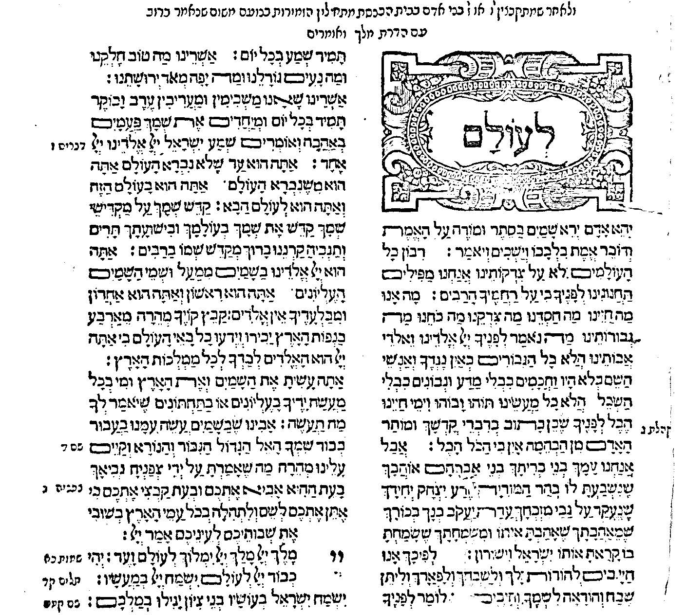
L’Olam Yihei Odom
In general, this section of the Siddur is difficult to explain. Why do we recite the first verse of Kriyas Shema at this point? The Machzor Roma may provide an answer by calling this section: Ha’Zemiros. Kriyas Shema may have been included as one of the Zemiros because Kriyas Shema is known as a song in the Talmud.

Slide 6
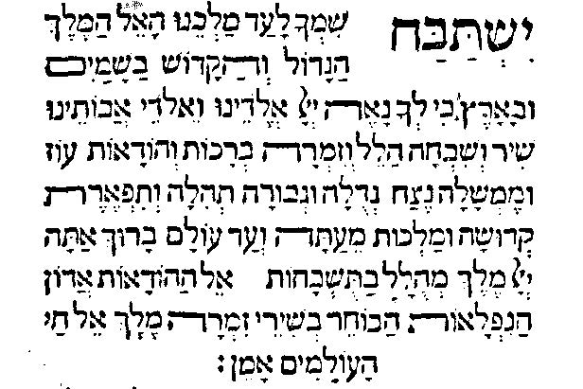
Yishtabach
The wording of Yishtabach in the Machzor Roma is significant because the Bracha begins: Melech Mihullal Ba’Tishbachos, the same Bracha that ends Baruch Sh’Amar and Hallel. Since all three prayers include the same three words, they can all be classified as representing: Birchas Ha’Shir, a prayer that is recited after saying a group of chapters of Tehillim. The wording of the Bracha of Yishtabach in the Machzor Roma also verifies that other versions of the Bracha of Yishtabach contain changes that were made to the core of the wording to the Bracha: Melech Mihullal Ba’Tishbachos.

Slide 7
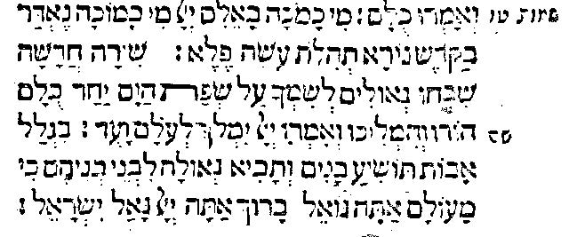
Semichas Geula L’Tefila
One of the most important concepts in Tefila is the rule: Semichas Geula L’Tefila -linking the concept of redemption to Shemona Esrei. The following words that appear just before the Bracha of Ga’Al Yisroel hold the key to understanding the rule of Semichas Geula L’Tefila: Biglal Avos Toshi’Ya Banim V’Savi Geula Livnei Vneihem Ki Mai’Olam Ata Go’Ail-Because of our forefathers, rescue their descendants and bring redemption to their descendants because You are the G-d who rescues. This request is made after we retell the story of the Exodus from Egypt in the third Bracha of Kriyas Shema. We mention the merit of our forefathers because we refer to our forefathers in the first Bracha of Shemona Esrei. We pray that just as G-d recued our ancestors from Egypt because of the merit of our forefathers so too G-d should rescue us today in their merit.

Slide 8
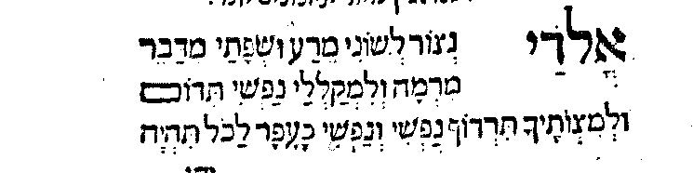
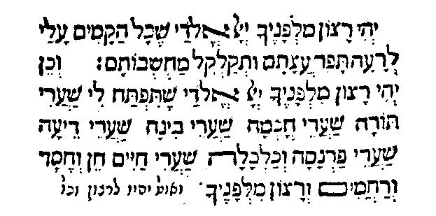
Adding Personal Requests To Shemona Esrei
The wording of Elokei Nitzor includes personal requests. Proof that Elokei Nitzor is an appropriate place in which to add personal requests.

Slide 9
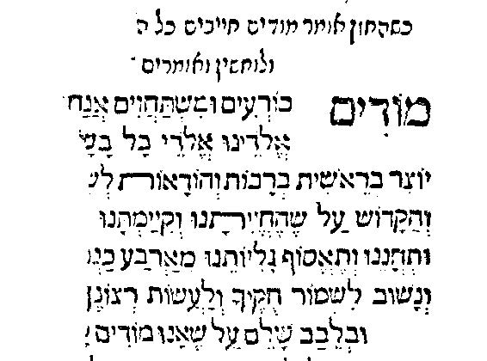
Defining The Word: Modim As Bowing
This version of Modim D’Rabbanan places the word: Modim next to the words: Korim Oo’Mishtachavim just as the word: Modim sits next to the words: Korim Oo’Mishtachavim in the prayer of Aleinu L’Shabei’Ach. This version of Modim D’Rabbanan supports those who define the word: Modim as bowing. That definition of the word: Modim supports the view that Shemona Esrei represents Avoda, a substitute for the service that took place in the Beis Hamikdash.

Slide 10
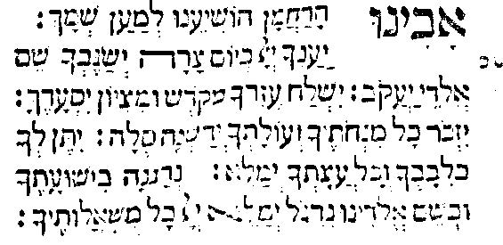
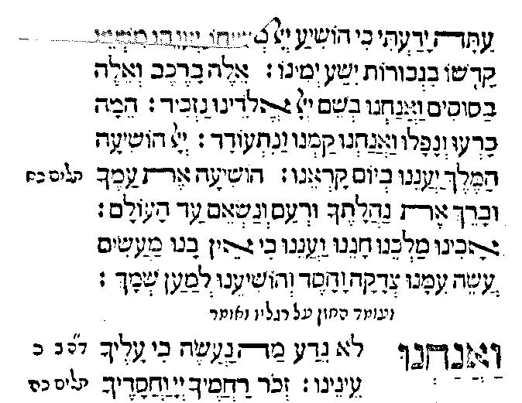
La’Minatzeach Mizmor L’Dovid
In current Siddurim the chapter that begins La’Minatzeach Mizmor L’Dovid is recited after Ashrei but before Oo’Vah L’Tziyon. It is a unique prayer because it is omitted on many days on which we also omit Tachanun. The Machzor Roma demonstrates to us that this chapter and Tachanun share rules because this chapter at one time was a part of the Tachanun prayer.

Slide 11
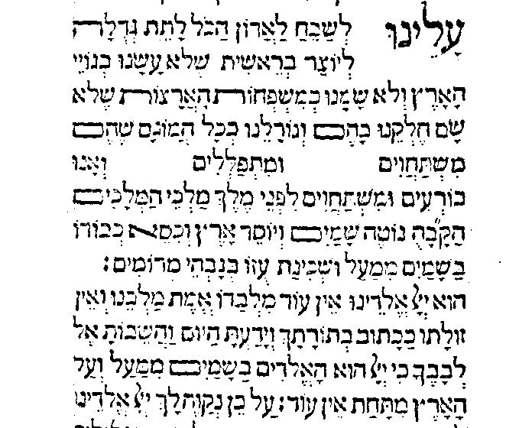
An Example Of Censorship Of Jewish Books
The fifth line of the prayer: Aleinu L’Shabeach shows two empty spaces. The line should read: Mishtachavim L’Hevel Va’Rik Oo’Mispallilim El Ail Lo Yoshiya. The words that are missing were probably censored by the Christian censors. In most cases the words that were censored appear with lines drawn through them. Because this example of censorship consists of empty space, it is difficult to determine whether the Christian censor erased the words or whether the printer omitted the words as an act of self-censorship-a not uncommon occurrence in the history of Jewish publishing.

Slide 12
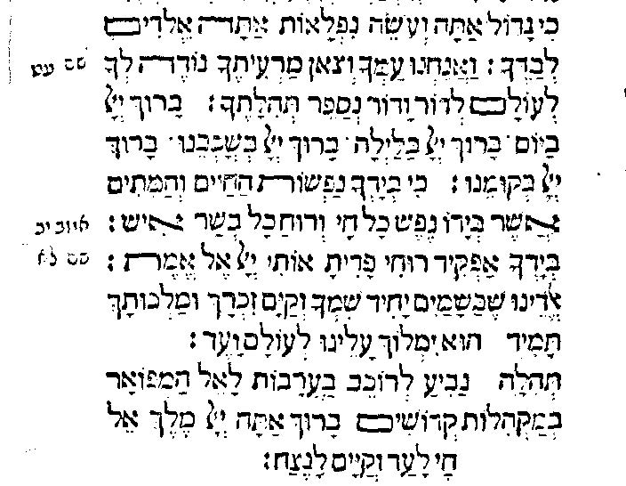
The Fifth Bracha Of Kriyas Shema In Tefilas Arvis
The Chasimas Ha’Bracha in the fifth Bracha of Birchos Kriyas Shema in Tefilas Arvis is different than the one found in other Nuschaos. This version of the Chasimas Ha’Bracha is cited in Sefer Shibbolei Ha’Lekket Inyan Tefila Siman 52. The words: Baruch Chai La’Ad V’Kayom La’Netzach also appear in the Bracha of Baruch Sh’Amar. That fact lends support to the argument that the Bracha of Baruch Sh’Amar may be a closing Bracha rather than an opening one.

Slide 13
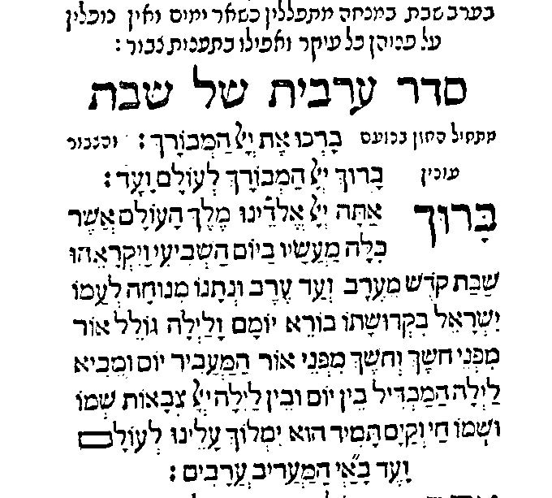
Seder Arvis Shel Shabbos
The Friday Night prayers found in the Machzor Roma are unique. The first Bracha of Kriyas Shema on Friday nights matches the one found in the Siddur of Rav Sa’Adiya Gaon and the Siddurim found in the Cairo Geniza representing Minhag Eretz Yisroel.
Notice should also be given to the fact that Kabbolos Shabbos and the singing of the poem of Lecha Dodi are not part of the Friday Night service included in this Siddur. This edition of the Machzor Roma was published in the mid 1500’s before the Lurianic movement gifted upon Judaism the practice of reciting Kabbolos Shabbos .

Slide 14
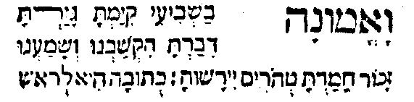
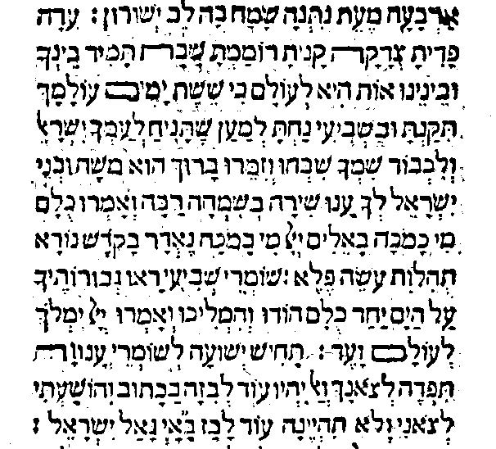
The Third Bracha Of Kriyas Shema On Friday Night
The third Bracha of Kriyas Shema on Friday Night was different as well.

Slide 15
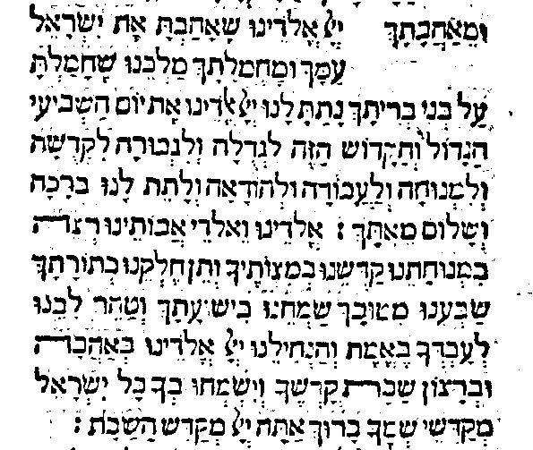
Middle Bracha Of Shemona Esrei On Friday Night
The middle Bracha of Shemona Esrei on Friday night in the Machzor Roma matches the middle Bracha of Shemona Esrei on Friday night as it was recited as part of Minhag Eretz Yisroel. This same Bracha is found in Seder Rav Amrom Gaon, known as the first Siddur.

Slide 16
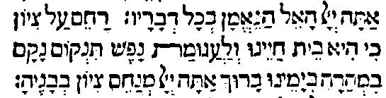
Second Bracha After The Haftorah
The Bracha that concludes the second Bracha after the Haftorah resembles the Bracha that is recited in Nusach Ashkenaz as the conclusion of the Bracha of Boneh Yerushalayim on Tisha B’Av

Slide 17
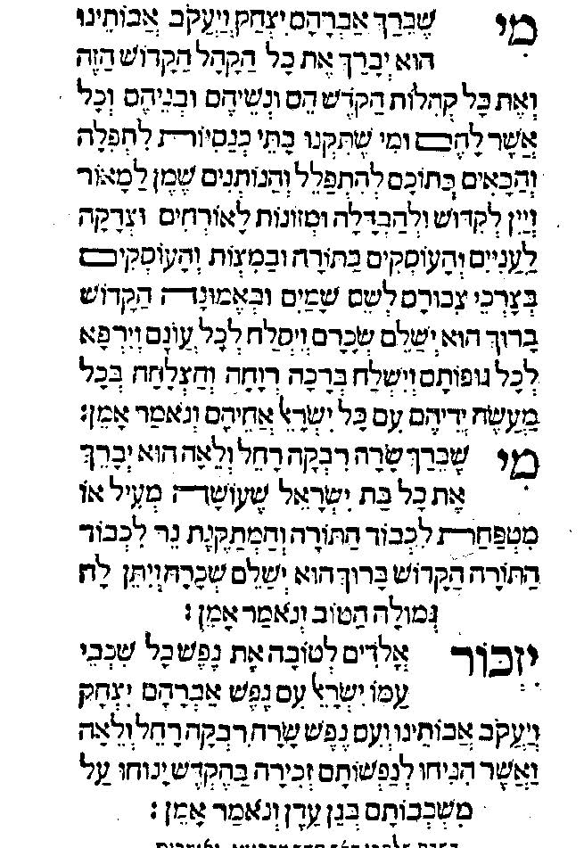
Mi Sh’Beirach And Yizkor
This excerpt shows three prayers that were recited immediately after the reading of the Haftorah:
A Mi Sh’Beirach for the community;
A Mi Sh’Beirach for women who contribute to the maintenance of the synagogue;
They recited Yizkor each Shabbos.

Slide 18
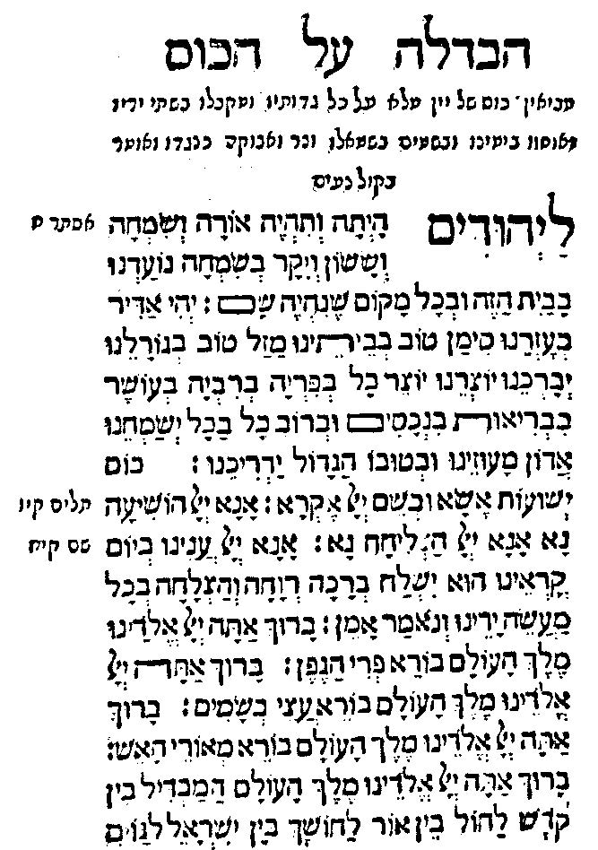
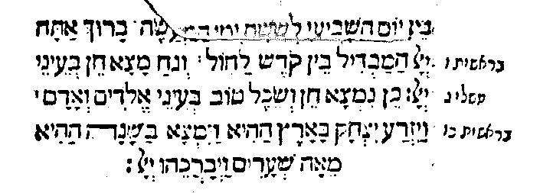
Havdalah
Please note the unique language that introduces the Brachos of Havdalah including requests for health, wealth and general welfare. The verses that are recited after Havdalah also appear to represent additional personal requests.

Slide 19
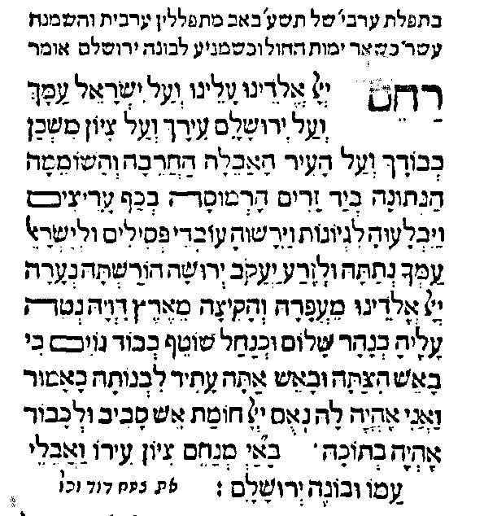
The Bracha Of Boneh Yersuhalayim On Tisha B’Av
According to the Machzor Roma, the Bracha of Boneh Yerushalayim in Shemona Esrei was modified for all of the prayer services on Tisha B’Av . The concluding words are also different than those in other Nuschaos.

Slide 20
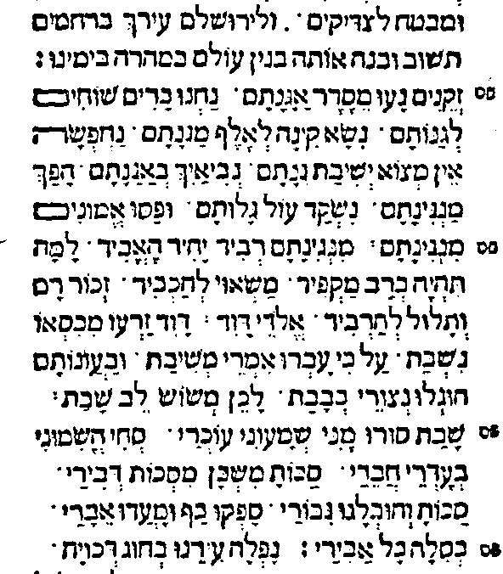
Kinos As Extension Of Keruva For Boneh Yerushalayim
In the Machzor Roma we learn that the Kinos which Rabbi Elazar Ha’Kalir wrote were initially meant to be an extension of the Keruva, liturgical poem, that was inserted into the Bracha of Boneh Yerushalayim. A look at the complete Shemona Esrei for Tisha B’Av Morning as found in the Machzor Roma reveals that each Bracha was embellished with a Keruva. The fact that the Kinos begin in the 15th Bracha of Shemona explain why the first Kina opens with the letter Samech, the 16th letter of the Hebrew Alphabet. The Keruva for Bonmeh Yerushalayim represented the 15th letter, Nun, and the Kinos which wee an extension of the Keruva began with the sixteenth letter.

Slide 21
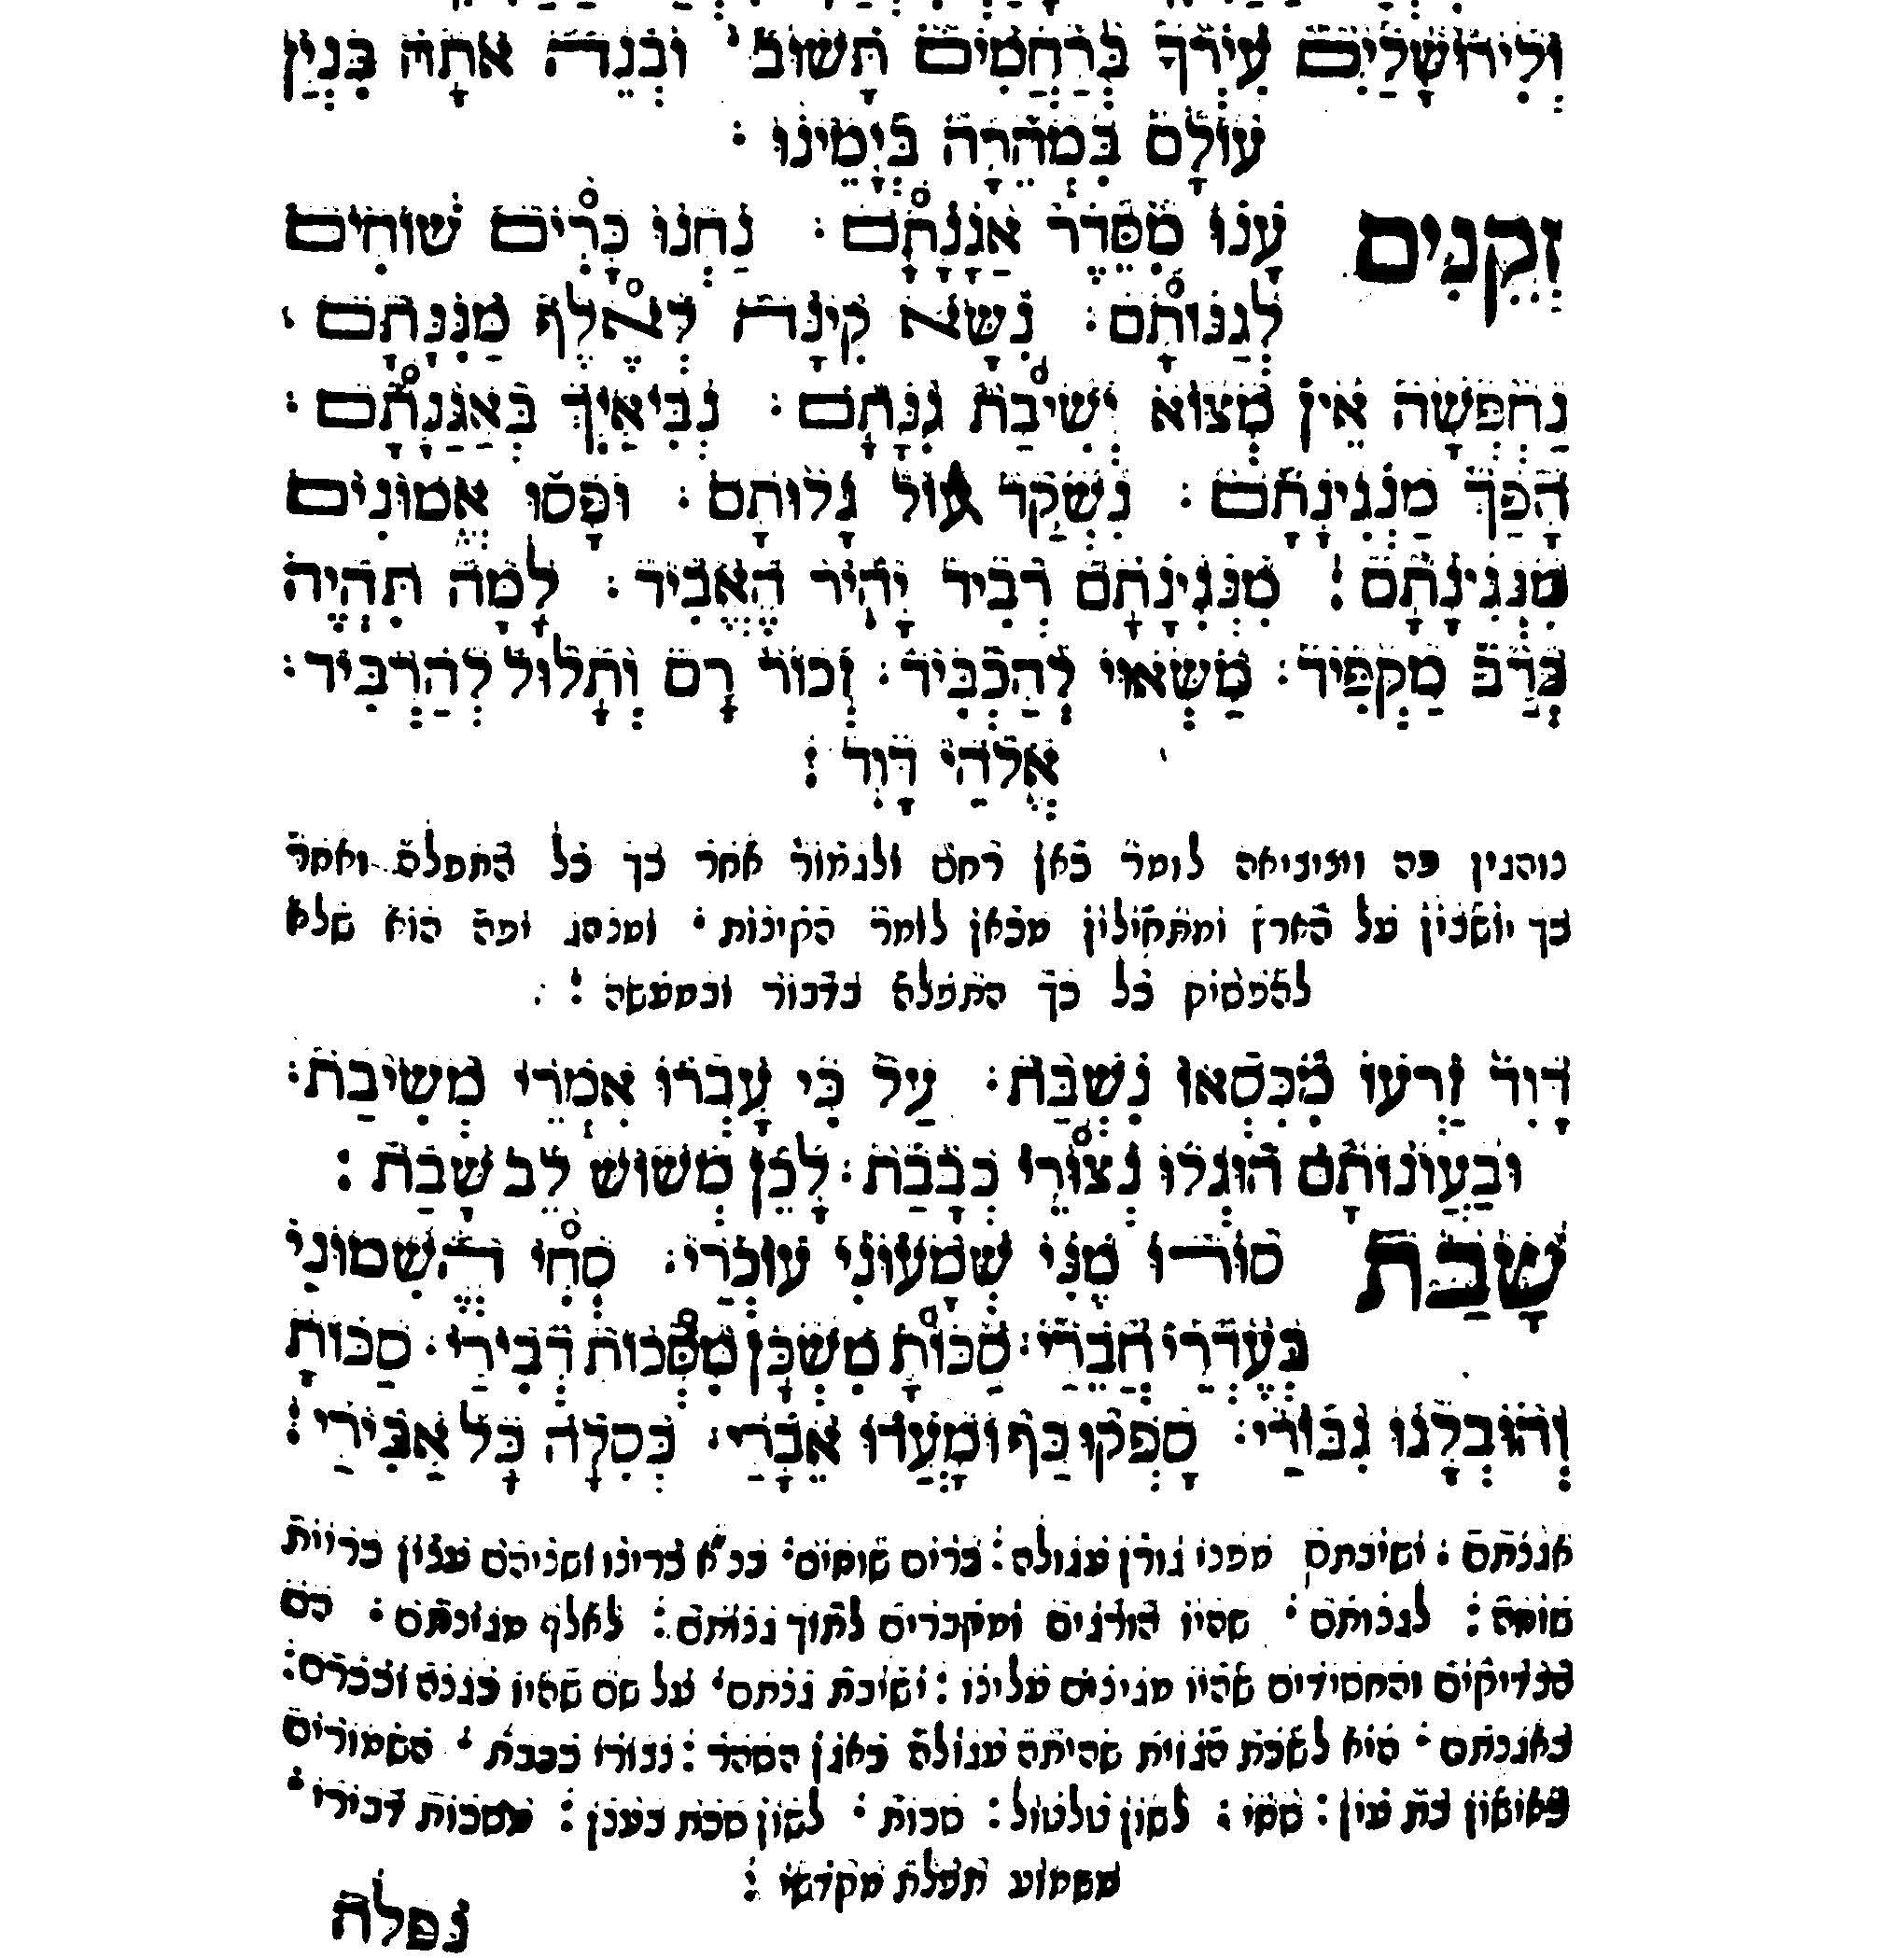
Why The Kinos Were Moved To after Shemona Esrei
This version of the Machzor Roma was published in Venice in 1710. It contains instructions to recite the Kinos after repeating Shemona Esrei. The Kinos were moved so as to not interrupt the repetition of Shemona Esrei. Apparently the interruption led to talking and other activities taking place.

Slide 22
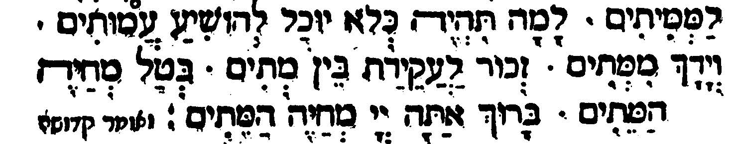
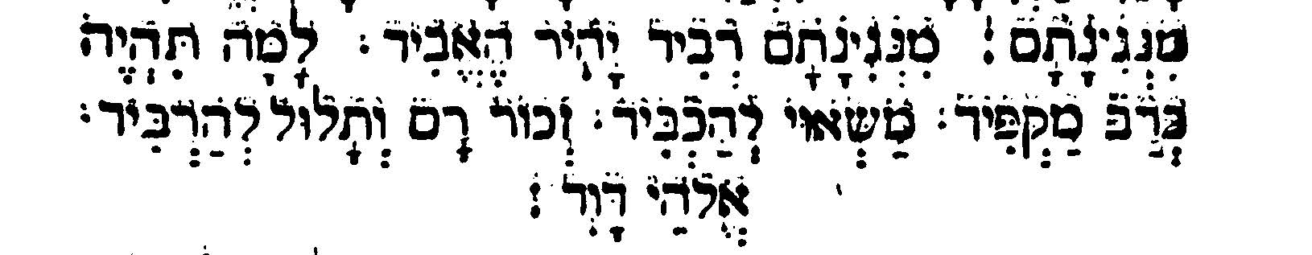
Unique Features Of Ha’Kalir’s Tisha B’Av Keruvos
Example 1
Example 2
The excerpts from the two Keruvos show the following distinct features:
Each contains a challenge to G-d that begins with the word: Lamah, why.
2. Each contains a reference to words that are found in the Chasimas Ha’Bracha, the Bracha ending. The second example is from the Keruva for the Bracha of Boneh Yerushalayim. By referring to the words: Elokei Dovid, the Keruva confirms that when Rabbi Elazar Ha’Kalir wrote this Keruva, the Chasimas Ha’Bracha for the Bracha of Boneh Terushalayim included the words: Elokei Dovid. We can conclude that Ha’kalir wrote this Keruva for Shemona Esrei that followed Minhag Eretz Yisroel in which the Chasimas Ha’Bracha for the Bracha of Boneh Yerushalayim was Elokei Dovid Oo’Boneh Yerushalayim.

Slide 23
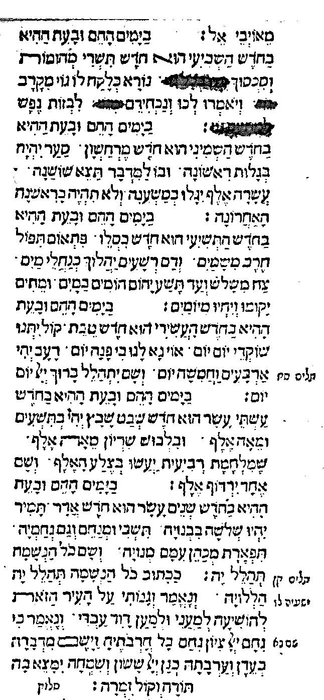
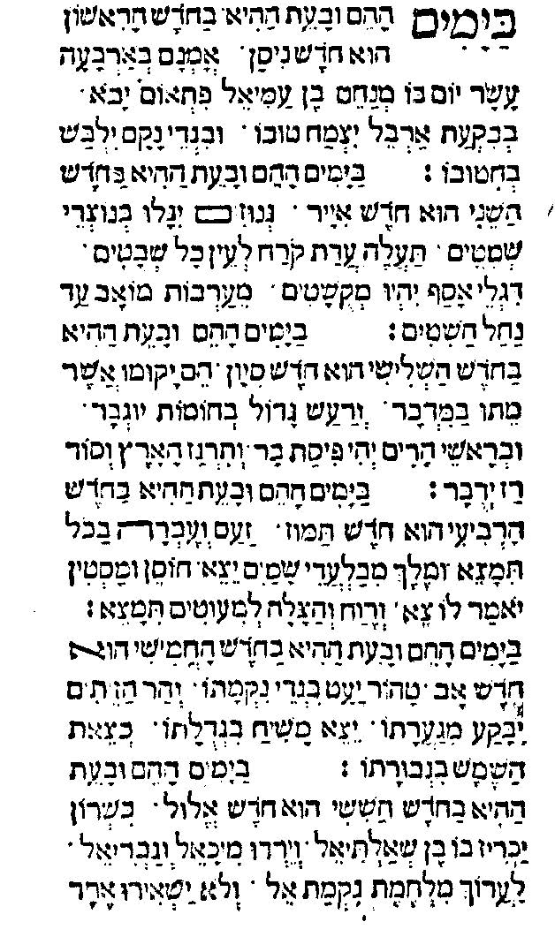
Ha’Kalir’s Messianic Kinah-
Ba’Yamin Ha’Heim Ba’Yom Ha’Hu
The Kinah-Ba’Yamim Ha’Heim Ba’Yom Ha’Hu is an example of a Nechama, comfort poem that Ha’Kalir added to be recited after the Kinos. This particular poem describes in great detail the schedule of events that will take place in the year in which the Moshiach will appear.

