Slide 1
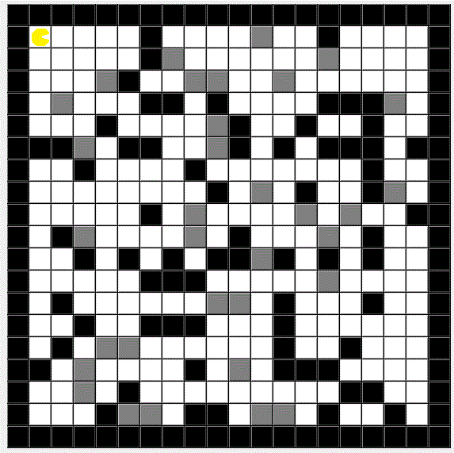
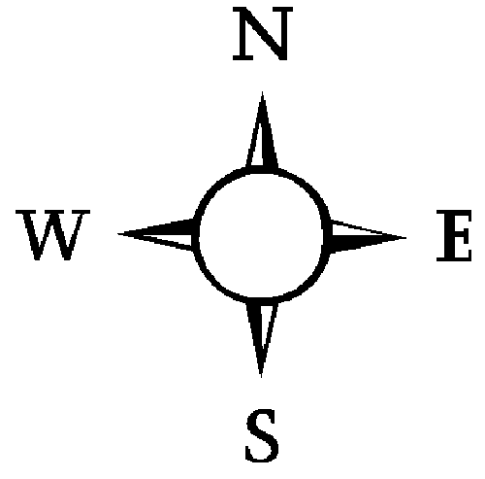
[0,0]
[0,19]
[3,2]
Wall
Dirt
Agent Heading
[19,0]
[19,19]

