Slide 1
Detector

Slide 2
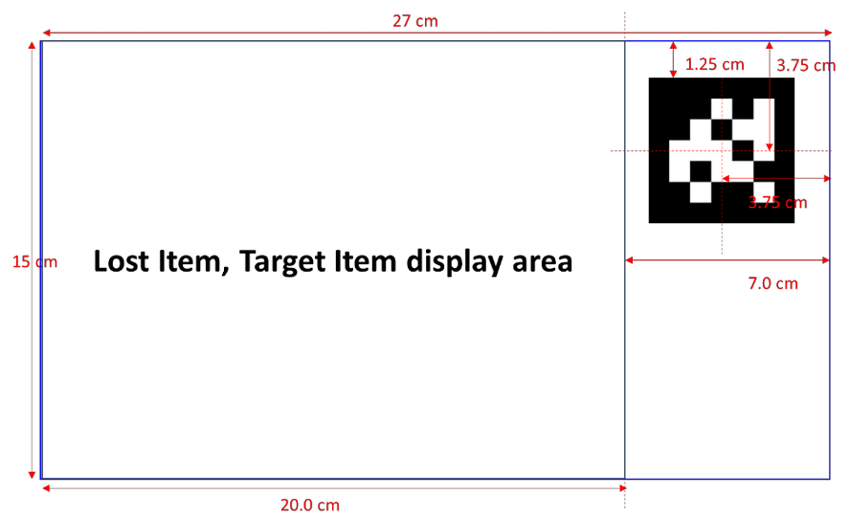
Calibration
Undistort using camera info
Cut target item using aruco marker’s pos, dir

Slide 3
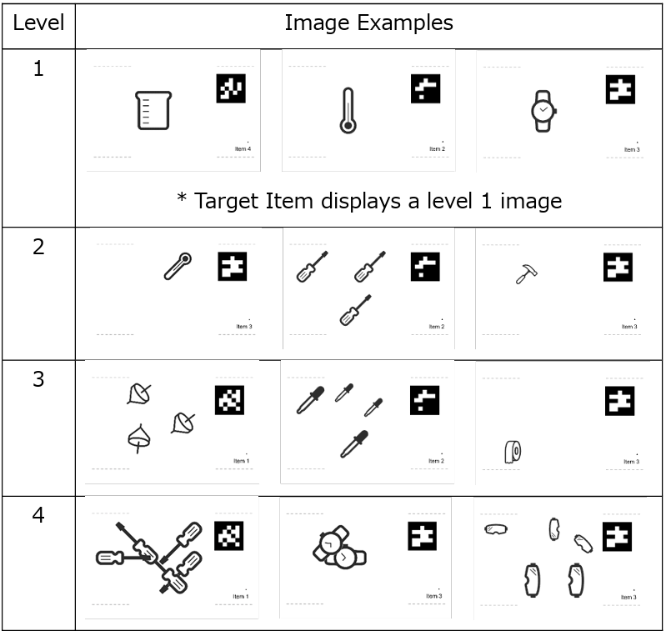
Detection
YOLO!!!!!!!!!!!!!
Data prepare
Randomly put items on image and give corresponding labels
Data quality is important
Train
Well… just run it.

Slide 4
Java implementation
Implement pipeline in java
OpenCV Java API for Image Classification (learnopencv.com)
检测 -Ultralytics YOLOv8 文档
org.opencv.dnn (OpenCV 4.5.3 Java documentation)

Slide 5
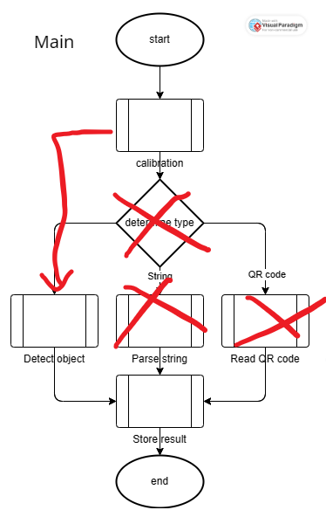
Create module
Combine all the module above into another module that can be used by Control

