Slide 1
Kibo

Slide 2
Procedure
Dock區出發
掃描紀錄位置、物品為何
告訴太空人在哪看到甚麼
辨識太空人手上的物件
移動到指定物件位置、拍照
告訴太空人物件位置

Slide 3
Potential sub-problems
Path finding
Requirement:
Find shortest path without entering KOZ(keep out zone)
Algorithm must consider the robot’s shape
If stuck (or lost), how to respond
And more constraints
Optimization
算法準確度重要性大於算法速度(Kibo移動時間優先於算法速度)
Less nodes is better because it takes time for kibo to accelerate.
Orientation may help shorten distance between KOZ and kibo to fit shorter path
And more detail

Slide 4
Path finding
Input: S, T, map
Output: a legal path from S to T
Known bugs: 有時候會卡在KOZ(機率很小)

Slide 5
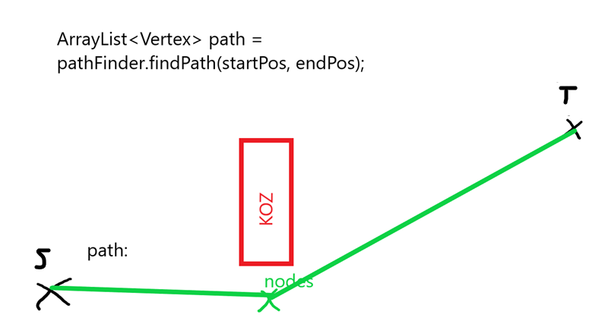
Path

Slide 6
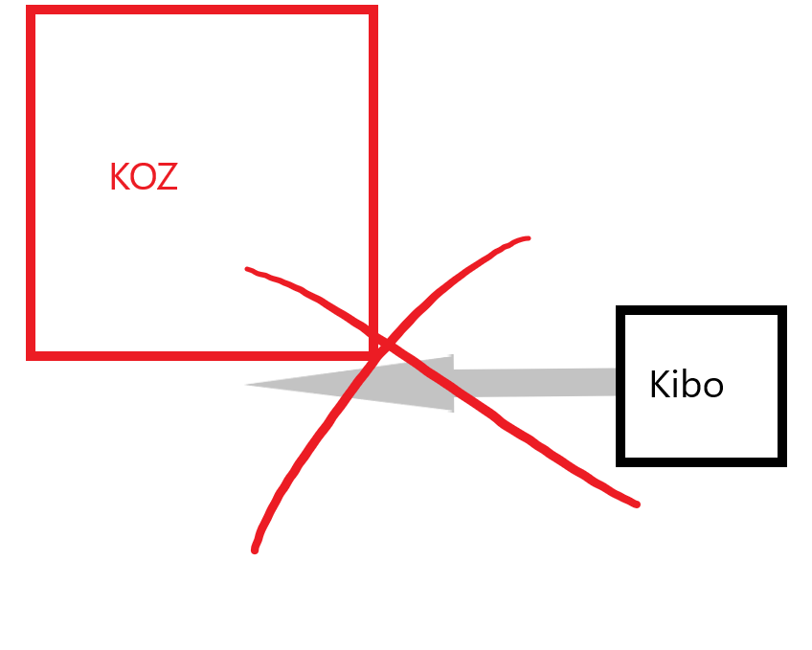
Avoid KOZ

Slide 7
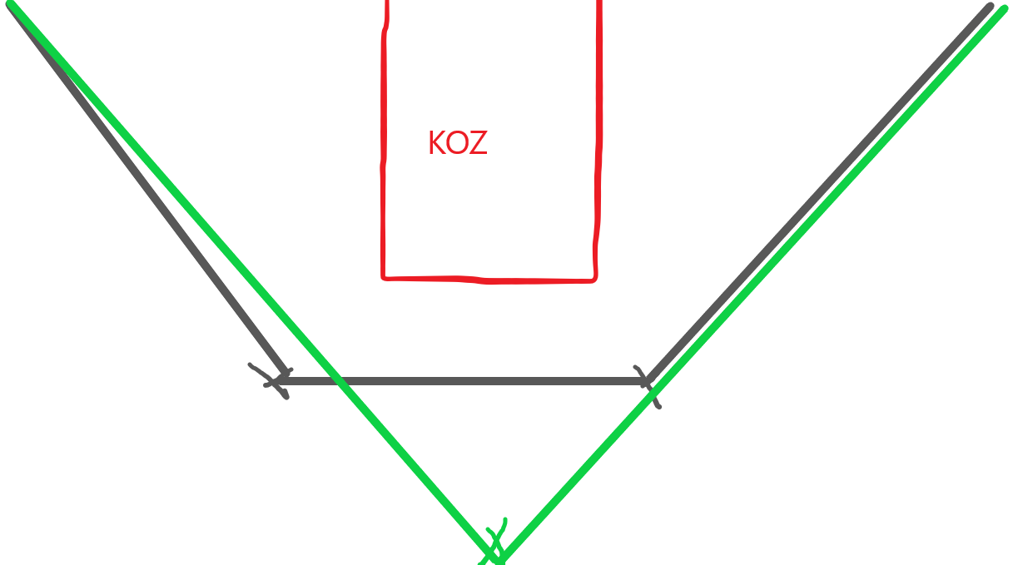
Less nodes is better

Slide 8
Potential sub-problems
Object detection
Requirement:
Where, what, how many are the objects on the map
Near 100% correctness
Save locations and image’s info
If match astronauts’ requirement, tell them directly.
And more constraints
Optimization
Efficiency
If the confidence of the scanning is low or even unrecognized, re-scan.
And more detail

Slide 9
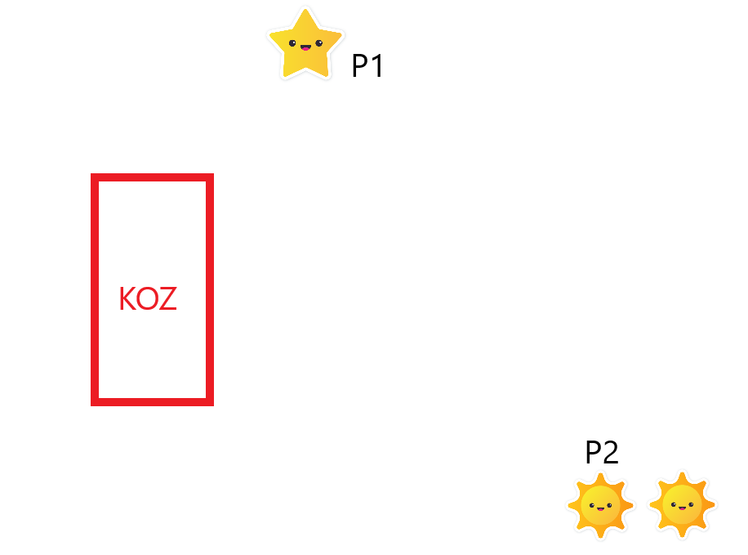
Where, what, how many are the objects

Slide 10
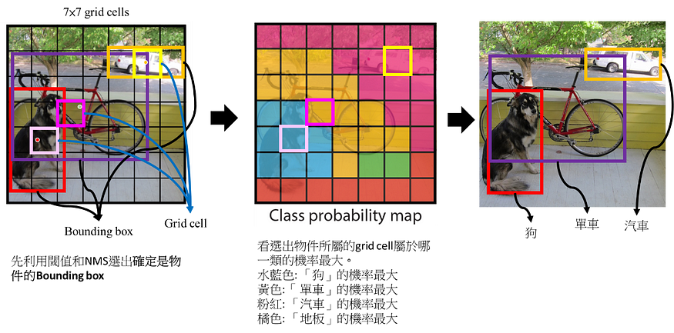
If detector using YOLO
What is yolo
In: image
Out: Where, what are the objects in the image

Slide 11
If detector using YOLO
How to use
Train:
Prepare training data
Train
Usage:
Implement an api in java.

Slide 12
Potential sub-problems
Control
Requirement:
Implement procedures by using other teams’ api
Use path finding to move
Use object detection to scan
Decide strategy to apply
Scan all the points first or just portion of them
If just scan portion of them, what’s the criterion

Slide 13
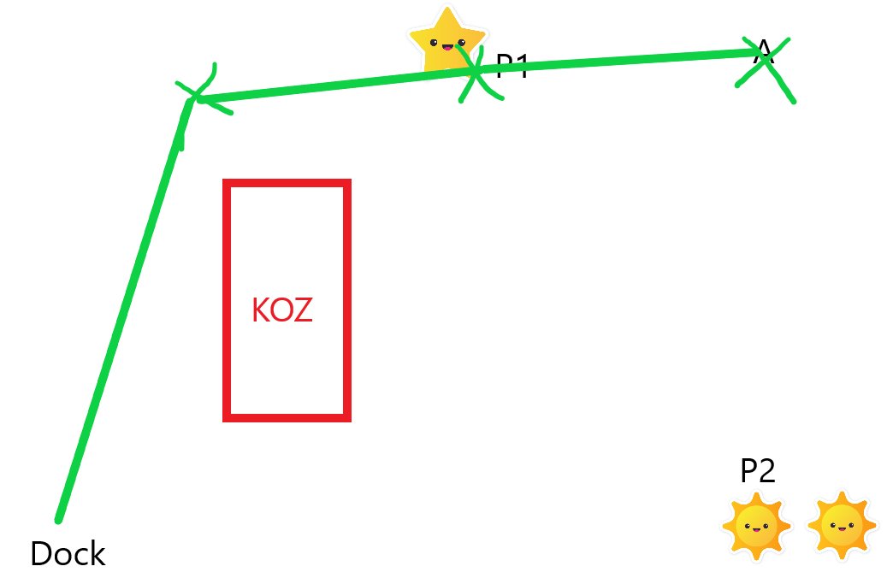
Scan portion of them

Slide 14
Division of labour
Phase 1 (~07/20)
If you’re interesting in graph algorithm…
Go path finding
If you’re interesting in ML, CV…
Go object detection
Phase 2 (5/13 ~07/20)
If you’re interesting in optimization, algorithm…
Go control
Structure is important!
Doc is important! MUST READ ALL!!

Slide 15
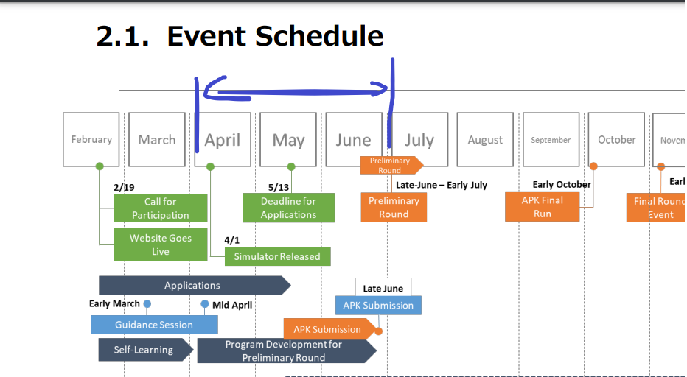
Division of labour
Workflow:
 | ~04/01 | ~04/30 | ~05/13 | ~06/01 | ~06/20
path finding | 了解問題 | 組內分工/開始實作 | 完成實作 | Optimization | Optimization
object detection | 了解問題 | 組內分工/開始實作 | 完成實作 | optimization | Optimization
control | 了解問題 | Unit test for other teams | X | Test all components | Optimization

Slide 16
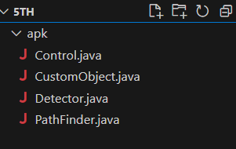
Basic structure
Control
Path finder
Detector

Slide 17
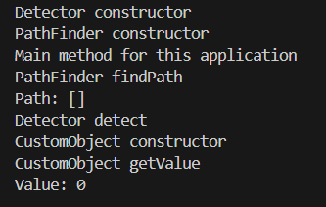
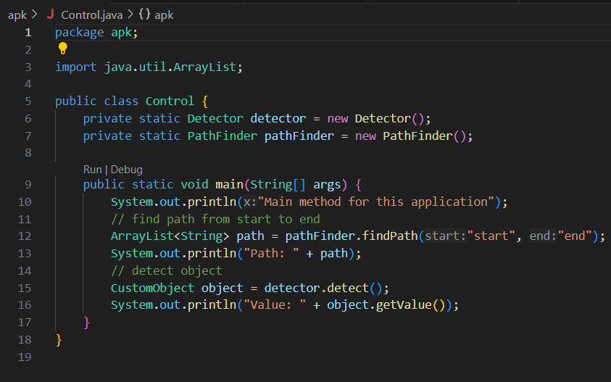
Control

Slide 18
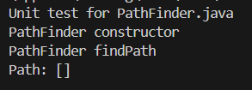
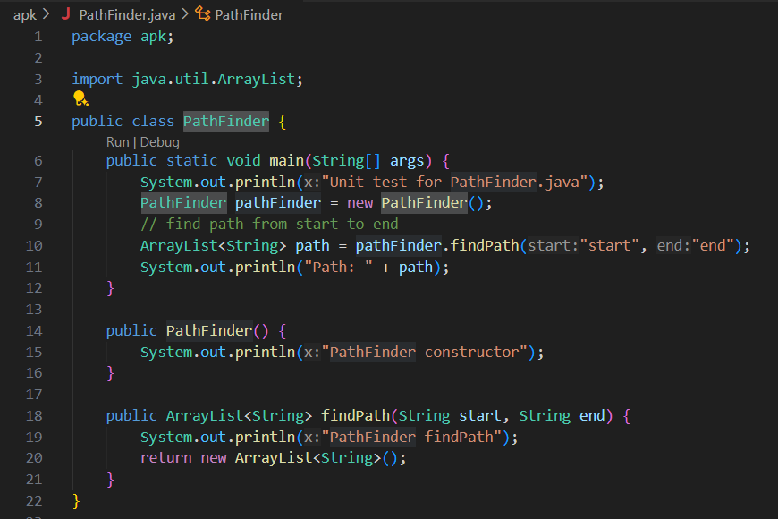
PathFinder

Slide 19

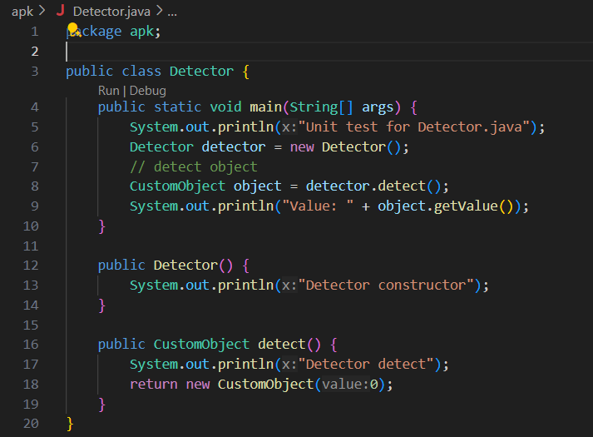
Detector

Slide 20
Friendly reminder
If the problem is too hard, find paper is a reasonable approach.

Slide 21
Unit test procedure
For detection
Go to point 1 (hard coded)
Scan
Report(log in to log file)
Fin

