Slide 1
Detector

Slide 2
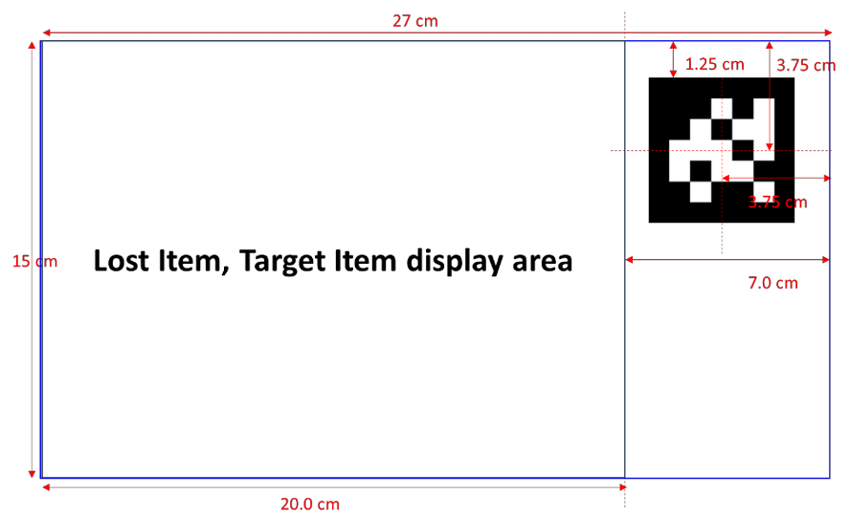
Calibration
OpenCV: Camera Calibration and 3D Reconstruction
OpenCV: Camera calibration and 3D reconstruction (calib3d module)
Undistort using camera info
Cut target item using aruco marker’s pos, dir
# be careful dealing with the marker’s direction

Slide 3
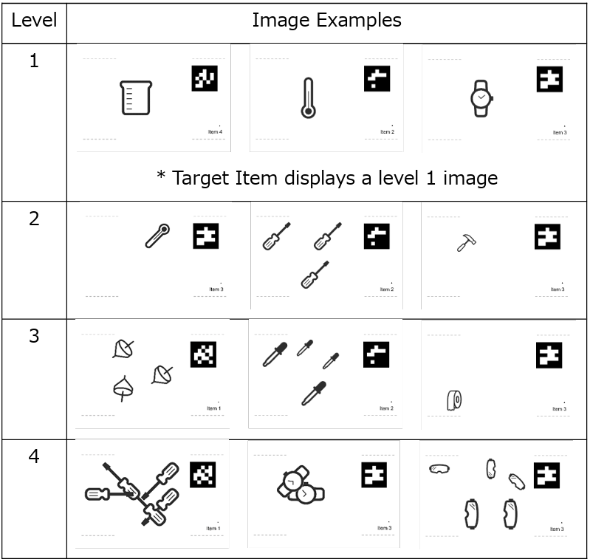
Detection
YOLO!!!!!!!!!!!!!
Data prepare
Randomly put items on image and give corresponding labels
Data quality is important
Train
Well… just run it.

Slide 4
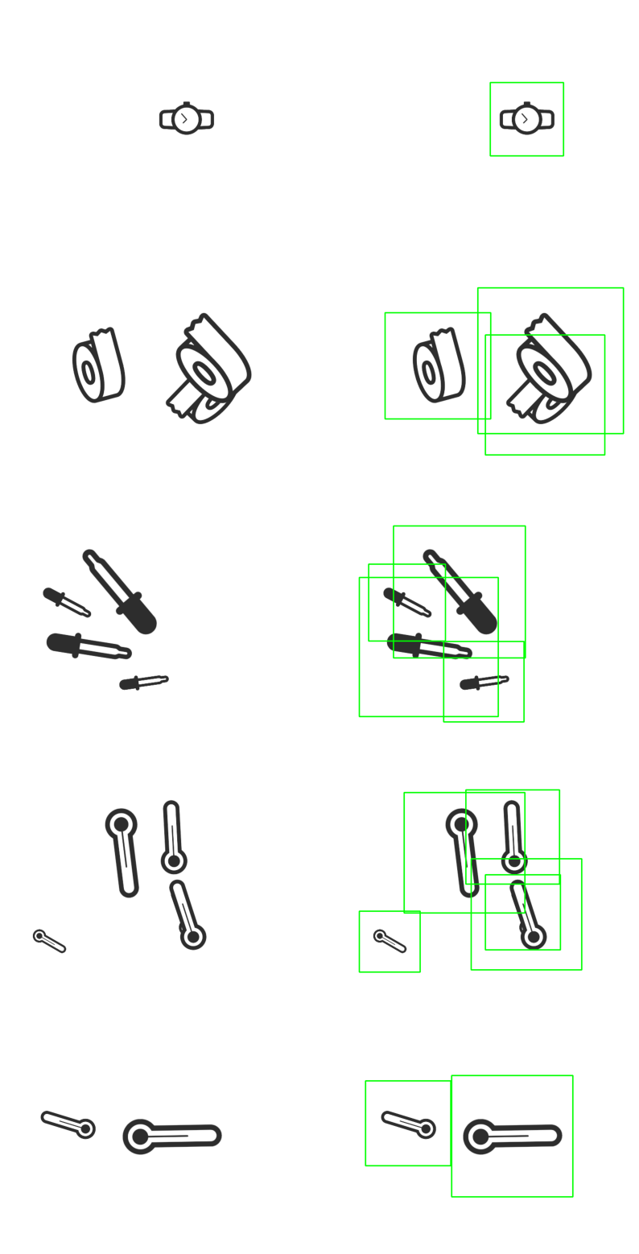
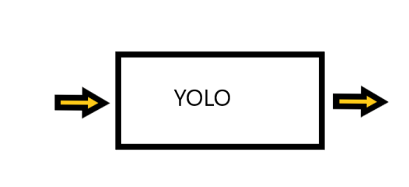
What is yolo
Input: image
Output: arraylike data, in opencv is Mat, which describe the bbox

Slide 5
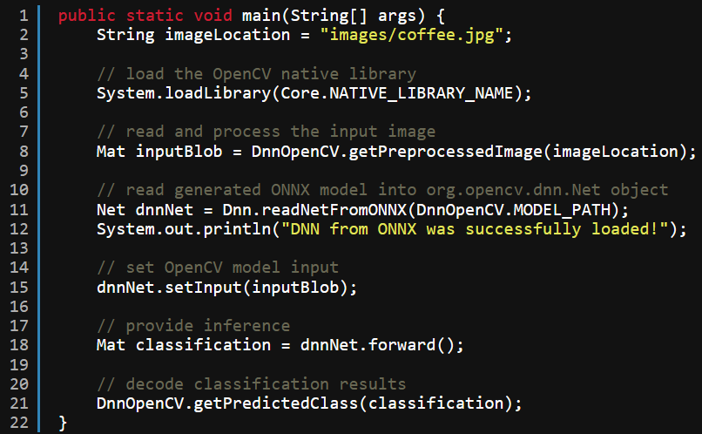
Java implementation
Implement the inference in java
OpenCV Java API for Image Classification (learnopencv.com)
检测 -Ultralytics YOLOv8 文档
推理 API -Ultralytics YOLOv8 文档
org.opencv.dnn (OpenCV 4.5.3 Java documentation)

Slide 6
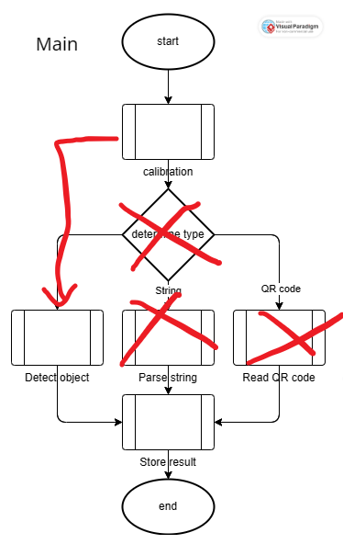
Create module
Combine all the module above into another module that can be used by Control

Slide 7
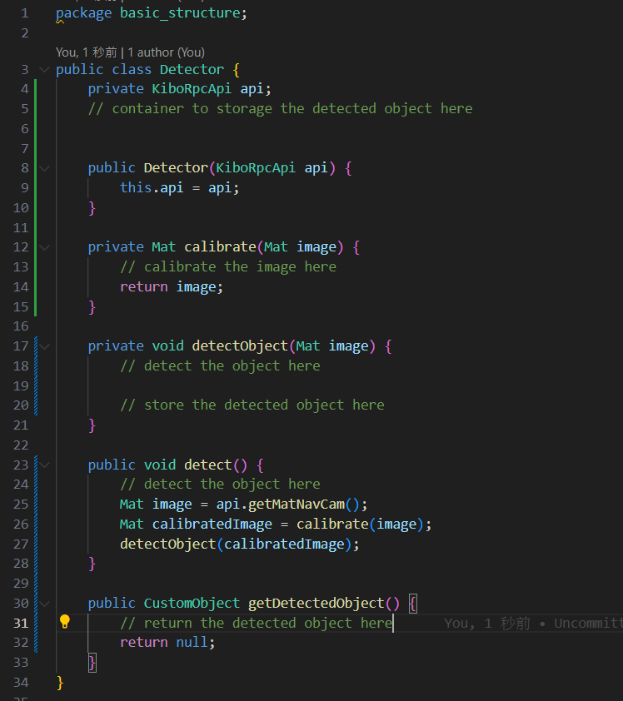
Create module

