Slide 1
Detector

Slide 2
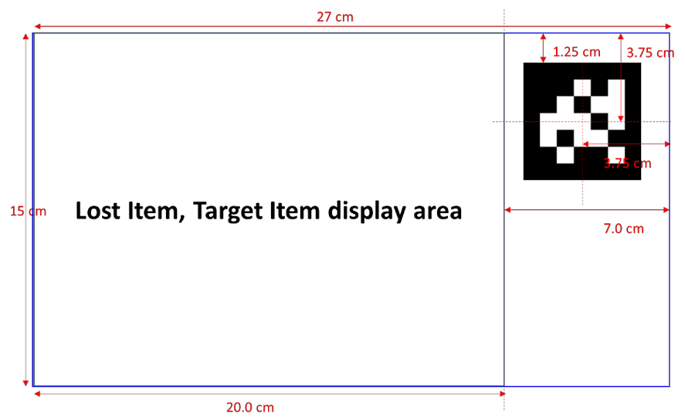
Calibration
OpenCV: Camera Calibration and 3D Reconstruction
OpenCV: Camera calibration and 3D reconstruction (calib3d module)
OpenCV: Detection of ArUco boards
Undistort using camera info
Cut target item using aruco marker’s pos, dir
# be careful dealing with the marker’s direction

Slide 3
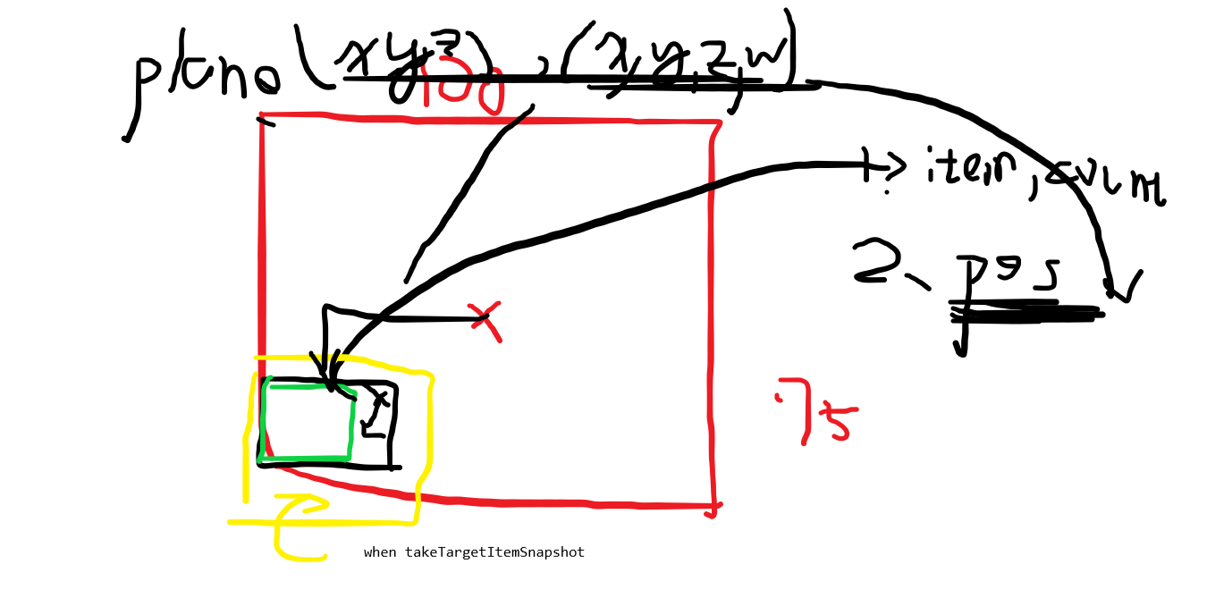
Pos estimation
考慮位置到不了的問題

Slide 4
Pos estimation
移動到所偵測出物件的中心點
可能要多次修正

Slide 5
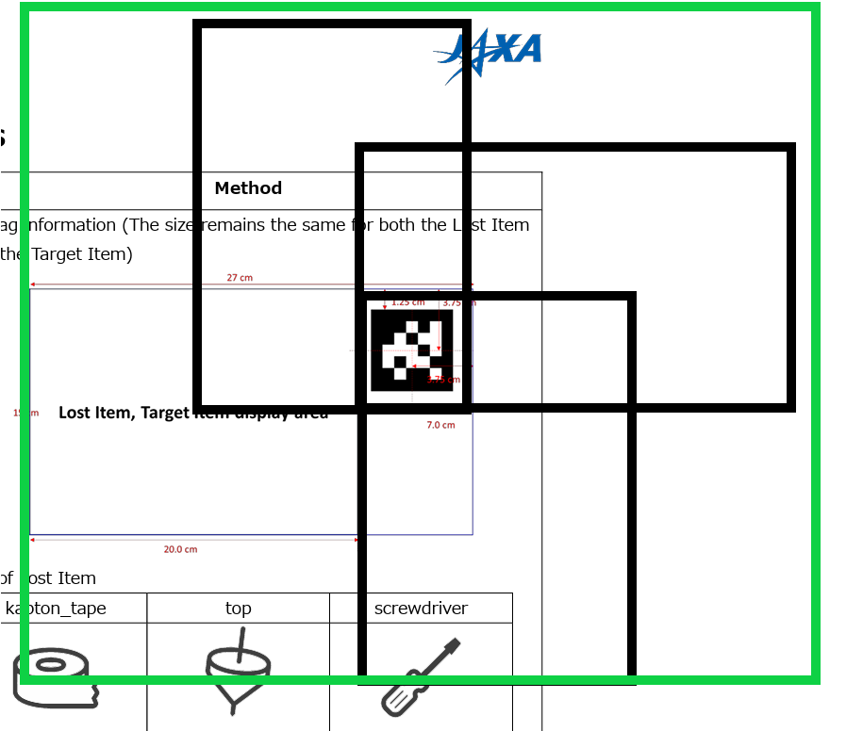
Calibration
透過ar tag切出綠色的區域

Slide 6
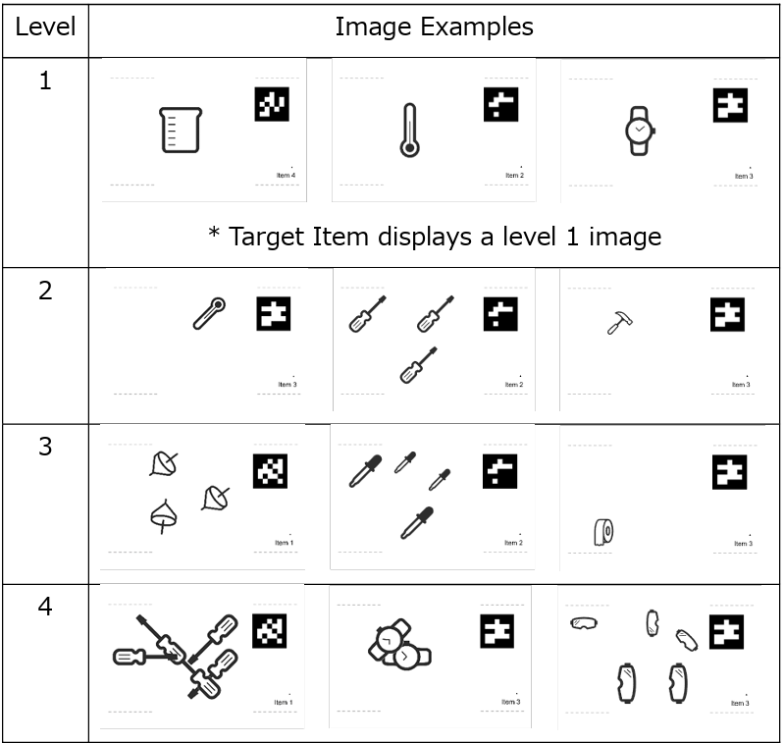
Detection
YOLO!!!!!!!!!!!!!
Data prepare
Randomly put items on image and give corresponding labels
Data quality is important
Train
Well… just run it.

Slide 7
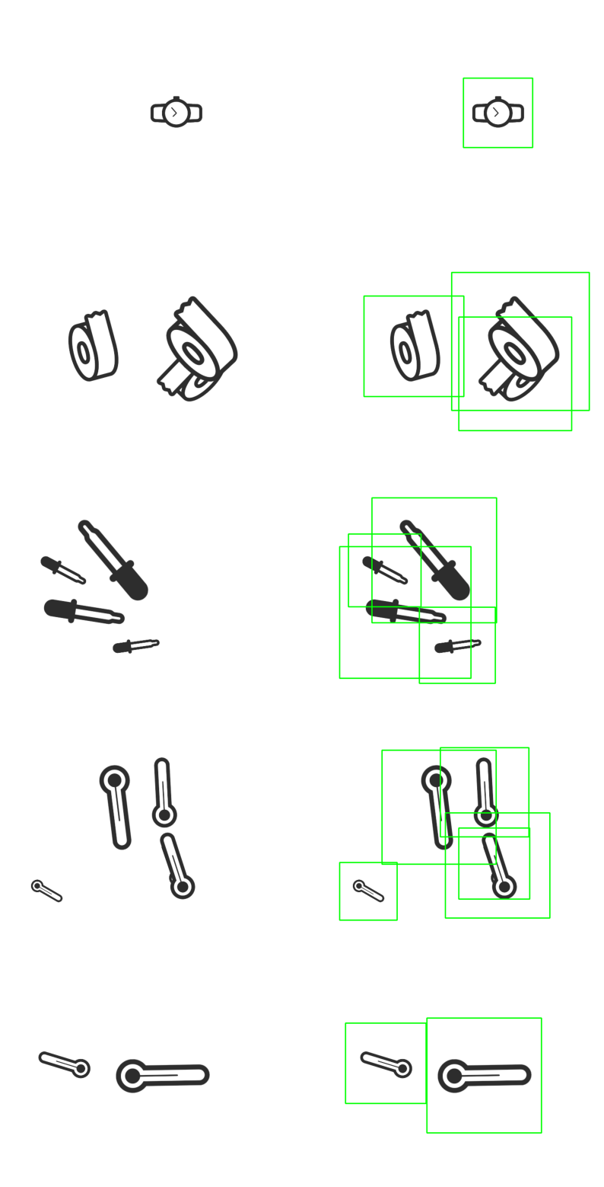
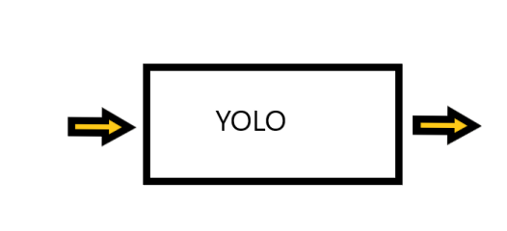
What is yolo
Input: image(arraylike)
Output: arraylike data, in opencv is Mat, which describe the bbox, ML is tensor

Slide 8
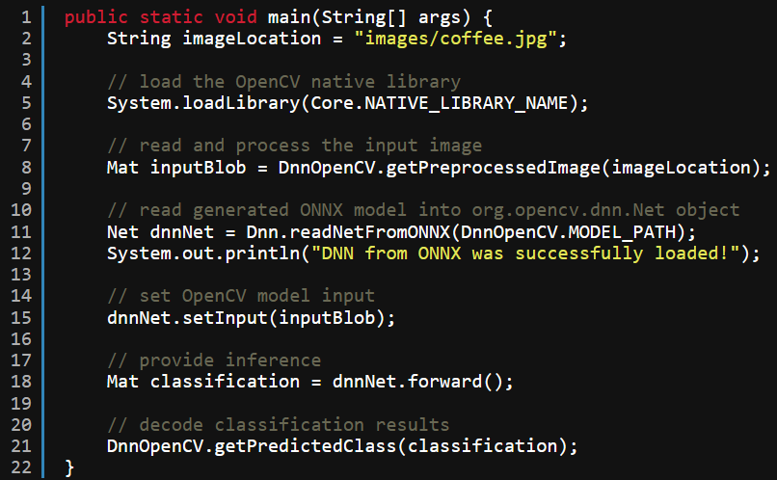
Java implementation
Implement the inference in java
OpenCV Java API for Image Classification (learnopencv.com)
检测 -Ultralytics YOLOv8 文档
推理 API -Ultralytics YOLOv8 文档
org.opencv.dnn (OpenCV 4.5.3 Java documentation)

Slide 9
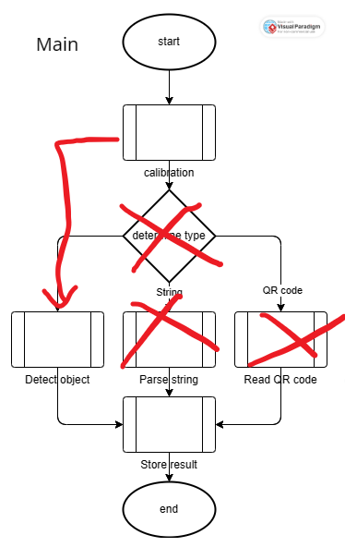
Create module
Combine all the module above into another module that can be used by Control

Slide 10
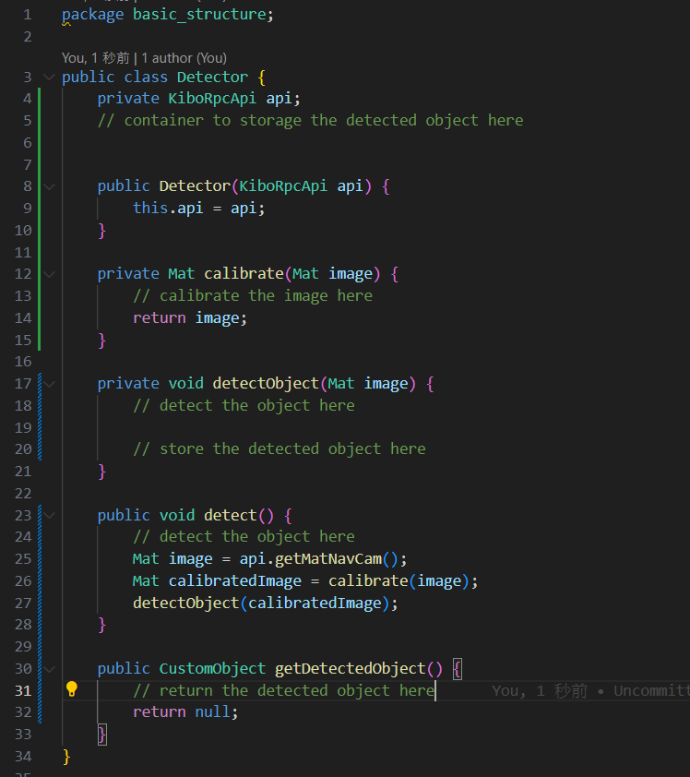
Create module

Slide 11
分工
Opencv：燁子、喵嗚喵
黑盒子：ChenChen
Deadline: 04/14 (日)

