Slide 1
Nemo

Slide 2
Nemo
AI Models - Computer Vision, Conversational AI, and More | NVIDIA NGC

Slide 3
Frame-VAD Multilingual MarbleNet
輸入： 16 KHz Mono-channel Audio (wav files) .
輸出：provides a sequance of speech probabilities for each 20ms frame of the input audio.
Frame-VAD Multilingual MarbleNet | NVIDIA NGC
[2010.13886] MarbleNet: Deep 1D Time-Channel Separable Convolutional Neural Network for Voice Activity Detection (arxiv.org)

Slide 4
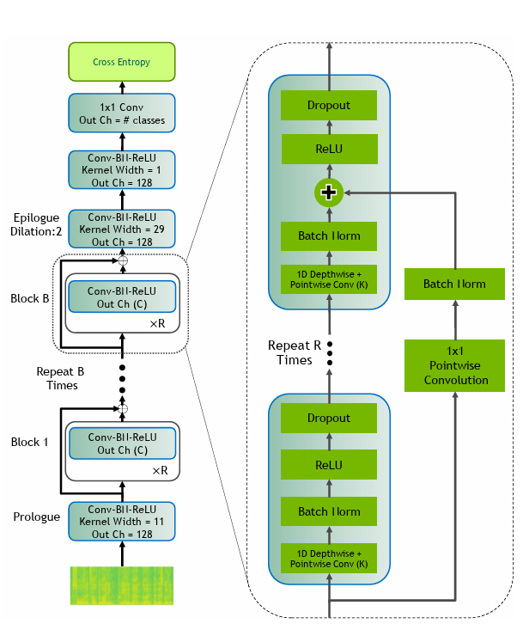
MarbleNet
Depthwise + pointwise = depthwise separable convolution (normal but less parms)

Slide 5
TitaNet-L
solves two major tasks: speaker identification (who is speaking?) and speaker verification (is the speaker who they claim to be?)
Input: wav
Output: probability that the cur rent segment belongs to a speaker from the training set
TitaNet-L | NVIDIA NGC

Slide 6
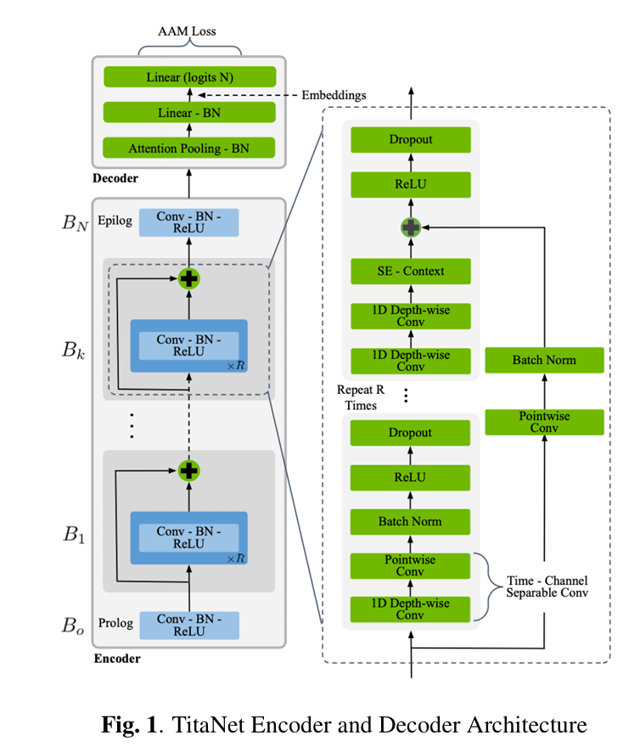
TitaNet-L
[2110.04410] TitaNet: Neural Model for speaker representation with 1D Depth-wise separable convolutions and global context (arxiv.org)

Slide 7
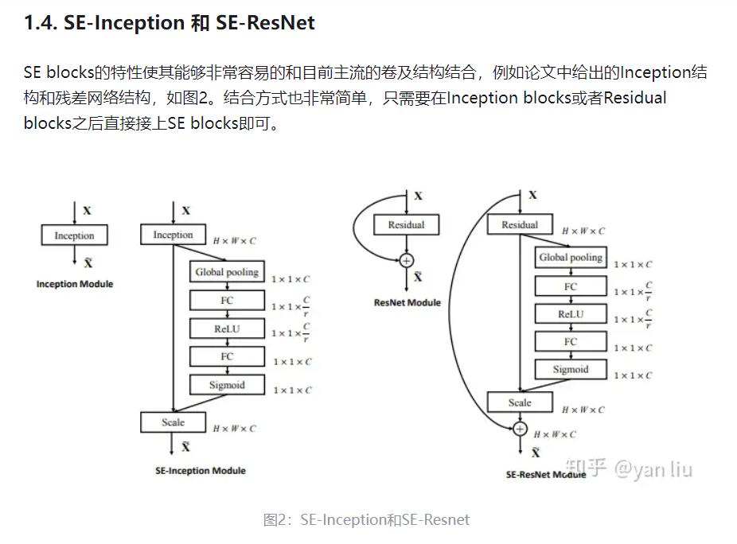
Squeeze-and-Excitation Networks
Squeeze-and-Excitation Networks - 知乎 (zhihu.com)

Slide 8
attentive statistics pooling layer
Pooling: extract features
Pooling using attention
【声纹识别】attention在声纹识别中的应用 - 知乎 (zhihu.com)
别再用平均池化层了！Meta AI把注意力塞到池化层，性能立刻提升0.3 - 知乎 (zhihu.com)

Slide 9
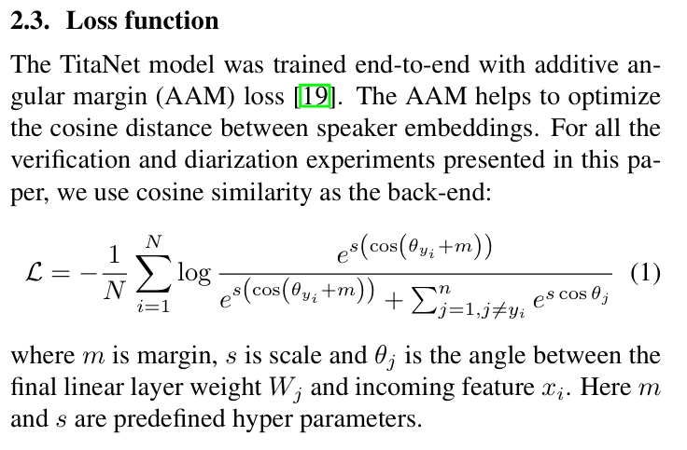
additive an gular margin (AAM) loss

Slide 10
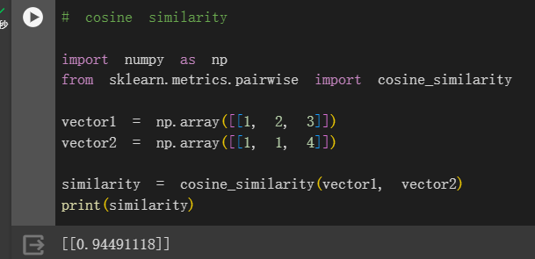
Compare 2 speakers
Compute cosine similarity between 2 output vectors
這是我猜的

Slide 11
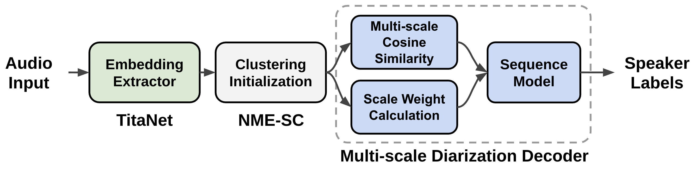
Multiscale Diarization Decoder (MSDD)
Models — NVIDIA NeMo

Slide 12
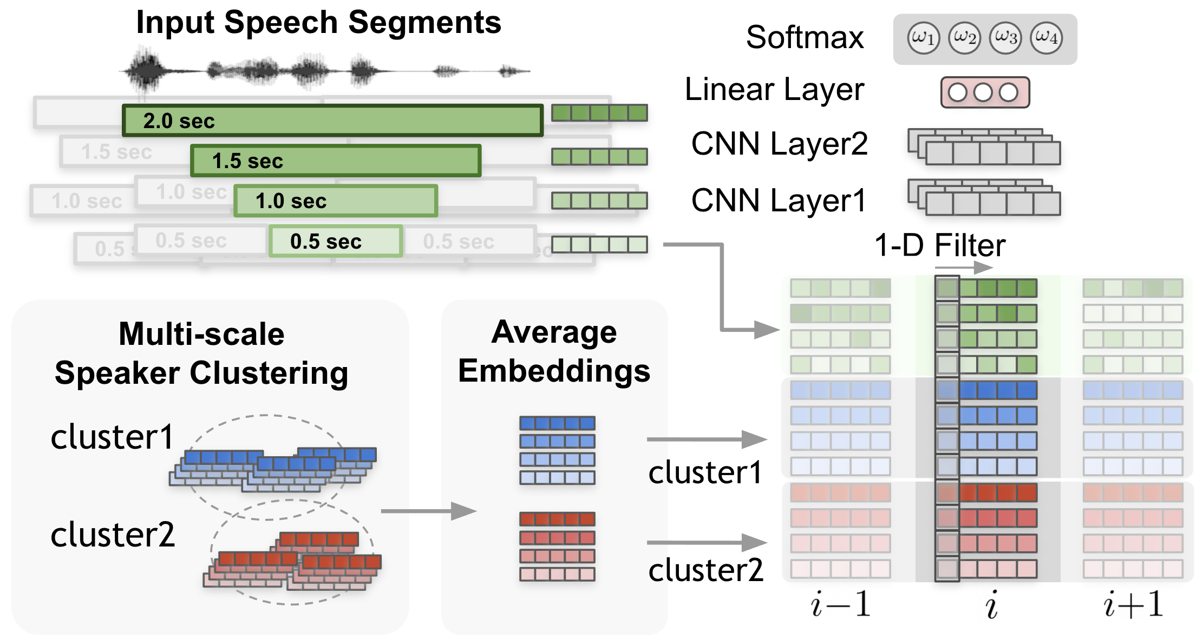
Scale Weight Calculation

Slide 13
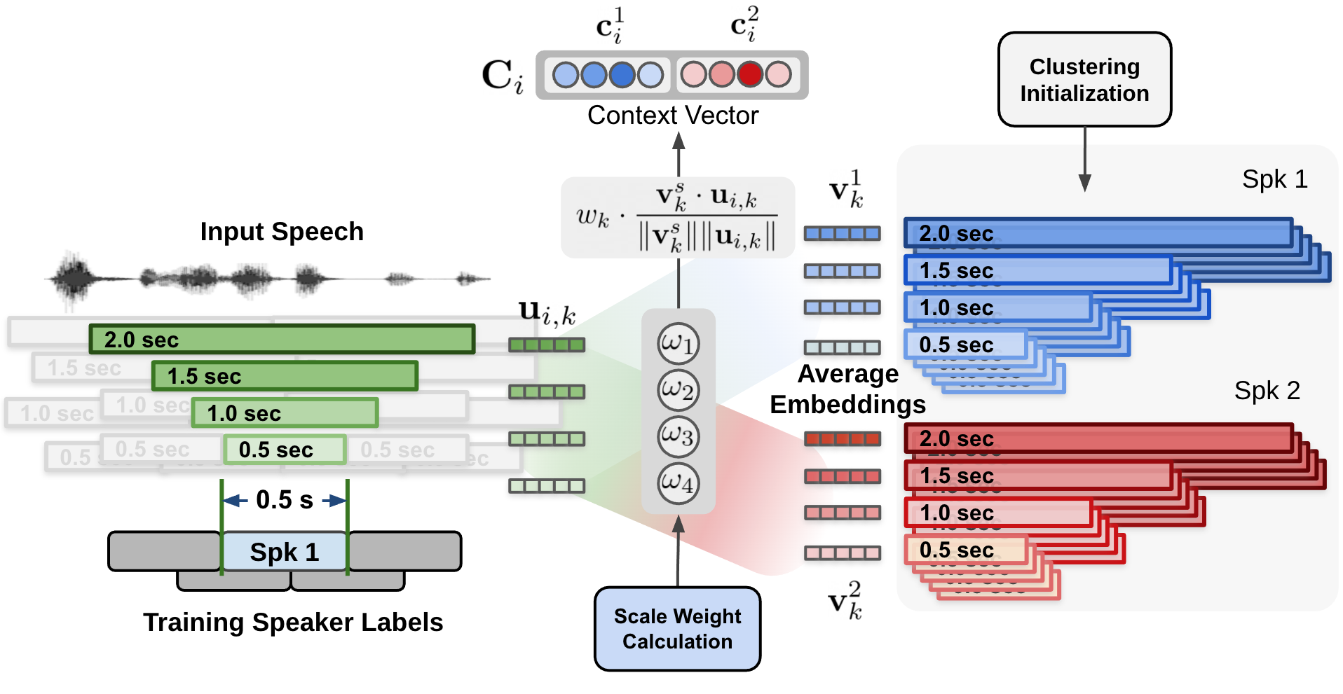
context vector

Slide 14
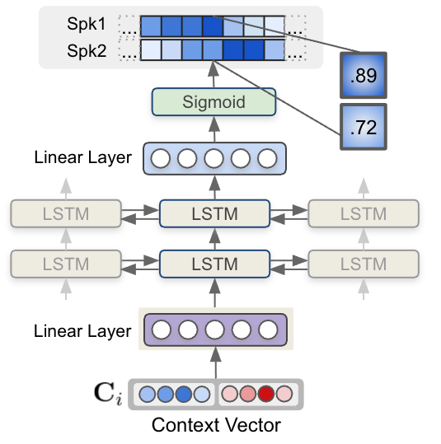
Sequence model

