Slide 1
VITS
VAE: variational auto encoder
GAN: Generative Adversarial Network
Concept of flow
Variational Inference with adversarial learning for end-to-end Text-to-Speech
[筆記]Tensorflow-Lesson10_變分自動編碼器(Variational Autoencoder)_20190706 - iT 邦幫忙::一起幫忙解決難題，拯救 IT 人的一天 (ithome.com.tw)
细读经典：VITS，用于语音合成带有对抗学习的条件变分自编码器 - 知乎 (zhihu.com)
2106.06103.pdf (arxiv.org)

Slide 2
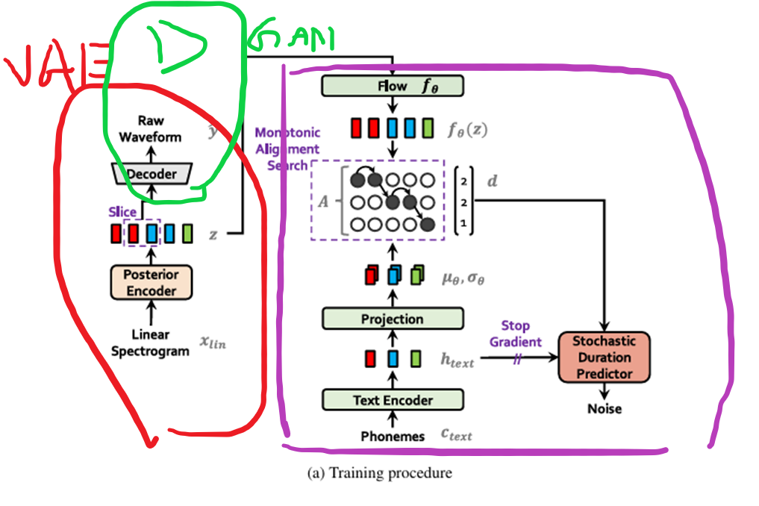
Training procedure
z: latent representation

Slide 3
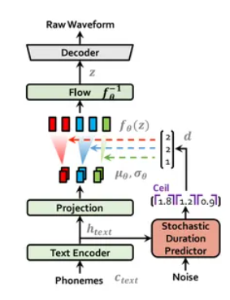
Interface procedure

Slide 4
TextEncoder (+ projection)
= embbeding + transformer encoder + conv1d

Slide 5
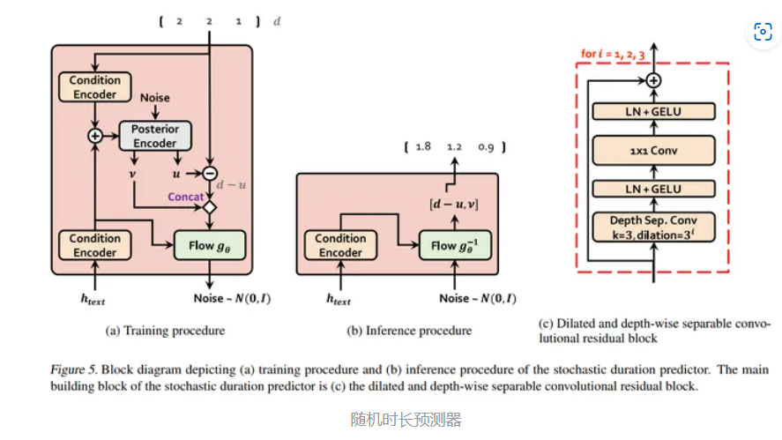
Stochastic duration predictor
吃透空洞卷积(Dilated Convolutions) - 知乎 (zhihu.com)
深度可分离卷积（Depthwise separable convolution） - 知乎 (zhihu.com)
Noise: prevent overfitting

Slide 6
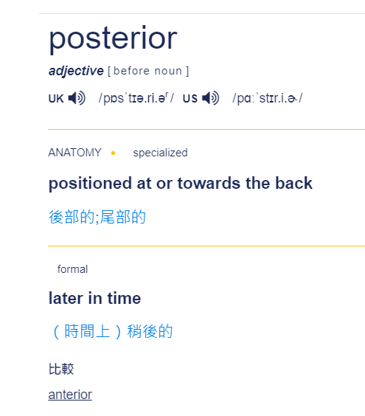
Posterior encoder
= conv1d + WaveNet + conv1d

Slide 7
WaveNet
Dialated conv
WaveNet，一种端到端的语音合成模型 - 知乎 (zhihu.com)

Slide 8
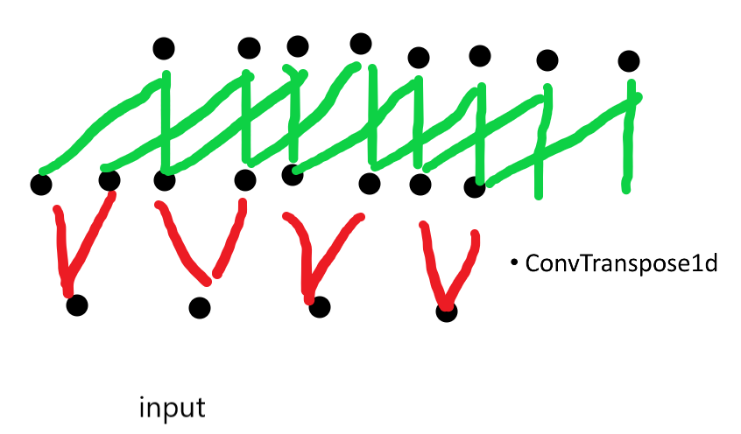
HiFiGAN gen
= (ConvTranspose1d + ResBlock) * n
ResBlock = (conv + dialated conv with residual) *n
细读经典：HiFiGAN，拥有多尺度和多周期判别器的高效声码器 - 知乎 (zhihu.com)

Slide 9
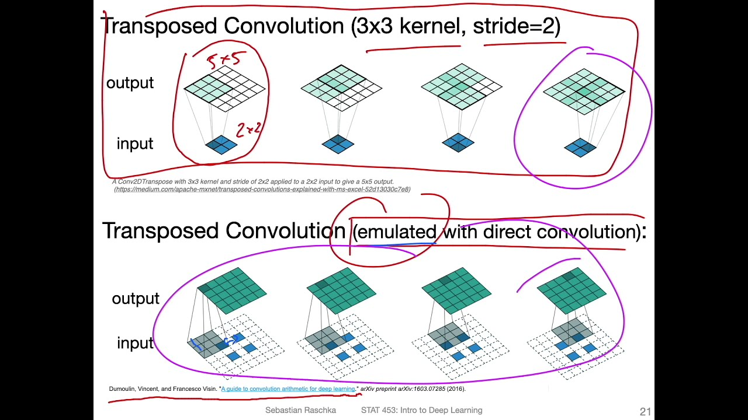
Transposed Convolution
Conv: Y = CX, give C, X to find Y
Transposed conv: give C^T, Y to find X
https://youtu.be/ilkSwsggSNM?si=Fv5VAxtP8YT7RAaA

Slide 10
HiFiGAN dis
= DiscriminatorS + DiscriminatorP

Slide 11
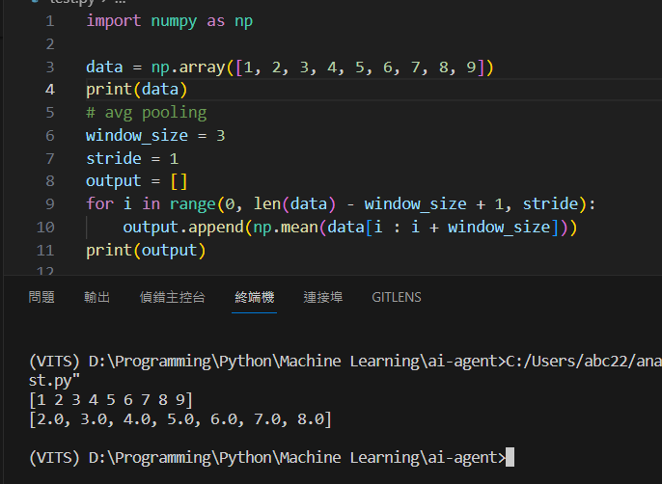
DiscriminatorS
= (conv1d + meanpool) * n
Meanpool -> size/2

Slide 12
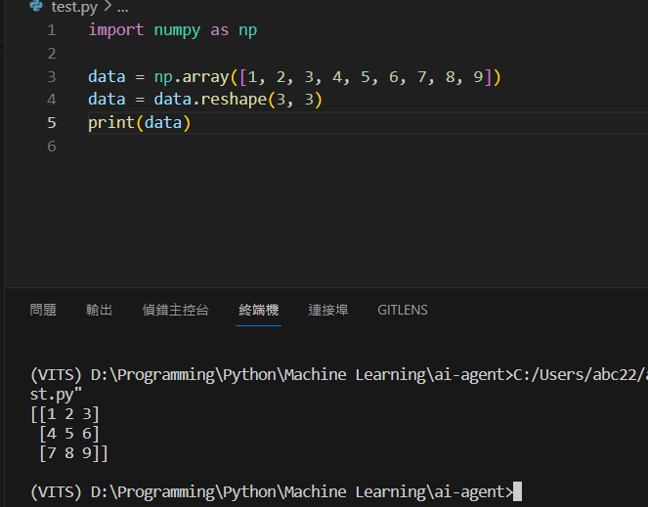
DiscriminatorP
Convert to 2d then use conv2d

