Slide 1
whisper
https://cdn.openai.com/papers/whisper.pdf
https://blog.csdn.net/weixin_44966641/article/details/127908459
https://www.youtube.com/watch?v=3eXCJd32UnM&t=193s

Slide 2
Robust Speech Recognition via Large-Scale Weak Supervision
When scaled to 680,000 hours of multilingual and multitask supervision, the resulting models generalize well to standard benchmarks and are often competitive with prior fully supervised results but in a zeroshot transfer setting without the need for any finetuning.

Slide 3
unsupervised pre-training (Wav2Vec 2.0) vs combining as many existing high-quality speech recognition datasets (SpeechStew) vs whisper
unsupervised pre-training
1,000,000 hours of training data
訓練和微調decoder依然需要有標記的資料，對不同場景仍需要微調
combining as many existing high-quality speech recognition datasets
only a moderate amount of this data easily available. SpeechStew mixes together 7 pre-existing datasets totalling 5,140 hours of supervision.
Whisper
relaxing the requirement of goldstandard human-validated transcripts,
scaling weakly supervised speech recognition the next order of magnitude to 680,000 hours of labeled audio data.
Of those 680,000 hours of audio, 117,000 hours cover 96 other languages.
Includes 125,000 hours of X→en translation data.

Slide 4
Data Processing
Whisper models to predict the raw text of transcripts without any significant standardization, relying on the expressiveness of sequence-to-sequence models to learn to map between utterances and their transcribed form. This simplifies 2 If an acronym or basis for the name is desired, WSPSR standing for Web-scale Supervised Pretraining for Speech Recognition can be used. the speech recognition pipeline since it removes the need for a separate inverse text normalization step in order to produce naturalistic transcriptions. (因為資料量夠大，可以直接預測文本，文本不用任何標準化或歸一化(所有單字變小寫，所有簡寫展開，所有標點去掉等操作)，因為所有情況都能涵蓋到了)

Slide 5
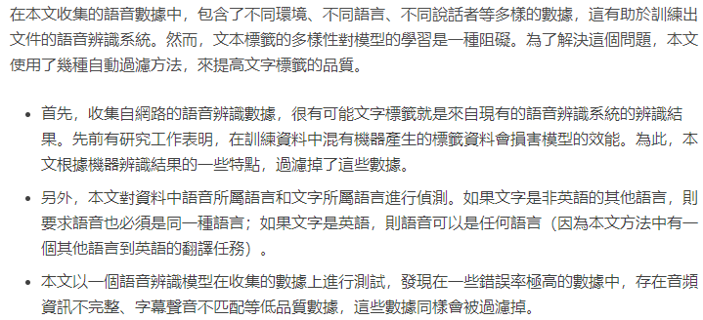
Data Processing

Slide 6
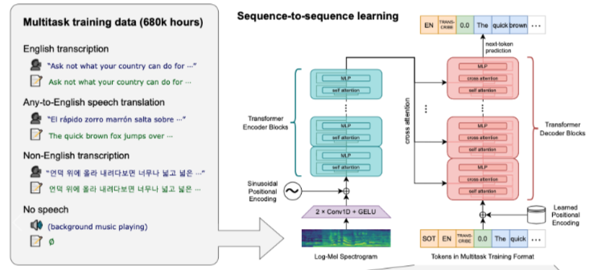
Model

Slide 7
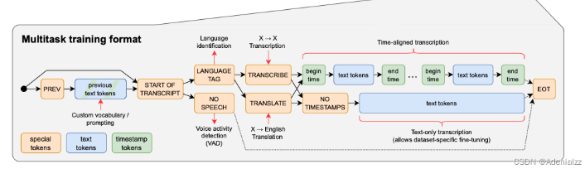
Model (Multitask training data)
multilingual speech recognition, speech translation, spoken language identification, and voice activity detection等等的任務都直接整合在這個模型內
優點:
符合語音辨識系統的期望，可以對應多種狀況
缺點:
假設此模型在某幾種特定場景中表現較差，調整模型的難度會很大

Slide 8
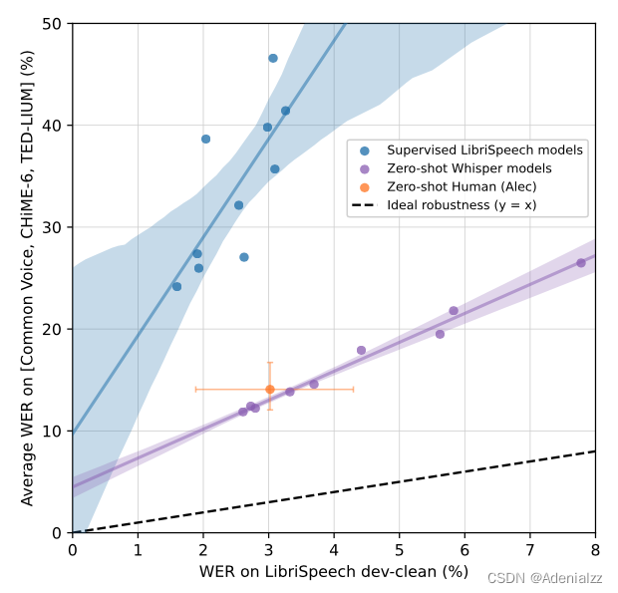
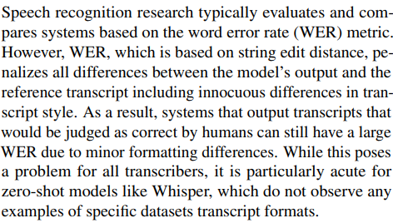
Experiments result (English)
對比很多模型，whisper有很優秀的泛化能力

Slide 9
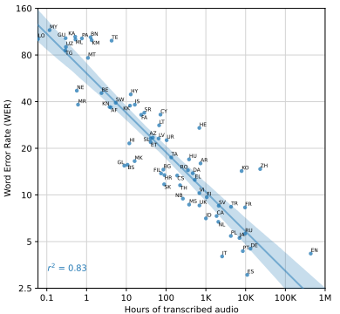
Experiments result (Multi-lingual Speech Recognition)
We also observed that many of the largest outliers in terms of worse than expected performance according to this trend are languages that have unique scripts and are more distantly related to the Indo-European languages making up the majority of the training dataset such as Hebrew (HE), Telugu (TE), Chinese (ZH), and Korean (KO). These differences could be due to a lack of transfer due to linguistic distance, our byte level BPE tokenizer being a poor match for these languages, or variations in data quality

Slide 10
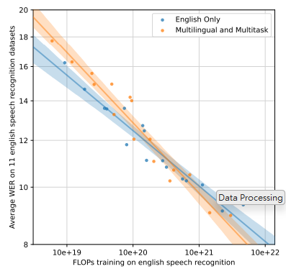
Experiment result (Multitask and multilingual transfer improves with scale)
Multitask and multilingual transfer improves with scale. For small models, performance on English speech recognition degrades when trained jointly in a multitask and multilingual setup. However, multilingual and multitask models benefit more from scale and eventually outperform models trained on English data only. 95% bootstrap estimate confidence intervals are shown.

Slide 11
Conclusion: 訓練資料量很重要
Whisper suggests that scaling weakly supervised pretraining has been underappreciated so far in speech recognition research. We achieve our results without the need for the self-supervision and self-training techniques that have been a mainstay of recent large-scale speech recognition work and demonstrate how simply training on a large and diverse supervised dataset and focusing on zero-shot transfer can significantly improve the robustness of a speech recognition system.

