Slide 1
Demucs
Deep Extractor for Music Sources with extra
unlabeled data remixed
https://paperswithcode.com/paper/demucs-deep-extractor-for-music-sources-with

Slide 2
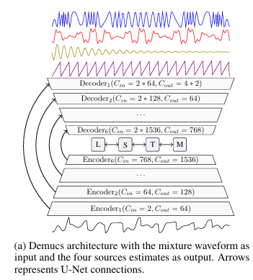
Model Architecture

Slide 3
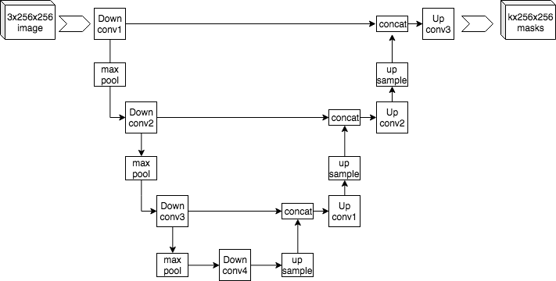
U-Net connections
https://en.wikipedia.org/wiki/U-Net
https://ithelp.ithome.com.tw/articles/10240314
During the contraction, the spatial information is reduced while feature information is increased. The expansive pathway combines the feature and spatial information through a sequence of up-convolutions and concatenations with high-resolution features from the contracting path.

Slide 4
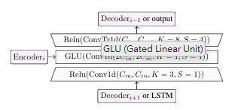
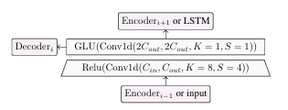
Encoder/decoder

Slide 5
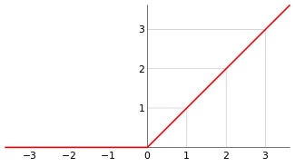
ReLU線性整流函式

Slide 6
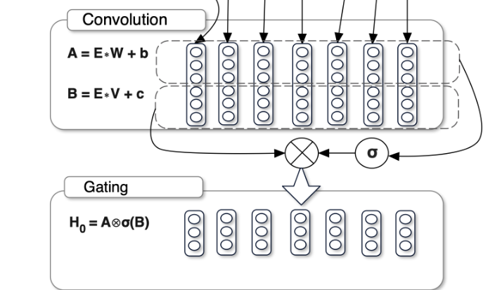

GLU (Gated Linear Unit)
https://blog.csdn.net/m0_48742971/article/details/123431686
https://blog.csdn.net/qq_32458499/article/details/81513720
其中W和V是不同的捲積核，卷積核寬度為k，輸出通道數為n，b和c是偏壓參數。
公式中的後半部分，即有激活函數的捲積就是所謂的門控機制，其控制了X*W+b中哪些資訊可以傳入下一層。這裡將其定義為Gated Linear Units (GLU).然後就可以將該模型進行堆疊，以捕獲Long_Term memory。

Slide 7
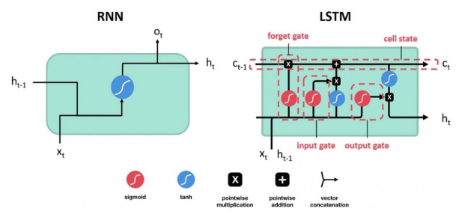
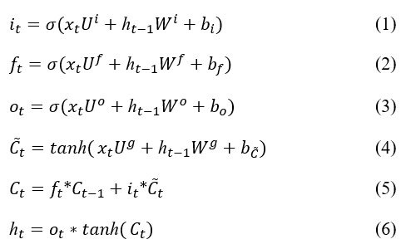
LSTM (Long short-term memory)
通常一個LSTM單元由細胞單元（cell）、輸入門（input gate）、輸出門（output gate）^{[3]}、遺忘門（forget gate）^{[4]}組成。
https://ithelp.ithome.com.tw/articles/10308248?sc=rss.iron

Slide 8
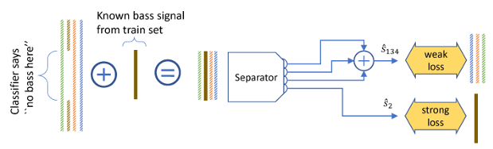
Unlabeled Data Remixing
Overall representation of our unlabeled data remixing pipeline. When we detect an excerpt of at least 5 seconds with one source silent, here the bass, we recombine it with a single bass sample from the training set. We can then provide strong supervision for the silent source, and weak supervision for the other 3 as we only know the ground truth for their sum.

Slide 9
信號失真比 (SDR)
源失真比（SDR）定义为目标能量与重建信号中所有误差的比值
具體來說，一個高的SDR值表示模型能夠更準確地分離出原始音樂源，而一個低的SDR值則表示模型在分離過程中引入了較多的失真。

Slide 10
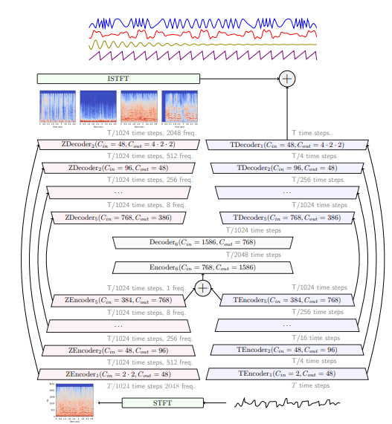
Demucs V3: Hybrid Spectrogram and Waveform Source Separation
2111.03600.pdf (arxiv.org)
perform end-to-end hybrid source separation, letting the model decide which domain is best suited for each source, and even combining both.
compressed residual branches, local attention or singular value regularization

Slide 11
Demucs architecture to perform hybrid waveform/spectrogram domain source separation
Different representations will lead to different artifacts, some being more noticeable for the drums and bass (phase inconsitency for spectrogram methods will make the attack sounds hollow), while others are more noticeable for the vocals (vocals separated by Demucs suffer from crunchy static noise)

Slide 12
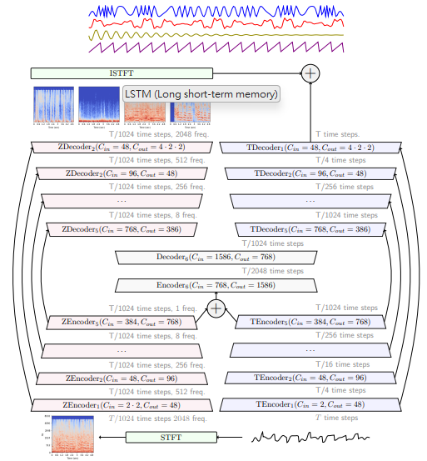
Figure 1: Hybrid Demucs architecture. The input waveform is processed both through a temporal encoder, and first through the STFT followed by a spectral encoder. The two representations are summed when their dimensions align. The decoder is built symmetrically. The output spectrogram go through the ISTFT and is summed with the waveform outputs, giving the final model output. The Z prefix is used for spectral layers, and T prefix for the temporal ones.

Slide 13
Hybrid Demucs Overall architecture: The temporal branch
Compared with the original architecture, all ReLU activations are replaced by Gaussian Error Linear Units (GELU)
It contains 5 layers, which are going to reduce the number of time steps by a factor of 45 = 1024.

Slide 14
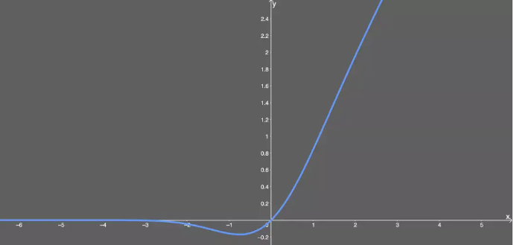
GELU
RELU的缺點: 死亡 ReLU 问题，即网络的大部分分量都永远不会更新。但这有时候也是一个优势；
优点：
似乎是 NLP 领域的当前最佳；尤其在 Transformer 模型中表现最好；
能避免梯度消失问题。

Slide 15
Hybrid Demucs Overall architecture: The spectral branch
The spectral branch takes the spectrogram obtained from a STFT over 4096 time steps, with a hop length of 1024.
Notice that the number of time steps immediately matches that of the output of the encoder of the temporal branch.
After being processed by the spectral encoder, the signal has only one “frequency” left
The output of the spectral branch is inversed with the ISTFT, and summed with the temporal branch output, giving the final model prediction.

Slide 16
Hybrid Demucs Overall architecture
The temporal and spectral representations are then summed before going through a shared encoder/decoder layer which further reduces by 2 the number of time steps (using a kernel size of 4).
The output of the spectral branch is inversed with the ISTFT, and summed with the temporal branch output, giving the final model prediction.
the model is free to use whichever representation is most convenient for different parts of the signal, even within one source, and can freely share information between the two representations.

Slide 17
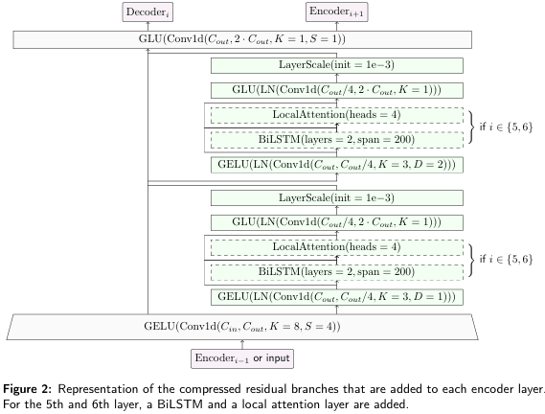
Compressed residual branches

Slide 18
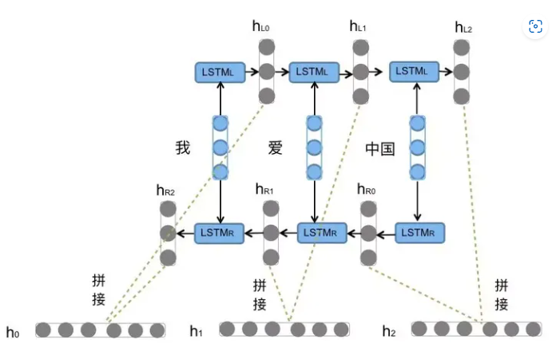
BiLSTM

Slide 19

LayerScale、 Local attention
LayerScale: LayerScale是一種用於神經網絡中的規範化（normalization）技術之一。
Local attention:
Local Attention是一種注意力機制。注意力機制會考慮所有位置之間的關係，Local Attention會專注於僅在一定範圍內的位置。這通常是通過一個可調節的懲罰項來實現的，這個懲罰項會懲罰那些遠離的位置，使得模型更專注於局部區域的信息。這種方式可以使模型在處理長距離依賴性時更有效率。

Slide 20
HT Demucs
2211.08553.pdf (arxiv.org)
Hybrid Transformer for music source separation論文譯注 - 知乎 (zhihu.com)

Slide 21
HT Demucs
因為其他領域中Transformer有很強的長序列資訊建模能力，所以demucs的作者在demucs中引入了Transformer，提出了HT Demucs （ Hybrid Transformer Demucs）。
以v3版本的時頻混合域雙U-net模型為基礎，然後將encoder和decoder中間的網路層換成了跨域的Transformer Encoder，在單域中使用自注意力，在不同域間使用交叉注意力。

Slide 22
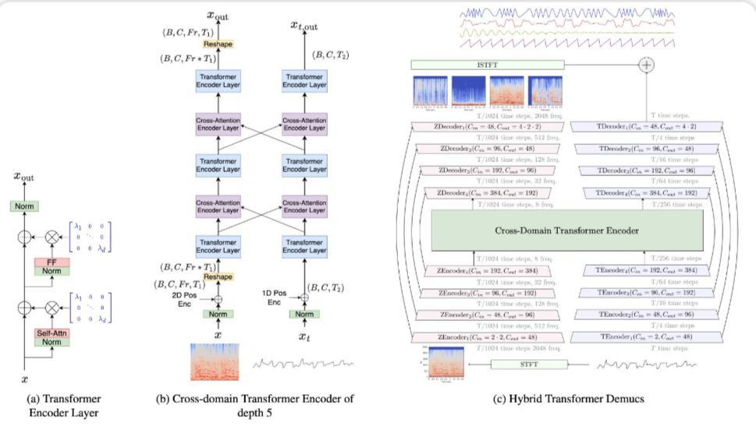
HT Demucs
Fig. 1: Details of the Hybrid Transformer Demucs architecture. (a): the Transformer Encoder layer with self-attention and Layer Scale [6]. (b): The Cross-domain Transformer Encoder treats spectral and temporal signals with interleaved Transformer Encoder layers and cross-attention Encoder layers. (c): Hybrid Transformer Demucs keeps the outermost 4 encoder and decoder layers of Hybrid Demucs with the addition of a cross-domain Transformer Encoder between them.

Slide 23
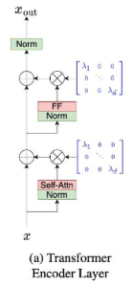

Slide 24
