Slide 1

404 MEMORY NOT FOUND
NİLAY DOĞAN 21685417
DENİZ ECE AKTAŞ 21626901
MUSTAFA CANDAN 21627059

Slide 2
WHAT IS 404 MEMORY NOT FOUND ?
3 DIMENSIONAL
FIRST PERSON
CLOSED WORLD
PUZZLE

Slide 3
STORY OF THE GAME
404 Memory Not Found takes place in Hacettepe University Computer Engineering Department.
The player is stuck inside the building and they have lost their memories.
In order to regain their memories and to get out of the building they have to collect certain objects.

Slide 4
To move forward in the game, the player has to collect the memory items.
After each item, the building opens up another part of the building.

Slide 5
MAP AND OBJECTS
We designed the map of the building based on our department’s first floor.
The map is designed with 3D MAX program.
The other objects were created with Blender program.
To convert the object files into .smf files 3D Object Converter was used.
There is a hidden easter egg object in the game.

Slide 6

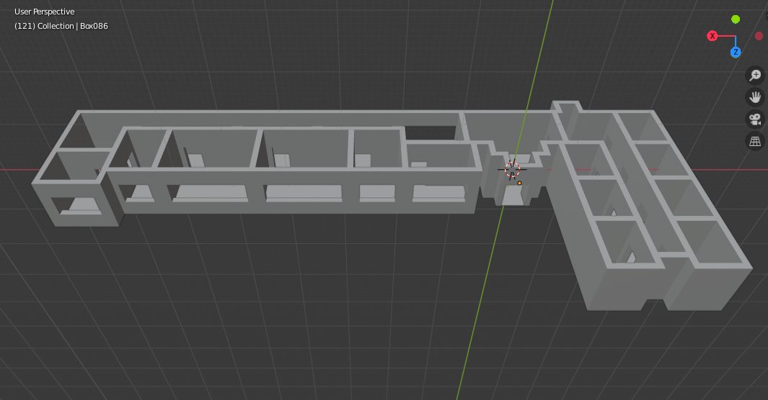

Slide 7
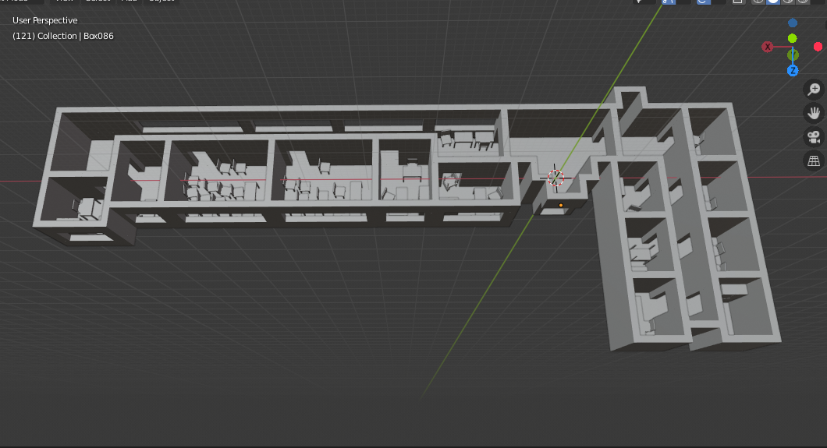

Slide 8
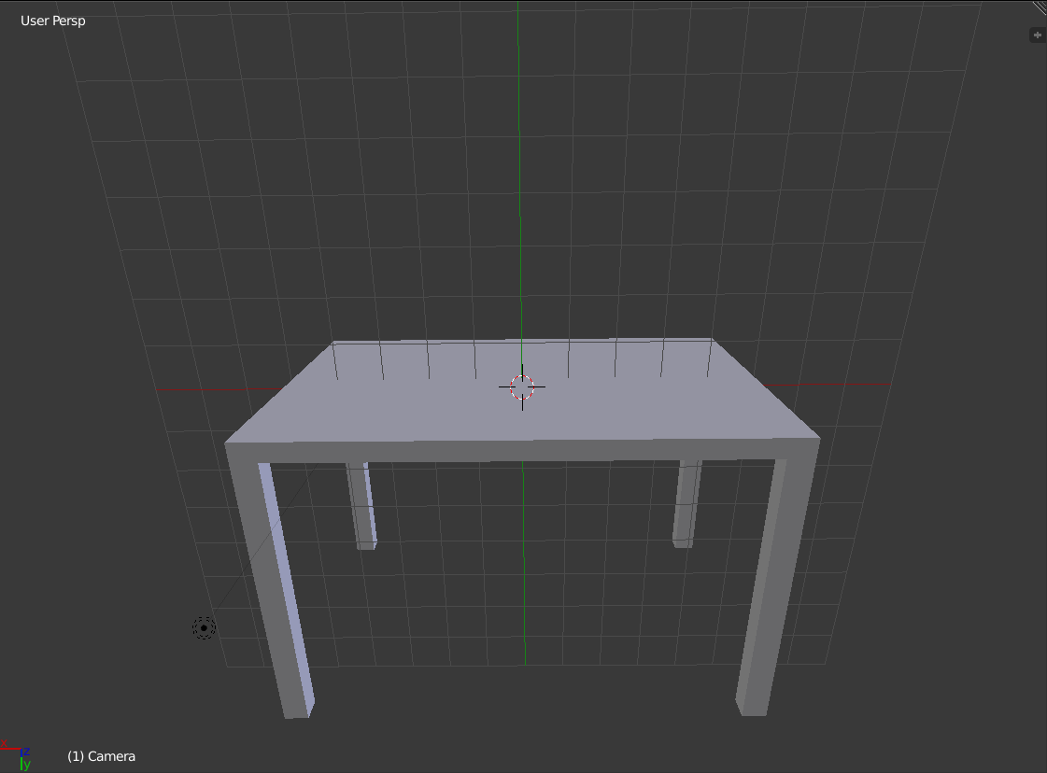
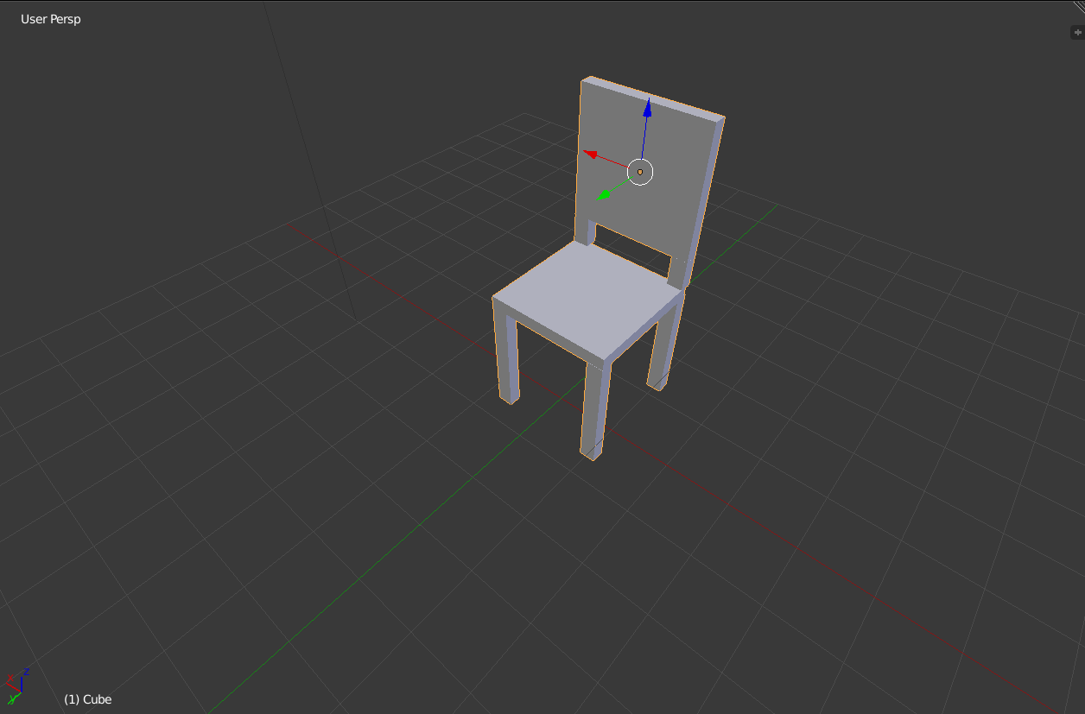
Movable objects

Slide 9
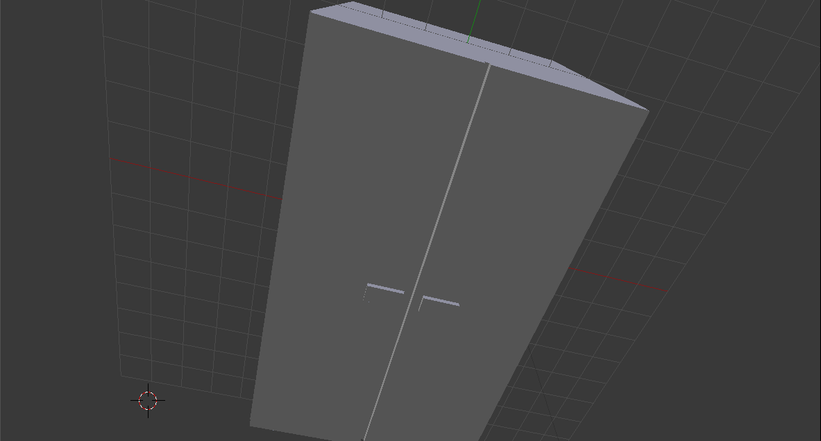
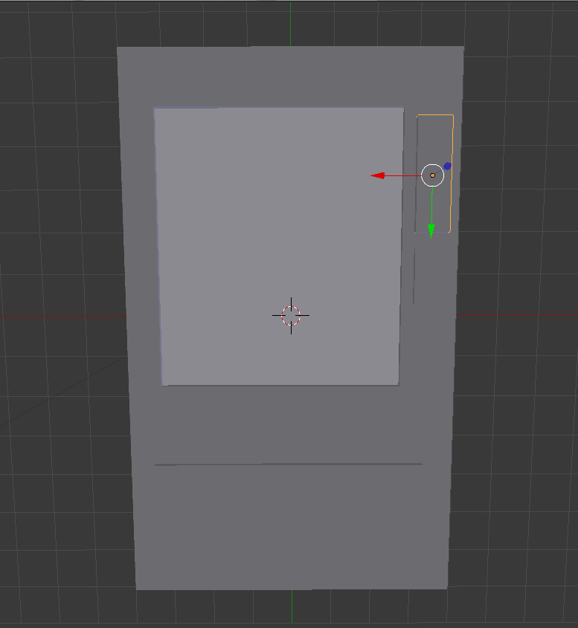
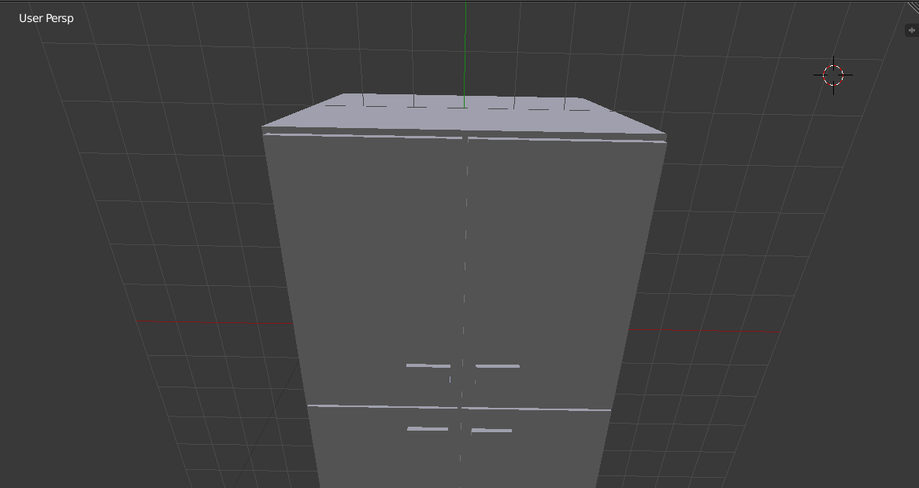

Slide 10
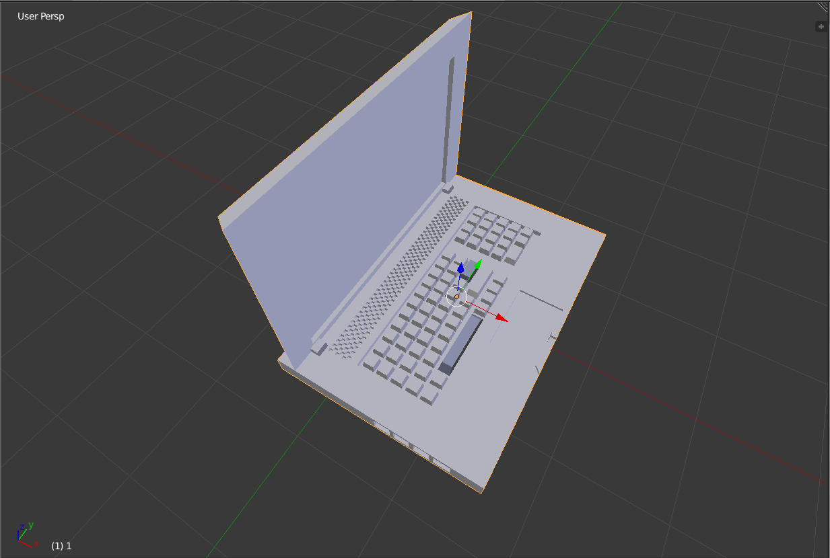
Collectıble ıtems

Slide 11
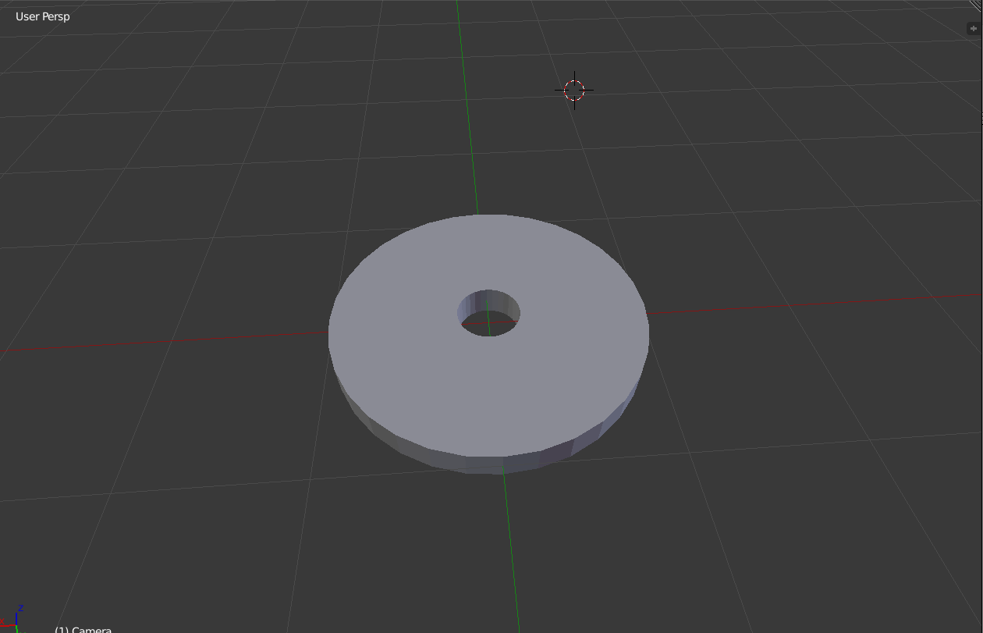
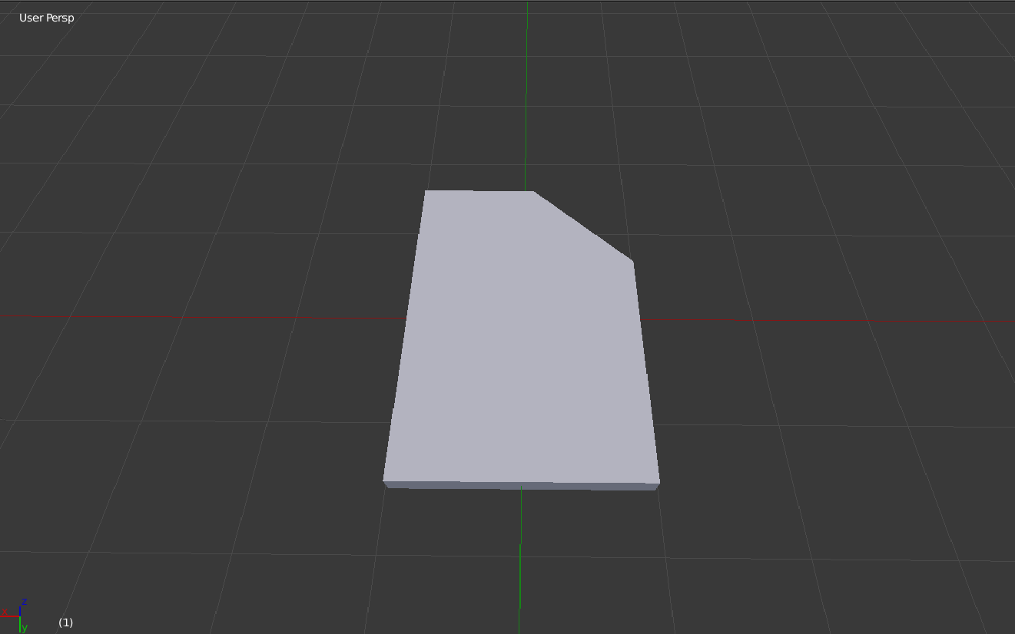

Slide 12
GAME MECHANISM
CAMERA
LIGHT
OBJECT INTERACTIONS

Slide 13
CAMERA
404 Memory Not Found is designed as a ‘first person view’ game.
To move the character on the XZ axis we use WASD buttons. Shift key changes the speed of the player. Also we use the mouse input to change the camera’s angle. We learned about the Mouse input from assignment 4 and 5.

Slide 14
LIGHT
To hold the lamp we use F button and this button also teleports the light into our hand.
While the button is pressed if we push down on + and – keys then the light’s intensity changes accordingly.

Slide 15
OBJECT INTERACTIONS
To interract with the objects, after geting close to the item E button is used. After pressing the E button, with the left and right arrow keys object can be rotated.
Collectible items always rotate around itselfs and when the player gets on the same coordinate as the item then object is collected and the game opens up a new part of the map.

Slide 16
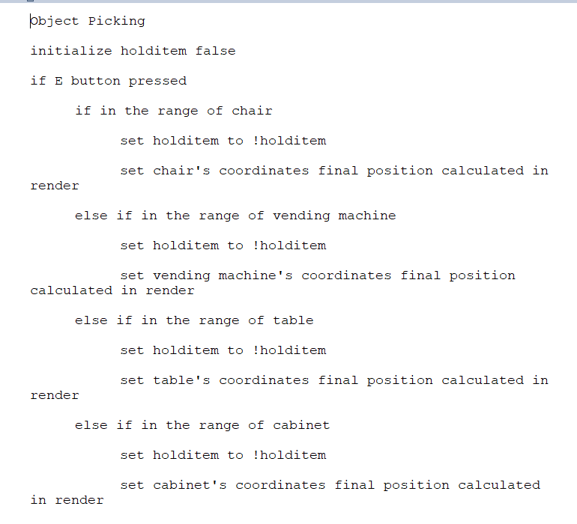
OBJECT PICKING

Slide 17
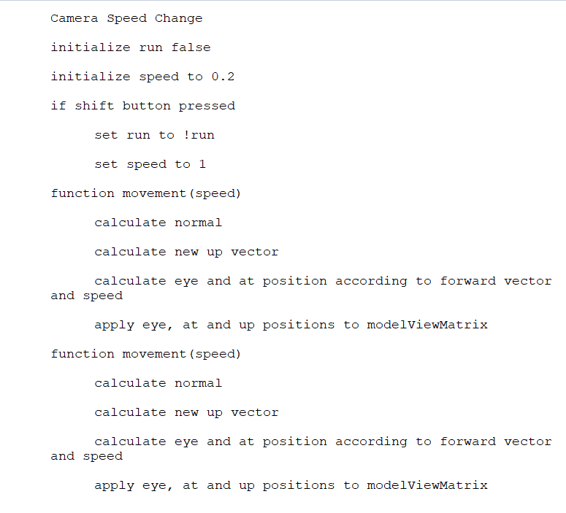
CAMERA SPEED CHANGE

Slide 18
Some extra features
Background music
Sound effects
Adding texture to the objects with webgl
The game ends in 10 minutes. If the player can’t get out in the time frame, game finishes and closes itself.

Slide 19
REFERENCES AND LIBRARIES USED
Jquery library for reading object model files.
Angel’s MV is used to implement the camera.
http://learnwebgl.brown37.net/07_cameras/camera_linear_motion.html was used to help with the camera movement as well.

