Slide 1
PROJECT PRESENTATION group 1
Block 1.3
Mentor: Jan Paredis

Slide 2
Summary
Multiple algorithms focused on both upper and lower bounds. This was the base of our research.
Focus on special graphs, using tailored heuristic and exact algorithms.

Slide 3
BACKGROUND
- Bipartite graph
- Chordal graph
- Connected and biconnected components

Slide 4
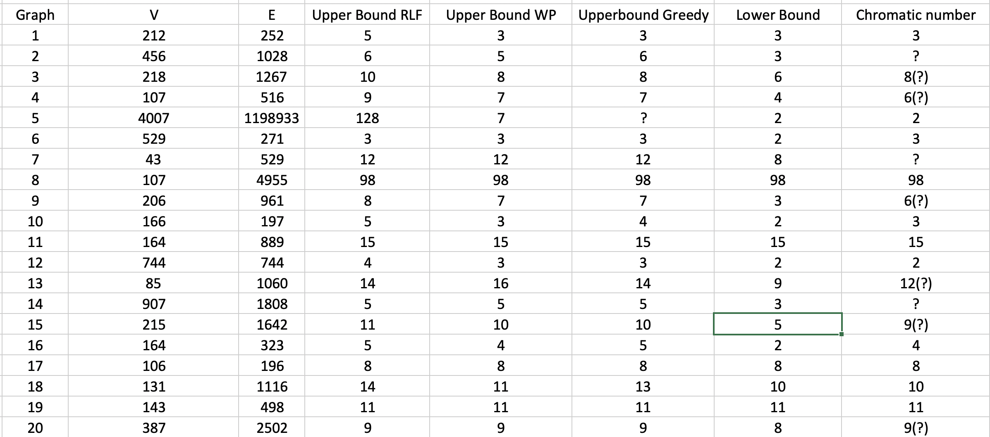
OBJECTIVES
Special graphs = efficient chromatic number computation?
RESULTS

Slide 5
Exact algorithm
- Backtracking for the chromatic number
- Backtracking for the clique number (the lower bound)

Slide 6
HEURISTIC ALGORITHMS
Greedy algorithm
Welsh-Powell algorithm
Recursive Largest First Algorithm

Slide 7
SPECIAL GRAPHS AND THEIR PROPERTIES
Bipartite graph: chromatic number <= 2
Chordal graph: chromatic number = clique number
Connected and biconnected components: divide and conquer

Slide 8
EXPERIMENTS
1. Running the algorithms before applying any graph property test;
2. Running the algorithms after applying all the graph property tests.

Slide 9
RESULTS
Chapter 4 involves the Results of all the experiments described in Chapter 3.

Slide 10
CONCLUSION
Chapter 5 provides the Conclusions and a summary of our study.

