Slide 1
June 14th Meeting

Slide 2
Overview
Overall, looking good with other sensors (CHWFLO, CHkW, CHCHWRT, CHCHWST)
SVM without LASSO overfits
Revised error at alphas to reflect SVM error (instead of LASSO error)
Open question of how to avoid building “too good” of a model
One solution is to limit the number of features allowed (8?)
Incorporated retraining model to simulate real-time use

Slide 3
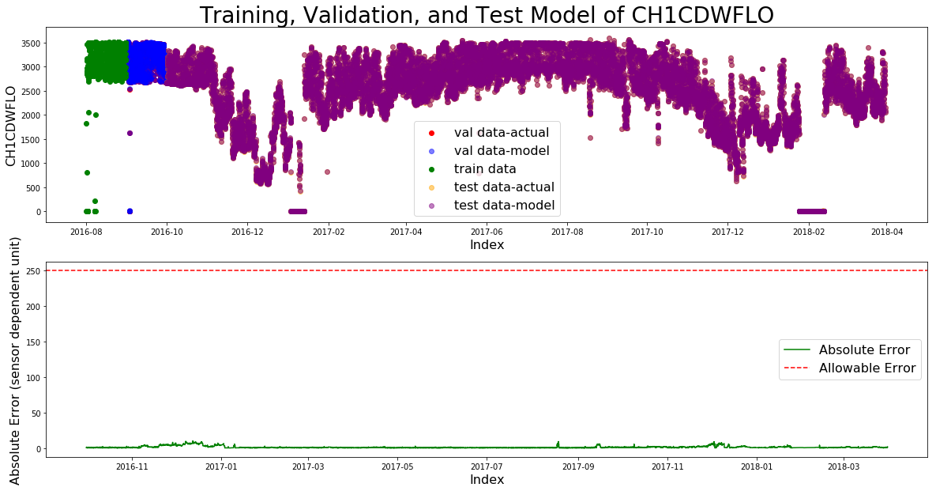
SVM without LASSO overfits

Slide 4
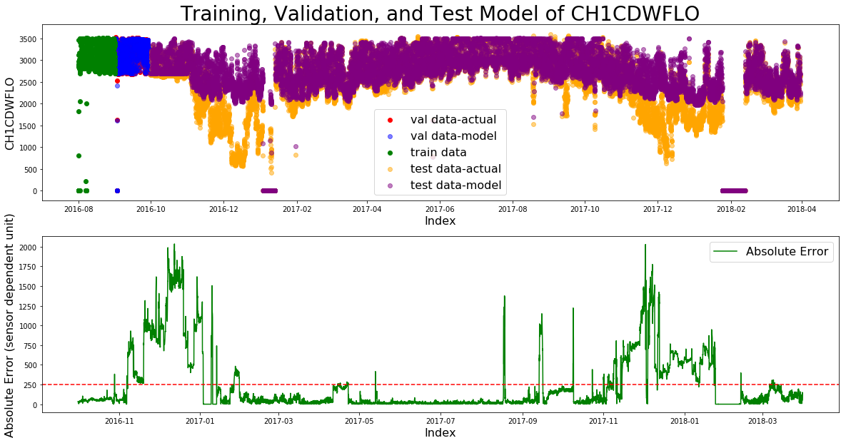
SVM with LASSO

Slide 5
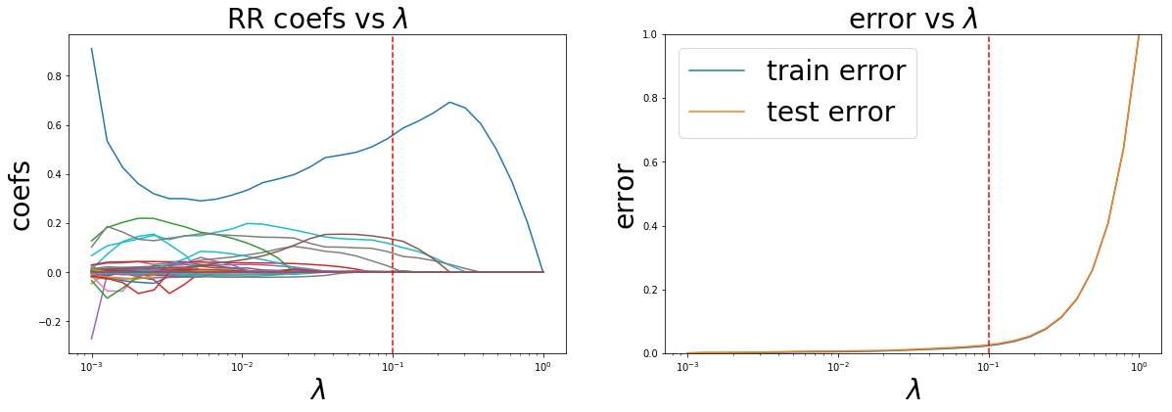
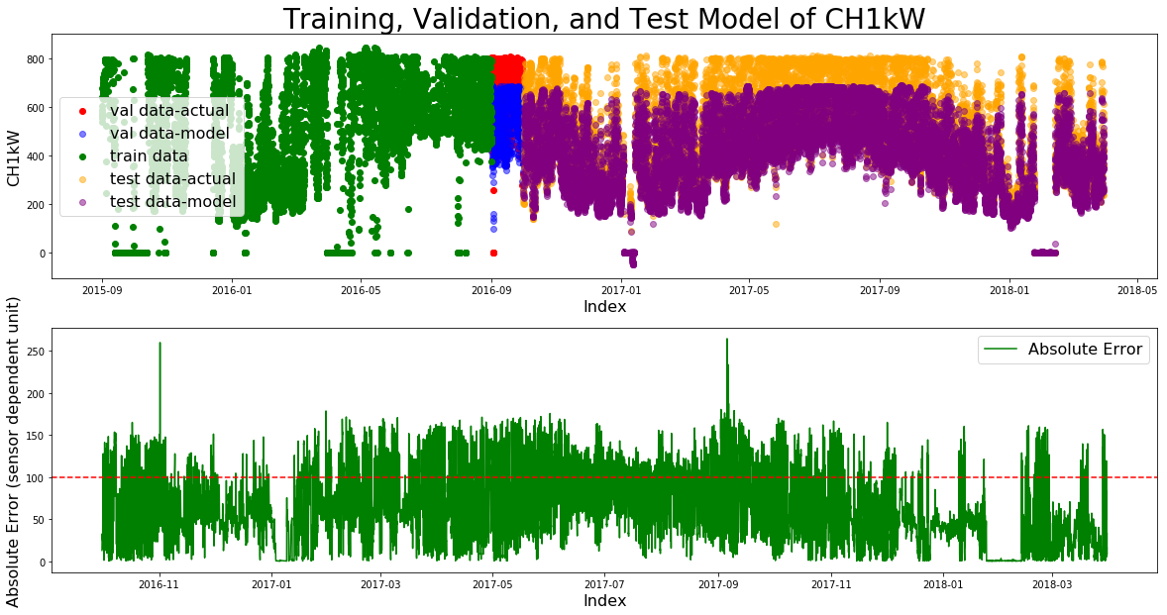
With LASSO – difficult to identify best alpha

Slide 6
Alpha selection based on SVM error
Integrated errors from SVM (instead of LASSO’s linear function)
Error is now based on the validation set (before it was a 20/80 test train split in the training set)
Much slower- at each alpha (30 total alphas):
Performs lasso to get features
Feeds those features into SVM, builds + gets error
Repeats 20 times (same features, new SVM model, new error)
takes the average of those 20 SVM models for each alpha to get the mean absolute error

Slide 7
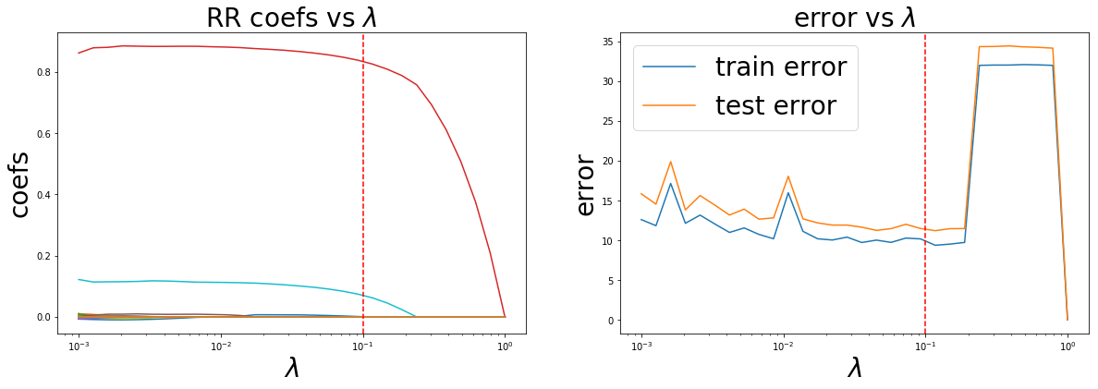
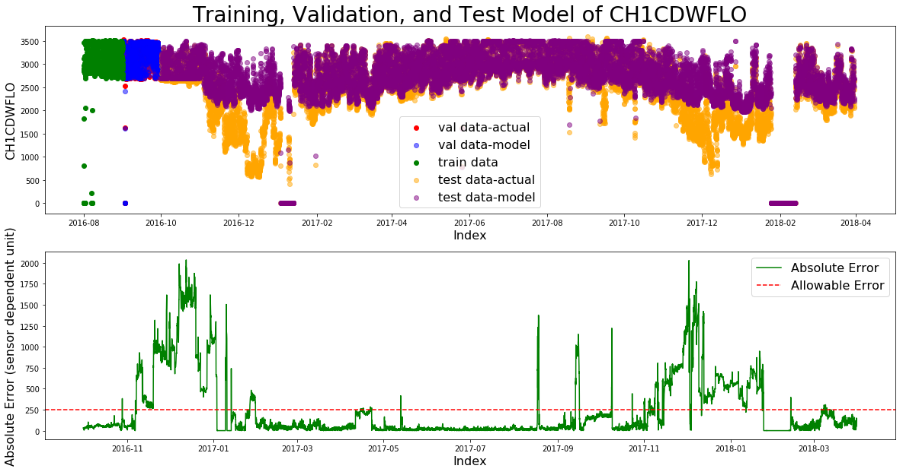
CH1CDWFLO – SVM error reported

Slide 8
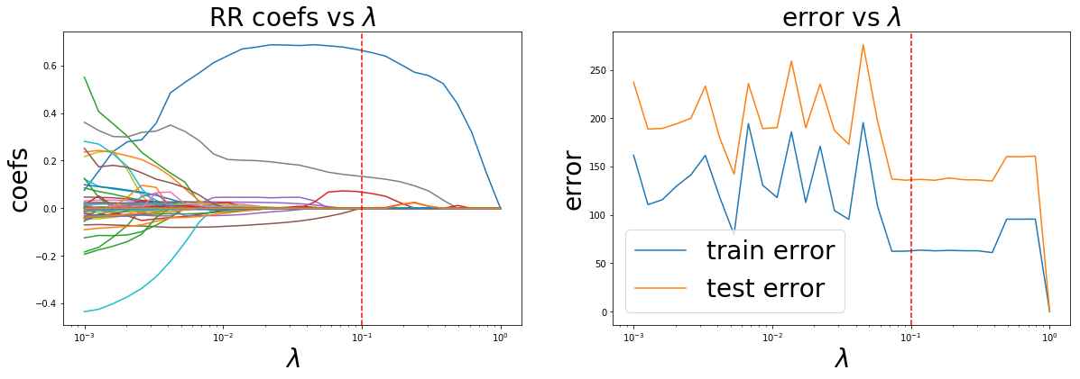
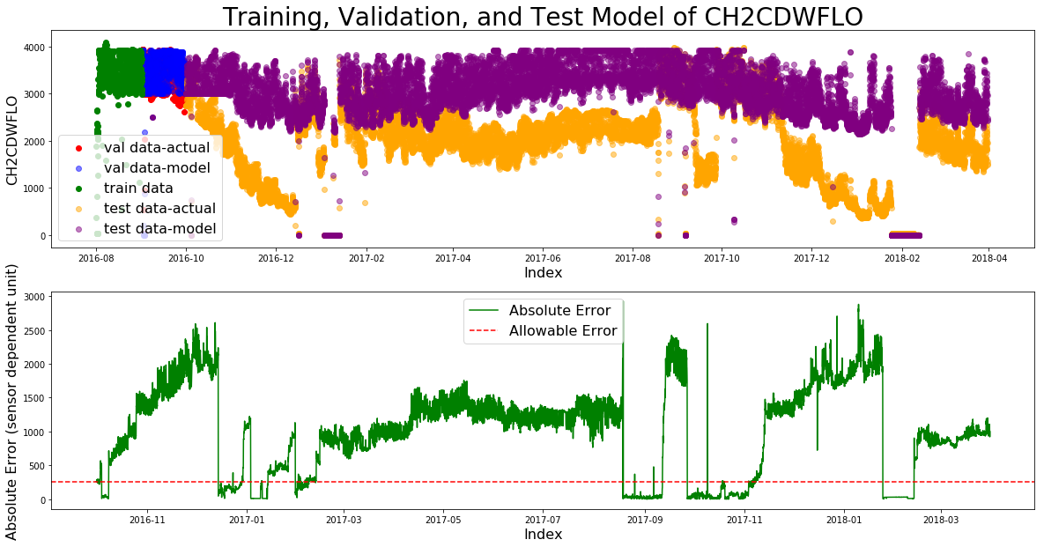
CH2CDWFLO – SVM error reported

Slide 9
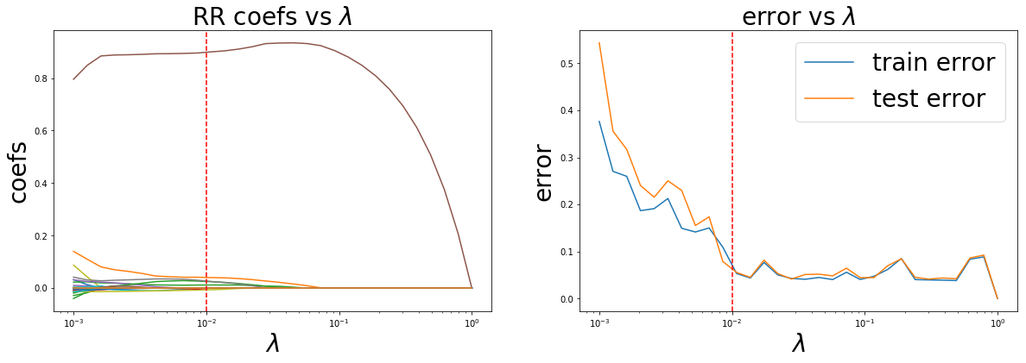
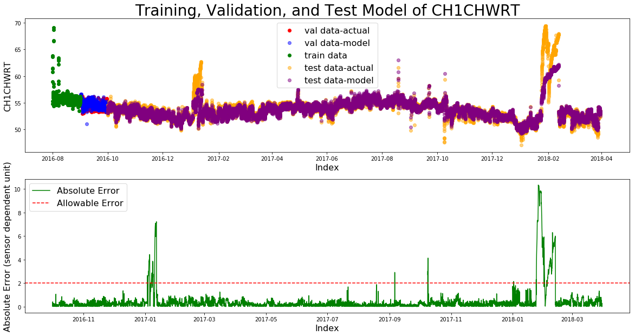
CH1CHWRT – SVM error reported

Slide 10
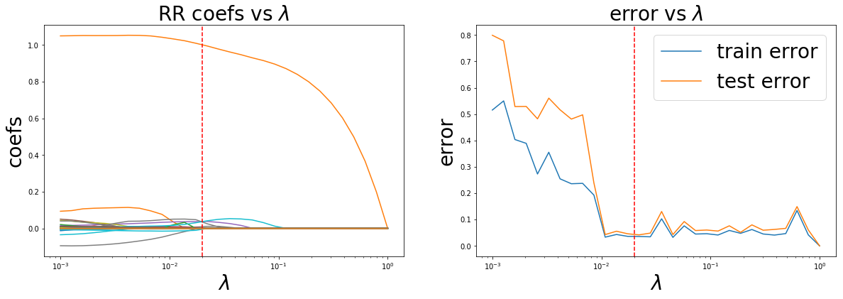
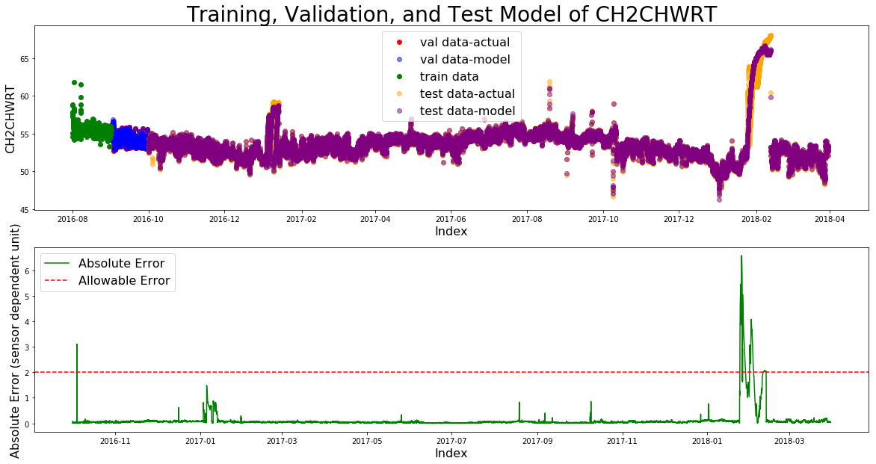
CH2CHWRT – SVM error reported

Slide 11
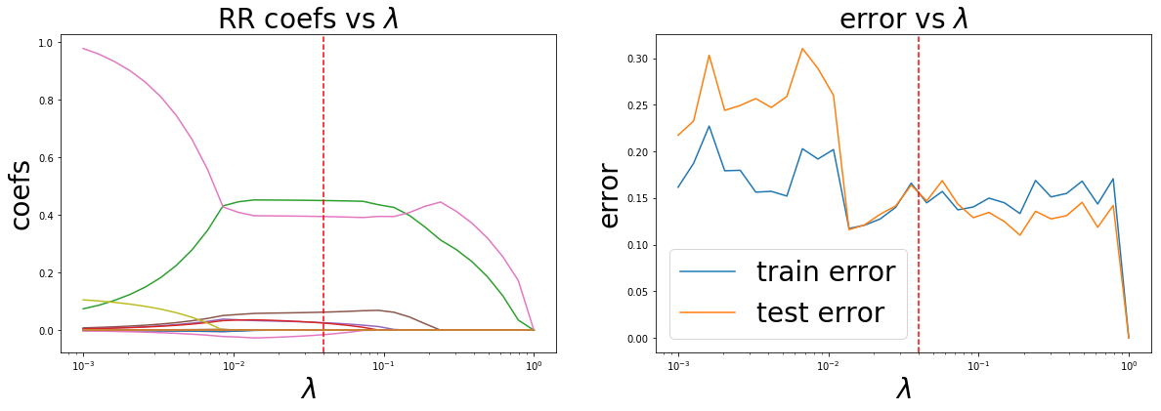
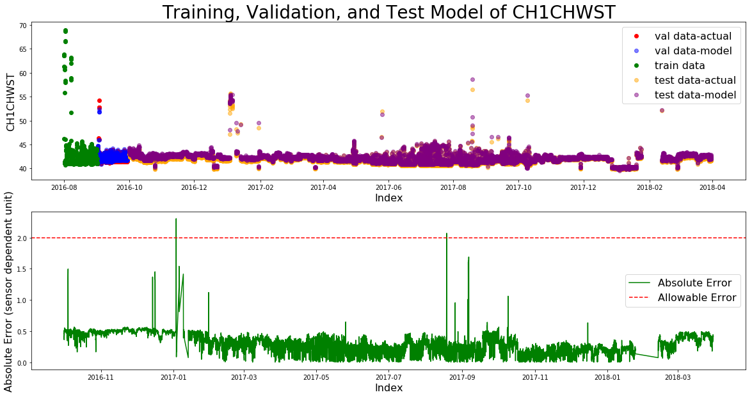
CH1CHWST – SVM error reported

Slide 12
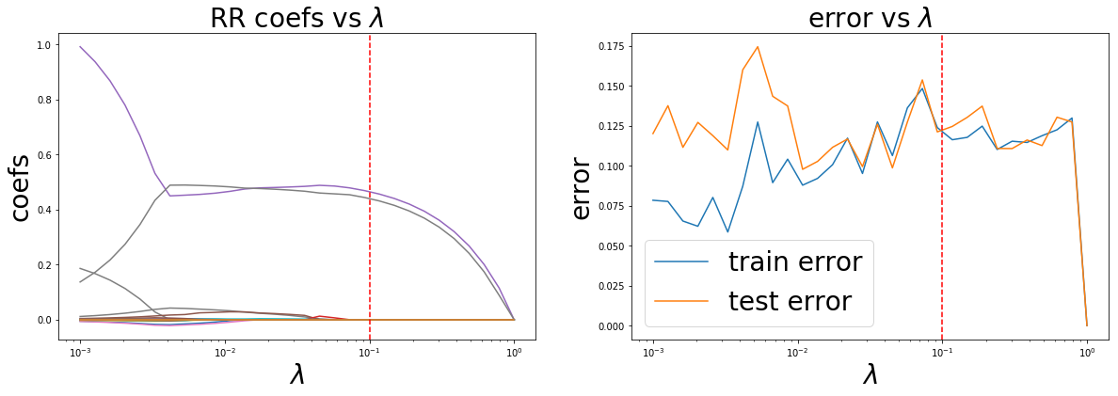
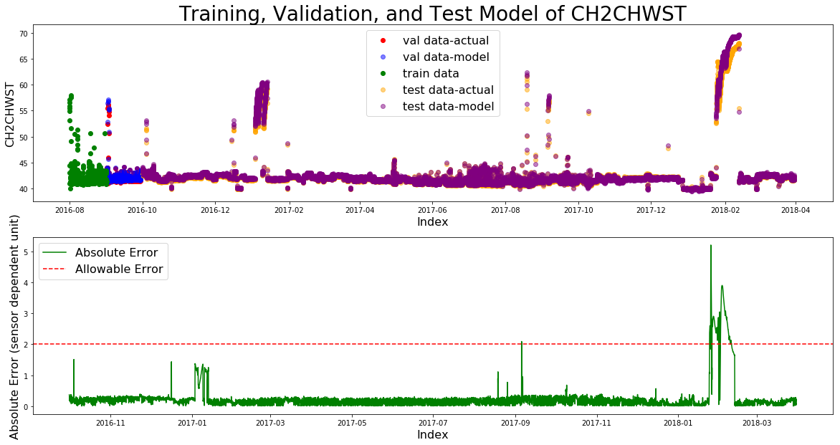
CH2CHWST – SVM error reported

Slide 13
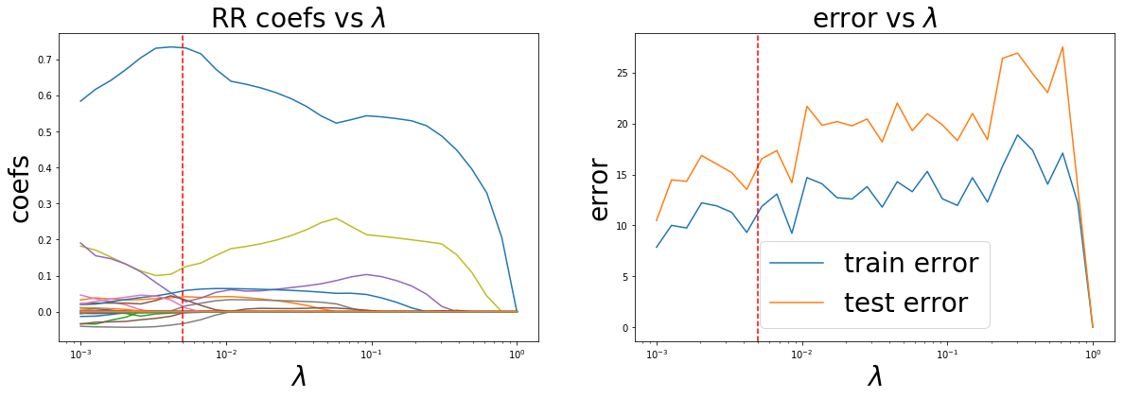
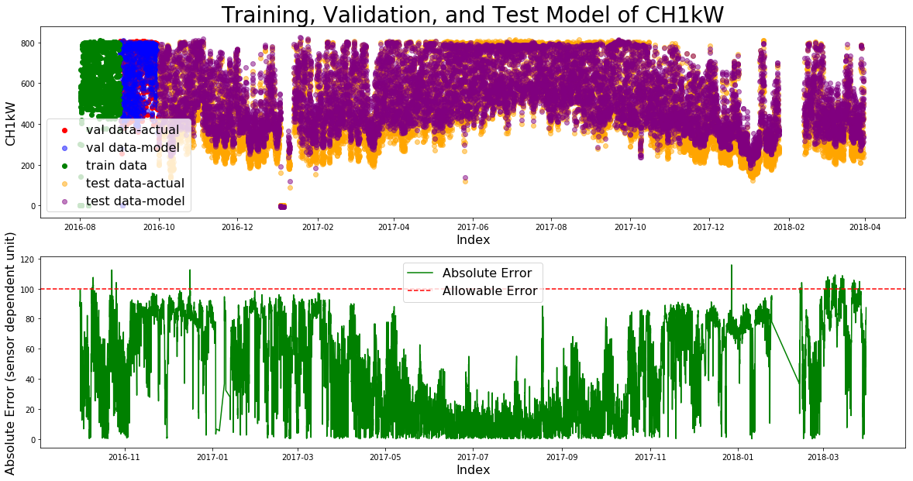
CH1kW – SVM error reported

Slide 14
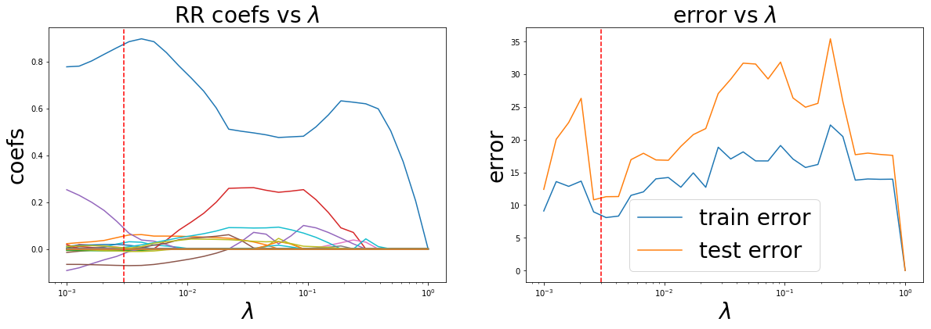
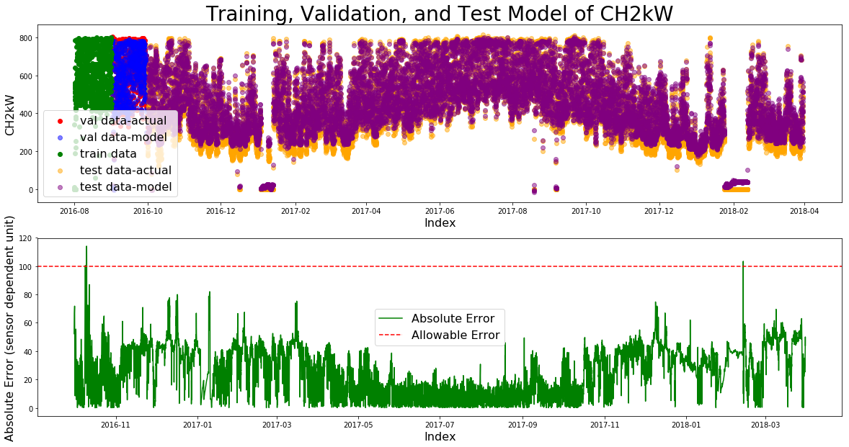
CH2kW – SVM error reported

Slide 15
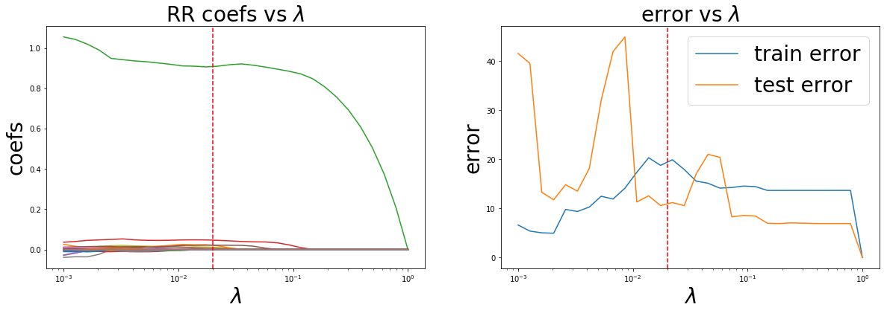
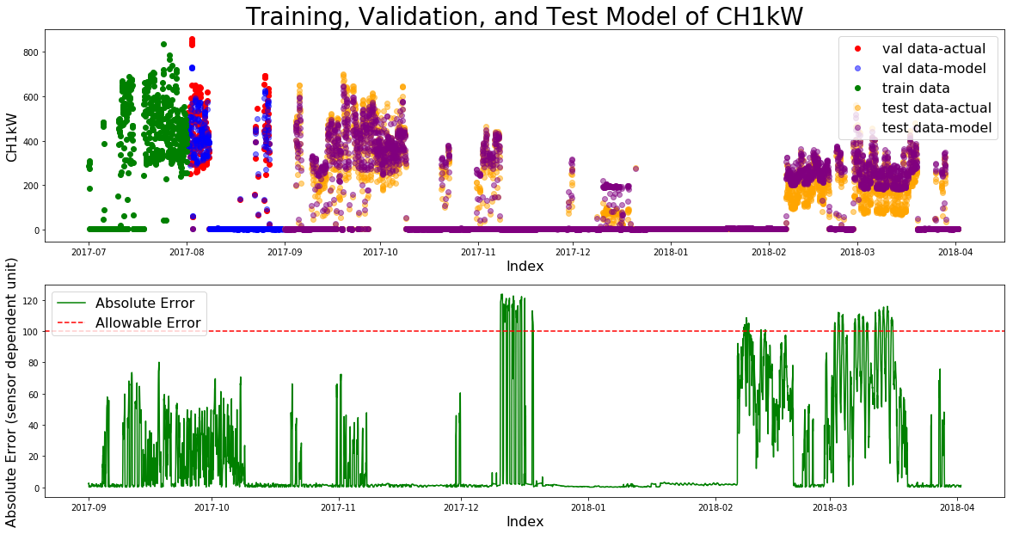
Initial Attempt on Plant 2 – CH1kW

Slide 16
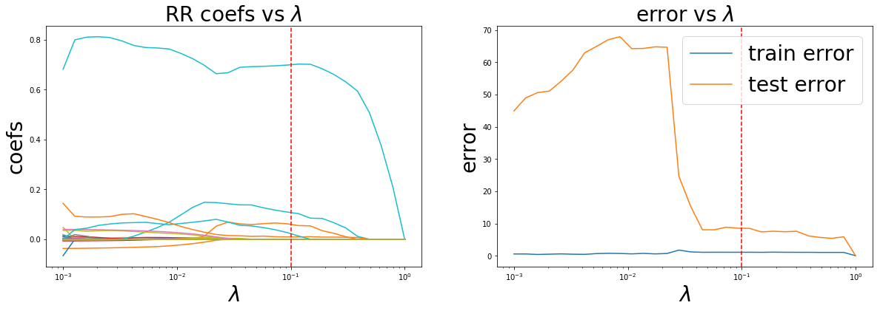
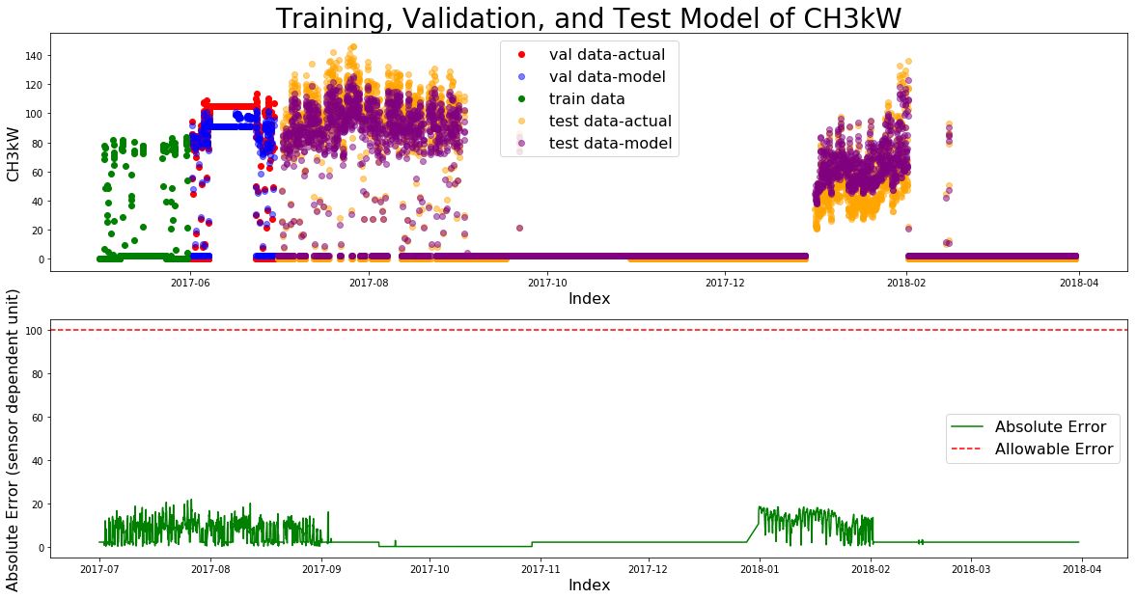
Initial Attempt on Plant 3

Slide 17
Next steps
Poster presentation next week
Optimize the code
Package code nicely

Slide 18
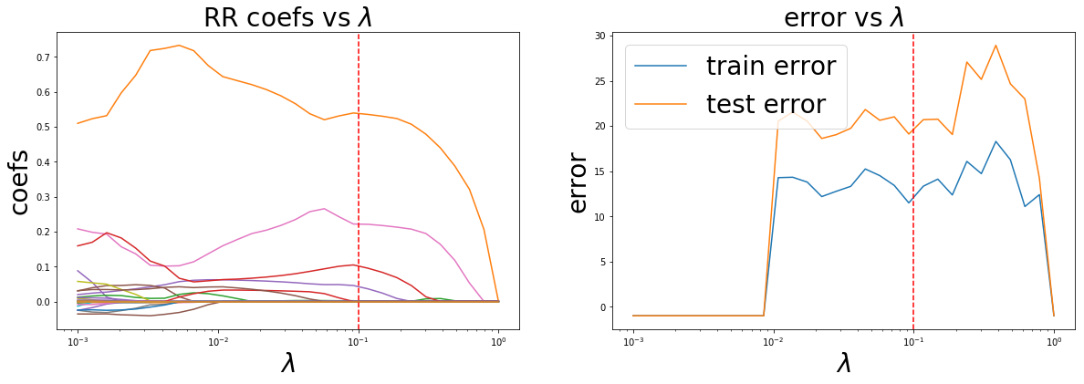
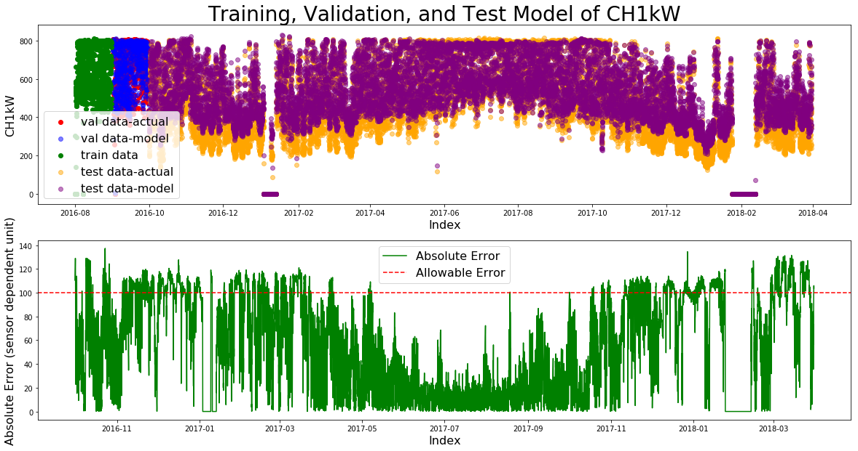
Example of Limiting Number of Allowed Features

