Slide 1
June 1 Meeting
Summary of Models (MLR, SVM, DTrees)
accuracy + speed
Train/Validation/Test of each
Dealing with features that are out of calibration themselves
Sensors besides CH1CDWFLO

Slide 2
Summary of Models
 | Mean Absolute Error using varying amounts of training data on CH1CDWFLO (gpm) |  |  |  | Time (1mo train)
Model | 1 month | 3 months | 6 months | 12 months
MLR | 10.27 | 54.46 | 110.77 | 130.55 | 11 ms
SVM | 11.70 | 24.01 | 24.6 | 30.88 | 15 ms
Decision Trees | 14.79 | 42.75 | 51.93 | 61.1 | ~300 ms
LASSO Features | CDWP1SPD', 'CDWP1kW', 'CH1FLA' | ‘CH1S', 'CDWP1SPD' | 'CDWP1SPD', 'CDWP1kW', 'CH1DPLift' | CDWP1SPD', 'CDWP1kW', 'CH1DPLift' | 1.6 s

Slide 3
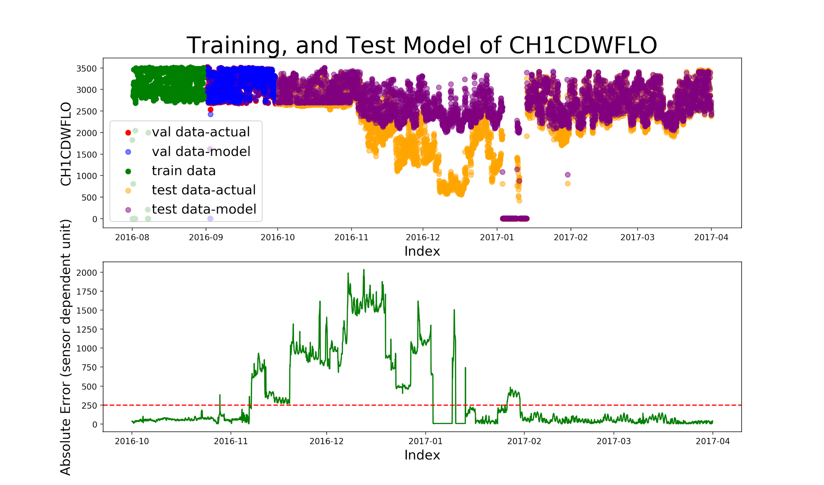
MLR - 1 month
CDWP1SPD', 'CDWP1kW', 'CH1FLA'
Mean Absolute Error in Validation Set: 10.3 gpm

Slide 4
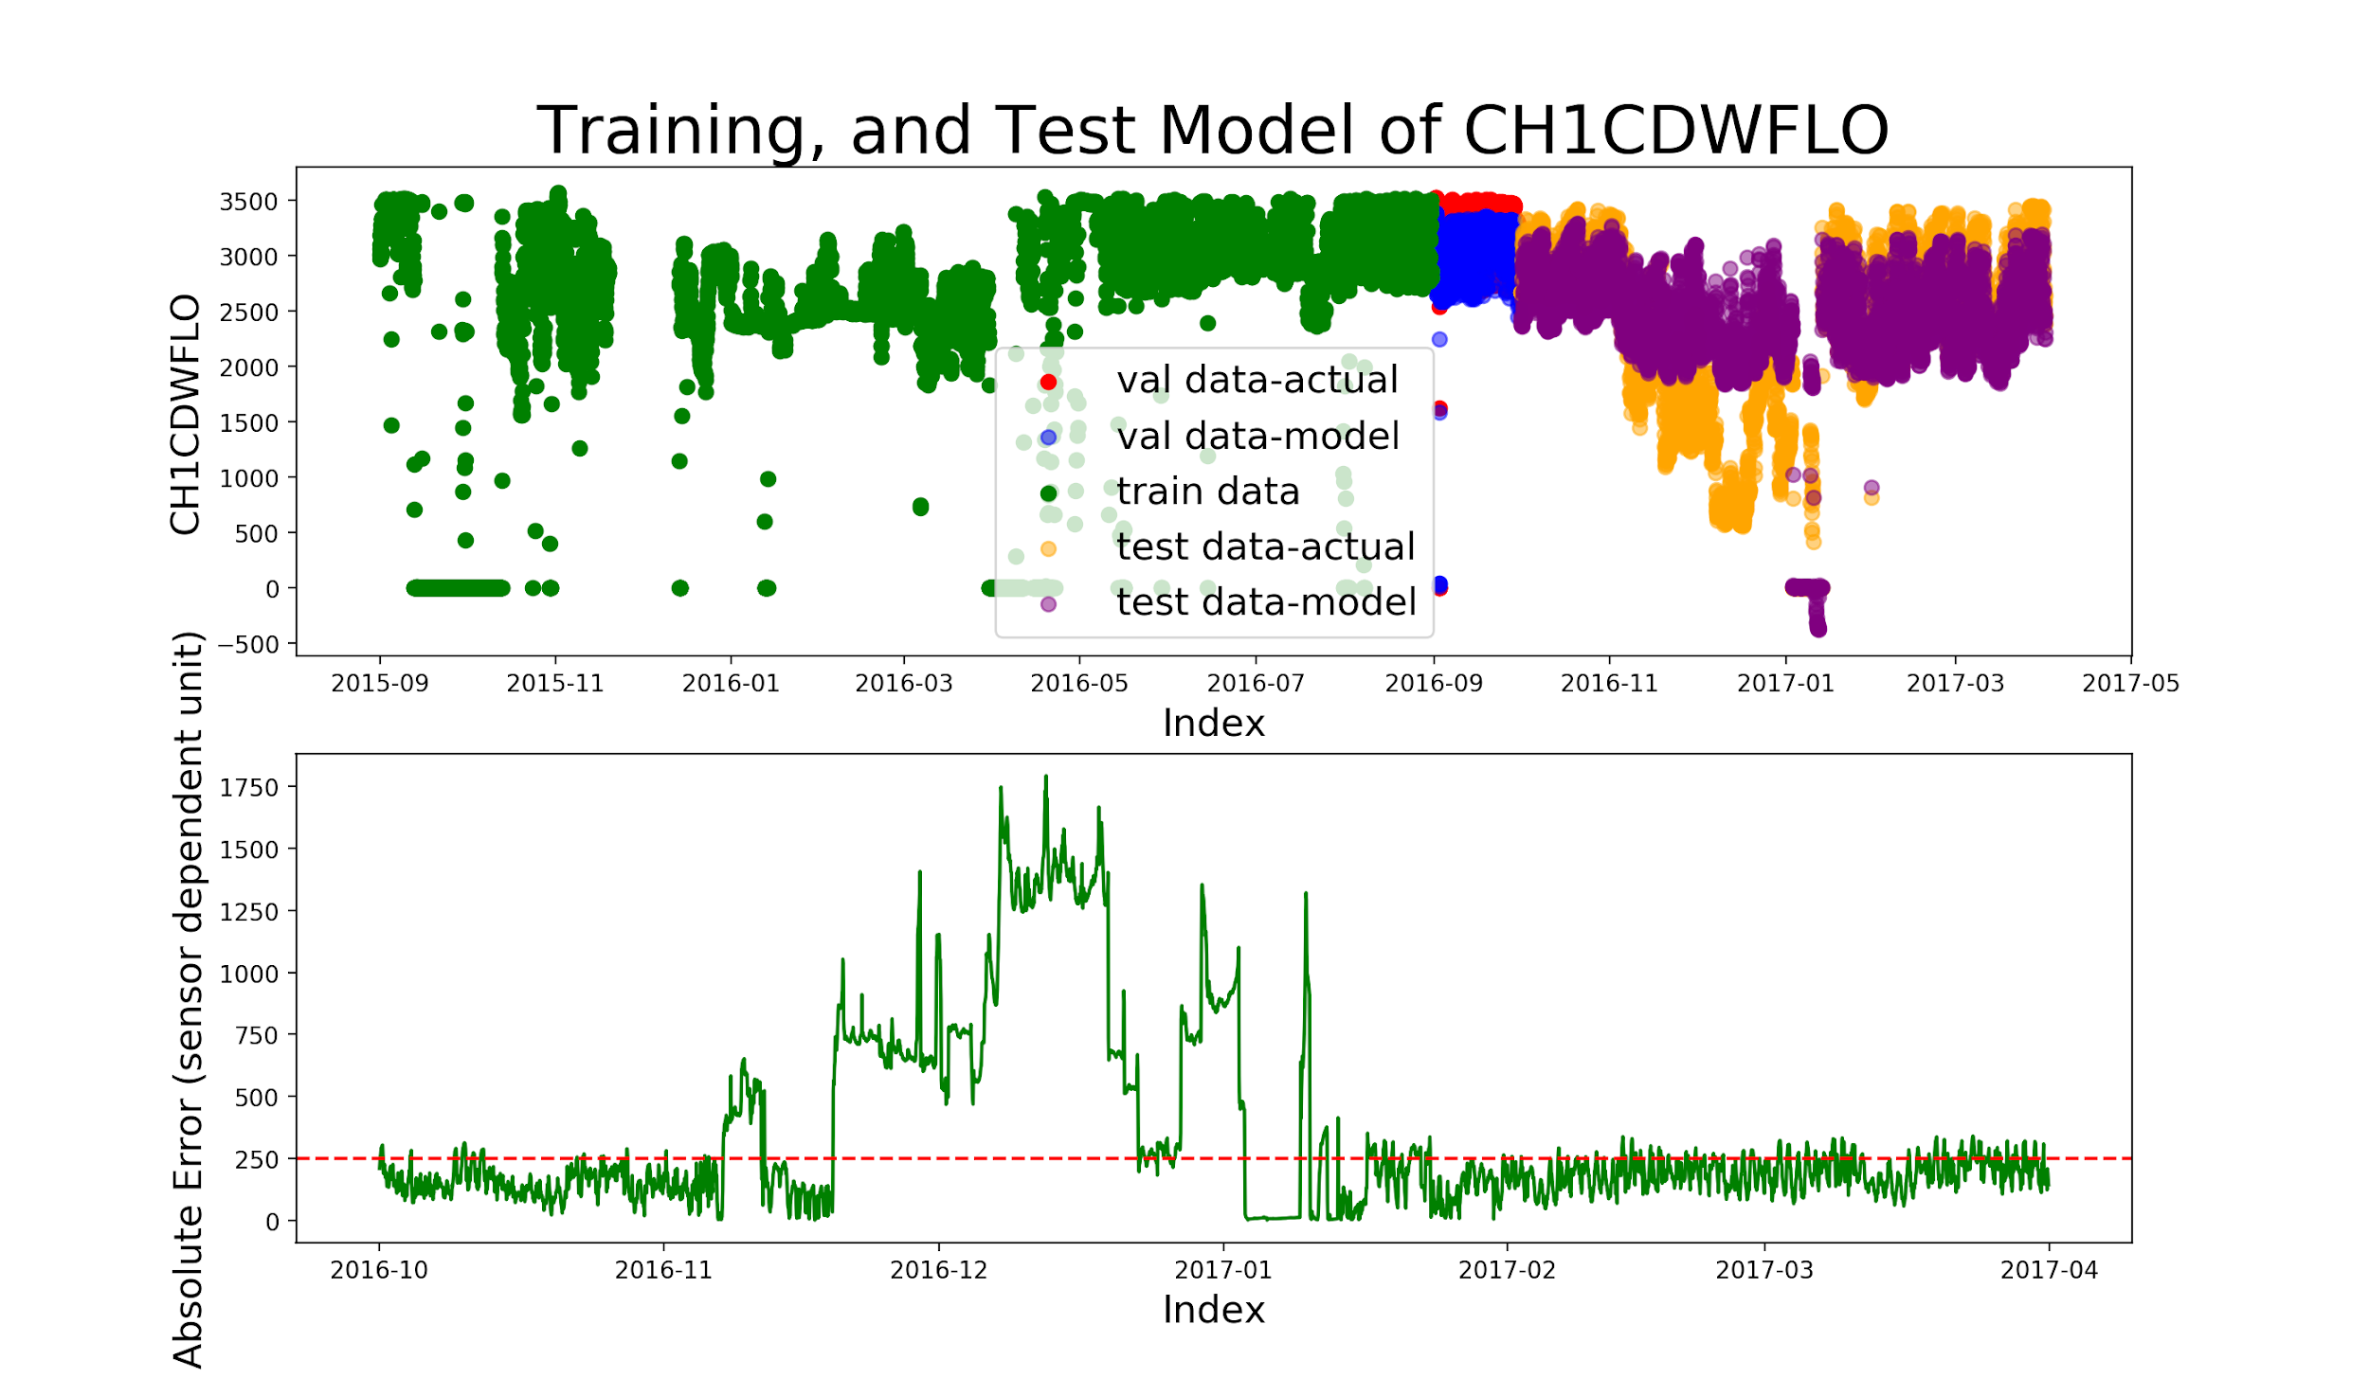
MLR - 12 months
CDWP1SPD', 'CDWP1kW', 'CH1FLA'
Mean Absolute Error in Validation Set: 130.6 gpm

Slide 5
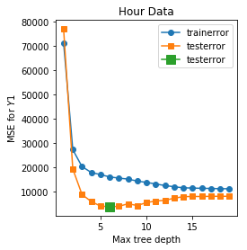
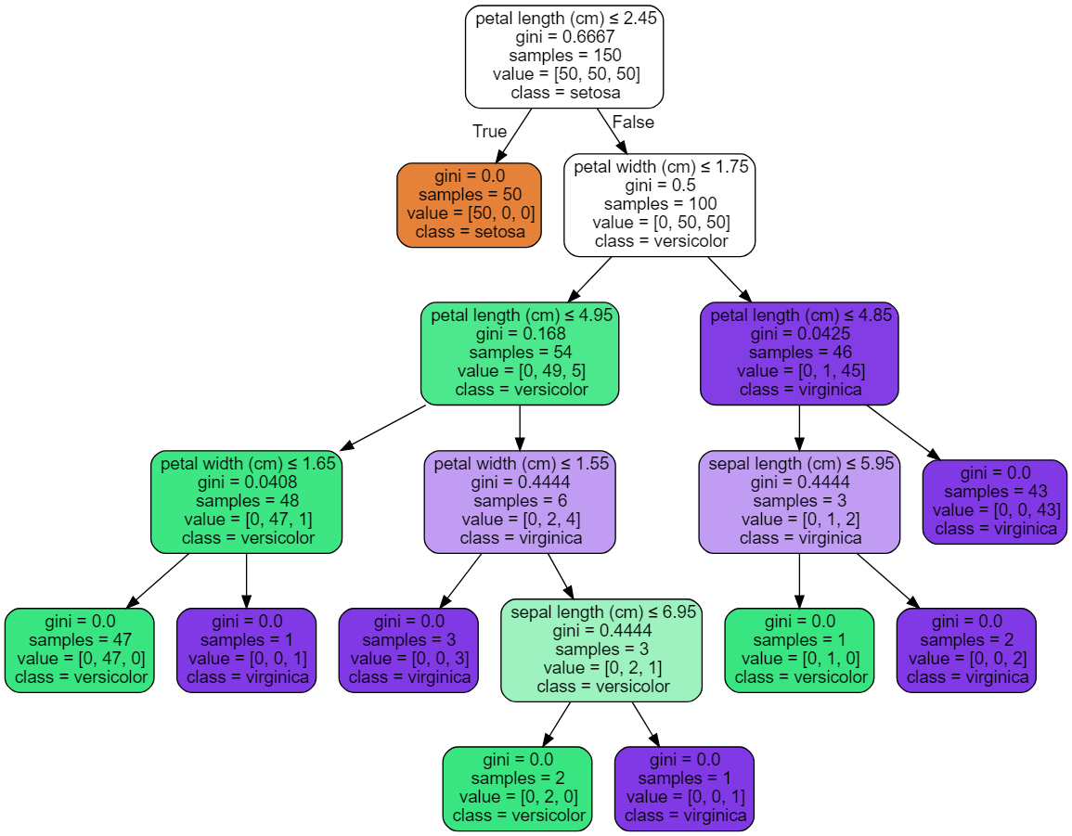
Decision Trees - Picking Tree Depths

Slide 6
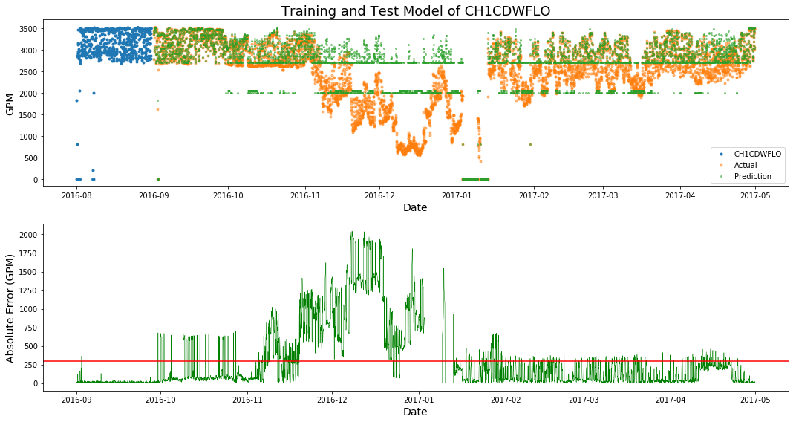
Decision Trees - 1 Month (Tree Depth = 7)
Average Abs Error for Training (Sept 2016) = 14.79 GPM

Slide 7
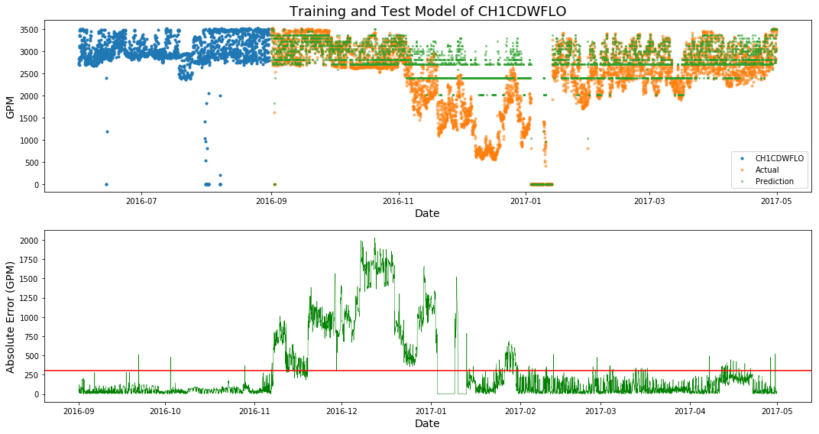
Decision Trees - 3 Month (Tree Depth = 6)
Average Abs Error for Training (Sept 2016) = 42.75 GPM

Slide 8
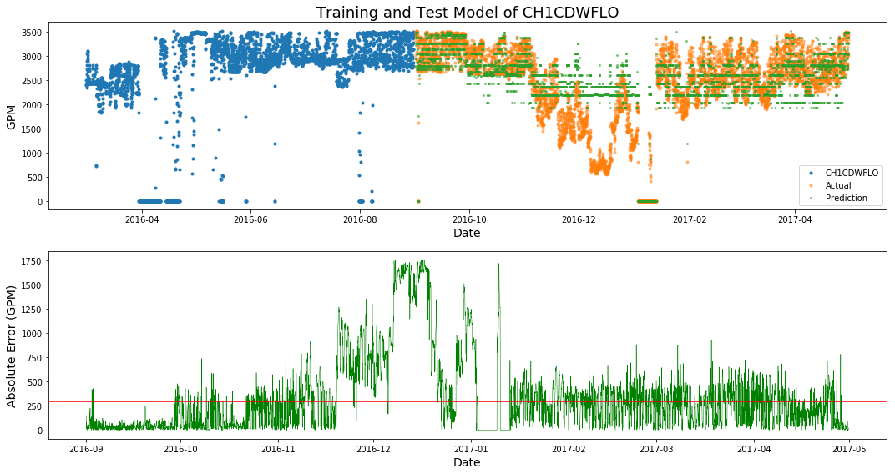
Decision Trees - 6 Month (Tree Depth = 8)
Average Abs Error for Training (Sept 2016) = 51.93 GPM

Slide 9
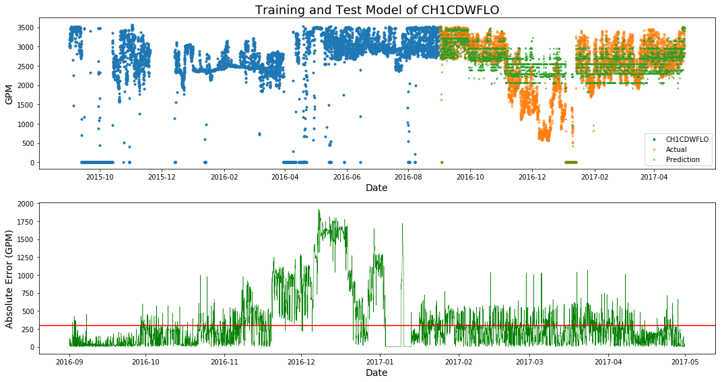
Decision Trees - 12 Month (Tree Depth = 9)
Average Abs Error for Training (Sept 2016) = 61.1 GPM

Slide 10
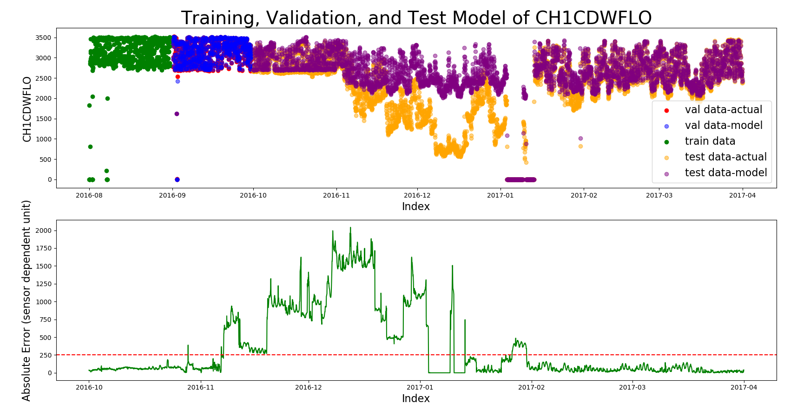
SVM - 1 month
CDWP1SPD', 'CDWP1kW', 'CH1FLA'
Mean Absolute Error in Validation Set: 11.7 gpm

Slide 11
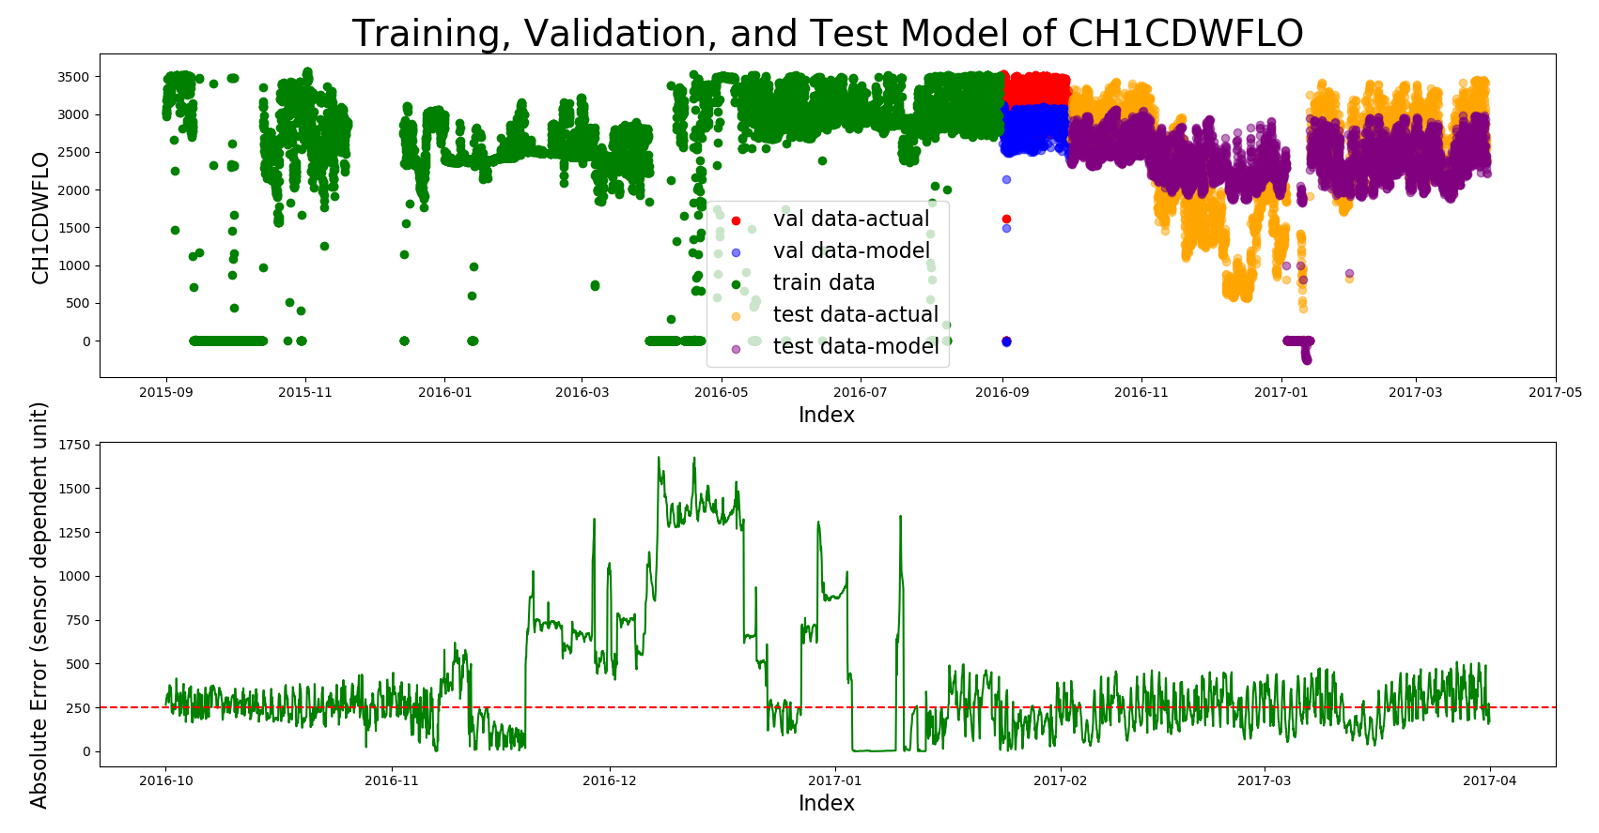
SVM - 12 months with LASSO features
'CH2CDWFLO', 'CDWP1SPD', 'CDWP1kW', 'CH1DPLift'
Mean Absolute Error in Validation Set: 316gpm

Slide 12
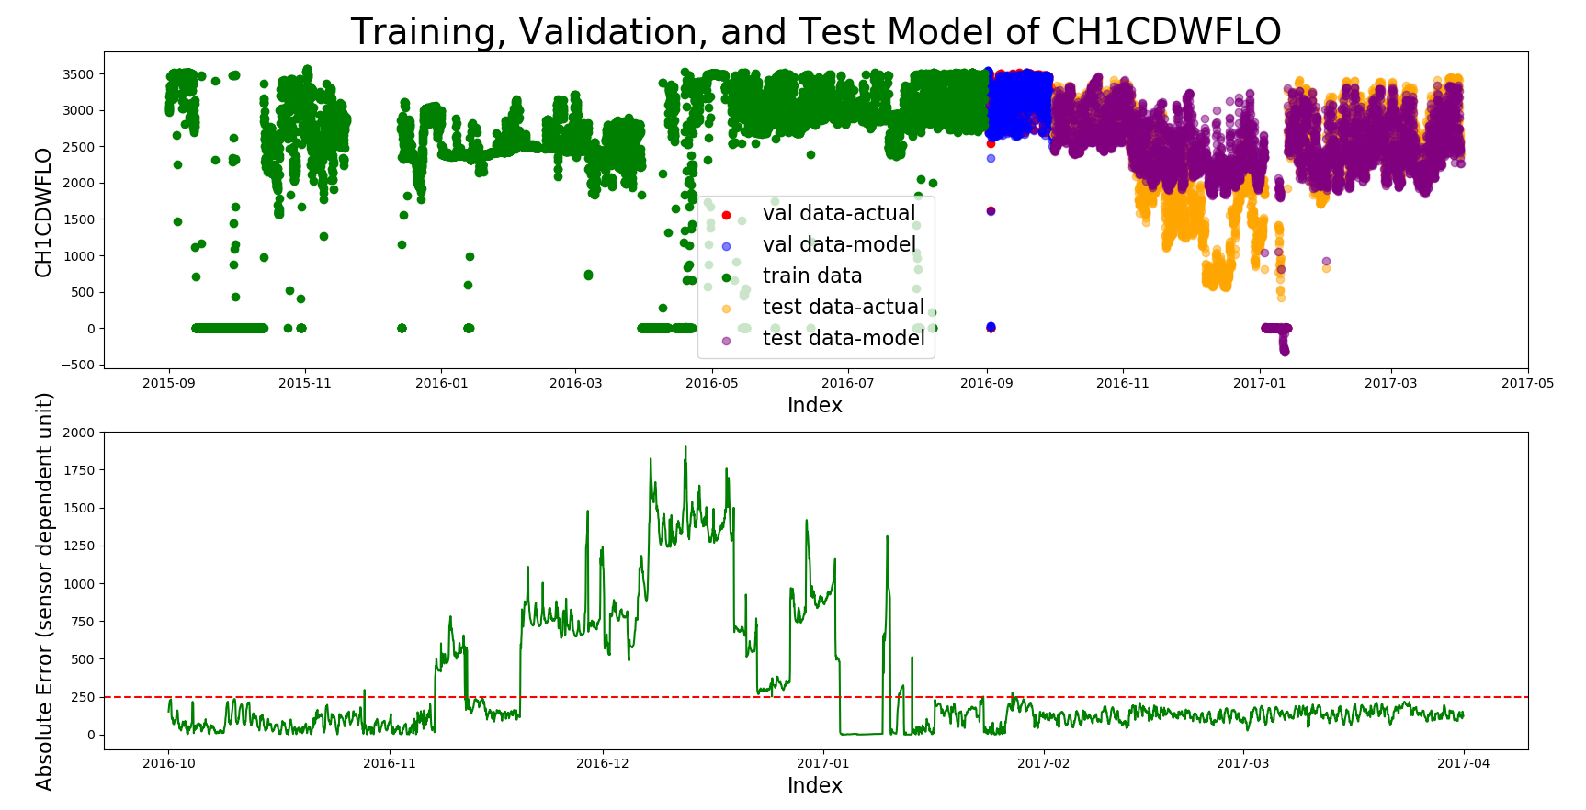
SVM - 12 months without CH2CDWFLO
'CDWP1SPD', 'CDWP1kW', 'CH1DPLift'
Mean Absolute Error in Validation Set: 30.9 gpm
Notes:
evidence that we need to take into account other sensors drift….. either keeping it as a manual check with validation sets or write in an auto removal of features that have been recorded as out of calibration during the training set

Slide 13
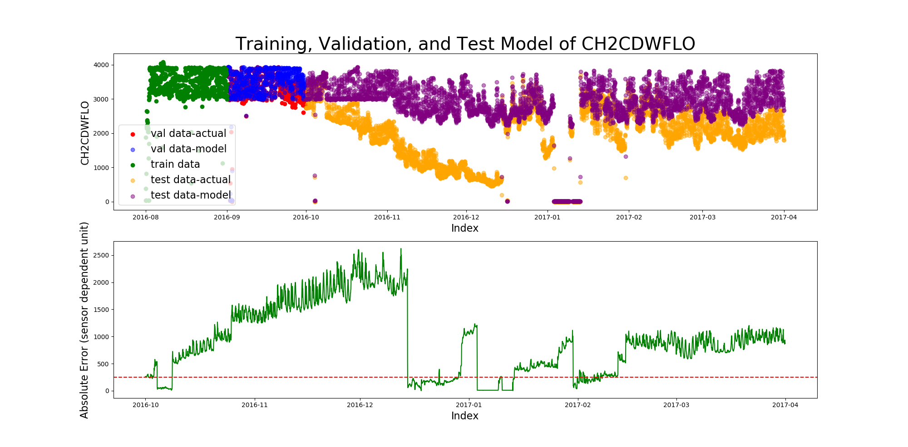
Ch2 with SVM
features = 'CDWP2SPD', 'CT1kW', 'CH2PCTLoad', 'CDWP2kW', 'CH2FLA', 'CDWP2Hz' mean absolute error = 138 gpm

Slide 14
Next Steps
Package model into more usable form
Unit tests
Figure out how to deal with out of calibration features - or just leave up to the user

