Slide 1
Trying to fix feature selection

Slide 2
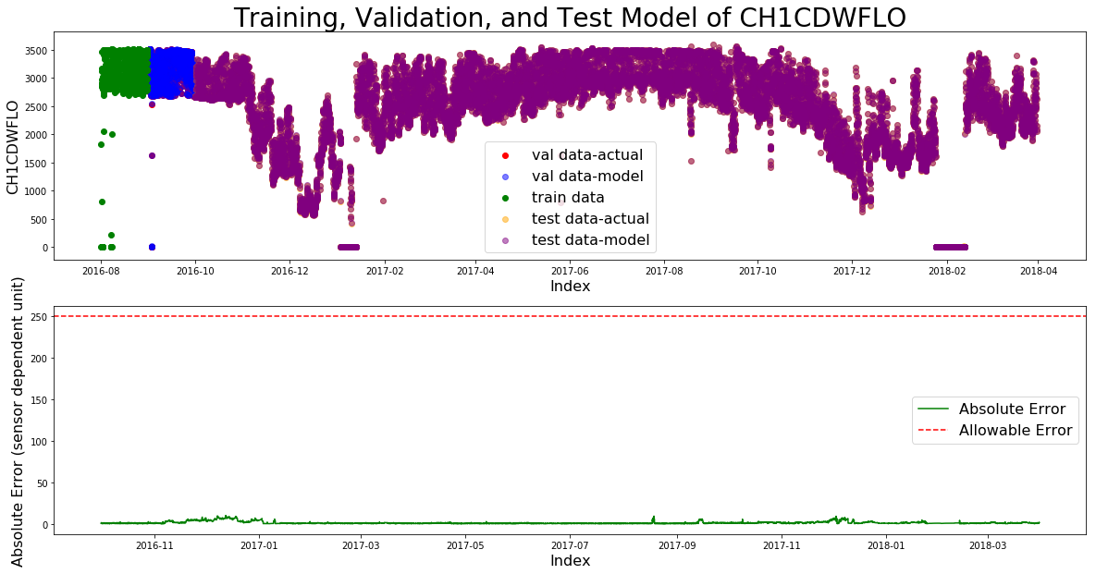
SVM without LASSO overfits

Slide 3
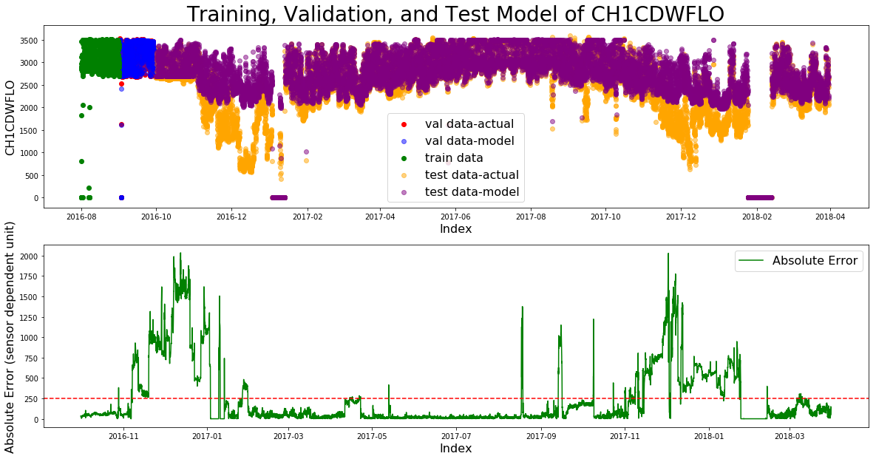
SVM with LASSO

Slide 4
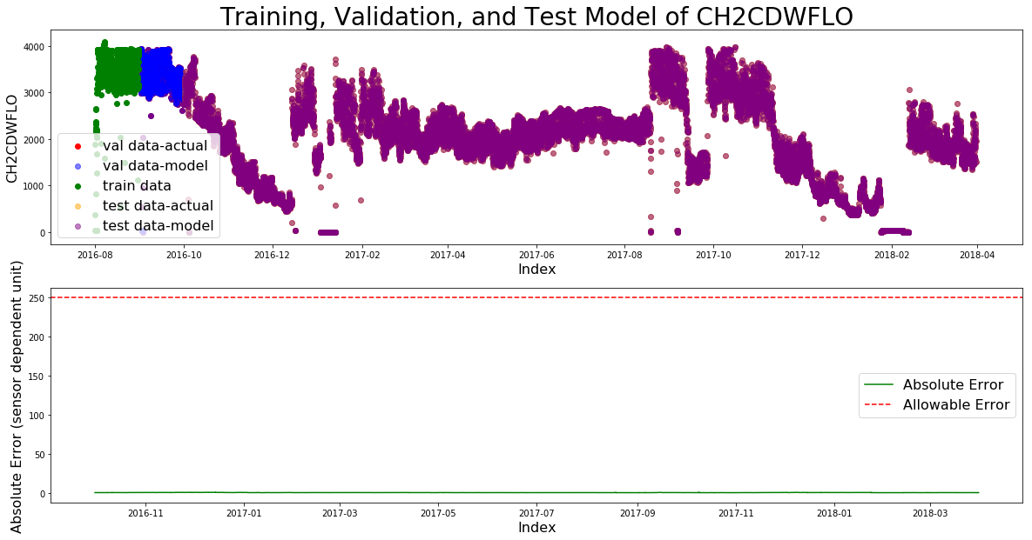
SVM without LASSO

Slide 5
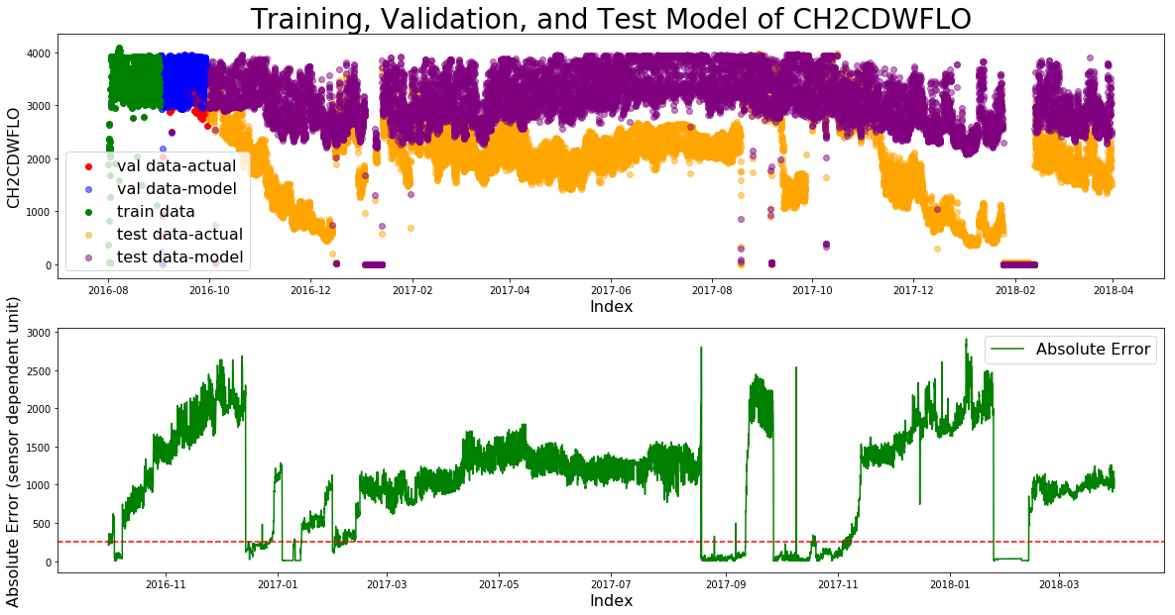
SVM with LASSO

Slide 6
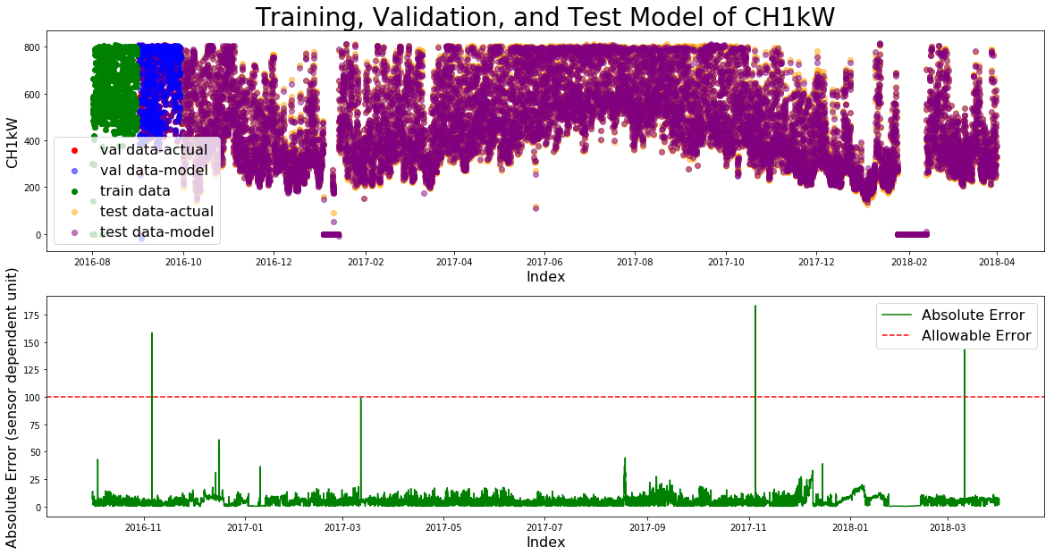
SVM without LASSO

Slide 7
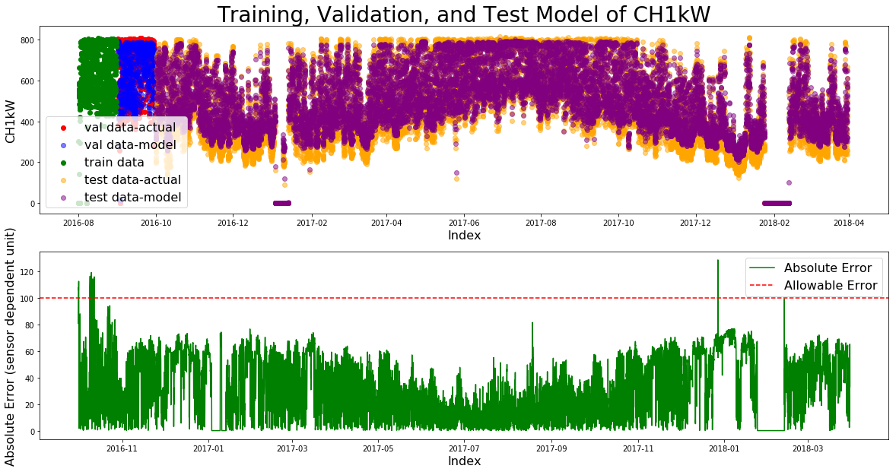
SVM with LASSO

