Slide 1
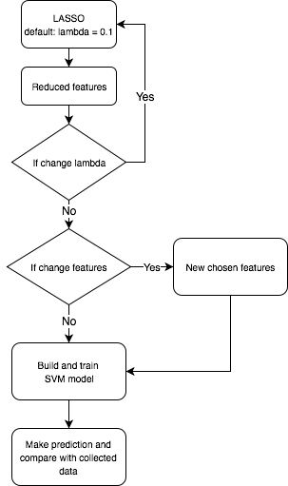
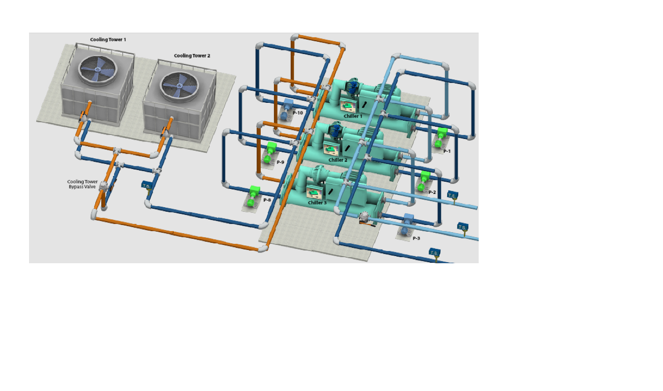





Optidrift
Zihao Tao, Victor W. Hu and Nicole L. Thompson
BACKGROUND
DESIGN
Optidrift is a tool developed to detect sensor drift or failure based off surrounding measurements for Optimum Energy.
FUNCTIONS
Project will realize following functions:
Use LASSO to reduce feature set;
Let user decide penalty and final result;
Train a Support Vector Machine Regression model;
Compare prediction with collected data to find out bad sensors.
Data source:
Dataset from 200+ sensors for multiple months of operation.
OUTPUT
FUTURE WORK
Acknowledgements: We would like to thank Professor David Beck, Professor Jim Pfaendtner and the group of teaching assistants in the DIRECT program.We would also like to thank the team at Optimum Energy for this opportunity. We would especially like to thank Fred Woo, Dana Lindquist, Michael Huguenard, and Tim Wehage for all their expertise, support, and guidance throughout this project.

