Slide 1
FINAL YEAR PROJECT · 19 OCTOBER 2026
TimetableMaster
An intelligent timetable platform for schools and universities
Constraint-based generation · drag & drop editing · cover, leave and calendar
PROJECT TEAM
Hira Hassan · F23607055
Iman Aftab · F23607041
Jawaria Sabir · F23607040
Hamza Abdul Karim · F23607046
Supervisor: Ms. Faria Sajjad
Built from scratch in Rust (Axum + SQLite) and React 19 + TypeScript

Slide 2
AGENDA
What this presentation covers
▪ 1. Problem & objectives — why timetabling is still done by hand
▪ 2. The scheduling engine — the technical core of the project
▪ 3. Architecture & technology choices
▪ 4. Live product tour — setup, timetable, cover, calendar
▪ 5. Security, roles and multi-tenancy
▪ 6. Testing & CI — 12 unit tests, 126 API checks, 33 browser checks
▪ 7. Results, limitations and future work
TimetableMaster · Final Year Project
1

Slide 3
PROBLEM STATEMENT
Timetabling is still a manual, error-prone ritual
▪ Manual spreadsheets and paper grids
▪ Hundreds of constraints per week: rooms, availability, caps
▪ Clashes found only after publishing → costly rework
▪ Cover arranged by phone calls and guesswork
▪ No audit trail of who changed what, and when
THE COST OF GETTING IT WRONG
▪ Re-issuing a timetable to 3 classes and 8 teachers
▪ Teacher conflicts → disputes, grievances, cover chaos
▪ Manual cover hunting on a normal teaching morning
▪ Version chaos: final_v7_REAL.xlsx
TimetableMaster · Final Year Project
2

Slide 4
OBJECTIVES
What the project set out to do
▪ Generate clash-free timetables automatically from a curriculum
▪ Respect every hard rule: rooms, availability, workload caps, two-week A/B cycles
▪ Keep human judgement: drag & drop edits that survive regeneration (pinned lessons)
▪ Handle day-2 operations: leave workflow, ranked cover suggestions, school calendar
▪ Make the result usable: CSV / PDF / ICS export, read-only share links, notifications
▪ Make it accountable and safe: role-based access, multi-tenancy, activity log
▪ Prove it works: automated tests at three layers, run in CI on every push
TimetableMaster · Final Year Project
3

Slide 5
ROLES & TENANCY
Who uses it, and what they can do
Role | Sees | Can do
admin | Everything in their school(s) | Manage users, settings, rebuild the demo workspace
scheduler | Timetable, setup, cover, calendar | Generate, drag & drop, assign substitutes, decide nothing about people
teacher | Own timetable, own leave | Request leave, view cover in which they are involved
student | Own class timetable, calendar | Read-only
Multi-tenant by design: every row in the database is scoped to one school, taken from the signed JWT — no account can read another school's data.
TimetableMaster · Final Year Project
4

Slide 6
PRODUCT
Feature set at a glance
Constraint-based generation
Drag & drop editing
greedy seed + simulated annealing
pinned lessons survive regeneration
Cover & substitutes
Leave management
ranked candidates with reasons
impact preview before approving
Two-week A/B cycles
School calendar
constraints applied across the cycle
holidays, exams, activities
CSV · PDF · ICS export
Read-only share links
print-ready, per class/teacher/room
revocable, no sign-in needed
Activity log
Notifications
who changed what, and when
webhook / email, optional, fail-open
TimetableMaster · Final Year Project
5

Slide 7
TECHNICAL CORE
The scheduling engine: rules that must never break
HARD CONSTRAINTS — never violated
SOFT GOALS — optimised
▪ A class, a teacher and a room host at most one lesson per period
▪ Teachers are only scheduled inside their availability
▪ Lesson max-per-day; teacher daily and weekly workload caps
▪ Fixed rooms must match; required room types must fit the class
▪ Hand-pinned lessons stay exactly where they are
▪ No gaps in a class's day; no gaps in a teacher's day
▪ The same subject is spread across the week, not clustered
▪ Teacher load is balanced across days
▪ Work is balanced across the cycle weeks (A/B)
▪ Weights are tunable per run through the API
TimetableMaster · Final Year Project
6

Slide 8
HOW THE SOLVER WORKS
Two phases, deterministic, and it explains itself
Greedy seeding
1
Most-constrained-first: the lessons with the fewest legal slots are placed first, so the search space never closes unnecessarily.
Simulated annealing
2
Relocate / swap / insert moves explore neighbouring solutions and accept worse ones at high temperature to escape local optima.
Report
3
Placed periods, unplaced periods with the dominant reason (teacher unavailable / busy / limits / room), moves and quality score.
Determinism is a tested property: the same seed and iteration count produce the same timetable — 12 unit tests cover feasibility, clashes, limits, room rules, pinned placements and two-week cycles.
TimetableMaster · Final Year Project
7

Slide 9
ARCHITECTURE
One binary serves the API and the UI
Vite builds the SPA into frontend/dist, and the Rust process serves it — a single deployable.
Browser
HTTP API
SQLite
React 19 · TypeScript · Vite
TanStack Query · React Router
JSON
Rust · Axum 0.8
JWT (HS256) · argon2
REST, school-scoped
JSON
sqlx, WAL mode
schema + migrations
seeded demo school
INDEPENDENT MODULES INSIDE THE SERVICE
solver/
pdf.rs
ical.rs
notifications.rs
audit.rs
Solver, PDF writer and iCalendar generator are pure functions with no I/O — that is what makes them unit-testable and what makes the API predictable.
TimetableMaster · Final Year Project
8

Slide 10
STACK
Technology choices
Layer | Choice | Why
Backend | Rust 2024 · Axum 0.8 · sqlx (SQLite) | Performance + type safety; the solver runs in-process, no queue needed
Auth | JWT (HS256) · argon2 | Stateless sessions, per-installation secret, modern password hashing
Frontend | React 19 · TypeScript · Vite · TanStack Query | Typed API client, cached server state, fast builds
Exports | dependency-free PDF writer · iCalendar generator | No heavyweight document library; output is unit-tested
Testing | cargo test · Python HTTP suites · Playwright Chromium | Solver logic, API contract and real browser behaviour
CI | GitHub Actions | Unit tests + full end-to-end run on every push and PR
TimetableMaster · Final Year Project
9

Slide 11
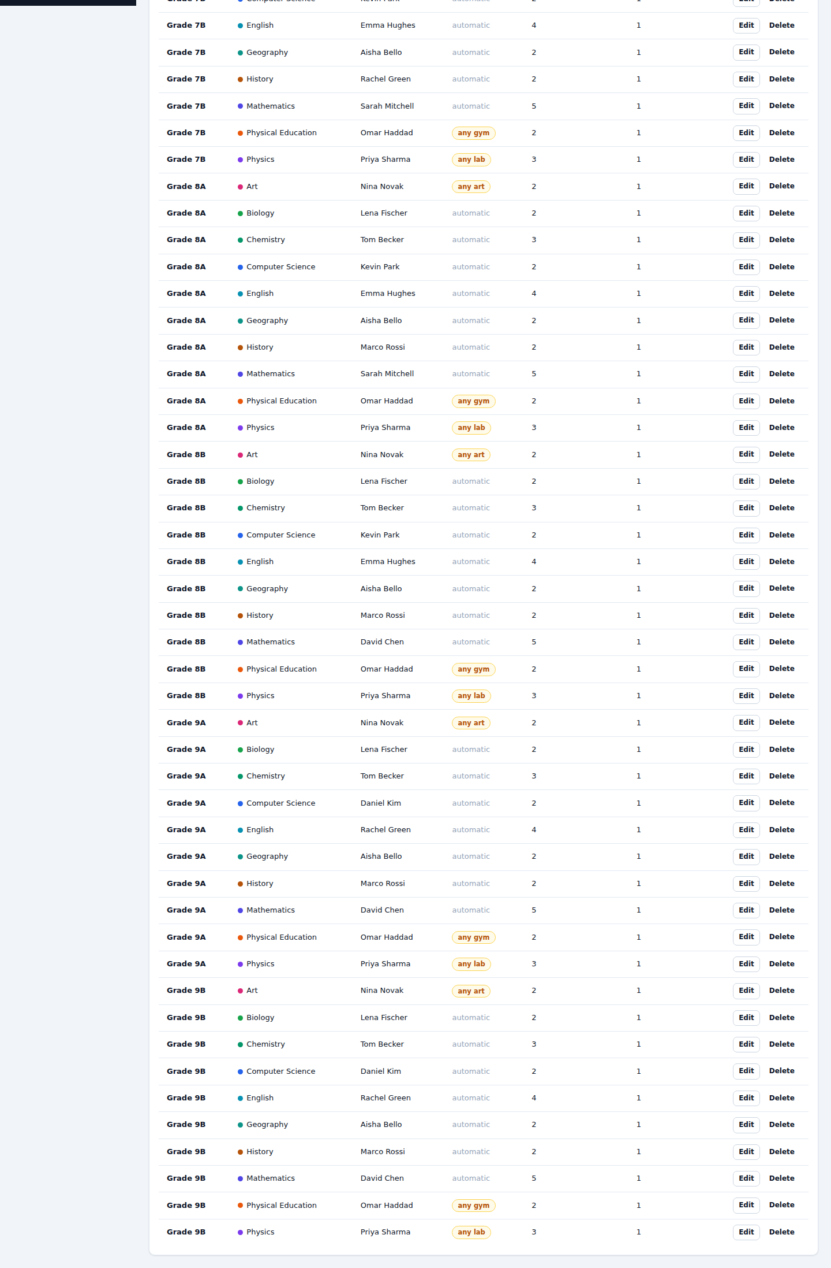
PRODUCT TOUR
Demo · defining the school
▪ Subjects, teachers, classes, rooms and lessons in one screen
▪ Teacher availability as a clickable grid
▪ Bell schedule defines the periods, breaks excluded
▪ Everything lands in one API call (/api/setup/all)
TimetableMaster · Final Year Project
10

Slide 12
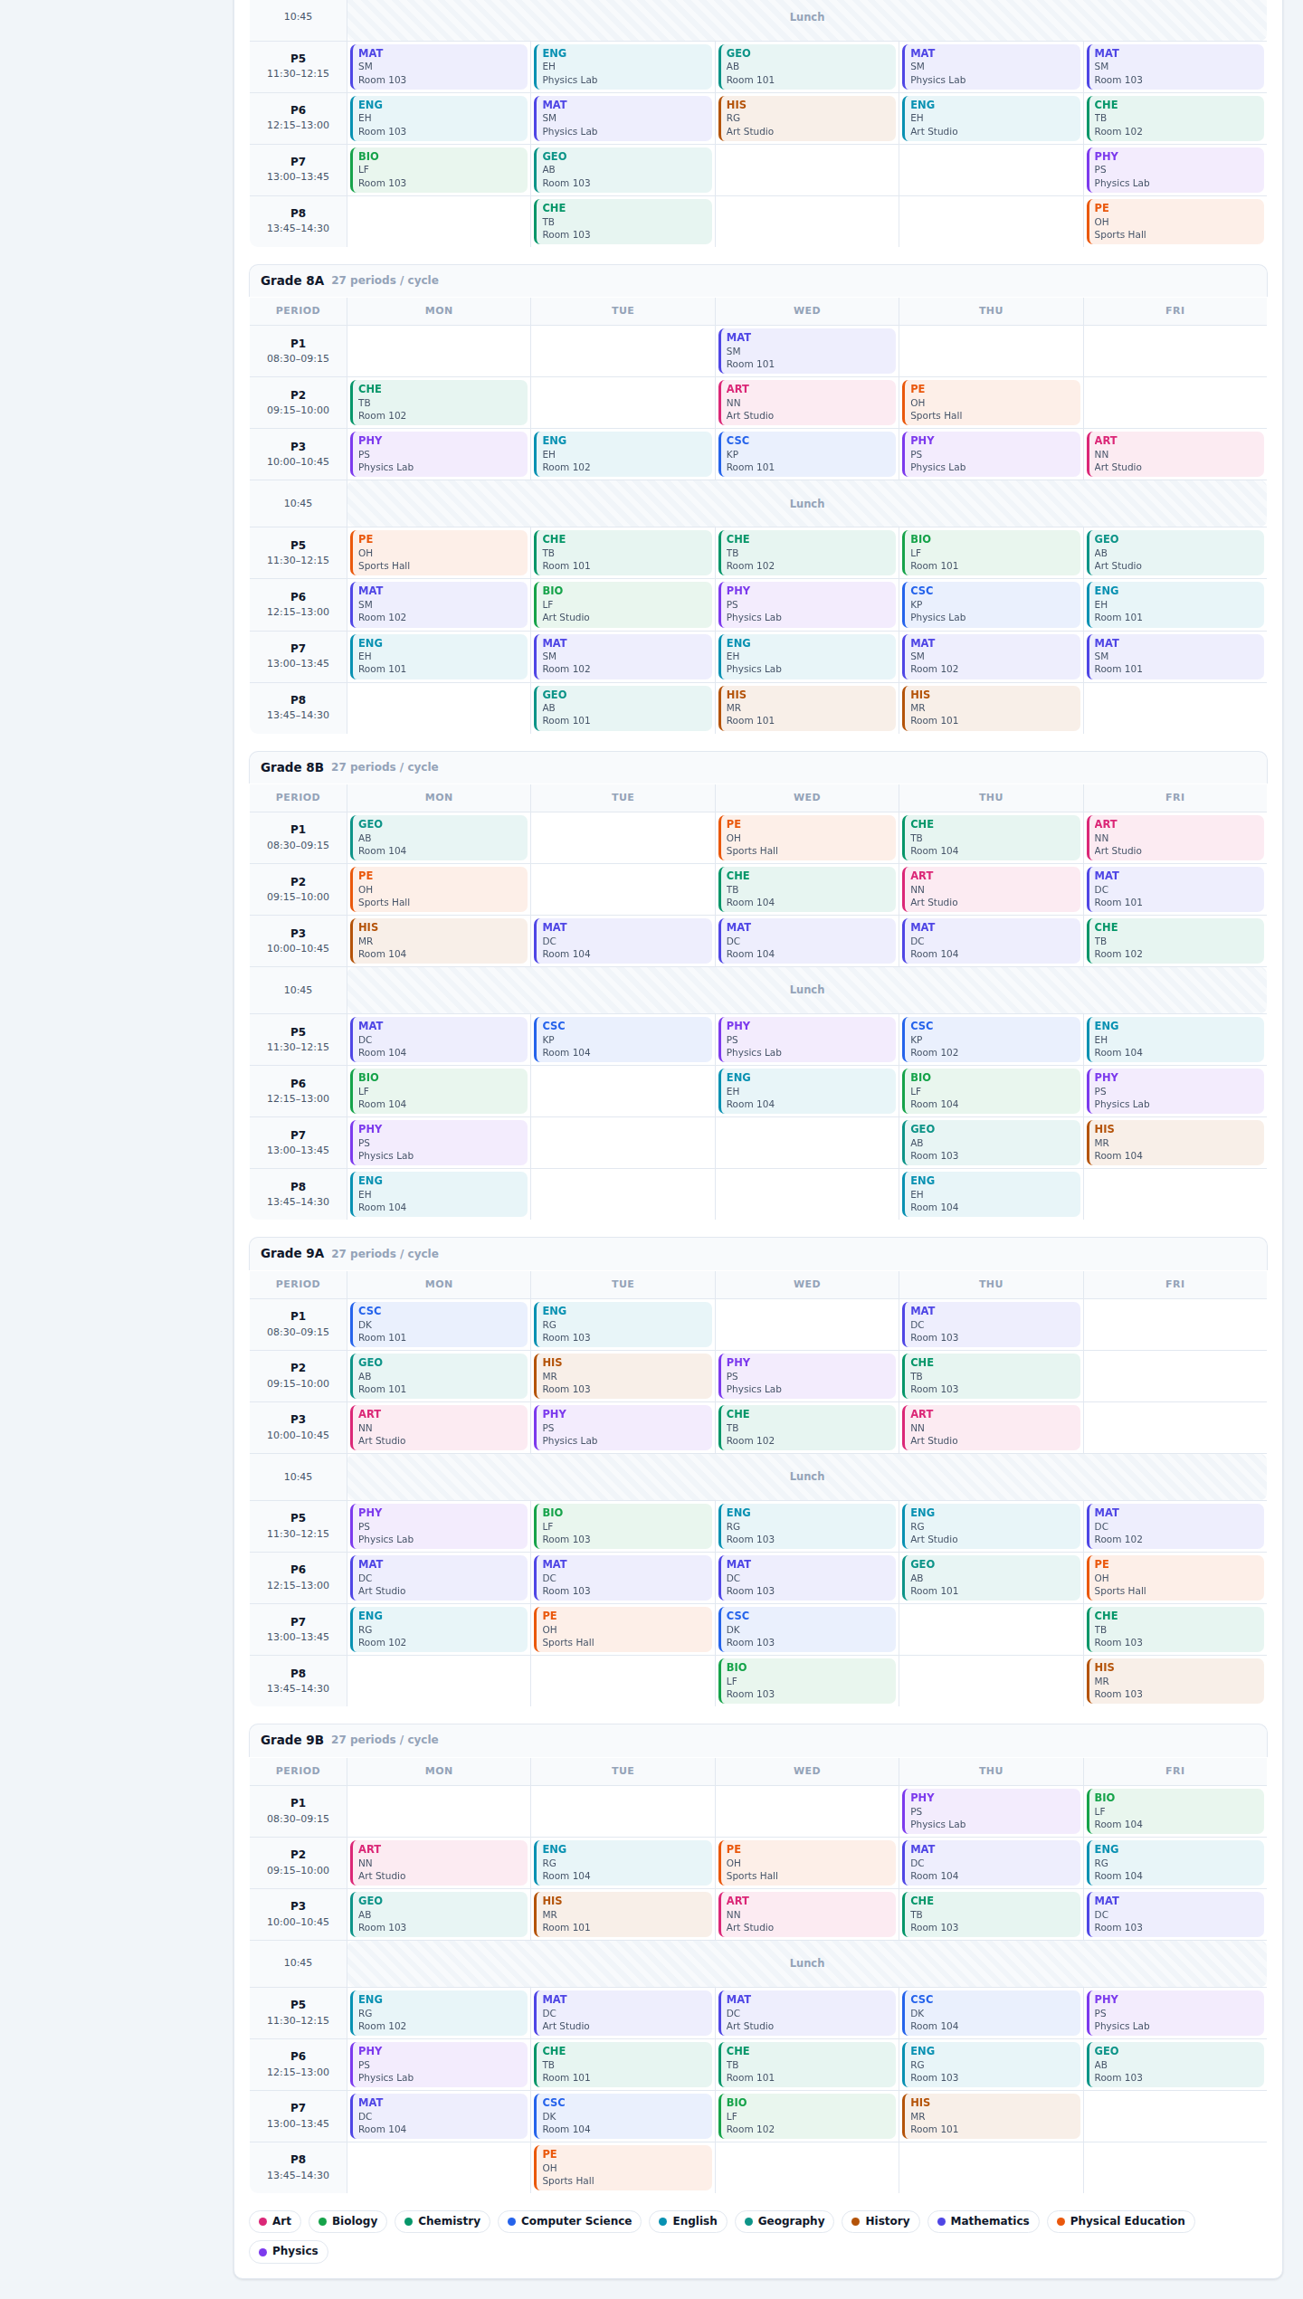
PRODUCT TOUR
Demo · the timetable, generated then edited by hand
▪ View by class, teacher or room — same grid, different grouping
▪ Drag a lesson to an empty slot: the API validates, the grid repaints
▪ Pin a lesson and it survives every future generation
▪ Conflicts are explained, not just rejected
▪ Exports and share links follow the current view
TimetableMaster · Final Year Project
11

Slide 13
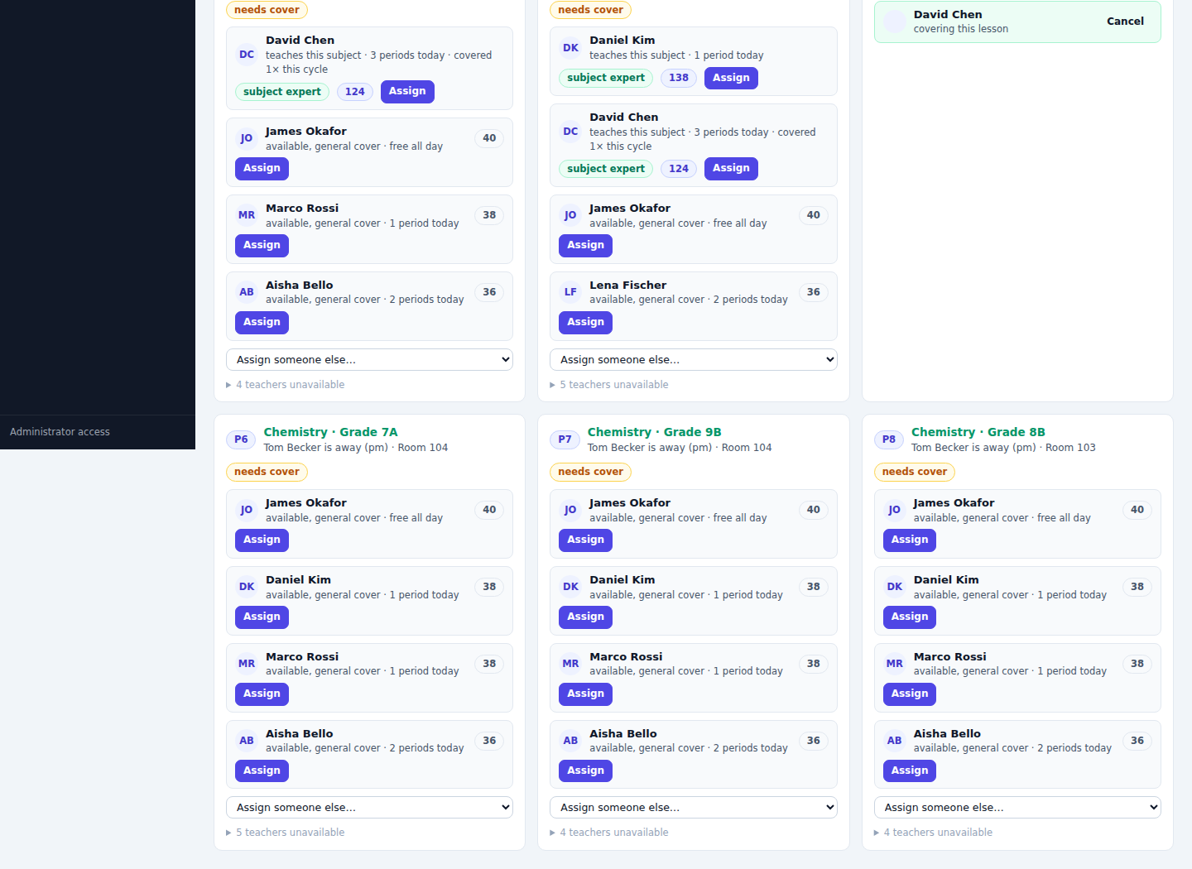
PRODUCT TOUR
Demo · a teacher is absent: who covers?
▪ Approved leave turns into an absence on the cover day
▪ Affected lessons are listed per period
▪ Candidates are ranked, each with a reason
▪ Blocked teachers are shown with why: on leave, busy, unavailable
▪ Assigning notifies over webhook; history keeps both assignments and cancels
TimetableMaster · Final Year Project
12

Slide 14
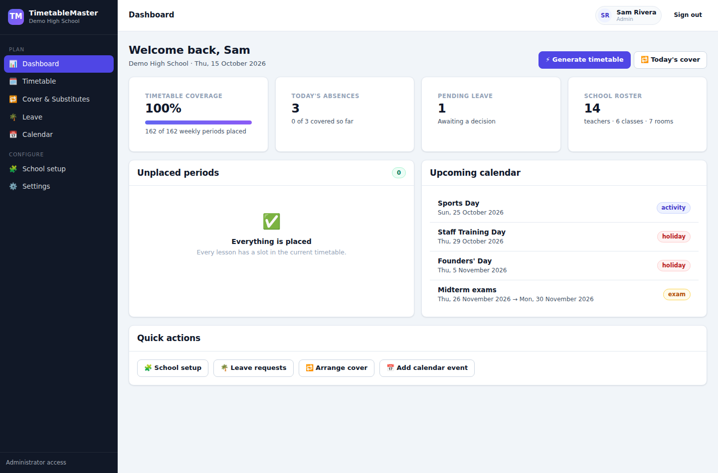
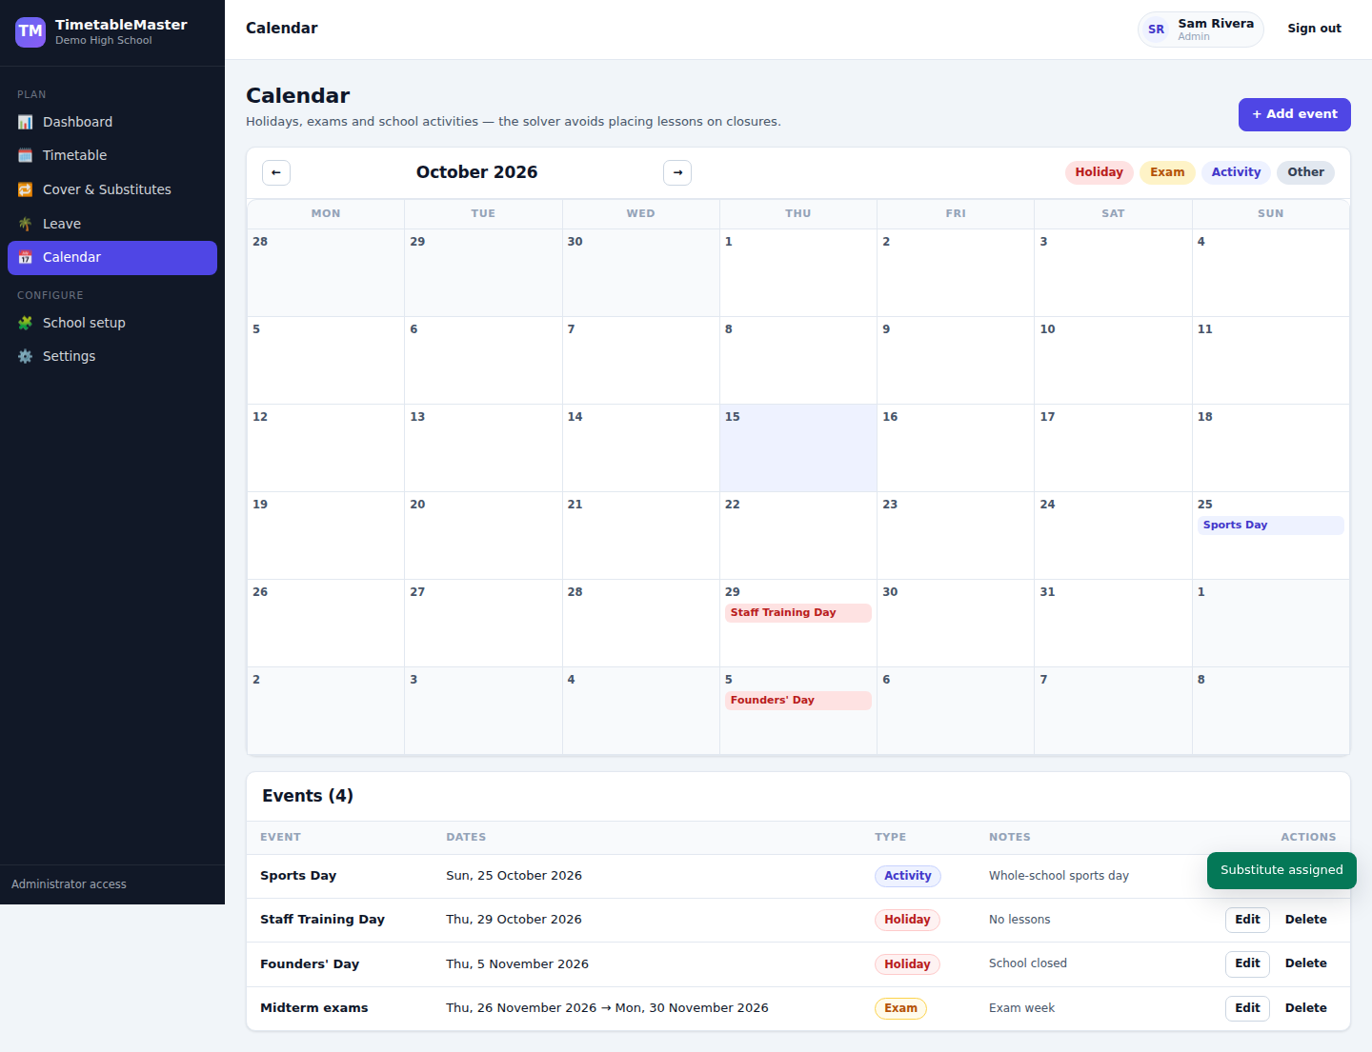
PRODUCT TOUR
Demo · the day view and the school calendar
Dashboard: coverage stats, unfilled periods, today's absences, upcoming events.
Calendar: holidays close the school — the solver and cover logic both respect them.
TimetableMaster · Final Year Project
13

Slide 15
NON-FUNCTIONAL
Security, roles and accountability
Passwords
Sessions
Authorisation
argon2 hashing; the demo school is rebuildable in one click
HS256 JWTs signed with a per-installation secret (auto-generated on first run)
every write endpoint requires admin or scheduler; teachers request leave only for themselves; students are read-only
Tenancy
Public links
Audit
every row is school-scoped from the token — no cross-school reads
unguessable tokens, revocable, return 404 the moment they are revoked
generation, edits, cover decisions and account changes are all logged with actor and timestamp
TimetableMaster · Final Year Project
14

Slide 16
QUALITY
Testing at three layers — and what it caught
Layer | Tool | Covers
Unit | cargo test | 12 tests: feasibility, clashes, workload caps, room rules, pinned placements, two-week cycles, determinism
API | Python suites (stdlib only) | 126 checks: auth and RBAC, setup CRUD, timetable conflicts, generation, cover/leave, exports, share links, notifications
Browser | Playwright (Chromium) | 33 UI assertions: drag & drop reaches the API and repaints, share links work for anonymous visitors, settings and activity log
A BUG ONLY THE SUITE COULD FIND
CI reported green while the runner was silently testing a stale server left behind by an earlier run — it killed a shell instead of the process. The runner now execs the server, refuses to start when the port is already answering, and prints every check it ran.
TimetableMaster · Final Year Project
15

Slide 17
OUTCOME
Results
7,814
5,177
43
17
171
lines of Rust
backend + solver
lines of TypeScript
frontend
REST routes
all school-scoped
SQLite tables
schema + migrations
automated checks
all passing in CI
▪ A full school (3 classes, 8 teachers, 6 rooms, 22 lessons) generates in well under a second
▪ Hand-edited lessons are honoured by every later generation — nothing is silently reverted
▪ Two-week A/B cycles solve with the same engine, with balance measured across both weeks
▪ The whole stack runs from one command: cargo run --seed-demo, plus the built SPA
▪ Cover assignment, leave impact, exports, share links and notifications all verified end to end
TimetableMaster · Final Year Project
16

Slide 18
NEXT STEPS
Limitations & future work
KNOWN LIMITATIONS
NEXT STEPS
▪ SQLite keeps the app single-node; no horizontal write scaling
▪ No teacher/team-taught lessons yet — one teacher per lesson
▪ Subject-vs-time-of-day preferences are not modelled
▪ Solver quality is bounded by the time budget, not proven optimal
▪ Multi-teacher lessons and lab/elective slots
▪ iCal subscription feed (the one-off .ics export already exists)
▪ Postgres + container deployment for multi-school districts
▪ Compare against an off-the-shelf CP-SAT solver as a benchmark
TimetableMaster · Final Year Project
17

Slide 19
Thank you
Questions welcome
Repository: github.com/Mephisto-Von/Intelligent-Time-Table-
Demo: sign in with admin@demo.school / demo1234

