Slide 1
MULTI-OMICS FACTOR ANALYSIS
of Glioblastoma
Integrating transcriptomic, proteomic, epigenomic, and microRNA profiles
to uncover shared axes of molecular heterogeneity and survival
Merna Amr Hassan
Supervised by Dr. Asmaa · Dr. Mohamed Hamed
Notes:
Opening. Introduce yourself and the one-sentence framing: "This project applies Multi-Omics Factor Analysis, or MOFA, to a real glioblastoma patient cohort, integrating five different molecular layers from the same 96 patients to find shared axes of variation and test whether any of them predict survival." Keep this to 20-30 seconds -- it's just orientation.

Slide 2
1
What is Glioblastoma?
#1
12–15 mo
~40%
Most common malignant
primary brain tumor in adults
Median overall survival
despite standard treatment
of tumors carry EGFR
amplification/mutation
Highly molecularly heterogeneous — no two tumors are alike at the genomic or transcriptomic level
Key clinically relevant markers: EGFR amplification, MGMT promoter methylation (predicts chemo response), IDH mutation status
Distinct transcriptional subtypes: Proneural, Classical, Mesenchymal (Verhaak et al., 2010)
This heterogeneity is exactly why a multi-omic approach is needed — no single molecular layer tells the full story
2
Notes:
This slide sets the medical stage. Say: "Glioblastoma is the most aggressive primary brain tumor in adults, with a median survival of only 12 to 15 months even with surgery, radiation, and chemotherapy. What makes it especially hard to treat is molecular heterogeneity -- tumors differ enormously from patient to patient in their EGFR status, MGMT methylation, and IDH mutation status, which is actually how tumors get classified into subtypes by Verhaak and colleagues in 2010." End with the bridge sentence: "Because no single molecular layer captures this heterogeneity, we used a multi-omics approach that looks at five layers simultaneously."

Slide 3
2
Research Question
What are the major axes of molecular heterogeneity in glioblastoma when jointly modeled across the transcriptome, proteome, epigenome, and microRNAome — and do any of the resulting latent factors correlate with patient survival or known clinical/molecular subtypes?
Approach: Multi-Omics Factor Analysis (MOFA) — unsupervised, joint factorization across 5 matched omics views, not simple data concatenation
3
Notes:
Read the research question slowly, it's the anchor for everything that follows. Then add: "The key word is 'jointly' -- we are not analyzing five separate datasets and comparing them afterward. We are using MOFA to find latent factors that are estimated simultaneously across all five layers, the same way PCA finds components in one dataset, but generalized to many."

Slide 4
3
Dataset
CPTAC Pan-Cancer Glioblastoma Cohort, via LinkedOmics
Source: Wang et al., 2021, Cancer Cell — proteogenomic characterization of 99 treatment-naive GBM tumors
Layer
Features (raw → used)
Samples
Plus clinical & survival data:
RNA-seq
60,669 → top 5,000
99
Age, Sex, BMI, smoking history
EGFR / TP53 / ATRX / PTEN / RB1 / PIK3CA mutation status
Overall survival (OS_days, OS_event)
Progression-free survival (PFS)
Proteomics
12,100 → top 5,000
99
Methylation
13,178 → top 5,000
97
miRNA-seq
2,582 → 1,983
98
Mutations (binary)
4,626 → 4,614
99
N = 96 patients with complete data across all 5 layers, after sample matching
4
Notes:
Say: "All data comes from the CPTAC pan-cancer glioblastoma cohort, made public through LinkedOmics -- this is the same cohort behind the 2021 Cancer Cell proteogenomics paper by Wang and colleagues. Importantly, all five layers come from the SAME 99 patients -- this is what makes it true multi-omics integration rather than just combining unrelated datasets." Point out the N=96: "After matching samples across all five layers, our final analysis cohort was 96 patients." Mention clinical data briefly -- this is what we'll correlate factors against later.

Slide 5
4
Analysis Pipeline
1
Data acquisition — 5 omics layers + clinical/survival (LinkedOmics)
7
Supervised DE — limma, EGFR-mutant vs. wildtype, all 4 continuous layers
2
Gene ID harmonization — Ensembl → gene symbol (unambiguous only)
8
Unsupervised integration — MOFA2, 5 views, 10 factors, Bernoulli likelihood for Mutations
3
Per-layer QC — missingness filtering, KNN imputation, zero-variance removal
9
Factor interpretation — variance decomposition, covariate screening, weights
4
Transformation — log2 already applied at source; M-value (logit) for methylation
10
Survival modeling — Cox proportional hazards on all 10 factors
5
Scaling (z-score) + top-5,000-variable feature selection
11
Biological interpretation & cross-referencing against primary literature
6
Exploratory QC — PCA, sample correlation, hierarchical clustering
5
Notes:
Walk through this quickly -- don't read every line. Group it verbally into three phases: "Steps 1 through 6 are quality control -- making sure every layer is clean, correctly transformed, and free of major outliers before anything else happens. Steps 7 and 8 are the two analytical cores of the project: a supervised differential expression analysis using limma, and the unsupervised MOFA integration. Steps 9 through 11 are interpretation -- turning statistical output into biology." This slide exists so the audience has a map before you dive into results -- keep it under 45 seconds.

Slide 6
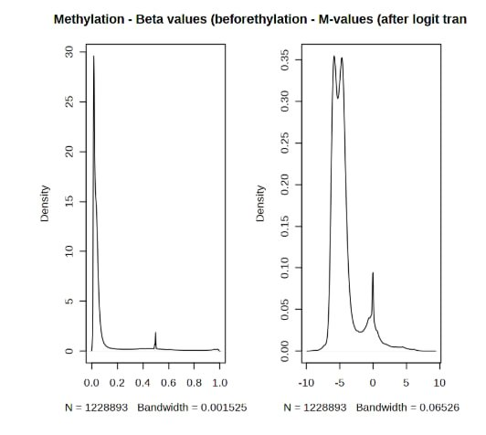
5
Quality Control: Missingness & the Methylation Transform
RNA-seq, Proteomics, and miRNA-seq were largely complete (<5% missingness); Methylation and Proteomics showed real, expected platform-typical missingness, addressed with a <50%/<30% feature filter + KNN imputation (k=10).
Why this matters: methylation beta values are bounded proportions [0,1] with unequal variance across that range — the M-value (logit) transform is the statistically correct input for MOFA's Gaussian model, not raw beta or plain log2.
6
Notes:
Say: "Before any modeling, each layer went through quality control. RNA-seq and miRNA were essentially complete. Proteomics and methylation had real missingness, which is expected for these platforms, and we handled it with a missingness filter plus KNN imputation." Then spend real time on this specific figure: "Methylation deserves special mention. Beta values are proportions between 0 and 1 -- on the left you can see almost everything piled up near 0. That's a problem for linear models because variance isn't constant across that range. So instead of log2, we applied the M-value, or logit, transform -- log2 of beta over 1 minus beta -- which spreads that out into an unbounded, more symmetric distribution, shown on the right. This is the statistically correct input for methylation data, and it's a detail many pipelines get wrong."

Slide 7
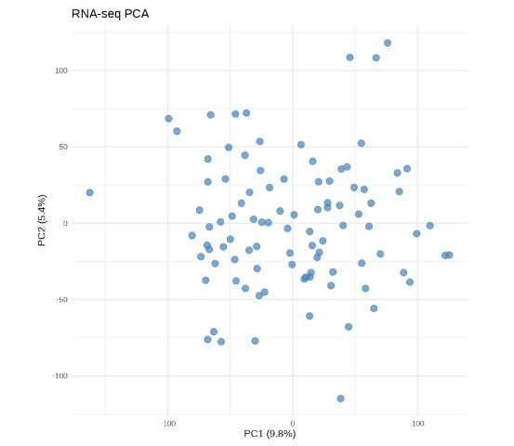
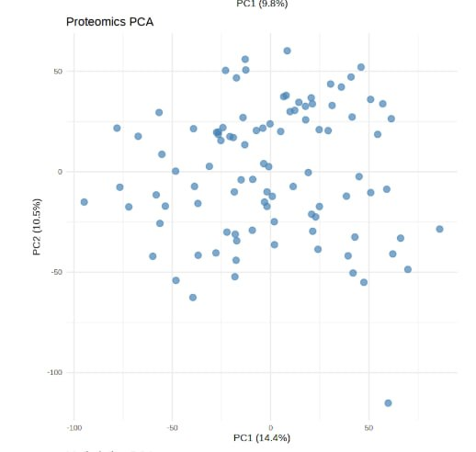
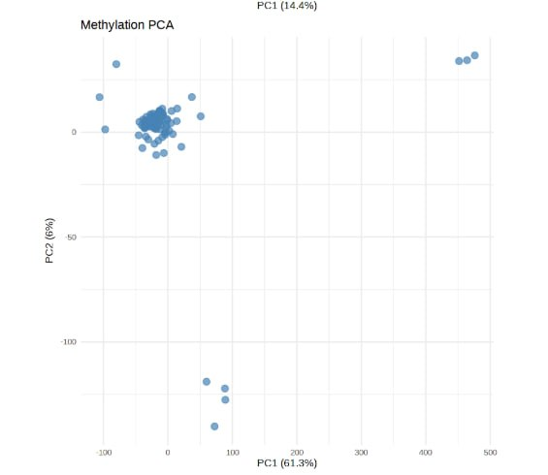
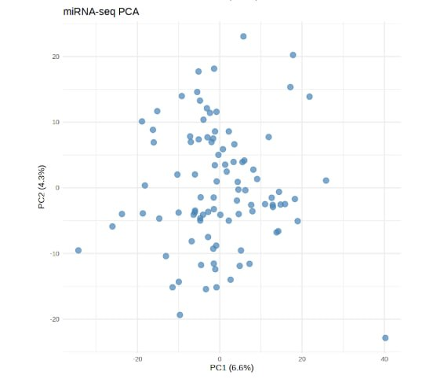
6
Quality Control: Per-Layer PCA — Outlier Screening
⚠ PC1 = 61.3%
7
Notes:
Say: "We ran PCA independently on each layer as a first outlier check, before any integration. RNA-seq and Proteomics -- top row -- look completely normal: diffuse clouds, no dominant structure, PC1 explains under 15% of variance in each. Methylation, bottom left, is the one to look at closely: PC1 alone explains 61.3% of variance, which is unusually high, and you can see why -- there are two to three extreme outlier points pulled far out from the main cluster. miRNA, bottom right, is mostly clean with a couple of milder outliers." Flag this explicitly: "We treated this as a finding that needed investigation, not something to ignore -- I'll come back to it."

Slide 8
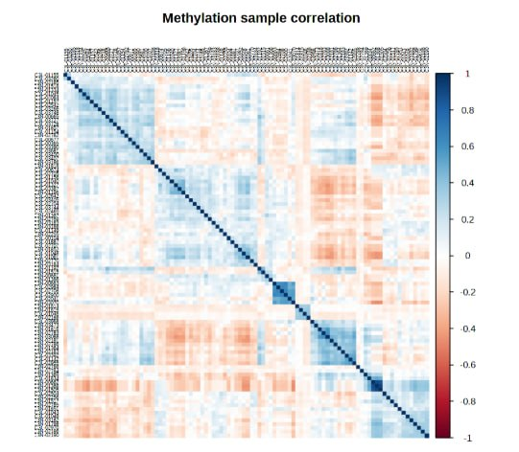
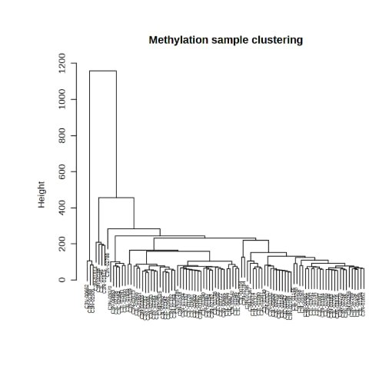
6
Confirming the Methylation Outlier Signal
8
Notes:
Say: "We cross-checked the PCA finding two more independent ways. On the left, sample-sample correlation -- you can see clear red/orange blocks, meaning some samples correlate poorly with the rest of the cohort. On the right, hierarchical clustering makes it unambiguous: one sample splits off completely on its own at a height far above every other split in the tree." This is the setup for a payoff later: "Keep this dendrogram in mind -- we'll come back to whether this outlier structure explains one of our MOFA factors."

Slide 9
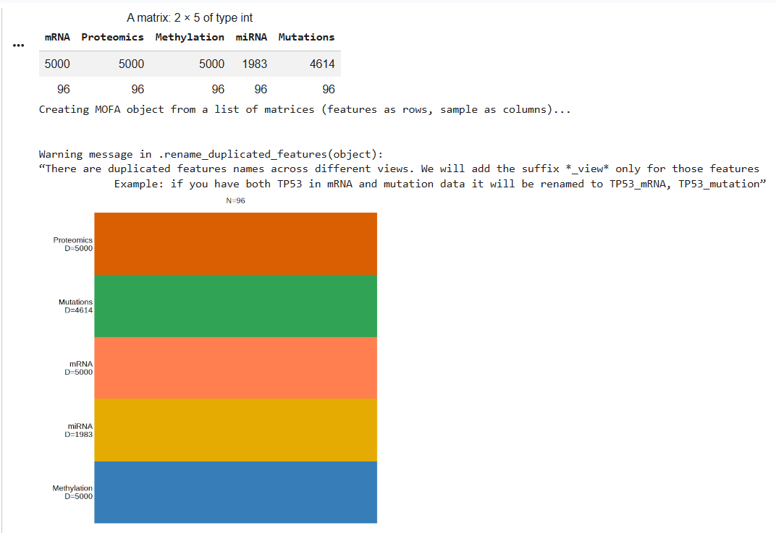
7
Building the MOFA Model
5 views · 96 samples · 0 missing · 10 factors requested
9
Notes:
Say: "This is the MOFA object right before training -- five stacked bars, one per view: Proteomics, Mutations, mRNA, miRNA, and Methylation, each with 96 samples and no missing segments, meaning every one of our 96 patients has complete data in all five views. The warning about duplicated feature names is expected and harmless -- MOFA automatically relabels a gene like TP53 as TP53_mRNA versus TP53_mutation when it appears in more than one view." Brief technical note if asked: "Mutations get a Bernoulli likelihood since they're binary; the other four views use the default Gaussian likelihood."

Slide 10
8
Differential Analysis: EGFR-Mutant vs. Wildtype
A shared limma-based function was applied identically across all 4 continuous omics layers (FDR<0.05, |log2FC|>1)
Layer
Features Tested
Significant Hits
RNA-seq
32,635
1 — EGFR (Up)
Proteomics
10,331
0
Methylation (M-values)
12,669
0
miRNA-seq
1,983
0
This is a positive control, not a weak result: samples labeled "EGFR-mutant" show ~8-fold higher EGFR transcript (log2FC≈3), confirming the pipeline and grouping variable are working correctly. Zero hits elsewhere reflects real statistical power limits (23 vs. 73 samples) and known attenuation of mRNA-level signal at the protein level (Wang et al. 2021).
10
Notes:
This slide often gets misread as "the DE analysis didn't work" -- correct that proactively. Say: "The only significant hit anywhere was EGFR itself, in RNA-seq, roughly 8-fold higher in EGFR-mutant tumors. That is exactly what we'd expect if our grouping variable is correct, and we treat it as a positive control validating the whole pipeline." Then: "Zero significant hits in Proteomics, Methylation, and miRNA is a real, honest result, not a bug. With only 23 EGFR-mutant patients against 73 wildtype, this comparison is underpowered for genome-wide correction, and it's well documented in the original CPTAC-GBM paper that mRNA changes don't always propagate cleanly to the protein level."

Slide 11
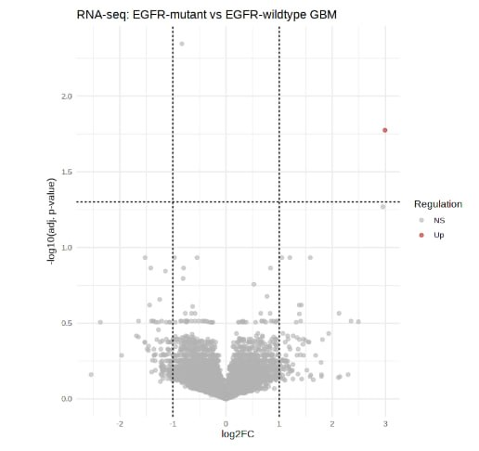
8
RNA-seq Volcano Plot — EGFR Recovered as Top Hit
11
Notes:
Point directly at the single red dot: "That one point in red, far to the right, is EGFR. Everything else -- 32,634 other genes -- falls in the grey, non-significant zone. This clean, single-hit picture is exactly what a well-behaved positive control should look like."

Slide 12
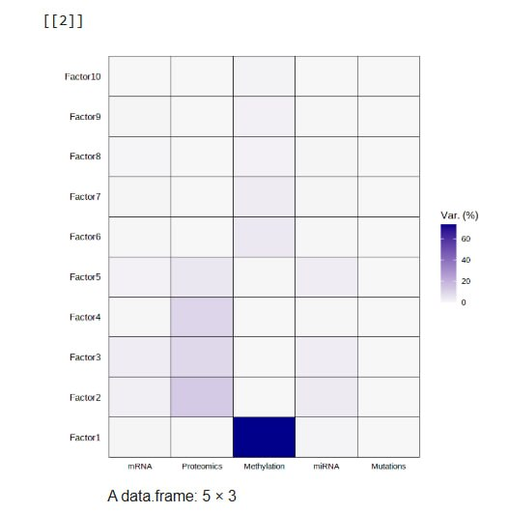
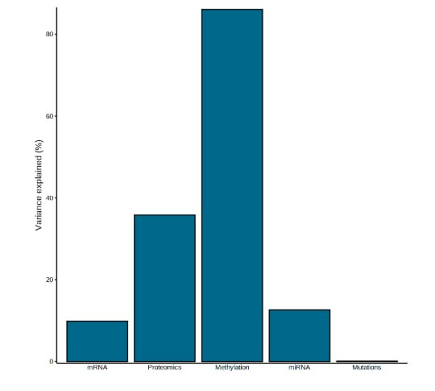
9
MOFA Variance Decomposition — The Centerpiece Result
12
Notes:
This is the single most important figure in the whole project -- take your time. Say: "The left heatmap shows, for each of our 10 factors, how much variance it explains in each of the five views. The right chart totals that up per view." "Methylation dominates -- 86% of its total variance, concentrated almost entirely in Factor 1. Proteomics, at 36%, and miRNA, at 13%, are more evenly distributed across several factors, which turns out to matter a lot for how much we trust them. Mutations explains under 0.1% of variance anywhere -- essentially nothing, likely because with 96 samples and sparse binary calls per gene, there isn't enough signal density for MOFA to find structure there. We report that as a real limitation rather than hiding it."

Slide 13
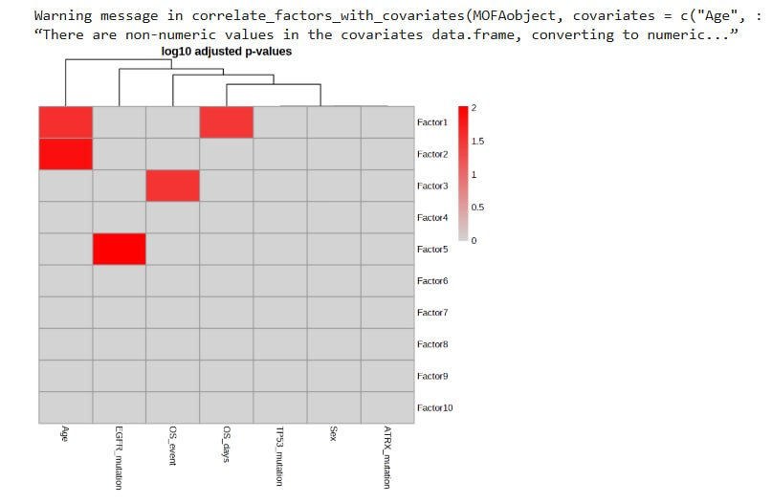
9
Which Factors Matter? A Systematic Screen
Before deep-diving any single factor, we tested all 10 against every available clinical covariate.
13
Notes:
Say: "Rather than picking a factor because its variance looked big, we screened all ten factors against every clinical variable we had -- age, sex, EGFR status, mutation markers, and both survival measures. Four significant associations came out: Factor 1 with Age and with survival time; Factor 2 with Age; Factor 3 with the binary death outcome; and Factor 5 with EGFR mutation status." "This heatmap is our roadmap for the rest of the talk -- we're going to walk through Factor 1, Factor 2, and Factor 3 in that order, because those are the ones the data itself told us to look at."

Slide 14
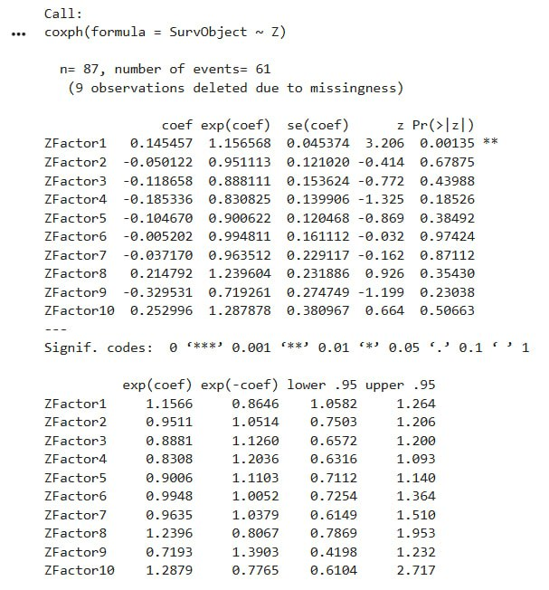
10
FACTOR 1
Our Strongest Statistical Result
14
Notes:
Say: "We fit a Cox proportional hazards model regressing overall survival on all ten factor scores simultaneously, using the 87 patients with complete survival data. Factor 1 is the only one that reaches statistical significance -- hazard ratio 1.16, p equals 0.0014. That means for every one-unit increase in a patient's Factor 1 score, their instantaneous risk of death goes up by about 16 percent, holding everything else constant. No other factor came close to significance." This is your strongest single number in the whole project -- say it clearly and let it land before moving to the next slide, which is the visual version.

Slide 15
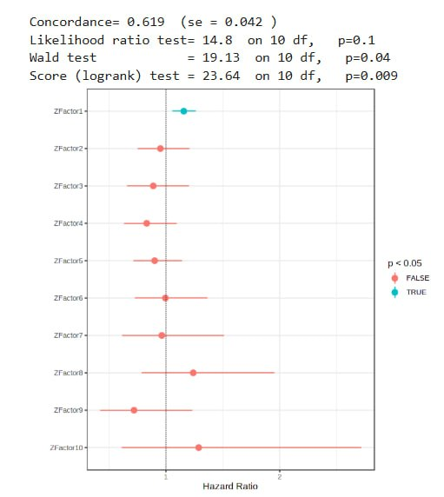
10
Factor 1: Hazard Ratio Forest Plot
15
Notes:
Say: "Visually, Factor 1 -- the teal point -- is the only one whose confidence interval clearly excludes a hazard ratio of 1. Everything else, in red, crosses the line, meaning we can't rule out no effect." Mention the model fit honestly: "Overall model concordance was 0.619 -- modest but meaningfully above the 0.5 you'd get from random chance, so there's real, if not overwhelming, prognostic signal in this factor structure."

Slide 16
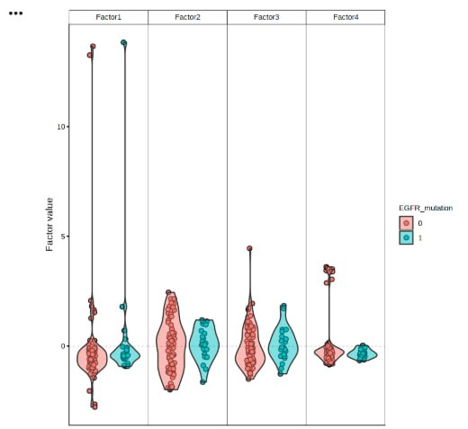
10
But: Is Factor 1 Driven by Outliers?
Two samples sit near value 13–14, while every other sample clusters between −2 and +3. Factors 2–4 show no such extreme separation.
16
Notes:
Pivot the tone here: "Before we celebrate that p-value, we need to check something. Look at the Factor 1 panel here -- two points sit way out at 13 to 14, while literally every other sample, in both EGFR groups, clusters tightly between about minus 2 and plus 3. Factors 2, 3, and 4, right next to it for comparison, show nothing like this." "This is the direct visual confirmation that Factor 1's huge methylation variance, and possibly its survival association, are disproportionately shaped by just two samples -- not a smooth, population-wide signal."

Slide 17
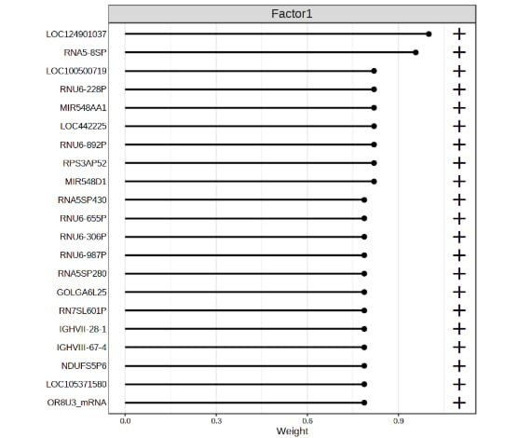
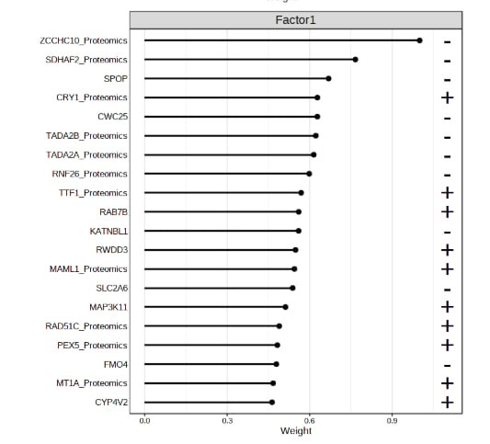
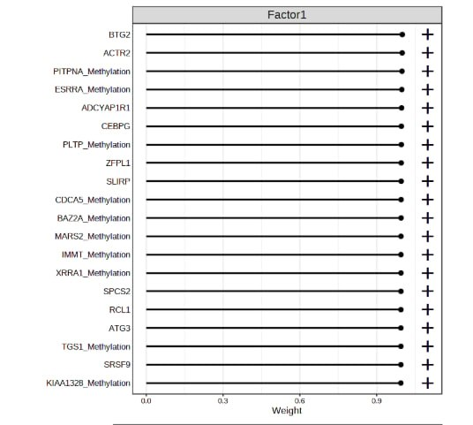
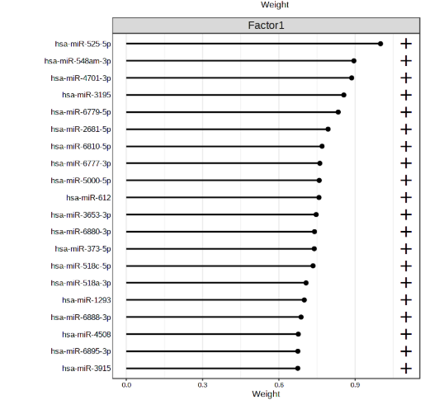
10
Factor 1 Weights: A Consistent Technical Signature
mRNA — dominated by pseudogenes
Proteomics — more plausible genes
Methylation — saturated at ~1.0
miRNA — low-confidence miRNAs
17
Notes:
This is a dense slide -- narrate it as four short beats, not one long paragraph: "mRNA -- top weights are almost entirely pseudogenes and unannotated loci, a classic RNA-degradation or technical-noise signature, not real biology. Proteomics -- more plausible: MAML1, RAD51C, MAP3K11, real cancer-relevant genes. Methylation -- notice nearly every gene sits at almost exactly the same maximal weight. That flat, saturated pattern is itself a signature of a small number of samples driving uniformly extreme values across many genes at once. miRNA -- dominated by obscure, poorly characterized miRNAs, no coherent story, unlike a factor we'll see later." Land the conclusion: "All four views point the same direction -- this looks technical, not biological."

Slide 18
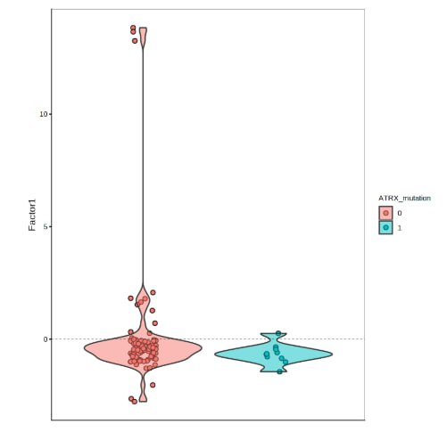
10
Testing a Hypothesis: Is This G-CIMP?
ATRX loss co-occurs with the IDH-mutant / G-CIMP hypermethylator glioma subtype (Noushmehr et al., 2010). We tested whether the Factor 1 outliers carried ATRX mutations.
Result: NOT supported. Both outlier samples are ATRX-wildtype. The driver of these outliers remains unresolved — IDH status was unavailable in this cohort's metadata.
18
Notes:
Say: "We had a specific biological hypothesis for these outliers: a rare, well-documented hypermethylated subtype of glioma called G-CIMP, associated with IDH mutation and, as a proxy marker, ATRX loss. So we tested it directly -- did our two outlier samples carry ATRX mutations?" "They did not. Both are ATRX-wildtype, shown in red here. This hypothesis is not supported by our data." This is important to say with confidence, not embarrassment: "We report this as an honest negative result. The actual driver of these outliers is still unresolved -- we didn't have IDH status available in this cohort's clinical file to test the more direct marker. That's a concrete, named limitation, not a hand-wave."

Slide 19
10
Factor 1: Holding Two Ideas at Once
The Statistical Case
The Caveat
Significant Cox survival association (HR=1.16, p=0.0014)
Age association is textbook-plausible — epigenetic drift with age is well documented
Only factor to reach significance among all 10
2–3 extreme outliers visible in PCA, correlation, clustering, AND violin plots
mRNA/Methylation/miRNA weights show technical, not biological, signatures
ATRX hypothesis tested and not supported
Conclusion: present as a flagged, high-priority finding requiring outlier-exclusion validation — not a confirmed result.
19
Notes:
This is your "we did rigorous science" slide -- say it plainly: "So we're left holding two things at once. Factor 1 is our strongest statistical result, and the age association makes real biological sense given known epigenetic aging effects. But four independent pieces of evidence -- PCA, correlation, clustering, and weight patterns -- all point toward this being disproportionately shaped by two or three samples." "Our conclusion is not to throw this away, and not to oversell it either -- we present it as a flagged finding that needs one more analysis: refitting everything with those samples excluded to see if the association survives."

Slide 20
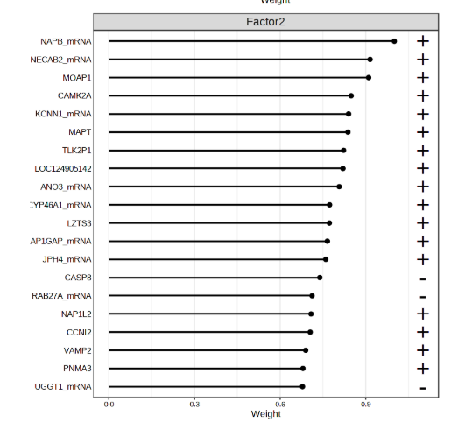
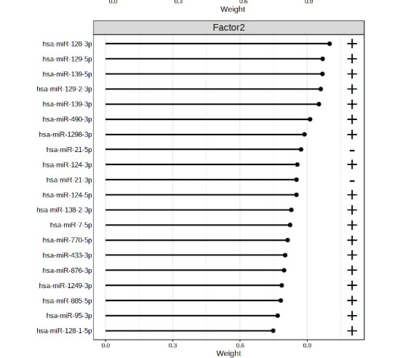
11
Factor 2: An Age-Associated Neuronal Signature
20
Notes:
Say: "Factor 2 is significantly associated with patient age. Its mRNA weights, left, are dominated by neuronal and synaptic genes -- CAMK2A, MAPT, the tau gene, VAMP2, CYP46A1, a brain-specific cholesterol gene. Its miRNA weights, right, include miR-21, the single best-documented oncomiR in glioma, and miR-124, a neuronal-differentiation miRNA frequently silenced in GBM." Add the important nuance: "We want to flag something honest here -- a neuronal gene signature in bulk tumor RNA-seq commonly reflects tumor purity, meaning how much normal, non-tumor brain tissue got captured alongside the tumor in the biopsy, rather than pure tumor biology. We don't have a way to fully rule that out with this data, so we present both explanations rather than picking the more exciting one."

Slide 21
12
FACTOR 3
Our Strongest Biological Story
Three independent omics layers — mRNA, Proteomics, and miRNA — independently converge on the same biological theme: chromatin regulation, immune signaling, and proliferation control.
21
Notes:
Transition slide -- build anticipation: "Now for the finding we're most confident in. Factor 3 doesn't have Factor 1's outlier problem, and instead of one omics layer telling a story, we have three, independently, all pointing the same direction. Let's walk through each one."

Slide 22
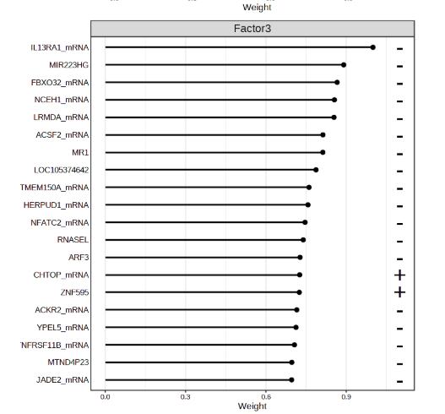
12
Factor 3 — mRNA: Immune & Inflammatory Signaling
22
Notes:
Say: "At the transcript level, Factor 3's top genes include IL13RA1, part of the interleukin-13 receptor signaling axis; RNASEL, an innate antiviral immune gene; NFATC2, a T-cell activation transcription factor; ACKR2, a chemokine-scavenging receptor; and MIR223HG, the host gene for an immune-associated microRNA." Highlight IL13RA1 specifically: "IL13RA1 is worth calling out -- its receptor-family relative, IL13 receptor alpha 2, is a clinically validated CAR-T cell immunotherapy target in glioblastoma, published in the New England Journal of Medicine in 2016. We're careful to say our finding is IL13RA1, not IL13RA2 itself, but this places our result in a very active area of GBM immunotherapy research."

Slide 23
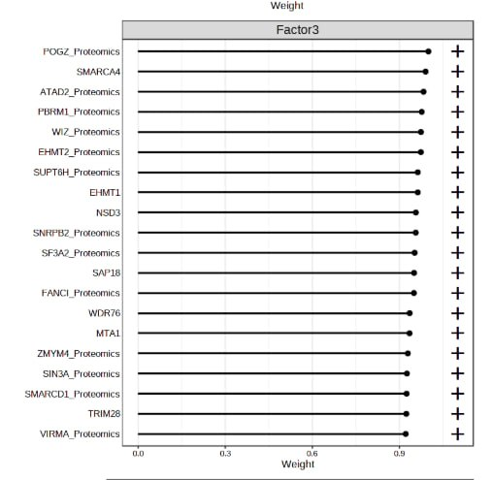
12
Factor 3 — Proteomics: Chromatin-Remodeling Machinery
23
Notes:
Say: "At the protein level, this is a remarkably coherent list -- SMARCA4, PBRM1, and SMARCD1 are three separate subunits of the same protein complex, the SWI/SNF chromatin remodeling complex, one of the most important cancer-associated protein machines. Alongside those: EHMT1, EHMT2, and NSD3, histone methyltransferases; TRIM28, SIN3A, and MTA1, heterochromatin and transcriptional repressor complexes; and FANCI, a DNA repair gene." "This is not a random gene list -- it's essentially a functional protein module for chromatin regulation, appearing together in an unsupervised, data-driven factor. That coherence is exactly the kind of signal MOFA is designed to surface."

Slide 24
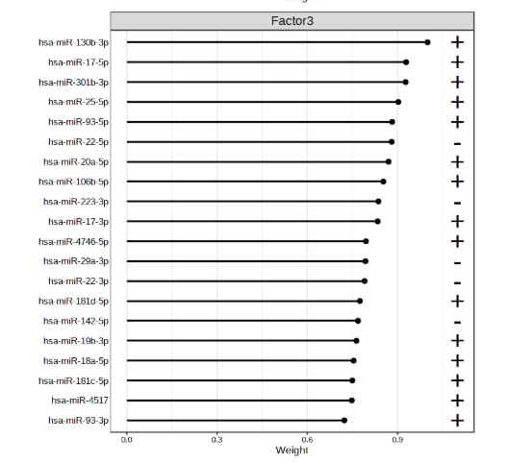
12
Factor 3 — miRNA: The Canonical Oncogenic Cluster
24
Notes:
Say: "The miRNA layer completes the picture. The top weights are dominated by the miR-17-92 cluster and its paralog, miR-106b-25 -- miR-17, miR-20a, miR-93, miR-106b, miR-25. This is one of the most extensively characterized oncogenic microRNA clusters in all of cancer biology, first described as a candidate human oncogene in Nature in 2005, and consistently implicated in proliferation and cell-cycle control since then. We also see the tumor-suppressive miR-181 family here, in the opposite direction." "So to summarize Factor 3 across all three slides: chromatin regulation at the protein level, immune signaling at the transcript level, and a canonical proliferation-associated miRNA cluster -- three independent layers, one coherent theme."

Slide 25
12
Factor 3: A Genuinely Convergent Signature
mRNA
IL13RA1 · RNASEL · NFATC2 · ACKR2 · MIR223HG
Immune / inflammatory signaling
Proteomics
SMARCA4 · PBRM1 · SMARCD1 · TRIM28 · SIN3A
Chromatin-remodeling machinery (SWI/SNF)
miRNA
miR-17/20a/93/106b/25 (miR-17-92 cluster)
Canonical oncogenic proliferation control
Three independent omics layers converging on one biological theme — this convergence, not any single p-value, is what makes Factor 3 our best-supported finding.
25
Notes:
This is the summary slide for your best finding -- speak with confidence here. "Unlike Factor 1, Factor 3's strength doesn't rest on a single statistical test. It rests on three independent omics layers, measured by completely different technologies, agreeing on the same underlying biology: chromatin regulation, immune signaling, and proliferation. That convergence is the actual finding."

Slide 26
13
How Do These Findings Compare to the Literature?
Finding
Consistent with
Relationship
EGFR up in EGFR-mut tumors
Brennan et al. 2013; Wang et al. 2021
Confirms known GBM biology (positive control)
Factor 3: SWI/SNF + miR-17-92
He et al. 2005 (Nature)
First independent MOFA evidence of this specific convergence
Factor 3: IL13RA1 signature
Brown et al. 2016 (NEJM)
Connects to an active GBM immunotherapy target family
Factor 2: miR-21, miR-124
Chan et al. 2005 (Cancer Research)
Reproduces the best-known glioma oncomiR
Factor 1 / ATRX (G-CIMP)
Noushmehr et al. 2010 (Cancer Cell)
Hypothesis tested — NOT supported by this cohort
26
Notes:
Walk down this table row by row briefly -- it's meant to directly answer the question "are your results similar to published work, or novel?" Say: "Most of our findings replicate well-established biology, which is reassuring, not disappointing -- it validates the pipeline. The specific three-way convergence in Factor 3 is, to our knowledge, not something the original CPTAC paper reported in this form, since they didn't run MOFA on this cohort. And the ATRX test is a case where we explicitly checked a hypothesis from the literature and it didn't hold in our data -- also a legitimate, reportable outcome."

Slide 27
14
Conclusion
MOFA identified two complementary findings
Factor 1 (statistically significant survival predictor) and Factor 3 (biologically coherent, three-omics convergent signature)
Pipeline validity confirmed
RNA-seq DE correctly recovered EGFR as the top hit in EGFR-mutant tumors — a clean positive control
Honest limitation, not overclaiming
Factor 1's survival association is tempered by consistent outlier evidence across all 4 continuous omics views — flagged as requiring validation
Strongest biological result
Factor 3 converges on chromatin regulation, immune signaling, and the miR-17-92 oncogenic cluster — independent of the Factor 1 outlier concern
27
Notes:
This is your closing scientific statement -- deliver it slowly. "To conclude: we asked whether jointly modeling five omics layers reveals shared axes of heterogeneity in glioblastoma that relate to survival. The answer is yes, in two complementary ways. Factor 1 is our statistically strongest result but comes with an honestly-reported outlier caveat. Factor 3 is our most biologically convincing result, converging across three independent omics layers on chromatin regulation, immune signaling, and a canonical oncogenic microRNA cluster. Together, these findings are consistent with, and extend, the original CPTAC-GBM proteogenomic study using an independent, unsupervised multi-omic factorization approach."

Slide 28
15
Future Directions
★ Priority
Re-fit variance decomposition + Cox model with Factor 1 outliers excluded — resolves the project's central open question
Validate
Test Factor 3's chromatin/immune/miR-17-92 signature in an independent cohort (e.g., TCGA-GBM)
Extend data
Incorporate IDH mutation status to directly test the G-CIMP hypothesis raised by Factor 1
Formalize
GO/KEGG pathway enrichment + miRNA target prediction (multiMiR) on all DE and factor-weight gene lists
Model upgrade
MOFA+ group-wise framework to compare EGFR-mutant vs. wildtype as explicit modeled groups
Functional follow-up
Validate miR-17-92 cluster and SWI/SNF subunits in GBM cell line models
28
Notes:
Say: "If I had one more week, the single highest-value thing to do is the top one -- re-running the Cox model with the Factor 1 outliers excluded. That one analysis would let us resolve, rather than just flag, the project's biggest open question. Everything below that is genuine, valuable follow-up work but secondary to that."

Slide 29
16
References
Wang, L.-B., et al. (2021). Proteogenomic and metabolomic characterization of human glioblastoma. Cancer Cell, 39(4), 509–528.
Argelaguet, R., et al. (2018). Multi-Omics Factor Analysis — a framework for unsupervised integration of multi-omics data sets. Molecular Systems Biology, 14, e8124.
Verhaak, R.G.W., et al. (2010). Integrated genomic analysis identifies clinically relevant subtypes of glioblastoma. Cancer Cell, 17(1), 98–110.
Chan, J.A., Krichevsky, A.M., Kosik, K.S. (2005). MicroRNA-21 is an antiapoptotic factor in human glioblastoma cells. Cancer Research, 65(14), 6029–6033.
He, L., et al. (2005). A microRNA polycistron as a potential human oncogene. Nature, 435(7043), 828–833.
Noushmehr, H., et al. (2010). Identification of a CpG island methylator phenotype that defines a distinct subgroup of glioma. Cancer Cell, 17(5), 510–522.
Brown, C.E., et al. (2016). Regression of glioblastoma after chimeric antigen receptor T-cell therapy. New England Journal of Medicine, 375(26), 2561–2569.
29
Notes:
Read only if asked, or summarize: "Seven references anchor this project — the CPTAC dataset paper, the MOFA methods paper, and five papers connecting specific factor findings to established glioma biology."

Slide 30
Thank You
Questions?
30
Notes:
Simple close. Invite questions and be ready to go back to the Factor 1 outlier slides or the Cox model slide -- those are the most likely to be challenged.

