Slide 1

WELCOME TO
Click to Buy E-Commerce Management System

Slide 2
Click to Buy
E-Commerce Management System
Developed Team:
Name
Md. Merajul Islam
Sunil Chandra Karmakar
Md. Mir-Jobair Mahamud
ID
15163203017
15163203028
15163203041
Project Supervisor :
M. M. Fazle Rabbi
Assistant Professor Department of Computer Science & Engineering
Bangladesh University of Business and Technology (BUBT)

Slide 3
Introduction
Ecommerce, also known as electronic commerce or internet commerce, refers to the buying and selling of goods or services using the internet, and the transfer of money and data to execute these transactions. Ecommerce is often used to refer to the sale of physical products online, but it can also describe any kind of commercial transaction that is facilitated through the internet.
Where as e-business refers to all aspects of operating an online business, ecommerce refers specifically to the transaction of goods and services.

Slide 4
Motivation
A wide range of products and services
Simplicity and comfort
E-commerce Saves money
E-commerce save time

Slide 5
Objective
Proper management and opportunities securely store all records
To increase the eﬃciency of online based E-commerce system.
The system should be built to make components reusable for future developments.
Unlimited changes without functional diﬃculties for addressing ever-changing business requirements.
Customers can easily select products from different providers.

Slide 6
Reasons For Choosing Click to Pay
Faster buying/selling procedure, as well as easy to find products
More reach to customers, there is no theoretical geographic limitations.
24 Hours And 7 day availability
Easy to start and manage a business
Low operational costs and better quality of services.
Customers can easily select products from different providers.

Slide 7
Features of Click to Buy-
Content management capabilities.
An easy-to-use checkout.
For buy any product must register customer
Reporting tools
Organized customer panel for tracking Order and Information
Invoice History of Customer.
Organized Dashboard for see all activities of business

Slide 8
What we used for Develop this system-
Design
Bootstrap Framework
CSS
jQuery
Ajax
HTML

Slide 9
What we used for Develop this system-
Development
ASP.NET CORE 3.1
SQL Server 2017

Slide 10
Limitations of This System
Online payment gateway not integrated yet
Reliance on technology
For use this system must need Internet Connection
Live chat is not integrated yet

Slide 11
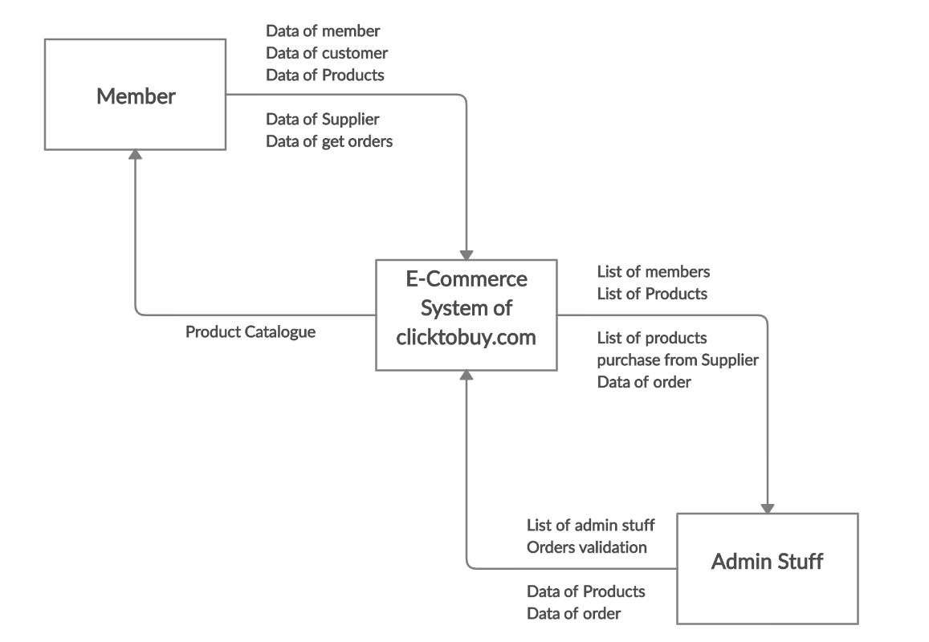
Context Diagram

Slide 12

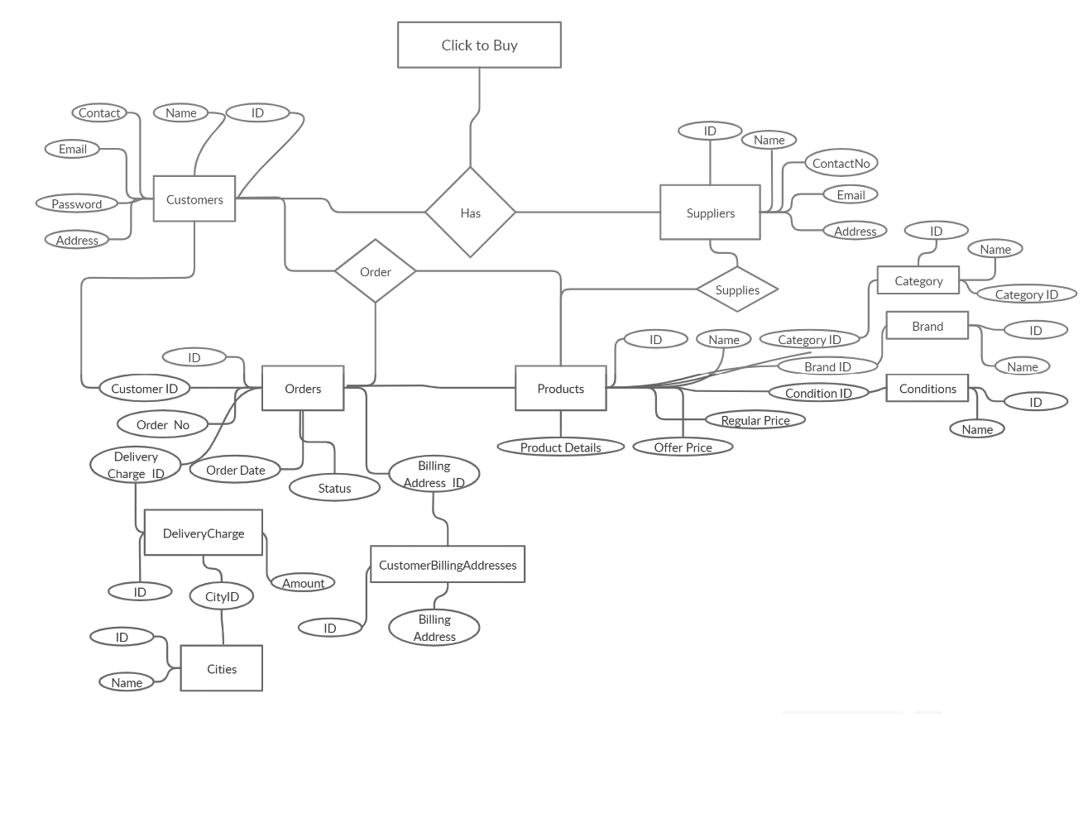
ER Diagram

Slide 14
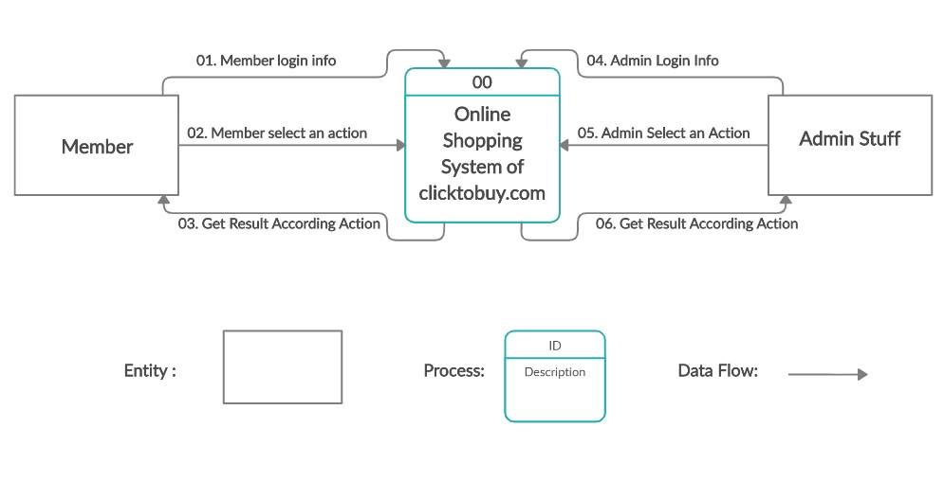
DATA FLOW DIAGRAM

Slide 15
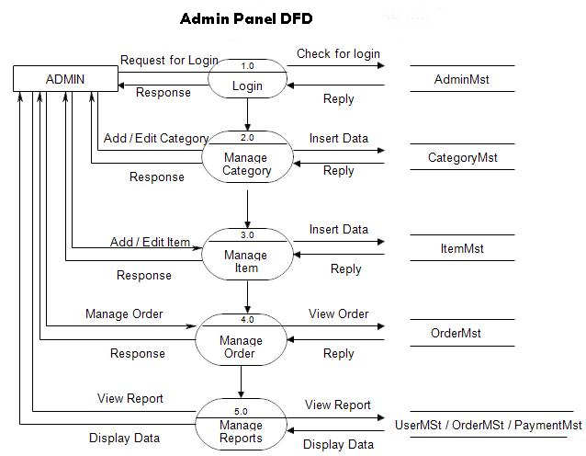

Slide 16
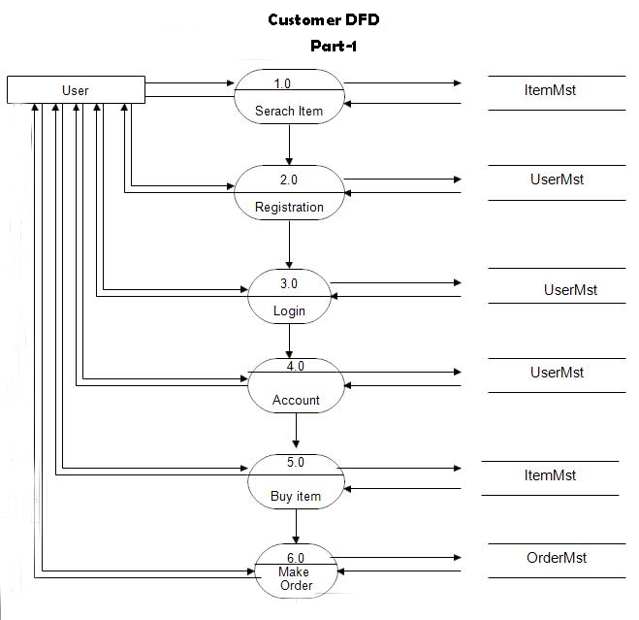

Slide 17
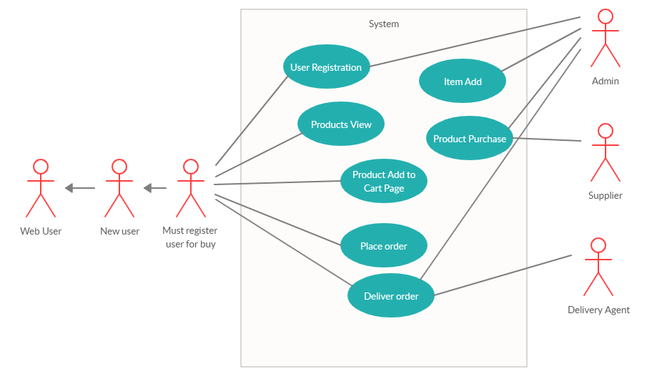
Use Case Diagram

Slide 18
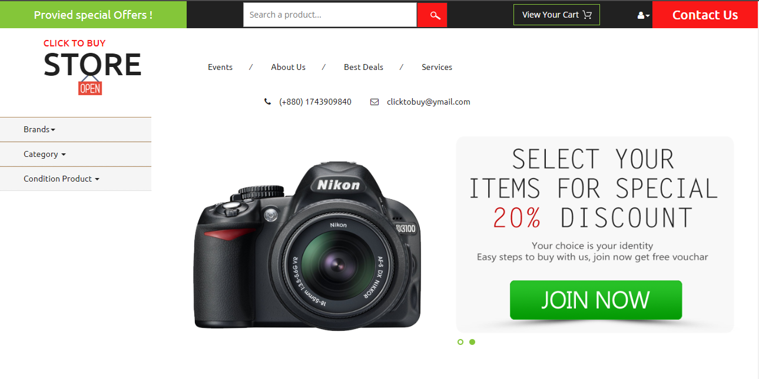
Home Page

Slide 19
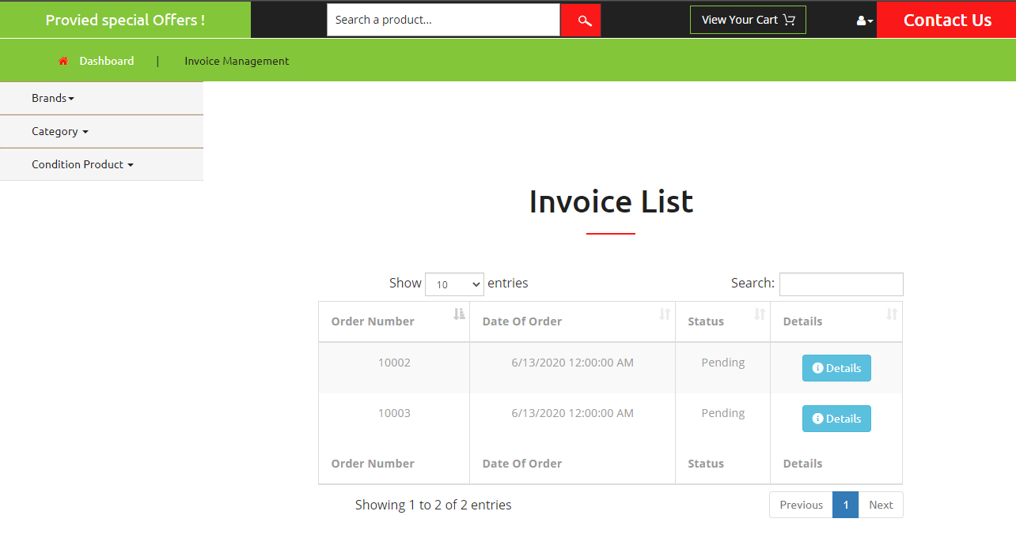
Customer Invoice List

Slide 20
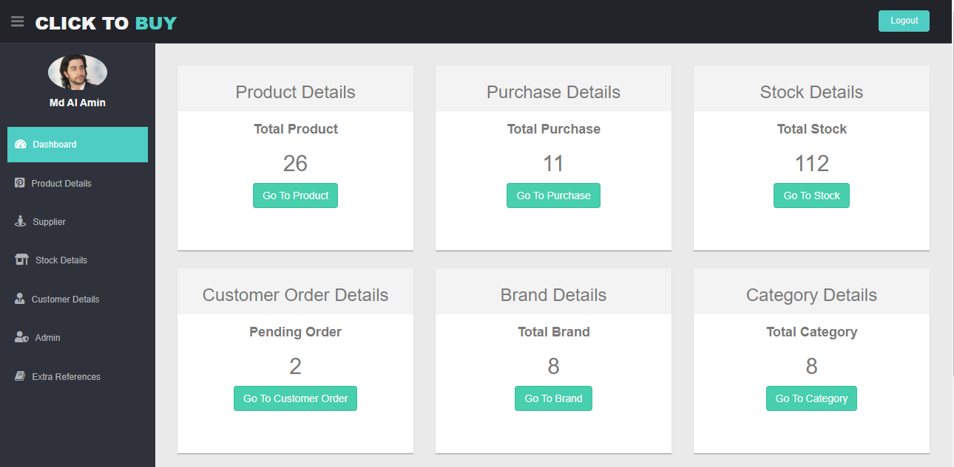
Admin Dashboard

Slide 21
Future Plan For This System
We will integrate a payment system for the future
We will integrate a Artificial Intelligence for better output
We will Integrate live chat
We will develop the coupon management system.

Slide 22
Have any Question
?

Slide 23

Thank You ☺

