Slide 1

MARDI PINEAPPLE
DETECTION AI (Training Report)
Model Training & Evaluation Report
Prepared 13 August 2026

Slide 2

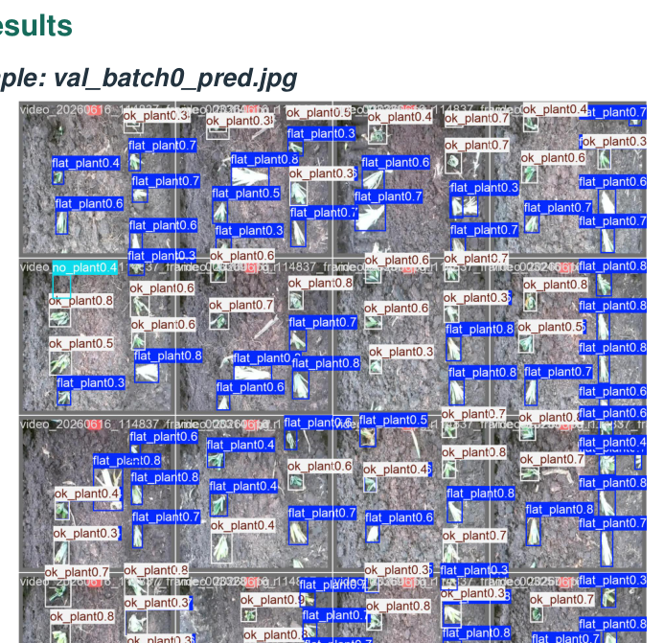
MARDI PINEAPPLE DETECTION AI
Executive Snapshot
Combined training report summary for pineapple detection model selection.
8
2
3
0.9046
model training reports combined
training phases evaluated
target classes
best Phase 2 mAP50
Recommended candidate for next field validation: RF-DETR Nano. It is the strongest Phase 2 model across the main reported metrics and remains the best Phase 1 performer on AP quality.
• Classes evaluated: flat_plant, no_plant, ok_plant
• Metrics compared: Precision, Recall, Macro F1, mAP50, mAP50-95
• Keep validation and independent-test results separated for fair interpretation
Validation predictions
‹2›

Slide 3
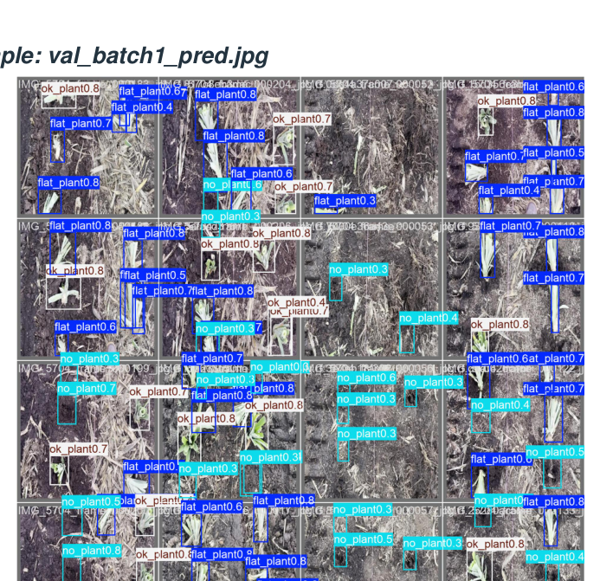
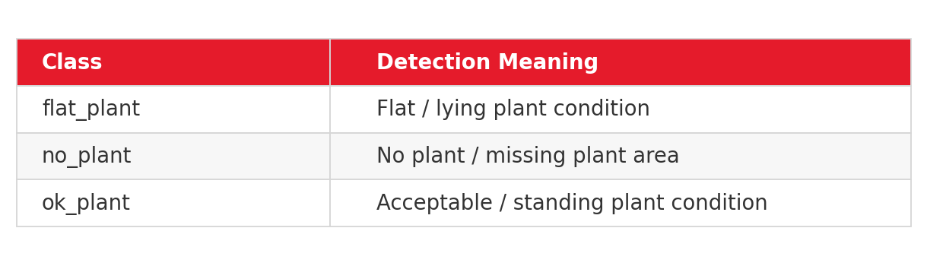
MARDI PINEAPPLE DETECTION AI
Project Objective
Detect pineapple field conditions using AI vision models for reporting and downstream agronomy analytics.
AI Detection Goal
Automatically identify and localize pineapple plant status in field imagery so that plantation teams can quantify flat plants, missing plants, and healthy plants consistently.
Model output examples show multi-class bounding boxes over plantation images, allowing counts and condition reports to be produced from field video frames.
Sample prediction montage
‹3›

Slide 4
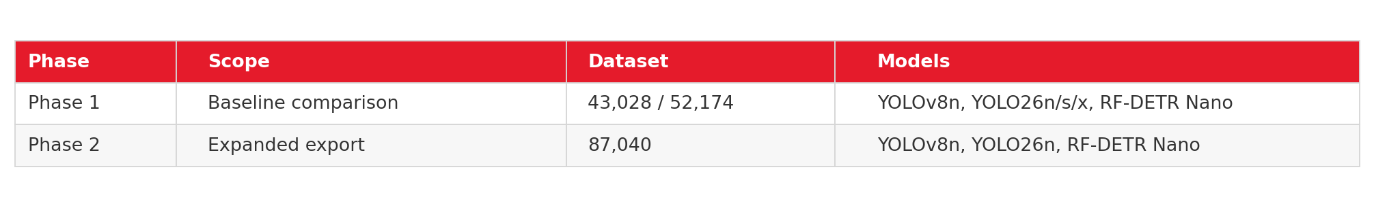
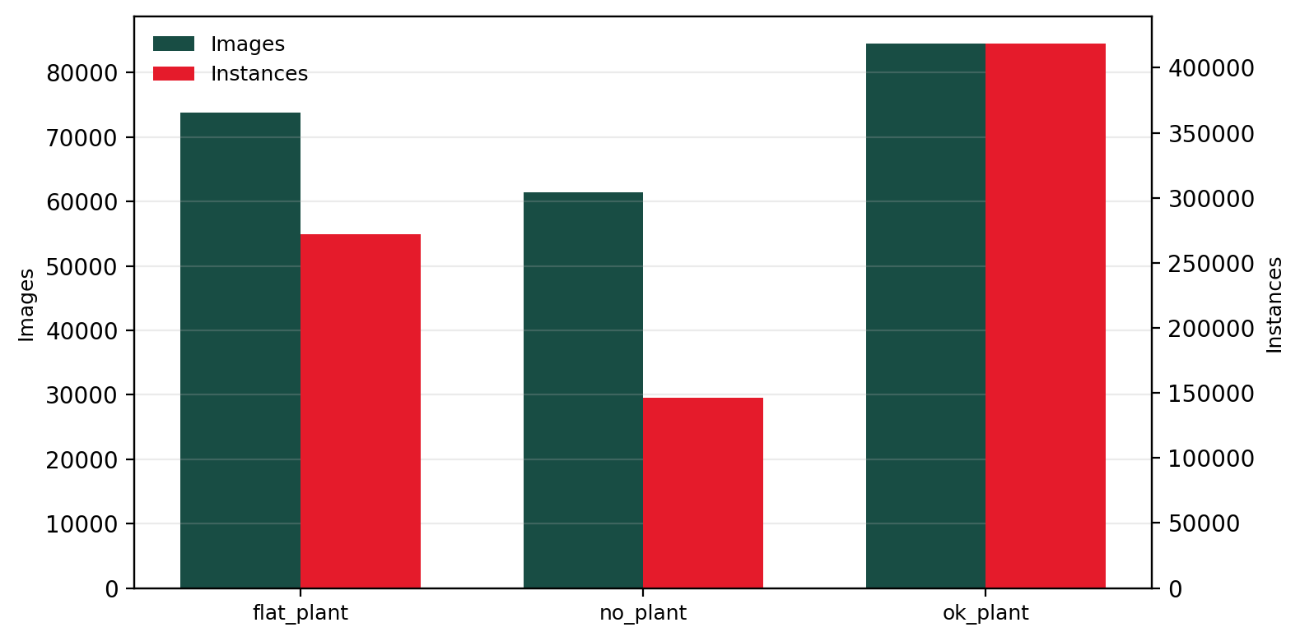
MARDI PINEAPPLE DETECTION AI
Dataset & Training Scope
Phase 1 established a baseline; Phase 2 expanded the image export and tested stronger candidates.
Phase 2 selected-model dataset summary
• Original source images: 20,724
• Exported training images: 87,040
• Split: train 95.24%, validation 2.38%, test 2.38%
• Missing labels: 0; warnings: none identified
The larger Phase 2 export increases coverage and supports the RF-DETR Nano deployment candidate.
‹4›

Slide 5
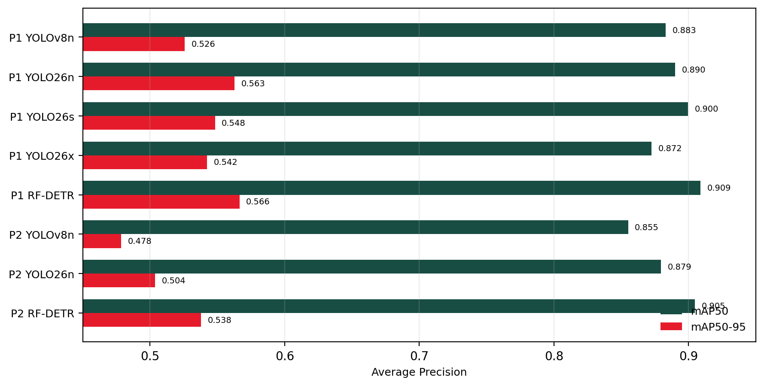
MARDI PINEAPPLE DETECTION AI
All Model AP Overview
Average Precision comparison across all combined model runs.
Top AP performers
0.9089
Phase 1 RF-DETR Nano mAP50
0.5664
Phase 1 RF-DETR Nano mAP50-95
0.9046
Phase 2 RF-DETR Nano mAP50
RF-DETR Nano remains the strongest reported localization candidate across both phases.
‹5›

Slide 6
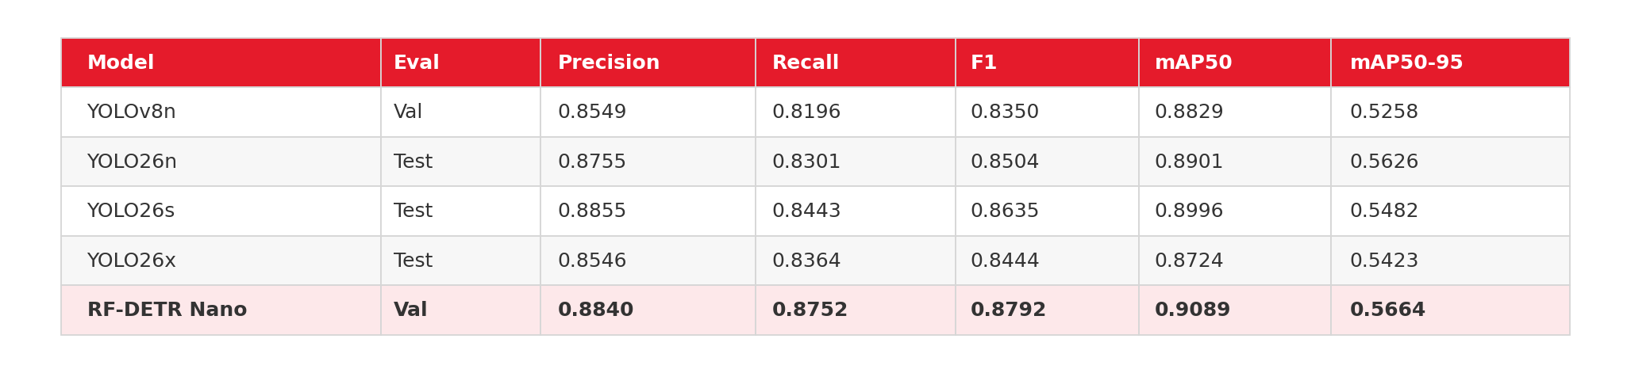
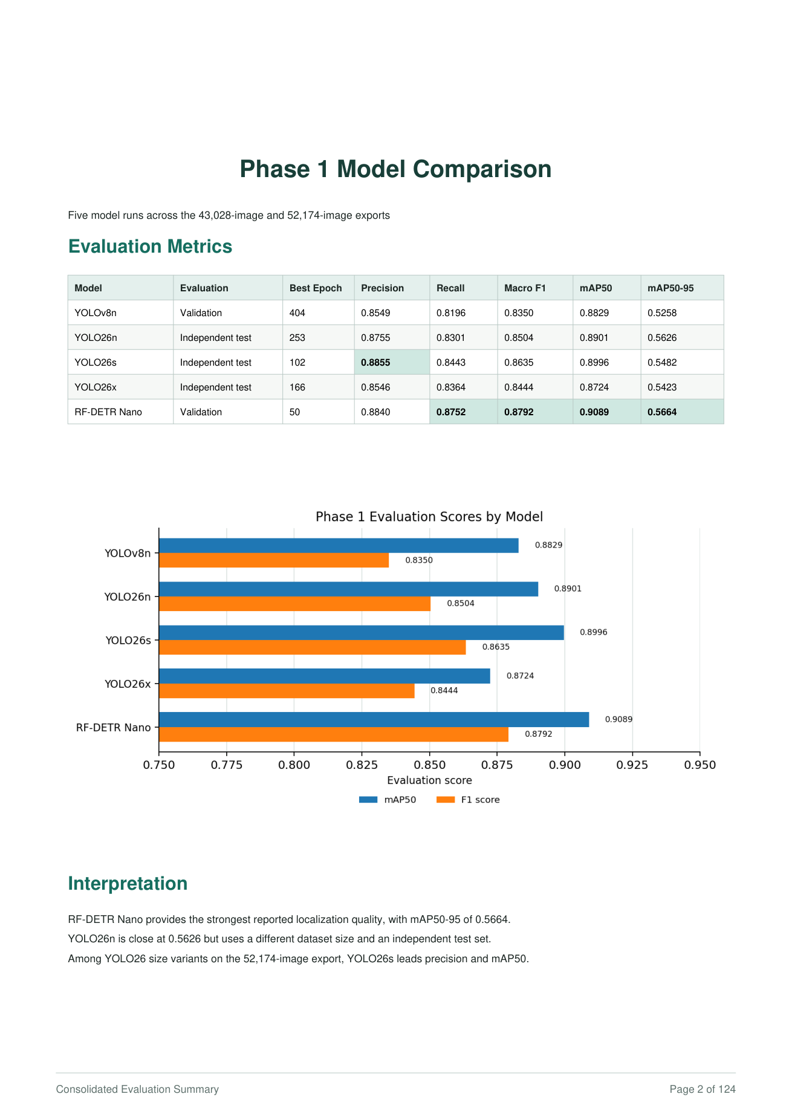
MARDI PINEAPPLE DETECTION AI
Phase 1 Model Comparison
Five model runs across the 43,028 and 52,174 image exports.
Interpretation
• RF-DETR Nano delivers the highest mAP50, mAP50-95, recall, and macro F1.
• YOLO26s records the highest precision among Phase 1 models.
• YOLO26n is close on mAP50-95, but uses an independent test source and smaller export.
Original report page reference
‹6›

Slide 7
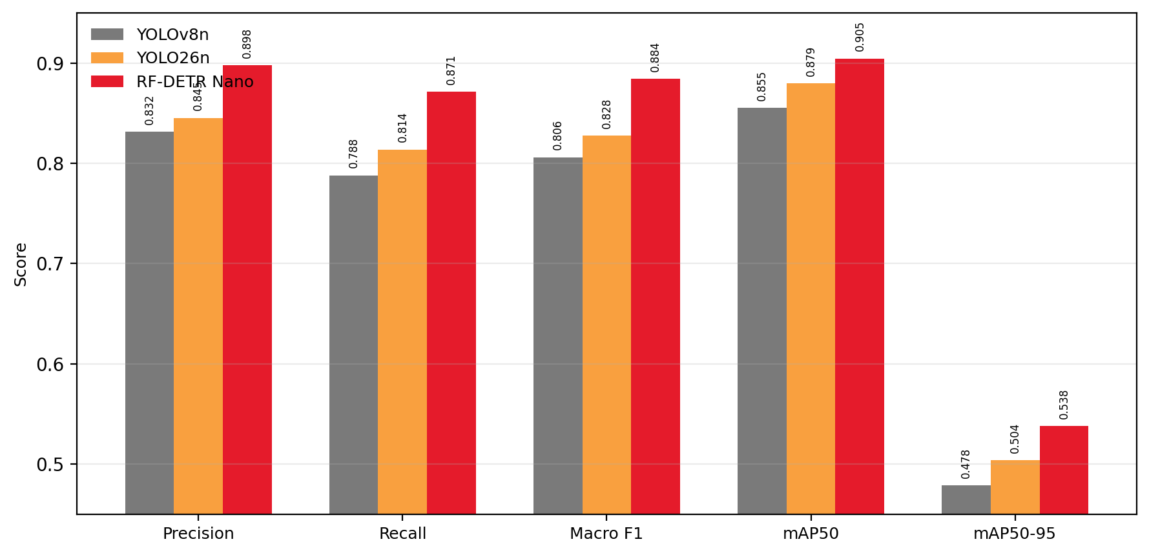
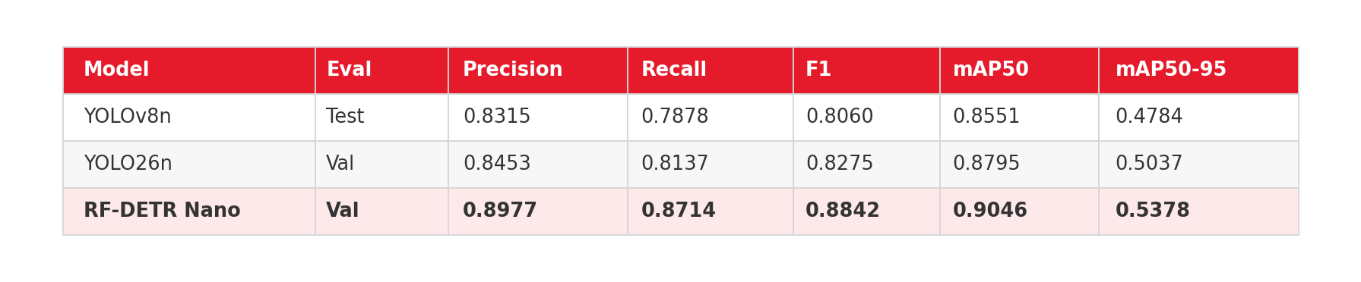
MARDI PINEAPPLE DETECTION AI
Phase 2 Model Comparison
Three model runs trained using the 87,040-image export.
Phase 2 selection
RF-DETR Nano leads across all five main Phase 2 metrics. It should proceed to a controlled field test and hardware benchmark before production release.
Important: compare final deployment candidates using the same untouched test set.
‹7›

Slide 8
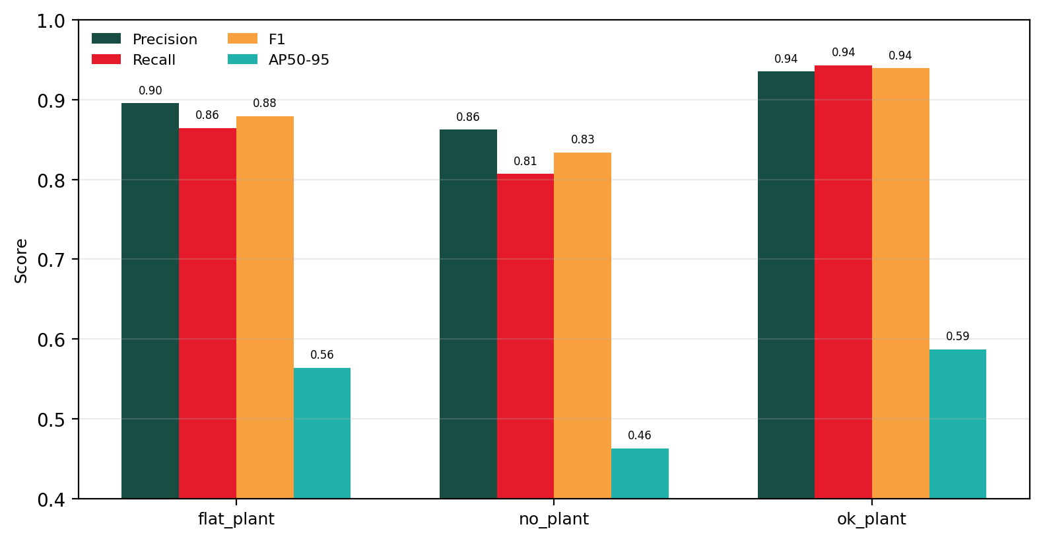
MARDI PINEAPPLE DETECTION AI
Selected Candidate: RF-DETR Nano
Phase 2 model with strongest reported validation metrics.
0.8977
0.8714
0.8842
0.9046
0.5378
Precision
Recall
Macro F1
mAP50
mAP50-95
Per-class takeaway
• ok_plant is strongest across precision, recall, and F1.
• no_plant has the lowest AP50-95 and should receive focused error review.
• flat_plant remains stable but should be tested under field lighting and occlusion.
Recommendation: deploy RF-DETR Nano into model testing first, then compare on the same untouched field test set.
‹8›

Slide 9
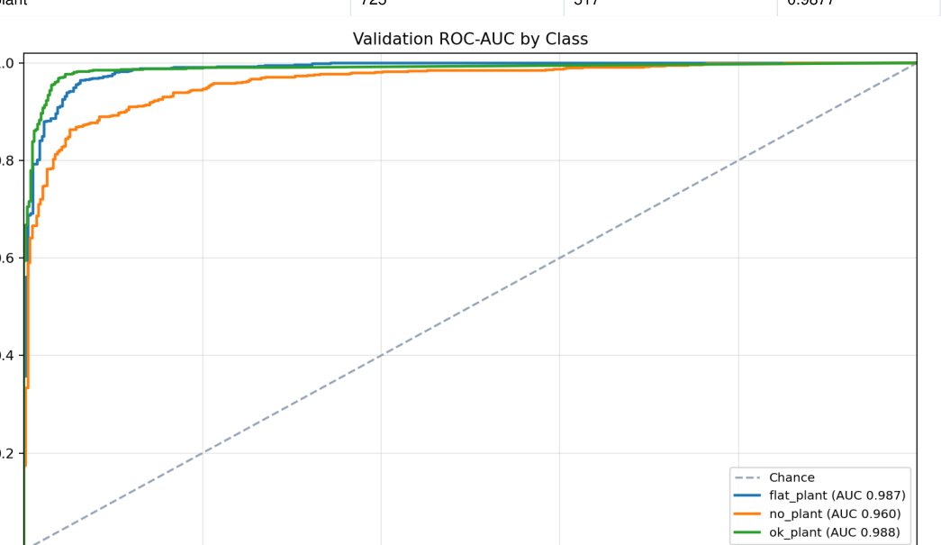
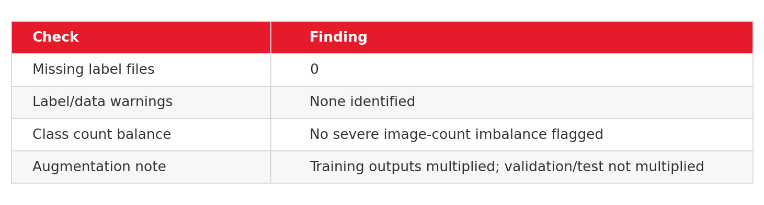
MARDI PINEAPPLE DETECTION AI
Dataset Quality & Training Notes
The report shows no missing label files and no identified label/data warnings.
Quality status
Focus error analysis on classes and environments where validation-to-field shift is expected: occlusion, soil brightness, plant overlap, motion blur, and changing camera height.
YOLOv8 validation ROC-AUC reference
‹9›

Slide 10
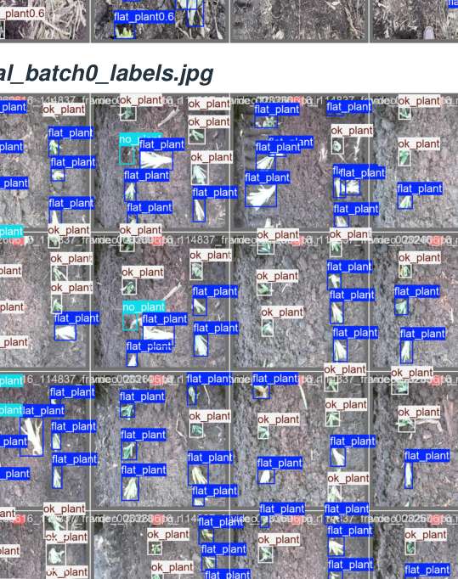
MARDI PINEAPPLE DETECTION AI
Qualitative Detection Results
Prediction examples show dense multi-class detections in plantation imagery.
Prediction: val_batch0
Prediction: val_batch1
Ground-truth labels
‹10›

Slide 11
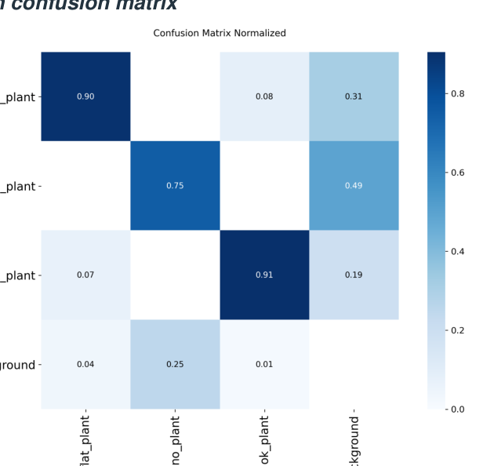
MARDI PINEAPPLE DETECTION AI
Risks & Validation Guidance
Model selection should be finalized after controlled field testing on target hardware.
Do not mix evaluation sources
Recommended validation checklist
Validation and independent-test results are useful for direction, but they are not strictly interchangeable. The report recommends evaluating every candidate on the same untouched test set and target hardware.
• Run model testing with saved prediction artifacts
• Benchmark FPS and memory on target compute
• Check failure cases: no_plant, occlusion, soil background
• Confirm confidence thresholds for automated reporting
• Monitor field performance against validation baseline
Review possible overfitting
For Phase 2 RF-DETR Nano, validation loss is materially higher than training loss, so possible overfitting should be reviewed before deployment.
Confusion-matrix based error review
‹11›

Slide 12
MARDI PINEAPPLE DETECTION AI
Next Deployment Plan
Move from training report to controlled plantation validation.
01
Prepare test set
Freeze one untouched test set for all final candidates.
02
Run model testing
Generate prediction artifacts, confusion matrices, and per-class error cases.
03
Hardware benchmark
Measure FPS, latency, VRAM/RAM, and robustness on target compute.
04
Field validation
Test under real plantation lighting, motion, occlusion, and camera height.
05
Deployment tuning
Set confidence thresholds, reporting logic, and monitoring baseline.
Decision gate
Proceed to pilot deployment only if RF-DETR Nano maintains field accuracy while meeting compute, latency, and reporting requirements.
‹12›

Slide 13


