Slide 1

L.O.S.T
Logically Oriented Software Technology
a post mortem analysis
Rasmus Tilljander
Erik Hörlin
Kim Hansson
Calle Ketola
DV1435
Fördjupning i objektorienterade tekniker

Slide 2
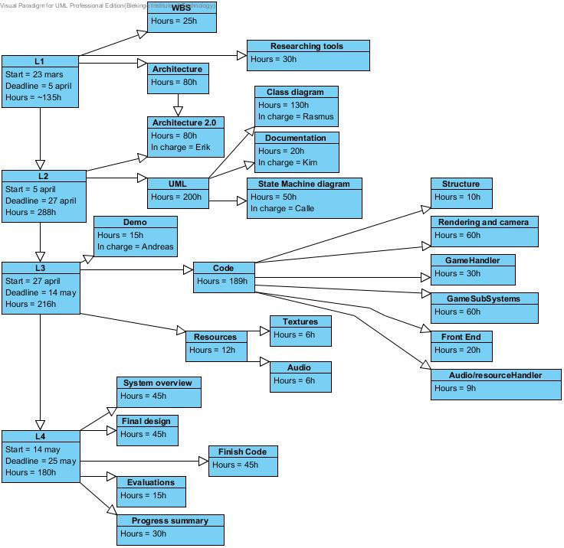
Prequel
First WBS version

Slide 3
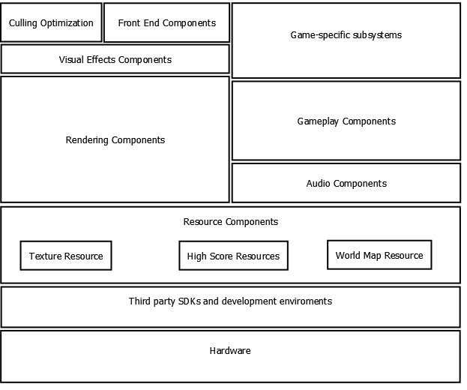
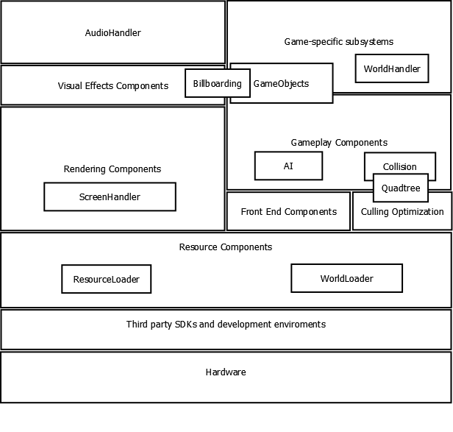
First Architecture
Final Architecture

Slide 4
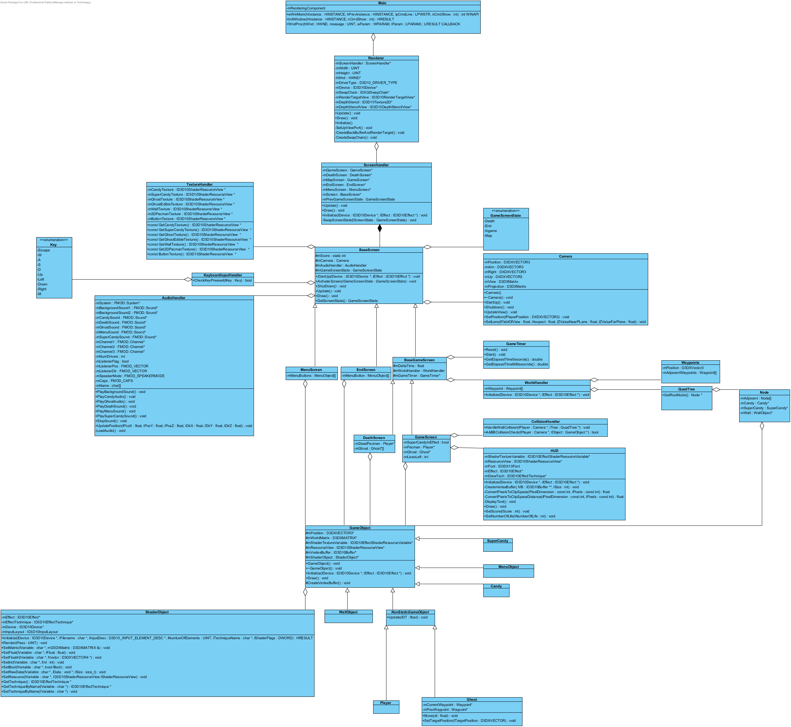
Class Diagram

Slide 5

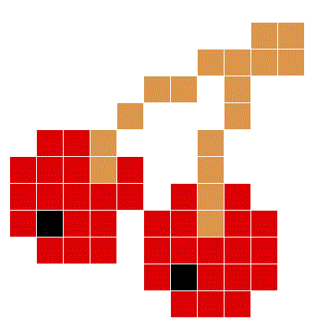
Proudest Design Moments
Observer pattern for Screen handler
Waypoint system for ghost AI

Slide 6

Problems Encountered
The only real problems we encountered where related to the code.
Implementing billboards
Reference driver mistake

Slide 7
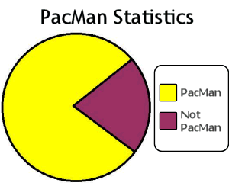
Product metrics
Planned time vs. Spent time
Requested features vs. Implemented features
1.5

Slide 8

Summary
Time estimates are hard
Compromises are unavoidable
Smiling Keanu Reeves

Slide 9

Fin

