Slide 1
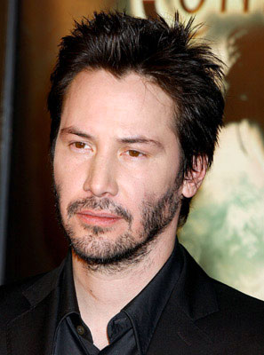

L.O.S.T
Logically Oriented Software Technology
a post mortem analysis
Rasmus Tilljander
Erik Hörlin
Kim Hansson
Calle Ketola
DV1435
Fördjupning i objektorienterade tekniker

Slide 2


Slide 3
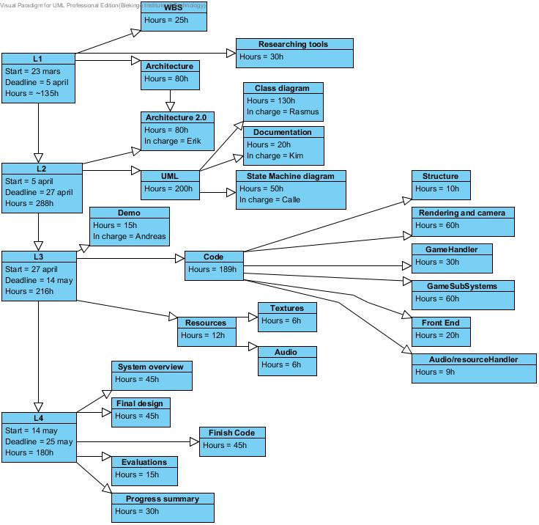
L1
First WBS version

Slide 4
Time Chart for R1, R2

Slide 5
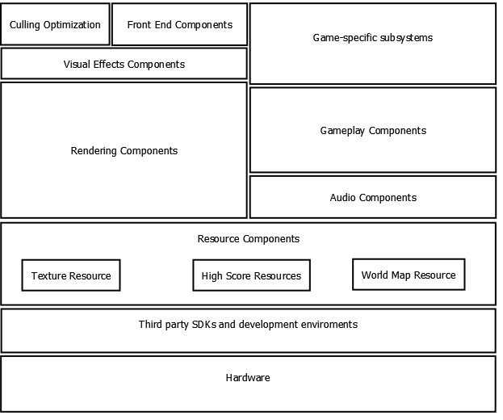
Architecture
Punkt

Slide 6
L2
Identifier | Responsible | Code | Start Date | End Date | Time Spent (h) | Percentage Done | Estimated time to complete (h)
L2 |  | L2-00 | 05-apr | 27-apr | 123,1 | 100,00 | 175
UML |  | L2-01 | 05-apr | 27-apr | 66,6 | 100,00 | 160
Class Diagram | Rasmus | L2-01a | 05-apr | 27-apr | 60,6 | 100 | 150
State Machine Diagram | Calle | L2-01b | 05-apr | 27-apr | 6 | 100 | 10
Architecture 2.0 | Erik | L2-02 | 23-apr | 27-apr | 3 | 100,00 | 3
Documentation | Kim | L2-03 | 05-apr | 27-apr | 31 | 100,00 | 12
R2 |  | L2-03a | 02-apr | 09-apr | 8 | 100 | 2
R3 |  | L2-03b | 09-apr | 16-apr | 7 | 100 | 2
R4 |  | L2-03c | 16-apr | 23-apr | 14 | 100 | 2
R5 |  | L2-03d | 24-apr | 30-apr | 2 | 100 | 2
L2 Documention |  | L2-03e | 05-apr | 27-apr | 17,5 | 100 | 4
Research |  | L2-04 | 05-apr | 27-apr | 6,5
Meeting |  | L2-05 | 05-apr | 27-apr | 16
Punkt

Slide 7
Time Chart for R3, R4

Slide 8
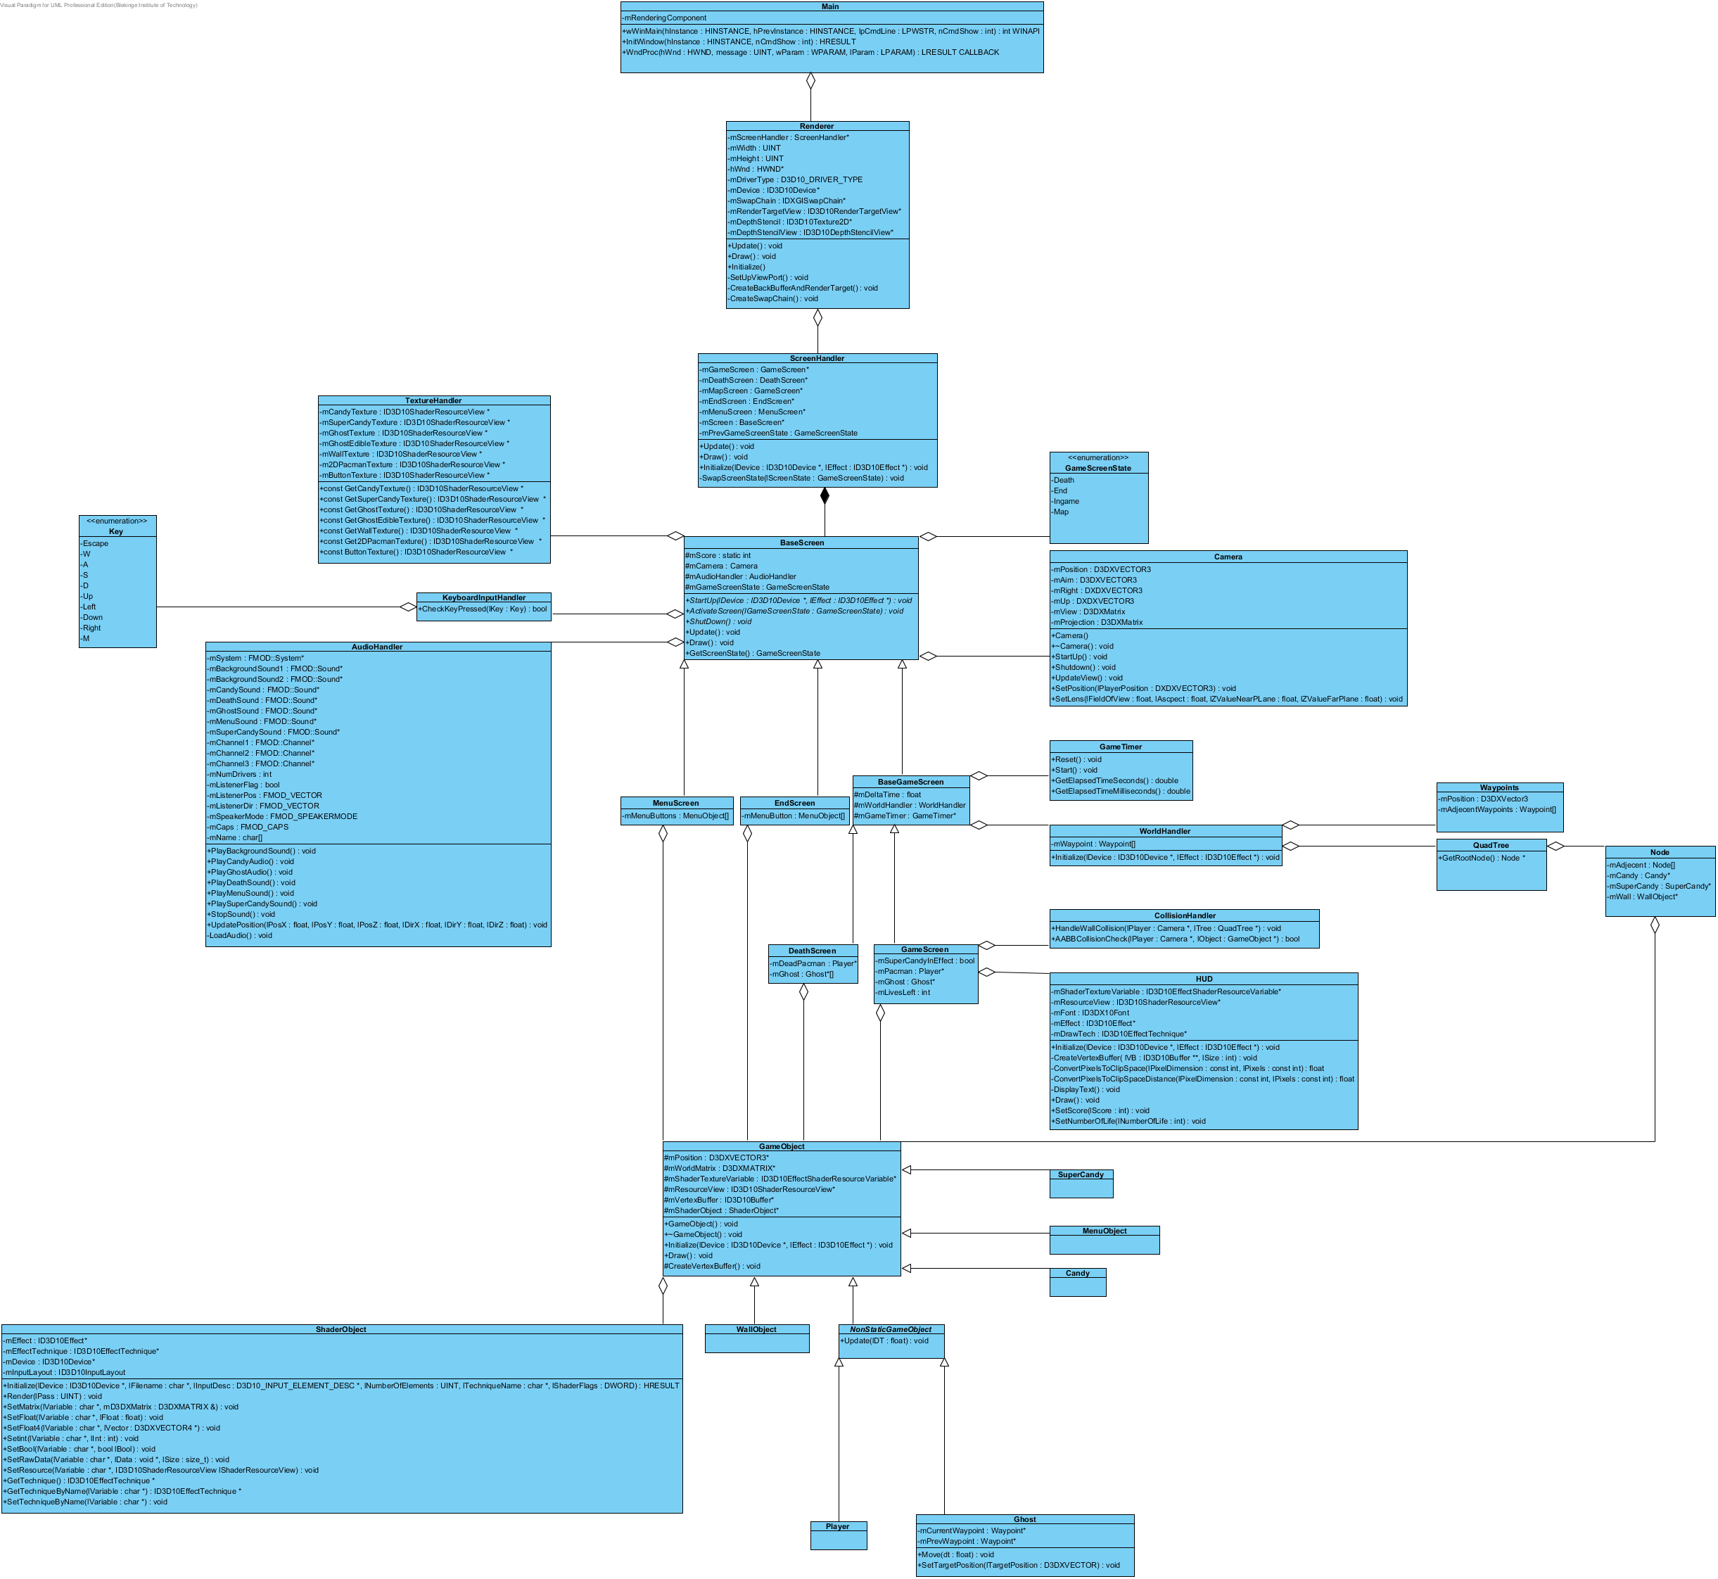
Class Diagram

Slide 9
L3
Identifier | Responsible | Code | Start Date | End Date | Time Spent (h) | Percentage Done | Estimated time to complete (h)
L3 |  | L3-00 | 28-apr | 14-maj | 131,5 | 94 | 166,5
Code |  | L3-01 | 18-apr | 14-maj | 119,5 | 76,6 | 148,5
FrontEndComponents | Kim | L3-01b | 18-apr | 28-apr | 4,5 | 95 | 4,5
Camera | Rasmus | L3-01c | 18-apr | 28-apr | 9 | 95 | 1,5
RenderingComponents | Erik | L3-01a | 18-apr | 02-maj | 22,5 | 95 | 32,5
Sound | Calle | L3-01d | 18-apr | 07-maj | 9 | 95 | 10
Game World | Kim | L3-01e | 18-apr | 07-maj | 39,5 | 75 | 30
Player input | Calle | L3-01f | 28-apr | 04-maj | 2 | 95 | 5
AI | Rasmus | L3-01g | 28-apr | 07-maj | 15 | 95 | 20
Collisions | Erik | L3-01h | 28-apr | 07-maj | 3 | 50 | 25
Menus | Kim | L3-01j | 07-maj | 11-maj | 0 | 1 | 5
GameScreen | Rasmus | L3-01i | 07-maj | 14-maj | 15 | 70 | 15
Demo | Erik | L3-02 | 10-maj | 14-maj | 2 | 100 | 4
Documentation | Kim | L3-03 | 01-maj | 14-maj | 5 | 100 | 8
R6 |  | L3-03a | 01-maj | 07-maj | 3 | 100 | 4
R7 |  | L3-03b | 08-maj | 14-maj | 2 | 100 | 4
State Machine Diagram | Rasmus | L3-04 | 07-maj | 14-maj | 1 | 100 | 0
Research |  | L3-05 |  |  | 2 | 100
Meeting |  | L3-06 |  |  | 2 | 100 | 6

Slide 10
Time Chart for R5, R6, R7

Slide 11
State Machine Diagram(s)

Slide 12
Demo

Slide 13
L4
Identifier | Responsible | Code | Start Date | End Date | Time Spent (h) | Percentage Done | Estimated time to complete (h)
L4 |  | L4-00 | 14-maj | 28-maj | 14 | 56 | 145
Post Mortem |  | L4-01 | 14-maj | 25-maj | 10 | 51,25 | 95
Update Architecture | Erik | L4-01a | 14-maj | 21-maj | 2 | 80 | 10
Update UML | Andreas | L4-01b | 14-maj | 21-maj | 4,5 | 90 | 30
Team Evaluation | Calle | L4-01c | 21-maj | 25-maj | 0 | 5 | 25
Project Summary | Rasmus | L4-01d | 21-maj | 25-maj | 3,5 | 30 | 30
Documentation | Kim | L4-02 | 14-maj | 25-maj | 3,5 | 30 | 20
Research |  | L4-03 | 14-maj | 28-maj | 0 | 100 | 5
Meetings |  | L4-04 | 14-maj | 28-maj | 0,5 | 100 | 5
Oral Presentation | Kim | L4-05 | 21-maj | 28-maj | 0 | 1 | 20

Slide 14
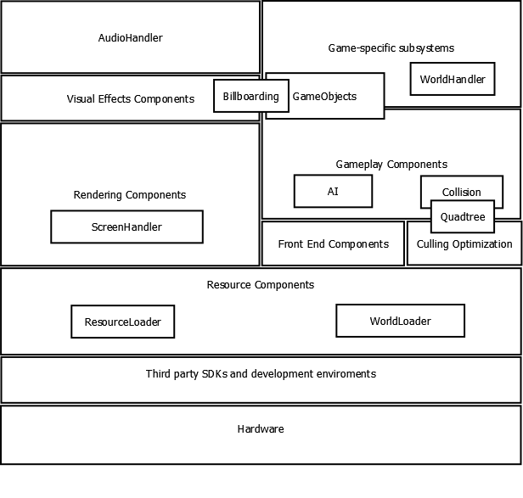
First Architecture
Final Architecture

Slide 15
Summary
TIL

