Slide 1
Troubleshooting
MercedEnergy.com
12-13-2018
Soldering
https://github.com/MercedEnergy/Soldering

Slide 2
Cold Joint
Problem: Components not heated properly
Solution: Reheating Joints Closer

Slide 3
Not Enough Solder
Bad Mechanical Connections
Solution : Reheat joint and add more solder.

Slide 4
To Much Solder
Problem: Short out leads of other components
Solution : Remove using copper braid or solder sucker

Slide 5
To Much Heat
May damage or melt PCB or components
Use less heat
Cold joints are easier to fix

Slide 6
To Much Movement
Disturbed joint
Solder is not smooth
Solution: Use a third hand or PCB vise

Slide 7
Wire Lead Soldered to PCB
Creates a short circuit
Solution: Do not bend leads more than 45 degrees
Fix by removing solder

Slide 8
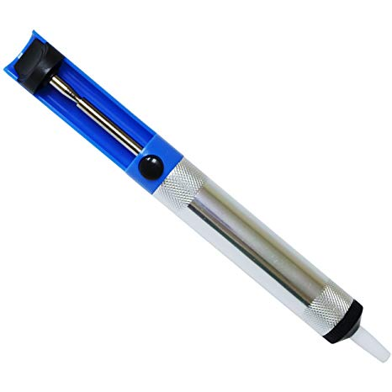
Removing Solder
Reheat-and-Wipe
Copper Braid
Solder Sucker
Small Vacuum Pump

Slide 9
Thank You!
Ramiro Gonzalez
ramirogonzalez@mercedenergy.com

Slide 10
Sources
Vinck, Marc De. Getting Started with Soldering: a Hands-on Guide to Making Electrical and Mechanical Connections. Maker Media, 2017.

