Slide 1

Introduction to Survival Analysis
November 4, 2022
Joseph N. Paulson
© 2003-2007, Genentech

Slide 2
Survival Analysis is Frequently Used in Clinical Research
2
New England Journal of Medicine (n = 91) |  |  |  | Nature Medicine (n = 34)
 | Types and Frequencies of Statistical Methods | n | % |  | n | %
 | No Statistical Methods | 2 | 2.2 |  | 1 | 2.9
 | Descriptive Statistics Only | 3 | 3.3 |  | 5 | 14.7
 | Inferential Methods | 86 | 94.5 |  | 28 | 82.4
 | t-tests | 32 | 35.2 |  | 14 | 41.2
 | Contingency Table Analysis
 | Basic (x2-, Fishers Exact test) | 42 | 46.2 |  | 0 | 0
 | Advanced | 6 | 6.6 |  | 0 | 0
 | Analysis of Variance
 | Basic (one-way ANOVA) | 6 | 6.6 |  | 9 | 26.5
 | Advanced | 6 | 6.6 |  | 1 | 2.9
 | Survival Analysis | 39 | 42.9 |  | 4 | 11.8
 | Confidence Intervals | 61 | 67.0 |  | 0 | 0
Strasak et al (2007). The Use Of Statistics in Medical Research: A Comparison of the NEJM and Nature Medicine. The American Statistician 61: 47-55

Slide 3
Agenda
3
Survival data
Analysis methods
Kaplan-Meier Curve
Medians
Milestone/landmark rates
Log-rank Test
Cox Proportional Hazards (PH) Model
Hazard Ratio
Study design
Sample size
Readout timing projection
Considerations linked to CDPs and TPPs

Slide 4
Survival (Time-to-event) Data
4
Event
Death (Overall survival, OS)
Cancer progression (Time-to-progression,TTP)
Cancer progression or death (Progression-free survival, PFS)
Cardiovascular events
Re-purchase (amazon.com), default (lender)
Censoring
Event of interest has not been observed.
Causes of censoring
Lost to follow-up
Administrative censoring
– People whose follow-up is up to date, but it’s time to run the analysis
Different from missing data in other endpoints
Unique in time-to-event data
Non-informative vs. informative

Slide 5
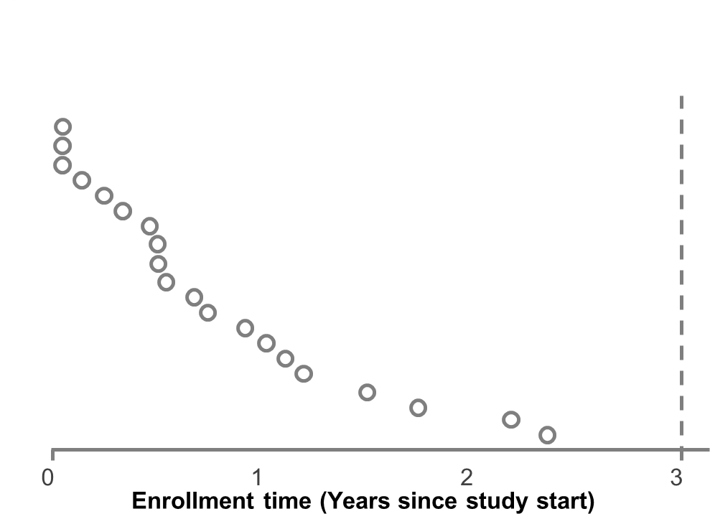
Time-to-Event Data
5
Patients recruited over period of time and have different follow-up times until Data Cut.
Y-axis = time from first-patient-in

Slide 6
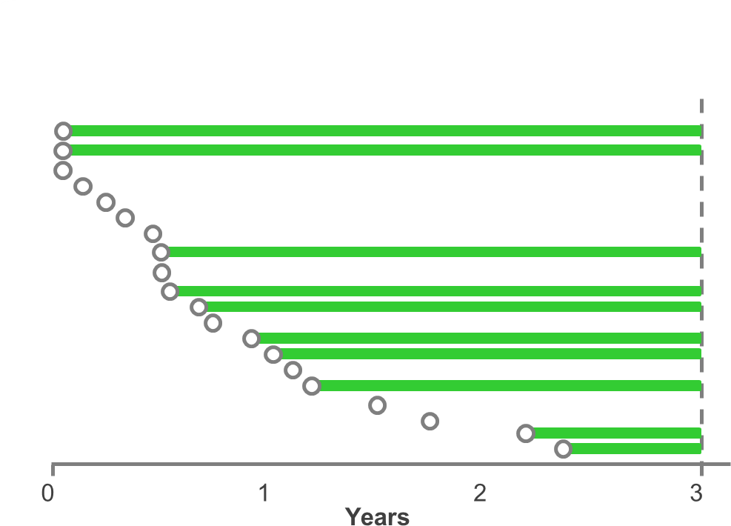
Time-to-Event Data
6
Some patients are alive at data cut-off ...

Slide 7
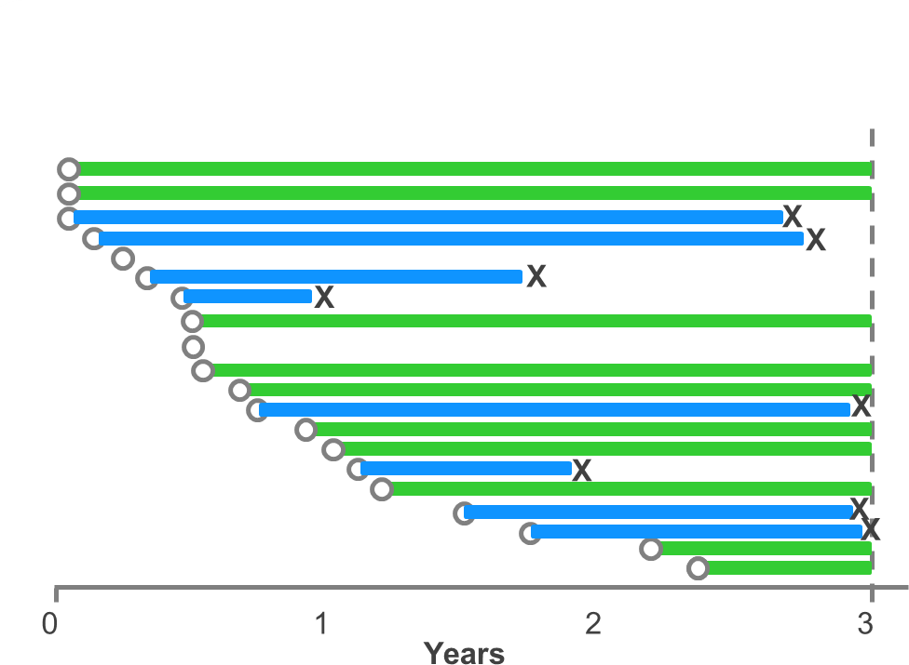
Time-to-Event Data
7
Some have died ...

Slide 8
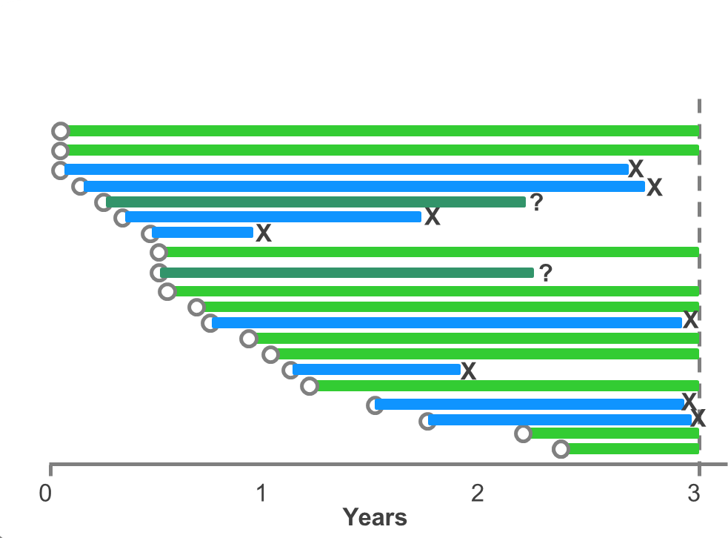
Time-to-Event Data
8
Others have been lost to follow-up but were alive at last contact.

Slide 9
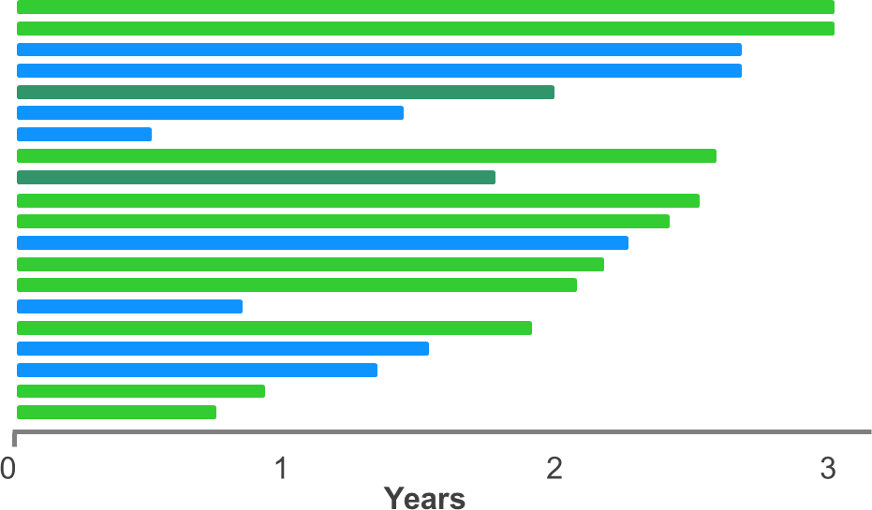
Time-to-Event Data
9
Set/standardize baseline to t = 0 for all patients.
Y-axis = follow-up time

Slide 10
Survival Analysis Incorporates Censored data
10
Excluding censored observation leads to bias
Incorporating censored data
Patients are known to be event-free up to the censoring time
Probability of having an event beyond the censoring time is assumed to be the same as those who were not censored
Non-informative censoring assumption
Censoring is independent of event
E.g, administrative censoring

Slide 11
Problem: Informative Censoring
11
Examples: Patients withdraw from the study because

Slide 12
Problem: Informative Censoring
12
Examples: Patients withdraw from the study because
They win a lottery
– OS should be the same as others

Slide 13
Problem: Informative Censoring
13
Examples: Patients withdraw from the study because
They win a lottery
OS should be the same as others
Disease is worsening / starting non-protocol therapies
OS may be shorter than others

Slide 14
Problem: Informative Censoring
14
Examples: Patients withdraw from the study because
They win a lottery
OS should be the same as others
Disease is worsening / starting non-protocol therapies
OS may be shorter than others
They are feeling better
OS may be longer than others

Slide 15
Problem: Informative Censoring
15
Examples: Patients withdraw from the study because
They win a lottery
OS should be the same as others
Disease is worsening / starting non-protocol therapies
OS may be shorter than others
They are feeling better
OS may be longer than others
They experienced treatment toxicity
OS might be shorter (if they are sicker)
OS might be longer (if they have higher PK exposure)

Slide 16
Problem: Informative Censoring
16
Examples: Patients withdraw from the study because
They win a lottery
OS should be the same as others
Disease is worsening / starting non-protocol therapies
OS may be shorter than others
They are feeling better
OS may be longer than others
They experienced treatment toxicity
OS might be shorter (if they are sicker)
OS might be longer (if they have higher PK exposure)
Take away: Minimize informative censoring. Can not be fixed in the statistical analysis.

Slide 17
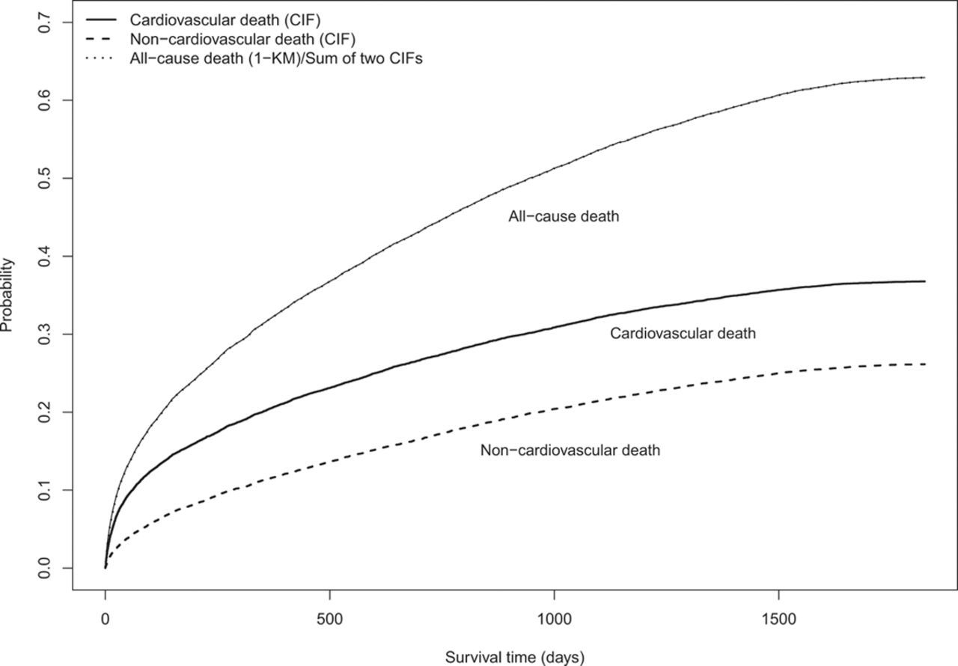

Slide 18
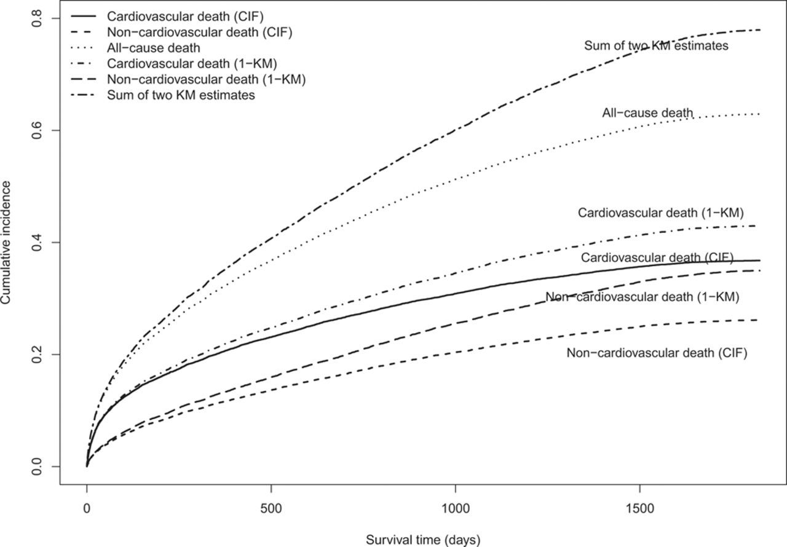

Slide 19
Agenda
17
Survival data
Analysis methods
Kaplan-Meier Curve
Medians
Milestone/landmark rates
Log-rank Test
Cox Proportional Hazards (PH) Model
Hazard Ratio
Study design
Sample size
Readout timing projection
Considerations linked to CDPs and TPPs

Slide 20
Classic Methods for Survival Analysis
18
Kaplan-Meier (KM) curves
Visual display of survival function
Medians and milestone/landmark rates
Log-rank test
Statistical test to examine whether the effect is “real” (not random)
P values
Cox proportional hazards model
Hazard ratio estimate to quantify treatment effect

Slide 21
Classic Methods for Survival Analysis
19
Kaplan-Meier (KM) curves
Visual display of survival function
Medians and milestone/landmark rates
Log-rank test
Statistical test to examine whether the effect is “real” (not random)
P values
Cox proportional hazards model
Hazard ratio estimate to quantify treatment effect

Slide 22
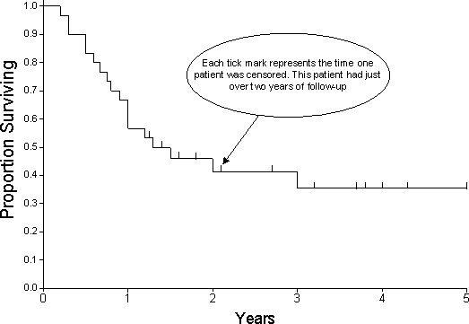
Kaplan-Meier Curve
20
Estimates the Event-free Probability at each time point
A Non-Increasing Step Function:
Each step occurs when one or more patients experience an event
Incorporating censored data up to the censoring time
Example: a study of 100 patients
1 Month: 3 pts died.
– OS rate=(100-3)/100=97%
1.5 Month: 2 pts withdrew
OS rate remains 97%
2 Months: 7 pts died
OS rate=97%*[(95-7)/95] = 97%*93% = 90%
Each tick mark represents the time one or more patients were censored.

Slide 23
Variability of the KM Curves
21
Variability is high if only a few patients at risk
Tails of the curves have high variability
Longer follow-up (more mature data) reduces variability
1.0
Ctrl (median = 8.5) Exp (median = 14.7)
0.8
Survival
0.6
0.4
0.2
0.0
 | 0 | 5 | 10 | 15 | 20 | 25
N at risk |  |  |  | Months
Ctrl | 75 | 48 | 26 | 10 | 2 | 0
Exp | 75 | 57 | 47 | 22 | 8 | 1

Slide 24
Comparing Two KM Curves
22
Visual impression
Median survival
Milestone/landmark (X-year) rates
Log-rank test (p value)
Cox Model (hazard ratio)
1.0
Ctrl (median = 8.5) Exp (median = 14.7)
0.8
Survival
0.6
0.4
0.2
0.0
 | 0 | 5 | 10 | 15 | 20 | 25
N at risk |  |  |  | Months
Ctrl | 75 | 48 | 26 | 10 | 2 | 0
Exp | 75 | 57 | 47 | 22 | 8 | 1

Slide 25
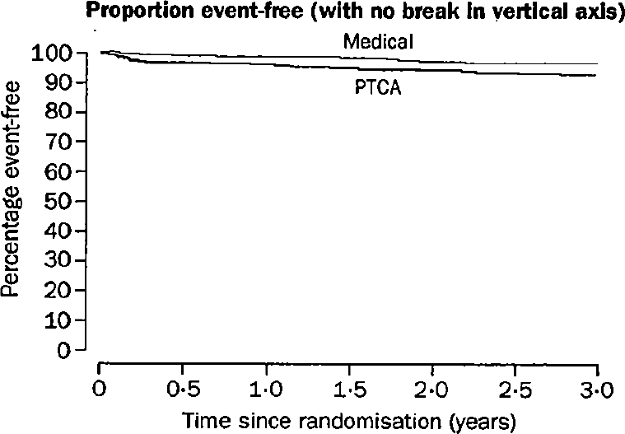
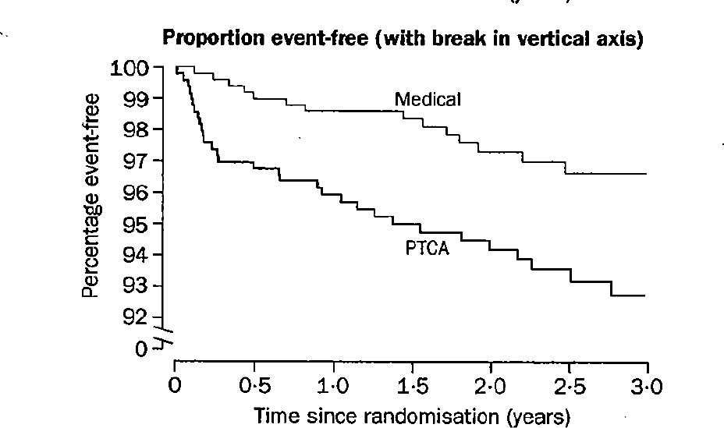
Visual Impression
23
Which of these shows a stronger treatment effect?

Slide 26
Median
24
Median
Time when the Survival Probability is 0.5
Single point on curve
A simple summary of the curve but with caveats
1.0
Ctrl (median = 8.5) Exp (median = 14.7)
0.8
Survival
0.6
0.4
0.2
0.0
 | 0 | 5 | 10 | 15 | 20 | 25
N at risk |  |  |  | Months
Ctrl | 75 | 48 | 26 | 10 | 2 | 0
Exp | 75 | 57 | 47 | 22 | 8 | 1

Slide 27
Median Describes a Single Point on the Curve
25
1.0
0.8
Proportion w/o Event
0.6
0.5
Median
0.4
0.2
0.0
0
6
12
18
24
30
36
Months

Slide 28
Medians may not be Good Estimate of Effect
26
100
Open-Label Phase III Trial of Panitumumab Plus Best Supportive Care Compared with Best Supportive Care Alone in Patients with Chemotherapy-Refractory Metastatic Colorectal Cancer
Eric Van Cutsen, Marc Peeters, Salvatore Siena, Yves Humblet, Alain Hendlisz, Bart Neyns, Jean-Luc Canon, Jean-Luc Van Laethem, Joan Maurel, Gary Richardson,Michael Wolf, and Rafael G. Amado
Panitumumab (Vectibix; Amgen)
80
Best supportive care
PFS rate (%)
60
Median PFS 8 weeks vs. 7.3 weeks
HR 0.54 (95% CI 0.44–0.66)
40
20
Product was approved because the HR benefit was highly significant
0
0
8
16
24
32
40
48
Time (weeks)
Van Cutsem E, et al. J Clin Oncol 2007; 25:1658–1664.

Slide 29
Medians may not be reached…
27
1.0
1.0
0.8
Event-free probability
0.8
median not reached
Event-free probability
0.6
0.6
median not reached
50%
0.4
0.4
median 5 yrs
HR = 0.50
p < 0.0001
0.2
0.2
median 2.3 yrs
0
0
0
2
4
6 8
Time (years)
10
12
0
2
4
6 8
Time (years)
10
12

Slide 30
Median is not stable if there is little follow-up
28
Median estimate has large variability when the N at risk is small around the median survival time
Median estimate may change as data matures (longer follow- up)
– R-CVP median PFS went from 27, to 30, to 32, to 34 months with more follow-up)

Slide 31
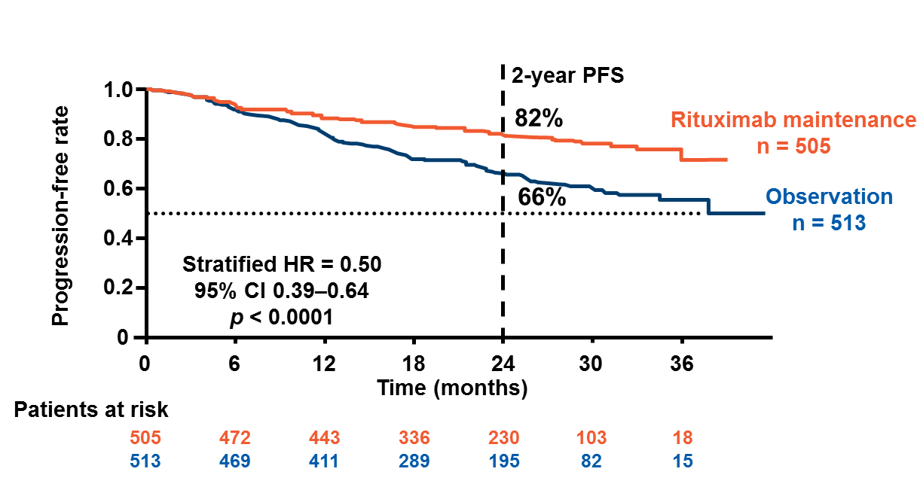
Milestone/Landmark Rates
29
Survival rates at a specific time point
– Milestone rates, Landmark rates, or XX-year (XX-month) rates

Slide 32
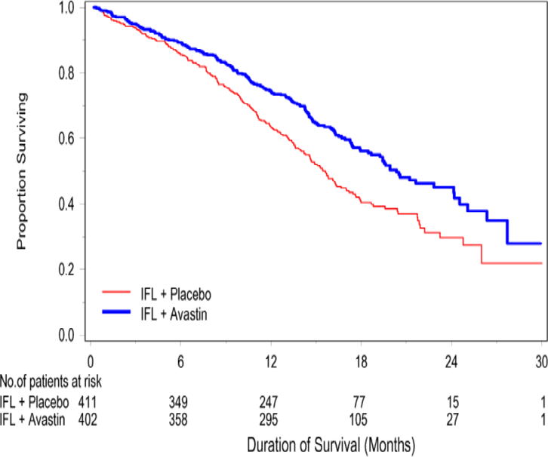
Practice Time
30
Kaplan-Meier Curves for Survival
Approximately What percentage of patients lived beyond 1- year in the two treatment arms?
Group 1:
Group 2:
Group 1
Group 2
What is the median survival time for patients in each treatment arm?
Group 1
Group 2
Group 1:
Group 2:

Slide 33
Practice Time
31
Kaplan-Meier Curves for Survival
Approximately What percentage of patients lived beyond 1- year in the two treatment arms?
Group 1: ~65%
Group 2: ~75%
Group 1
Group 2
What is the median survival time for patients in each treatment arm?
Group 1:
Group 1
Group 2
Group 2:

Slide 34
Practice Time
32
Kaplan-Meier Curves for Survival
Approximately What percentage of patients lived beyond 1- year in the two treatment arms?
Group 1: ~65%
Group 2: ~75%
Group 1
Group 2
What is the median survival time for patients in each treatment arm?
Group 1: 15.6 months
Group 1
Group 2
Group 2: 20.3 months

Slide 35
KM Curves Summary
33
KM curve describes survival distribution
Medians, milestone/landmark rates are useful but do not by themselves completely describe the data
Cautious about the unit of x-axis and y-axis
Careful not to over-interpret the end of a KM curve where relatively few patients are in follow-up
N at risk
Can use Stratified K-M curves to examine subgroups (prognostic factors)

Slide 36
Classic Methods for Survival Analysis
34
Kaplan-Meier (KM) curves
Visual display of survival function
Medians and milestone/landmark rates
Log-rank test
Statistical test to examine whether the effect is “real” (not random)
P values
Cox proportional hazards model
Hazard ratio estimate to quantify treatment effect

Slide 37
Log-rank Test
35
Hypothesis test for testing whether the survival distributions are different in arms
Most commonly used and well accepted by health authorities and research community
Powerful test and preserves Type-I error
Compares the actual number of events observed with the expected number under the null hypothesis for each time interval
Compares the whole curves and gives equal weight to events occurring throughout time
Not most powerful when curves cross

Slide 38
Classic Methods for Survival Analysis
36
Kaplan-Meier (KM) curves
Visual display of survival function
Medians and milestone/landmark rates
Log-rank test
Statistical test to examine whether the effect is “real” (not random)
P values
Cox proportional hazards model
Hazard ratio estimate to quantify treatment effect

Slide 39
Hazard and Survival Curve
37
Hazard
The risk of having an event in the next moment, among those patients are at risk at the current moment
Survival curve
Drops rapidly when hazard is high in that period
Is stable when hazard is very low in that period
E.g., bathtub-shaped hazard in life
0.15
Survival Probablity
1.0
0.8
Hazard
0.10
0.6
0.05
0.4
0.2
0.00
0.0
0
20
40
60
Age
80
100
0
20
40
60
Age
80
100

Slide 40


Hazard Ratio
38
Hazard ratio (HR)
The ratio of the hazard in the Experimental vs. the Control arm
Treatment benefit if HR<1
Hazard in Experimental arm
HR =
Hazard in Control arm
Interpreted as “% reduction in risk”
HR | Risk Reduction (1 - HR)
0.7 | 0.3 or 30% reduced risk of death
0.54 | 0.46 or 46% reduced risk of death
1.5 | 0.5 or 50% increased risk of death
“Averaged” treatment effect throughout the follow-up time
Does not give information as to WHEN events may occur

Slide 41
Cox Proportional Hazard Model
39
Provides quantitative estimate of treatment effect in terms of hazard ratio
Assumes the hazard ratio between two groups is constant over time (proportional hazards)
One HR estimate for the whole follow-up time
Absolute hazards may change while ratio stays fixed
– For instance early low risk period followed by higher risk for both treatment arms
Even when assumption is incorrect, the Hazard Ratio can still be a useful summary for “averaged effect”
Confidence interval of hazard ratio
Quantifies the variability of the hazard ratio estimate
Take away: Be aware the PH assumption is behind the HR reported.

Slide 42
Practice Time
40
Do these curves follow proportional hazard (PH) assumption?
Survival
0.8
Survival
0.8
0.4
0.4
0.0
0.0
0 | 5 | 10 | 15 | 20 | 25 | 30 | 0 | 5 | 10 | 15 | 20
 |  |  |  | Months |  |  |  |  |  | Months
Survival
0.8
Survival
0.8
0.4
0.4
0.0
0.0
0
5
10
15 20
Months
25
30
0
5
10
15
20
25
Months

Slide 43
Practice Time
41
Do these curves follow proportional hazard (PH) assumption?
Proportional Hazard
Survival
0.8
Survival
0.8
0.4
0.4
0.0
0.0
0 | 5 | 10 | 15 | 20 | 25 | 30 | 0 | 5 | 10 | 15 | 20
 |  |  |  | Months |  |  |  |  |  | Months
Survival
0.8
Survival
0.8
0.4
0.4
0.0
0.0
0
5
10
15 20
Months
25
30
0
5
10
15
20
25
Months

Slide 44
Practice Time
42
Do these curves follow proportional hazard (PH) assumption?
Proportional Hazard NPH - Diminishing Effect
Survival
0.8
Survival
0.8
0.4
0.4
0.0
0.0
0 | 5 | 10 | 15 | 20 | 25 | 30 | 0 | 5 | 10 | 15 | 20
 |  |  |  | Months |  |  |  |  |  | Months
Survival
0.8
Survival
0.8
0.4
0.4
0.0
0.0
0
5
10
15 20
Months
25
30
0
5
10
15
20
25
Months

Slide 45
Practice Time
43
Do these curves follow proportional hazard (PH) assumption?
Proportional Hazard NPH - Diminishing Effect
Survival
0.8
Survival
0.8
0.4
0.4
0.0
0.0
0
5
10 15 20 25
Months
NPH - Delayed Effect
30
0
5
10
15
20
Months
Survival
0.8
Survival
0.8
0.4
0.4
0.0
0.0
0
5
10
15 20
Months
25
30
0
5
10
15
20
25
Months

Slide 46
Practice Time
44
Do these curves follow proportional hazard (PH) assumption?
Proportional Hazard NPH - Diminishing Effect
Survival
0.8
Survival
0.8
0.4
0.4
0.0
0.0
0
5
10 15 20 25
Months
NPH - Delayed Effect
30
0
5 10 15 20
Months
NPH - Crossing Curves
Survival
0.8
Survival
0.8
0.4
0.4
0.0
0.0
0
5
10
15 20
Months
25
30
0
5
10
15
20
25
Months

Slide 47
Non-Proportional Hazards
45
Hazard ratio changes over time
Cox hazard ratio estimate is not correct
“Average” treatment effect over time
Log-rank test may lose power
Not able to distinguish the curves
Median survival and milestone/landmark survival rates are not representative
Take away: Cautious about interpretation of results if there is strong NPH

Slide 48
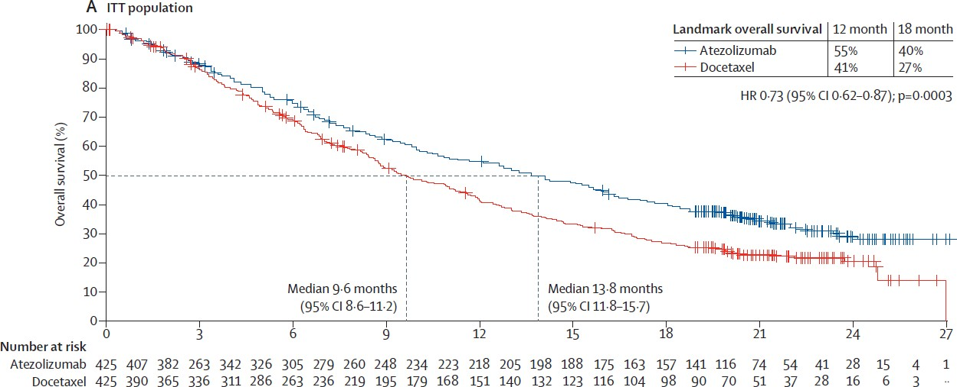
Practice Time
46

Slide 49
Practice Time
47

Slide 50
Practice Time
48

Slide 51
Practice Time
49

Slide 52
Practice Time
50

Slide 53
Practice Time
51

Slide 54
Practice Time
52

Slide 55
Practice Time
53

Slide 56
Practice Time
54
OS from OAK (GO28915) Atezo vs Doc in 2L NSCLC
– Regular approval from FDA, Oct 2016
– Published in Lancet, Dec 2016

Slide 57
Agenda
55
Survival data
Analysis methods
Kaplan-Meier Curve
Medians
Milestone/landmark rates
Log-rank Test
Cox Proportional Hazards (PH) Model
Hazard Ratio
Study design
Sample size
Readout timing projection
Considerations linked to CDPs and TPPs

Slide 58
Study Design
56
CDP
Study phase (I/II/III)
Patient population, Regimen, Comparator, Endpoints
Timeline
TPP
Efficacy and safety profile
– Optimistic, target, minimal treatment benefit
Study design
Sample size
Testing strategy (alpha spent)
Enrollment and readout timeline
Take away: CDP and TPP guide study design and study design informs CDP and TPP regarding its feasibility. This is an iterative process.

Slide 59
Hazard Ratio and Median Improvement in TPP
57
For TPP and study design, survival is assumed to have constant hazard (i.e., exponential distribution)
Proportional hazard
Easy conversion between HR and medians
Hazard in Experimental arm Median in Control arm
HR =
=
Hazard in Control arm Median in Experimental arm

Slide 60
Practice Time
58
Example 1
Target TPP: 5 months in median OS
10 months in ctrl
15 months in exp
HR ?
Example 2
Target TPP OS HR = 0.5
Median OS
Ctrl: 5 months
Exp: ?

Slide 61
Practice Time
59
Example 1
Target TPP: 5 months in median OS
10 months in ctrl
15 months in exp
HR ?
(HR = 10/15 = 0.67)
Example 2
Target TPP OS HR = 0.5
Median OS
Ctrl: 5 months
Exp: ?

Slide 62
Practice Time
60
Example 1
Target TPP: 5 months in median OS
10 months in ctrl
15 months in exp
HR ?
(HR = 10/15 = 0.67)
Example 2
Target TPP OS HR = 0.5
Median OS
Ctrl: 5 months
Exp: ?
(Exp: 5/0.5 = 10 months)

Slide 63
Sample Size
61
Study power for Log-rank test is driven by number of events (not number of patients)!
Number of events is determined based on
Target HR
– More aggressive HR ⇒ fewer events
Type I error (alpha), usually 5%
Power, usually ≥ 80% for PhIII
Number of patients determines
Enrollment timeline
Readout timeline
Cost…

Slide 64
Step 1: Determine Number of Events
62
Target HR = 0.75
Target HR | α (2-sdd) | Power | # Required Events for Log- Rank Test
0.75 | 0.05 | 70% | 300
 |  | 75% | 337
 |  | 80% | 381
 |  | 85% | 435
 |  | 90% | 509

Slide 65
Step 2: Determine Number of Patients
63
Assuming enrollment rate of 15 pts/mo
mPFS: ctrl = 10 mos; exp = 13.3 mos
Target HR | Power | # Required Events | # Patients Enrolled | Event/Patient Ratio | Enrollment Duration (mos) | Readout Timing (yrs)
0.75 | 80% | 381 | 381 | 100% | 26 | 9
 |  |  | 450 | 85% | 30 | 4
 |  |  | 500 | 76% | 34 | 3.6
 |  |  | 550 | 69% | 37 | 3.4
 |  |  | 600 | 64% | 40 | 3.4
A fixed number of events can be observed sooner with a larger number of patients. The benefit of increasing enrollment are limited however and reach a point of diminishing returns. Design considerations must carefully balance of cost vs speed.

Slide 66
Minimal Detectable Difference (MDD)
64
The minimal effect size that leads to a positive study
Determined by sample size and alpha spent
Should be in general consistent with the minimal TPP to ensure if the study is positive, its treatment effect is also
Clinically meaningful
Commercially viable
Hypothetical example:
TPP in 1L NSCLC Dx+
Target PFS HR=0.65 (9.2 to 14.2 mos mPFS)
Minimal PFS HR=0.75 (9.2 to 12.2 mos mPFS)
Study design
N=300, #event=180
Power: 82% at 5% alpha
Enrollment: 18 mos; Readout 28 mos
MDD = 0.75

Slide 67
Summary
65
Survival data
Event
Censoring
Analysis methods
Kaplan-Meier Curve
Medians, milestone/landmark rates useful but with caveats
Log-rank Test
Cox Proportional Hazards (PH) Model
Hazard Ratio estimates
Study design
Guided by CDP and TPP (iterative process)
Study powered for target TPP; MDD consistent with minimal TPP
Sample size driven by #events
Timeline mainly driven by #patients
Trade off: cost vs. speed

