Slide 1
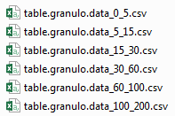
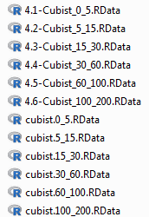
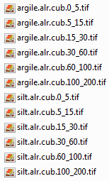
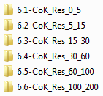
Home directory: AWC_DSM
Modelling stage
Other input
Scripts: Clean_Scripts
Output: Clean_Output
Extraction and quadratic splines of calibration data
Original scripts by Marine Lacoste
functions_texture.R
1-extraction_data_AWC
preparation_data_granulo_4.RData
spline.lib.r
2-spline_granulo_AWC
granulo_GSM.RData
Preparation of calibration dataset
From GSM by Titia Mulder
eg_cor2.RData
3.1-Join_texture_Gravel_Data
soil_data.RData
Covariates:
Tiff
Prediction_Tiff
3.2-Covariates
igcs_granulo.gsm.RData
4.1-Cubist_0_5
4.2-Cubist_5_15
4.3-Cubist_15_30
4.4-Cubist_30_60
4.5-Cubist_60_100
4.6-Cubist_100_200
Model residuals at training locations
Spatial modelling of particle size fractions:
1. Calibrate Cubist models. Predict at training locations and calculate residuals.
2. Map Cubist predictions at 90m resolution.
Calibrated models. Cubist objects.
5.1-Cubist_preds
5.2-Cubist_preds
5.3-Cubist_preds
5.4-Cubist_preds
5.5-Cubist_preds
5.6-Cubist_preds
Covariates:
Prediction_tiff_granulo
Cubist predictions
3. Cokriging the residuals in a 90m x 90m grid.
Hocine did this part with the software ISATIS
Cokriged model residuals for clay-alr and silt-alr
Input/Import_ISATIS /Results_Layer_*_*:
R_Clay_*_*.asc
R_Silt_*_*.asc
Std_R_Clay_*_*.asc
Std_R_Silt_*_*.asc
4. Resample and align cokriged residuals with the cubist predictions.
6.1.1-CoK_Res_0_5
6.2.1-CoK_Res_5_15
6.3.1-CoK_Res_15_30
6.4.1-CoK_Res_30_60
6.5.1-CoK_Res_60_100
6.6.1-CoK_Res_100_200
In each of the six folders
argile.alr.ckR.*_*.tif → cokriged residuals for clay-alr
argile.alr.ckSTD.*_*.tif → standard deviation of cokriged residuals for clay-alr
limon.alr.ckR.*_* → cokriged residuals for silt-alr
limon.alr.ckSTD.*_*.tif → standard deviation of cokriged residuals for silt-alr

Slide 2
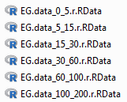
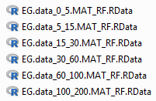
Home directory: AWC_DSM
Modelling stage
Other input
Scripts: Clean_Scripts
Output: Clean_Output
COARSE ELEMENTS
2.1-CropChelsa
Preparation of calibration dataset
Covariates/CHELSA/90m
2.2-CovariatesChelsa
Covariates/CHELSA/90m
Covariates/Tiff
2.3-CovariatesAddChelsa
Clean_Output/CoarseElements /
2.3-CovariatesAddChelsa.RData
Information on SMU
stu.csv
smu.csv
stu_org.csv
2.4-ReclassParentMaterial
smu.RF.csvv
Folder: Input/CoarseElements/BDGSF/GeoTiff
New classification parent material tiff
MAT_RF.tif
AGL_RF.tif
Session image
Folder: Clean_Output/CoarseElements
2.PredictorStack.RData
2.3-CovariatesAddChelsa.RData
Shapefile with soil map
soil2_L93.shp
Covariates/Prediction_tiff_EG
clc06.tif
ecoclim.tif
soil1.tif
2.5-RasterizeParentMaterial
id_profil_sondage_normandie.csv
3.1-CalibrationData
Shapefile with soil map
soil2_L93.shp
3.2-CalDatParentMaterial
3.3-CalDatChelsa
CalibrationDataCoarse.RData

Slide 3
Home directory: AWC_DSM
Modelling stage
Other input
Scripts: Clean_Scripts
Output: Clean_Output
Spatial modelling of coarse elements
Calibration data for coarse elements
8-CoarseElementsMaps
For each of the 6 GSM depth intervals
coarse_*_*.preds.05p.tif → 5 % percentile
coarse_*_*.preds.95p.tif → 95 % percentile
coarse_*_*.preds.mean.tif → mean
coarse_*_*.preds.sd.tif → standard deviation
CalibrationDataCoarse.RData
8-CoarseElementsMaps
Raster stack with predictor variables
2.PredictorStack.RData
6-Calculate_AWC
For each of the 6 GSM depth intervals
argile.alr.preds.*_*.tif → Sum of cubist predictions and cokriged residuals for clay-alr
limon.alr.preds.*_*.tif → Sum of cubist predictions and cokriged residuals for silt-alr
argile.preds.RK.*_*.tif → backtransformed CLAY predictions (%)
limon.preds.RK.*_*.tif → backtransformed SILT predictions (%)
sable.preds.RK.*_*.tif → backtransformed SAND predictions (%)
SMFC_*_*.tif → volumetric soil moisture at field capacity. Unit is cm³ cm⁻³.
SMPWP_*_*.tif → volumetric soil moisture at permanent wilting point. Unit is cm³ cm⁻³.
ru_vol_*_*.tif → difference between soil moisture at field capacity and soil moisture at permanent wilting point, or elementary (volumetric) available water capacity. Unit is cm³ cm⁻³.
ru_mm_*_*.tif → without subtracting coarse elements (assuming all soil is fine earth), available water capacity of the GSM layer, multiplied by the layer thickness in mm. Unit is mm of water.
awc_mm_*_*.tif → Subtracting the volume of coarse elements, this is the available water capacity of the GSM layer (multiplied by the layer thickness in mm). Unit is mm of water.
Calculate clay, sand, silt, soil moisture at field capacity, soil moisture at permanent wilting point, and available water capacity (subtracting, and without subtracting coarse elelemts) by GlobalsoilMap layer
Cubist predictions and cokriged model residuals for clay-alr and silt-alr
For each GSM depth
argile.alr.ckR.*_*.tif limon.alr.ckR.*_*.tif
argile.alr.cub.*_*.tif
silt.alr.cub.*_*.tif
6.1.2-CoK_Res_0_5
6.2.2-CoK_Res_5_15
6.3.2-CoK_Res_15_30
6.4.2-CoK_Res_30_60
6.5.2-CoK_Res_60_100
6.6.2-CoK_Res_100_200
Continuous pedotransfer functions developed with the SOLHYDRO dataset.
ContinuousPTF.RData
Calculate the variance of clay, sand, silt, soil moisture at field capacity, soil moisture at permanent wilting point with Taylor analysis
7.X-AWC_Taylor_*_*
varInput_w20_*_*.tif → uncertainty component for soil moisture at field capacity due to the soil input variables
varInput_w42_*_*.tif → uncertainty component for soil moisture at permanent wilting due to the soil input variables
varPTF_w20_*_*.tif → uncertainty component for soil moisture at field capacity due to PTFs coefficients uncertainty
varPTF_w42_*_*.tif → uncertainty component for soil moisture at permanent wilting due to PTFs coefficients uncertainty
Total_var_w20.*_*.tif → Variance of soil moisture at field capacity
Total_var_w42.*_*.tif → Variance of soil moisture at permanent wilting point
var_clay_*_*.tif → variance of backtransformed clay
var_sand_*_*.tif → variance of backtransformed sand
var_silt_*_*.tif → variance of backtransformed silt
Matrix with variance-covariance of the PTFs coefficients
7.1-AWC_Taylor_0_5
7.2-AWC_Taylor_5_15
7.3-AWC_Taylor_15_30
7.4-AWC_Taylor_30_60
7.5-AWC_Taylor_60_100
7.6-AWC_Taylor_100_200
Input/lm_w20_ClSd_coeff_cov.csv
Input/lm_w42_ClSd_coeff_cov.csv

Slide 4
Home directory: AWC_DSM
Modelling stage
Other input
Scripts: Clean_Scripts
Output: Clean_Output
Independent validation dataset
RMQS profiles data
3.3-RMQS_RG
RMQS_EG.RData
rmqs_coarse_fosses.07062018.csv
rmqs_coords_fosses.07062018.csv
3.4-RMQS_RG
RMQS_granulo.RData
rmqs_granulo_fosses.07062018.csv
3.5-RMQS_merge
RMQS.validation.RData
Independent validation of particle size fractions and coarse elements
Raster with predictions for clay, sand, silt, and coarse elements, and raster with their estimated variances/standard deviation.
6-Calculate_AWC
7.X-AWC_Taylor_*_*
8-CoarseElementsMaps
argile.preds.RK.0_5.tif,…, limon.preds.RK.0_5.tif, …, sable.preds.RK.0_5.tif,…, coarse_0_5.preds.mean.tif,…,
var_clay_0_5.tif,…, var_silt_0_5.tif,…, var_sand_0_5.tif,…, coarse_0_5.preds.sd.tif,…
9-Validation.preds.RMQS
9-Validation.preds.RMQS.RData
Independent validation of soil moisture at field capacity and at permanent wilting point
Independent validation dataset for soil hydraulic properties
BDD_LYATOU_FPT_MVA.toute_methode.csv
Raster with predictions for soil moisture at field capacity and at permanent wilting point and raster with their estimated variances.
9-Validation.preds.GEVARNOVIA
9-Validation.preds.GEVARNOVIA.RData
6-Calculate_AWC
7.X-AWC_Taylor_*_*
SMFC_*_*.tif
SMPWP_*_*.tif
Total_var_w20.*_*.tif
Total_var_w42.*_*.tif

Slide 5
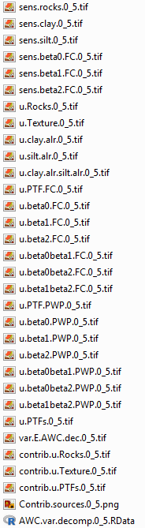
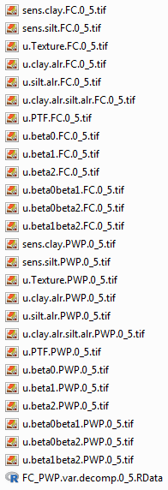
Home directory: AWC_DSM
Modelling stage
Other input
Scripts: Clean_Scripts
Output: Clean_Output
Variance of elementary AWC by GSM layer
6-Calculate_AWC
ru_vol_0_5.tif, …
awc_mm_0_5.tif, …
8-CoarseElementsMaps
coarse_0_5.preds.mean.tif, …
Input/soil_depth_mm.tif
Pedotransfer functions
ContinuousPTF.RData
variance-covariance matrix of the PTFs coefficients
Input/lm_w20_ClSd_coeff_cov.csv
Input/lm_w42_ClSd_coeff_cov.csv
10-SensitivityAWC_general/
Variance of elementary AWC by GSM layer
•varAWC.0_5/var.E.AWC.dec.0_5.tif
•varAWC.5_15/var.E.AWC.dec.5_15.tif
•varAWC.15_30/var.E.AWC.dec.15_30.tif
•varAWC.30_60/var.E.AWC.dec.30_60.tif
•varAWC.60_100/var.E.AWC.dec.60_100.tif
•varAWC.100_200/var.E.AWC.dec.100_200.tif
For each of the GSM layers (described in the word document suivi.doc) →
10-SensitivityAWC_general
11-AWC_TotalDepth.RData
awc_R_vol_*_*.tif → volumetric AWC (cm3 cm-3), accounting for the volume of coarse elements, by GSM layer.
AWCr_mm_0_200.tif → total AWC in mm, considering the coarse elements and the predicted soil depth. Maximum depth of 2 m.
AWCr_mm_0_200.VAR.tif → Variance of total AWC (maximum 2 m depth) to the estimated soil depth, calculated by Taylor analysis and considering the correlation between the volumetric AWC (considering coarse elements) between layers.
AWCr_mm_0_200.sd.tif → standard deviation of total AWC (mm).
rel_error_AWC.tif → coefficient of variation of total AWC.
Calculate total AWC and its variance
6-Calculate_AWC
ru_vol_0_5.tif, …
awc_mm_0_5.tif, …
8-CoarseElementsMaps
coarse_0_5.preds.mean.tif, …
Input/soil_depth_mm.tif
10-SensitivityAWC_general/
•varAWC.0_5/var.E.AWC.dec.0_5.tif
•varAWC.5_15/var.E.AWC.dec.5_15.tif
•varAWC.15_30/var.E.AWC.dec.15_30.tif
•varAWC.30_60/var.E.AWC.dec.30_60.tif
•varAWC.60_100/var.E.AWC.dec.60_100.tif
•varAWC.100_200/var.E.AWC.dec.100_200.tif
11-AWC_TotalDepth
Sensitivity of soil moisture at field capacity and at permanent wilting point to different variables
Pedotransfer functions
ContinuousPTF.RData
variance-covariance matrix of the PTFs coefficients
Input/lm_w20_ClSd_coeff_cov.csv
Input/lm_w42_ClSd_coeff_cov.csv
Raster files:
6.1-CoK_Res_0_5/argile.alr.ckSTD.0_5.tif, …
6.1-CoK_Res_0_5/limon.alr.ckSTD.0_5.tif, …
6-Calculate_AWC
argile.alr.preds.0_5.tif, …
limon.alr.preds.0_5.tif, …
For each of the GSM layers (described in the word document suivi.doc)
12-Sensitivity_FC_PWP

