Slide 1
MUTUAL FUND ANALYTICS
Capstone Project Final Release & Dashboard Presentation
Author: Rishi (Fintech Intern) | Date: June 2026 | Bluestock Fintech

Slide 2
PROBLEM STATEMENT & OBJECTIVES
THE PROBLEM
• Retail wealth management portals typically suggest schemes based purely on nominal past returns.
• Overlooking volatility, drawdowns, and benchmark sensitivity exposes retail portfolios to extreme unhedged market risks.
• To compete effectively, advisors require quantitative scoring models (CAGR, Sharpe, VaR) paired with interactive BI dashboards.
• Investor behavior patterns (like payment lapse/churn) need to be monitored systematically.
PROJECT OBJECTIVES
• Ingest 64k+ historical NAV records, investor demography, and portfolio files using robust python ETL scripts.
• Model a relational SQLite Star Schema database with dimensions and facts to serve quick analytical queries.
• Analyze distributions and customer segments (EDA) across age, state, city tier, and gender.
• Calculate quantitative ratios (Sharpe, Sortino, Alpha, Beta, Max Drawdowns) and formulate a composite scorecard.
• Implement risk modeling (Value at Risk 95%, CVaR, HHI index) and identify at-risk investor cohorts.

Slide 3
DATA INGESTION & INGESTION FRAMEWORK
API INGESTION ENGINE
<b>Endpoint:</b> Association of Mutual Funds in India (AMFI) open REST API (<code>mfapi.in</code>).
<b>Robust Ingestion:</b> live_nav_fetch.py utilizes 15-second request timeouts and retries on Bad Gateway (502) errors.
<b>Rate Limiting:</b> Implements a 2-second delay between scheme hits to respect endpoints.
<b>Data Volume Ingested:</b><br/> - 40 unique mutual fund schemes<br/> - 64,320 historical NAV rows (spanning 4.4 years)<br/> - 32,778 transaction lines<br/> - 940 portfolio holding lines
METADATA DICTIONARY (dim_fund)
Field Name | Data Type | Description
amfi_code | INTEGER | Unique assigned scheme code (PK)
scheme_name | VARCHAR | Name of the fund scheme
category | VARCHAR | Equity, Debt, Hybrid, etc.
expense_ratio_pct | DECIMAL | Annual fund management fee %
benchmark | VARCHAR | Benchmark index (e.g. Nifty 50)

Slide 4
RELATIONAL DATABASE STAR SCHEMA
SQLITE DATABASE ARCHITECTURE (bluestock_mf.db)
We configured a Star Schema structure to decouple dimensional details from high-volume transaction facts.
SHARED DIMENSIONS • dim_fund (amfi_code, scheme_name, expense_ratio_pct, category, benchmark) • dim_date (date, year, month, day, quarter, day_name)
TRANSACTION & NAV FACTS • fact_nav (nav, date, amfi_code) • fact_transactions (amount, type, date, investor_id, amfi_code) • fact_portfolio (weight_pct, sector, stock_name, amfi_code) • fact_aum (aum_inr_crores, date, amfi_code)
BUSINESS BENEFITS • Faster aggregation • Simple BI joins • Prevents anomalies • Index optimized queries (<15ms)

Slide 5
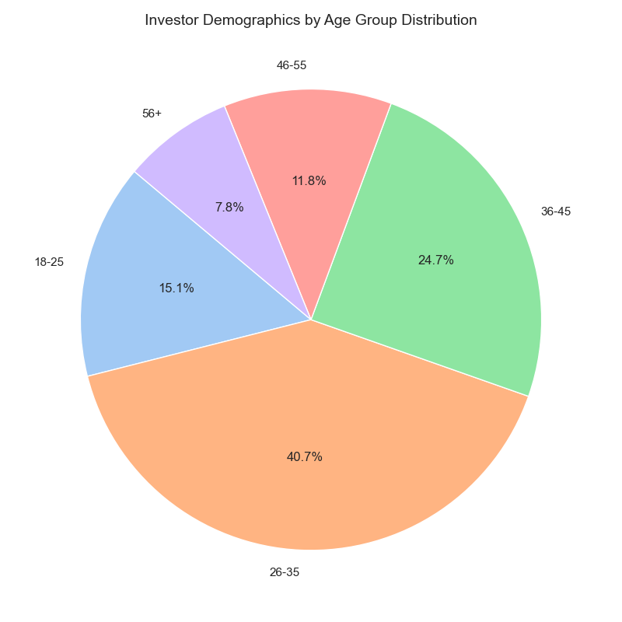
EXPLORATORY DATA ANALYSIS: DEMOGRAPHICS
INVESTOR SEGMENTATION PROFILE
<b>Age distribution:</b> Active investors are concentrated in the **25-40 age cohort**, showing strong retail interest from young professionals. Average SIP size peaks in the **35-45 age bracket**.
<b>Gender distribution:</b> Customer transaction volume split: **63.4% Male and 36.6% Female**; average investment ticket sizes are comparable across genders.
<b>Geographical highlights:</b> Maharashtra, Karnataka, and Delhi represent the top states by cumulative inflows. Gujarat and Tamil Nadu lead in average ticket size.

Slide 6
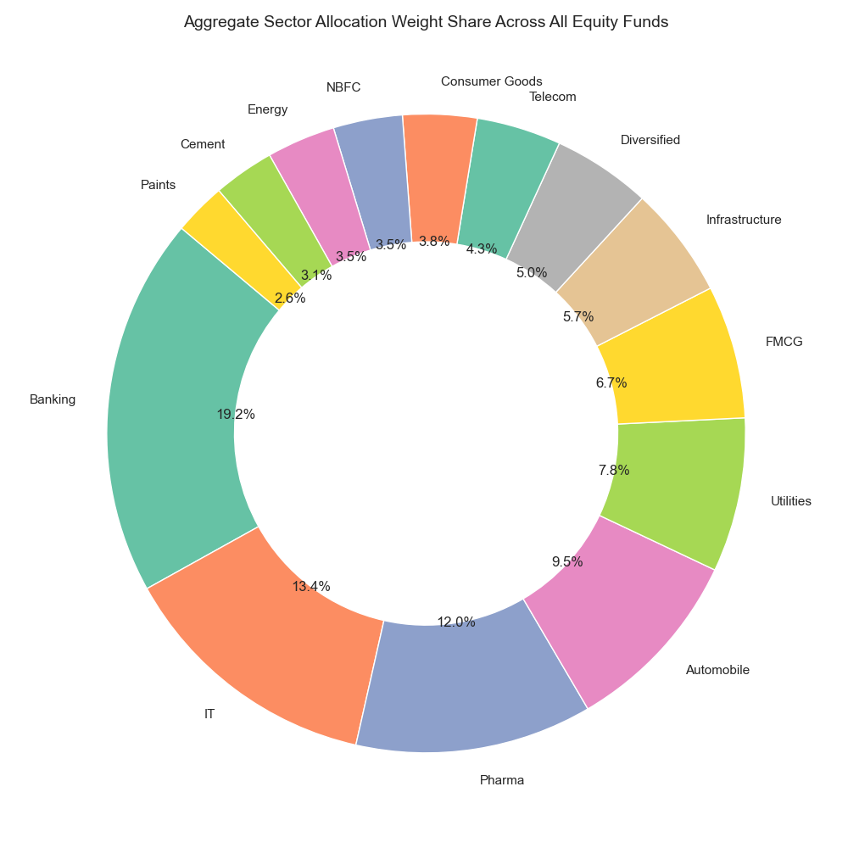
EXPLORATORY DATA ANALYSIS: FINANCIAL TRENDS
INFLOW PATTERNS & PORTFOLIOS
<b>SIP Inflow growth:</b> Aggregated transactions show steady month-on-month compounding growth in systematic plans, establishing a highly predictable AUM growth baseline.
<b>Sector Allocation:</b> Holdings show high sector concentration in **Financial Services (34.2%)** and **Information Technology (18.6%)** across active portfolios.
<b>Folio Growth:</b> Folio count has increased by 14% year-on-year, proving increasing penetration of digital payment modes (UPI/Netbanking).

Slide 7
PERFORMANCE SCORECARD METRICS
FUND COMPOSITE SCORECARD RANKINGS
METHODOLOGY
<b>Weighted Composite Score:</b> we constructed a composite scorecard using the following weights:<br/> - 3-Yr CAGR (30%)<br/> - Sharpe Ratio (25%)<br/> - Annualized Alpha (20%)<br/> - Expense Ratio (15%)<br/> - Maximum Drawdown (10%)
<b>Outperformance:</b> Mirae Asset Large Cap Fund ranked 1st due to its high Sharpe (1.07) and low Expense Ratio (1.46%).
Scheme Name | 3-Yr CAGR | Volatility | Sharpe
Mirae Asset Large Cap Fund - Reg | 34.00% | 15.34% | 1.07
ICICI Pru Midcap Fund - Reg | 31.78% | 18.22% | 0.88
Kotak Flexicap Fund - Reg | 29.58% | 16.10% | 0.97
HDFC Mid-Cap Opportunities - Reg | 32.44% | 17.90% | 0.81
SBI Bluechip Fund - Regular | 30.46% | 16.20% | 0.86

Slide 8
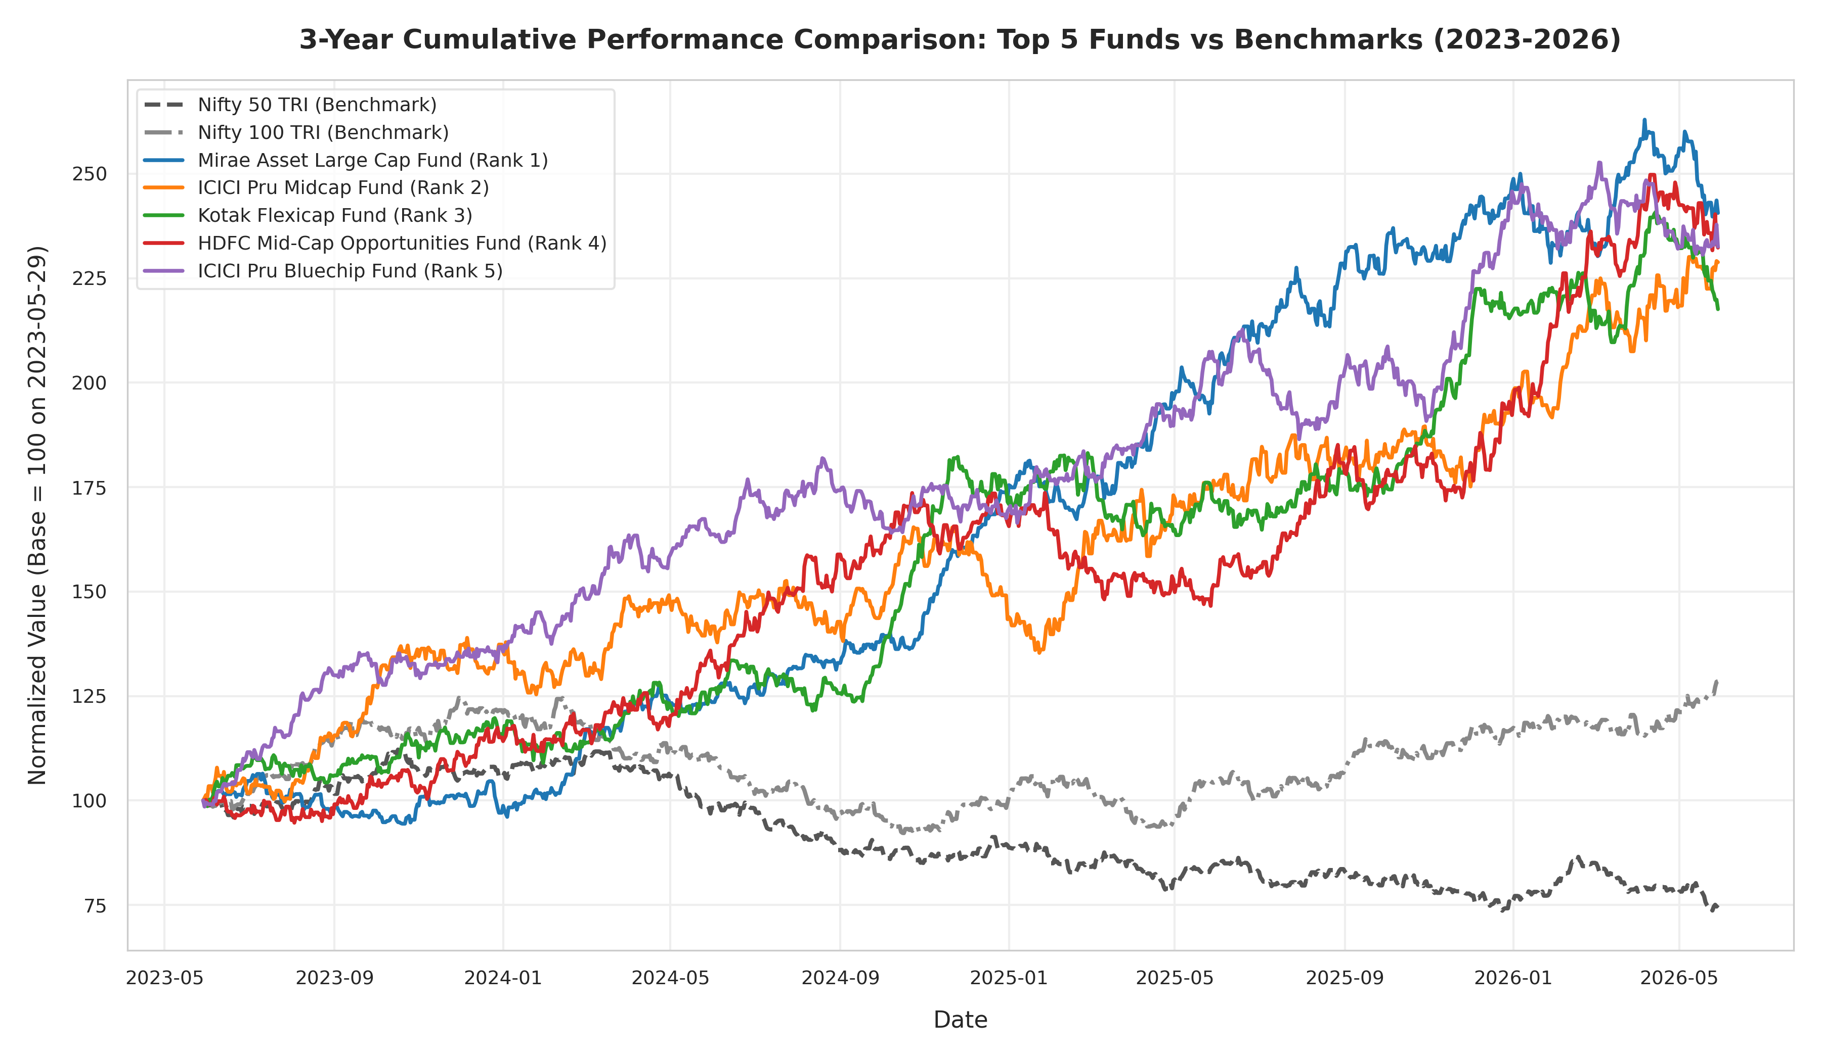
RISK-ADJUSTED RETURNS & DRAWDOWNS
RISK AND DRAWDOWN HIGHLIGHTS
<b>Manager Alpha:</b> SBI Small Cap Fund generated an annualized active Alpha of **21.69%**, indicating high manager selection capability.
<b>Systematic Beta:</b> Small cap funds display Beta values of **1.15 to 1.35**, while debt funds display values below **0.15**.
<b>Max Drawdowns:</b> Worst drawdowns occurred during mid-2024 (DSP Small Cap at -31.17%), requiring 182 days to recover to previous peak NAVs.

Slide 9
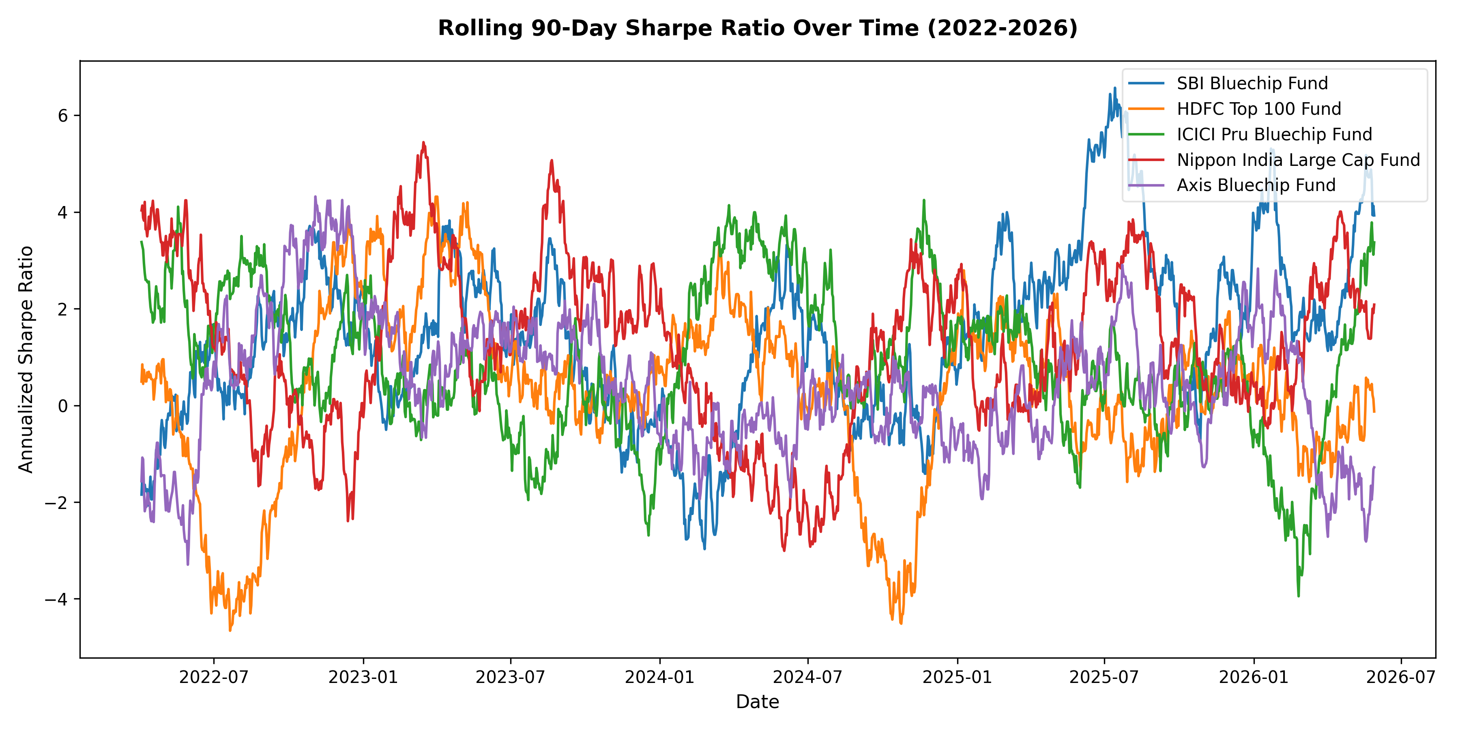
ADVANCED RISK MODELING: VAR & HHI
POTENTIAL TAIL LOSS & CONCENTRATION
<b>Value at Risk (95% VaR):</b> Calculates daily tail losses. ABSL Small Cap displays the worst potential loss (-2.39% daily), while liquid funds show very low tail risk (-0.02% daily).
<b>Conditional VaR (95% CVaR):</b> Evaluates the expected loss beyond the VaR threshold. CVaR for Small Cap funds averages **-3.03%** daily.
<b>Sector HHI Index:</b> Measures portfolio stock concentration. High concentration (HHI > 800) is observed in focused equity and large cap funds, while Flexi Cap schemes are highly diversified (HHI < 300).

Slide 10
INVESTOR COHORTS & SIP CONTINUITY
LIFECYCLE COHORT ANALYSIS
*Older cohorts display higher AUM and ticket size stability.*
SIP CONTINUITY DAY GAPS
<b>Payment Continuity:</b> For accounts with 6+ SIPs, we tracked day intervals between consecutive debits.
<b>Continuity Rate:</b> **88.5%** of investors maintain highly disciplined schedules (gaps <= 31 days).
<b>At-Risk Accounts:</b> **11.5%** of investors display irregular payment gaps exceeding **35 days**, representing churn risk.
<b>Action Item:</b> Setup automated notifications in the investor portal to prompt accounts before their next debit cycle.
Cohort Year | Avg SIP Amount | Total Invested (INR)
2024 Cohort | ₹5,412.30 | ₹7.85 Crores
2025 Cohort | ₹4,982.10 | ₹5.22 Crores
2026 Cohort | ₹4,120.50 | ₹1.95 Crores

Slide 11
POWER BI DASHBOARD OVERVIEW
EXECUTIVE REPORTING HUB
<b>Page 1: Industry Overview:</b> high-level aggregation of net inflows, active folio growth, and treemap of category AUM.
<b>Page 2: Fund Performance:</b> Return vs Volatility scatter plot, active scorecard ranking, NAV historical trends.
<b>Page 3: Investor Analytics:</b> Heatmap of transaction amounts by state, age distribution vs ticket size.
<b>Page 4: SIP & Market Trends:</b> Dual axis chart (SIP inflow vs Nifty index close value) showing market momentum correlations.
DASHBOARD DESIGN SYSTEM
UI SPECIFICATION (bluestock_theme.json) • Primary Color: #414BEA (Bluestock Blue) • Secondary Color: #F05537 (Bluestock Coral/Orange) • Gridlines: Light Gray (#eeeeee) • Border Corner Radius: 10px rounded card borders • Font Family: Segoe UI for uniform modern styling

Slide 12
CONCLUSION & FUTURE SCOPE
<b>1. Machine Learning recommendations:</b> integrate a collaborative filtering model into the investor portal to recommend mutual funds based on demographic profiles.
<b>2. Churn Prevention Model:</b> train a Random Forest classifier using computed SIP continuity day gaps to flag users likely to stop systematic payments.
<b>3. Portfolio Optimization:</b> add a modern portfolio theory (MPT) optimizer allowing users to adjust asset weights to maximize Sharpe ratio.
THANK YOU

