Slide 1
Analyzing college student bar crawls affect on alcohol consumption
By Nathan Padgett and Heath Mercer

Slide 2
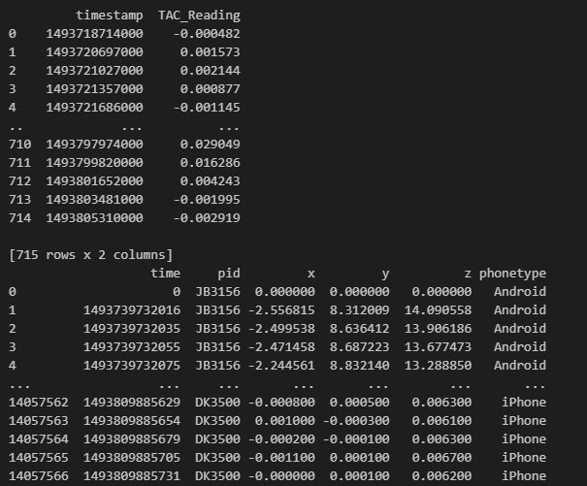
Dataset we chose
Our data set was a collection of multiple college participants of a bar crawl and contained the data of their movements, BAC level, time spent, and phone type.
(Picture is only a part of the dataset)

Slide 3
Approaches that we tried to implement
Random Forest
  Our first approach due to binary classification of our original approach
Logistic Regression
  Follow up from random forest due to the similar nature of focusing on binary classification
Linear Regression
  New approach from our newly cleaned dataset
SVM
  Future goal to add since it helps with overfitting and limited datasets

Slide 4
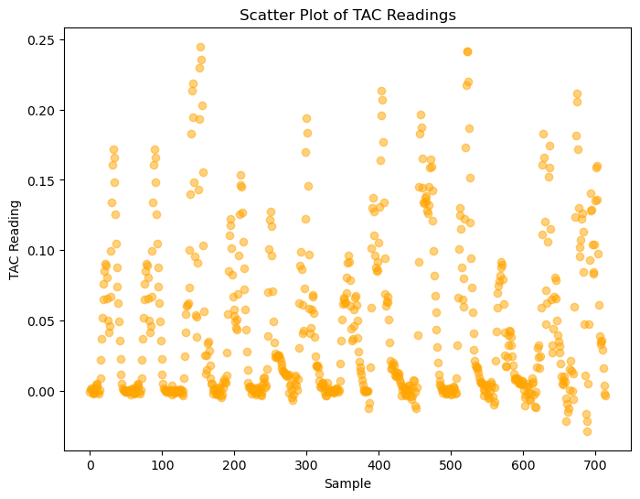
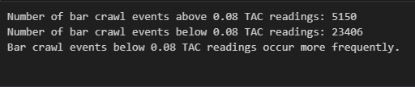
Most useful findings from our dataset

Slide 5
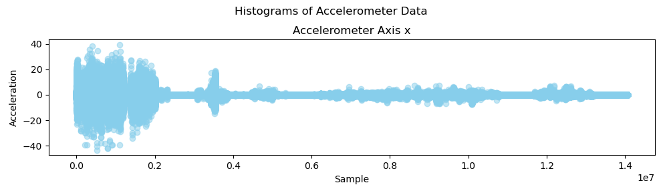

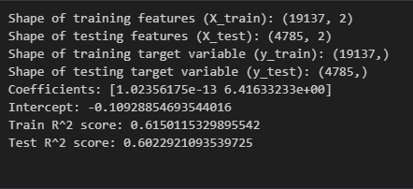
(Cont.)
Logistic Regression
Linear Regression
Analyzing Filtered Dataset

