Slide 1
BellaBeat: How consumers use their smart devices
Author: Tamakloe Vivian Anuoluwa
July 2024

Slide 2
INTRODUCTION
About Bellabeat
Bellabeat is a high-tech company that manufactures health-focused smart products which are based on beautifully designed technology that informs and inspires women around the world. Collecting data on activity, sleep, stress, and reproductive health has allowed Bellabeat to empower women with knowledge about their own health and habits. One can say Bellabeat is a tech-driven wellness company for women.
Bellabeat’s Product
Bellabeat App
Leaf
Time
Spring
Bellabeat Membership

Slide 3
Scenario
I am a junior data analyst working on the marketing analyst team at Bellabeat. I have been asked to focus on one of Bellabeat’s products and analyze smart device data to gain insight into how consumers are using their smart devices. This insights will help guide marketing strategy for the company.
Target Audience
The targeted audience of this analysis business tasks are women, who are busy with their daily activities and need to strike a balance between their work life and health using BellaBeat products

Slide 4
Product: The focused product of this analysis is BellaBeat App
Tool used: R programming language
Dataset used:• FitBit Fitness Tracker Data https://www.kaggle.com/datasets/arashnic/fitbit
(CC0: Public Domain, dataset made available through Mobius)

Slide 5
BUSINESS TASK
Focusing on Bellabeat product and analyzing how people are already using their smart devices in order to gain insights that would reveal more opportunities for growth and recommendations for Bellabeat marketing team based on trends in smart device data usage.

Slide 6
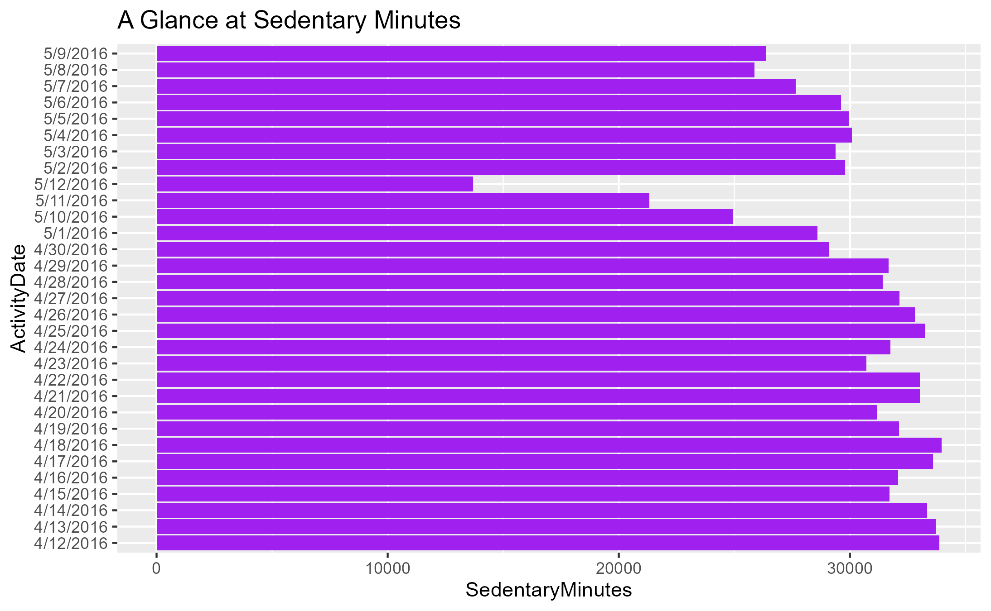

Slide 7
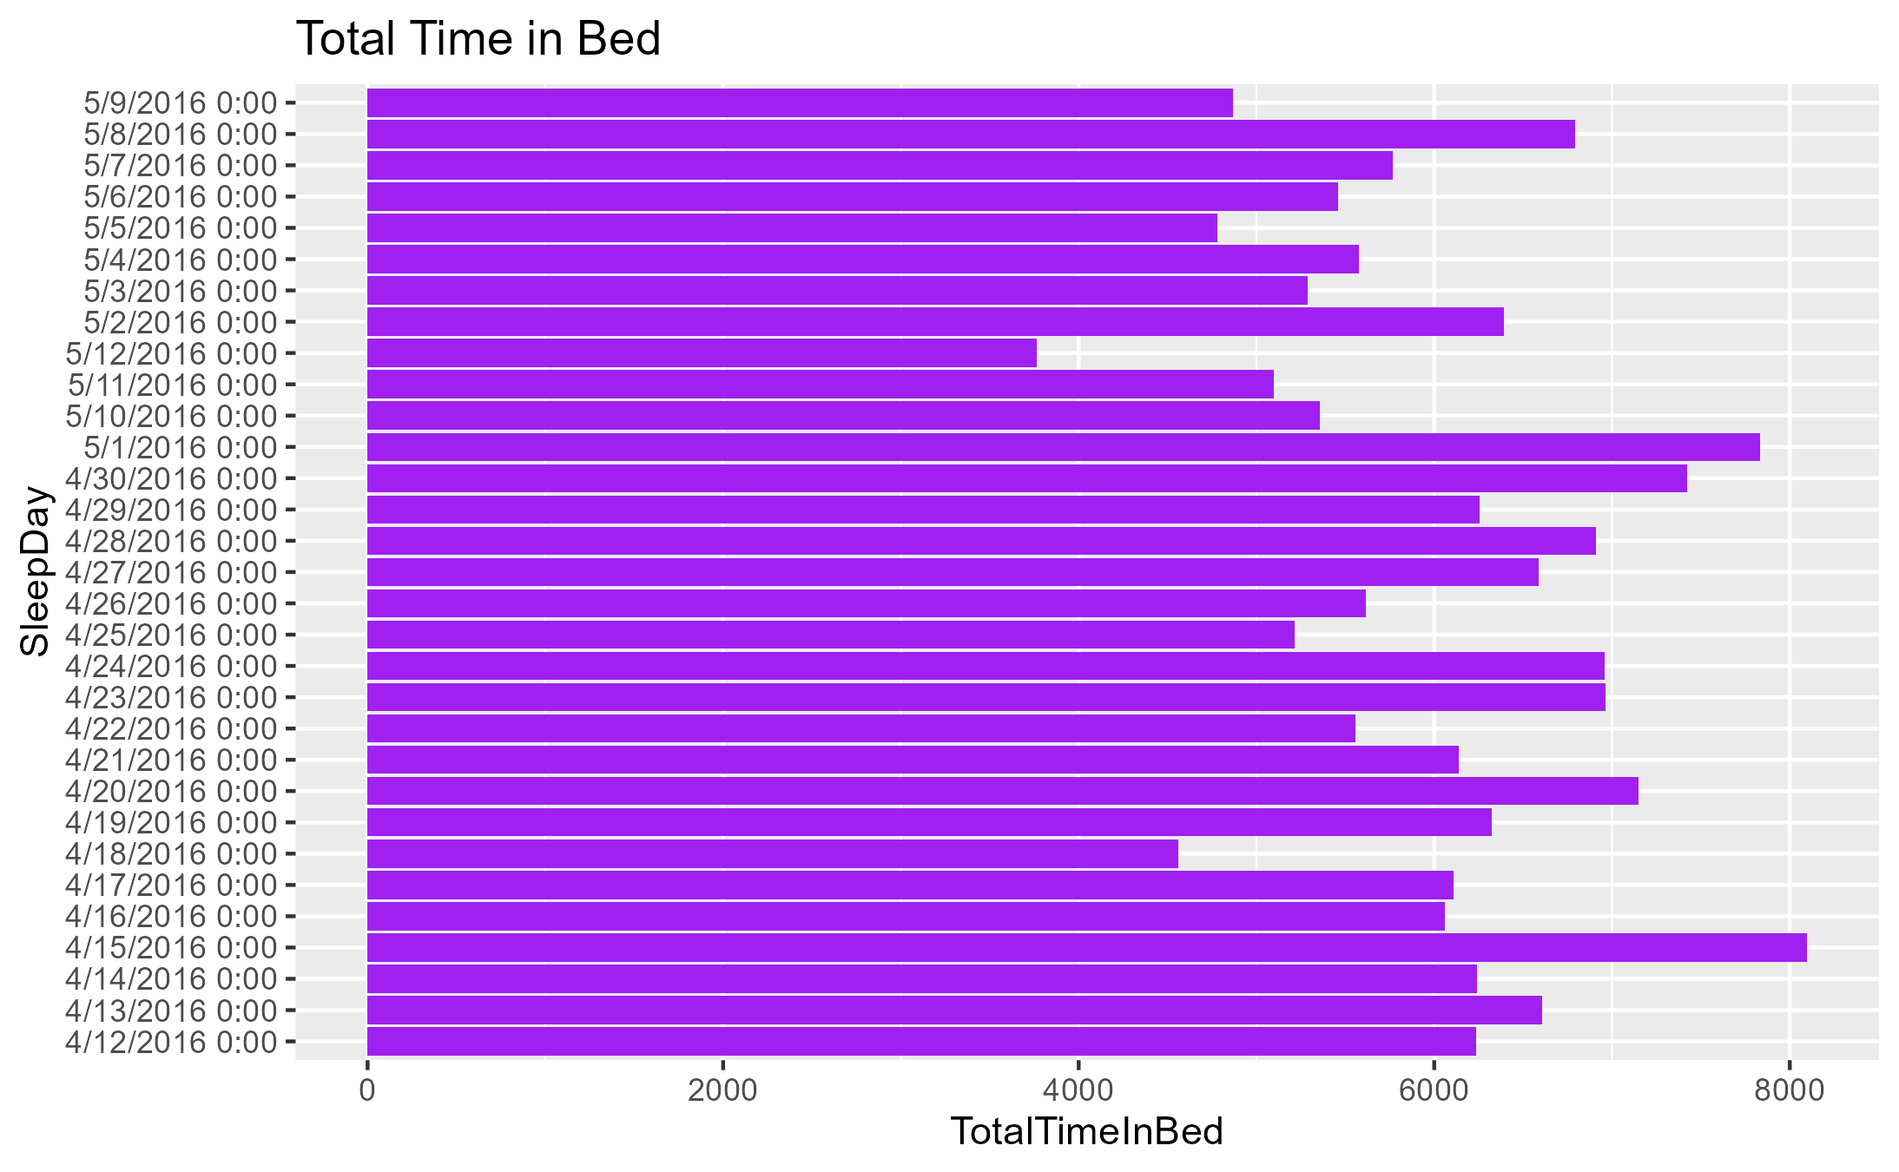

Slide 8
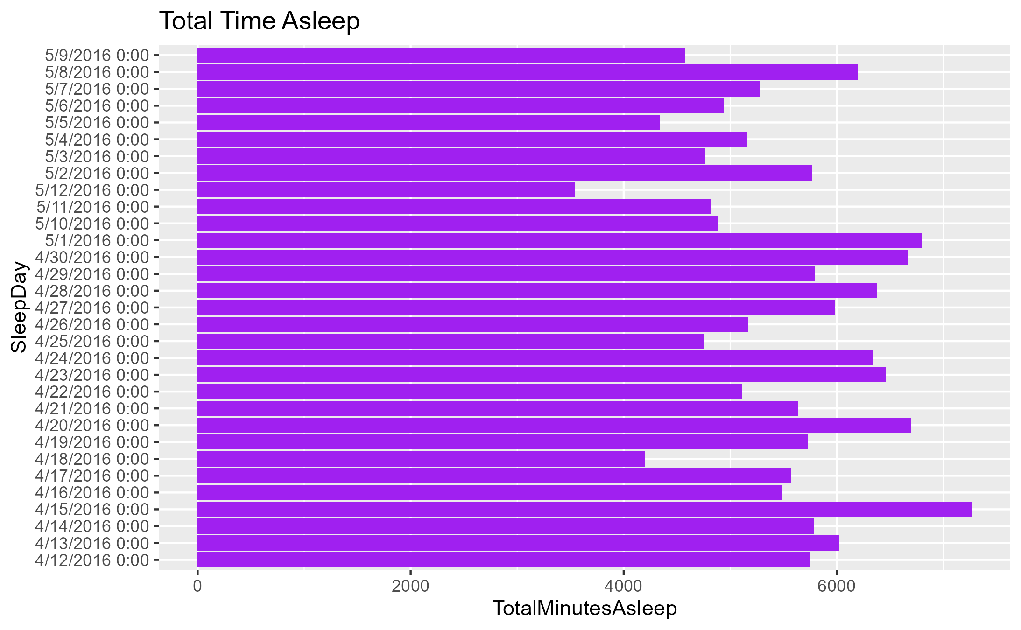

Slide 9
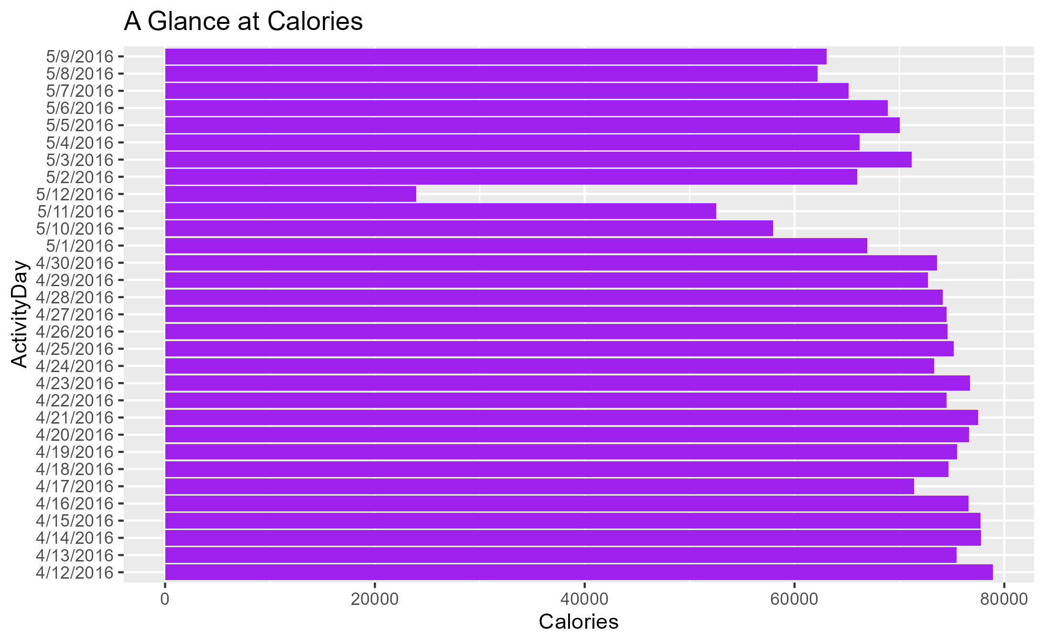

Slide 10
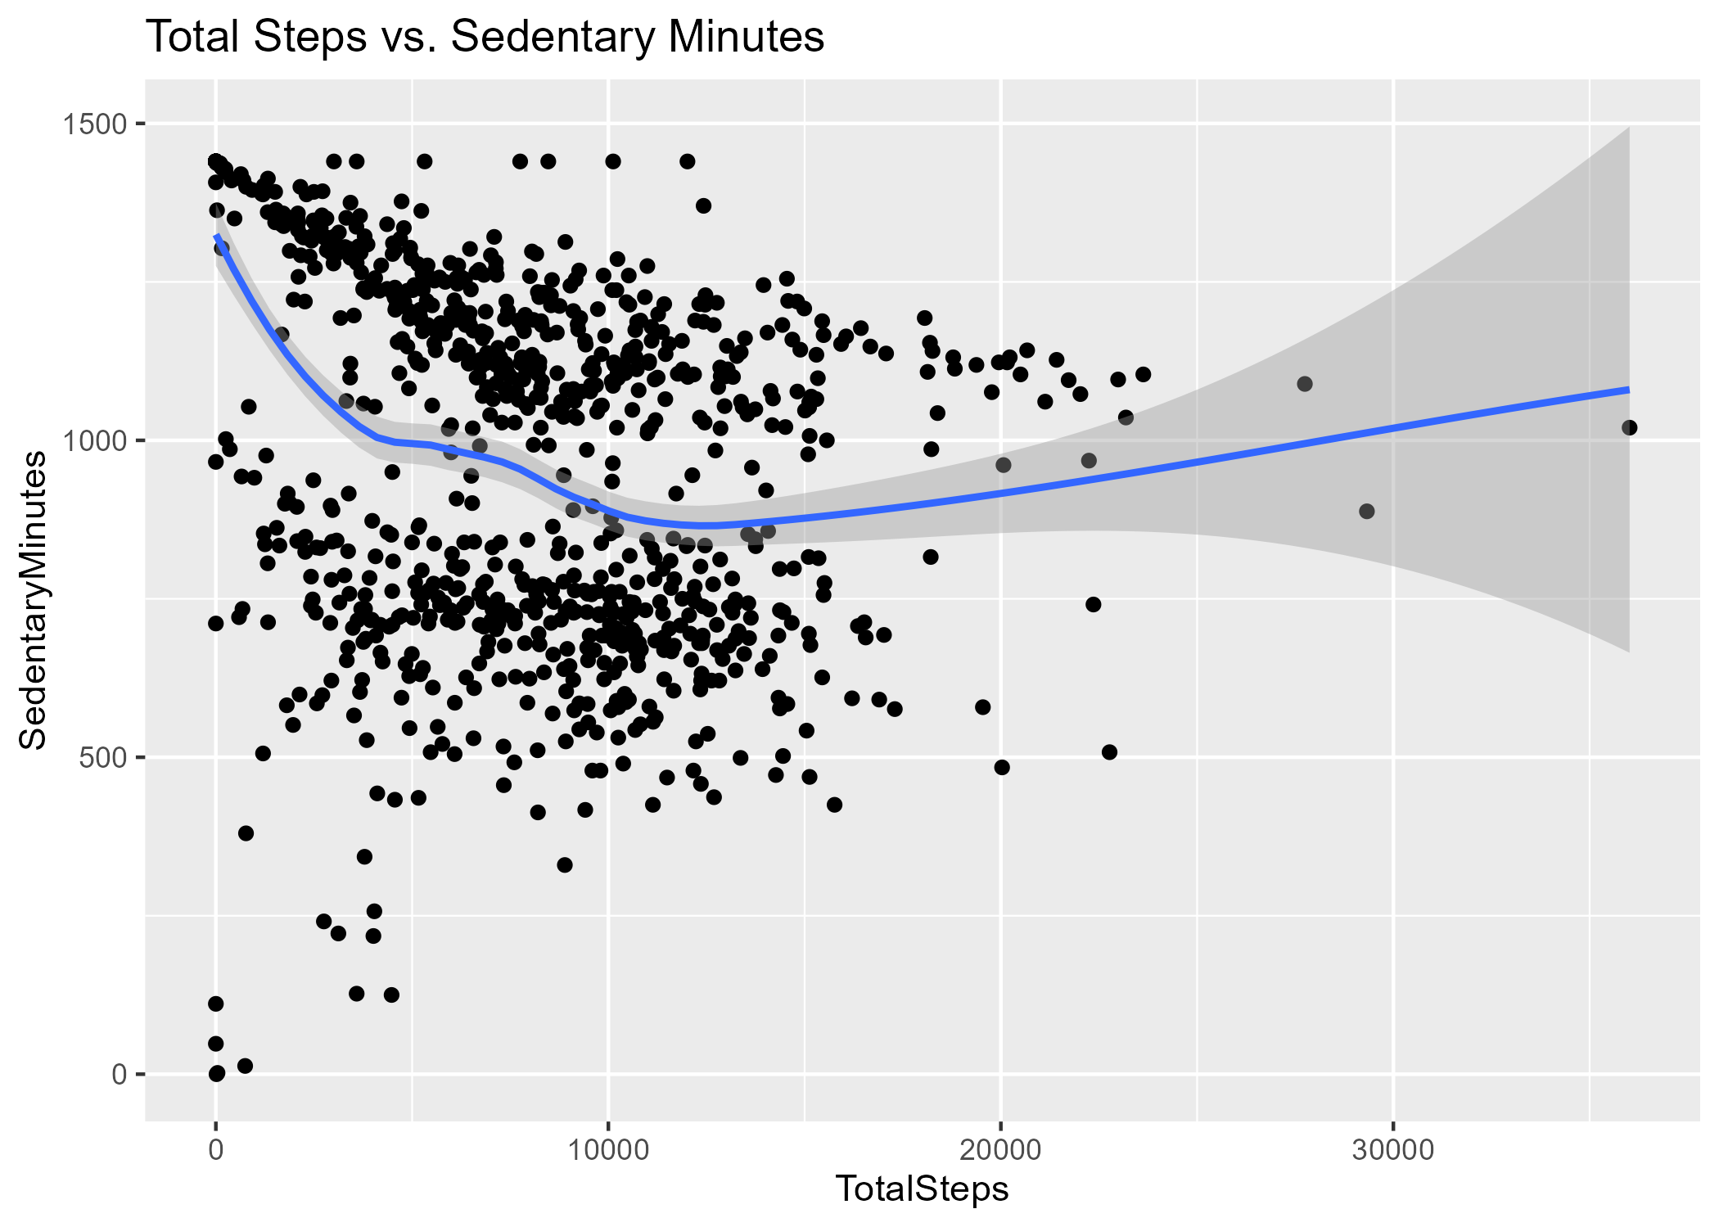
A negative relationship exists between Total Steps and Sedentary Minutes, i.e. the higher the Sedentary Minutes, the lower the Total steps. So therefore, to increase the Total Step of Bellabeat Users, sedentary time must be reduced

Slide 11
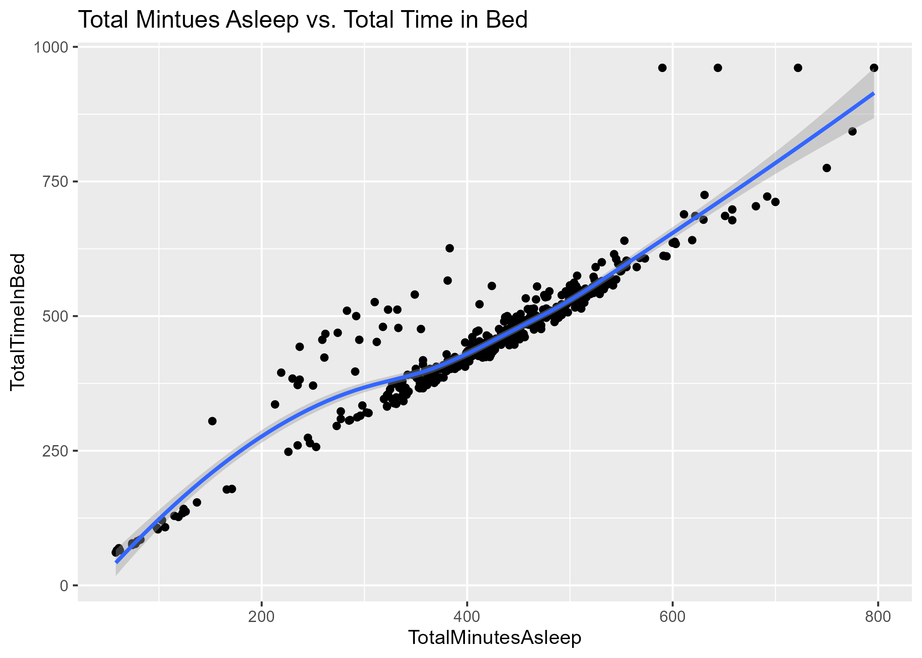
A positive linear relationship exists between Total Minutes Asleep and Total Time in Bed, i.e. the higher the Total Minutes Asleep, the higher the Total Time in Bed.

Slide 12
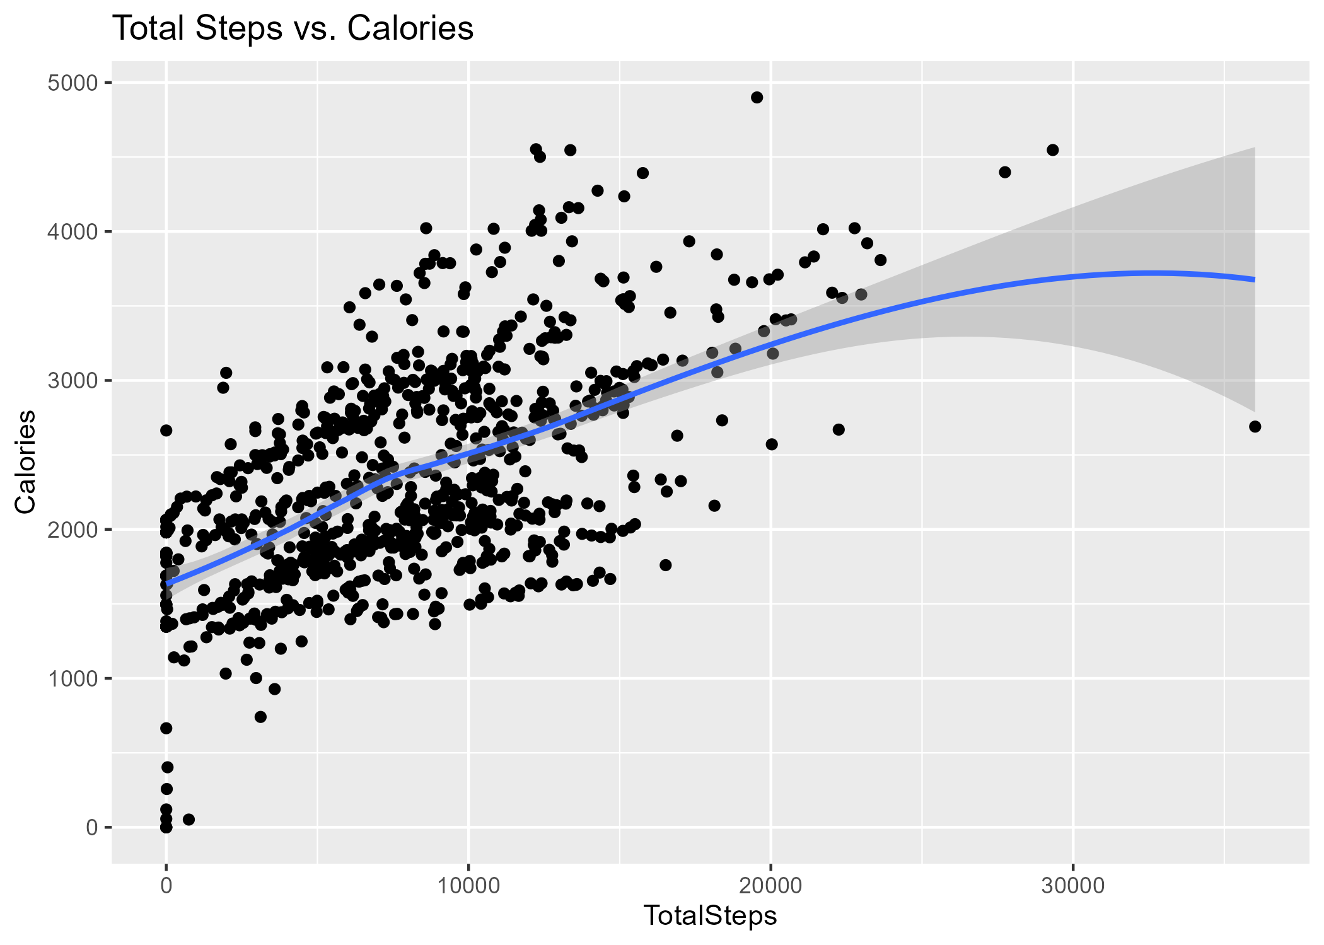
A positive relationship exist between Total Step taken and Calories, i.e. the more steps taken, the more Calories are burnt.

Slide 13
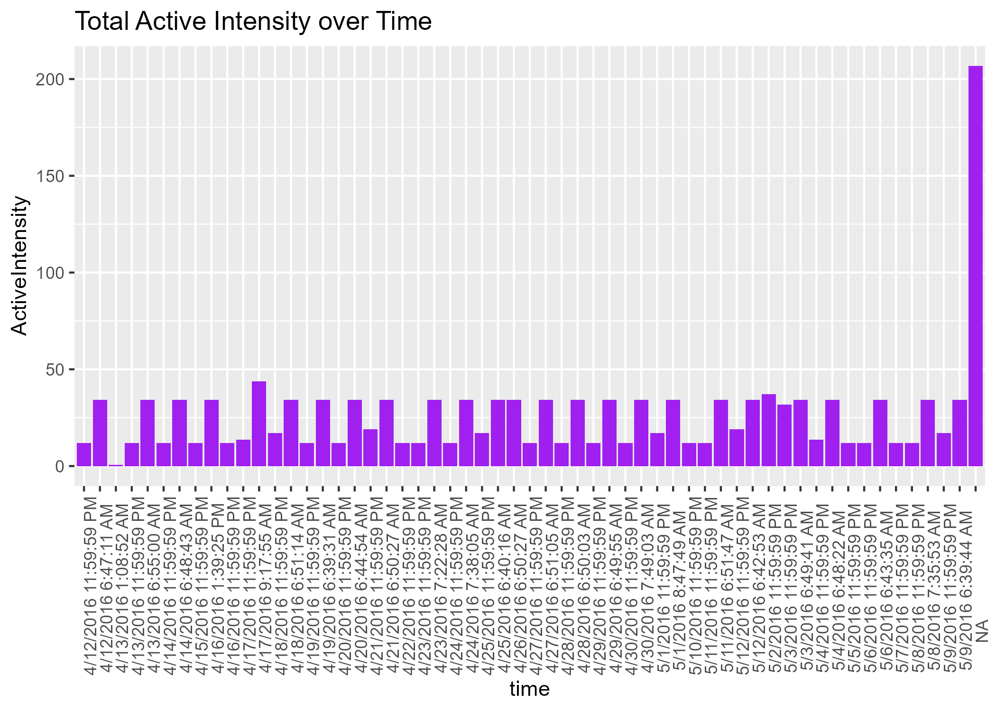
The chart above shows that most customers are more active during morning hours at around 6:30am - 8am and during evening hours at around 11:40pm -11:59pm

Slide 14
KEY FINDINGS
The Maximum Sedentary time is high 1440mins(24hrs)
The Average Sedentary time is high 991.2mins(16hours and 52seconds)
The mean Total Distance is low 5.490
The average Total steps is low 7630
Majority of these Users are lightly active, posses lightly-active-distance and have a high sedentary time
Average sleep time of almost 7hours is observed
A User slept for 796 mins(over 13hours) as recorded by Maximum Total Minutes Asleep
A User was in bed for 961 mins(over 16hours) as recorded by Maximum Total Time in bed

Slide 15
RECOMMENDATIONS
1. BellaBeat App should be redesigned to have an alarm/notification function which should be able to notify users periodically during the day to take a walk, thereby encouraging activeness and burning of calories
Recommended steps according to Howdy Health 7,000-10,000steps per day for adults aged 18-59years. 6,000-8,000steps per day for adults aged 60+years. 7,500steps per day for adults aged 62-101years.These steps could be achieved in bits during the day, say 4 notification per day, each notification aiming to achieve 2,000steps

Slide 16
2. BellaBeat App should be redesigned to have an alarm/notification function which should be able to notify users when to sleep, calculate the recommended sleep hours and also notify Users when to wake up so as to encourage a healthy sleeping habit.
According to the National Sleep Foundation’s recommendations, adult aged 18 to 64years require 7-9hrs of sleep a night, while adults older than 64years require 7-8hrs of sleep.

Slide 17
3. BellaBeat App should be redesigned to calculate and give feedback to User on their progress.
These feedback should be weekly, which will encourage User to do better in the new week. These feedback should be in percentages. Total Recommended Steps per week should be 52,500steps so 26,250steps will be a 50% progress. Total Recommended Hours of sleep per week should be 56hrs so 45hrs should be 80% progress. Total Recommended Calories that should be burned by women per week 12,425 (as recommended by WebMD Fitness and Exercise is 1600-1950 per day, averagely 1775 ) so 8,000 should be 64%

Slide 18
4. BellaBeat App should be redesigned to have an information section.
This information section should be able to inform users on the benefits of healthy lifestyle, which includes taking walks, sleeping adequately, eating healthy which we help reduce calories in take.
5. Intensity-over-time chart should be created so as to monitors users activity and constantly come up with strategy that will help keep BellaBeat in trend, unique and up-to-date.

Slide 19
REFERENCES
This analysis was done with help of sample R codes and guidelines from the following site
Coursera notes
Case-study guidelines
Case-study roadmap
https://rmarkdown.rstudio.com
https://www.geeksforgeeks.org
https://cran.r-project.org

