Slide 1
Biosynthetic Gene Clusters classification
Lucie Cervenkova
2022

Slide 2
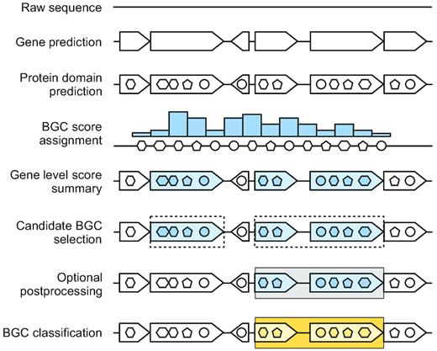
Introduction
Biosynthetic Gene Clusters (BGCs)
Co-localized microbial genes producing small molecules as their secondary metabolites
Drug candidates – antimicrobial drugs, anticancer therapies, immunomodulatory agents
DeepBGC (Hannigan et al., 2019, Nucleic Acids Res.)
Detects BGCs and classifies them into groups based on their product

Slide 3
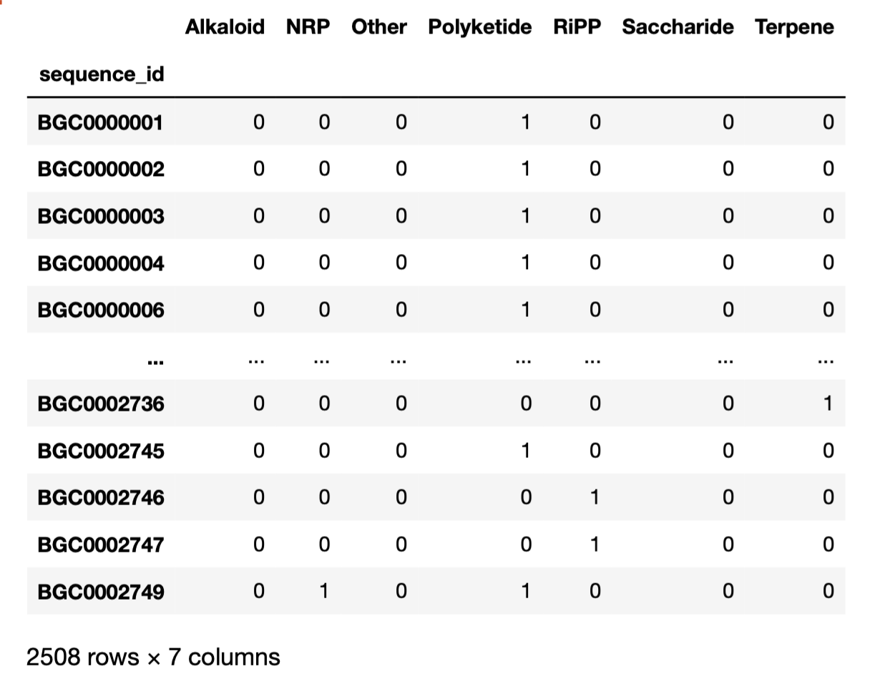
Target variables (multi-label classification)
MiBIG database 1.3
1355 BGCs
MiBIG database 3.0
2508 BGCs

Slide 4
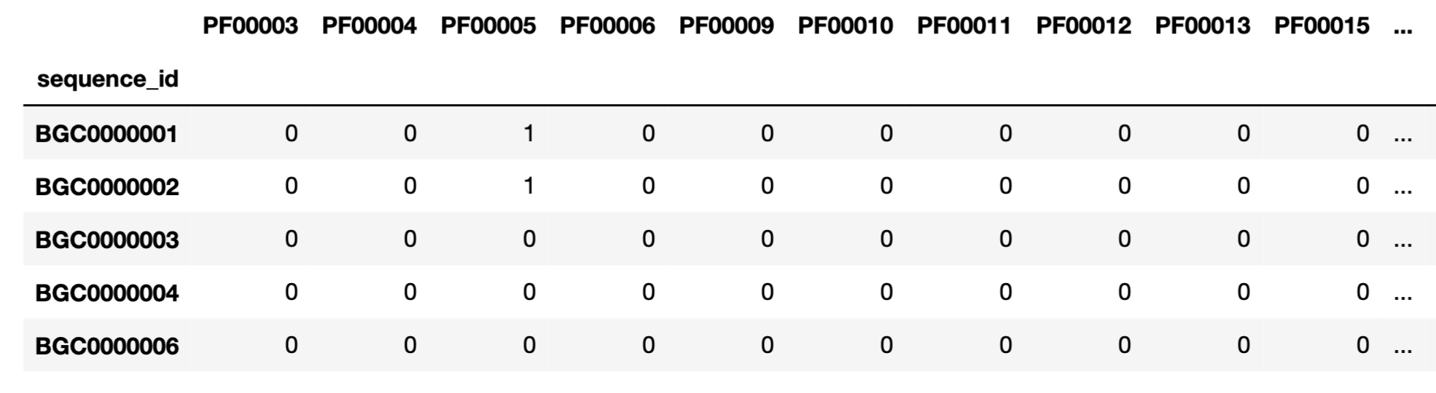
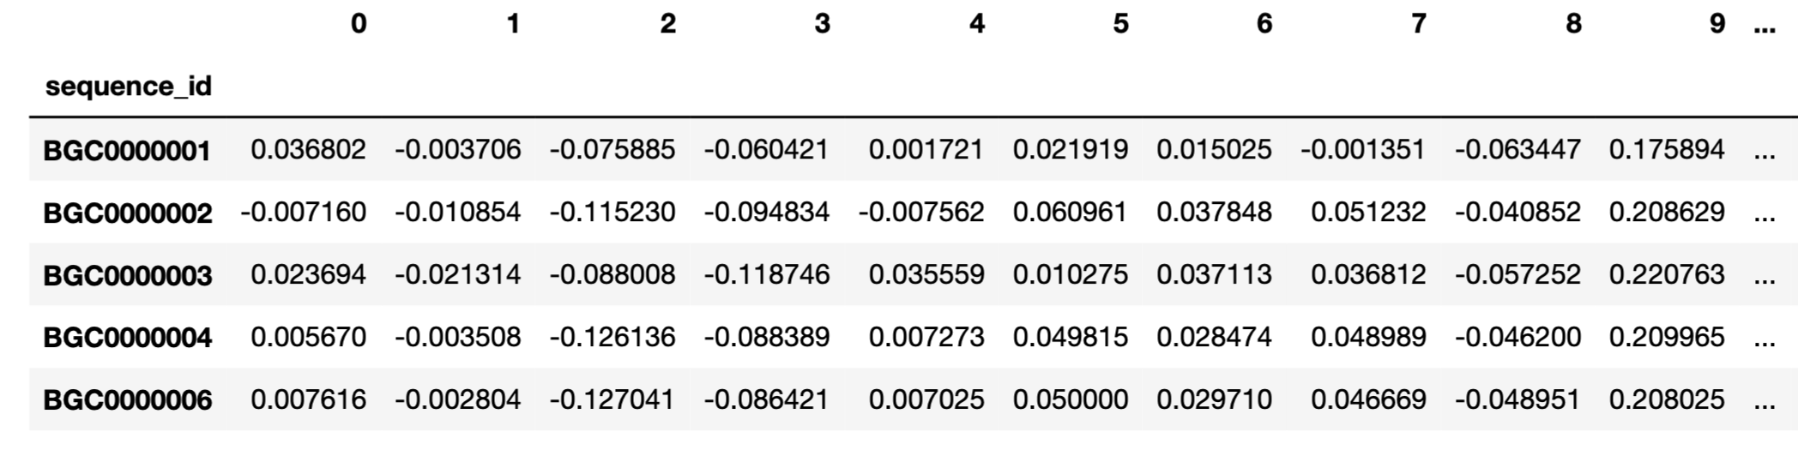
Input variables: one-hot encoding vs. pfam2vec

Slide 5
Scikit models for multi-label classification
tree.DecisionTreeClassifier
tree.ExtraTreeClassifier
ensemble.RandomForestClassifier
ensemble.ExtraTreesClassifier
neighbors.KNearestNeighbors
neural_network.MLPClassifier

Slide 6
Models comparison
Overfitting?
Previous dataset: AUC = 0,792

Slide 7
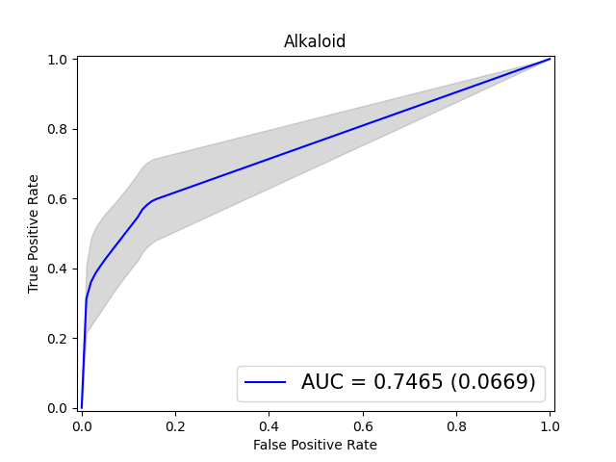
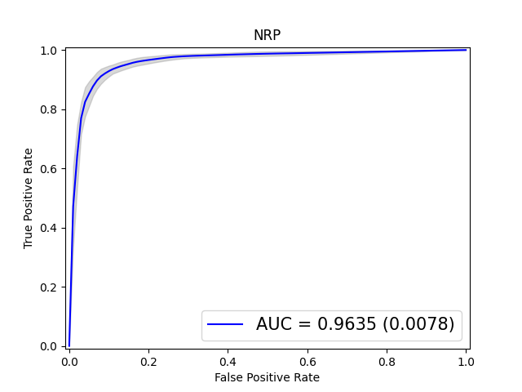
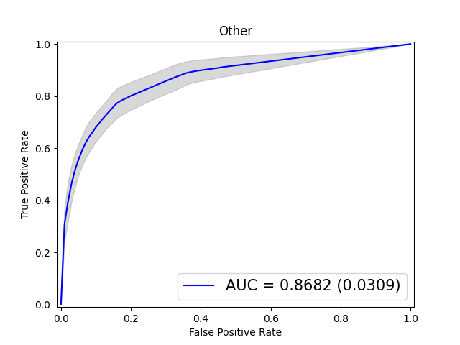
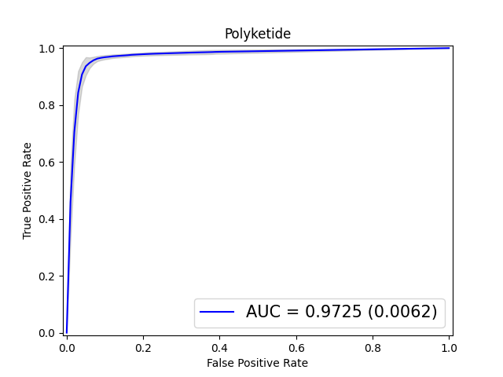
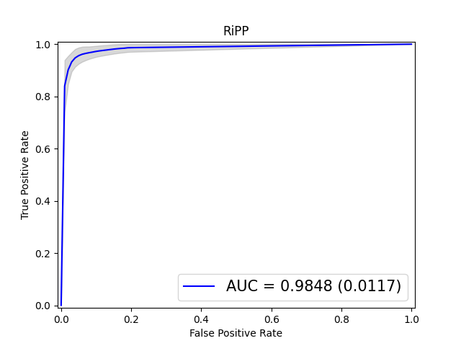
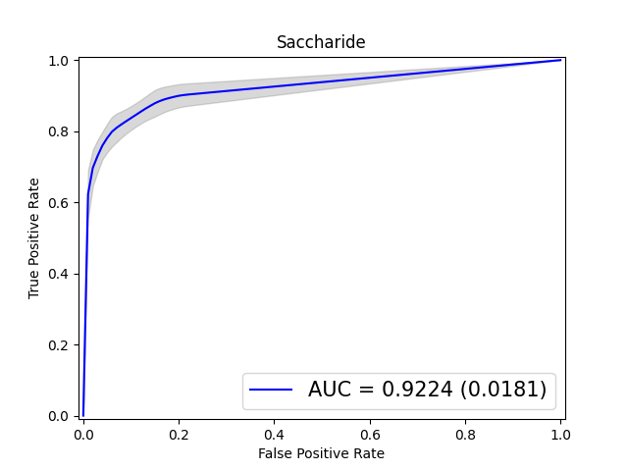

Random Forest + One-Hot Encoding

Slide 8
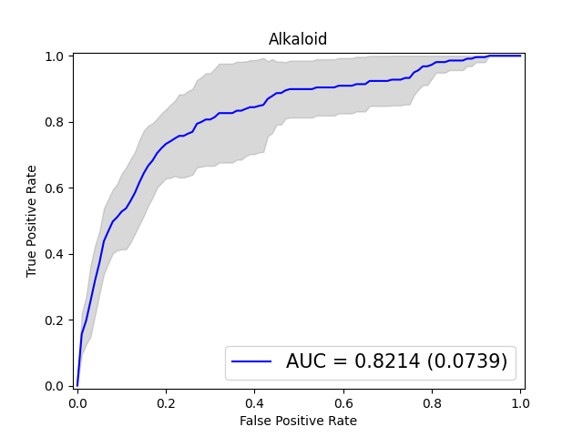
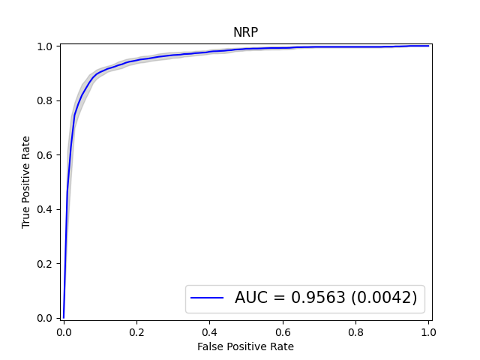
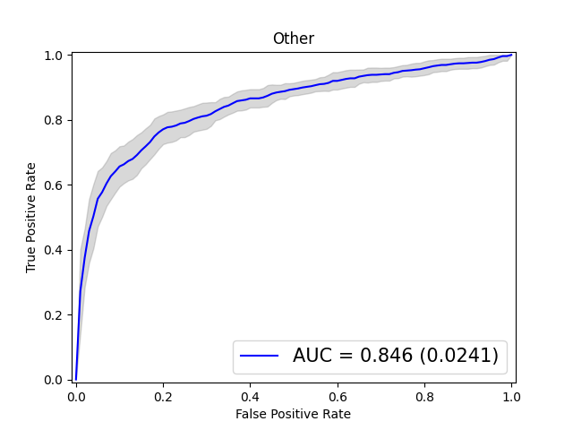
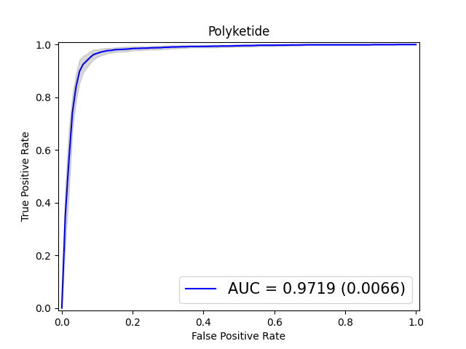
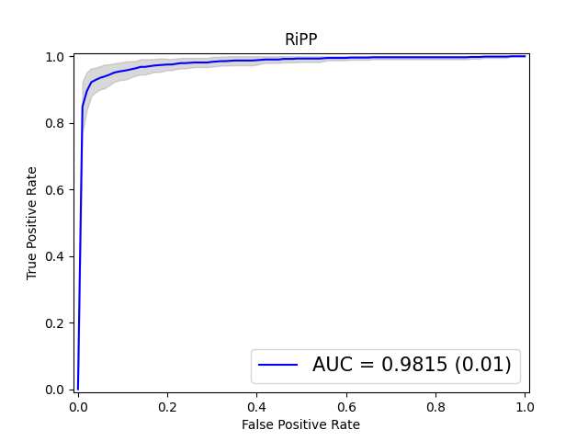
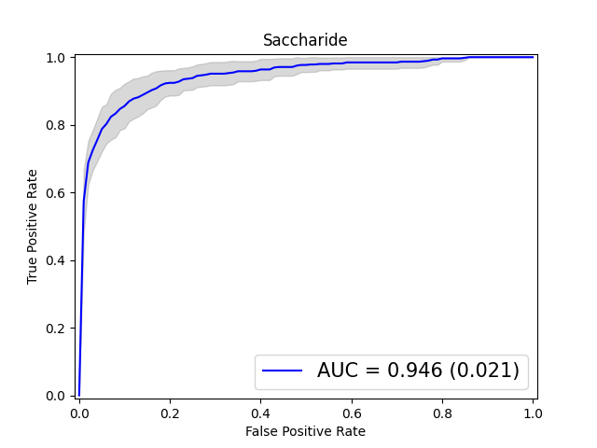
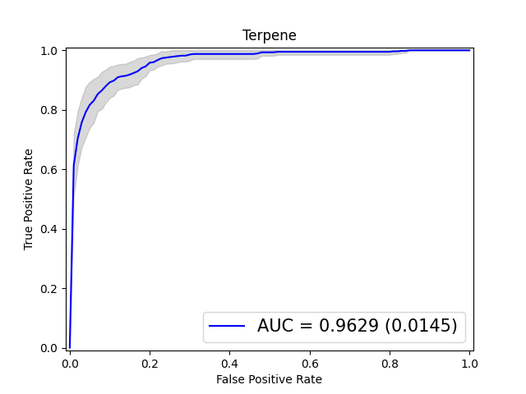
Scikit Multi Layer Perceptron+ Pfam2Vec

Slide 9
Neural network architectures
Tensorflow + Keras
Multi layer perceptrons with different hyperparamaters
3 times repeated 5-fold cross validation with random splits
Model | Hidden Layers | Neurons per layer
NN1 | 1 | 100
NN2 | 2 | 100
NN3 | 3 | 100
NN4 | 4 | 100
NN5 | 3 | 50
NN6 | 2 | 50
NN7 | 1 | 50
NN8 | 1 | 10

Slide 10
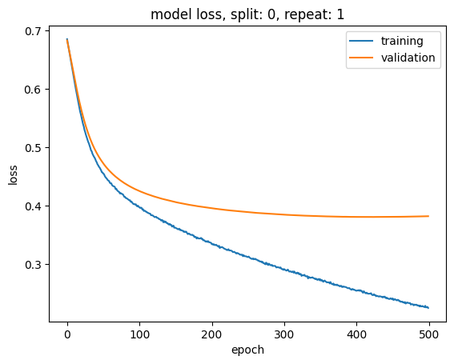
Overfitting issues and strategies
Fig.: Overfitting with One-Hot Encoding representation
Training loss keeps decreasing
Dropout in between layers (0.2)
Early stopping (patience = 10)
Decreasing learning rate (10-100x)
One-Hot Encoding input appears unsuitable for MLP ☹

Slide 11
Neural networks AUC comparison

Slide 12
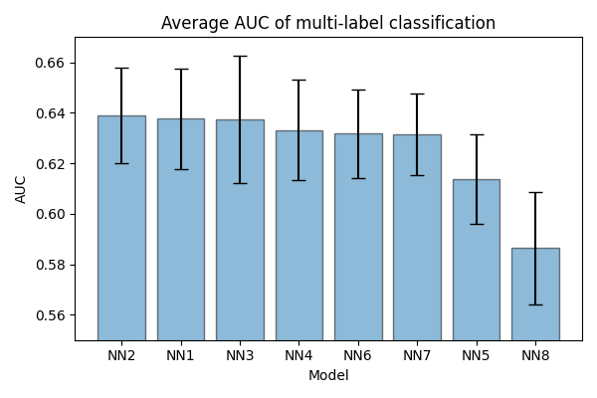
Neural networks AUC comparison

Slide 13
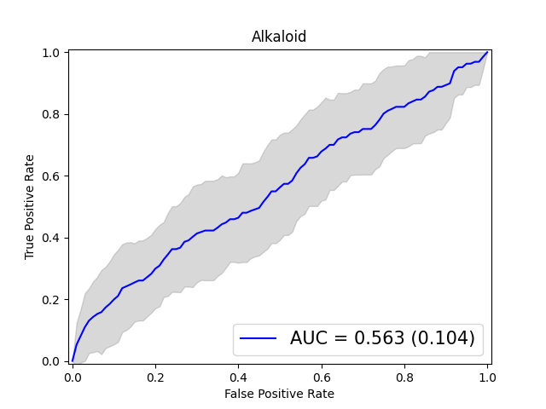
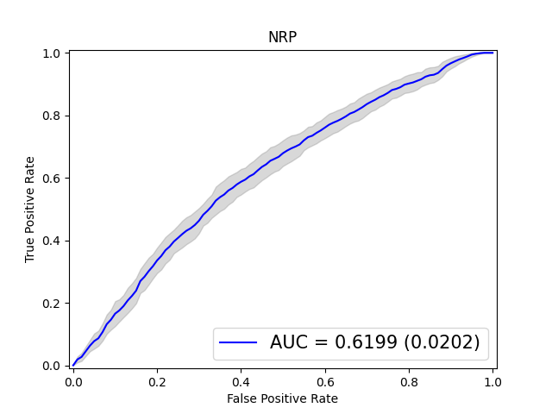
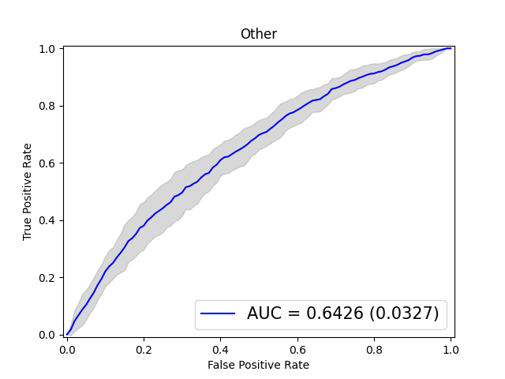
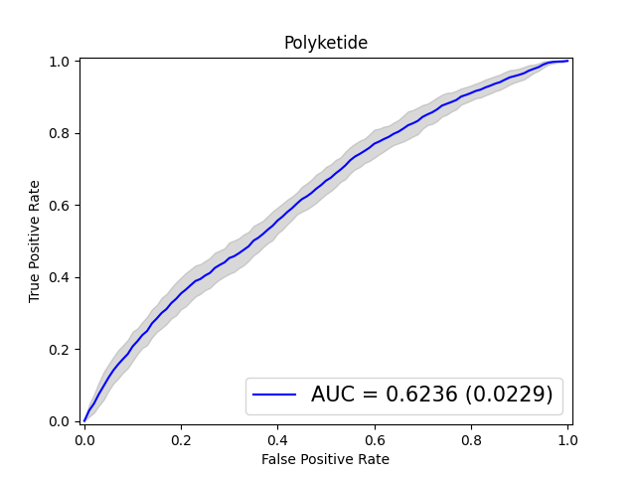
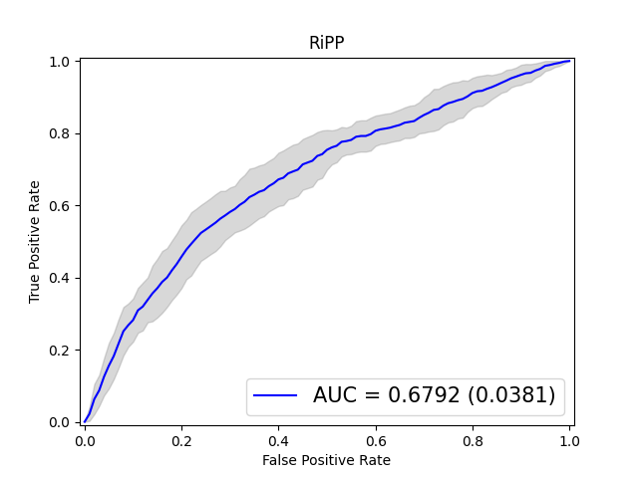
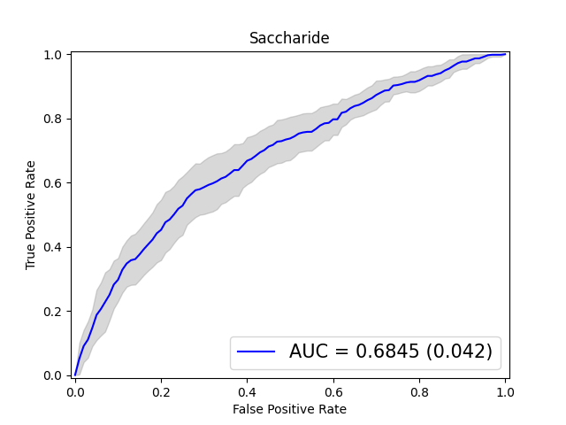
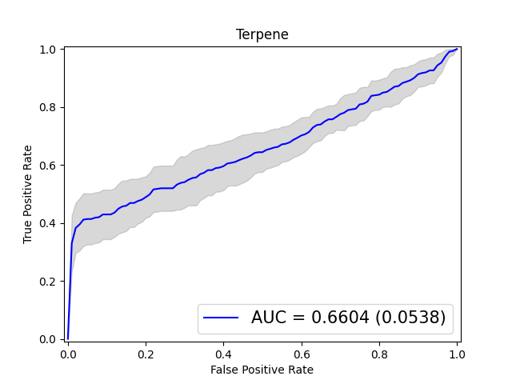
NN2 (2 hidden layers, 100 nodes) + Pfam2Vec

Slide 14
Conclusions
Multiple layer perceptron is unsuitable for BGCs classification problem
Overfitting issues (especially for one-hot encoding input)
Poor performance compared to simpler sklearn methods
Current strategy (Random Forest) could be replaced with Extra Trees Classifier

