Slide 1
Giving an effective talk and project scoring

Slide 2
In short, what makes a talk effective
Knowing the audience
Large fonts, minimal text
Clear graphics with MINIMAL TEXT
Personalization/attention grabbing
Only put content you know 100%
Always set up the background

Slide 3


Today, I will discuss using ODEs to model biochemical networks
What’s an ODE?

Slide 4

Knowing your audience
It’s your job to not bore us to death
Never explain to people what they already know
Give them something interesting
Focus on goals – NOT METHODS

Slide 5
Maximize B-p concentration using computational modeling
Goal
Brief method; described in words
Modifying the Kd2 rate optimally maximizes our product concentrations
Clear result

Slide 6
Background
Background is often 20-25% of the talk!!
Try to establish why your work is interesting to you, your audience and people in general
Justify your study
if study is successful, then what?
For long talks, repeat background/justification several times for your audience
Take breaks ☺

Slide 7
Large fonts; minimal text
Good rule of thumbs: 28 pt font should be the smallest
Minimal text
Audiences hate to read
Audience can only remember a few things
Related to quals
the more text you put, the harder questions you will get

Slide 8
One last time: MINIMAL TEXT
Common challenge for international students
I sympathize
DO NOT DO IT

Slide 9
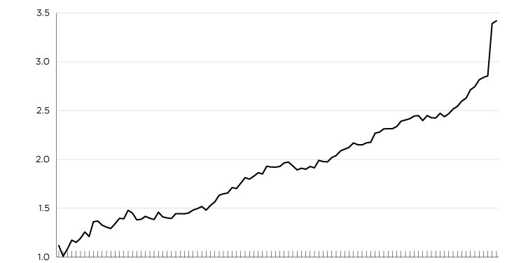
Clear graphics
Super common mistake
Crap graphics will destroy a talk
Clear Labels
Avoid acronyms
Don’t make people learn!!

Slide 10

Personalize
Make your audience connect with you
If you don’t care, why do I?
Doesn’t have to relate to talk content all the time
But helps!

Slide 11
Know your content
#1 reason to fail a qual, not get a job offer, etc.
You control the content
You better know that content
If you put in content you don’t know…

Slide 12

For our class project presentation
You must include
Background/discussion: why did you choose this? Why is it interesting? What have others already published on the matter?
Explain the data you collected and it’s limitations
A clear explanation of the analyses you performed and the results
Discuss the implications of your results
And what would be your next steps as a scientist, based on your findings

Slide 13
Grading
Presentation (50% total; 10% each)
Background and rationale
Explanation and presentation of data
Explanation and presentation of analysis
Clear summary of findings and implications
Clearly stated next steps
Github & Code (50% total)
Documentation (25%)
Clear Readme file that explains your project and summarizes your finding
Must includes graphics of the results in the readme
Code must be clearly organized and commented
Github updates must be used
Coding Standard & Execution (25%)
Code must be able to run and regenerate all presented results

