Slide 1

Effects of Mask Mandates & Vaccination on Infection Rate
Ali Alaryan
CHE 2231
10/25/2022

Slide 2
Background
What? Mask Mandates & Vaccination Factors
Why? Disbelief & Fear
Goal? Answer Proposed Questions

Slide 3
Data Used

Slide 4
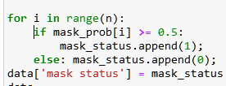
Analysis (Effect of Mask Mandates)
Assumption: Mask = 1 if (Mask_ALWAYS > 0.5)
Data was partitioned

Slide 5

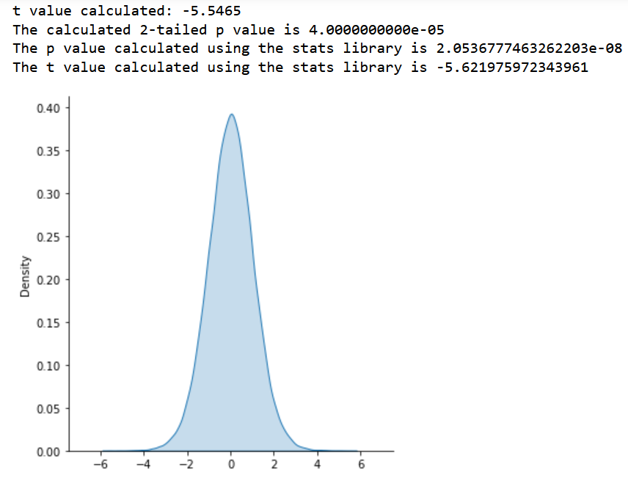
Analysis (Effect of Mask Mandates)
t-value = -5.5465 calculated from built-in function
p < 0.05
There is sufficient evidence to reject Null hypothesis.
Alternate hypothesis is valid

Slide 6
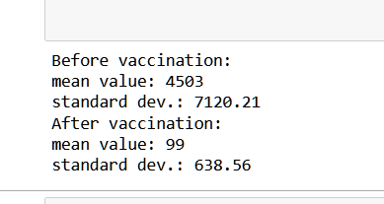
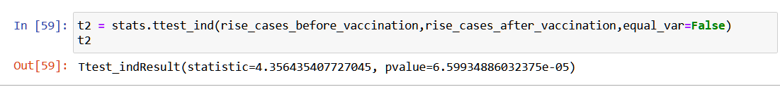
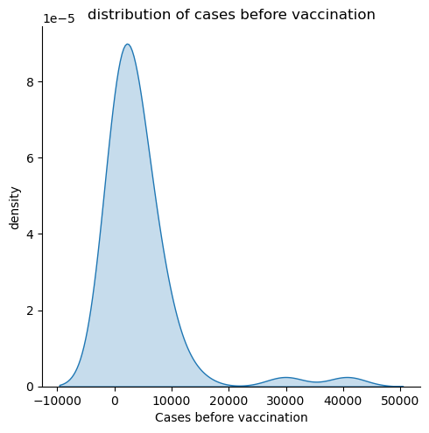
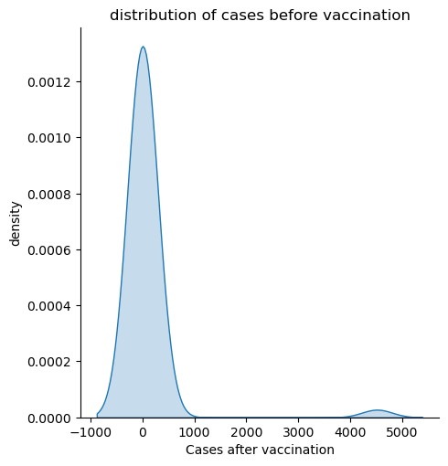
Analysis (Effect of Vaccination)
Percentage of population vaccinated
Percentage of population vaccinated > 0.7

Slide 7
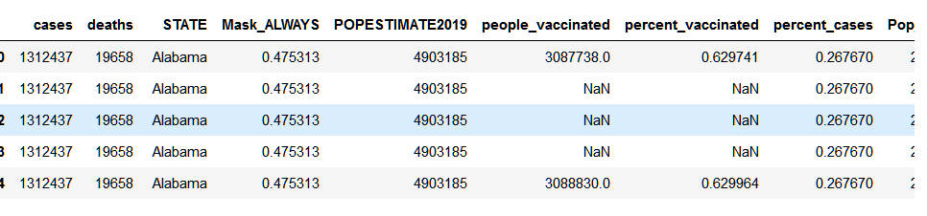
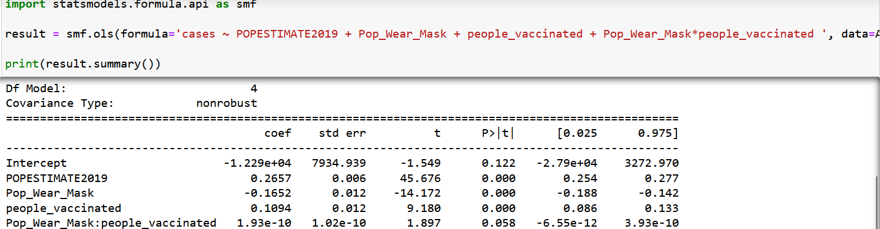
Regression Analysis

Slide 8
Findings & Implications
Wearing Mask
Vaccinated
Wearing Mask & Vaccinated

Slide 9
Next Steps…
Doses of Vaccination
Vaccine Type
Effect of other mask wearing behavior
Assumptions Change

