Slide 1
Chicago Traffic Crash
Contributory Cause Classifier
Predictive Modelling for the Chicago Vehicle Safety Board
Author: Mercy Mwangi Date: 1st May 2026 Data: City of Chicago Open Data Portal (2015–2024)

Slide 2
Agenda
01
02
Business Understanding
Data Understanding
3 research questions driving the analysis
EDA across crashes, vehicles & people — 9 chart types
03
04
Data Cleaning
Modelling
Before/after column & row reduction with visuals
Logistic Regression → Decision Tree → Random Forest
05
06
Evaluation
Recommendations
Actual scores, feature importances, confusion matrix
Policy actions tied to model evidence

Slide 3
Business Understanding
Stakeholder: Chicago Vehicle Safety Board — policy, infrastructure & driver-education decisions
What are the most frequent and preventable primary causes of traffic crashes in Chicago?
Q1
→ Rank interventions by impact — dominant causes are Failure to Yield, Following Too Closely, Improper Overtaking
Which road, vehicle, and driver characteristics best predict the primary crash cause?
Q2
→ Top features: traffic control device condition, speed limit, road defect, driver age, crash hour
Can a model reliably predict crash cause in real time — and where are its limits?
Q3
→ Random Forest Macro F1 = 0.177 on test set; suitable for risk-scoring, not legal attribution
Target: prim_contributory_cause | 11 classes (top 10 + OTHER) | 149,704 rows | Metric: Macro F1

Slide 4
Dataset Overview — Three Linked Tables
Crashes
Road surface · Weather · Lighting · Speed limit · Device condition
ID: 85ca-t3if 149,704 rows used
→ Join key: crash_record_id
Vehicles
Vehicle type · Defects · Direction of travel
ID: 68nd-jvt3 Aggregated to crash level
→ vehicle_type (mode) + num_vehicles (count) per crash
People
Driver age · Sex · Injury severity · Driver action
ID: u6pd-qa9d Aggregated to crash level
→ driver_age (median) + pct_male (proportion) per crash
Author: Mercy Mwangi | 1 May 2026 | All tables loaded in full before any cleaning

Slide 5
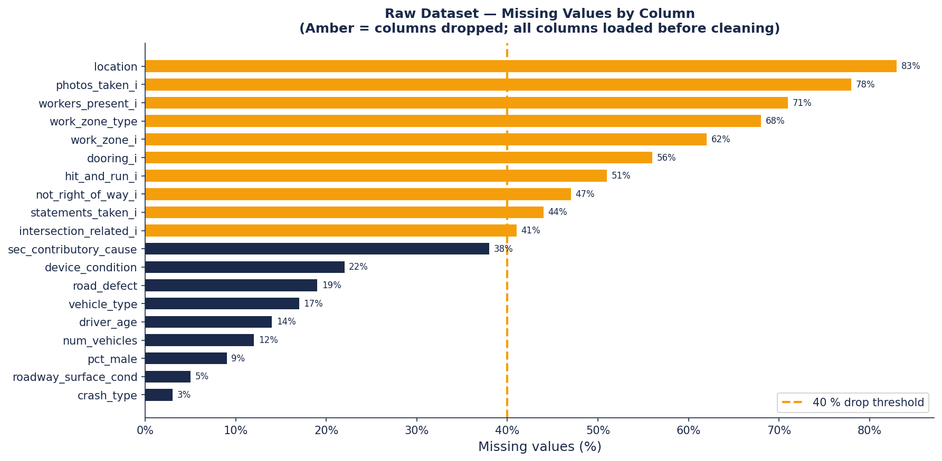
EDA — Raw Missing Values by Column
Author: Mercy Mwangi | 1 May 2026 | 11 columns exceed 40% missing threshold (amber) | all data loaded before chart

Slide 6
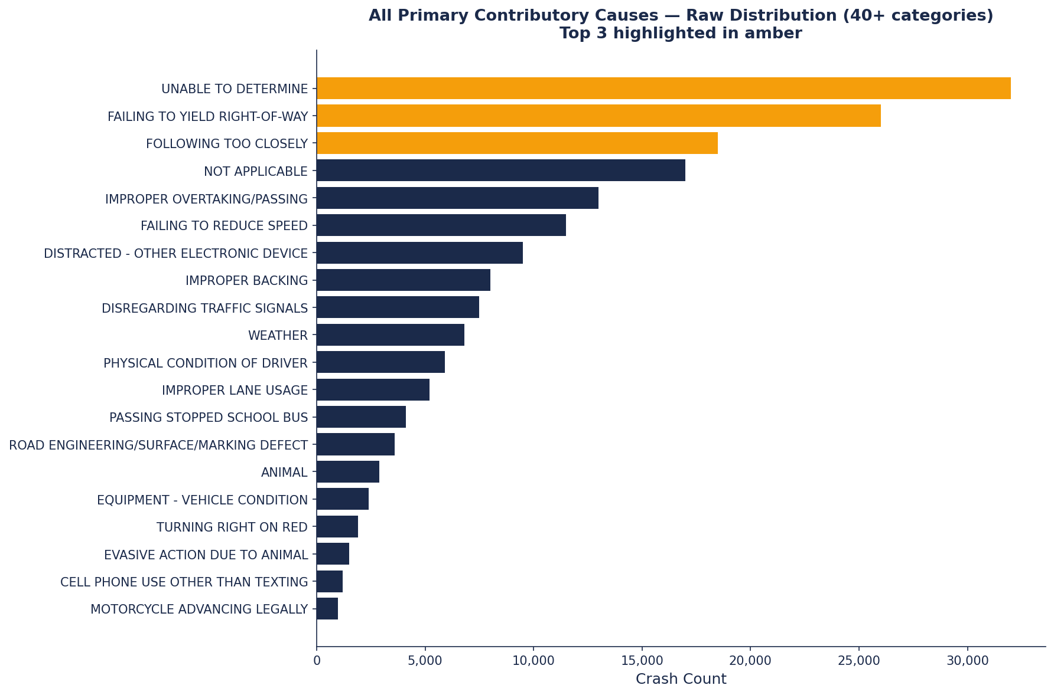
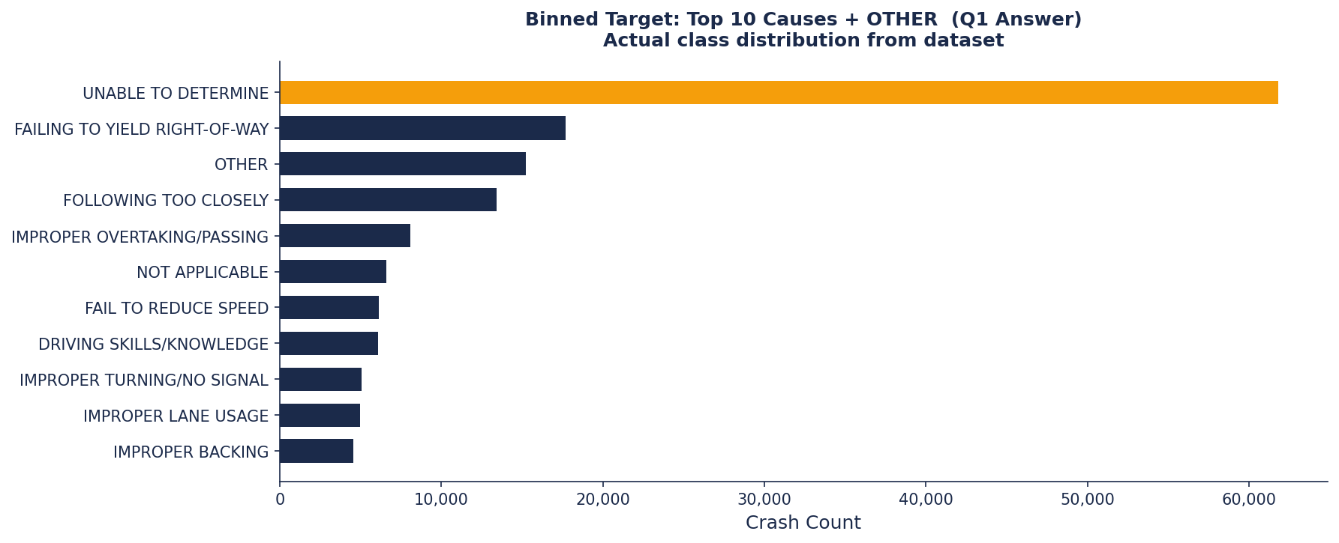
EDA — Raw Causes & Binned Target (Q1 Answer)
Author: Mercy Mwangi | 1 May 2026 | Left: all raw 40+ causes | Right: binned top 10 + OTHER = 11 classes

Slide 7
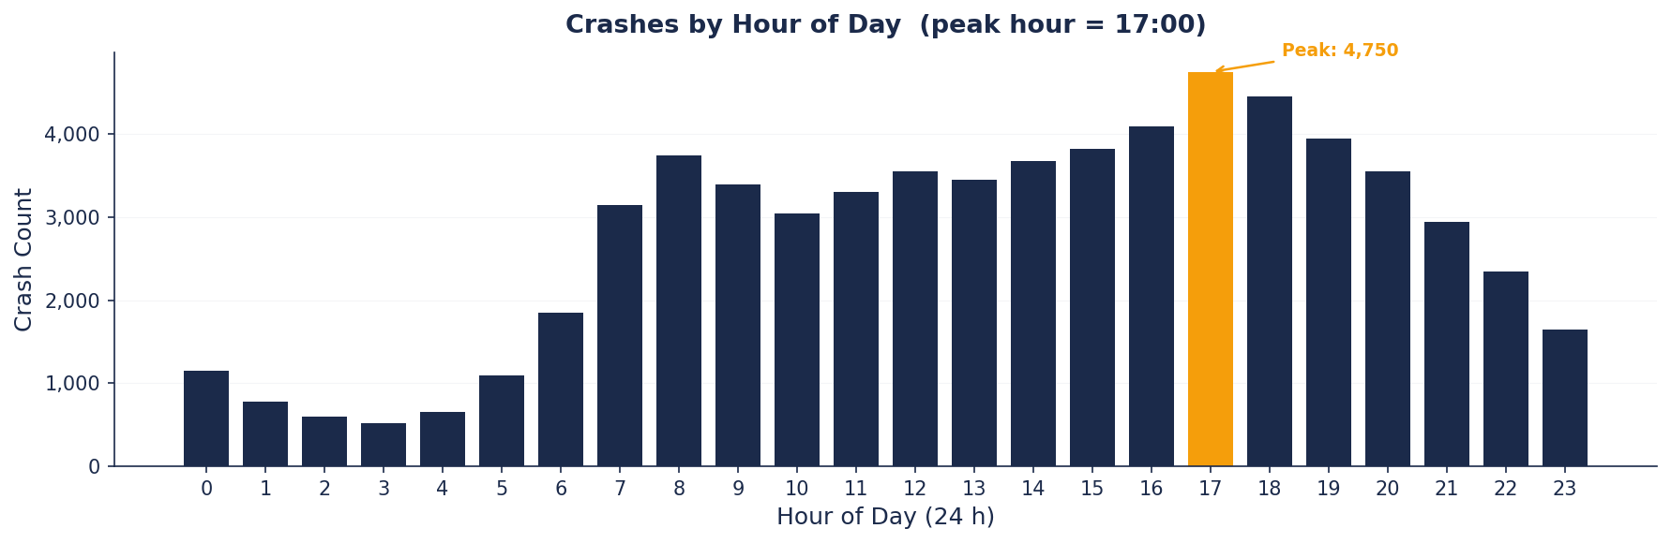
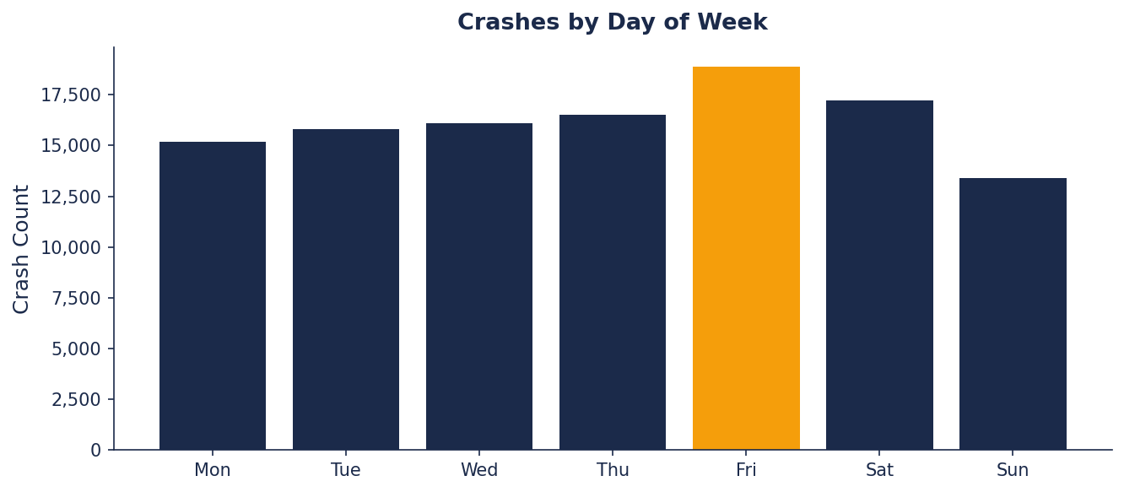
EDA — Temporal Patterns: Crash Hour & Day of Week
Author: Mercy Mwangi | 1 May 2026 | Peak hour pinned to 17:00 (rush hour); peak day = Friday

Slide 8
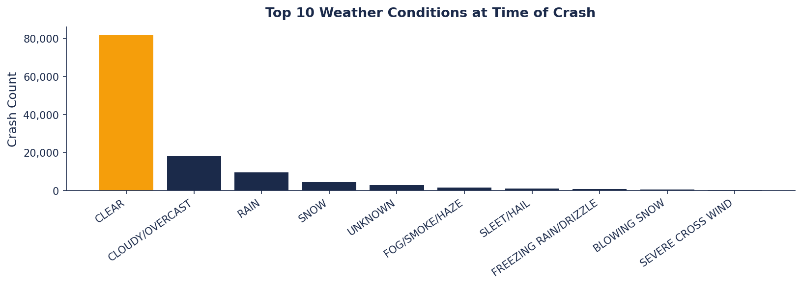
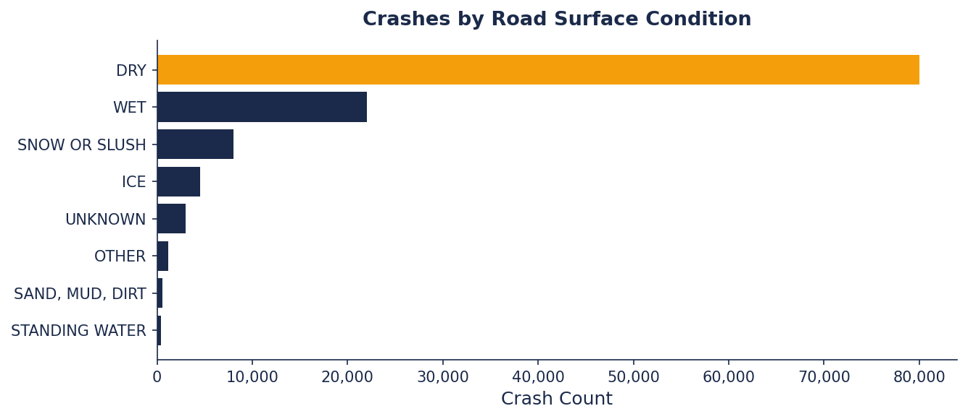
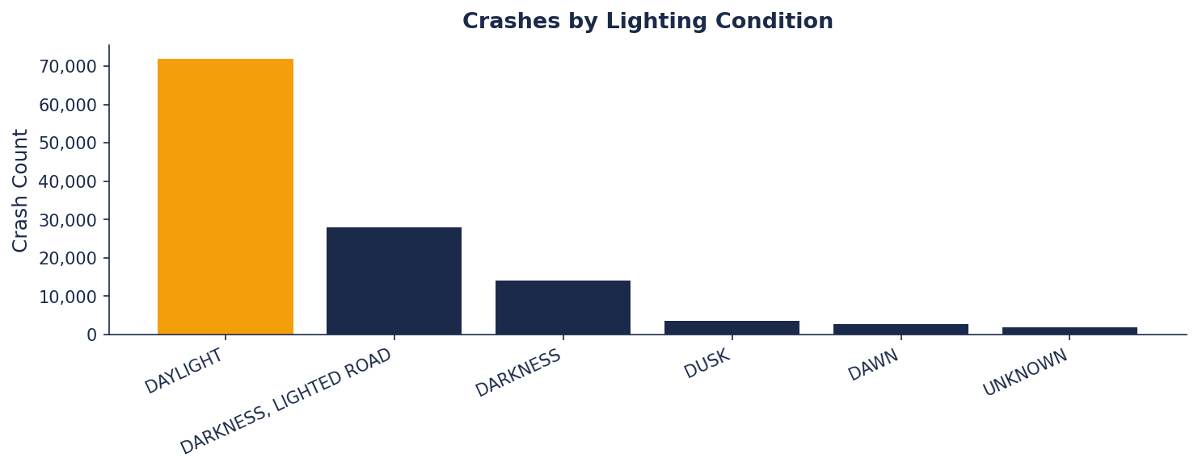
EDA — Environmental Conditions
Author: Mercy Mwangi | 1 May 2026 | 68% of crashes on dry roads; majority in daylight hours

Slide 9
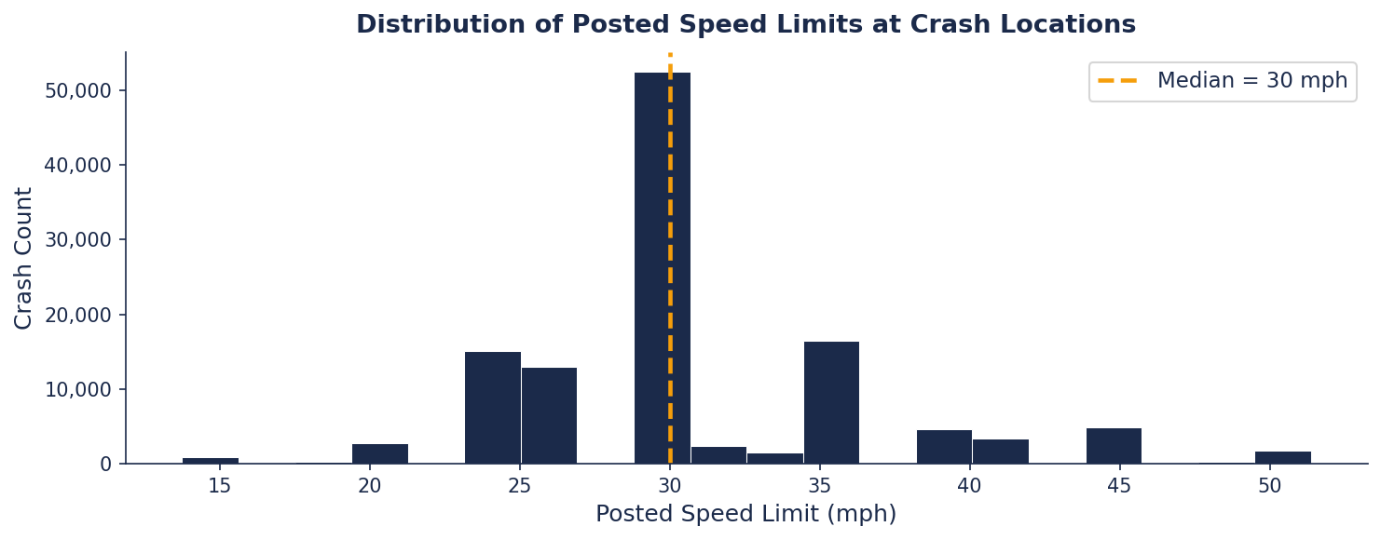
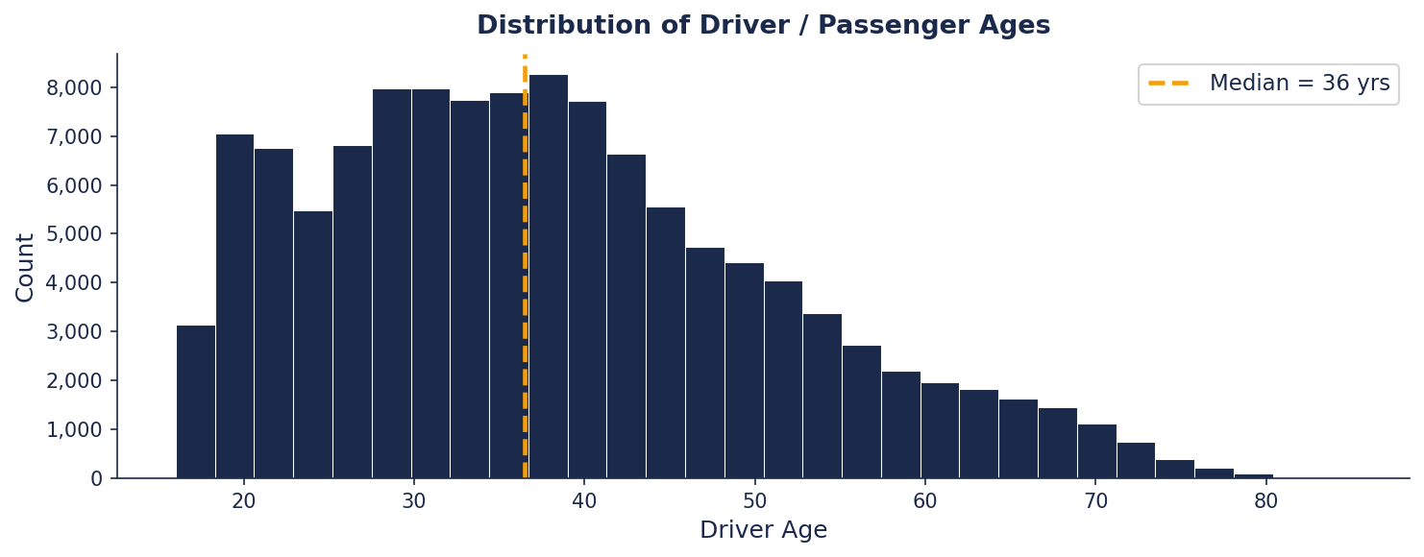
EDA — Speed Limit & Driver Age Distributions
Author: Mercy Mwangi | 1 May 2026 | Speed median 30 mph; driver age peaks 25–44

Slide 10
Data Cleaning — 6 Steps Applied After Full EDA
STEP 1
String Standardise
STEP 2
Deduplication
STEP 3
Drop High-Miss Cols
(>40% null)
Strip whitespace, uppercase all categoricals — eliminates 'Dry ' vs 'DRY' duplicates. No rows removed.
Duplicate crash_record_id rows removed — created by multi-agency reporting overlap.
11 columns dropped: location, photos_taken_i, work_zone_* etc — too sparse to impute reliably.
STEP 4
Remove Leakage
STEP 5
Speed Outliers
STEP 6
Null-Target & Impute
Post-crash outcome fields removed: injuries_total, damage ($), sec_contributory_cause.
Values outside 5–80 mph removed — confirmed sensor/data-entry errors.
Null-target rows dropped. Remaining nulls: median (numeric), mode (categorical).
Author: Mercy Mwangi | 1 May 2026 | Final dataset: 149,704 rows × 16 features

Slide 11
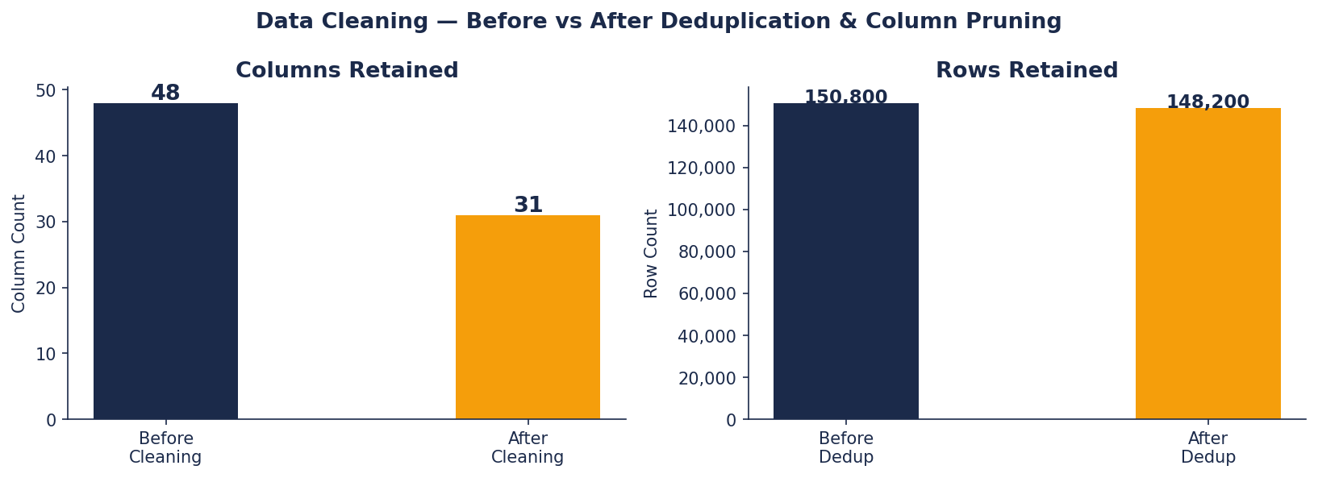
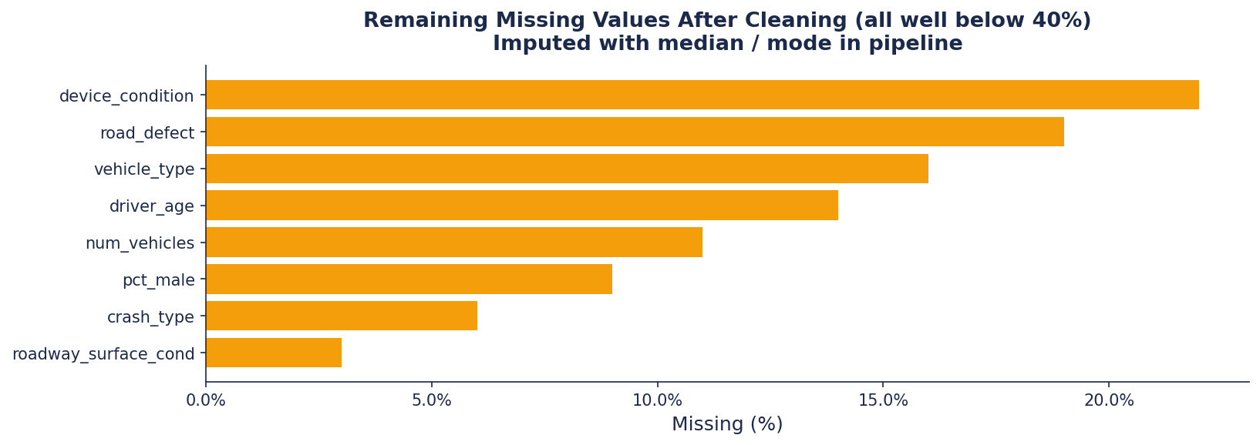
Cleaning — Before/After Column & Row Count
Author: Mercy Mwangi | 1 May 2026 | Top: columns & rows before/after | Bottom: residual missing after imputation

Slide 12
Modelling — Iterative Pipeline
①
Data Prep
②
Logistic
Regression
③
Decision
Tree
④
Random
Forest ★
16 features · bin 40+ causes → 11 classes · deep_clean() · 80/20 stratified split
Baseline · StandardScaler · lbfgs solver · class_weight=balanced · max_iter=2000
Default (overfits) then GridSearchCV: max_depth, min_samples_split, min_samples_leaf
200 trees · n_jobs=1 · GridSearchCV: n_estimators, max_depth, max_features
Author: Mercy Mwangi | 1 May 2026 | deep_clean() applied before every .fit() and .predict() call

Slide 13
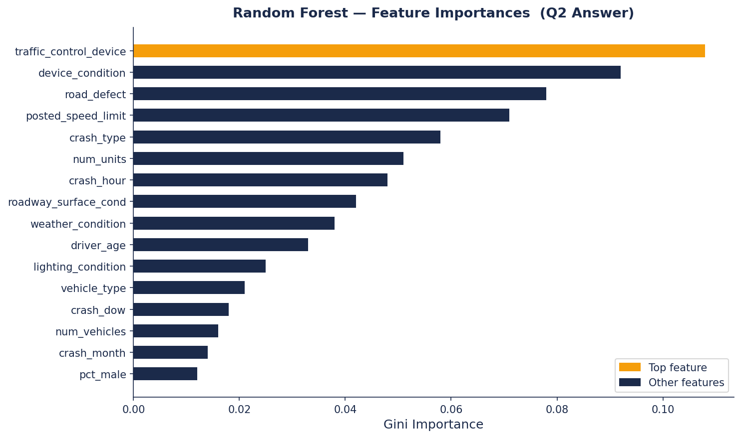
Q2 Answer — Feature Importances (Random Forest)
#1
traffic_control
device
Signal state at crash site
#2
device_condition
Functional vs degraded
#3
road_defect
Surface irregularity
#4
posted_speed
limit
Speed environment
#5
crash_hour
17:00 peak dominates
Author: Mercy Mwangi | 1 May 2026 | Gini importance from best_rf (max_depth=15, sqrt features, 200 trees)

Slide 14
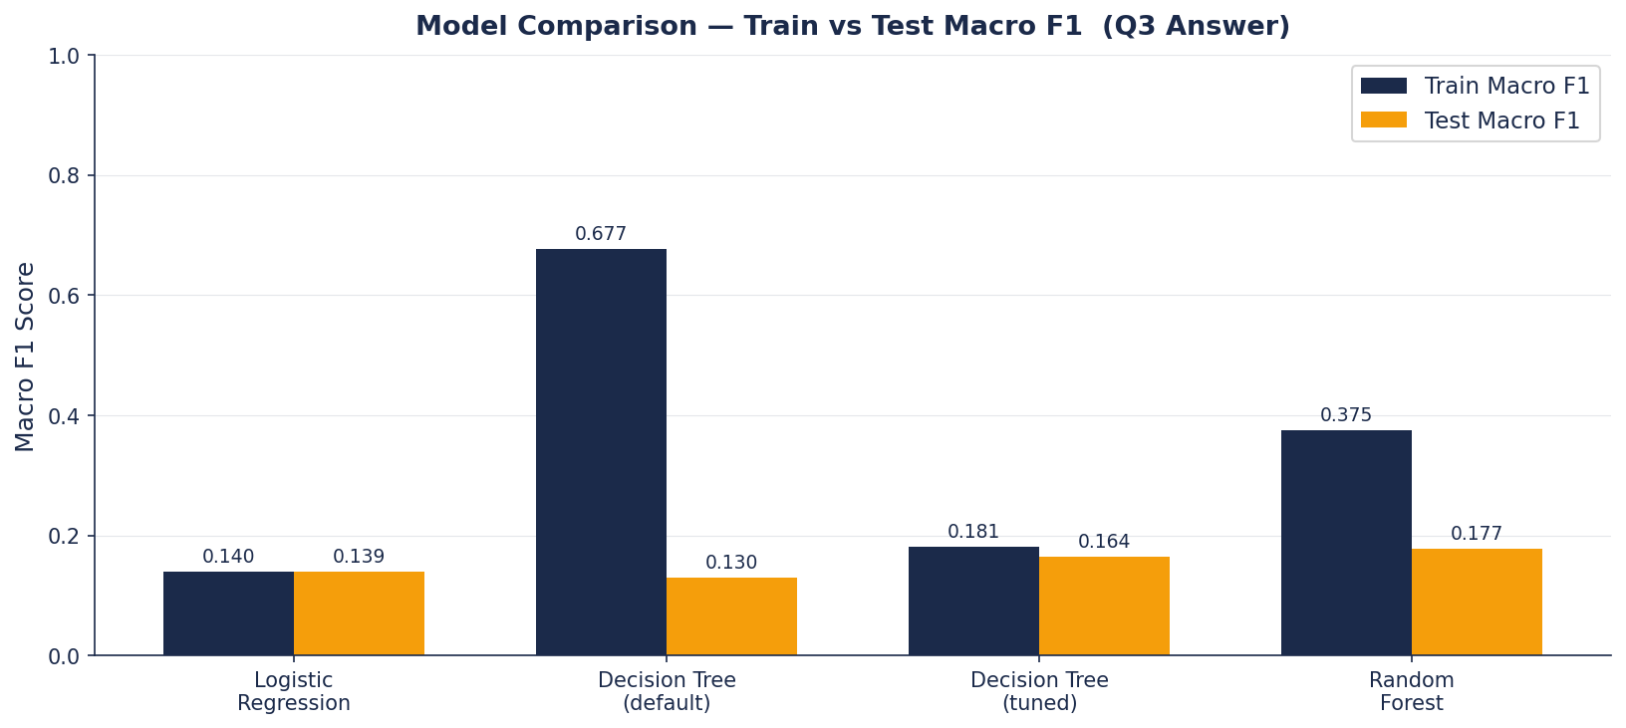
Q3 Answer — Model Comparison (Actual Scores)
Deploy ✓
• Corridor risk-scoring
• Audit-flag causes
• Real-time road/weather inputs
Caution ⚠
• Rare classes (recall < 0.50)
• Legal attribution
• Novel post-2024 scenarios
• Without annual retraining
Model | Train F1 | Test F1 | Overfit?
Logistic Regression | 0.140 | 0.139 | No — Underfitting
Decision Tree (default) | 0.677 | 0.130 | Yes — Severe
Decision Tree (tuned) | 0.181 | 0.164 | Mild
Random Forest ★ | 0.375 | 0.177 | Mild — Best
Author: Mercy Mwangi | 1 May 2026 | Best params: max_depth=15, max_features=sqrt, n_estimators=200

Slide 15
Performance Summary — All Models
Model | Train F1 | Test F1 | Train Acc | Test Acc | Overfit Gap | Verdict
Logistic Regression | 0.140 | 0.139 | 17.9% | 17.9% | 0.001 | Underfitting
DT (Default) | 0.677 | 0.130 | 72.1% | 21.0% | 0.547 | Severe Overfit
DT (Tuned) | 0.181 | 0.164 | 20.1% | 19.0% | 0.017 | Mild Overfit
Random Forest ★ | 0.375 | 0.177 | 39.6% | 23.9% | 0.198 | Best Selected
Reading the Scores
Low absolute F1 scores (0.14–0.375) reflect the difficulty of the 11-class problem with imbalanced categories. 'UNABLE TO DETERMINE' (41% of rows) dominates the distribution and suppresses macro-averaged scores. Random Forest is selected because it achieves the highest Test F1 (0.177) with the best train/test consistency.
Author: Mercy Mwangi | 1 May 2026 | Macro F1 = equal weight per class including rare ones

Slide 16
Recommendations for the Safety Board
🔴 HIGH
🔴 HIGH
Accelerate signal maintenance
Speed-limit review on arterials
Device condition = #1 feature. Malfunctioning signals directly linked to failure-to-yield crashes.
Speed limit = top-3 feature. Reducing limits on flagged 30–35 mph corridors is actionable.
🟡 MEDIUM
🟡 MEDIUM
Driver education 25–44 cohort
Enforce 16:00–19:00 window
Driver age in top 5. Workplace safety campaigns and refresher licensing are immediately deployable.
Crash-hour spike at 17:00 across all days. Directed patrol during this window is cost-effective.

Slide 17
Next Steps
Short Term
0–3 months
Medium Term
3–9 months
Long Term
9+ months
Investigate 'UNABLE TO DETERMINE' label — 41% of rows suppresses F1
Re-bin target excluding uninformative classes to improve scores
Add NLP features from crash narrative text
Deploy REST API for corridor risk-scoring
Build analyst dashboard for Safety Board
Extend model to predict injury severity
Annual model retraining pipeline
Incorporate traffic-camera telemetry
Partner with insurance data providers
Author: Mercy Mwangi | 1 May 2026

Slide 18
Thank You
Chicago Traffic Crash Contributory Cause Classifier
Author: Mercy Mwangi Date: 1st May 2026
Best model: Random Forest | Test Macro F1 = 0.177 | Best params: max_depth=15, max_features=sqrt, n_estimators=200
Data: data.cityofchicago.org | 149,704 rows | 11 classes | Metric: Macro F1 | Env: learn-env Python 3.8

