Slide 1
Employee Data Analysis using Excel
STUDENT NAME: MERCY PREMA.V
REGISTER NO:122204094
DEPARTMENT:III B.COM (CROPRORPORATE SECRETARYSHIP)
COLLEGE:SHRI KRISHNASWAMY COLLEGE FOR WOMEN

Slide 2
PROJECT TITLE
Employee Gender Analysis using Excel

Slide 3


AGENDA
Problem Statement
Project Overview
End Users
Our Solution and Proposition
Dataset Description
Modelling Approach
Results and Discussion
Conclusion
3/21/2024 Annual Review

Slide 4

PROBLEM STATEMENT
A problem statement is a description of an issue to be addressed. or a condition to be improved upon. It identifies the gap between the current problem and goal. The first condition of solving a problem is understanding the problem, which can be done by way of a problem statement.

Slide 5

PROJECT OVERVIEW
A project overview is a document that summarizes a project's key details, including its goals, objectives, and steps to achieve them. It also outlines the project's schedule, budget, resources, and status. A project overview can help simplify complex information into a single document that can be easily managed throughout the project's lifecycle.

Slide 6

WHO ARE THE END USERS?
The term "end user" refers to the consumer of a good or service, often one who has some innate know-how that is unique to consumers.
In a literal sense, the term is used to distinguish the person who purchases and uses the good or service from individuals who are involved in the stages of its design, development, and production

Slide 7

OUR SOLUTION AND ITS VALUE PROPOSITION
An Employer Value Proposition (EVP) is a set of offerings and benefits provided by an organisation in exchange for the skills, capabilities, and experiences that employees bring. It is essentially the unique value that employees receive from working at the organisation. A well-defined EVP communicates why the company is an attractive place to work and is a critical component in attracting, engaging, and retaining talent. The key elements of an EVP typically include:

Slide 8
Dataset Description
A dataset in Excel is a range of cells in a worksheet that contains data for analysis. Datasets can be in Excel (.xlsx) or Comma Separated Values (CSV) format.

Slide 9

THE "WOW" IN OUR SOLUTION
The other day at work a colleague who had recently joined the Finance organisation asked me on how she could get a wow from her senior manager by showing some insights never thought of and get appreciated for what she bought to the table. She also told me that she had done some finance number crunching and got some data out of our convoluted system and now she wanted help with what to do with the data. Now in a MNC that is always the confusion, you end up tending to go back to the same analysis that you were taught to do by someone else without understanding the relevance of it.
3/21/2024 Annual Review
9

Slide 10
MODELLING
Microsoft Excel spreadsheets allow individuals to organize and display their data visually with models. Excel models are an effective way to forecast future events and occurrences. Learning about Excel modeling can help you make better decisions and predictions for your organization based on past data.
10

Slide 11
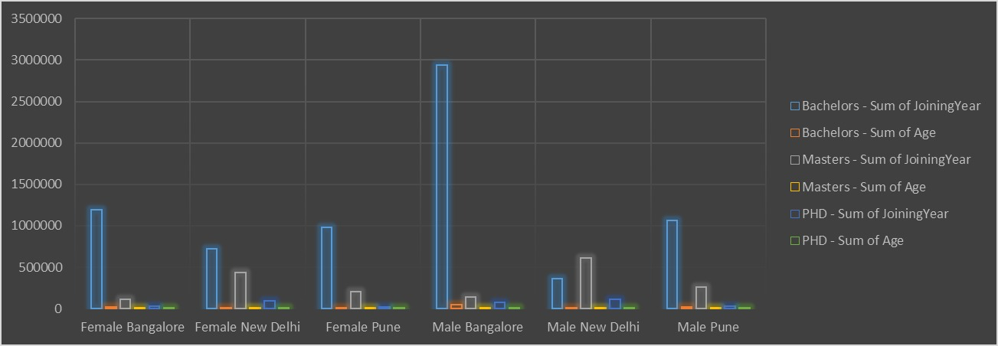
RESULTS
11

Slide 12
conclusion
This article highlights Excel's remarkable versatility and utility as a project management tool. From familiar interface and cost-effectiveness to its advanced data analysis capabilities and robust reporting features, Excel stands out as a comprehensive solution for various project management needs.

