Slide 1
MATERNAL MORTALITY IN
SELECTED AFRICAN COUNTRIES
Trends and Nigeria's Outlier Status (2018-2023)
A Data Analytics Project
Prepared by Mercy Dalhatu

Slide 2
BACKGROUND
Why Maternal Mortality Matters
Maternal mortality measures how many mothers die from pregnancy or childbirth-related causes, per 100,000 live births.
It's one of the clearest signals of how well a country's health system supports women.
Comparing countries over time — and against peers at similar income levels — helps show whether progress is happening fast enough, and where.
This project checks how MMR changed across 7 African countries between 2018 and 2023, and looks closely at why Nigeria remains so far ahead of the rest.

Slide 3
WHAT WE SET OUT TO ANSWER
Research Questions
1
How did MMR change for each of the 7 countries between 2018 and 2023?
2
Is there a relationship between income group and maternal mortality outcomes?
3
How does Nigeria's MMR compare to the Sub-Saharan Africa regional average and to its income-level peers?
4
Which country improved the most (or least), and what does that suggest about what's driving change?

Slide 4
HOW WE GOT OUR ANSWERS
Methodology
DATA
CLEANING
ANALYSIS
World Bank maternal mortality ratio data (SH.STA.MMRT), narrowed to 2018-2023 and 7 countries: Angola, Egypt, Ethiopia, Ghana, Kenya, Nigeria, South Africa.
Data was unpivoted from a wide year-by-year format into a long format (Country, Region, Income Group, Year, MMR) to allow trend and comparison analysis.
DAX measures and filters in Power BI compared MMR by year, country, income group, and region; results were visualized across a 2-page dashboard.
Final dataset: 7 countries • 6 years (2018-2023) • 6 fields per record

Slide 5
THE HEADLINE NUMBERS
297.31
-15.29%
993
312
Average MMR across
all countries and years
Overall % change
in MMR, 2018-2023
Nigeria's 2023 MMR
(highest in the dataset)
Sub-Saharan Africa
regional average (2023)
Every country studied improved but Nigeria's MMR is still more than 3x the regional average.

Slide 6
FINDING 1 OF 4
MMR Trends by Country (2018-2023)
ALL COUNTRIES IMPROVED, AT DIFFERENT SPEEDS
Ethiopia had the steepest drop (-34.3%), followed by Kenya (-18.6%) and Ghana (-15.2%).
South Africa improved the least (-7.8%), despite already having a relatively low starting MMR.
Nigeria improved by 11.2% — but started, and ended, far above every other country in the group.

Slide 7
FINDING 2 OF 4
Income Group and Maternal Mortality
INCOME LEVEL DOESN'T EXPLAIN THE GAP
Nigeria and Egypt are both classified as lower-middle-income — yet Nigeria's MMR (993) is over 58x higher than Egypt's (17).
Ethiopia, the only low-income country in the dataset, had a lower MMR (195) than three lower-middle-income countries.
Income classification alone does not predict maternal health outcomes in this data.
Low income
Lower middle income
Upper middle income

Slide 8
FINDING 3 OF 4
Nigeria vs. Regional and Income-Peer Averages
NIGERIA IS AN OUTLIER ON BOTH FRONTS
Nigeria's MMR (993) is more than 3x the Sub-Saharan Africa average (312).
It's also more than 3x the average among its own income-peer countries (315.2).
Since both benchmarks land close together (~312-315), Nigeria's gap isn't explained by region or income — something specific to Nigeria's health system is driving the difference.

Slide 9
FINDING 4 OF 4
Rate of Improvement, Ranked
ETHIOPIA LED, SOUTH AFRICA LAGGED
Ethiopia (-34.3%) improved nearly 3x faster than Nigeria (-11.2%), despite having far fewer economic resources.
South Africa (-7.8%), the wealthiest country in the group, had the slowest rate of improvement.
Faster progress isn't tied to having more resources — it may be tied to how those resources (or policies) are used.

Slide 10
WHAT THIS DATA CAN'T TELL US
Limitations
!
Only 7 countries were studied — findings can't be generalized to the rest of the continent.
!
MMR data reflects reported figures, which can vary in accuracy and reporting methods between countries.
!
The dataset doesn't include specific healthcare system indicators (e.g. skilled birth attendance rates, health spending), so the “why” behind Nigeria's gap is inferred, not directly measured.
!
All findings show correlation, not proof of what's causing the differences.

Slide 11
CONCLUSION
Nigeria's maternal mortality rate remains far above both its regional and income peers and income level alone doesn't explain why.
INSIGHT
If a health program or government wanted to close Nigeria's gap fastest, it wouldn't wait for income growth — it would look at what lower-resourced countries like Ethiopia are doing right, and apply that same urgency to Nigeria's health system, since money clearly isn't the main barrier holding progress back.

Slide 12
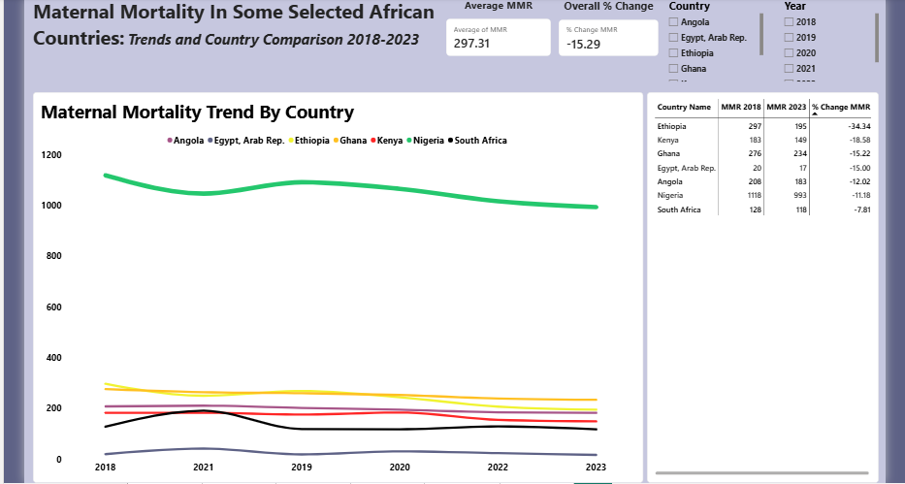
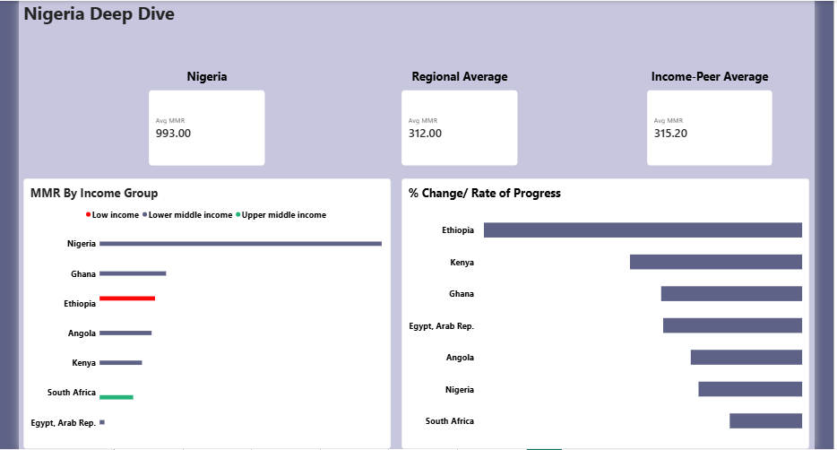
INTERACTIVE DASHBOARD
Maternal Mortality in Selected African Countries — Power BI Dashboard
Maternal Mortality in Selected African Countries • Data Analytics Project • Mercy Dalhatu

